Slide 1

IS4S706 Project Management & Research Methodology
ETHICAL & PROFESSIONAL ISSUES
David Kidner (J302)
david.kidner@southwales.ac.uk

Slide 2
Ethical Dilemma: What Would You Do?
What would you do?
Your company policy on reimbursement for meals while travelling on company business is that you will be reimbursed for costs, up to a maximum of £60 per day. You will not need receipts for these expenses - your company ‘trusts’ you.
You tend to eat at fast food outlets and rarely spend more than £15 per day.
Most of your colleagues put in claims for £45-£50.
Do you:
Claim the actual amount you spend
Put in a claim that is between £45-£50
Claim the full amount of £60 per day

Slide 3
Ethical Dilemma: What Would You Do?
You are negotiating a contract with a potentially very large customer. A representative of the customer has hinted that you would almost certainly get the customer’s business if you gave him and his wife an all expenses paid cruise to the Caribbean.
You know the representative’s employer wouldn’t approve of such a payoff
Your own current job is dependant upon you getting this contract
What would you do?
Take the bribe
Report it to your employer
Report it to the employer of the representative

Slide 4
Ever Heard Any of These?
The end justifies the means
Treat others in the way you would like to be treated by them
Always obey the rules
Nobody got hurt, so what’s the problem?
Everybody else is doing it….

Slide 5
Ethics …
Ethics is a set of moral principles that govern the behaviour of a group or individual.
Likewise, Computer Ethics is set of moral principles that “regulate” the use of computers.

Slide 6
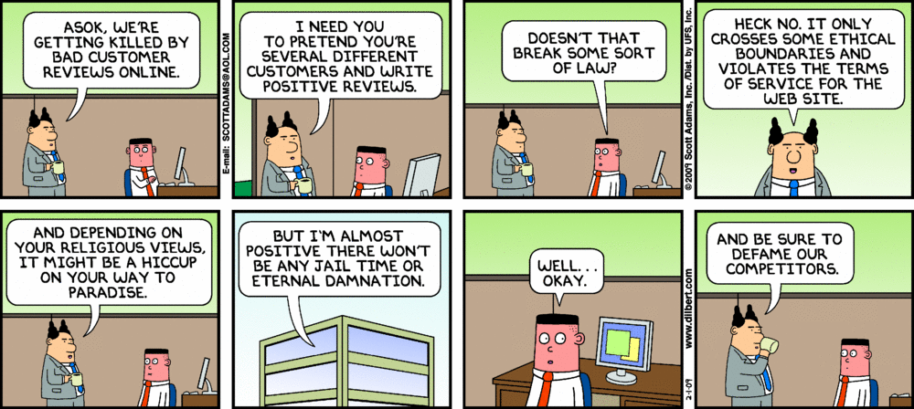
Ethics …

Slide 7
What Are Ethics?
http://www.bbc.co.uk/ethics/introduction/intro_1.shtml
Ethics are the system of moral principles and a branch of philosophy that defines what is good for individuals and society
Ethics covers the following dilemmas:
how to live a good life
our rights and responsibilities
the language of right and wrong
moral decisions - what is good and bad?
Collins dictionary definition
The philosophical study of the moral value of human conduct and of the rules and principles that ought to govern it. A code of behaviour considered correct, especially that of a particular group, profession or individual.

Slide 8
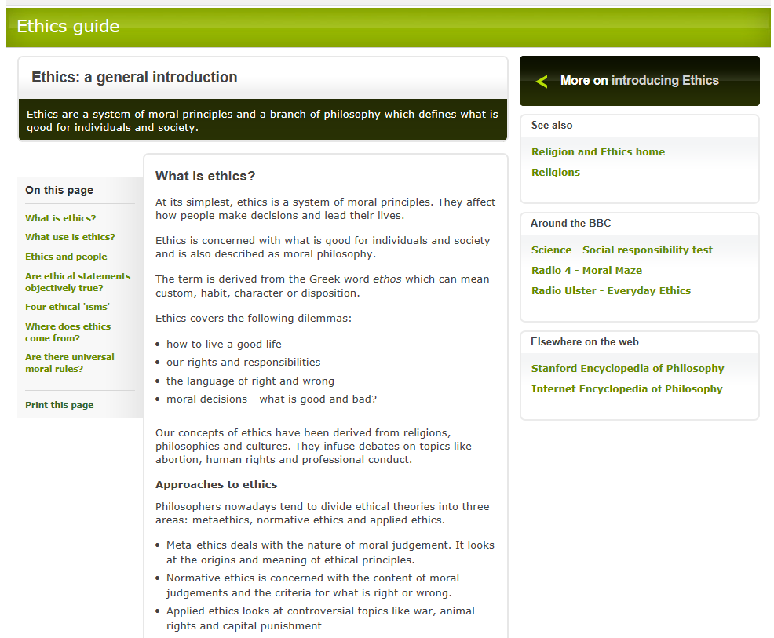
http://www.bbc.co.uk/ethics/introduction/intro_1.shtml

Slide 9
Business Ethics
The application of ethical values, such as integrity, fairness, respect and openness to business behaviour … it is about how an organisation does its business and how individuals carry out their roles. It applies to any and all aspects of business conduct, from boardroom strategies, to sales techniques, accounting practices and how companies treat their suppliers (Living up to our values, Dando and Raven, IBE 2006)

Slide 10
Business Ethics
Doing business ethically goes beyond legal compliance. It is assumed that businesses operate in accordance with applicable regulations and laws. Doing business ethically requires people to think about discretionary responsibilities and make sound ethical choices.

Slide 11
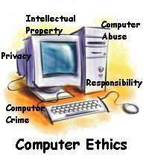
Computer Ethics
Some common issues of computer ethics include Intellectual Property Rights (IPR) such as copyrighted electronic content, privacy concerns, and how computers affect society.
For example, while it is easy to duplicate copyrighted electronic or digital content, computer ethics would suggest that it is wrong to do so without the author’s approval.
And while it may be possible to access someone’s personal information on a computer system, computer ethics would advise that such an action is unethical.

Slide 12
Computer Ethics
Can you think of a set of Ethical Guidelines? E.g. …
Thou Shall Not Steal (IPR / Data / Software)
Thou Shall Not Use Computers to Harm Others
Thou Shall Not Spy on Individuals / Organisations
Thou Shall Not Bear False Witness (or Fake News / Reviews)
Thou Shall Not Deepfake
Thou Shall Not Hack
Thou Shall Not Break GDPR, CMA, etc.
Thou Shall Always Use a Computer in Ways that Ensure Consideration & Respect for your Fellow Humans
…

Slide 13
Ethics Simplified
3 Questions to Ask when Making a Decision:
Transparency - Do I mind others knowing what I’ve done?
Effect – Who or what does this decision affect or hurt?
Fairness - Will those affected consider this decision fair?

Slide 14
Business - Ethical Questions
BCS:
Can IT suppliers win your business through competitive tendering processes without lying to your business?
Would a fair number of your customers be angry if they knew what your business does with their personal data?
Do your staff know the potential impact on their jobs of your impending big new IT system, or have you chosen to keep quiet about that side of the project?
Could your IT project team possibly deliver an IT system on time and budget without making them work unpaid overtime?
If the methods used for your differential pricing policies become public - would you be happy with that?

Slide 15
How do Businesses Ensure that its Directors, Managers and Employees Act Ethically?
A common approach is to implement a code of practice. Ethical codes are increasingly popular – particularly with larger businesses and cover areas such as:
Corporate social responsibility
Dealings with customers and supply chain
Environmental policy & actions
Rules for personal and corporate integrity
… and advertise it to their customers and clients.

Slide 16
Ethics and Professional Responsibility in Computing
Make sure to read the book chapter “Ethics and Professional Responsibility in Computing” by Loui and Miller (on Blackboard)

Slide 17
Professional Bodies
Many professional bodies in UK covering wide range of professions, including law, medicine, accountancy, architecture, various branches of science and engineering
Professional body for computing professionals is BCS, The Chartered Institute for IT
Two US based professional bodies with lots of influence world-wide are:
The Institute of Electrical and Electronic Engineering (IEEE) - https://www.ieee.org/index.html
The Association for Computing Machinery (ACM) – www.acm.org

Slide 18
BCS – The Chartered Institute for IT
http://www.bcs.org/
Set up in 1957 as the British Computer Society
Currently about 70,000 members
Awarded Royal Charter in 1984
To promote study and practice of Computing and advance knowledge therein for the benefit of the public
Authorised to
Establish a code of conduct
Promote education
Set educational standards
Establish mechanisms for disseminating knowledge of good practice
To promote and support standards of good practice
To advise government and regulatory bodies

Slide 19
Codes of Ethics & Professional Conduct
For each profession, professional obligations are stated in a code of ethics or code of conduct
Computing examples
BCS code of conduct (see Blackboard handout)
ACM code of ethics https://www.acm.org/about/code-of-ethics
IEEE code of conduct https://www.ieee.org/about/ieee_code_of_conduct.pdf ACM Software Engineering Code of Ethics: http://www.acm.org/about/se-code

Slide 20
BCS Code of Conduct
A code of conduct sets out the standards of behaviour that members of a body are expected to follow in the professional life
The BCS Code of Conduct (https://www.bcs.org/category/6030) is separated into the following sections:
The Public Interest
Professional Competence and Integrity
Duty to Relevant Authority
Duty to the Profession

Slide 21
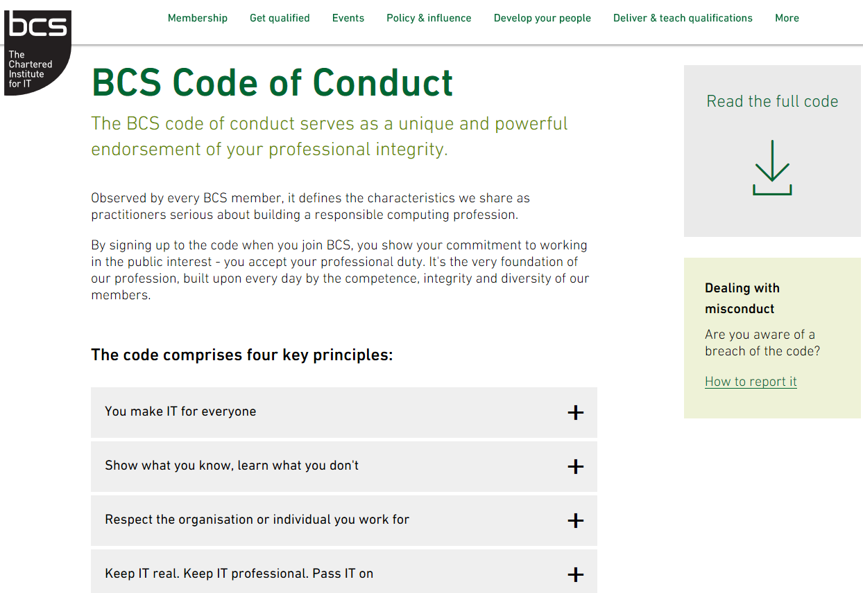

Slide 22
BCS Code of Conduct
Public Interest
This section requires members to be aware of and comply with aspects of the law and regulations that govern acting in the public interest.
For example, members need to safeguard public health, protect the environment, have due regard for privacy and human rights, and avoid discrimination.

Slide 23
BCS Code of Conduct
Public Interest You shall: a) have due regard for public health, privacy, security and wellbeing of others and the environment. b) have due regard for the legitimate rights of Third Parties. c) conduct your professional activities without discrimination on the grounds of sex, sexual orientation, marital status, nationality, colour, race, ethnic origin, religion, age or disability, or of any other condition or requirement d) promote equal access to the benefits of IT and seek to promote the inclusion of all sectors in society wherever opportunities arise

Slide 24
BCS Code of Conduct
Professional Competence and Integrity
This sections addresses what has been, and to some extent continues to be, a serious problem for the IT industry – that is, individuals and companies claiming to be able to undertake work that they are not competent to carry out, leading to system failures
For example –
London Ambulance Service’s Computer Aided Dispatch System,
Failure of the system caused by small software company claiming expertise that they did not have
Not deliberate deception, the company had so little expertise that it failed to recognise it did not have the necessary skills

Slide 25
BCS Code of Conduct
Professional Competence and Integrity You shall: a) only undertake to do work or provide a service that is within your professional competence. b) NOT claim any level of competence that you do not possess. c) develop your professional knowledge, skills and competence on a continuing basis, maintaining awareness of technological developments, procedures, and standards that are relevant to your field. d) ensure that you have the knowledge and understanding of Legislation* and that you comply with such Legislation, in carrying out your professional responsibilities. e) respect and value alternative viewpoints and, seek, accept and offer honest criticisms of work. f) avoid injuring others, their property, reputation, or employment by false or malicious or negligent action or inaction. g) reject and will not make any offer of bribery or unethical inducement

Slide 26
BCS Code of Conduct
Duty to Relevant Authority
Members should carry out their professional duties with due care and diligence – this is what society has the right to demand of any professional
“Relevant authority” – the person or organisation that has authority over what you are doing (your employer, your client, your university etc.)

Slide 27
BCS Code of Conduct
Duty to Relevant Authority You shall a) carry out your professional responsibilities with due care and diligence in accordance with the Relevant Authority’s requirements whilst exercising your professional judgement at all times. b) seek to avoid any situation that may give rise to a conflict of interest between you and your Relevant Authority. c) accept professional responsibility for your work and for the work of colleagues who are defined in a given context as working under your supervision. d) NOT disclose or authorise to be disclosed, or use for personal gain or to benefit a third party, confidential information except with the permission of your Relevant Authority, or as required by Legislation e) NOT misrepresent or withhold information on the performance of products, systems or services (unless lawfully bound by a duty of confidentiality not to disclose such information), or take advantage of the lack of relevant knowledge or inexperience of others

Slide 28
BCS Code of Conduct
Duty to the Profession
The purpose of this section of the Code is to impress on members what is expected of them in order to uphold the reputation and good standing of BCS in particular, and the computing profession in general.

Slide 29
BCS Code of Conduct
Duty to the Profession You shall: a) accept your personal duty to uphold the reputation of the profession and not take any action which could bring the profession into disrepute. b) seek to improve professional standards through participation in their development, use and enforcement. c) uphold the reputation and good standing of BCS, the Chartered Institute for IT. d) act with integrity and respect in your professional relationships with all members of BCS and with members of other professions with whom you work in a professional capacity. e) notify BCS if convicted of a criminal offence or upon becoming bankrupt or disqualified as a Company Director and in each case give details of the relevant jurisdiction. f) encourage and support fellow members in their professional development

Slide 30
Ethical Dilemma – What Would You Do?
XYZ Corporation plans to monitor secretly the Web pages visited by its employees, using a data mining program to analyze the access records. Christine, an engineer at XYZ, recommends that XYZ purchase a data mining program from Robin, an independent contractor, without mentioning that Robin is her brother. Robin had developed this program while previously employed at UVW Corporation, without the awareness of anyone at UVW.
With reference to the BCS Code of Conduct, comment on this scenario.

Slide 31
Ethics at the University
Research at the University of South Wales
Ethical Principles and Guidelines for Research
The University has set up a two tier structure for ethical issues with responsibility shared between the University Ethics Sub Group (UESG) - a committee of Quality Assurance Committee - and a Faculty Research Programmes Committee (FRPC) which will consider all research proposals.
Further information is available from the Research Office: here
General Ethical Concerns
Ethics is a complex subject, but in professional contexts its four central concerns are:
to treat people Fairly
to respect the Autonomy of individuals to act with Integrity
to seek the best Results - by avoiding or minimising harm and by using resources as beneficially as possible
Mnemonic: f a i r

Slide 32
Ethical Practices in Research (O’Leary, 2014)
Ethical Responsibility as a Researcher
Legal Obligations
comply with the law in your research methods
what to do if your research identifies illegal activity - as a researcher can you provide assurances of confidentiality (like a doctor)
Moral Obligations
rights and wrongs
honesty - collect data for a particular reason and not re-use for a different purpose
O’Leary, Z (2014) “The Essential guide to Doing Your Research Project 2nd Edition, Sage Publications.

Slide 33
Ethical Obligations of you as a Researcher
Ensuring Respondents have given informed consent, they are competent, autonomous, voluntary, not deceived
Ensuring no harm comes to respondents
Ensuring confidentiality - or respondents understand limitations

Slide 34
A good read …
https://www.ideals.illinois.edu/bitstream/handle/2142/12247/ecse909.pdf
http://www.bcs.org (and search the latest articles on ETHICS !!).

Slide 35
Acknowledgments
This lecture relies heavily on ideas and text taken from:
Professional issues in IT, Frank Bott, 2014, published by BCS

