Slide 1
Project Management & Research Methodology (IS4S706)
Time Management 2

Slide 2
Last time
Activity based planning
Define Activities (or Tasks)
Sequence Activities
Estimate Activity Resources
Estimate Activity Durations
Develop Schedule
Control Schedule

Slide 3
Control schedule
The project schedule is put in place at the start of the project.
The schedule needs to be controlled in order to keep the project on track.
Remember, the overall goal of time management is to ensure to project finishes on time.

Slide 4
Activity delays
In any project, you can expect delays to occur.
Reasons include
An activity takes longer to complete than was originally estimated
A resource assigned to an activity becomes unavailable
Person is sick or leaves for another job or is called away to another project or…..
Computer network fails or server room is flooded or supplier does not meet deadline or……

Slide 5
Critical Path Analysis
Identifies the Activities in a network diagram that MUST be completed on time for the project to have ANY CHANCE of finishing on time
These activities are called CRITICAL activities.
Identifying them is important
Project manager can assign extra resources to them if there is a likelihood of them over running
(These extra resources might be new to the project or simply re-assigned resources from non-critical tasks)

Slide 6
Why is Critical Path important?
Because....
Any delay to activities on the critical path will likely delay the completion of the project
So
when planning and running a project, avoid delaying activities on the Critical Path

Slide 7
Also
If you want the project to finisher sooner than originally planned, throw resources at critical activities

Slide 8
Paths through a network diagram
Paths start at any activity with no predecessors (i.e. no arrows arriving at the activity)
Paths end at any activity with no dependants (i.e. no arrows leaving the activity)
A path consists of all activities connecting start and end activities, including the start and end

Slide 9
Example 1
start
A
B
C
D
end
path: A, B, C, D

Slide 10
Example 2
start
A
B
C
D
end
start
E
F
Path 1: A, B, C, D
Path 2: E, F, C, D

Slide 11
Example 3
G
H
I
end
start
A
B
C
D
end
start
E
F
start
J
K
end
Path 1: A, B, C, D
Path 2: A, B, C, I
Path 3: E, F, C, D
Path 4: E, F, C, I
Path 5: A, G, H, I
Path 6: J, K

Slide 12
Critical Path Analysis
Identifies the critical path, and hence the critical activities
Critical path(s)
The longest path(s) (in terms of TIME taken) through the network diagram
This path(s) represents the shortest possible time in which the project could be completed
Activities on the critical path(s) are critical activities
i.e. delaying these activities will probably delay the project
i.e. if you want to finish the project sooner, add resources to the critical activities

Slide 13
Project “Simple” example
Task | Duration (days) | Precedence
A | 4
B | 7 | A
C | 5 | A
D | 3 | B, C
Critical path (the longest path)
A, B and D are critical activities
B
7 days
B
7 days
A
4 days
A
4 days
D
3 days
D
3 days
C
5 days
Path 1 = A, B, D Total time = 14 d
Network Diagram
Path 2 = A, C, D Total time = 12 d

Slide 14
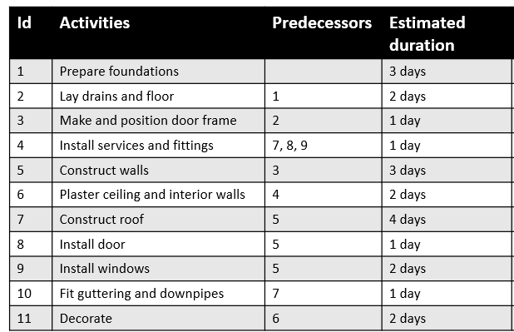
Example
Path 1 = 1, 2, 3, 5, 7, 10. Total time = 14 days
Path 2 = 1, 2, 3, 5, 7, 4, 6, 11. Total time = 18 days
Path 3 = 1, 2, 3 ,5, 8, 4, 6, 11. Total time = 15 days
Path 4 = 1, 2, 3, 5, 9, 4, 6, 11. Total time = 16 days
Path 2 = 1, 2, 3, 5, 7, 4, 6, 11. Total time = 18 days
10.
Fit guttering and downpipes
(1)
7.
Construct roof
(4)
4.
Install services and fittings
(1)
6.
Plaster ceiling and interior walls
(2)
1.
Prepare foundations
(3)
2.
Lay drains and floor (2)
3.
Make and position door frame
(1)
5.
Construct walls
(3)
8.
Install door
(1)
11.
Decorate
(2)
9.
Install windows
(2)

Slide 15
Example application
Accident analysis
Neville A. Stanton & Christopher Baber (2008) Modelling of human alarm handling response times: a case study of the Ladbroke Grove rail accident in the UK, Ergonomics, 51:4, 423-440

Slide 16
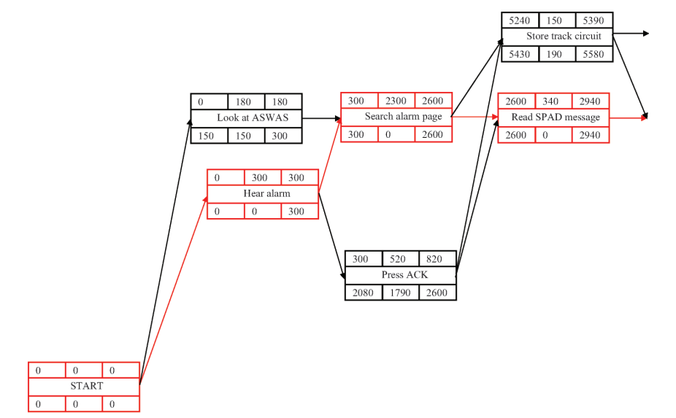
Part of the Critical path analysis of the signaller’s activities

Slide 17
Activity Float
Also known as Slack
The float for any activity is the amount of time that it can slip (be delayed) before it causes the project to be delayed.
Its quite straightforward to calculate the float for an activity in a network diagram.

Slide 18
Activity Float Example 1
Task | Duration (days) | Precedence
A | 3
B | 1 | A
C | 7 | B
D | 4
E | 3 | D
F | 2 | D
G | 2 | F
B
C
A
E
G
D
F

Slide 19
Activity Float Example 1
The float for every activity on the critical path is zero.
Float=0
Float=0
Float=0
B (1)
B (1)
C (7)
C (7)
A (3)
A (3)
E (3)
D (4)
G (2)
F (2)
3 paths through network
A, B, C. Total time = 11
D, E Total time = 7
D, F, G Total time = 8

Slide 20
Activity Float Example 1
Find next longest path. Subtract its duration from duration of critical path, that’s the float for these activities (ignoring the activities that have already been assigned a float value).
Float=0
Float=0
Float=0
B (1)
B (1)
C (7)
C (7)
A (3)
A (3)
Float=3
E (3)
Float=3
D (4)
G (2)
D (4)
G (2)
Float=3
3 paths through network
A, B, C. Total time = 11
D, E Total time = 7
D, F, G Total time = 8
F (2)
F (2)

Slide 21
Activity Float Example 1
Do the same for the next longest path, and so on. In this example, the next longest path is D, E. The float for activity D has already been calculated, so this is left as it is.
Float=0
Float=0
Float=0
B (1)
B (1)
C (7)
C (7)
A (3)
A (3)
Float=4
E (3)
Float=3
E (3)
Float=3
D (4)
G (2)
D (4)
G (2)
D (4)
Float=3
F (2)
F (2)
3 paths through network
A, B, C. Total time = 11
D, E Total time = 7
D, F, G Total time = 8

Slide 22
Activity Float Example 1
Task | Duration (days) | Precedence | Float
A | 3 |  | 0
B | 1 | A | 0
C | 7 | B | 0
D | 4 |  | 3
E | 3 | D | 4
F | 2 | D | 3
G | 2 | F | 3
Activities A, B and C cannot be delayed.
Activity D or F or G can be delayed by up to 3 days.
Activity E can be delayed by up to 4 days.
NOTE – as soon as an activity is delayed, the critical path and float information has to be recalculated for all activities.

Slide 23
Activity Float Example 2
Project survival. Collect wood. Light fire. Fetch water. Boil water. Gather branches. Build shelter. Catch fish. Cook fish.
ID | Task | Duration (minutes) | Precedence
A | Collect wood | 40 | -
B | Light fire | 60 | A
C | Fetch water | 45 | -
D | Boil water | 20 | B, C
E | Gather branches | 60 | -
F | Build shelter | 75 | E
G | Catch fish | 90 | -
H | Cook fish | 20 | B, G

Slide 24
Activity Float Example 2
ID | Task | Duration (minutes) | Precedence
A | Collect wood | 40 | -
B | Light fire | 60 | A
C | Fetch water | 45 | -
D | Boil water | 20 | B, C
E | Gather branches | 60 | -
F | Build shelter | 75 | E
G | Catch fish | 90 | -
H | Cook fish | 20 | B, G
20
90
H
G
40
60
A
B
45
20
C
D
60
75
E
F

Slide 25
Activity Float Example 2
20
90
H
G
Float = 15
Float = 25
40
60
A
B
Float = 15
Float = 15
45
20
C
D
Float = 70
Float = 15
60
75
E
F
Float = 0
Float = 0
Path 1: G, H. Time = 110
Path 2: A, B, D. Time = 120
Path 3: C, D. Time = 65
Path 4: E, F. Time = 135
Path 5: A, B, H. Time = 120
Third longest. Difference = 135-110 = 25
Second longest. Difference = 135-120 = 15
Fourth longest. Difference = 135-65 = 70
Critical path. Float = 0
Second longest. Difference = 135-120 = 15

Slide 26
Activity Float Example 2
ID | Task | Duration (minutes) | Precedence | Float
A | Collect wood | 40 | - | 15
B | Light fire | 60 | A | 15
C | Fetch water | 45 | - | 70
D | Boil water | 20 | B, C | 15
E | Gather branches | 60 | - | 0
F | Build shelter | 75 | E | 0
G | Catch fish | 90 | - | 25
H | Cook fish | 20 | B, G | 15

Slide 27
Early Start and Early Finish
Activity float is a useful value that tells us the length of time we can delay an activity without impacting project completion date
A network diagram can provide other useful information about project activities, including Early Start (ES) and Early Finish (EF)
Early start
Is the earliest time (or date) that an activity can start
An activity towards the end of path will only start early if all of the previous activities in the path started early
Early finish
Is the earliest time (or date) that an activity can finish
Only occurs if all previous activities in path started early and none of them slipped

Slide 28
Early Start and Early Finish
Company boss asks project manager………
When is the earliest Bob can get started on writing the software for your new CMS? He isn’t working on anything at the moment, but might be required for another project that starts next month.
When is the earliest you can finish the system testing? The testing suite is needed for another project.

Slide 29
Early Start and Early Finish
These values are useful in that they show exactly how much freedom a project manager has to move an activity’s start date without impacting the project as a whole
Example
If project duration is being measured in days, then if an activity has ES=10 and EF=18 , then this means that the earliest it can start is beginning of day 10 and the earliest it can finish is end of day 18.

Slide 30
Calculating ES and EF
ES and EF of each activity in a network diagram can be calculated using the Forward Pass method
Forward Pass method
Start on left-hand side of activity network and move forward. Apply the following rules:
the ES of any activity without a predecessor is 1
the EF of any activity is its ES plus its duration minus 1
the ES of an activity with one predecessor is EF of its predecessor plus one
the ES of an activity with more than one predecessor is the latest EF of all its predecessors plus one

Slide 31
Rule 1
1. the ES of any activity without a predecessor is 1
ES=1
Activity A
(3 days)
Activity B
(4 days)
Activity C
(5 days)
Activity D
(9 days)
Activity A does not have a predecessor, meaning it is not dependant on any other activity being finished. Therefore Activity A can start at the beginning of day 1 (i.e. its ES = 1)

Slide 32
Rule 2
2. the EF of any activity is its ES plus its duration minus 1
ES=1
EF = 3
Activity A
(3 days)
Activity B
(4 days)
Activity C
(5 days)
Activity D
(9 days)
Activity A has an ES of 1 (i.e. the earliest it can start is at the beginning of day 1).
It has a duration of 3 days.
Therefore the earliest it can finish is at the end of day 3.
EF = ES + duration – 1 = 1 + 3 – 1 = 3

Slide 33
Rule 3
3. the ES of an activity with one predecessor is EF of its predecessor plus one
ES=1
EF = 3
ES = 4
Activity A
(3 days)
Activity B
(4 days)
Activity C
(5 days)
Activity D
(9 days)
Activity B has 1 predecessor, Activity A.
Activity A has an earliest possible finish of end of day 3.
Therefore, the earliest possible start for Activity B is start of day 4.
ES = EF of predecessor + 1 = 3 + 1 =4

Slide 34
Rule 4
4. the ES of an activity with more than one predecessor is the latest EF of all its predecessors plus one
ES=1
EF = 3
ES = 4
EF = 7
ES=10
Activity A
(3 days)
Activity B
(4 days)
Activity C
(5 days)
ES=1
EF = 9
Activity D
(9 days)
Activity C has 2 predecessors, Activity B and Activity D.
Activity B has an EF of 7.
Activity D has an EF of 9.
Therefore the earliest C can start is after Activity D has finished.
ES = latest EF of all predecessors + 1 = 9 + 1 = 10

Slide 35
ES and EF example 1
ES=4
EF=4
ES=5
EF=11
ES=1
EF=3
B (1)
C (7)
A (3)
f=0
f=0
f=0
ES=5
EF=7
ES=1
EF=4
E (3)
ES=7
EF=8
D (4)
f=4
G (2)
f=3
ES=5
EF=6
f=3
F (2)
f=3
ES of any activity without a predecessor is 1
EF of any activity is its ES plus its duration minus 1
ES of an activity with one predecessor is EF of its predecessor plus one

Slide 36
ES and EF example 2
ES=1
EF=90
G (90)
ES=101
EF=120
H (20)
f=25
f=15
ES=1
EF=40
ES=41
EF=100
A (40)
Finish
B (60)
ES=101
EF=120
f=15
f=15
D (20)
ES=1
EF=45
C (45)
f=15
f=70
ES=61
EF=135
ES=1
EF=60
F (75)
E (60)
f=0
f=0
ES of any activity without a predecessor is 1
EF of any activity is its ES plus its duration minus 1
ES of an activity with one predecessor is EF of its predecessor plus one
ES of an activity with more than one predecessor is the latest EF of all its predecessors plus one

Slide 37
Late Start and Late Finish
Late start (LS)
Is the latest an activity can start without it impacting project completion time
If an activity is on a path that is much shorter than the critical path then it can start very late without delaying the project
Late finish (LF)
Is the latest an activity can finish without it impacting project completion time
If an activity is on a path that is much shorter than the critical path and all other activities on the path start and finish early then it can finish very late without causing the project to be late

Slide 38
Calculating LS and LF
LS and LF of each activity in a network diagram can be calculated using the Backward Pass method
It assumes ES and EF are already calculated for all activities
Backward Pass method
Start at end of network diagram (right-hand side). Apply the following rules:
the LF of the last activity in a path is the same as the EF of the last activity in the critical path
the LS of any activity is its LF minus duration plus one
the LF of an activity with one dependant activity is the LS of the dependant activity minus one.
the LF of an activity with more that one dependant activity is the lowest LS of all its dependant activities minus one.

Slide 39
Rule 1
1. the LF of the last activity in a path is the same as the EF of the last activity in the critical path
ES=1
ES=3
ES=4
EF=7
ES=8
EF=9
Activity A
(3 days)
Activity B
(4 days)
Activity C
(2 days)
LF=9
ES=1
EF=2
ES=3
EF=4
Activity D
(2 days)
Activity E
(2 days)
LF=9
Critical path = A, B, C (9 days)
Activity E is the last activity on critical path.
Its EF is 9.
Because it is on the critical path, its LF is also 9 (there is no flexibility if critical path)
All other paths could potentially finish as late as this, but no later.
LF of Activity E = 9.

Slide 40
Rule 2
2. the LS of any activity is its LF minus duration plus one
ES=1
ES=3
ES=4
EF=7
ES=8
EF=9
Activity A
(3 days)
Activity B
(4 days)
Activity C
(2 days)
LS=8
LF=9
ES=1
EF=2
ES=3
EF=4
Activity D
(2 days)
Activity E
(2 days)
LS=8
LF=9
The latest Activity C can finish is end of day 9.
Activity C takes 2 days.
The latest it could have started is beginning of day 8.
LS = LF – duration + 1 = 9 – 2 + 1 = 8.

Slide 41
Rule 3
3. the LF of an activity with one dependant activity is the LS of the dependant activity minus one.
ES=1
ES=3
ES=4
EF=7
ES=8
EF=9
Activity A
(3 days)
Activity B
(4 days)
Activity C
(2 days)
LF=7
LS=8
LF=9
ES=1
EF=2
ES=3
EF=4
Activity D
(2 days)
Activity E
(2 days)
LF=6
LS=8
LF=9
Activity B has 1 dependant activity, Activity C.
The latest Activity C can start is beginning of day 8.
The latest Activity B could finish is therefore the end of day 7.
LF of B = LS of C – 1 = 8 – 1 = 7.

Slide 42
Rule 4
4. the LF of an activity with more that one dependant activity is the lowest LS of all its dependant activities minus one.
ES=1
ES=3
ES=4
EF=7
ES=8
EF=9
Activity A
(3 days)
Activity B
(4 days)
Activity C
(2 days)
LS=1
LF=3
LS=4
LF=7
LS=8
LF=9
ES=1
EF=2
ES=3
EF=5
Activity D
(2 days)
Activity E
(2 days)
LS=6
LF=7
LS=8
LF=9
Activity A has 2 dependant activities, Activity B and Activity E.
The latest Activity B can start is beginning of day 4.
The latest Activity E can start is beginning of day 8.
The latest Activity A could finish is therefore the end of day 3.
LF of B = LS of C – 1 = 8 – 1 = 7.

Slide 43
LS and LF example 1
ES=4
EF=4
ES=5
EF=11
ES=1
EF=3
B (1)
C (7)
A (3)
f=0
f=0
f=0
LS=4
LF=4
LS=5
LF=11
LS=1
LF=3
ES=5
EF=7
E (3)
f=4
Critical path = A, B, C
ES=1
EF=4
ES=7
EF=8
D (4)
LS=9
LF=11
G (2)
f=3
ES=5
EF=6
f=3
LS=4
LF=7
F (2)
LS=10
LF=11
f=3
LS=8
LF=9
the LF of the last activity in a path is the same as the EF of the last activity in the critical path
the LS of any activity is its LF minus duration plus one
the LF of an activity with one dependant activity is the LS of the dependant activity minus one.
the LF of an activity with more that one dependant activity is the lowest LS of all its dependant activities minus one.

Slide 44
LS and LF example
ES=1
EF=90
G (90)
ES=101
EF=120
f=25
H (20)
LS=26
LF=115
f=15
LS=116
LF=135
ES=1
EF=40
ES=41
EF=100
A (40)
B (60)
f=15
f=15
ES=101
EF=120
LS=16
LF=55
LS=56
LF=115
D (20)
ES=1
EF=45
f=15
C (45)
LS=116
LF=135
f=70
LS=71
LF=115
ES=61
EF=135
ES=1
EF=60
F (75)
Critical path= E, F
E (60)
f=0
f=0
LS=61
LF=135
LS=1
LF=60
the LF of the last activity in a path is the same as the EF of the last activity in the critical path
the LS of any activity is its LF minus duration plus one
the LF of an activity with one dependant activity is the LS of the dependant activity minus one.
the LF of an activity with more that one dependant activity is the lowest LS of all its dependant activities minus one.

Slide 45
Activity boxes
Sometimes nodes represented using an activity box
Activity box for “C”
Activity identifier / description
ES
duration
EF
LS
float
LF
C
4
5 days
9
6
2 days
11

Slide 46
Example 1
B
4
1
4
C
A
5
7
11
1
3
3
1
0
3
4
0
4
5
0
11
E
D
5
3
7
1
4
4
4
3
7
9
4
11
G
F
7
2
8
5
2
6
8
3
9
10
3
11

Slide 47
Next time
Resource Management

