Slide 1
Project Management & Research Methodology (IS4S706)
Resource Management

Slide 2
This video
Resource management
Resource and the project schedule
Crashing the critical path
Resource clashes

Slide 3
What is resource management?
The processes used to identify, acquire and manage the resources needed for the successful completion of a project.
PMBOK’s 6 processes
Plan resource management
Estimate activity resources
Acquire resources
Develop team
Manage team
Control resources

Slide 4
Plan resource management
First step of resource management.
Involves deciding what tools and techniques that will be used in the subsequent steps.
Usually only performed once, at the start of a project.

Slide 5
Estimate activity resources
Identifies what resources are required by the project.
Carried out at the project activity level
People, skills, qualifications, certification
Hardware, software
Facilities – that is, each project activity is scrutinized
Identifies type, quantity and characteristics of resources
Relies on
Activity list
Activity attributes
Resource costs
Generally done at start and also reviewed

Slide 6
Acquire resources
Obtaining the people, equipment, software and other resources need to deliver the project.
Can be bureaucratic and time consuming – so should take place as early as possible in the project cycle
Guides the selection of resources and assigns them to their respective activities.
Uses project schedule

Slide 7
Develop team
People are main resource on many IT projects.
Often part of the team.
Project team needs to be motivated and on-side.
Teamwork is a crucial factor for project success.
Improving knowledge and skills
Increase trust and agreement
Dynamic, cohesive and collaborative team culture
Empowering the team

Slide 8
Manage team
Project team key resource.
Monitoring and tracking team members
Identify issues and address problems.
Influences team behaviour
Manages conflict and resolves issues
Responsibility of the Project Manager
strong leadership
emotional intelligence.

Slide 9
Control resources
Ensures that resources that are assigned and allocated as planned.
Monitoring and controlling planned usage against actual usage and taking corrective actions when required to keep the project on track.
Ensures that correct resources are available to correct tasks at the correct times
Should be performed continuously in all project phases

Slide 10
Resource and the project schedule
Crashing the critical path
Resource clashes

Slide 11
Meeting the deadline
Why project deadlines might be tight
Delay in one or more tasks
Unrealistic task durations in project plan
Estimates were wrong
Wanted to win a contract
Commercial pressure

Slide 12
How to meet a deadline?
Crash the critical path
A schedule compression technique
How does it work?
Identify critical activities that can be completed sooner by adding extra resource
Assign extra resources (usually people)
Overtime
Contractors
Bear in mind that crashing the critical path can result in a new critical path

Slide 13
Crashing the critical path by allocating more resources
Critical path A, B, C, F
Project duration = 45 days
B (10)
C (20)
A (10)
F (5)
D (10)
E (15)
Add resources to activity C.
It’s duration is now 16 a reduction of 4.
B (10)
C (16)
A (10)
F (5)
D (10)
E (15)
Critical path is still A, B, C, F
Project duration = 41 days.
Project finishes 4 days earlier than original plan.

Slide 14
Crashing the critical path by continuing to allocate more resources
Critical path A, B, C, F
Project duration = 41 days
B (10)
C (16)
A (10)
F (5)
D (10)
E (15)
Add resources to activity C.
It’s duration is now 5, a reduction of 11.
B (10)
C (5)
A (10)
F (5)
D (10)
E (15)
Critical path A, D, E, F
Project duration = 40 days.
Project finishes 1 day earlier than previous plan.

Slide 15
Split activities into sub-activities to collapse the critical path
Write
Software
(10)
Write user
Documentation
(10)
20 days
Write
Data Entry
Documentation
(5)
Write
Data Entry
Software
(5)
15 days
Write
Report
Software
(5)
Write
Report
Documentation
(5)

Slide 16
Other ways to meet the deadline
Trim the scope (strongly deadline-driven projects)
Can the customer do without the bells and whistles?
Time-box the project (time is fixed, scope varies)
Phase the implementation
the customer might be happy to take only part of the system by the “deadline” while you work on the rest for later implementation
Phase 1
Live use of parts of the system
Phase 2
Phase 3

Slide 17
Resource allocation
So far we have assumed that the project has sufficient resources available to carry out tasks according to the schedule
In practice, the availability of suitable resources needs to be considered. These resources include
Labour
Tools & equipment
Material & supplies
In IT projects, the main concern is usually with labour (i.e. people)
If certain resources are limited, then some activities might have to be delayed
Resource allocation attempts to allocate available resources in such a way as to limit impact on the project plan

Slide 18
Resource types
On this module, resource type is a reference to a skill or
For example
Activity: Write C++ software component
Resource type: Programmer
For example
Activity: Recruit staff
Resource type: HR manager

Slide 19
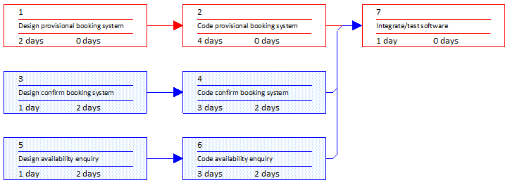
Activity network
In the activity network below, 3 resource types have been identified – System designer, Programmer and Tester.
The resource types have been allocated to activities
System designer
Programmer
Tester
System designer
Programmer
System designer
Programmer

Slide 20
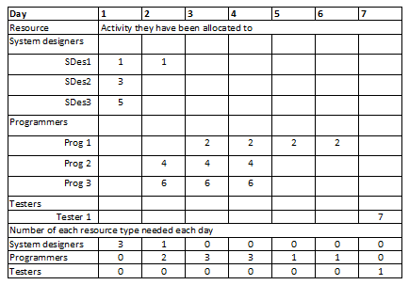
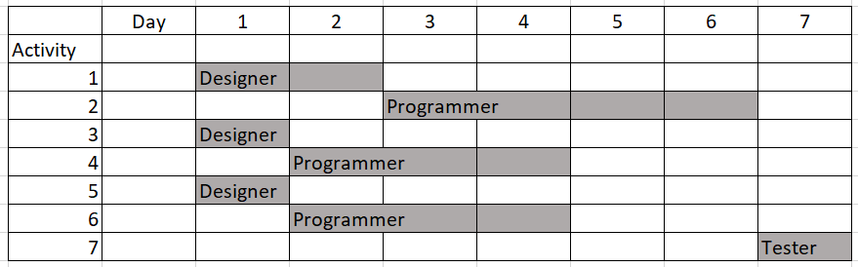
Resource by day table
Records the numbers of each resource type needed on each dayy

Slide 21
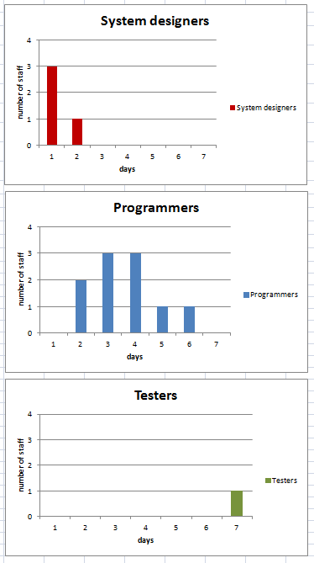
Resource histograms

Slide 22
Resource clashes
In some cases we may find that the project plan needs more resource of a particular type than are available
This results in a resource clash

Slide 23
Example
3 system designers needed on day 1.
1 system designer needed on day 2.
What if only 2 system designers available?

Slide 24
Resolving a resource clash
Possible options to resolve clash
Smooth: Use the float of an activity to delay its start until the required resource becomes available
Level: Delay the start of activity even though float is used up. This will delay completion of project, but might be preferred to extra cost of increasing resources
Buy in additional resources (staff) to cover the deficiency. This will probably increase project cost

Slide 25
Example
3 system designers needed on day 1.
1 system designer needed on day 2.
What if only 2 system designers available?

Slide 26
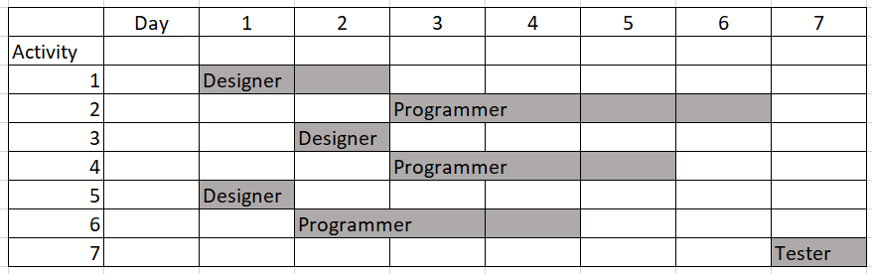
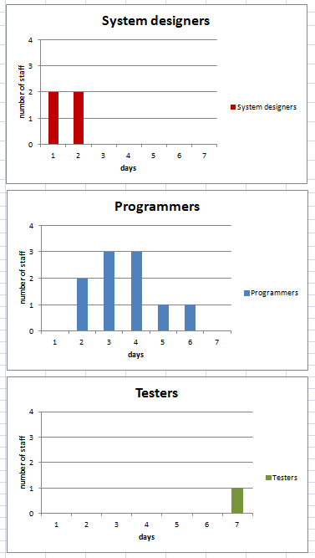
Smoothing solution
Activity 3 has float>0 so pushed back by a day
Activity 4 also forced back, but it too has float>0
Resource clash resolved – we now only need a maximum of 2 system designers on any given day
Project remains on schedule
Notice the System designers histogram is “smoother”

Slide 27
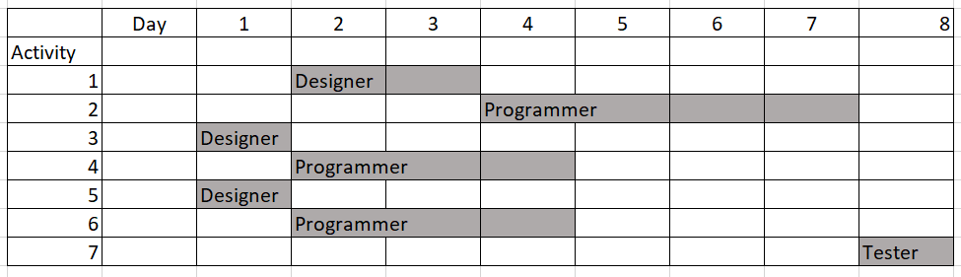
Levelling solution

Slide 28
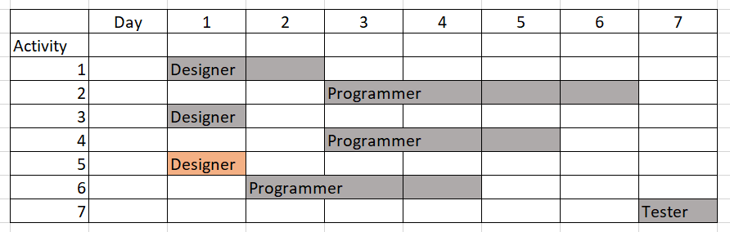
Add resource solution
Contractor £££££

Slide 29
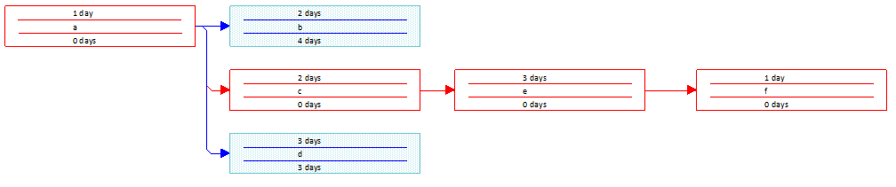
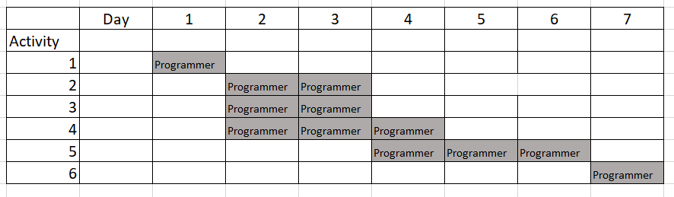
Example
What if only 2 programmers available to the project?
Programmer
Programmer
Programmer
Programmer
Programmer
Programmer

Slide 30
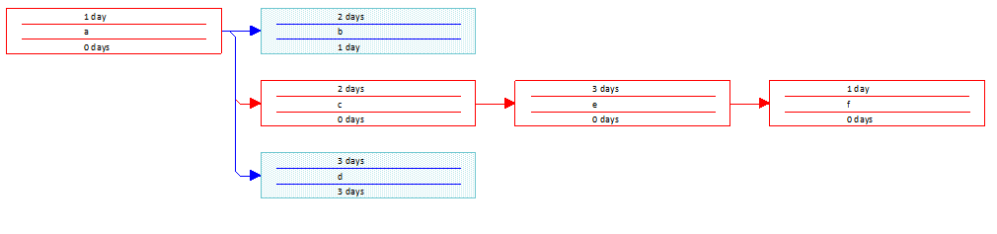
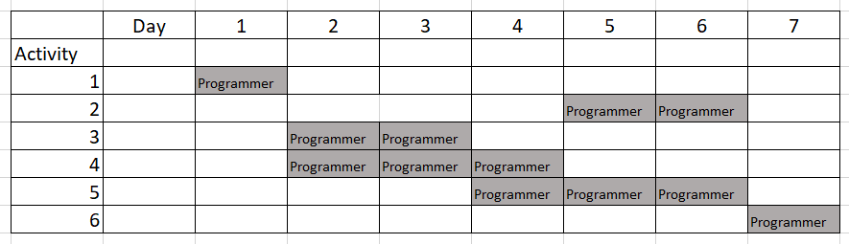
Smoothing solution – delay activity 2

Slide 31
Review
✓ Screen
We have looked at several techniques for time planning
Meeting tight deadlines
crashing the critical path
trimming the scope
phasing implementation
Resource smoothing and levelling
remember, real projects have many tasks, some of which may require resource rescheduling due to smoothing and levelling

Slide 32
What next…
Cost planning
Cost management
Coursework…..

