Slide 1
Project Management & Research Methodology (IS4S706)
Cost Management

Slide 2
What is Project Cost Management?
The process of
Estimating project costs
Budgeting project costs
Controlling project costs
Main objective
Ensure project expenditures remain within project’s budget.
Monitoring/documenting project financial transactions and payments.
It’s important, one of the ‘triple constraints’
Cost
Scope
Time
Continuous process
Improves likelihood of project success

Slide 3
Cost management processes
Cost Estimating
Cost Budgeting
Cost Control
Estimate
Budget
Control

Slide 4
Estimate Costs
How much will the project cost?
Inputs include
Scope baseline (e.g. WBS + activity descriptions)
Project schedule (activity duration and resource requirements)
Organizational factors
How much will each project activity costs?
Apply appropriate technique
Output
Software developer
8 days
Activity: Develop GUI
£6,500
Software license
Workstation

Slide 5
Estimate budget
Inputs
Cost estimates
Project schedule
Scope baseline
Risk register
Aggregate estimated costs
Contingency reserves
Funding limit reconciliation
Funding requirements
Outputs
Time-phased project baseline

Slide 6
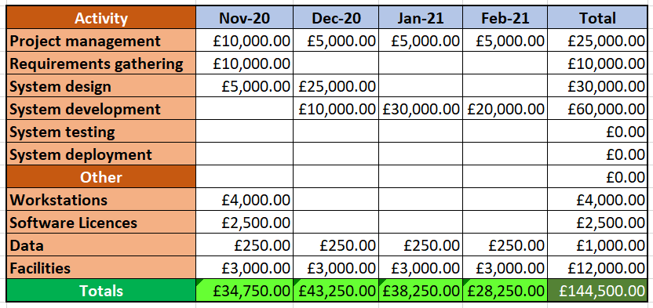
Project budget

Slide 7
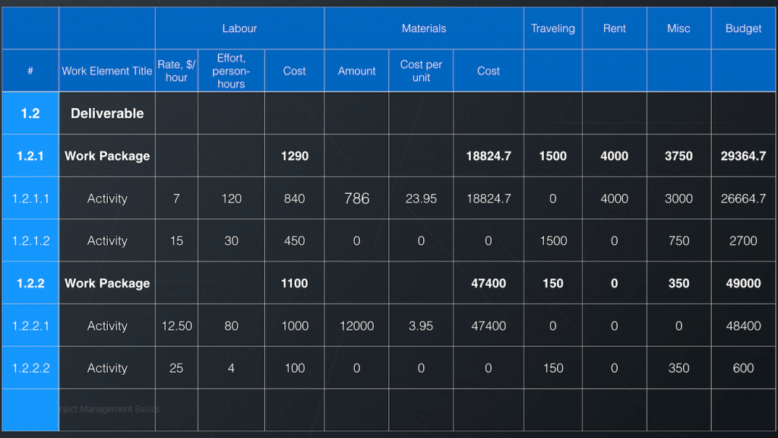
Project budget
Image from https://pmbasics101.com/project-budget-example/

Slide 8
Project baseline
Cumulative cost
Funding requirements
Cost baseline
Time

Slide 9
3 Project Baselines
Scope
The WBS (plus accompanying documentation)
Time
The Project Schedule
Cost
The Project Budget/Baseline

Slide 10
Control Cost
Monitor status of project
Unexpected things happen during the course of a project
For example
Software development takes 10 days instead of predicted 7 days
Original predicted cost = 7 x £400 = £2800
Actual cost = 10 x £400 = £4000
Control costs
Knowing how the project is progressing compared to your plan and making adjustments where necessary

Slide 11
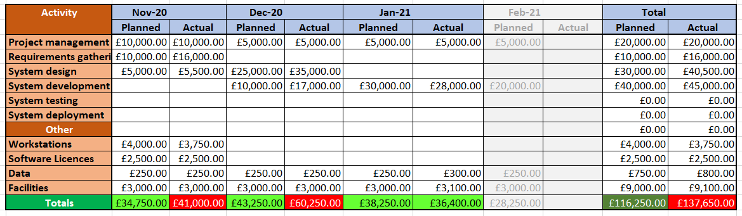
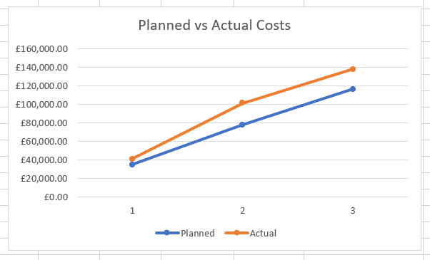
Monitoring the budget
Project budget at end of January 2021
Expected cost to date = £116,250.0
Actual cost to date = £137,650.0

Slide 12
Earned Value Management
Standard method for monitoring project progress
Used to assess a progress at any given point in time
Analyzes variances in the schedule and budget
Compares planned work with completed work
Determines if cost, schedule and work completed are progressing as planned
Compares the value of what the schedule says we should have delivered against the value of what has actually been delivered.

Slide 13
Earned Value Method
Make a note of Budget at Completion (BAC)
This is the total budget
Determine Planned % Complete (P%C)
How much of the work was planned to have been done
Determine Actual % Complete (A%C)
How much of the work has been done
Determine Planned Value (PV)
PV = BAC x P%C
Determine Earned Value (EV).
EV = BAC x A%C

Slide 14
Earned Value Method
Calculate Schedule Performance Index (SPI)
SPI = EV
PV
Calculate Schedule Variance (SV)
SV = EV – PV

Slide 15
Earned Value Method
Actual Cost (AC)
The amount of money actually spent so far
Calculate Cost Performance Index (CPI)
CPI = EV
AV
Calculate Cost Variance (CV)
CV = EV - AC

Slide 16
Earned Value Example
BAC = £75,000
6 months in on a 12 month project
P%C = 50%, A%C = 30%, AC = £40,000
PV = £75,000 x 50% = £37,500
EV = £75,000 x 30% = £22,500
SPI = 22,500/37,500 = 0.6
SV = £22,500 – £37,500 = -£15, 000
CPI = 22,500/40,000 = 0.5625
CV = £22,500 - £40, 000 = -£17,500

Slide 17
Forecasting
Estimate at Complete (EAC)
EAC = BAC
CPI
EAC = £75,000 / 0.5625 = £133,333
To-complete performance index (TCPI)
TCPI = (BAC – EV)
(BAC – AC)
TCPI = (75,000-25,000)/(75,000-40,000) = 1.43

Slide 18
Acknowledgement
Lecture material based on ideas presented in
“Project Management for IT-Related Projects” , Bob Hughes (editor), 2012, BCS, ISBN 978-1-78017-118-0
“Head First PMP – A brain friendly guide”, Jennifer Greene and Andrew Stellman, 2013, O’Reilly, ISBN 978-1-449-36491-5

Slide 19
Next couple of videos / slides
Estimating
Risk management

