Slide 1
Project Management & Research Methodology (IS4S706)
Project Financial Business Case

Slide 2
Cost management
Project Business Justification
Project Cost Management

Slide 3
Project Business Case
A crucial document for most projects.
Produced right at the start of a project (or pre-project)
Helps inform decisions on whether the project should go ahead or not – so, you could regard it as being a pre-project document.
Uses both qualitative and quantitative data to govern its recommendations.
Qualitative
Organization fit
Future development
Business risks
Quantitative
Costs v Benefits

Slide 4
Project “Lifetime”
Project development
Project development
Project deliverable in use
-£
+£ +£ +£ +£ +£

Slide 5
Assumptions (for this talk)
Project “lifetime” measured in years
First year of project
Year 0
Project Development
High costs
“Cost management”
Years 1…..n
Project deliverable deployed
Benefits
On-going costs
Costs and benefits for years 0…..n have already been estimated

Slide 6
Common quantitative financial criteria
Net Present Value
Payback Period

Slide 7
Budget and Projected Cash Flow
A Budget is simply the predicted project income and expenditure for a set period of time
Cash Flow is the difference the between money generated by a delivered project less the costs of the project over a fixed period of time
At project planning stage, expenditure (costs) and income (benefits) will be based on estimates, giving rise to a Projected Cash Flow
In the notation used here, expenditure is represented by a negative value
 | Year 0 | Year 1 | Year 2 | Year 3 | Year 4
Expenditure £ | -11000 | -2000 | -2000 | -2000 | -2000
Income £ | 0 | 6000 | 6000 | 8000 | 8000
Projected Cash Flow £ | -11000 | 4000 | 4000 | 6000 | 6000

Slide 8
Project value
Predicted overall value of a project can be calculated by adding together the cash flow estimates for each year (or summing the income and expenditure totals)
 | Year 0 | Year 1 | Year 2 | Year 3 | Year 4 | Total
Expenditure £ | -11000 | -2000 | -2000 | -2000 | -2000
Income £ | 0 | 6000 | 6000 | 8000 | 8000
Projected Cash Flow £ | -11000 | 4000 | 4000 | 6000 | 6000 | 9000
Project Value

Slide 9
Net Present Value
Note however that the true value of a cost or a benefit is influenced by when it occurs.
In simple terms
There is an advantage in generating benefits sooner rather than later
There is an advantage in delaying expenditure
Net Present Value
Is a technique that takes account of this when performing calculations that use project costs and project benefits estimation

Slide 10
For example….
 | Year 0 | Year 1 | Year 2 | Year 3 | Year 4 | Total
Expenditure £ | -11000 | -2000 | -2000 | -2000 | -2000
Income £ | 0 | 6000 | 6000 | 8000 | 8000
Projected Cash Flow £ | -11000 | 4000 | 4000 | 6000 | 6000 | 9000
 | Year 0 | Year 1 | Year 2 | Year 3 | Year 4 | Total
Expenditure £ | -11000 | -2000 | -2000 | -2000 | -2000
Income £ | 0 | 6000 8000 | 6000 | 8000 | 0
Projected Cash Flow £ | -11000 | 12000 | 4000 | 6000 | -2000 | 9000

Slide 11
For example….
 | Year 0 | Year 1 | Year 2 | Year 3 | Year 4 | Total
Expenditure £ | -11000 | -2000 | -2000 | -2000 | -2000
Income £ | 0 | 6000 | 6000 | 8000 | 8000
Projected Cash Flow £ | -11000 | 3000 | 4000 | 6000 | 6000 | 8000
 | Year 0 | Year 1 | Year 2 | Year 3 | Year 4 | Total
Expenditure £ | -11000 | -2000 | -2000 | -2000 | -2000
Income £ | 0 | 6000 8000 | 6000 | 8000 | 0
Projected Cash Flow £ | -11000 | 12000 | 4000 | 6000 | -2000 | 9000
8000
Invested
8000
+ 750

Slide 12
For example….
 | Year 0 | Year 1 | Year 2 | Year 3 | Year 4 | Total
Expenditure £ | -11000 | -2000 | -2000 | -2000 | -2000
Income £ | 0 | 6000 | 6000 | 8000 | 8000
Projected Cash Flow £ | -11000 | 4000 | 4000 | 6000 | 6000 | 9000
 | Year 0 | Year 1 | Year 2 | Year 3 | Year 4 | Total
Expenditure £ | -11000 | -2000 | -2000 | -2000 | -2000
Income £ | 0 | 6000 8000 | 6000 | 8000 | 0
Projected Cash Flow £ | -11000 | 12000 | 4000 | 6000 | -2000 | 9750
8000
Invested
8000
+ 750

Slide 13


Present Value
Present value calculation translates future costs and benefits to a present day value:
i is the discount rate (similar to an interest rate)
the rate you’d receive elsewhere for an investment of comparable risk
n represents the time period being considered (in our examples this value represents the year)
NOTE: first year of a project is designated as year 0
the value is called the Discount Factor

Slide 14
Discount rate
i is the discount rate (similar to an interest rate)
the rate you’d receive elsewhere for an investment of comparable risk
Sometimes given as a percentage
5%
Needs to be represented as a decimal in the formula
0.05

Slide 15
n
n represents the time period being considered
First year of project is year 0
Second year of project is year 1
Third year of project is year 2
Fourth year of project is year 3
etc….

Slide 16


Present Value example
Remember, the project starts in year 0.
A project is expected to generate £100 in year 1.
The discount rate is set at 5% (0.05)
The present value (i.e. start of project value) of that £100 is calculated as:

Slide 17


Another present value example
£100 expected to be generated in year 4 of a project
Using a discount rate of 0.05, at the start of project this would have a present value of:
c/w year 1 example (£95.24)
NOTE: £100 generated in Year 0 of a project would have a Present Value of £100.

Slide 18
Discounted Cash Flow
Apply NPV formula to cash flows
So, assume discount rate (i) = 5%
 | Year 0 | Year 1 | Year 2 | Year 3 | Year 4
Expenditure £ | -11000 | -2000 | -2000 | -2000 | -2000
Income £ | 0 | 6000 | 6000 | 8000 | 8000
Projected Cash Flow £ | -11000 | 4000 | 4000 | 6000 | 6000

Slide 19
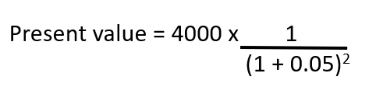
Discounted Cash Flow
Apply PV formula to cash flows
So, assume discount rate (i) = 5%
 | Year 0 | Year 1 | Year 2 | Year 3 | Year 4
Expenditure £ | -11000 | -2000 | -2000 | -2000 | -2000
Income £ | 0 | 6000 | 6000 | 8000 | 8000
Cash flow £ | -11000 | 4000 | 4000 | 6000 | 6000
Discounted cash flow £ | -11000 | 3809.5 | 3628.12 | 5183.03 | 4936.21

Slide 20
Net Present Value of Project
Sum the discounted cash flows
 | Year 0 | Year 1 | Year 2 | Year 3 | Year 4 | Total
Expenditure £ | -11000 | -2000 | -2000 | -2000 | -2000 | -19000
Income £ | 0 | 6000 | 6000 | 8000 | 8000 | 28000
Cash flow £ | -11000 | 4000 | 4000 | 6000 | 6000 | 9000
Discounted cash flow £ | -11000 | 3809.5 | 3628.12 | 5183.03 | 4936.21 | 6556.9
Net present value of project
(compare with previous value, which was £9000.00)

Slide 21
Move some costs back
NPV increases
 | Year 0 | Year 1 | Year 2 | Year 3 | Year 4 | Total
Expenditure £ | -5000 | -2000 | -4000 | -4000 | -4000 | -19000
Income £ | 0 | 6000 | 6000 | 8000 | 8000 | 28000
Cash flow £ | -5000 | 4000 | 2000 | 4000 | 4000 | 9000
Discounted cash flow £ | -7000 | 3809.5 | 1814.1 | 3455.4 | 3290.8 | 7369.7
(compare with previous NPV which was £6556.9)

Slide 22
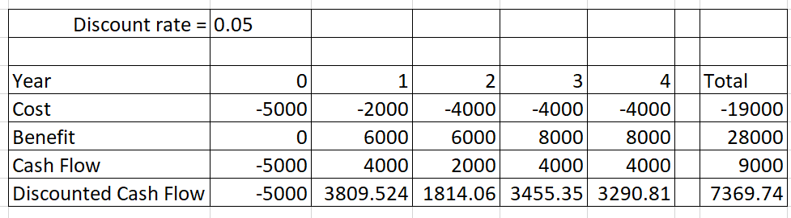
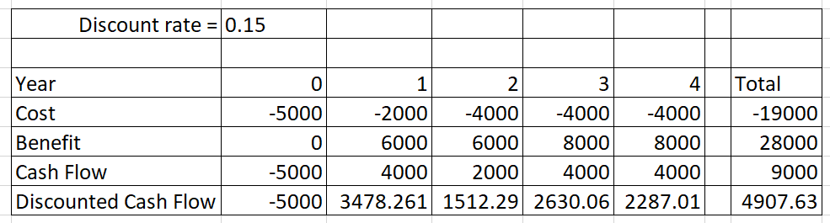
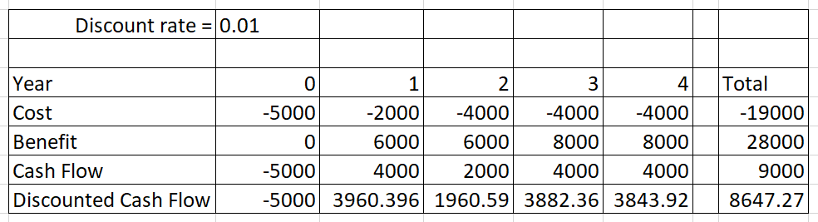
Alternative scenarios
Expected
Worst case
Best case

Slide 23
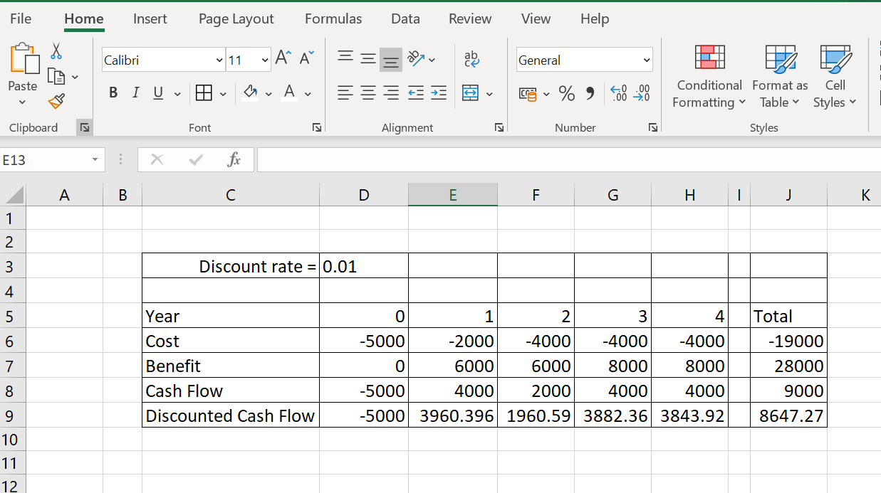
Spreadsheet

Slide 24
Payback Period
An alternative method for deciding if there is a business case for a project
Payback period is the time required to recoup the funds expended in an investment, or to reach the break-even point
This will sometimes be a crucial factor in deciding whether to go ahead with (or invest in) the project
Can be worked out by examining Accumulated Cash Flow
Does not use Present Value of money
Ignores benefits that occur after payback
Can be used to compare alternative project plans

Slide 25
Accumulated Cash Flow
 | Year 0 | Year 1 | Year 2 | Year 3 | Year 4
Expenditure £ | -11000 | -2000 | -2000 | -2000 | -2000
Income £ | 0 | 6000 | 6000 | 8000 | 8000
Cash flow £ | -11000 | 4000 | 4000 | 6000 | 6000
Accumulated cash flow £
-11000
-7000
-3000
3000
9000
Accumulated cash flow Year 0 = Cash flow Year 0
Accumulated cash flow Year 1 = Cash flow Year 1 + Accumulated cash flow Year 0
Accumulated cash flow Year 2 = Cash flow Year 2 + Accumulated cash flow Year 1
Accumulated cash flow Year 3 = Cash flow Year 3 + Accumulated cash flow Year 2
Accumulated cash flow Year 4 = Cash flow Year 4 + Accumulated cash flow Year 3
Payback period hit when Accumulated cash flow turns from negative to positive
Accumulated cash flow becomes positive somewhere near the middle of year 3
Payback period is about 3.5 years

Slide 26
Acknowledgement
Lecture material based on ideas presented in
“Project Management for IT-Related Projects” , Bob Hughes (editor), 2012, BCS, ISBN 978-1-78017-118-0

Slide 27
What to do next…?
NPV tutorial sheet
Coursework !
Next video……Project Cost Management

