Slide 1
Project Management & Research Methodology (IS4S706)
Estimating

Slide 2
Estimating
What do we need to estimate?
Time
Cost
Resources
If you want to delve deeper
http://courses.cs.washington.edu/courses/cse403/07sp/assignments/estimationbasics.pdf

Slide 3
Estimating Resources
Identifies what resources are required by the project.
Carried out at the project activity level
People, skills, qualifications, certification
Hardware, software
Facilities – that is, each project activity is scrutinized
Identifies type, quantity and characteristics of resources
Relies on
Activity list
Activity attributes
Resource costs
Generally done at start and also reviewed
Coordinated with other processes
e.g. Activity: Develop web site GUI
Web developer (10 days)
Adobe Dreamweaver
Apple iMac

Slide 4
Estimate Costs
How much will the project cost?
Inputs include
Project activity list (e.g. WBS + activity descriptions)
Project schedule (activity duration and resource requirements)
Organizational factors
How much will each project activity costs?
Apply appropriate technique

Slide 5
Cost Estimating Tools and Techniques
Quotes (preferred suppliers?, consider options)
Organizational procedures / rates
How long will it take? (cost = daily rate x number of days)
Analogous
Parametric
Expert judgement
Three-point
optimistic, most-likely, pessimistic
Vendor bid analysis
Reserve analysis
Project management software

Slide 6
Estimating cost outputs
For each project activity
Cost estimate
Basis of estimate
Web developer
10 days
Activity: Develop GUI
£7,560.00
Dreamweaver license
iMac

Slide 7
Estimating time
Allocating an estimated duration to the activities of a project
Allows us to calculate overall duration of the project
Allows us to identify when (and for how long) we need to call upon the services of individuals to carry out particular tasks
a major contributor to the cost of IT projects

Slide 8
When are estimates carried out?
At the start
Throughout the project
Activities change
As the project proceeds, accuracy and detail will be improved

Slide 9
Under estimating
If time, cost and resources are under estimated a project can fail
Delayed beyond its agreed completion date
Exceeds budget
Quality of deliverable suffers

Slide 10
Over estimating
If time, cost and resources are over estimated
A bid to carry out work for external customer might be rejected due an excessively high estimate
Failure due to estimated cost not being competitive
Generous estimate may lead to lower productivity
Parkinson’s Law (‘work expands to fill time available’)
Excess time, resource and money could have been used more productively elsewhere

Slide 11
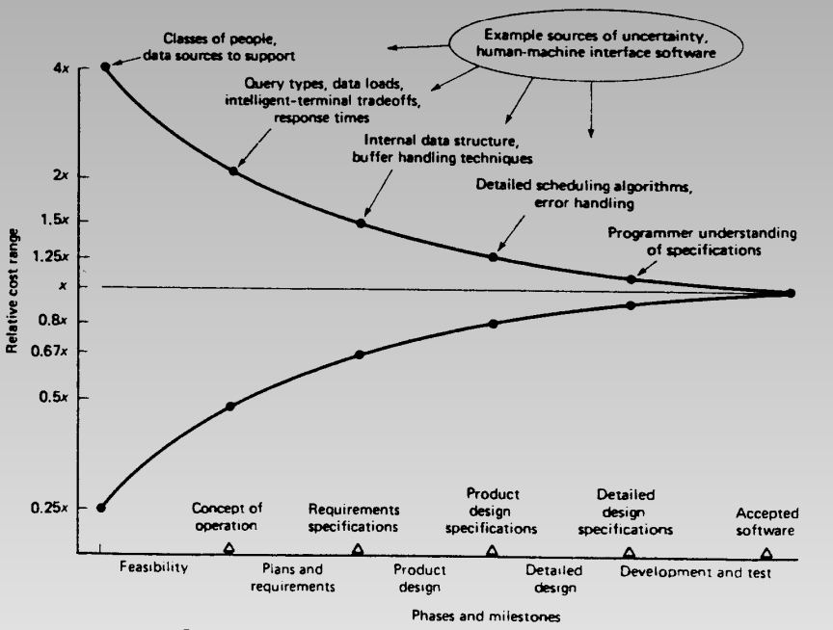
Estimating is not easy
Estimation required at the start of a project
That’s the time at which we have the most uncertainty
The cone of uncertainty (Barry Boehm, Software Engineering Economics, Prentice Hall, 1981)
Uncertainty greatest at the start
Variance of 4x to 0.25x in range
For example, a project estimated to last 1 year could actually take as long as 4 years or as short as 3 months
As the project proceeds accuracy and detail will be improved

Slide 12
Travelling home example
It usually takes me an hour to get home by car
My quickest time to date is 45 minutes
My slowest time to date is over 5 hours
My estimate at the start of the journey will usually be wrong
An estimate 5 miles from home will usually be very accurate

Slide 13
Implications
Make sure estimates are as accurate as they possibly can be when putting project plan together
However
Revisit the project
Contingency

Slide 14


Estimating methods
Expert judgement
Analogy
Parametric approaches
Scrum techniques
3-Point
How many sweets
in the jar?

Slide 15
Expert judgement
Ask somebody who is familiar with the tasks to be carried out, somebody who is an expert
Advantages
Involves the people with the best experience of similar work in the past
Problems
What if the task is “new”, so no prior experience
Experts can be prone to human error – e.g. they may underestimate in case a larger figure suggests they are less capable
It can be difficult for project planner to evaluate the quality of somebody else’s estimate

Slide 16


How long will it take 1 person to eat all the sweets? Expert.
Physiologist: In my expert opinion, an average person could eat 1 cola cube every 2 minutes.
Shopkeeper: I sell sweets for a living. In my expert opinion, there are 200 sweets in the jar.
Time = 200 x 2 minutes = 400 minutes

Slide 17
Estimating by analogy
What if no experts available?
An alternative approach is the analogy (or comparative) approach
Analogy approach involves
Identify key characteristics of new project
Search for previous project with similar characteristics (if no past project exists that matches new, it might be necessary to select parts of old projects that match parts of new)
Use actual effort recorded for previous project as basis for estimating new one
Identify key differences between the old and new project
Adjust the base estimate to take account of these differences

Slide 18


How long will it take 1 person to eat all the sweets? Analogy.
Jars of sweets have been eaten before !
Similar sized jar, different sweets – 4 people at all the sweets in 20 minutes.
Similar sweets, different sized jar – 1 person ate the lot in 130 minutes !
Time = 300 minutes

Slide 19
Parametric approaches
Project data used as input a formula or computer program that subsequently produces an estimate.
Make use of a model derived using data from previous project
Uses a statistical relationship between the historical data and other variables
Estimation is based on the value of certain parameters or variables
Size drivers

Slide 20
Function point analysis
Function point analysis Mk II
A measure of the functional size of a software application
Count the inputs, outputs and data entities accessed
Adjust the function points for technical complexity
Weight the counts to take account of relative difficulty of implementing (e.g. output tends to be easier than input, since input requires error checking)
In Mark II method, weightings are
inputs 0.58
outputs 0.26
entities accessed 1.66

Slide 21
Function point example
In a proposed E-Booking system there is a transaction that records the final payment made by a customer for a booking for which they have already paid a deposit
There are 2 inputs for the payment
Booking number
Amount paid
There are 3 possible outputs
Payment reference number
Customer name
Error message
There are 2 data entities
Customer table
Booking table

Slide 22
The function point count (FPC) for this transaction is
(2 x 0.58) + (3 x 0.26) + (2 x 1.66) = 5.26
What does 5.26 mean in this context?
For a single transaction, not very useful
But, if all the FPCs for the proposed system are added, it gives a useful measure of the size of a project
Looking back at previous projects, we can work out how many function points are implemented per day on average (e.g. it may turn out to be 40)
When new project is analysed, then it is possible to estimate number of days to complete
(FPC total)/average FP per day
So, a project with 2400 function points would take approx. 2400/40 = 60 days

Slide 23

How long will it take 1 person to eat all the sweets? Parametric.
Number of sweets = Volume of Jar
Volume of 1 sweet
Consumption rate = 1 sweet every 1.5 minutes
Jars of sweets have been eaten before !
14mm
12mm
12mm
12mm
Time = 60 x 60 x 140 x 1.5 mins = 437 mins
12 x 12 x 12
60mm
60mm

Slide 24
Estimating in Scrum
Scrum doesn't impose the use of estimation techniques.
Important to
Estimate how much work can be done in a Sprint
Update estimate during Sprint
Relative Story Point Estimation
Numeric Sizing (1, 2, 3, 5…., 10)
T-shirt sizes (XS, S, M, L, XL XXL, XXXL)
Fibonacci Sequence (1, 2, 3, 5, 8, 13, 21 etc)
Estimating
Planning poker
https://www.youtube.com/watch?v=_jYiuYtrpp8
XS
S
M
L
XL
XXL
XXXL

Slide 25
How long will it take 1 person to eat all the sweets? Poker.
Round1
Round2
Round3
Estimator 1
Estimator 2
Estimator 3
Estimator 4
Estimator 5
144
233
377
377
377
377
377
377
377
233
233
377
610
377
377
Time = 377 min

Slide 26
Three-point estimates
Three estimates
Most likely
Optimistic
Pessimistic
Use the average
Triangular
Estimate =
O = 5, ML = 10, P = 22
Estimate = = 12.33
Optimistic + Most Likely + Pessimistic
3
5 + 10 + 22
3

Slide 27
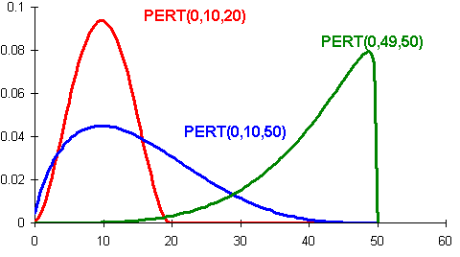
PERT (Program Evaluation and Review Technique)
*
PERT / Beta distribution
Optimistic and Pessimistic less likely than Most likely
Estimate =
O = 5, ML = 10, P = 22
Estimate = = 11.7
Optimistic + (4 x Most Likely) + Pessimistic
6
5 + (4 x 10) + 22
6

Slide 28
How long will it take 1 person to eat all the sweets? 3-Point.
Best case:
Person is really, really hungry.
Time = 200 minutes
Worst case:
Person has just eaten a large Sunday dinner.
Time = 600 minutes
Expected case:
Time = 310 minutes.
Time = 200 + 4x310 + 600 = 340 minutes
6

Slide 29
Reserve Analysis
So far, we have assumed things will go according to plan
Activities starting and finishing when they are supposed to, and taking no longer than the estimated time
However
Things can go wrong
Estimates are only estimates
Prudent project manager will allow some additional margin, or contingency

Slide 30
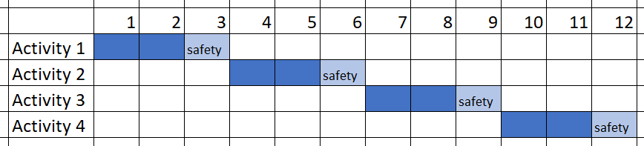
Allocating contingency to tasks
Traditional approaches insist that, in order to meet a promised deadline:
every task must start and finish exactly on published dates
therefore every task must have contingency (or safety)

Slide 31
How much safety?
Again, this will have to be estimated
Will be governed to some extent by how much risk you are willing to take
% of Expected
Westheimer's Rule
“... multiply that figure by two and change the unit of measure to the next higher unit. So, in this way, you allocate two days to a one hour task.”
Use PERT*
Standard Deviation = (Pessimistic - Optimistic)/6
Add SD as safety to Expected for 68% confidence
Add SDx2 as safety to Expected for 95% confidence
Add SDx3 as safety for to Expected 99% confidence

Slide 32
A problem with adding contingency to tasks
Parkinson’s law
work expands to fill the time available to it
Student’s syndrome
So
In order to meet the project deadline we force team members to meet each task deadline
Therefore each task probably needs a safety margin
Consequently team members don’t start on time and don’t focus on the task
Consequently when things go wrong, some tasks finish late, despite the safety margin
Some tasks finish late, none finish early, meaning the project over-runs

Slide 33
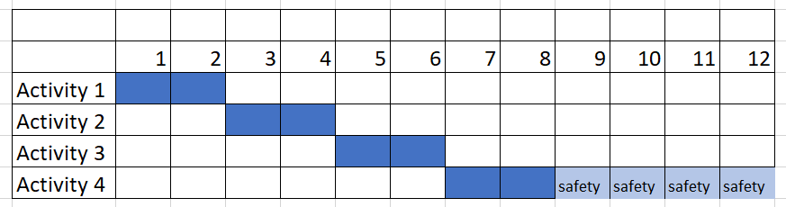
Critical Chain with Buffer Management (CCBM)
Removes the “safety” from individual tasks
Safety summed and buffer placed the end of the critical path

Slide 34
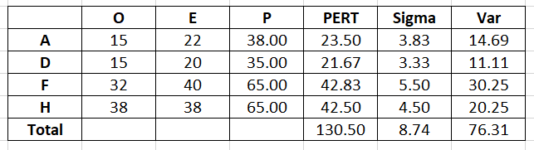
CCBM with PERT*
Activity duration SD (Sigma) = (P – 0) / 6
Activity Variance (Var) = (Activity Sigma)²
Project Var = Sum of all Activity Var
Project Sigma = (Project Var) ^{½}
No project buffer, project duration = 130.5 (50% confidence)
Project buffer = Project Sigma = 8.74 (68% confidence)
Project buffer = 2 x Project Sigma = 17.5 (95% confidence)
Project buffer = 3 x Project Sigma = 26.2 (99% confidence)
Assumes some activities will finish earlier than Expected

Slide 35
Closing remarks
Estimating is important
Time, cost, risk…..
Estimating can be difficult
Variety of methods exists
Pick most appropriate
Use more than 1 method
Seek out a range of opinions
Estimates will always include error
Keep a close eye on the schedule
Contingency
Re-visit estimates as project progresses

Slide 36
Next topic
Risk management
Thanks for listening

Slide 37

Stinger…
Normally, the class tries these techniques out on a real jar of sweets.
More often than not, the winner is…..
The Wisdom of Crowds - Wikipedia

