Slide 1

Introducing your University IT, Email
and Learning Systems
MSc Data Science
Dr Penny Holborn
Course Leader
(Generic IT Induction v4)

Slide 2
IT Regulations
In using the University’s online services, you commit to accepting the University of South Wales IT Regulations. Please ensure that you have read the following:
Computer Regulations — the full version of the University’s Terms and Conditions.

Slide 3
Today’s aims
By the end of today's session you will:
Have been introduced to UniLife
Know where to go to get a round up of all IT-related issues
Know where to go for IT support and to update your account’s password
Know how to access your email, wifi and the internet
Know where to find support on setting up your own device
Know where to go to access computer labs and printing facilities
Know how to access your associated Office 365 account
Know how to access Blackboard
Find out about some of Blackboard’s common features
Explore one of your modules and access course materials
Practise communicating with fellow students and staff
Practise uploading assessment work via Turnitin

Slide 4
All accessed through UniLife
UniLife (http://unilife.southwales.ac.uk/) is the main student portal of the University of South Wales.
UniLife is also used as an umbrella term for various student information web sites provided by the University.
To find out more about UniLife, please visit Unilife: An Overview

Slide 5
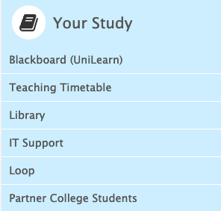

Where to go for IT Support
Firstly check the IT Services channel for help and advice:
https://its.southwales.ac.uk/
If you still can’t find what you are looking for,
please visit our IT help and support page
You can also log a call with
IT Customer Support Service:
https://support.southwales.ac.uk/
This is the first point of contact for students and staff seeking assistance with IT-related queries or guidance.

Slide 6
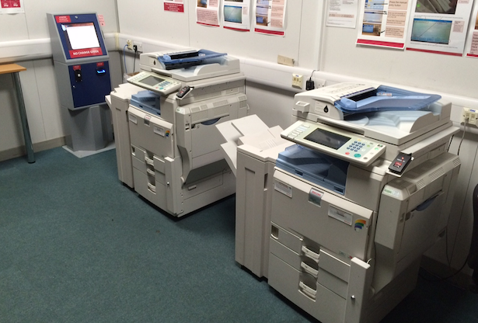
Where to go for IT Support
If you require a quick face-to-face response then you can always get in touch with our
IT Customer Support Teams at the following locations:
Cardiff – Please log a helpdesk call, details as per previous slide.
City (Newport) – On floor B behind the advice zone in the library NCCCB10 available 8:30am - 5pm
Glyntaf – on the ground floor of the Elaine Morgan Building by the main reception GTEM022 available 8:30am - 5pm
Treforest – on the first floor of the library TRL201 available 8:30am - 7pm (5pm non-term time)
Need help locating a room? Use our findaroom service
You can also find details of computer labs via the IT Services webpage
Self-service machines that enable you to print, scan or photocopy are available in various locations on all campuses. For further details you may want to access the Student Printing Advice pages.

Slide 7
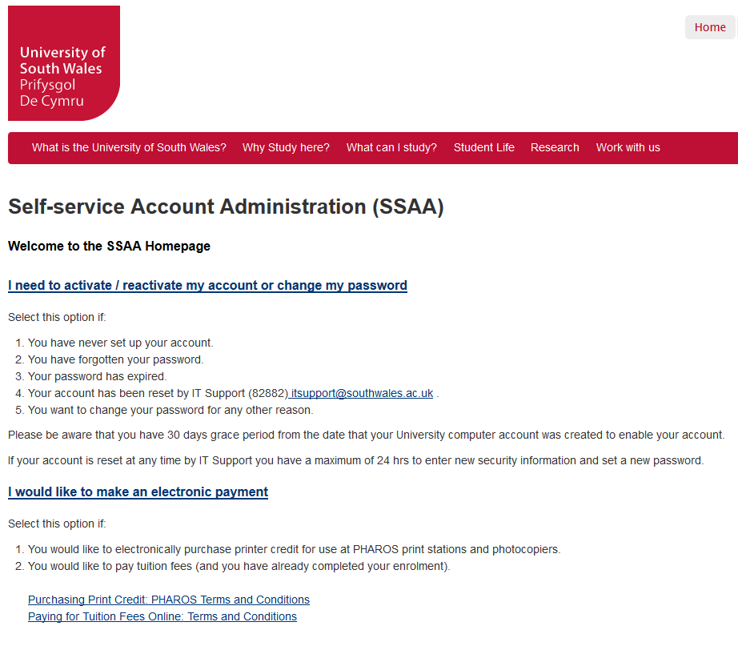
Updating your password
At regular intervals, you will be asked to update your password to maintain the security of your account.
You can do this online through the SSAA system:
https://ssaa.southwales.ac.uk/

Slide 8
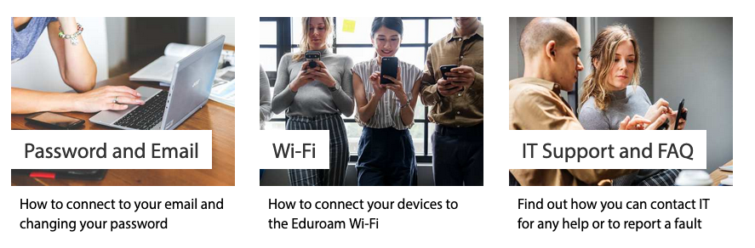
Access to email, wifi and the internet
Visit the IT Services channel for help and advice:
https://its.southwales.ac.uk/

Slide 9
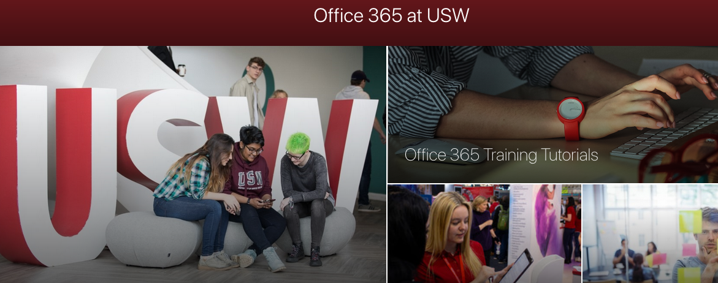
Access to Office 365
University of South Wales students have access to Office 365 as part of their student account, providing up to 1TB of online email & storage space for saving or backing up documents.
Find out more about Office 365

Slide 10
Access to Blackboard
You can access Blackboard directly from UniLife:
http://unilife.southwales.ac.uk/
Note that the direct URL to get to Blackboard and all other learning systems tools is:
https://unilearn.southwales.ac.uk/
www.
mobile
Blackboard Mobile Learn is an app available for iOS and Android
Note: UniLearn is the umbrella term for the integrated system which supports USW learning and teaching activities through technology.
Notes:
Tutor Notes: If, for some reason, the link above to Unilearn.southwales.ac.uk isn’t working, you can show students Blackboard by navigating to The Hub and choosing ‘Blackboard’ from the ‘Take Me to …’ drop-down menu.

Slide 11
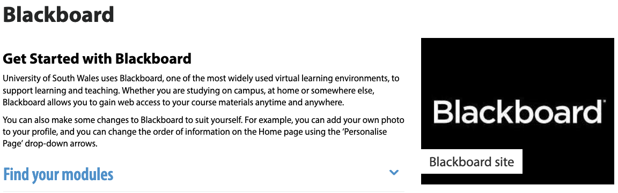
Exploring the UniLearn environment
Take a look at the 'Getting Started with Blackboard page' which includes a video introducing you to the main tabs of the Blackboard online learning environment and shows you how to personalise your settings.

Slide 12
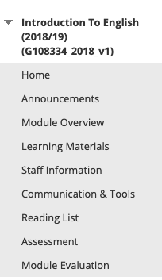
How will you use Blackboard?
You will use Blackboard to:
access notes, resources and assignments
contact and be contacted by lectures
via email
be kept up to date via
‘Announcements’
hand in assignments via the
'Assessment’ button

Slide 13
“I can’t find a module in Blackboard – what do I do?”
In the first instance, contact your Campus Advice Zone
For particular queries relating to online enrolment, please visit the Unilife 'Contact Us' Page.

Slide 14
Course / Module Communications
In Blackboard:
Your tutor will use the announcements page to keep you up to date with important news.
You can send emails to others enrolled in a Blackboard module from the Communications & Tools page.
Discussion boards, blogs wikis or other communication tools may be used to complement your studies.
Notes:
Why not get your students to practice sending an email and posting to and responding to discussion board posts.
An example activity which could be used as an icebreaker on discussion forums is the ‘Truth or Lie’ activity. Ask students to post 3 truths and 1 lie and then to try and guess the lie for each other by asking and responding to questions.
If you unfamiliar with any of these please refer to our page on teach http://teach.southwales.ac.uk/blackboard/communicating_online/

Slide 15
Using Turnitin
Most assignments are submitted online, and many use a system called Turnitin, which also checks for plagiarism.
Take a look at the information on the
Student IT, Media and Technical Services Channel to find out about:
Submitting an assignment
Viewing your Turnitin score
Resubmitting an assignment
Downloading your submission
Viewing your grades and feedback
Notes:
Why not set up a dummy Turnitin link in a module for students to try out the process of uploading an assignment

Slide 16
What is learning analytics?
The “digital footprints” left when students use Unilearn (USW’s virtual learning environment) and other institutional
systems can be combined with data such as grades and past academic history. We already collect most of the data required, and use it to review aspects of our courses and manage our use of resources more efficiently. However the use of this data for learning analytics is new, and will provide additional information to you, lecturers, tutors and support staff to support your learning journey.
The resulting picture can give you a better idea of how your learning is progressing. It can also help us to understand how we can best support you to meet your goals, and achieve your full potential at USW. During the session 2018/19 we will be trialing some tools for students to see and track their own progress.
Another use for learning analytics is to make predictions by comparing a learner’s patterns of activity and achievement with those of previous groups of students. These can help us to identify those who may be struggling academically.
This information is then analysed and used to:
Identify a projected outcome and where a student is at risk of withdrawing from their study
Indicate to the University that a student’s course engagement may have fallen below expectations, so that the lack of engagement process can be initiated.
The other main way that learning analytics can help is by giving your personal coach better information on your progress. Students will be contacted by their Personal Academic Coach to arrange a meeting to review your progress. Personal Academic Coaches have access to a system called Data Explorer, which has data about your engagement and attainment, and can be used to provide a focus for conversations between the two of you.
Find Out More.
Notes:
Why not set up a dummy Turnitin link in a module for students to try out the process of uploading an assignment

Slide 17
Summary of useful links
UniLife
Blackboard: New students and getting started
Updating your password through SSAA
Find out more about Office 365
Access to UniLearn and Blackboard
Exploring the UniLearn environment
Online Assessment and Submission > Plagiarism and Turnitin
Blackboard Mobile
Computer Regulations
Help support and feedback
Logging a call with IT Customer Support Services
Computer Labs
Student Printing
Find out more abourt Learning Analytics
Notes:
Tutor Notes: If, for some reason, the link above to ‘Access to UniLearn and Blackboard’ isn’t working, you can show students Blackboard by navigating to The Hub and choosing Blackboard from the ‘Take Me to …’ drop-down menu.

