Slide 1


IS4S761 Principles of Computing
Introduction to Python Programming
Lecture 3
David Kidner (J302)
david.kidner@southwales.ac.uk

Slide 2
Last Time …
Computer Programming Basics
High vs. Low Level; Compiling vs. Interpreting
Introduction to Python
IDLE / Simple Single Line Commands / .py Programs
Practical Python Nitty-Gritty
Variables
Print
Basic Maths
Comments
Editing, Saving & Running Programs
Boolean Expressions
Importing Libraries (Math & Turtle)
Loops (For) … in the Graphics programs

Slide 3
This Week – Part 1
Practical Python Nitty-Gritty Continued …
Any Tutorial Questions Arising from Python Programming Exercises 1 & 2
Basics, Variable, Strings, Lists, Tuples, Programs
Software Development Process
Conditional Statements
IF, FOR & WHILE
Functions
Python Programming Exercises 3
Do the Exercises and Then Look at the Answers!

Slide 4
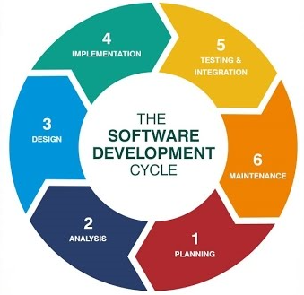
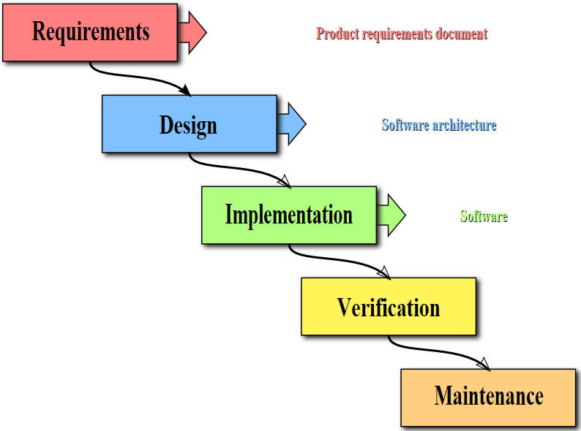
The Software Development Process
The process of creating a program is often broken down into stages according to the information that is produced in each phase.
Different Contrasting Methodologies

Slide 5
The Software Development Process
Planning & Analysis of the Problem Figure out exactly the problem to be solved. Try to understand it as much as possible. If in doubt, go back and clarify the requirements, inputs & outputs.
E.g. Coursework

Slide 6
The Software Development Process
Determine Specifications Describe exactly what your program will do.
Don’t worry about how the program will work, but what it will do.
Includes describing the inputs, outputs, and how they relate to one another.

Slide 7
The Software Development Process
Create a Design
Formulate the overall structure of the program.
This is where the how of the program gets worked out.
Develop your own algorithm that meets the specifications.

Slide 8
The Software Development Process
Implement the Design
Translate the design into a computer language, i.e. Python (for this module).
Test/Debug the Program
Try out your program to see if it worked.
If there are any errors (bugs), they need to be located and fixed (debugging).
Your goal is to find errors, so try everything that might “break” your program!

Slide 9
The Software Development Process
Maintain the Program
Continue developing the program in response to the needs of your users.
In the real world, most programs are never completely finished – they evolve over time.

Slide 10
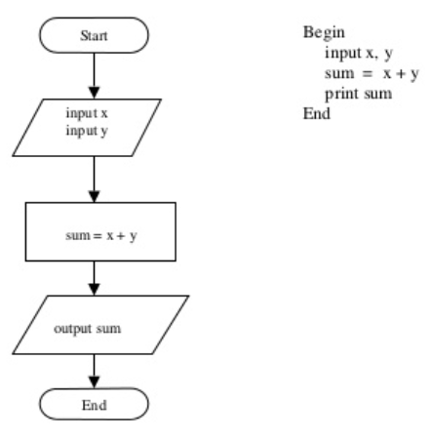
The Software Development Process
Write a Program to input two numbers and then output the sum of these numbers
Plan:
Flowchart
Pseudocode

Slide 11
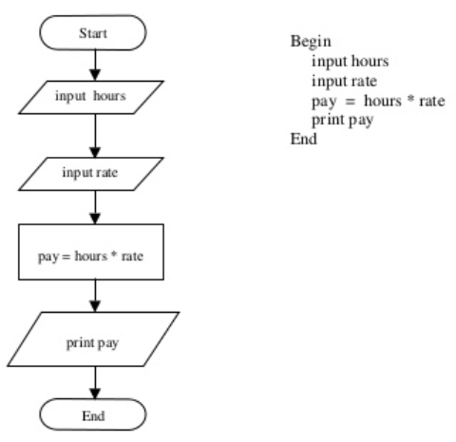
The Software Development Process
Write a Program to input the number of hours worked, the rate of pay and then calculate and output the total pay
Plan:
Flowchart
Pseudocode

Slide 12
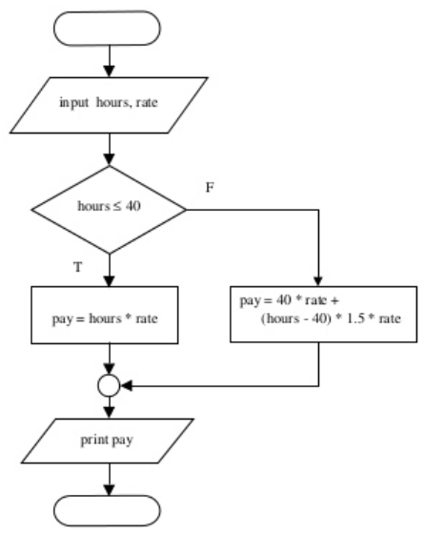
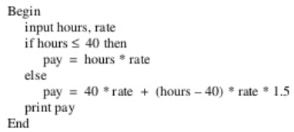
The Software Development Process
Write a Program to input the number of hours worked, the rate of pay and then calculate and output the total pay. For any additional hours worked over and above 40 hours, pay is time and a half:
Plan:
Flowchart
Pseudocode

Slide 13
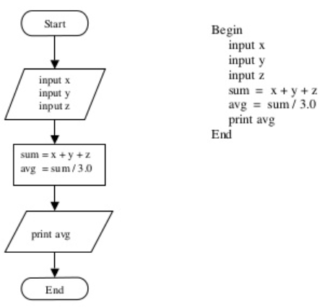
The Software Development Process
Write a Program to input three numbers and calculate and output the average of them:
Plan:
Flowchart
Pseudocode

Slide 14
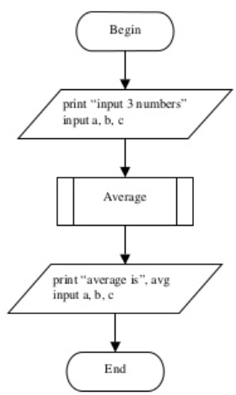
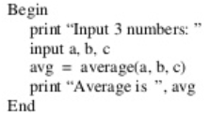
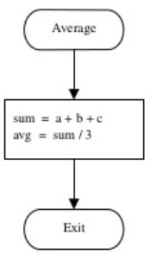
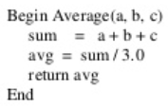
The Software Development Process
Write a Program to input three numbers and calculate and output the average. The average must be calculated in a separate function.
Plan:
Flowchart
Pseudocode

Slide 15
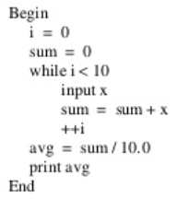
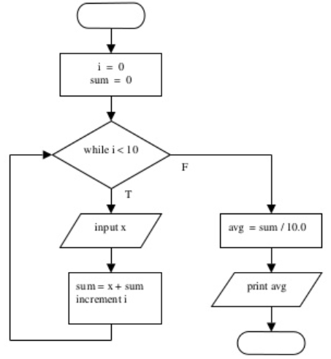
The Software Development Process
Write a Program to allow the user to input ten numbers (one at a time) and calculate and output the average of them:
Plan:
Flowchart
Pseudocode

Slide 16
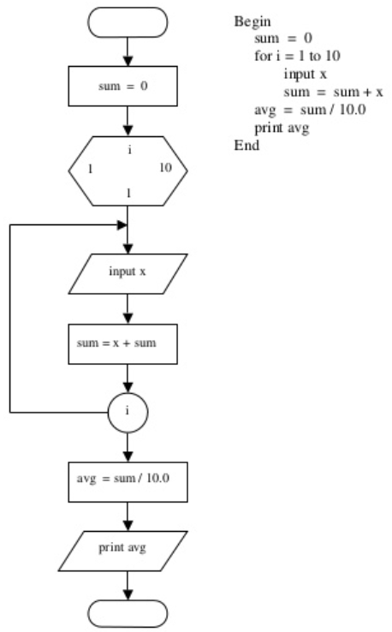
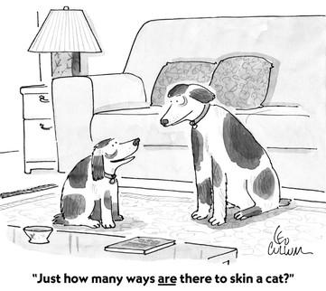
The Software Development Process
Write a Program to allow the user to input ten numbers (one at a time) and calculate and output the average of them:
Plan:
Flowchart
Pseudocode

Slide 17
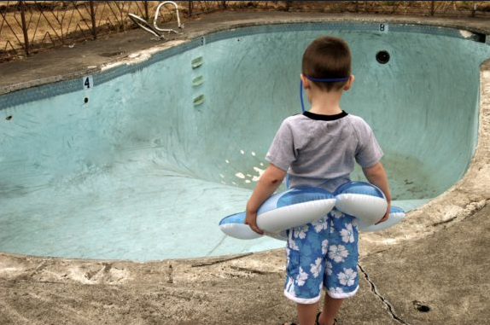
The Software Development Process
Don’t just jump straight in!! Think about the problem first!

Slide 18
Basic Constructs of a Program
Input
Getting data from keyboard, a file, the network or other devices
Output
Displaying data on the screen, saving to a file, send to another device
Math
Basic mathematics like addition, multiplication
Conditional Execution
Check for certain conditions and execute the appropriate sequence of statements
Repetition
Perform some action repeatedly, usually with some variation
[Reference: http://openbookproject.net/thinkcs/python/english3e/way_of_the_program.html]
Last Time
This Week

Slide 19
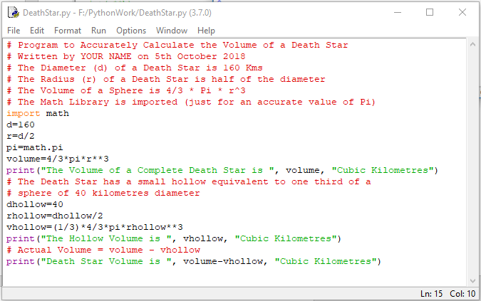
Simple Decisions
So far, we’ve viewed programs as sequences of instructions that are followed one after the other.
While this is a fundamental programming concept, it is not sufficient in itself to solve every problem. We need to be able to alter the sequential flow of a program to suit a particular situation.

Slide 20
Conditional Statements
Checks for a condition
Executes line or lines of code or code blocks based on fulfilling a certain condition
if
while
for (range)
Code blocks / lines of code are identified by indentation !!
not with brackets as in some other languages

Slide 21
Comparison Operators
Operation | Meaning
< | strictly less than
<= | less than or equal
> | strictly greater than
>= | greater than or equal
== | equal
!= | not equal

Slide 22
Try These
>>> x = 7
>>> y = 8
>>> x < y
>>> x <= y
>>> x > y

Slide 23
Try These
>>> x = 7
>>> y = 8
>>> x < y
True
>>> x <= y
True
>>> x > y
False
>>> x >= y
>>> x == y
>>> x != y

Slide 24
Try These
>>> x = 7
>>> y = 8
>>> x < y
True
>>> x <= y
True
>>> x > y
False
>>> x >= y
False
>>> x == y
False
>>> x != y
True

Slide 25
IF Statement
Simple Decisions: IF Statement
Two-Way Decisions: IF-ELSE Statement
Multi-Way Decisions: IF-ELIF-ELSE Statement
Useful to have an understanding of Boolean Expressions

Slide 26
IF Statement
if <expression>:
<execute code>
<execute code2>
Could be one line or many lines within the code block
Notice the indentation?
If the expression evaluates to non-zero or True – then the code block is executed
Otherwise jumps to the next line after the code block

Slide 27
IF Statement
>>> x = 7
>>> if x > 6 :
... print('x squared = ',x**2)
...
>>> y = 5.5
>>> if y/0.5 == 11:
... print('y is equal to 5.5')
... print('y * 3 equals ',y*3)
...

Slide 28
IF Statement
>>> x = 7
>>> if x > 6 :
... print('x squared = ',x**2)
...
x squared = 49
>>> y = 5.5
>>> if y/0.5 == 11:
... print('y is equal to 5.5')
... print('y * 3 equals ',y*3)
...
y is equal to 5.5
y * 3 equals 16.5

Slide 29
IF Statement Example
Suppose we want to develop a program that will convert temperatures in degrees Celsius to degrees Fahrenheit.
We also want to the program to print a warning when the weather is extreme.
Any temperature over 90 degrees Fahrenheit and lower than 30 degrees Fahrenheit will cause a hot and cold weather warning, respectively.

Slide 30
IF Statement Example
Pseudocode:
Input the temperature in degrees Celsius (call it celsius)
Calculate fahrenheit as 9/5 celsius + 32
Output fahrenheit
If fahrenheit > 90 print a heat warning
If fahrenheit > 30 print a cold warning
Flowchart:

Slide 31
IF Statement Example
# convert.py
# A program to convert Celsius temps to Fahrenheit.
# Also issues heat and cold warnings.
celsius = float(input("What is the Celsius temperature? "))
fahrenheit = 9 / 5 * celsius + 32
print("The temperature is", fahrenheit, "degrees fahrenheit.")
if fahrenheit >= 90:
print("It's really hot out there, be careful!")
if fahrenheit <= 30:
print("Brrrrr. Be sure to dress warmly")

Slide 32
If Else Statement
In Python, a two-way decision can be implemented by attaching an else clause onto an if clause.
if <expression>:
<execute code>
<execute code2>
else:
<execute code>
<execute code2>

Slide 33
Two-Way Decisions
When Python encounters this structure, it first evaluates the condition. If the condition is true, the statements under the if are executed.
If the condition is false, the statements under the else are executed.
In either case, the statements following the if-else are executed after either set of statements are executed.

Slide 34
IF-ELSE
x = 7
if x > 6 :
print('x squared = ',x**2)
else:
print('x is smaller than 7')

Slide 35
IF-ELSE
x = 7
if x > 6 :
print('x squared = ',x**2)
else:
print('x is smaller than 7')
x squared = 49
Try above code with x = 3

Slide 36
If-elif-else Statement
if <expression>:
<execute code>
<case 1 statements>
elif <expression2>:
<execute code>
<case 2 statements>
elif <expression3>:
<execute code>
<case 3 statements>
else:
<execute code>
<default code>

Slide 37
IF-ELIF-ELSE Statement
x = 7
if x > 6 :
print('x squared = ',x**2)
elif x == 6:
print('x is 6 exactly')
else:
print('x is smaller than 7')

Slide 38
IF-ELIF-ELSE Statement
x = 7
if x > 6 :
print('x squared = ',x**2)
elif x == 6:
print('x is 6 exactly')
else:
print('x is smaller than 7')
x squared = 49
Try above code with x = 2 and x = 6

Slide 39
Loop the Loop!
To be able to design and implement solutions to problems, it is often necessary to use LOOP patterns.
Definite and Indefinite loops are realised in Python using the for and while statements.

Slide 40
For Loops: A Quick Review
The for statement allows us to iterate through a sequence of values.
for <var> in <sequence>: <body>
The loop index variable var takes on each successive value in the sequence, and the statements in the body of the loop are executed once for each value.

Slide 41
While Statement
while <expression>:
<execute code>
<execute code2>
Could be one line or many lines within the code block
Notice the indentation?
If the expression evaluates to non-zero or True – then the code block is executed
This happens / loops continuously until it evaluates to False
Otherwise jumps to the next line after the code block

Slide 42
While Statement
>>> x = 7
>>> while (x < 10):
... print('x squared = ',x**2)
... x = x + 1
...

Slide 43
While Statement
>>> x = 7
>>> while (x < 10):
... print('x squared = ',x**2)
... x = x + 1
...
x squared = 49
x squared = 64
x squared = 81

Slide 44
Output: Special / Escape Characters
Escape Sequence | Meaning
\\ | Backslash (\)
\' | Single quote (')
\" | Double quote (")
\b | ASCII Backspace (BS)
\n | ASCII Linefeed (LF)
\r | ASCII Carriage Return (CR)
\t | ASCII Horizontal Tab (TAB)

Slide 45
The Function of Functions
Our aim is to write programs that use functions to reduce code duplication and increase program modularity.
Make’s life easier for us.
We’ve been using them already:
Built-in Python functions (print, len)
Functions from the standard libraries (math.pi)
Functions from the Turtle graphics module (t.circle)

Slide 46
The Function of Functions
Having similar or identical code in more than one place has some drawbacks.
Issue one: writing the same code twice or more.
Issue two: this same code must be maintained in two separate places.
Functions can be used to reduce code duplication and make programs more easily understood and maintained.

Slide 47
The Function of Functions
A function is like a subprogram, a small program inside of a program.
The basic idea – we write a sequence of statements and then give that sequence a name. We can then execute this sequence at any time by referring to the name.
The part of the program that creates a function is called a function definition.
When the function is used in a program, we say the definition is called or invoked.

Slide 48
Functions & Parameters
A function definition looks like this: def <name>(<formal-parameters>): <body>
The name of the function must be an identifier
Formal-parameters is a (possibly empty) list of variable names
Formal parameters, like all variables used in the function, are only accessible in the body of the function. Variables with identical names elsewhere in the program are distinct from the formal parameters and variables inside of the function body.

Slide 49
Functions & Parameters
A function is called by using its name followed by a list of actual parameters or arguments. <name>(<actual-parameters>)
When Python comes to a function call, it initiates a four-step process.
The calling program suspends execution at the point of the call.
The formal parameters of the function get assigned the values supplied by the actual parameters in the call.
The body of the function is executed.
Control returns to the point just after where the function was called.

Slide 50
Functions that Return Values
Passing parameters provides a mechanism for initialising the variables in a function.
Parameters act as inputs to a function.
We can call a function many times and get different results by changing its parameters.
This function returns the square of a number: def square(x): return x*x
When Python encounters return, it exits the function & returns control to the point where the function was called.
In addition, the value(s) provided in the return statement are sent back to the caller as an expression result.

Slide 51
Functions that Return Values
>>> square(3) 9
>>> print(square(4)) 16
>>> x = 5 >>> y = square(x) >>> print(y) 25
>>> print(square(x) + square(3)) 34

Slide 52
Functions that Return Values
Sometimes a function needs to return more than one value.
To do this, simply list more than one expression in the return statement.
def sumDiff(x, y): sum = x + y diff = x – y return sum, diff
num1, num2 = eval(input("Enter two numbers (num1, num2) ")) s, d = sumDiff(num1, num2) print("The sum is", s, "and the difference is", d)

Slide 53
Summary
There’s usually more than one way to solve a problem.
Don’t rush to code the first idea that pops out of your head. Think about the design and ask if there’s a better way to approach the problem.
Your first task is to find a correct algorithm. After that, strive for clarity, simplicity, efficiency, scalability, and elegance.
Don’t reinvent the wheel.
If the problem you’re trying to solve is one that lots of other people have encountered, find out if there’s already a solution for it!
As you learn to program, designing programs from scratch is a great experience!
Truly expert programmers know when to borrow.

