Slide 1


IS4S761 Principles of Computing
Introduction to Python Programming
Lecture 4
David Kidner (J302)
david.kidner@southwales.ac.uk

Slide 2
To Date …
Covered:
Introduction to Python
IDLE / Simple Single Line Commands / .py Programs
Editing, Saving & Running Programs
Variables
Strings, Lists, Tuples
Boolean Expressions
Conditional Statements
IF, FOR & WHILE
Functions
Ability to develop some simple programs …

Slide 3
Last Time …
EXERCISE 4: Write a Program to find the largest of 3 inputted numbers (x1, x2, x3) using either the IF, IF-ELSE, or IF-ELIF-ELSE statement. There’s a number of ways of doing this, so think about it first.
x1, x2, x3 = eval(input("Please enter three values: "))
# missing code sets max to the value of the largest
print("The largest value is", maxval)
Think about the problem first!
Jot down a plan with pen and paper!

Slide 4
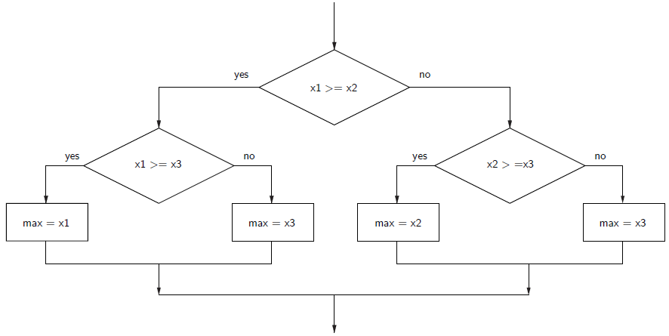

Slide 5
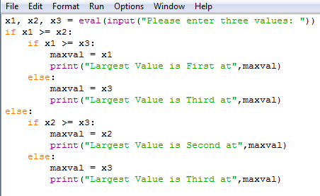
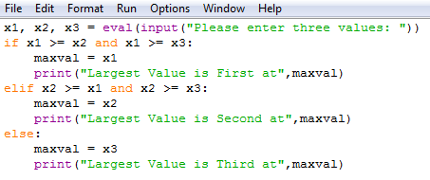

Slide 6
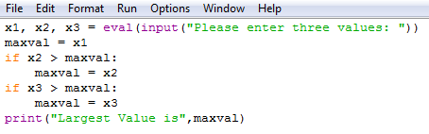
OR Sequentially Look through a list, trying to find the biggest:

Slide 7
Last Time …
All the solutions will be up on Blackboard, so take a look through them and make sure you understand the logic behind the code.
Type up the solutions and test for yourself.
Keep your code (you might want to re-use snippets again).

Slide 8
This Week
More nitty-gritty to expand your programming skills
range & arange
main()
Input & Output:
Reading & Writing Files

Slide 9
range() - function
range(<start>,<end>,step=1)
Produces a list of numbers from start to end
While stepping with the value defined as the third
By default step is set to 1, and hence can be left out if you want your range of numbers to step by 1
range(<start>,<end>)
where step = 1
range(<end>)
where start is defaulted to zero and step = 1

Slide 10
range() in for loops?
>>> for i in range(10):
... print(i)
0
1
2
3
4
5
6
7
8
9
the range of i is 0 ≤ i ≤ 9 so print(i) is
executed ten times, once for each value of i
in this range. Note that i is an integer and is
called the loop index.

Slide 11
range() in for loops?
Add Integers from 1 to 10
sum = 0
for i in range(11):
sum = sum + i
print(i, sum)
0 0
1 1
2 3
3 6
4 10
5 15
6 21
7 28
8 36
9 45
10 55
the range of i is 0 ≤ i ≤ 10 so covers the integers up to 10. For preciseness and efficiency …
sum = 0
for i in range(1,11):
sum = sum + i
print(i, sum)
…the range of i is now 1 ≤ i ≤ 10

Slide 12
range() in for loops?
Add Integers from 1 to 10 in reverse
sum = 0
for i in range(10,0,-1):
sum = sum + i
print(i, sum)
10 10
9 19
8 27
7 34
6 40
5 45
4 49
3 52
2 54
1 55
The -1 indicates a negative increment of 1.
The range of i is 10>= i >= 1.

Slide 13
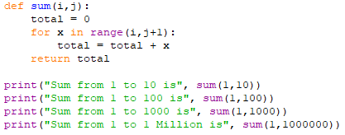

Functions: from last week
Suppose we want to sum integers from 1 to 10, then sum 1 to 100, then sum 1 to 1000, then sum 1 to 1 million.
We learnt it was easier to use a function …

Slide 14
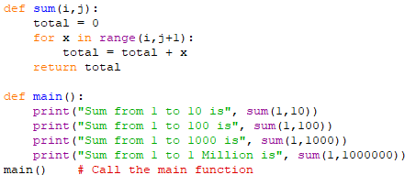
Main Method Function

Slide 15
Structure of a Python Program
def main():
This is the first line of the “main function” where the program does all its work
Python does not need a main function, but it is good practice to use in all your programs from now on.
Indentation and blocks.
Code is arranged in indented blocks.
The body of the main function is one block.
It can have several blocks inside it.
The last line in the file is main()
This is the call to the main function.
It is not inside the main function!
The line (the call) is not indented at all!
If you forget this line, the program does nothing when run!

Slide 16
A Complete Program with Functions
def main():
number = int(input(“Enter a number: “))
limit = square (number)
print(“Counting up to”, limit)
countto(limit)
def square(x):
return x ** 2
def countto (number):
for i in range(1, number):
print(i, end= “, “)
print(number)
main()

Slide 17
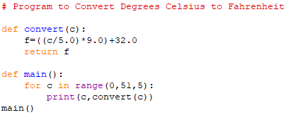

A Complete Program with Functions
How would we change this program to run at 2.5 Degrees Celsius Intervals?

Slide 18
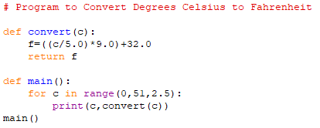
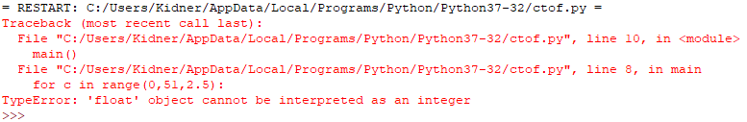
A Complete Program with Functions

Slide 19
Alternative to range() is arange() from numpy
Numpy is a numerical package for python
[http://www.numpy.org/]
It has many mathematical and useful functions
We’ll look at further in future classes
You can import any package or python library by using ‘import’
Eg. >>>import numpy
Today we shall try arange() function in numpy

Slide 20
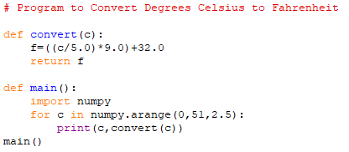

A Complete Program with Functions
If in doubt, use help
>>> help (numpy.arange)

Slide 21

You can use ‘import <package> as <name>’
Its like assigning an alias for the package
Usually numpy is imported as np
This also reduces retyping numpy to use every function
Instead you use np to get to the function

Slide 22
Reading Data from a File Why?
To get huge amounts of data instead of typing all of it in at the terminal / keyboard
Read old data you logged from some equipment
Search for particular output / data
Process data output from another program
Access large amounts of publicly available data
E.g. Police Monthly Crime Statistics
Essential part of programming!

Slide 23
Reading Data from a File
The process of opening a file involves associating a file on disk with an object in memory.
We can manipulate the file by manipulating this object.
Reading the whole file
Reading x lines of file
Closing the file

Slide 24
Reading Data from a File
Associate a disk file with a file object using the open function
<filevar> = open(<filename>, <mode>)
open() function returns a file object <filevar> and usually takes two arguments <filename>,<mode>
Filename is the string of the filename including its path
Mode is another string containing a few characters how the file is to be used
Such as ‘r’ for read only access (default is assumed to be ‘r’ if argument left out)
‘w’ for writing only (existing file will be erased)
‘a’ for appending to the file
‘r+’ for reading and writing
infile = open("numbers.dat", "r")

Slide 25
File Methods
<file>.read() – returns the entire remaining contents of the file as a single (possibly large, multi-line) string
<file>.readline() – returns the next line of the file. This is all text up to and including the next newline character
<file>.readlines() – returns a list of the remaining lines in the file. Each list item is a single line including the newline characters.

Slide 26
Reading a File
# printfile.py
# Prints a file to the screen.
def main():
fname = input("Enter filename: ")
infile = open(fname,'r')
data = infile.read()
print(data)
infile.close()
First, prompt the user for a file name
Open the file for reading
The file is read as one string and stored in the variable data
Close the file

Slide 27
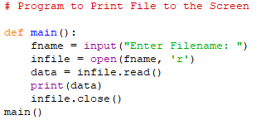

Reading a File: Tutorial Exercise

Slide 28
Reading a File
Once we have the file object, we can use it with a number of methods to do operations on the file data
<fileobject>.read(size)
Size is optional
If size is omitted or negative it will read the entire file
Make sure the file is smaller than your available memory
If end of file is reached, this method would return ‘ ’ – empty string

Slide 29
Always close a file once done!!!
Always close a file once you are done with it
This helps reduce memory usage
Allows other programs to access the file, as file opened with open() function might only accessible as read only for other programs
As you might have guessed it, its <file_object>.close() to close the file
If you want to check if its been done, you can use <file_object>.closed which would return a Boolean
True if its closed and False if its not

Slide 30
Reading a File
Sometimes reading line by line would be efficient, especially if it’s a large file
Or if you don’t need the entire contents of the file for processing
You could use the method <file_object>.readline()
This method reads the entire line (meaning until end of line escape character) if the currently not at end of file
If end of file is reached, this method would return ‘ ’ – empty string

Slide 31
Reading a line from file
You will notice that each line ends with ‘\n’ except for the last line
For a blank line you will only get ‘\n’
If it returns an empty string then the end of file has been reached

Slide 32
File object useful methods
<file_object>.tell() → to get current position in the file
<file_object>.seek(<offset>,<from_what>) → to directly get to a specific position if you know the format of the file / data location

Slide 33
Writing to a File
Use write(<string>) method for the file object to write to file
As with read open the file first, to write
You can write multiple lines using ‘\n’ within your strings
This method only accepts strings, so numbers need to be converted using the function str(<number>) [similar to int(<string>)]

Slide 34
Any Questions?

