Slide 1


IS4S761 Principles of Computing
Introduction to Python Programming
Lecture 5
David Kidner (J302)
david.kidner@southwales.ac.uk

Slide 2
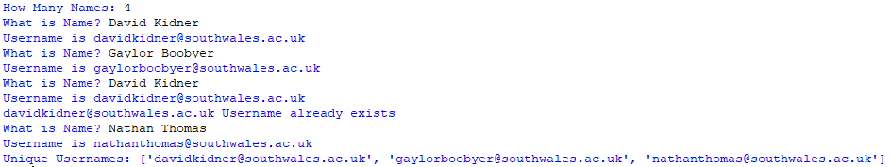
Last Week …
EXERCISE 4: Amend your code from EXERCISE 2 to read a text file (people.txt) of 10 names and output a new text file (usernames.txt) of unique usernames. Produce some screen output to inform the user whether a username is NOT unique.
EXERCISE 2 Output:
Think About It First!
(1) Given any First & Last Name (user)
(2) Merge First & Last Name
(3) Remove any Spaces
(4) Add @southwales.ac.uk
(5) Make Lower Case (username)
Function:
gen_user(user)
return(username)
(6) Check username is Unique
Already generated username?
In a List?
Amend to Read names from people.txt and output usernames to usernames.txt

Slide 3
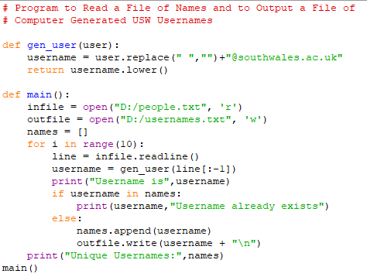
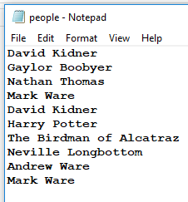
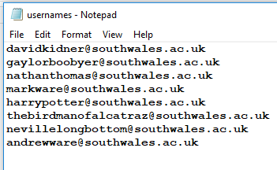
A Solution

Slide 4
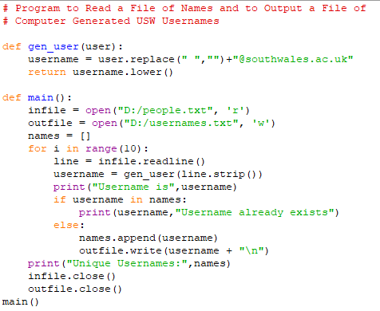
Another Solution

Slide 5
This Week …
Part 1: More File Handling
Including CSVs
Part 2: Visualisation of Data
Including matplotlib

Slide 6
Using ‘with’ keyword
It’s good practice to use ‘with’ for file objects
Has the advantage of closing the file automatically even if an exception (or error) is raised
Usage:
with open(‘<file_path>\\data1.txt','r') as abc:
print(abc.read())
#other file operations or other code
#same as code block under if, for, while, etc.

Slide 7
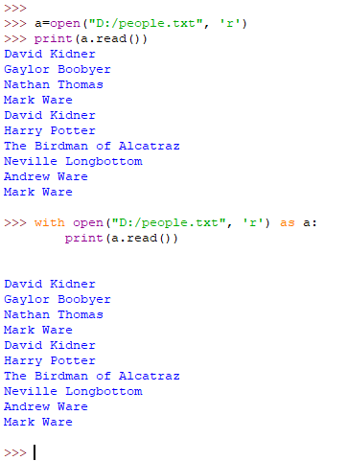
Try this

Slide 8
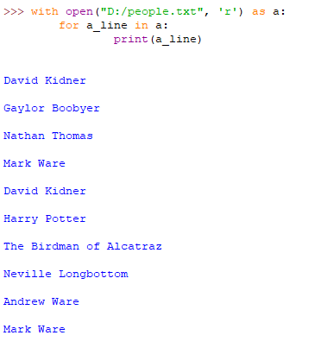
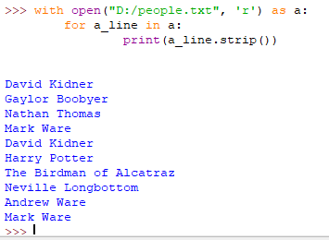
Try this

Slide 9
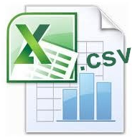
What is a CSV file?
It stands for a Comma Separated Value (csv) file
Very common data exchange format that is widely supported by consumer, business, and scientific applications
These files are generally used for importing or exporting data to / from spreadsheets or databases
Tabular Data
Each value (or field) is separated typically by a comma – its called a delimiter
Delimiter can be comma, tabs, spaces

Slide 10
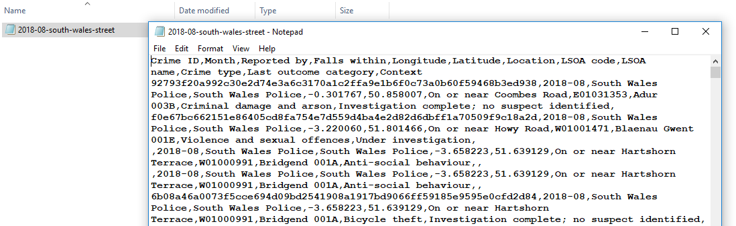
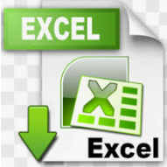
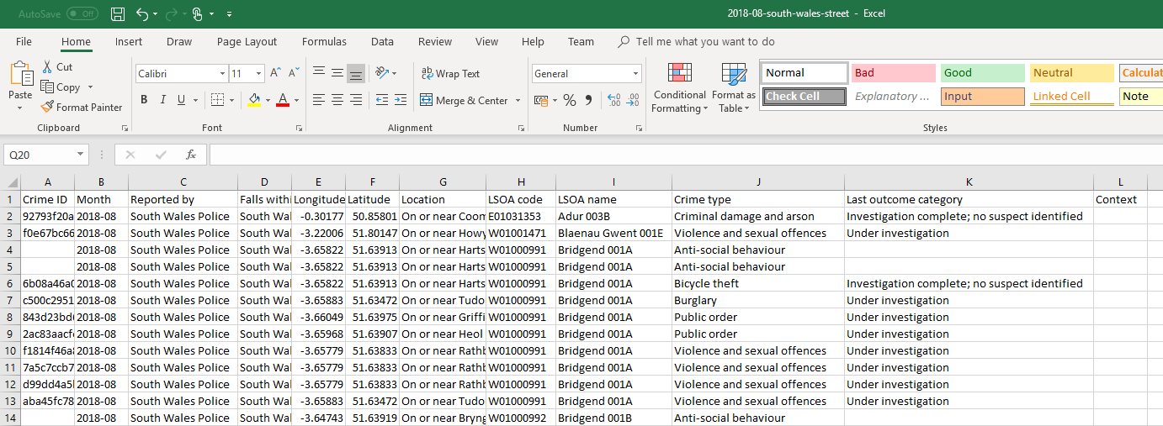

Slide 11
How to Read a CSV file?
Similar to reading text files, need to use open
To make life easier, a package / library could be used - csv (this needs to be imported)
Once you have the file handle use the reader method for csv
Then use the reader method Eg. – csv.reader(<file handle>)
Usage:
import csv
<file handle> = open('<file path>\\filename.csv', 'r')
reader1 = csv.reader(<file handle>)
….#use the files contents
<file handle>.close()

Slide 12
How to Read a CSV file?
Specify Delimiter
Usage:
import csv
with open('<file path>\\filename.csv','r’) as infile:
data = csv.reader(infile, delimiter = “;”)
for line in data:
….#use the files contents
infile.close()

Slide 13
How to Write to a CSV File?
Similar to writing text files, need to use open
To make life easier, a package / library could be used – csv (which needs to be imported)
Once you have the file handle use the writer method for csv
Then use the writerow or writerows methods to write strings, tuples or lists
Usage:
import csv
<file handle> = open('<file path>\\filename.csv', 'w')
writer1 = csv.writer(<file handle>)
writer1.writerows('some string')
<file handle>.close()

Slide 14
Python Programming Exercises 5

