Slide 1


IS4S761 Principles of Computing
Introduction to Python Programming
Lecture 6
David Kidner (J302)
david.kidner@southwales.ac.uk

Slide 2
This Week …
Part 1: More File Handling
Including CSVs
Part 2: Visualisation of Data
Including matplotlib

Slide 3
Visualisation of Data
Some Questions:
1. What data is important to show?
2. What do I want to emphasise in the data?
3. What options do I have for displaying this data?
4. Which option is most effective in communicating the data?

Slide 4
What is the rate-limiting step in data understanding?
Amount of data in the world
Processing power: Moore’s Law
Notes:
And processing power, either as raw processor speed or via novel multi-core and many-core architectures, is also continuing to increase exponentially…

Slide 5
What is the rate-limiting step in data understanding?
Amount of data in the world
Processing power: Moore’s Law
Human cognitive capacity
Notes:
… but human cognitive capacity is remaining constant. How can computing technologies help scientists make sense out of these vast and complex data sets?

Slide 6
A picture is worth a thousand words
So, for your 3,000 Word report …
Just put in 3 Pictures!

Slide 7
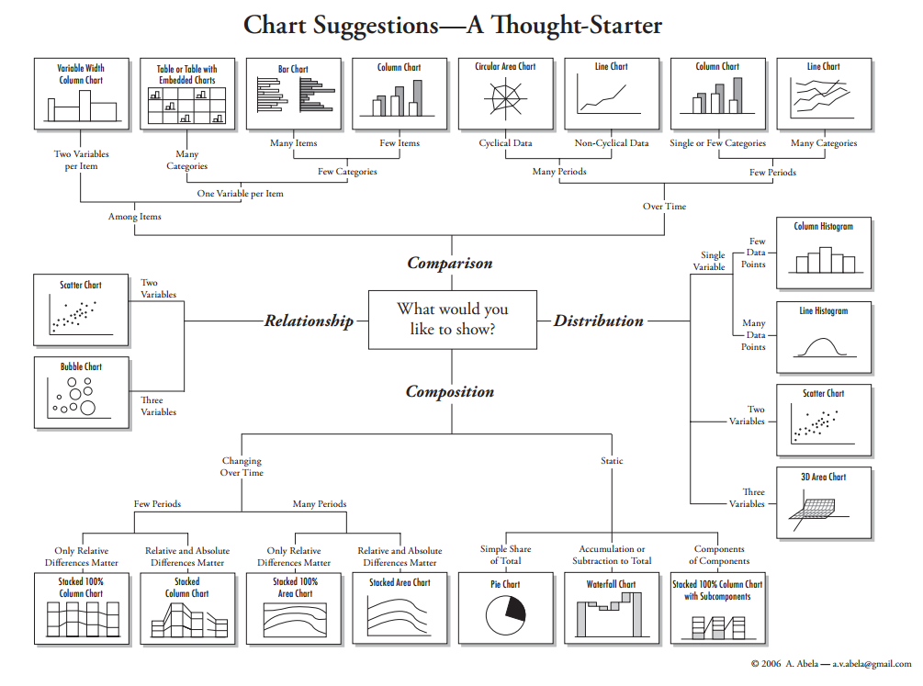

Slide 8
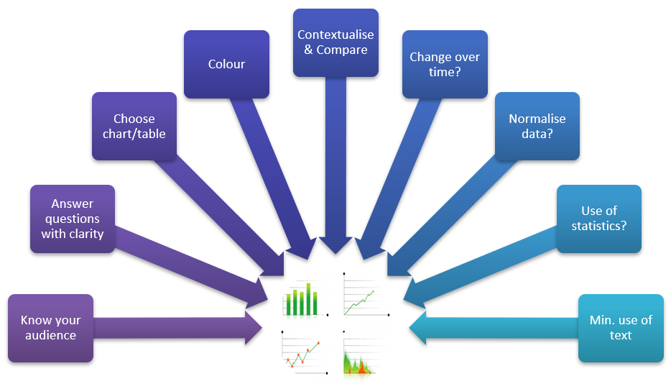

Slide 9
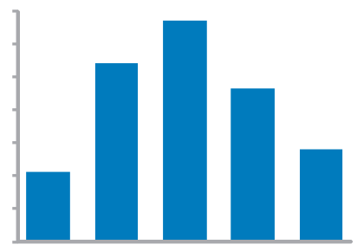
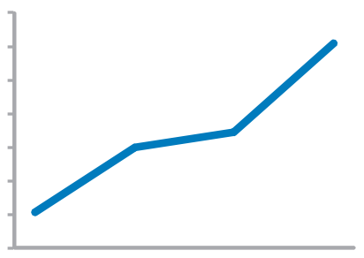
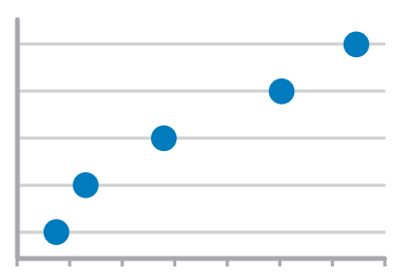
Time series values display how something changed over time
Bar Graph (vertical)
To feature individual values and support their comparisons. Quantitative scale must begin at zero.
Line Graph
To feature overall trends and patterns and support their comparisons
Dot Plot (vertical)
When you do not have a value for every interval of time

Slide 10
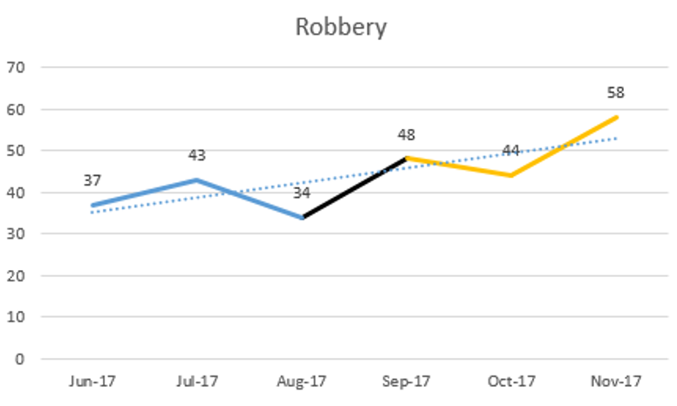
Line Charts

Slide 11
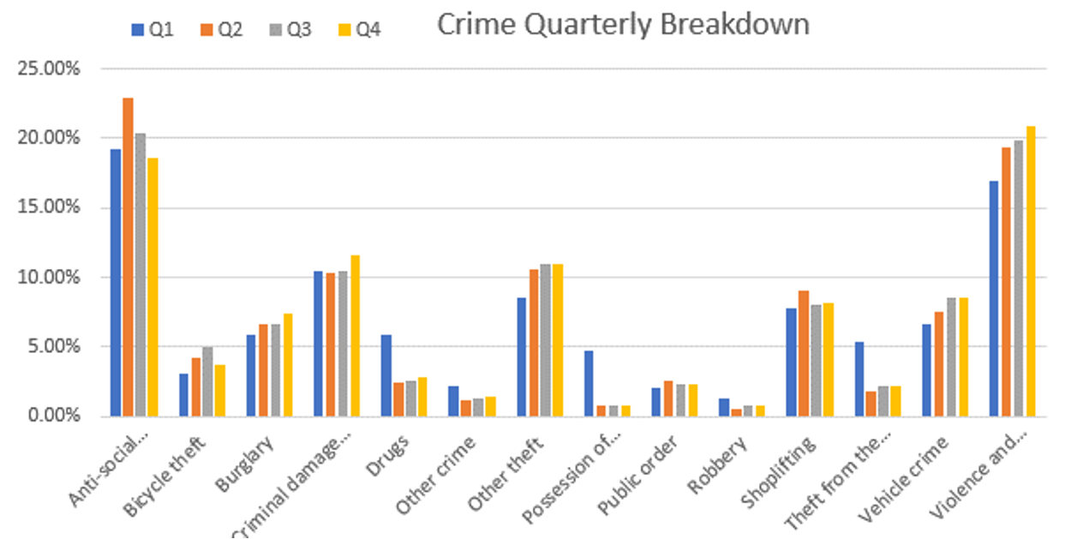
Bar Charts

Slide 12
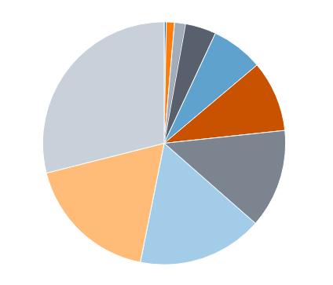
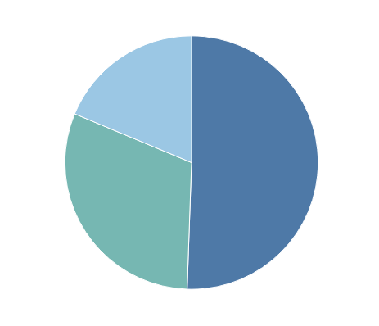
Pie Charts
Commonly used to show parts of a whole
However…
Hard to judge relative size of pie slices – better at differentiating length
Take up a lot of space to present little information
Require labels and good colour contrast to even be usable (often difficult)
Best use is when one overwhelmingly larger value than the rest – no need to focus on actual values

Slide 13
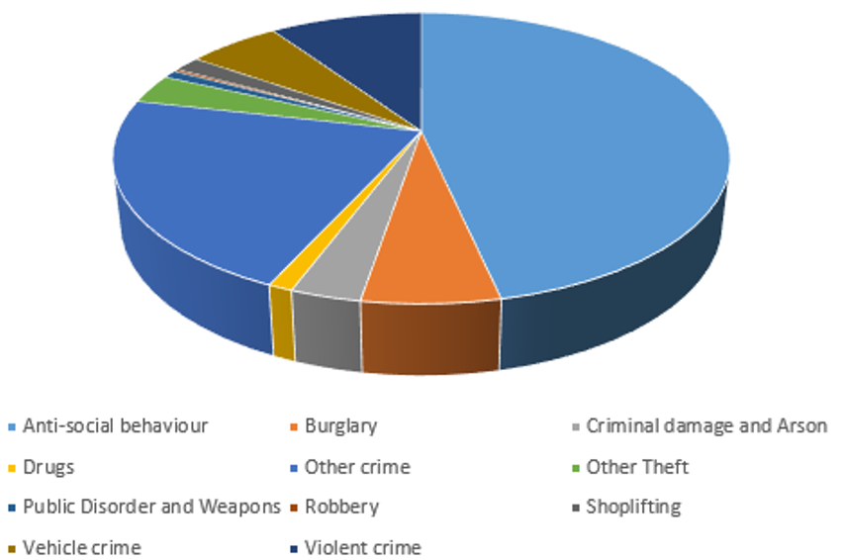
Pie Charts

Slide 14

Matplotlib is a Python 2D plotting library which produces publication quality figures in a variety of hardcopy formats and interactive environments across platforms.
Matplotlib tries to make easy things easy and hard things possible. You can generate plots, histograms, power spectra, bar charts, error charts, scatterplots, etc., with just a few lines of code.
Very Low Level Scripting: Individual commands for individual elements of the plot!
Impossible to learn all the commands without a good reference source
https://matplotlib.org/index.html

Slide 15
Matplotlib
Is a python 2d plotting library
capable of producing publication quality figures
Lets you create plots, histograms, power spectra, bar charts, error charts, scatter plots….
Pyplot interface allows matlab like plotting for those familiar with matlab
Need to import matplotlib
[http://matplotlib.org/index.html]

Slide 16
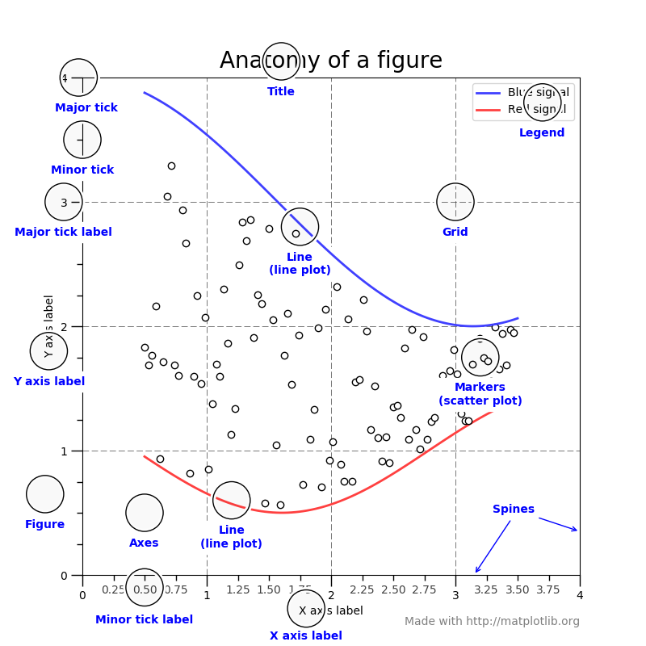
FIGURE out
The Terminology!!

Slide 17
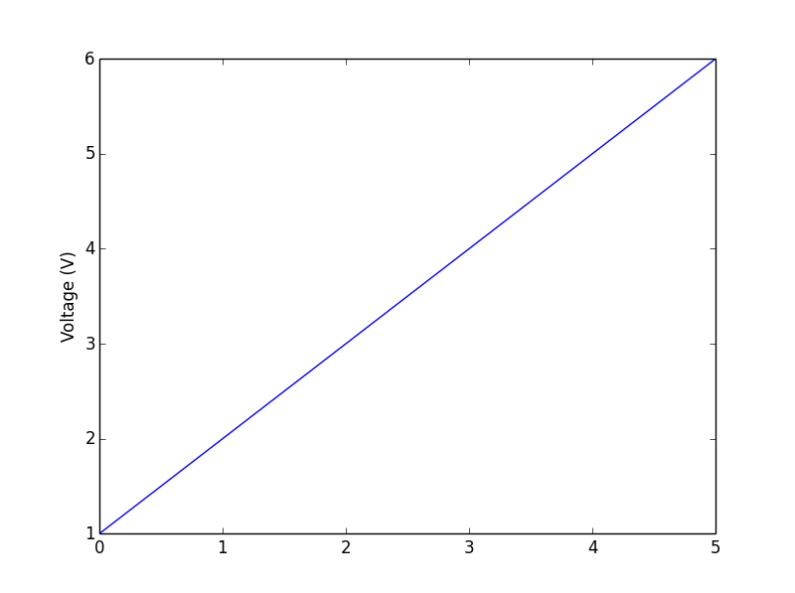
Matplotlib
Pyplot interface allows matlab like plotting for those familiar with matlab
import matplotlib.pyplot as plt
plt.plot([1,2,3,4,5,6])
plt.ylabel('Voltage (V)')
plt.show()

Slide 18
Using Plot Command
Usage plt.plot(<list or array>)
Assumes the list / array is a sequence of y values
Auto generates x values from 0 to len(y)-1
Hence in previous example produces [0,1,2,3,4,5]

Slide 19
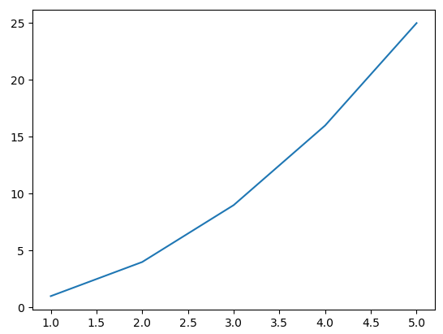
Using Plot Command
import matplotlib.pyplot as plt
xs = [1,2,3,4,5]
ys = [x**2 for x in xs]
plt.plot(xs, ys)
plt.show()
Essentially, we are operating on a “hidden” variable representing the figure.
Some would say it’s a bit of a Guessing Game!

Slide 20
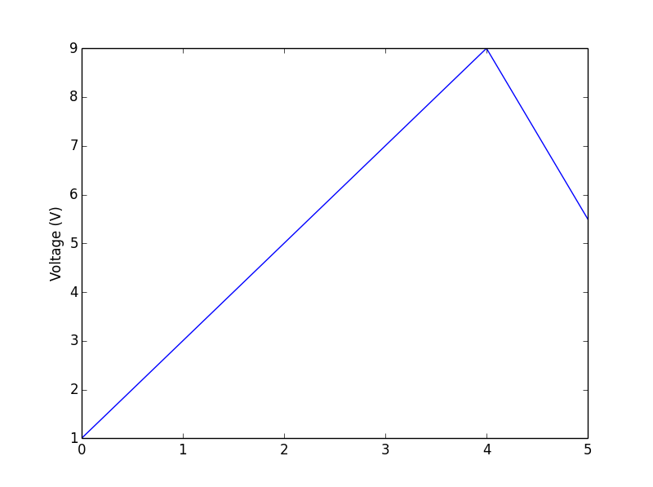
Plot – Other Variations
plot(x,y) where x , y are two lists or arrays with equal number of elements
Eg.- plt.plot([0,1,2,3,4,5],[1,3,5,7,9,5.5])
import matplotlib.pyplot as plt
plt.plot([0,1,2,3,4,5],[1,3,5,7,9,5.5])
plt.ylabel('Voltage (V)')
plt.show()

Slide 21
Plot – Other Variations
plot(x,y,format string) where x , y are two lists or arrays with equal number of elements, format string consists of letters and symbols (follows matlab convention on colours and line style)
Default format string is 'b-' meaning blue solid lines
Eg.- plt.plot([0,1,2,3,4,5],[1,3,5,7,9,5.5],'ro’)
import matplotlib.pyplot as plt
plt.plot([0,1,2,3,5],[1,3,5,3.6,5.5],'ro')
plt.ylabel('Voltage (V)')
plt.show()

Slide 22
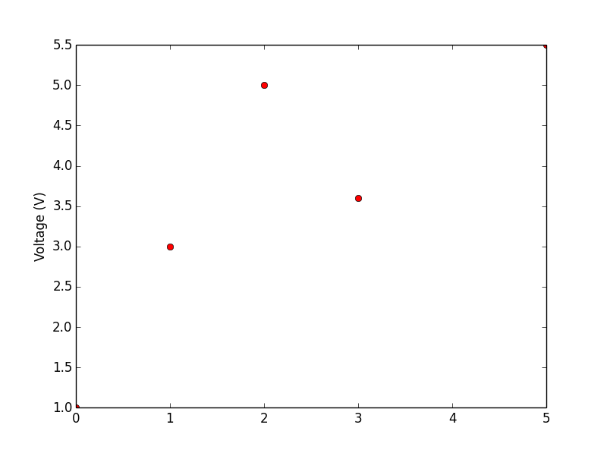
Expected Output

Slide 23
show() / savefig()
To display the graphs
If run in interactive mode / shell can see changes made
The figure could also be saved to a file / format / location if running in scripts using plt.savefig('filename‘)
Could take extensions like .png, .pdf
Which avoids opening / calling for output to screen

Slide 24
Try this
import matplotlib.pyplot as plt
import numpy as np
plt.plot(np.arange(0,10,0.5), np.arange(0.26,10.26,0.5))
plt.ylabel('Voltage (V)')
plt.xlabel('Time (s)')
plt.show()

Slide 25
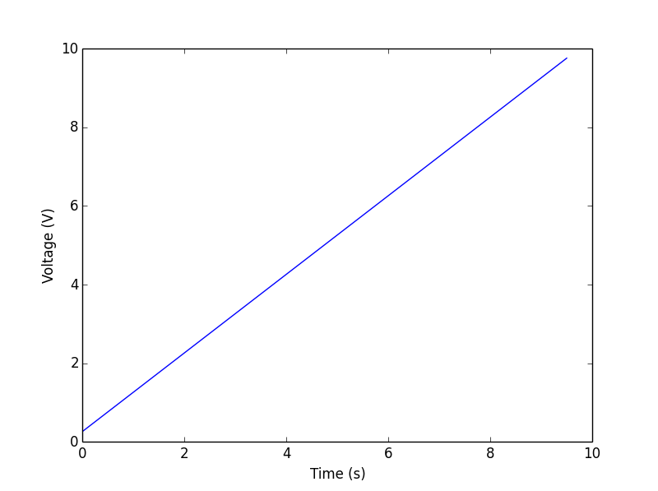
Expected Output

Slide 26
Try This
import matplotlib.pyplot as plt
import numpy as np
plt.plot(np.arange(0,10,0.5), np.arange(10.26,0.26,-0.5),'g.')
plt.ylabel('Voltage (V)')
plt.xlabel('Time (s)')
plt.savefig('<file path>\\figX.png')

Slide 27
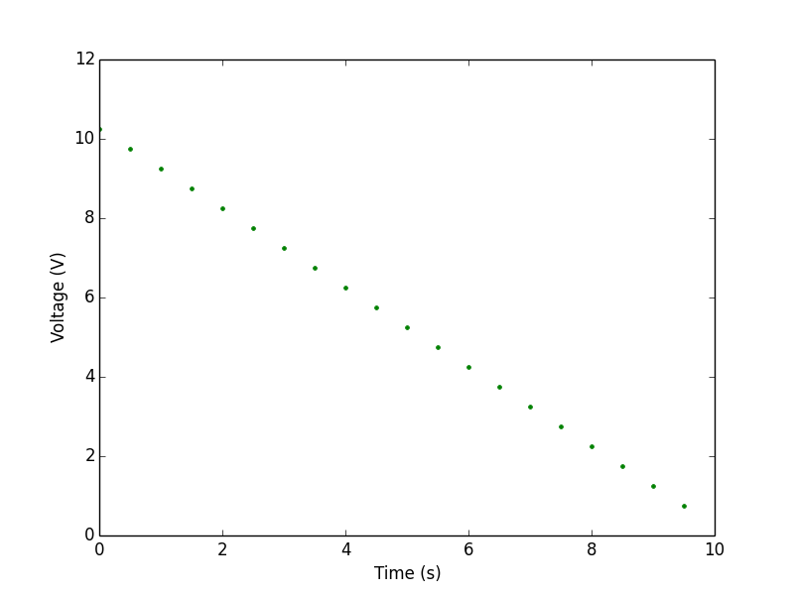
Expected Output

Slide 28
How to adjust axis to display all the values?
import matplotlib.pyplot as plt
import numpy as np
plt.plot(np.arange(0,10,0.5),np.arange(10.26,0.26,-0.5),'g.')
plt.ylabel('Voltage (V)')
plt.xlabel('Time (s)')
plt.axis([-0.25, 10, 0, 10.5])
#axis takes the following paramaters [xmin, xmax, ymin, ymax]
plt.savefig('<file path>\\figureX.png')

Slide 29
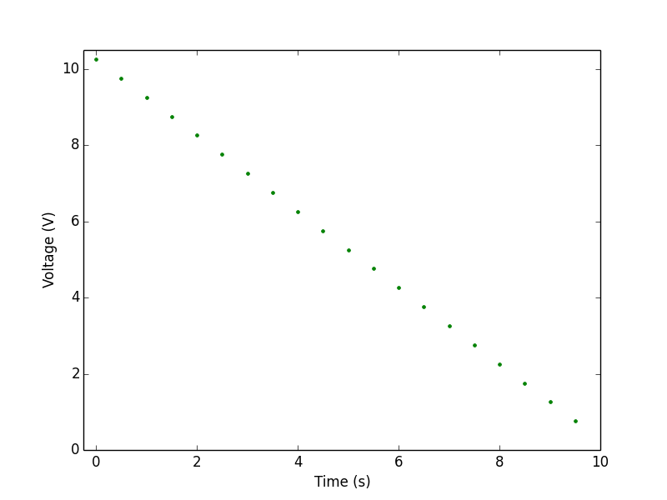
Expected Output

Slide 30
import matplotlib.pyplot as plt
xs = range(-100,100,10)
x2 = [x**2 for x in xs]
negx2 = [-x**2 for x in xs]
plt.plot(xs, x2)
plt.plot(xs, negx2)
plt.xlabel("x”)
plt.ylabel("y”)
plt.ylim(-2000, 2000)
plt.axhline(0) # horiz line
plt.axvline(0) # vert line
plt.savefig(“quad.png”)
plt.show()
Incrementally modify the figure.
Save your figure to a file
Show it on the screen

Slide 31
Python Programming Exercises 6

