Slide 1
Project Management & Research Methodology (IS4S706)
Time Management 1

Slide 2
Time management
In this lecture we will be considering an aspect of project planning called Time Management
The overall aim is to make sure the project finishes on time (while not compromising Cost and Scope)
The approach used here is called Activity Based Planning

Slide 3
Time management processes
Define Activities (or Tasks)
Sequence Activities
Estimate Activity Resources
Estimate Activity Durations
Develop Schedule
Control Schedule

Slide 4
Define Activities
Break down the project into smaller activities (or tasks)
Decomposition (take work packages defined in Scope Management* processes and break them down into activities that can be estimated)
Expert judgement (ask somebody who has done something similar before to give an opinion on what activities will be needed)

Slide 5
For example:
Project: Build new web site
Activities (or Tasks):
Activities
Design client-side GUI
Design server-side database
Implement GUI
Implement database
Test web site
Deploy web site

Slide 6
For example:
Project: Build garage
Activities (or Tasks):
Id | Activities | Predecessors
1 | Prepare foundations
2 | Lay drains and floor | 1
3 | Make and position door frame | 2
4 | Install services and fittings | 7, 8, 9
5 | Construct walls | 3
6 | Plaster ceiling and interior walls | 4
7 | Construct roof | 5
8 | Install door | 5
9 | Install windows | 5
10 | Fit guttering and downpipes | 7
11 | Decorate | 6

Slide 7
Sequence Activities
Put the activities in the order they need to be undertaken
Firstly requires us to identify dependencies between activities
e.g. Software cannot be tested before software has been written
e.g. Staff cannot be trained before staff have been hired

Slide 8
Dependencies (or predecessors)
An activity can have zero, one or more predecessors
The most common form of predecessor is the Finish to Start (FS) predecessor
Task A is a FS predecessor of Task B if Task A has to have been completed before Task B can begin.
Task B starting is dependent on Task A being finished.
The are other kinds of dependency, including
Start to Start (SS), B can only start if A has started
Finish to Finish (FF), B can only finish if A has finished
Start to Finish (SF), B can only finish if A has started

Slide 9
Dependencies (or predecessors)
Example: Make a cup of tea and toast
fill kettle, boil kettle, put tea bag in cup, add water, add milk, put bread in toaster, toast the bread, get butter from fridge, butter the toast
fill kettle is an FS predecessor of boil kettle (boil kettle is dependent on fill kettle)
put bread in toaster is an FS predecessor of toast the bread (toast the bread is dependent on put bread in toaster)
Dependencies are not always so obvious
e.g. what is correct order here:
put tea bag in cup, add water, add milk

Slide 10
Dependencies (or predecessors)
If Task A is not dependent on Task B, and Task B is not dependent on Task A, then they can, potentially, be undertaken simultaneously.
Example: Cup of tea and toast
Fill kettle, Boil kettle, Put tea bag in cup, Add water, Add milk, Put bread in toaster, Get butter from fridge, Butter the toast
We could be boiling the kettle while at the same time making our toast

Slide 11
Dependencies (or predecessors)
Dependencies are recorded in a Dependency Table, as shown in the example below:
Project: Build new web site
Id | Activities | Predecessors
1 | Design client-side GUI
2 | Design server-side database
3 | Implement GUI | 1
4 | Implement database | 2
5 | Test web site | 3, 4
6 | Deploy web site | 5

Slide 12
Dependencies (or predecessors)
Id | Activities | Predecessors
1 | Prepare foundations
2 | Lay drains and floor | 1
3 | Make and position door frame | 2
4 | Install services and fittings | 7, 8, 9
5 | Construct walls | 3
6 | Plaster ceiling and interior walls | 4
7 | Construct roof | 5
8 | Install door | 5
9 | Install windows | 5
10 | Fit guttering and downpipes | 7
11 | Decorate | 6
NOTE – the dependencies are not always obvious. and will be arrived at after discussion amongst project team

Slide 13
Network Diagram
One way to visualize the way activities relate is to create a network diagram
Activities represented by rectangles.
Dependencies represented by arrows
The diagram is drawn from left to right.
All Activities with no dependencies are drawn on the left.

Slide 14
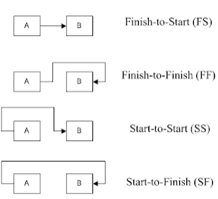
Drawing the various dependency types
On this module, we deal almost exclusively with FS dependencies.

Slide 15
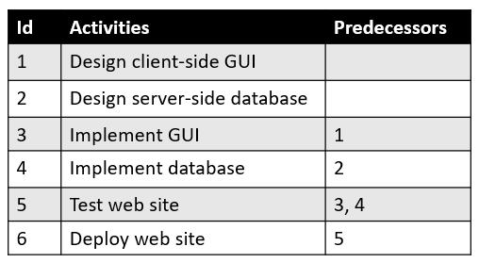
Network diagram example 1
1.
Design
GUI
3.
Implement
GUI
5.
Test
web site
6.
Deploy web site
2.
Design
database
4.
Implement
database

Slide 16
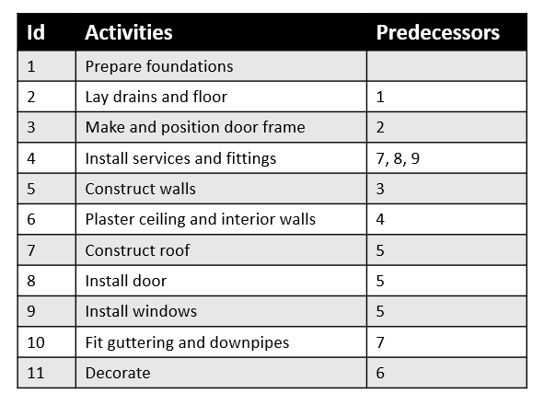
Network diagram example 2
10.
Fit guttering and downpipes
7.
Construct roof
4.
Install services and fittings
6.
Plaster ceiling and interior walls
1.
Prepare foundations
2.
Lay drains and floor
3.
Make and position door frame
5.
Construct walls
8.
Install door
11.
Decorate
9.
Install windows

Slide 17
Activity Table
Estimate Activity Resources
Estimate Activity Duration
Will discuss in future lectures
Id | Activities | Predecessors | Estimated duration | Resource
1 | Design client-side GUI |  | 3 days | Jane
2 | Design server-side database |  | 2 days | Bob
3 | Implement GUI | 1 | 4 days | Charita
4 | Implement database | 2 | 3 days | Bob
5 | Test web site | 3, 4 | 2 days | Bob, Charita
6 | Deploy web site | 5 | 1 day | Dave

Slide 18
Activity Table
Id | Activities | Predecessors | Estimated duration | Resource
1 | Prepare foundations |  | 3 days | Tim
2 | Lay drains and floor | 1 | 2 days | TIm
3 | Make and position door frame | 2 | 1 day | Jeff
4 | Install services and fittings | 7, 8, 9 | 1 day | Lim
5 | Construct walls | 3 | 3 days | Tim
6 | Plaster ceiling and interior walls | 4 | 2 days | Jeff
7 | Construct roof | 5 | 4 days | Tim
8 | Install door | 5 | 1 day | Jeff
9 | Install windows | 5 | 2 days | Satu
10 | Fit guttering and downpipes | 7 | 1 day | Jeff
11 | Decorate | 6 | 2 days | Tim, Satu

Slide 19
Develop Schedule
Everything done so far is brought together into a “final” schedule
This “final” schedule can change

Slide 20
Gantt charts
A Gantt chart, commonly used in project management, is one of the most popular and useful ways of displaying the project schedule - showing activities (tasks or events) displayed against time.
Shows what the various activities are;
Shows when each activity begins and ends;
Shows how long each activity is scheduled to last;
Shows where activities overlap with other activities, and by how much;
Should respect task dependencies;
Shows the start and end date of the whole project.

Slide 21
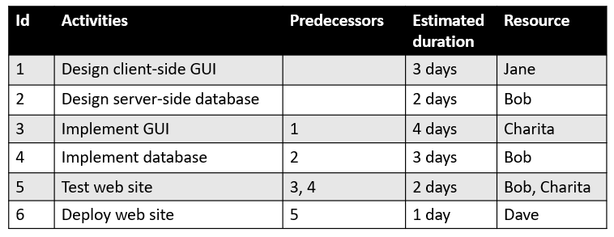
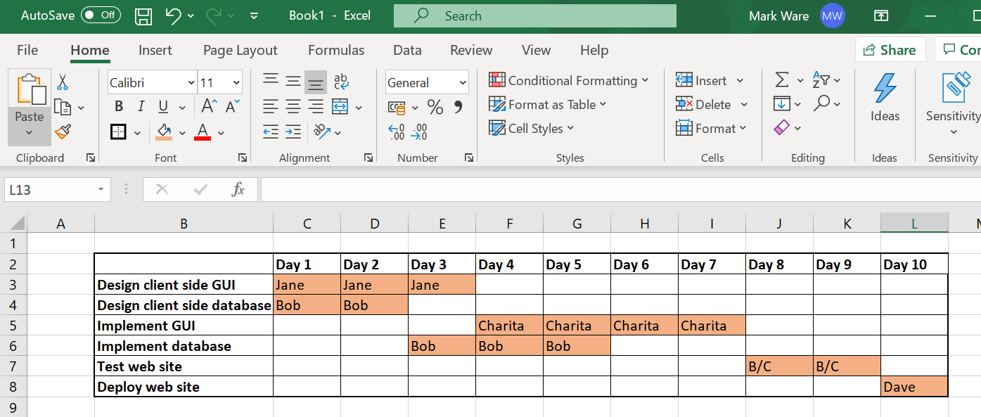
Simple Excel example

Slide 22
Next time….
Control schedule
Critical path analysis

