Slide 1
Project Management & Research Methodology (IS4S706)
Risk Management

Slide 2
Outline
What is risk?
Risk management
Identifying risk
Assessing the risk
Quantitative approaches
Qualitative approaches
Taking action
Monitoring and control

Slide 3
What is risk?
PRINCE2 definition
“The chance of exposure to the adverse consequences of future events”
Chance
It’s something that might happen
Adverse consequences
e.g. reduction in value of project, failure of project (higher development costs, delayed completion, reduced scope, reduced performance), less competitive system, failure to meet appropriate capability
Future events
It hasn’t yet happened – still time to make plans

Slide 4
Risk management
A continuous process, throughout the life of a project
Involves
Identify issues (root causes)
Identifying risk
Assessing risk
Make plans to deal with risk
Monitor and control risk
Initiate actions when required

Slide 5
Identifying Risk – How?
Detect every possible risk
Information gathering
Brainstorming
Interviews
Root cause identification
Documentation reviews
Assumption analysis
Checklist analysis

Slide 6
Identifying Risk – Where?
Where to look?
Resources
The Critical Path
Assumptions
Estimates
Outside the project
Generic risks

Slide 7
Generic risks
Barry Boehm’s “Top ten software project risks”
Personnel shortfalls
Unrealistic schedules and budgets
Developing the wrong functions and properties
Gold-plating
Continuous stream of requirements changes
Shortfalls in externally furnished components
Shortfalls in externally performed tasks
Real-time performance shortfalls
Straining computer science capabilities
Not all generic risks will be relevant

Slide 8
Property development example
Bobby is about to hand in his notice at work in order to embark on a career in property development. He is planning on buying his first property. He has enough money saved for the deposit, the building work, and, at most, 9-months of mortgage repayments. There is quite a lot of development work needed, but he has friends in the building trade who have promised to help at reasonable rates. In any case, he thinks he’ll be able to undertake lots of the work himself – after all, how hard can it be!?. The property to be purchased is currently a single dwelling 3-storey house. Bobby is hoping to get planning permission to convert to 3 one-bedroom flats. The plan is to get to the flats ready for rent within 6-months (i.e. next May). The market for one-bedroom flat rental is buoyant at the moment – lot of young professionals live and work in the area - so he is anticipating making a large profit.

Slide 9
Property development – generic risks
Interest rates sometimes go up
Property market fluctuates
Builders let you down
Gold-plating (do you really need the expensive kitchen?)
Cost estimates are nearly always an underestimate
DIY usually takes longer than you expected
Poor weather
Project bottlenecks (plasterer can’t start until the electrician has finishes)
Planning permission delayed or rejected

Slide 10
Drone Survey Project- risks
Risk
1. Interest rates can go up, mortgage repayments can increase
2. Builder friends are not available
3. Planning permission is turned down
4. Bobby can’t do the work – its not as straightforward as he thought
5. Work takes longer than 6-months – its winter after all
6. Bobby gets ill
7. Slump in the market for 1-bedroom flats so cannot sell (or not as much profit, maybe even a loss)
8. Expected work costs more than planned (unexpected costs)
9. Extra work increases costs(Gold Plating)

Slide 11
Assessing the risk
It might not be possible to take action for all possible risks identified
Therefore need to prioritise
But first, we need to evaluate the risk
Risk evaluation based on
The probability that an event that leads to harm will occur
e.g. 10% chance, very likely, not much chance
The adverse impact the event will have, should it occur
e.g. an extra 10 days on the project, 25% increase in project costs, scope of project will have to change
Probability and Impact combine to give Risk Exposure

Slide 12
Measuring Risk Exposure
2 general approaches
Quantitative
Probability value (e.g. 0.4)
Monetary value (e.g. £50,000)
Qualitative
Qualitative descriptions (e.g. “Very low”, “Medium”

Slide 13
Measuring risk exposure
Quantitative
Probability and impact can be multiplied to create a risk exposure
risk exposure = impact x probability
Example
if there is a 0.1 probability of hardware component failing and the impact of such a failure is £25,000 then
risk exposure = £25,000 x 0.1 = £2,500

Slide 14
Measuring risk exposure
Quantitative ordered list
Risk id | Description | Probability | Impact £ | Exposure £
3 | Planning permission is turned down | 0.4 | 20000 | 8000
5 | Work takes longer than 6-months | 0.8 | 8000 | 6400
4 | Bobby can’t do the work | 0.2 | 12000 | 6000
1 | Interest rates can go up | 0.7 | 5000 | 3500
8 | Expected work costs more than planned | 0.3 | 9000 | 2700
6 | Bobby gets ill | 0.4 | 4000 | 1600
7 | Slump in market, cannot sell | 0.1 | 11000 | 1100
2 | Builder friends are not available | 0.1 | 10000 | 1000
9 | Extra work increases costs(Gold Plating) | 0.1 | 1000 | 100

Slide 15
Measuring risk exposure
Qualitative
Agreed terms: High, Significant, Medium, Low
Discuss (team, experts, stakeholders)
Risk id | Description | Probability | Impact
1 | Interest rates can go up | High | Significant
2 | Builder friends are not available | Low | High
3 | Planning permission is turned down | High | High
4 | Bobby can’t do the work | Low | High
5 | Work takes longer than 6-months | Medium | High
6 | Bobby gets ill | Medium | Medium
7 | Slump in market, cannot sell | Low | High
8 | Expected work costs more than planned | Significant | Medium
9 | Extra work increases costs(Gold Plating) | Low | Low

Slide 16
Measuring risk exposure
Qualitative ordered list Probability Impact Grid
2, 4, 7 | 5 |  | 3
 |  |  | 1
 | 6 | 8
9
High
Significant
Impact
Tolerance Line
Legend
Priority level 1
Priority level 2
Priority level 3
Priority level 4
Medium
Low
Low
Medium
Significant
High
Probability

Slide 17
Taking action
Project uncertainty due to identified risks can be reduced by taking mitigating action
Accept the risk
Prevent the risk
Reduce the risk
Transfer the risk
Contingency
A mitigating action will mean revisiting and updating
the project plan
the development costs
the functional scope

Slide 18
Taking action
Accept the risk
Take no action (other than monitor)
Reasons
Risk exposure is low
Risk probability is low
Impact is acceptable
No other appropriate action available
Cost of action outweighs the impact cost

Slide 19
Taking action
Prevent the risk
Also known as risk avoidance
How?
Change the activity from which the risk originates
For example
Activity: Develop a particular software component using C++.
Risk: Project team has very limited experience with C++ and so quality of the work is likely to be compromised.
Risk prevention: The project team has plenty of C# development experience. It is therefore decided to develop this particular software component using C# - there is no obvious reason for this switch to compromise the project.

Slide 20
Taking action
Reduce the risk
Reduce the probability of the risk occurring
and/or
Reduce the impact of the risk
For example
Activity: Data collection (drone survey)
Risk: Drone can only be flown in good weather. Poor weather will result in data collection being delayed.
Risk reduction: Schedule data collection for no earlier than May and no later than September.

Slide 21
Taking action
Transfer the risk
Shift the risk to another party
For example
Activity: Install new server and network hardware/software.
Risk: This activity is on the critical path. The project team has some experience but have some concerns that work might take longer than planned.
Risk transfer: Contract the work out to specialist company. As part of the contract, make sure that costs associated with over-runs are transferred to the specialist company.

Slide 22
Taking action
Contingency
Take no action before the risk occurs
However,
Plan an action to be taken once the risk occurs (or when the probability of risk occurring becomes high)
For example
Activity: Database implementation.
Risk: Only 1 database specialist on the project team. Team members sometimes get ill. Completion of work will be delayed if the database specialist becomes unavailable.
Contingency: Identify staff in other teams who could cover the role in the event of the database specialist becoming ill. Creating the conditions in which the contingency action can take place will need to be managed.

Slide 23
Taking Action – is it worth it?
Taking action comes at a "cost"
Financial cost
Scope change
Schedule change
Do the benefits gained by the action outweight its associated cost.
Quantitative
Risk reduction leverage
RRL = (RE_{before} – RE_{after})/cost
If RRL is greater than 1.0, it means the reduction action is probably worth taking

Slide 24
Risk reduction leverage
Example:
Risk: Drone gets irreparably damaged during survey
Impact = £5000
Probability = 0.1
Exposure (before) = £5000 x 0.1 = £500
Action: Insure drone at a cost of £250
Impact = £200 (excess)
Probability = 0.1
Exposure (after) = £200 x 0.1 = £20
RRL = (RE_{before} – RE_{after})/cost = (500 – 20)/250 = 1.92

Slide 25
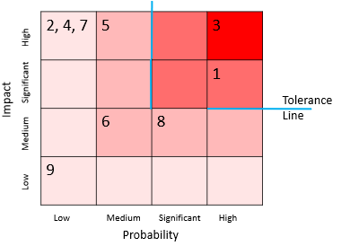
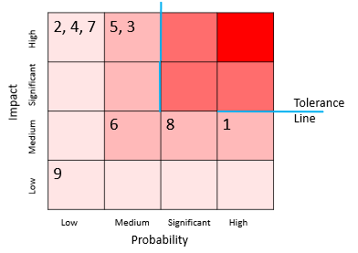
Project go-ahead?
Do not give go-ahead if there are any activities above a project specific tolerance line
Action must be taken to ensure a new position in the grid that is below the tolerance line

Slide 26
Monitoring and control
Risk management continues throughout the life of the project
New risks may be identified
Secondary risks arising from actions to reduce initial risk
Monitoring risk should be part of the project control cycle
Regular reviews
Reviews after significant events
Documentation
Risk register
Risk record

Slide 27
Monitoring and control
Risk register
Number | Description | Owner | Probability | Impact | Action | Status | Last updated
1 | Slow response times due to lack of expertise in temporal database design | D. Evans | Low | High | Get expert opinion on database and query design | On-going | 3/9/2015
2 | Updated spatial data not available in time for system deployment | R. Smith | High | Medium | Make sure that earlier version of data is available | Done | 5/8/2015
3 | Implementation delay due to non-availability of specialist staff | R. Smith | Medium | Medium | Employ short-term contract staff on attractive terms to cover | Contingency – contractors’ details are in place | 5/8/2015
: | : | : | : | : | : | : | :
: | : | : | : | : | : | : | :

Slide 28
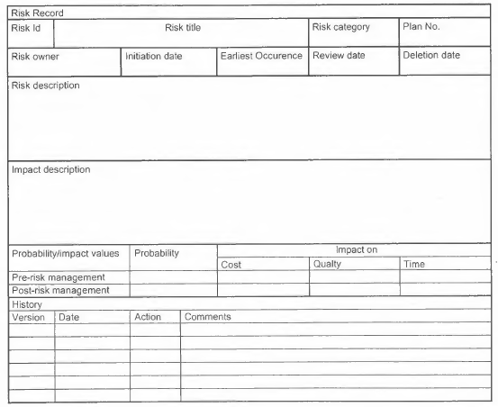
Monitoring and control
Risk record
From Hughes (2012)

Slide 29
Summary
Most (if not all) projects will carry risk
Structured risk management will help reduce the impact of these risks
Managing risk is a continuous process
It involves
Identifying risks
Establishing
Probability
Exposure
Priority
Determine and plan remedial actions
Monitoring

Slide 30
What to do next?
Risk management tutorial
Coursework !!!
Next topic….
Quality Management
Thanks for listening

Slide 31
Acknowledgement
Lecture material based on ideas presented in
“Project Management for IT-Related Projects” , Bob Hughes (editor), 2012, BCS, ISBN 978-1-78017-118-0
“Head First PMP – A brain friendly guide”, Jennifer Greene and Andrew Stellman, 2013, O’Reilly, ISBN 978-1-449-36491-5

