Slide 1


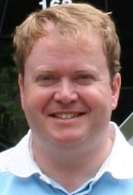
IS4S706 Project Management & Research Methodology
Introduction to Research Methods
David Kidner (J302)
david.kidner@southwales.ac.uk

Slide 2
Timetable
Today …
Research Methodology:
Weds (1-3) or Fri (10-12) Every Other Week
The Focus
The End Product: YOUR COURSEWORK!
Introduction to Research & Research Methodology
Choosing a Research Project
Deliverables / Purpose of Research / Research Questions
Literature Review

Slide 3
Coursework (50%)
Research Project Proposal
Fill out the Form before Midnight on Friday, 30th April 2021.
Simples?
Start Thinking About Ideas Now!

Slide 4
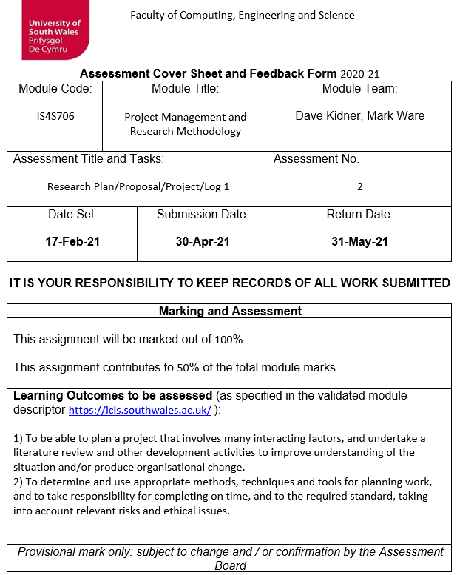

Slide 5
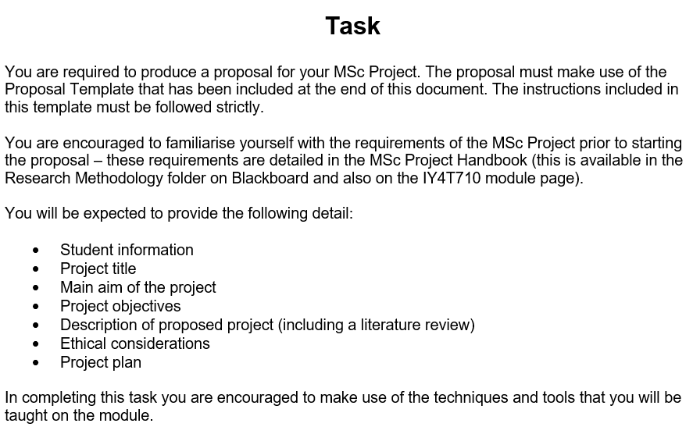

Slide 6
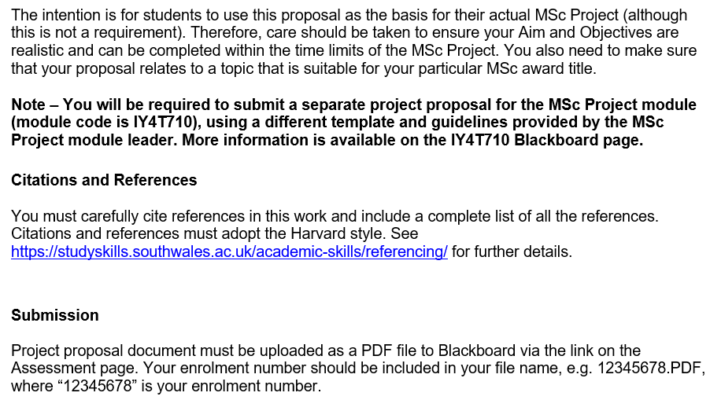

Slide 7
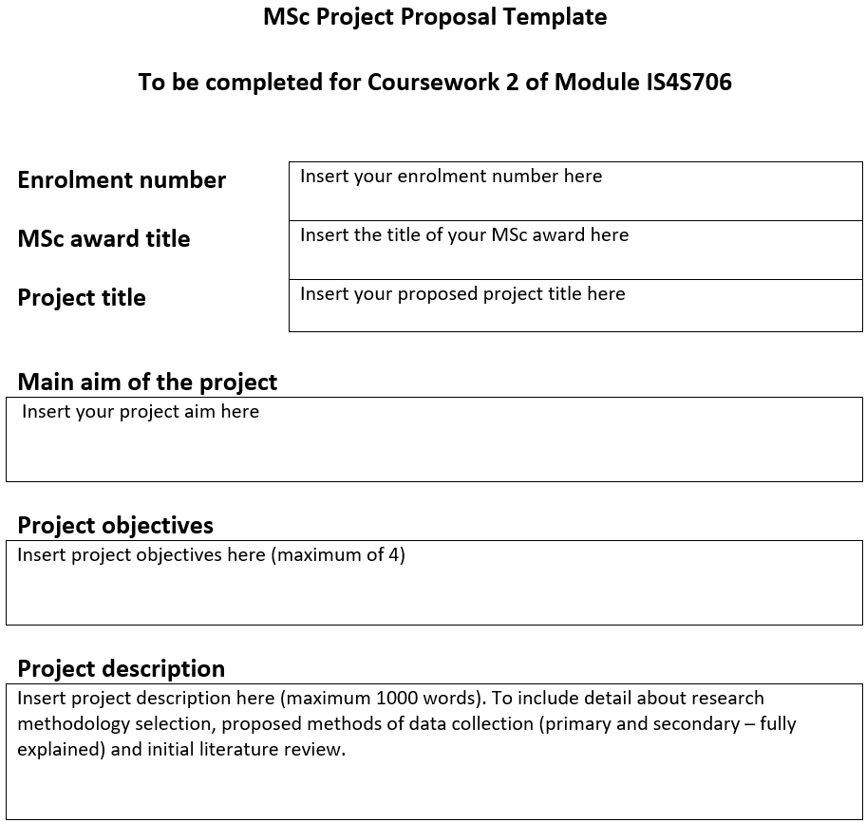

Slide 8
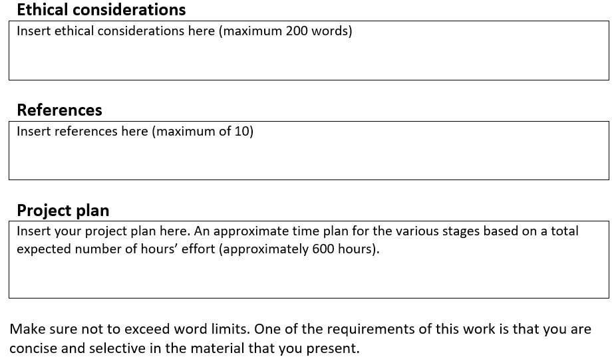

Slide 9
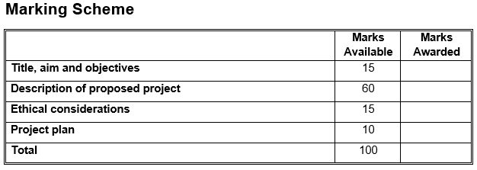

Slide 10
Think about Project Topics Now!
Next time, you’ll submit a cut-down “Expression of Interest” Form to your tutor
Forms the basis for class seminars, e-mail discussions and Teams 1-2-1 Chats in future Weeks.
Even if it’s just a “ballpark” area of interest
Also, check out the Project Handbooks (both Computing & Data Science).

Slide 11
CW vs. MSc Dissertation:
Your Coursework (Project Proposal) DOES NOT HAVE TO BE THE SAME as your actual MSc Project Proposal.
Your CW research might put you off doing this as an MSc Dissertation (e.g. too difficult; can’t get S/W or data needed; not what you expected).
Or your CW Proposal can be speculative / fun / topical (but not what you want to do for your Dissertation).
Or you already have a Dissertation topic lined up (but not a typical “Research Methods” project).
Or you will be assigned a Dissertation topic after Easter (e.g. Data Science), so don’t know what it is now!
Doesn’t Matter!

Slide 12
CW vs. MSc Dissertation:
You will still have to submit a separate MSc Project Dissertation proposal to your MSc Project tutor.
Form / Template will be different.
Don’t assume that by submitting the Coursework then you have submitted your MSc Project Proposal!

Slide 13
Disclaimer:
The Lectures (and me in particular) use the term “Research” or “Research Project” to mean anything from your CW Proposal to your MSc Project Dissertation to a PhD.
Very generalised, so not everything presented will be specific to your CW Proposal, but may be relevant for Research in general.

Slide 14

What is Research?

Slide 15
What is Research?
“a detailed study of a subject, especially in order to discover (new) information or reach a (new) understanding” (Cambridge Dictionary)
“Research is creating new knowledge” (Neil Armstrong)
“If we knew what we were doing, it would not be called research, would it?” (Albert Einstein)
“Research is what I’m doing when I don’t know what I’m doing” (Werner von Braun)
“If you steal from one author it's plagiarism; if you steal from many it's research” (Wilson Mizner)

Slide 16
What is Research?
“… is the process of gathering data in order to answer a particular question and this question will generally relate to a need for knowledge that can facilitate problem solving.”
Can help us:
understand more about particular issues and problems
find workable solutions
work towards that solution
evaluate success
offer robust recommendations
O’Leary, Z. (2014) The Essential Guide To Doing Your Research Project. 2nd ed. London:Sage.

Slide 17

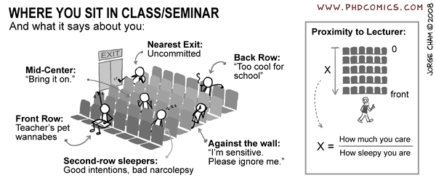
What is Research?
For example, can we deduce anything about where a student sits in the classroom, and can we define a relationship to formalise this?
… Or in Covid Times

Slide 18
What is the difference between an undergraduate and postgraduate project?

Slide 19
What is the difference between an undergraduate and postgraduate project?
At undergraduate your tutors are mainly assessing your dissertation on your ability to follow academic procedure and ability to produce a coherent piece of research. At Master’s degree level your tutors are looking for you to produce research on a topic that adds new insight to a specific area of study. Therefore, your Master’s dissertation has to be more original than your undergraduate thesis - this makes everything that little bit harder because you are venturing out into lesser known areas of academia.

Slide 20
Your Research Project
Scary – Yes
Clearly define the stages?
Important to do it ONE STEP at a time
Logic and rhythm to doing research
Move from being a knowledge CONSUMER to being a knowledge PRODUCER
“… research is more of a journey than a task, …. it needs to be managed, navigated and negotiated from early conception to final destination.”
O’Leary, Z. (2014) The Essential Guide To Doing Your Research Project. 2nd ed. London:Sage.

Slide 21
What is Research Methodology?
Methods to navigate through a research process.
Research methodology is the specific procedures or techniques used to identify, select, process, and analyse information about a topic. It defines those tools that are used to gather relevant data in a specific research study.
In a research paper, the methodology section allows the reader to critically evaluate a study’s overall validity and reliability. The methodology section answers two main questions: How was the data collected or generated? How was it analysed?

Slide 22
What is Research Methodology?
Includes:
Choosing & Planning a Research Project
Searching & Reviewing the Literature
Formulating a Research Problem & Objectives
Constructing Hypotheses
Conceptualising a Research Design
Data Collection, Processing, Analysing, Visualisation
Ethics
Writing a Research Report
Ranjit Kumar (2014) Research Methodology: a step-by-step guide for beginners. 4th edition, London:Sage.

Slide 23
Choosing a Research Project
Choosing a research project is normally the decisive feature of successful research!
Don’t start with an overambitious project
Make use of your mentor or supervisor to narrow down the research field in order to make the project practicable, useful and workable.
For this module: Me
For your dissertation: Nominate a supervisor who has a research interest in your chosen area.
Do your research on them!

Slide 24
Choosing a Research Project
Where do we start?
Ideally, with a pressing need from the “Real World”
Business or organisation that may sponsor the project
(or Research Council / Agency / Charity etc.).
MSc Data Science projects are in collaboration with industry. These projects will have a short description and some aims/objectives, and possibly some suggested specific methods or approaches.
Part-time students could/should liaise with their employer as a potential project sponsor and work together to choose a project

Slide 25
Choosing a Research Project
A problem encountered in everyday work or outside everyday work;
An issue that the researcher has read about or seen;
A problem that has arisen in the locality, e.g. in response to government policy or practices or to local developments;
An area of the researcher’s own interest;
An area of the researcher’s own experience;
A perceived area of importance;
An interesting question;
A testable guess or hunch;

Slide 26
Choosing a Research Project
A topical matter;
Disquiet with a particular research finding that one has met in the literature or a piece of policy;
An awareness that a particular issue or area has been incompletely studied, and a wish to plug the gap;
A wish to apply a piece of conceptual research to actual practice, or to test a theory in practice;
A wish to rework the conceptual or theoretical frameworks that are often used in a specific area;
A wish to revise or replace the methodologies that are often used in researching a specific area;

Slide 27
Choosing a Research Project
A desire to improve practice in a particular area;
A desire to involve participants in research and development;
A desire to test out a particular methodology in research;
An interest in seeing if reported practice holds true for the researcher’s own context (e.g. a comparative study);
An interest in investigating the causes of a phenomenon or the effects of a particular intervention in the area of the phenomenon;
A priority identified by funding agencies;
An issue identified by the researcher’s supervisor or a project team of which the researcher is a member.

Slide 28
Choosing a Research Project
REMEMBER:
Your actual MSc study will take 600 Hours.
Sustaining interest and momentum in the project are important considerations
Don’t pick a project which you are not 100% committed to.
Pick a project which you do find interesting and/or enjoyable.

Slide 29
Choosing a Research Project
Ideally, with a pressing need from the “Real World”
A problem encountered in everyday work or outside everyday work;
An issue that the researcher has read about or seen;
A problem that has arisen in the locality, e.g. in response to government policy or practices or to local developments;
A topical matter;
A Covid
Project?

Slide 30
A Covid Project?
The Impact of Covid on Digital Working & Cybersecurity
Covid: The Case for Increased Cybersecurity
Covid: The Changing Cyber Threat Landscape
Covid: Internet Fraud & The OAP
AI & Covid – Fact or Fiction?
Mapping Covid Worldwide: Why the UK?
Mapping Covid in the UK: Why Rhondda Cynon Taff?
Managing & Visualising Covid Datasets ….

Slide 31
The Importance of the Research
The project should ideally be original, significant, non-trivial, relevant, topical, interesting to a wider audience and to advance the field.
Ask your tutor if it is (you might not know).
Ask yourself:
What is the use of this research / project?
What is the point of doing this research / project?
Is this research / project worth doing?
If you don’t, then you can bet your examiners will!

Slide 32
Choosing a Research Project
Why Do the Research / Project?
You need to be clear what you want the Project to Deliver.
What are the Deliverables?
What do we want to know as a result of the project that we did not know before the project commenced?
What do we want the research / project to do?
What do we want to find out?
Not the same as what we want the results to be.
BE CLEAR!

Slide 33
Different Purposes of Research Project
To examine effects of causes
To evaluate an intervention
To examine causes of effects
To look at an issue in detail
To generalise
To look at long-term effects
Classroom-based research
To investigate sensitive issues or groups
To develop theory
To see what happens if . . .
To test a theory/hypothesis
To test practice
To clarify concepts
To identify common features
To investigate and examine
To collect opinions
To model
To compare
To look at trends
To collect views
To critique policy/practice

Slide 34
Different Purposes of Research Project
Hopefully, which all encapsulate enough of the (Computer / Data) Science to fulfil the requirements of your MSc.
Different Purposes Suggest Different Approaches
“Fitness for Purpose”
You can’t say “I like questionnaires”, “I don’t like stats”, “I want to use Python”, etc.
Tail wagging the Dog.
The Purpose determines the kind of research, the research questions, the instruments for data collection, the sampling, the ethics, the scope, etc.

Slide 35
Conducting the Project
Biggest pitfall in MSc Projects is the belief that what YOU want to do can actually be done.
Often a significant gulf between this and what you can deliver.
Rather than deliver a lot less than you originally promise (at the risk of being penalised), let’s make sure you get the achievable deliverables defined at the outset.
Good initial research and pre-planning.

Slide 36
Pitfalls: ACCESS
You will not necessarily be granted access to the data you need; access to the software you need; access to the people or institutions you need to speak to; access to ethical approval.
Do your homework before planning the research project in any detail
Speak to the people / organisations you will depend on at the earliest opportunity.
Prepare an outline plan of your project to circulate to them to explain the benefits of what you can offer and why you need …

Slide 37
Pitfalls: RESOURCES
TIME: OK, you’ve got 600 hours. Is it enough?
Make sure your project is manageable within your 600 hour time frame.
Produce your time management plan.
Don’t underestimate certain tasks (e.g. processing questionnaires; debugging code; number crunching, …)
Access & Availability of your Mentor / Supervisor.
MATERIAL RESOURCES: Costs!
Some tasks may be expensive (e.g. postal questionnaires; travel to interviews/organisations; software; data).

Slide 38
Research Questions:
It is often useful to consider the role of RESEARCH QUESTIONS and the guidance to the project that they might provide.
Keeps you Focused during the project.
E.g. Which question(s) does this task help me answer?
If it doesn’t, should I really be spending a week or 2 on it?
Should sit alongside your Project Deliverables.
Helps fulfil the Project Objectives.
Can be formally presented (in your dissertation) for the reader; or informally used by you (not presented in thesis) to focus your project day-by-day.

Slide 39
Types of Research Questions
‘How?’
‘Wh’ questions: who, where, why, what, what if, when
Achievement
Alternatives to something
Causation
Comparisons
Correlations
Description
Evaluation
Explanation
Exploring
Factors
Function or purpose
How to achieve outcomes
How to achieve something
How to do something
How to improve or develop something
Prediction
Processes
Properties and characteristics
Relations (e.g. between variables, people, events)
Stages of something
Structures of something;
Testing
Types of something
Understanding

Slide 40
Literature Review
Literature Review is essential for any research project.
Gives credibility and legitimacy to the research;
Shows that the research is up-to-date, focuses on key issues, is aware of the theoretical, conceptual, methodological and substantive problems in the field;
Clarifies key concepts, issues, terms and meanings;
Leads into the researcher’s study, raising issues, showing where there are gaps in the research field, how to move the field forwards, and justifying the need for the research;
Shows the researcher’s own critical judgment on prior research or theoretical matters in the field;

Slide 41
Literature Review
Provides new theoretical, conceptual, methodological and substantive insights and issues for research;
Sets the context for the research and establishes key issues to be addressed;
The literature must inform the research, not simply stand alone with no relation to what comes after.

Slide 42
Summary
Planning every element of your research project is essential.
Keeping the focus (e.g. research questions) will help you stick to the plan.
Homework:
Read the Coursework & Project Handbook(s)
Jot down some preliminary ideas for projects
Start some initial research into these ideas
NEXT LECTURE:
Lecture 2: Literature Review (in more detail).
NEXT TIME:
Searching for Information (Sharon, LRC).
Submitting some preliminary ideas.

