Slide 1


IS4S706 Project Management & Research Methodology
The Literature Review
David Kidner (J302)
david.kidner@southwales.ac.uk

Slide 2
The Literature Review
“A researcher cannot perform significant research without first understanding the literature in the field” (Boote and Beile, 2005)
Boote, D. N., and P Beile. (2005). Scholars before researchers: on the centrality of the dissertation literature review in research preparation. Educational Researcher, 34(6), 3-15.

Slide 3
Remember: You will need to produce TWO Literature Reviews (1) A Scoping Review for your Coursework (2) A more Comprehensive Review for your Dissertation.

Slide 4
What is a Literature Review?
A literature review summarises, critically analyses and evaluates previous research available on the subject, presenting this in an organised way. It should address a clearly articulated question or series of questions …
Remember our research questions from last time?

Slide 5
What If There Is No Previous Published Research?
If Not, Why Not?
Too Irrelevant? Make a Case for Your Work.
Don’t underestimate the value of a MSc Thesis.
Too Specific? Need to Put Your Work into Context.
Too Applied? Ditto.
Makes the Need for Your Work More Relevant & Necessary?
Sell Yourself & Your Project
Look for Empirical Work from other Related Areas
Need to broaden our Literature Search.

Slide 6
The Literature Review in Context …
Your opportunity to persuade your reader (and examiner) that your work is relevant and that it is/was worth doing!
Making the case from what’s gone before.

Slide 7
Approaching the Literature Review
To complete a literature review requires planning, time, reading, writing, drafting, reflection and editing.
A successful literature review has a firm idea of the research problem and an understanding of the research framework/paradigm.
In order to refine the research problem, conduct preliminary research which will help you narrow your focus and identity key search terms.

Slide 8
Approaching the Literature Review
You are expected to ‘place’ your research in the existing academic literature.
Simply describing the literature should be avoided. A critical and analytical judgement which demonstrates how/where your work is best placed as well as work that needs developing is essential.
Your work should contribute to existing literature in the field.
Ensure consideration is given to the methodological and/or theoretical arguments that inform the literature.

Slide 9

FOCUS is the Key!

Slide 10
What the Lit Review IS NOT
It is NOT:
A descriptive list or summaries of books/articles etc
Organised around the sources with each described in great detail
An exhaustive bibliography on everything ever written on the topic - you need to make a decision about what to include
An argument for the importance of what you are researching with no contextualisation of key issues
Your arguments and ideas (like an essay)

Slide 11
Instead, your literature review must be organised around ideas with an assessment of previous studies (including their strengths and weaknesses).

Slide 12
Questions that your examiners ask that your literature review can help you answer …
What research question(s) are you asking? Why?
Has anything similar been done in this area before?
What is already known/understood about this topic?
How might your project challenge existing beliefs or add to this understanding?

Slide 13
So, your Literature Review shows …
You’ve an in-depth understanding of your topic area including key concepts, terminology, theories and definitions
You’ve identified who the major thinkers & players are
You’ve identified what research has been done in your area
You’ve identified gaps in the research or current areas of interest to help you formulate your own research question
You’ve identified the main research methodologies in your subject area
You’ve identified main areas of agreement or controversy
You can convince the reader that your research questions are significant, important and interesting
You can convince the reader that your thesis will make an original contribution to the area being investigated.

Slide 14
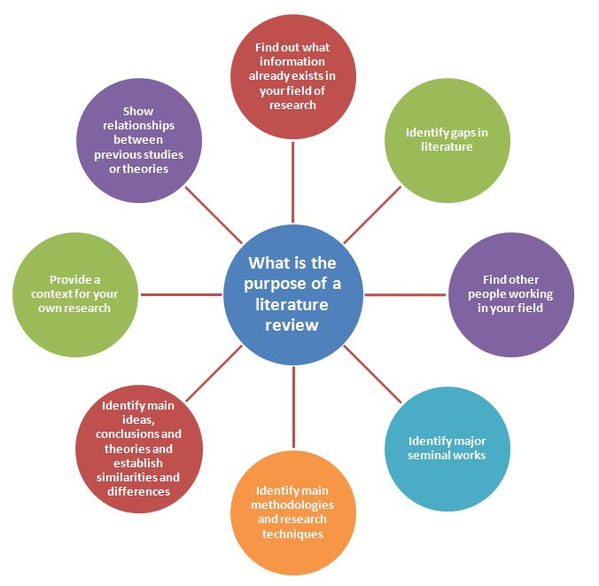

Slide 15
Merriam (1988) literature review as “an interpretation and synthesis of published work”
You need to be actively involved in interpreting the literature that you are reviewing, and in explaining that interpretation to the reader, rather than just listing what others have written.
The term ‘synthesis’ refers to the bringing together of material from different sources, and the creation of an integrated whole.
Merriam S. (1988) Case study research in education: a qualitative approach. San Francisco, CA:Jossey-Bass

Slide 16
OK, so how do we go about organising, interpreting and synthesising the literature?
Find the Literature!
Refer back to Sharon’s Slides (on Blackboard)
Make use of the LRC Resources (NOT Google or Wikipedia).
Have an organised system in place for storing your important papers; your findings, interpretations and comments on these papers; the relative importance of each paper …

Slide 17

2. Kidner Methodology … Don’t Quote Me On This
1980s-1990s: Foolscap Boxfile of Papers with Different Coloured Post-It Notes (Main Points / My View) organised in order (of importance).
Digital Age: Textbooks will say use a reference manager tool, e.g.
Keep it Simple: USB Stick & POWERPOINT
Download all your papers to a folder
Powerpoint: 1 Page per Paper
Reference (and link), Relevant Snippets, Screen Grabs, Your Views, Context (of your work)
Quotes which will have to be included; Quotes to be re-written!
Figures / Pictures from the Literature
Organised in Order of Importance / Relevance
E.g. Coursework: a 10-Page Powerpoint File

Slide 18
OK, so how do we go about organising, interpreting and synthesising the literature?
Critically question each paper you read …
Who is the author?
What is the authors central point or main argument?
What findings and conclusions are made?
What evidence is used to support the conclusions?
Is the evidence relevant? What methodology has the author used? What are the strengths and limitations?
Does the author make any assumptions?
What is not being said?
Is there any explicit or hidden bias?
How is the text relevant to YOUR project or assignment?
How does this link with other texts that you have read?
Checklist
Or Table?

Slide 19
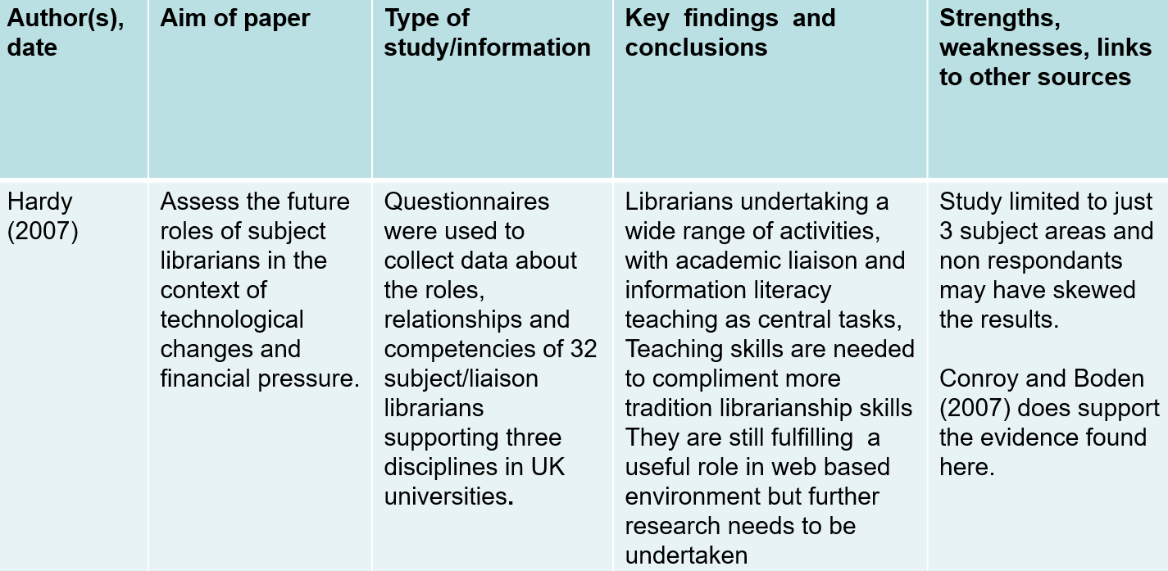
For Example …

Slide 20
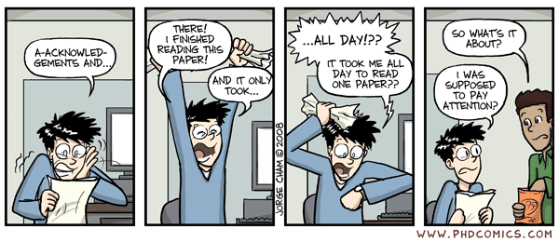
We’ve all been there!
Manage your time efficiently and effectively
Don’t try to understand everything in every paper …
Move On!

Slide 21
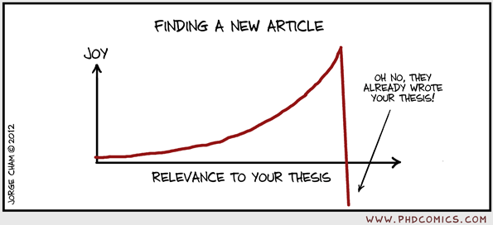
We’ve all been there also!
Don’t lose heart. More often than not, it’s in a different context to yours; or you can adapt your approach; or apply to different criteria / data etc.

Slide 22
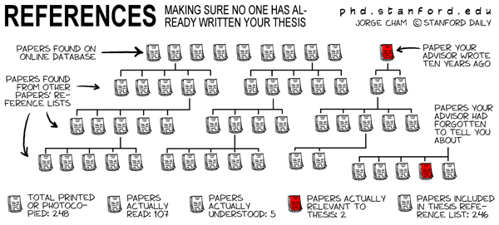
You’ll never find (or get access to) every paper in your field, so don’t stress yourself too much in trying to find everything! (Leave that for your PhD!).

Slide 23

4. Don’t Lose Sight of …

Slide 24
4. Don’t Lose Sight of the Big Picture
Ask yourself:
What ideas seem to come up in several articles?
Are the same ideas presented from the same or different perspectives?
Are there any major debates that need addressing
Does there seem to be a change in thought over time?
What ideas/themes are relevant to answer my question(s)
Are there different methodologies being applied? (a review might evaluate different methods)

Slide 25

5. Write the Literature Review
Structure:
Introduction:
Scope & Structure
Distantly related to
your work
Background, more to do with your topic area than your research question
Closer to what you’re doing but not match directly
Narrow categories you may deal with sources in more detail
Research that is particularly pertinent to your work
Categories close to your research and you may find you are looking at a few key papers in detail
Your study/current research issues

Slide 26
5. Write the Literature Review
Introduction: Could Include …
Why the topic is important - is it an area of current interest?
The scope of the review - the aspects of the topic that will be covered
How the review is organised
Has the topic been widely researched? Or not?
Significant gaps in the research into your topic
Is there debate and controversy about the topic or a consensus?

Slide 27
5. Write the Literature Review
Main Body: Should Include …
Strong Topic Sentences (aka Umbrella Statements) at beginning of paragraphs
State the purpose of your message and summarises the points that support the purpose
Use language to show confidence/caution:
There is clearly a link.../This suggests a possible link...
Comes across as you using own voice to comment on the literature
Don’t use the first person, “I believe”, “I did”, etc.
Critical Reflection …

Slide 28
6. Critical Reflection …
Don’t be afraid to express your own thoughts and opinions; and sell your own work & methodology. You can …
Compare and contrast different theories, concepts etc. and indicate the position you are taking for your own work;
Show how limitations in others’ work creates a research gap for you;
Use strategic and selective referencing to support the underpinning arguments which form the basis of your work;
Synthesise and reformulate arguments from various sources to create new/more developed points of view;
Agree with / defend a point of view or finding
Accept current viewpoints have some strengths but qualifying your position by highlighting weaknesses
Reject a point of view with reasons (e.g. Lack of evidence)
Make connections between sources
Adapted from RIDLEY, D 2008. The literature review: a step-by- step guide for students. London: Sage

Slide 29
7. Conclusions
Conclude your literature review with a statement which summarises your review and links this to your own research/current issues
In conclusion, extensive research has shown that …
There is clearly a need for …
This research therefore fills an evident gap in …
The project will demonstrate …

Slide 30
8. References
We’ll cover this more in a couple of weeks time, but for now …
Keep a record of all the sources that you use!
Make sure you quote directly sourced material
… but don’t overdo it for the Coursework (limited word count)
Use the Harvard Referencing System:
https://studyskills.southwales.ac.uk/academic-skills/referencing/

Slide 31
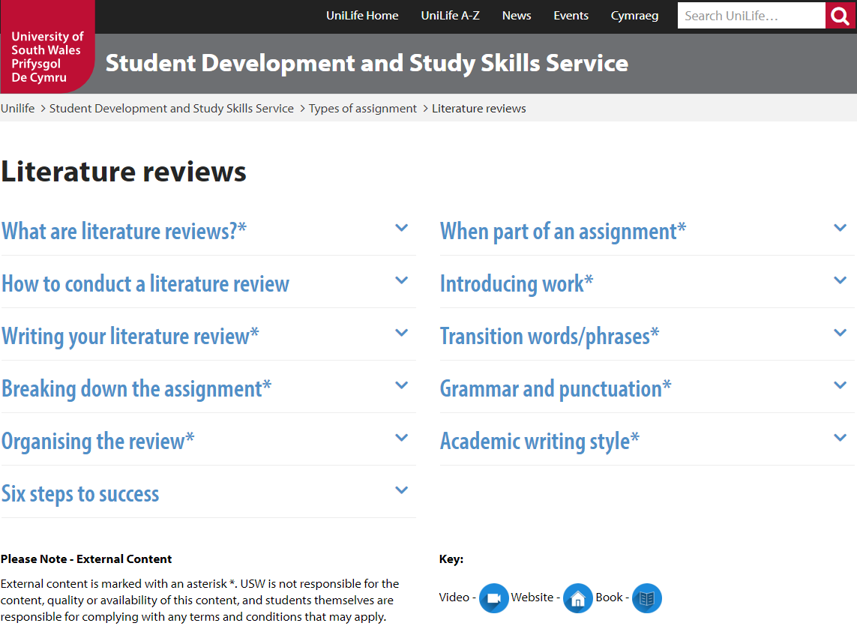
Literature Review
Finally … Please check this out:
https://studyskills.southwales.ac.uk/type-assignment/lit-reviews/

