Slide 1

Can We Predict Student Grades?
Mark Baber
Notes:
Now I will present a recent project that I carried out for university, which will be presented in the STAR format, meaning I will break it down into:
Situation
Task
Actions
Results
I have also sent a link to where you can see a copy of the presentation, and the full copy of the project I will be talking about.
https://github.com/M4rk3h/interview-docs/blob/main/predict-student-grades-REPORT.pdf

Slide 2
S - Project Description
First Machine Learning Project - January 2021
Individual Project
Predicting Student Grades
Knowledge Media Institute, The Open University
Open University Learning Analytics Dataset
Python
MatPlotLib
SciKit Learn
Numpy
Pandas
Notes:
This was the first machine learning project we were given at university, which was assigned to us at January 2021.
This project was going to be an individual project per student, and the main task set was to predict student grades.
The dataset came from Knowledge Media Institute, The Open University with the dataset being known as ‘Open University Learning Analytics Dataset’.
This project was to be completed using Python and a Jupyter Notebook with a few python packages.

Slide 3
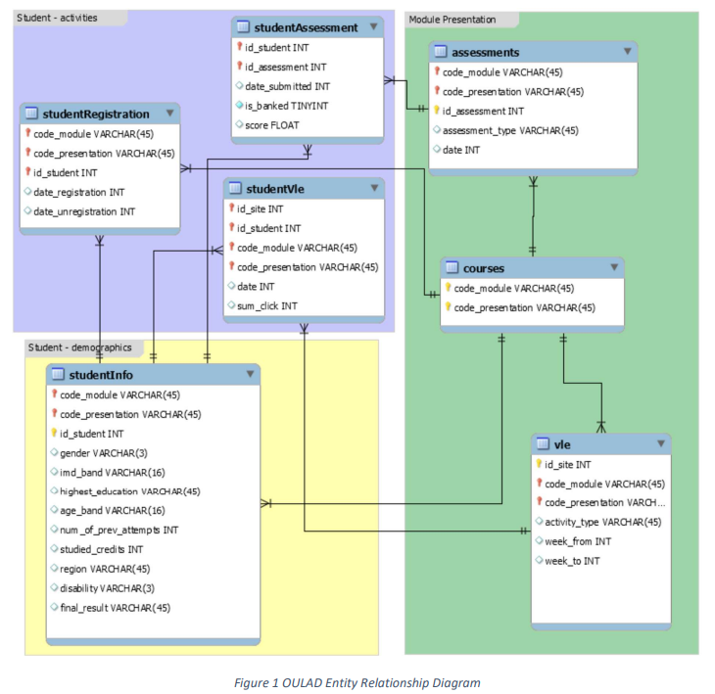
S - Dataset
Open University Learning Analytics dataset
32,593 students
22 courses
Students taking online courses
Course
Virtual Learning Environment (VLE)
Assessments
Students VLE
Student Info
Student Registration
Student Assessment
Notes:
This dataset was provided by the Open University and the dataset is around students who were taking online courses at the open university.
This dataset is made up of over 32,000 students and 22 courses. The data is split across 7 tables, which is as follows:
-

Slide 4
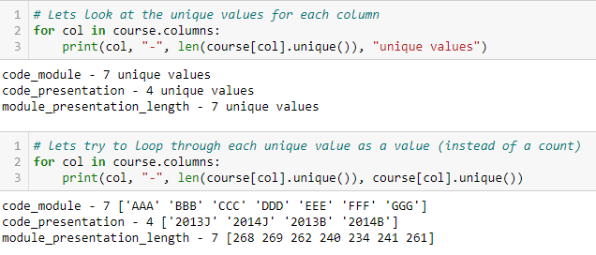
T - EDA
Import the Data
Exploratory Data Analysis
Draw Insights from Data
Unsupervised Analysis
Supervised Analysis
Notes:
My main tasks for this project were set out in the report brief, these were as follows:
Import Data
Exploratory Data Analysis
Draw Insights
Unsupervised Analysis
Supervised Analysis
These main tasks will be broken down with multiple tasks for each.

Slide 5
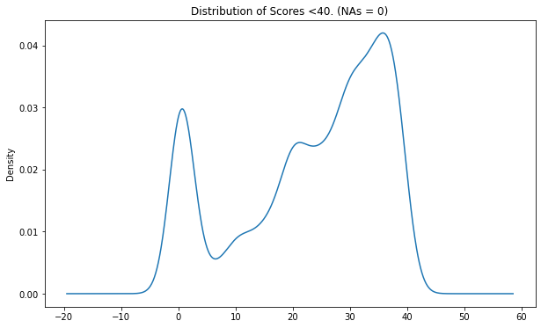
A – Exploratory Data Analysis (EDA)
Check Head
Check Tail
Check Info
Find Unique
Describe data
Missing Data
Feature Engineering
Notes:
The first task was to explore the data, to begin this I followed a few steps for each of the datasets, which were as follows:
- Check Head
- Check Tail
- Check Info
- Find Unique
- Describe data
- Missing Data
After going through the datasets, the student assessment table had information about students scores, with this I created a graph showing the students who scored < 40 which in USW is a fail. There are a lot of 0’s but that is due to me changing missing values to 0’s. This could have also been converted to the averages.
I also looked at the number of students who passed, which can be seen in the report pdf.

Slide 6
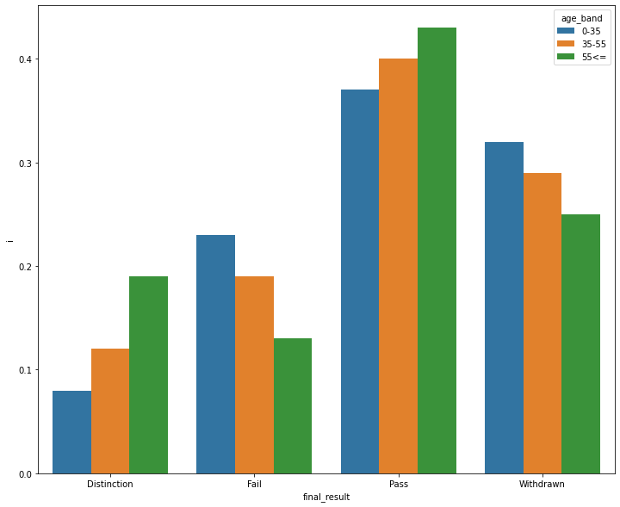
A -
Dealing with Categories
Label Encoders
Feature Engineering when applicable
Notes:
After exploring a few tables, one dataset had a 6 categories which needed to be converted if I was going to use them for machine learning techniques.
I started by finding all of the unique values for each categories and plotting them for an easier understanding, these categories were:
- Age
- Disability
- Education
- Gender
- IMD_Band
- Region
After exploring the categories, plotting them out and getting a better understanding. These were converted using an encoding method called One Hot Encoding, which will make the next few steps easier.
This is the process of changing the categories from text into values ranging from 0 – number of classes – 1, which is required when dealing with Machine Learning techniques.
The final dataset at this point was a combination of Student Info with Student VLE – with the hypothesis: “The amount number of time a student spends on content,

Slide 7
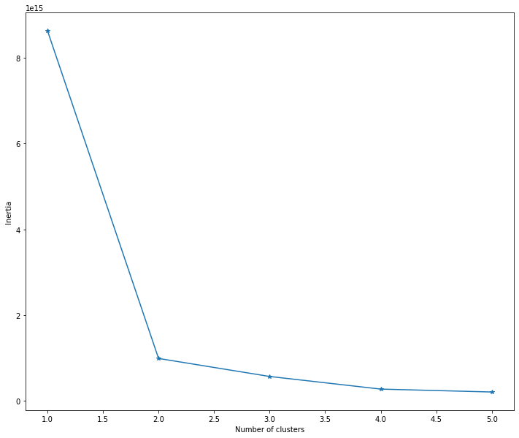
A - Unsupervised
Gaussian Mixture
30% Accuracy
Kmeans
89% Accuracy
Notes:
When dealing with the unsupervised part of the project, we were asked to carry out 2 different types of unsupervised models to see which would be better for our dataset,
My first step was to prepare the data by removing a few features to narrow down my process, splitting the dataset and using a standard scaler on the data.
Next I carried out 2 unsupervised models with a Gaussian Mixture and then a KMeans model.
For the Gaussian Mixture, This turned out to have an accuracy of 30%, which lead me to believe I may have done something wrong – Seeing as I didn’t know what else to do, I moved on to the Kmeans model.
For the Kmeans model, I started by plotting the number of inertia’s against the number of clusters to find out how many clusters I should use, from the plot we can see that 2 clusters is the ‘elbow’ of this plot – which is what to look for when finding the number of clusters.
Running the Kmeans at 2 clusters resulted with an 89% accuracy score which I was happy with. With this being the case I moved on to the supervised learning section.

Slide 8
A - Supervised
Test/Train Split
Linear Regression
X
Y
Z
Logistic Regression
X
Y
Z
Notes:
To start with a supervised model, I needed to use a test/train split for the data – This is an important step for the supervised model, as we can use some of the data for testing and some for training.
After splitting the data into test train, the first model was a Linear Regression and the second was a Logistic Regression.

Slide 9
R - Results

Slide 10
Conclusion

