Slide 1


IS4S761 Principles of Computing
Introduction to Python Programming
Lecture 7
David Kidner (J302)
david.kidner@southwales.ac.uk

Slide 2
This Week …
Part 1: COURSEWORK
Preliminary Work: File Handling / Reading / Plotting
Part 2: Other Python Libraries / Exception Handling

Slide 3
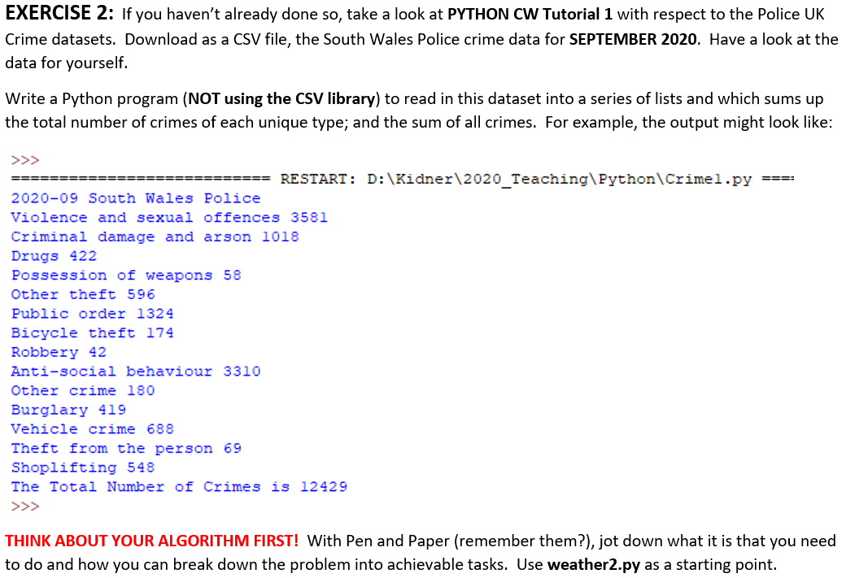
Last Time …

Slide 4

Looking at the Data …
Crime ID
Month
Reported By
Falls Within
Longitude
Latitude
Location
LSOA Code
LSOA Name
Crime Type
Last Outcome
Context
Do we need to read all of this Data?
Or Just Crime Type?

Slide 5
Last Time …
We read a file of (1) all Columns and (2) Just 1 Column
Re-Use!
(1) All Columns
Initialise all Lists (Empty) for Each Column
Open File
Read Header Line (Column Names)
For Each Line (Row of Data)
Separate by Comma Delimited Values
Store Values in Each List (i.e. Append)
Calculate Summary Statistics
Close File

Slide 6
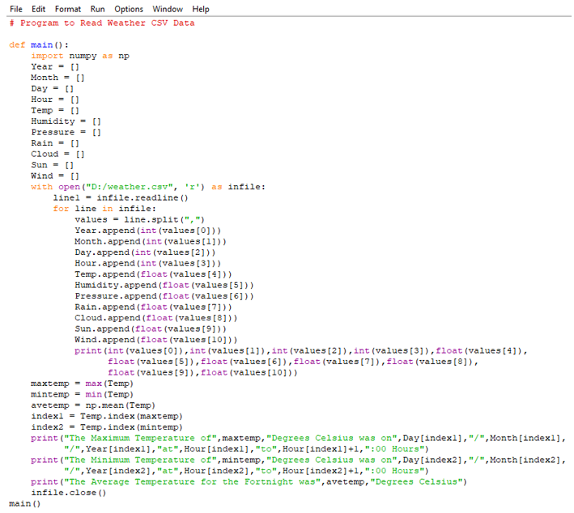

Slide 7
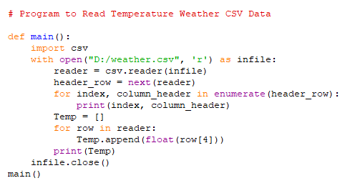
Last Time …
… and (2) Just 1 Column
Open File
Read Header Line (Column Names)
Initialise The List (Empty) for Column of Interest
For Each Line (Row of Data)
Store Specific Value in List (i.e. Append)
Print Out Values
Close File

Slide 8
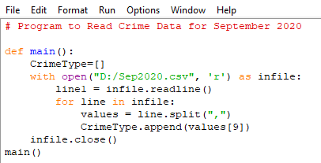
Amend (Either) for our Crime Data …
So …
And extend for summarising the Totals …

Slide 9
Summarising the Totals?
Jot down what we want to do …
(1) Need to count the total instances of each Crime Type
(2) And Sum up the Total of All Crimes
(3) Need to have a list of ALL Different Unique Crime Types
(4) For Each Crime Instance Increment a Count?
(5) Finally, sum up All the Counts.

Slide 10
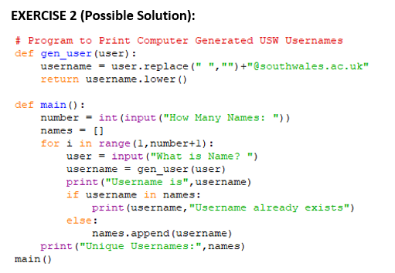
Unique List of Crime Types?
Remember back to Week 4 …
Could use the same approach …
So when we read our crime data
Set up a separate list of Unique Crime Types
Only Append if Doesn’t Already Exist
OK, but …

Slide 11
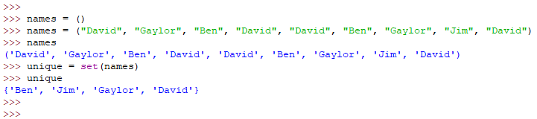
There is an easier way …
Use a Python Data Type that only allows unique elements (no duplicates) …
E.g. Data Dictionary
E.g. Set (unordered & unique)

Slide 12
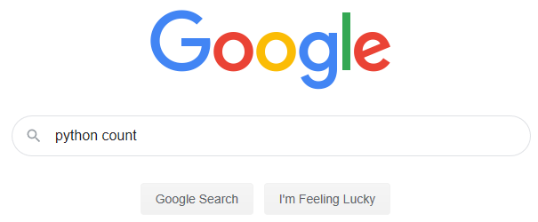

Counting Unique Crime Types
We could set up a count for each and check (in a for loop) to see whether the instance exists and increment the count.
Is there an easier way?

Slide 13
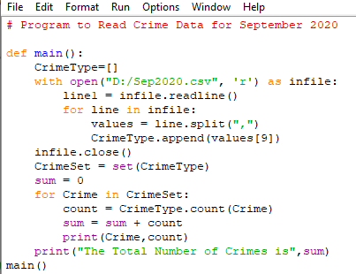

Slide 14
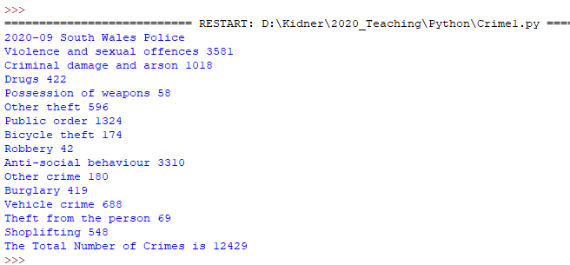
Visualise the Month’s Data?
e.g. As a Pie Chart …

Slide 15
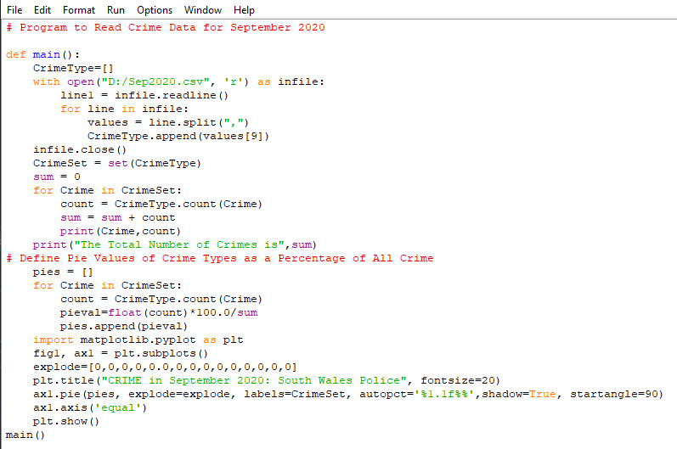

Slide 16
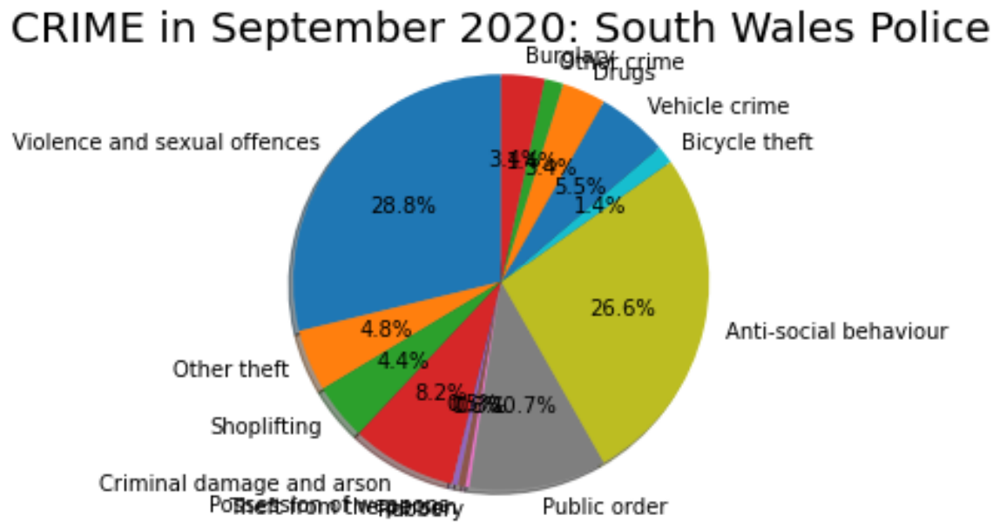

Slide 17
Taking this further …
Can we read the Crime Data in a separate function
Pass a filename / Return a List of Crimes
Pass it a filename of filenames (36 months data)
Pass 2 filenames (SWP & Met Police)
Generate a different range of graphs
E.g. a line chart of 36 months (burglary data)
E.g. 2 Pie Charts of SWP vs. Met Police
Etc.

Slide 18
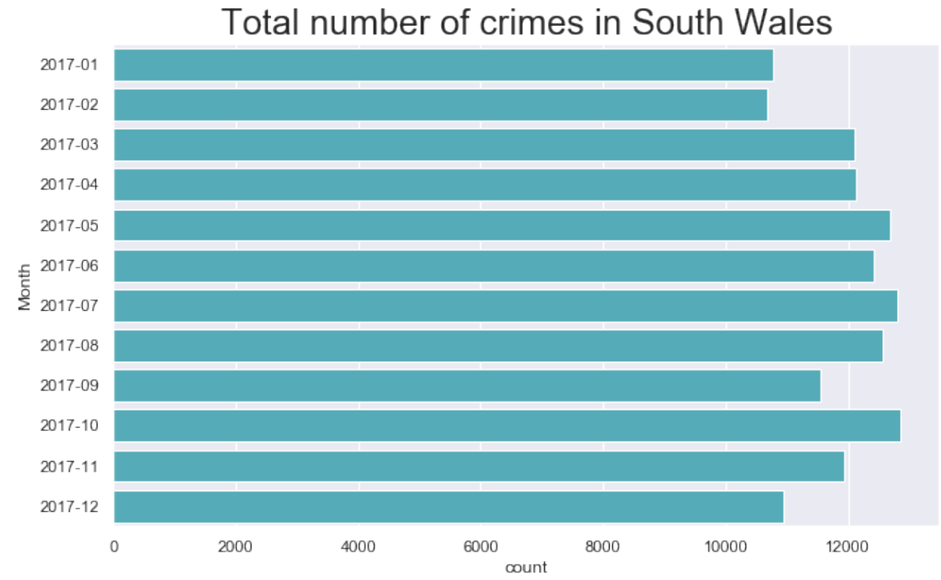

Slide 19
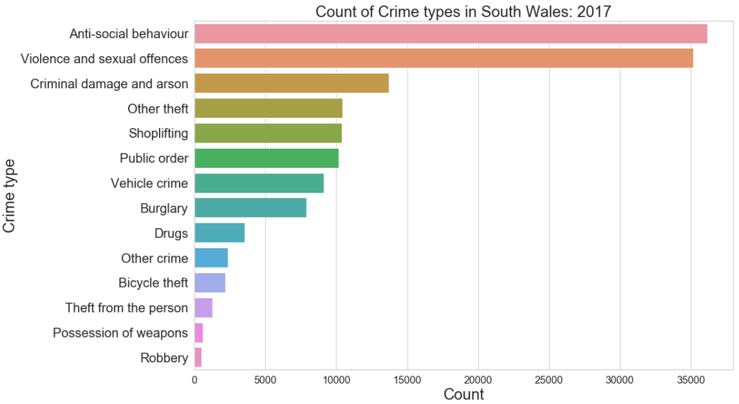

Slide 20
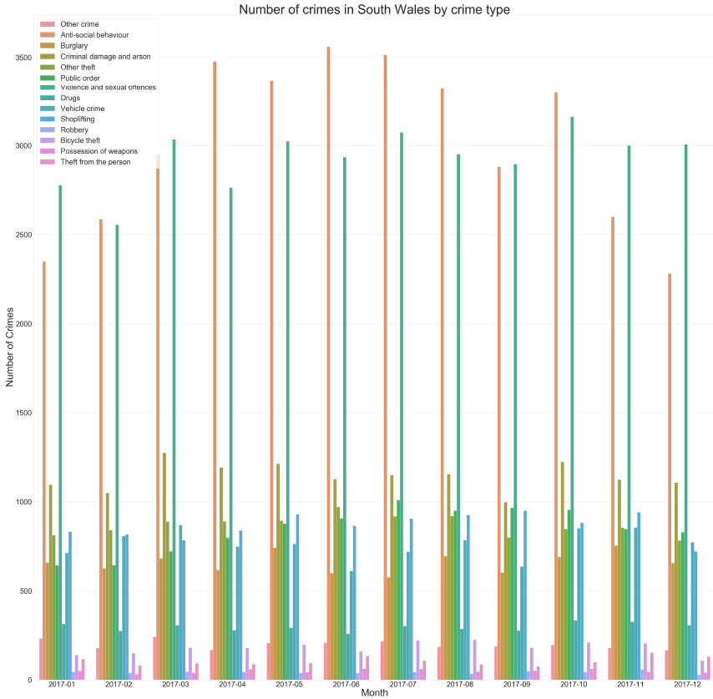

Slide 21
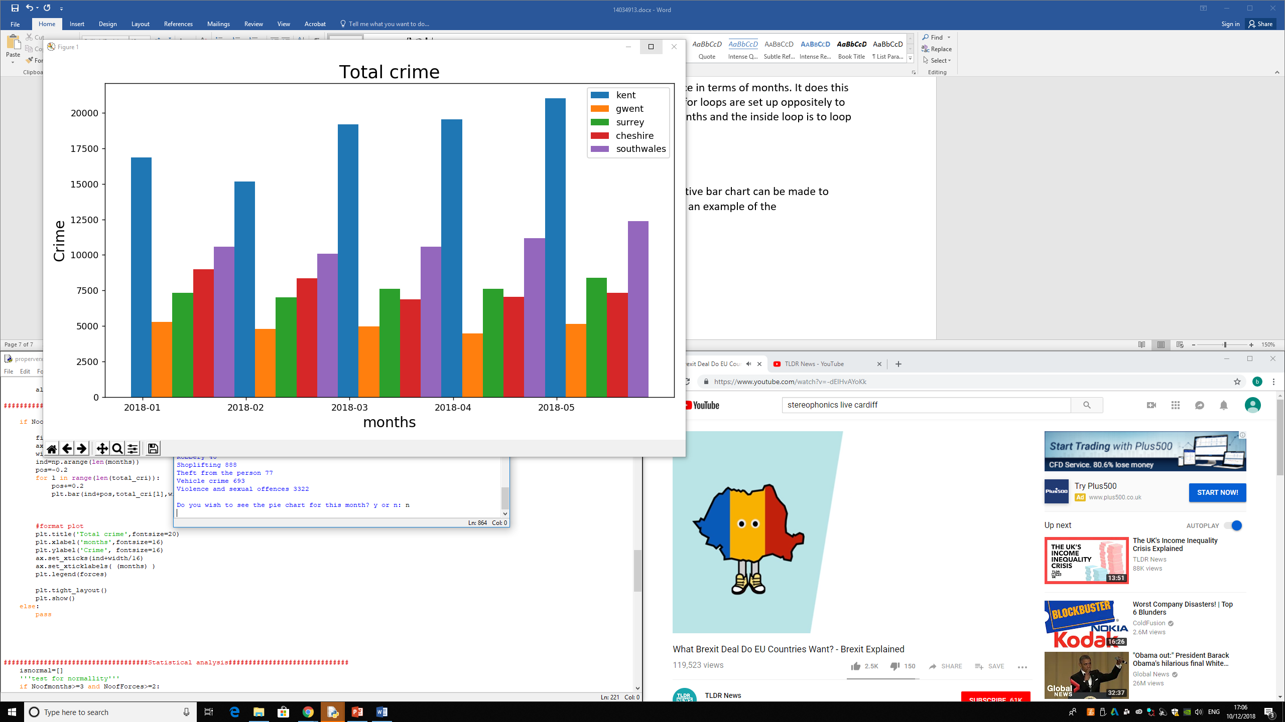

Slide 22
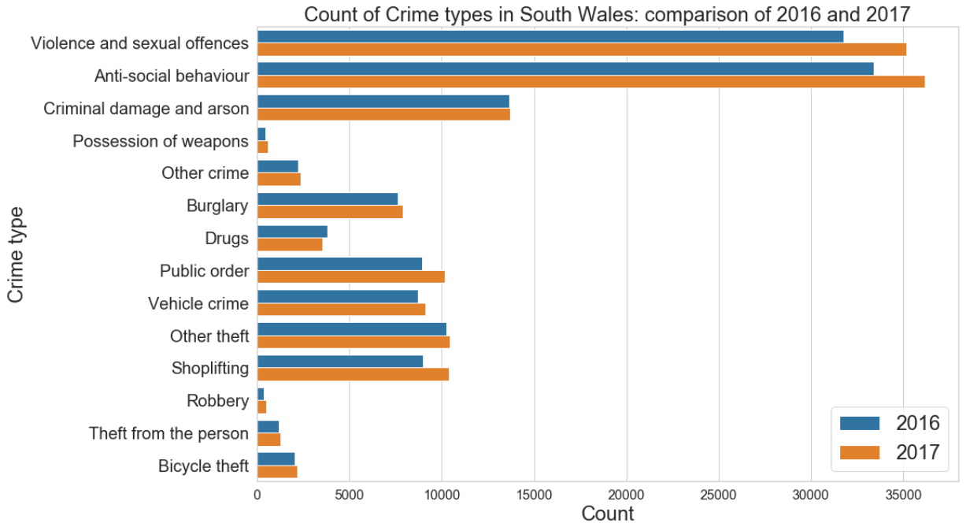

Slide 23
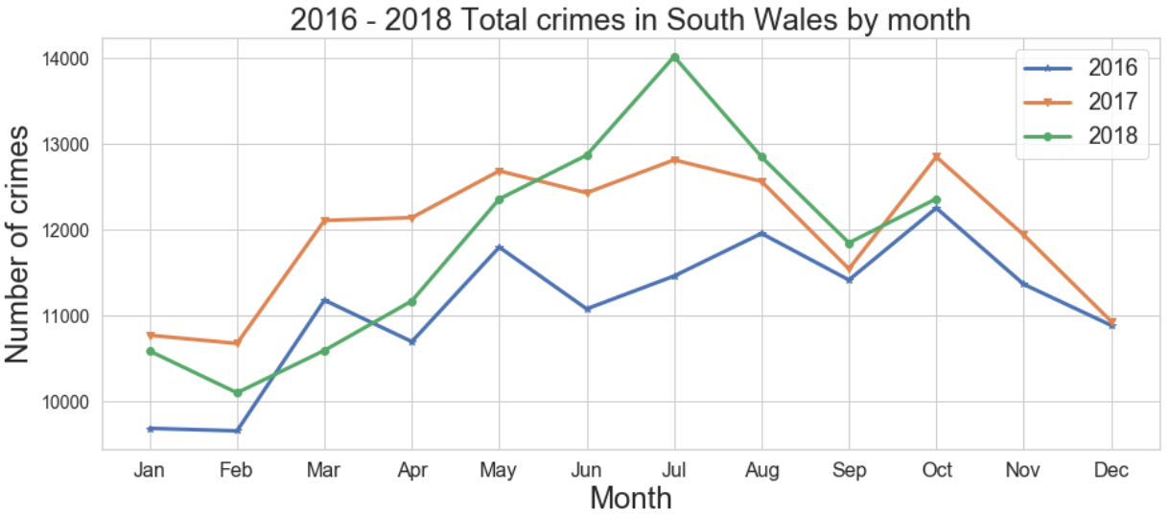

Slide 24
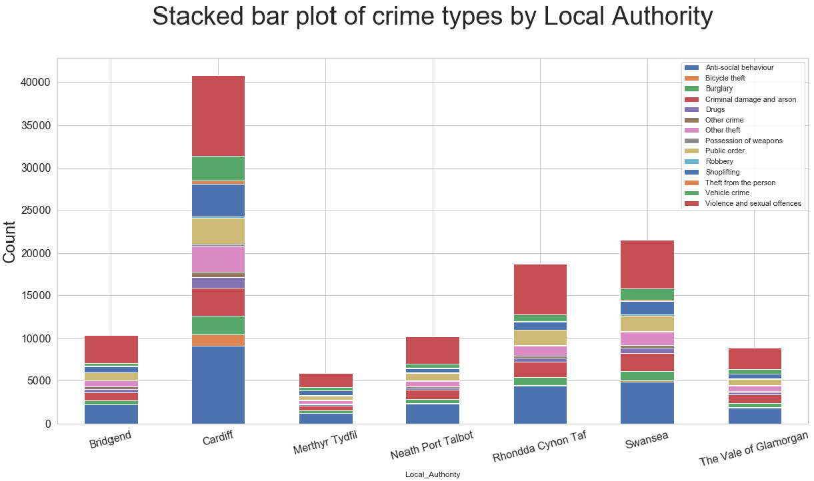

Slide 25
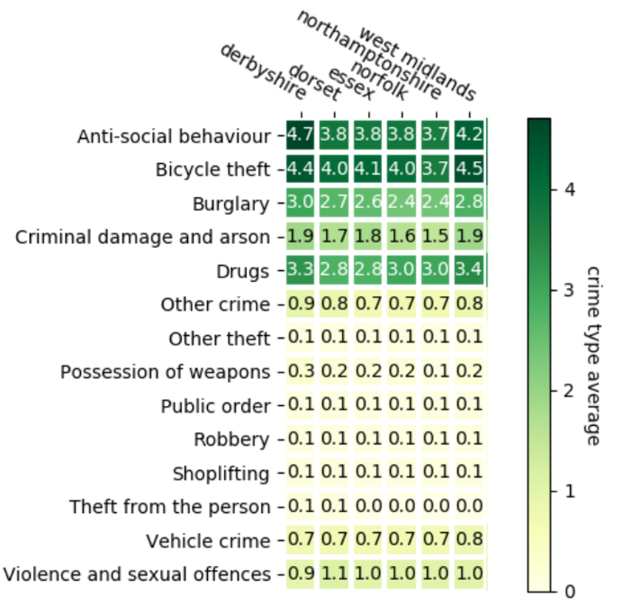

Slide 26
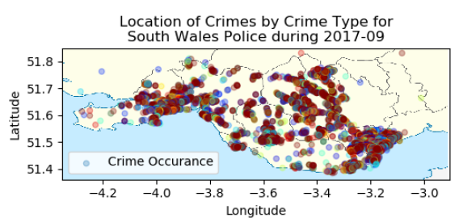

Slide 27
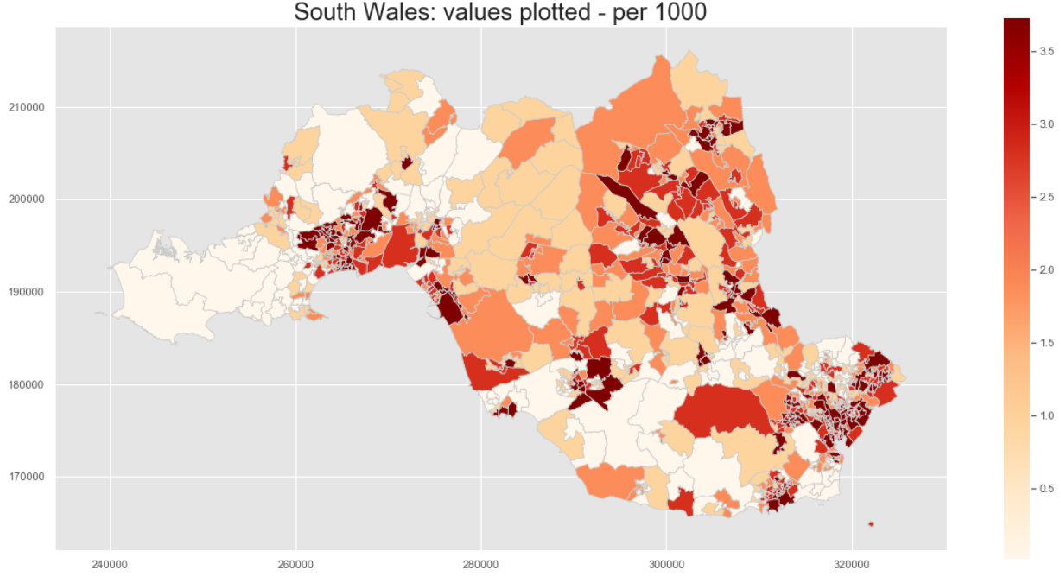

Slide 28

… over to you
Get to Know and Explore your data
Understand what is possible
Tell me something about your data
Identify the information or hidden trends in your data
Your code doesn’t have to be perfect
More than one way to …

Slide 29
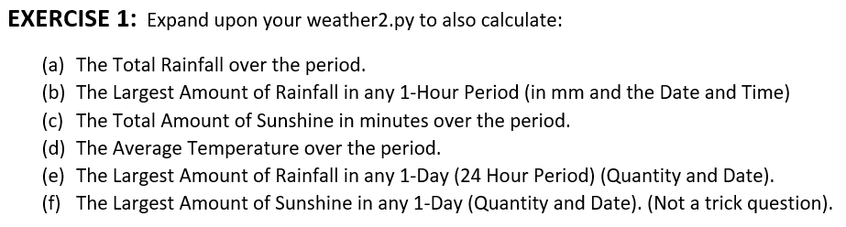
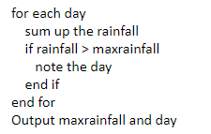
Other Exercise …
But Lists Are in Hours!
We can use the day to identify which 24 hours we need to sum up the rainfall for, i.e. Day 1 = 0 to 23 (1 to 24); Day 2 = 24 to 47 (25 to 48) etc.
We can use the day to identify the starthour and endhour (i1 and i2); put the data for these rainfall list elements into a sublist (DRain); then sum them up (SumRain).

Slide 30
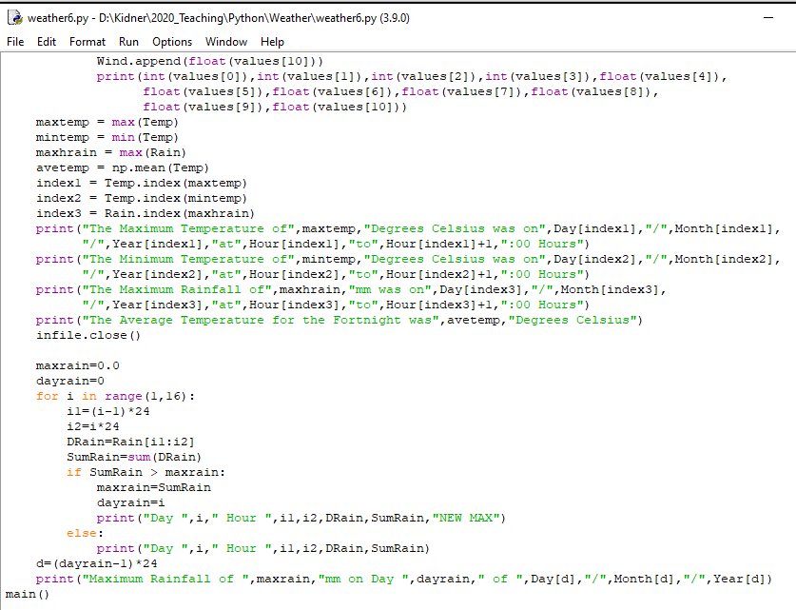

Slide 31
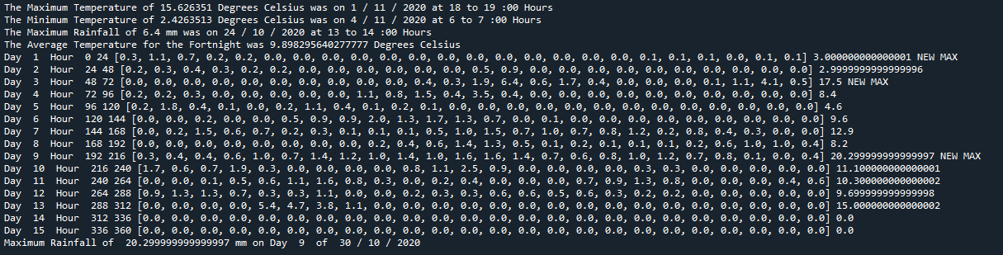
When developing code, it is always good practice to PRINT out your variables (data), so that you can double-check what’s going on and easily identify problems.

Slide 32
Errors and Exceptions
Syntax error – to indicate errors in software that cannot be executed
Logical error – any other errors other than syntax error
Usually invalid input, expecting something but get something else
Exceptions are basically action(s) taken than the usual flow of the program to fix / avoid an error crashing the program
This helps avoiding crashing the program on trivial errors, from crashing the entire program (or calculation)

Slide 33
Try these…
>>> yahoo
>>> templist = []
>>> templist[0]
>>> for

Slide 34
Try these…
>>> yahoo
Traceback (most recent call last):
File "<console>", line 1, in <module>
NameError: name 'yahoo' is not defined
>>> templist = []
>>> templist[0]
Traceback (most recent call last):
File "<console>", line 1, in <module>
IndexError: list index out of range
>>> for
File "<console>", line 1
for
^
SyntaxError: invalid syntax

Slide 35
How to detect and handle exceptions?
Using 'try' to monitor for exceptions
If you do get an exception then 'except' / 'finally' could be used to handle that
'except' – allows the handling of the exception(s), so can have multiple 'except' commands
'finally' – allows the clean up after handling the error occurs, with or without exception handling, so can only have one finally command under try

Slide 36
Usage of try - except
try:
<line 1 of code> #note the indentation like with, for…..
<line 2 of code>
#can have any number of lines, where try monitors for error conditions
except Exception[,reason]:
<line 1of code to handle exception>
<line 2 of code to handle exception>
#can have any number of lines to handle the exception

Slide 37
Try these
Say I create a function to convert a string to float
def myfloat_to_num_func1(float_str):
return float(float_str)
And call this function with ‘12.3’, ‘12..3’

Slide 38
Try these
>>> myfloat_to_num_func1('12.3')
>>> myfloat_to_num_func1('12..3')

Slide 39
Try these
>>> myfloat_to_num_func1('12.3')
12.3
>>> myfloat_to_num_func1('12..3')
Traceback (most recent call last):
File "<console>", line 1, in <module>
def myfloat_to_num_func1(float_str):
File "<tmp 26>", line 2, in myfloat_to_num_func1
ValueError: could not convert string to float: '12..3'

Slide 40
Modified code
def myfloat_to_num_func2(float_str):
try:
return float(float_str)
except ValueError:
print('Invalid string given for conversion to float')
And call this function with ‘12.3’, ‘12..3’,()

Slide 41
Try these
>>> myfloat_to_num_func2('12.3')
>>> myfloat_to_num_func2('12..3')
>>> myfloat_to_num_func2(())

Slide 42
Try these
>>> myfloat_to_num_func2('12.3')
12.3
>>> myfloat_to_num_func2('12..3')
Invalid string given for conversion to float
>>> myfloat_to_num_func2(())
Traceback (most recent call last):
File "<console>", line 1, in <module>
def myfloat_to_num_func1(float_str):
File "<tmp 25>", line 3, in myfloat_to_num_func2
TypeError: float() argument must be a string or a number

Slide 43
All exceptions
def myfloat_to_num_func3(float_str):
try:
return float(float_str)
except ValueError:
print('Invalid string given for conversion to float')
except TypeError:
print('Object given for conversion to float')
And call this function with ‘12.3’, ‘12..3’,()

Slide 44
Try these
>>> myfloat_to_num_func3('12.3')
>>> myfloat_to_num_func3('12..3')
>>> myfloat_to_num_func3(())

Slide 45
Try these
>>> myfloat_to_num_func3('12.3')
12.3
>>> myfloat_to_num_func3('12..3')
Invalid string given for conversion to float
>>> myfloat_to_num_func3(())
Object given for conversion to float

Slide 46
What if I want to catch all exceptions?
Say I don’t want to handle different errors differently
Or just want to handle all errors similarly
→ use except without any exception values
Eg:
try :
<code>
except:
<code to handle all exceptions>

Slide 47
All exceptions
def myfloat_to_num_func4(float_str):
try:
return float(float_str)
except:
print('all errors can be handled here!')
And call this function with ‘12.3’, ‘12..3’,()

Slide 48
Try these
>>> myfloat_to_num_func4('12.3')
>>> myfloat_to_num_func4('12..3')
>>> myfloat_to_num_func4(())

Slide 49
Try these
>>> myfloat_to_num_func4('12.3')
12.3
>>> myfloat_to_num_func4('12..3')
all errors can be handled here!
>>> myfloat_to_num_func4(())
all errors can be handled here!

Slide 50
Errors & Exceptions
For your code, you will identify and correct all errors
So, no need for Exception Handling?
In practice, your code will be used by many others (and not just you)
So, good practice to include Exception Handling.
… and plenty of foolproof advice and comments
Enter a Value …
Enter an Integer Value Between 1 and 100 …
Enter a Filename (e.g. “D:/Kidner/Crime_2020Sep.csv”) …

Slide 51
Last Time …
We looked at the Python Standard Library and the Python Package Index for adding extra functionality to our coding.
PLEASE EXPLORE!
For Example …

Slide 52
Operating System Interface
The os module provides dozens of functions for interacting with the operating system:
import os #imports the os interface module
dir(os) #returns a list of module’s functions
help(os) #returns an extensive manual page
Some os module functions:
os.getcwd() # get current working directory
os.chdir('/usr/cs265') # change current working directory
os.system('mkdir lab1') # perform a mkdir in the system shell

Slide 53
Shutil module
The shutil module offers a number of high level operations on files and collections of files.
Functions are provided which support file copying and removal.
For operations on individual files, see also the os module.
import shutil
#copies data.db to archive.db
shutil.copyfile('data.db', 'archive.db')
#move(source, destination)
shutil.move('/build/executables', 'installdir')

Slide 54
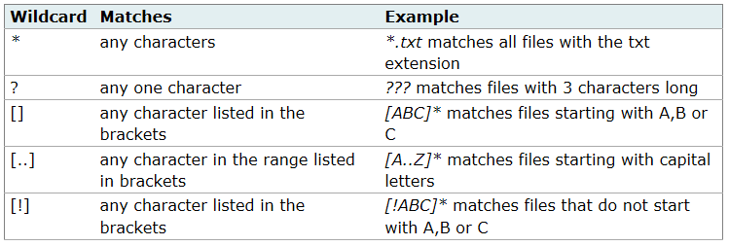
File Wildcards
The glob module provides a function for making file lists from directory wildcard searches
import glob
glob.glob('*.py')
['primes.py', 'random.py', 'quote.py']

Slide 55
Mathematics
The math module gives access to the underlying C library functions for floating point math:
>>> import math
>>> math.cos(math.pi / 4.0)
0.70710678118654757
>>> math.log(1024, 2)
10.0

Slide 56
Random
The random module provides tools for making random selections:
>>> import random
>>> random.choice(['apple', 'pear', 'banana'])
'apple’
# sampling without replacement
>>> random.sample(xrange(100), 10)
[30, 83, 16, 4, 8, 81, 41, 50, 18, 33]
# random float
>>> random.random()
0.17970987693706186
# random integer chosen from range(6)
>>> random.randrange(6)
4

Slide 57
Dates and Times
The datetime module supplies classes for manipulating dates and times in both simple and complex ways. The module also supports objects that are timezone aware.
# dates are easily constructed and formatted
>>> from datetime import date
>>> now = date.today()
>>> now
datetime.date(2020, 11, 20)
>>> now.strftime("%m-%d-%y. %d %b %y is a %A on the %d day of %B.")
‘11-20-20. 20 Nov 2020 is a Friday on the 20 day of November.’
# dates support calendar arithmetic
birthday = date(1997, 7, 31)
age = now – birthday
age.days
8513

Slide 58
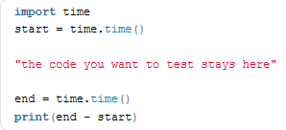
Performance Measurement
TIME
Useful for measuring the performance of our code:

Slide 59
Performance Measurement
timeit module provides a simple way to time small bits of Python code.
>>> from timeit import Timer
>>> timer('t=a; a=b; b=t', 'a=1; b=2').timeit()
0.57535828626024577
>>> timer('a,b = b,a', 'a=1; b=2').timeit()
0.54962537085770791

Slide 60
What is NumPy?
Numpy, Scipy, and Matplotlib provide MATLAB-like functionality in python.
Numpy Features:
Typed multidimentional arrays (matrices)
Fast numerical computations (matrix math)
High-level math functions

Slide 61
Why do we need NumPy?
Python does numerical computations slowly (relatively speaking).
A = 1 + 2 creates 3 objects in memory (Interpreter)
Compiled Language (e.g. C++) Much Quicker
1000 x 1000 matrix multiply
Python triple loop takes > 10 min.
Numpy takes ~0.03 seconds
Python is very One Dimensional

Slide 62

Why do we need NumPy?
NumPy more suited for dealing with multi-dimensional lists, matrices, images (image processing), etc.
And plenty of standard routines for analyzing them.
Consider a LANDSAT Satellite Image …
170 x 183 Km at 30m resolution (in 7, 8, 9 Spectral Bands)
Consider a Hyperspectral Image …
5000 x 5000 Pixels in 256 Spectral Bands

Slide 63
Jupyter Notebook
"Jupyter" is a loose acronym meaning Julia, Python, and R.
A "notebook" or "notebook documents" denote documents that contain both code and rich text elements, such as figures, links, equations, ...
Because of the mix of code and text elements, these documents are the ideal place to bring together an analysis description, and its results, as well as being executed to perform the data analysis in real time.

Slide 64
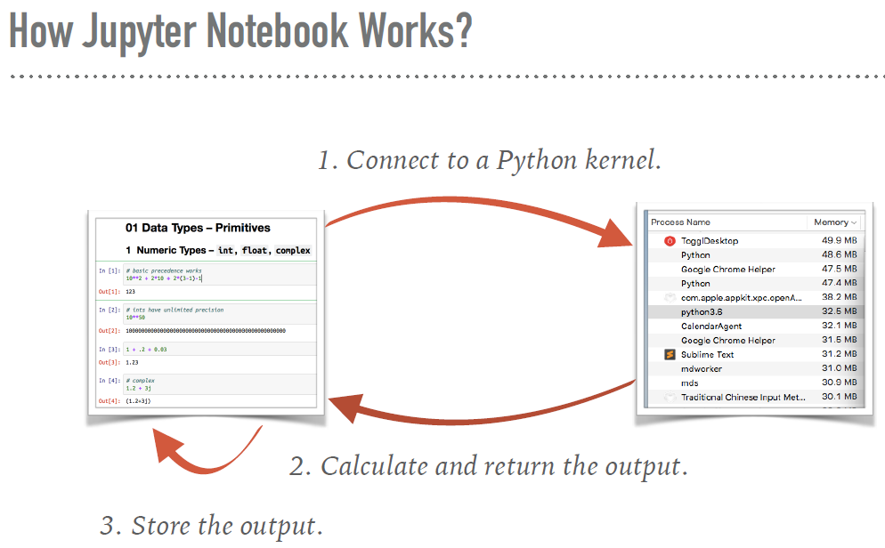

Slide 65
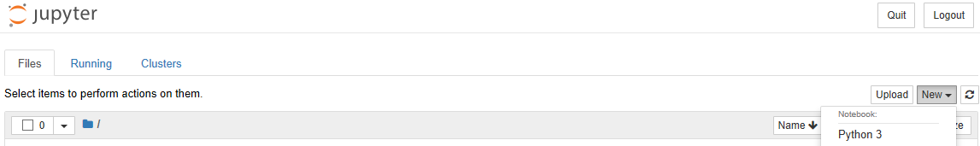
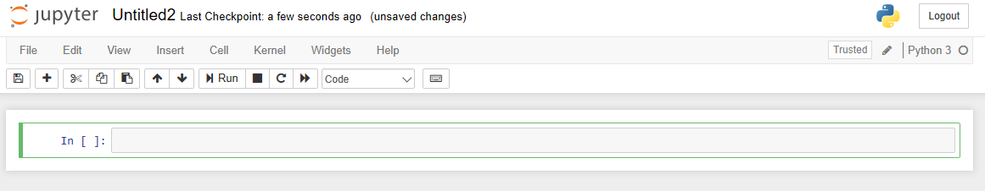
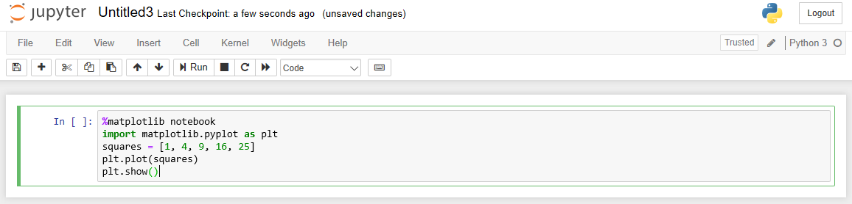
At the command prompt> Jupyter Notebook
The notebook consists of a sequence of cells. A cell is a multi-line text input field, and its contents can be executed by using Shift-Enter.

Slide 66
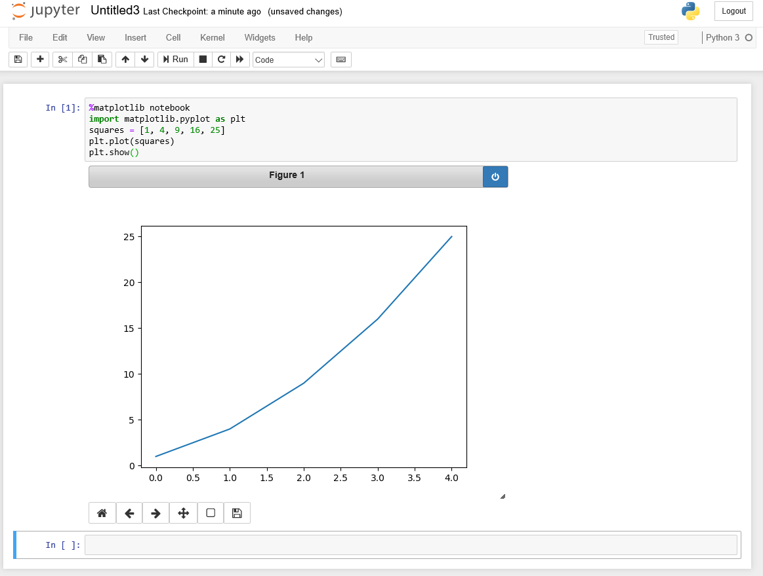

Slide 67
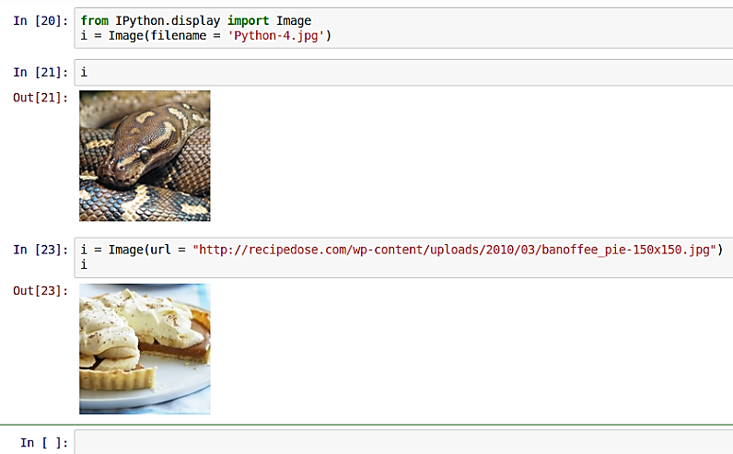

Slide 68
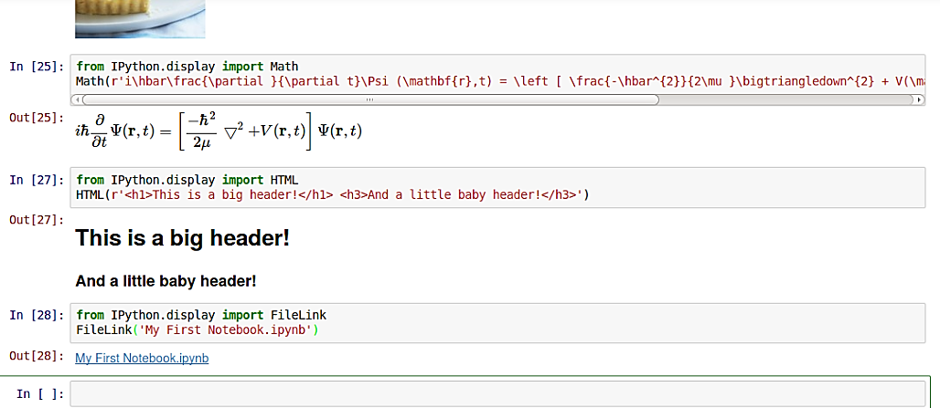

Slide 69
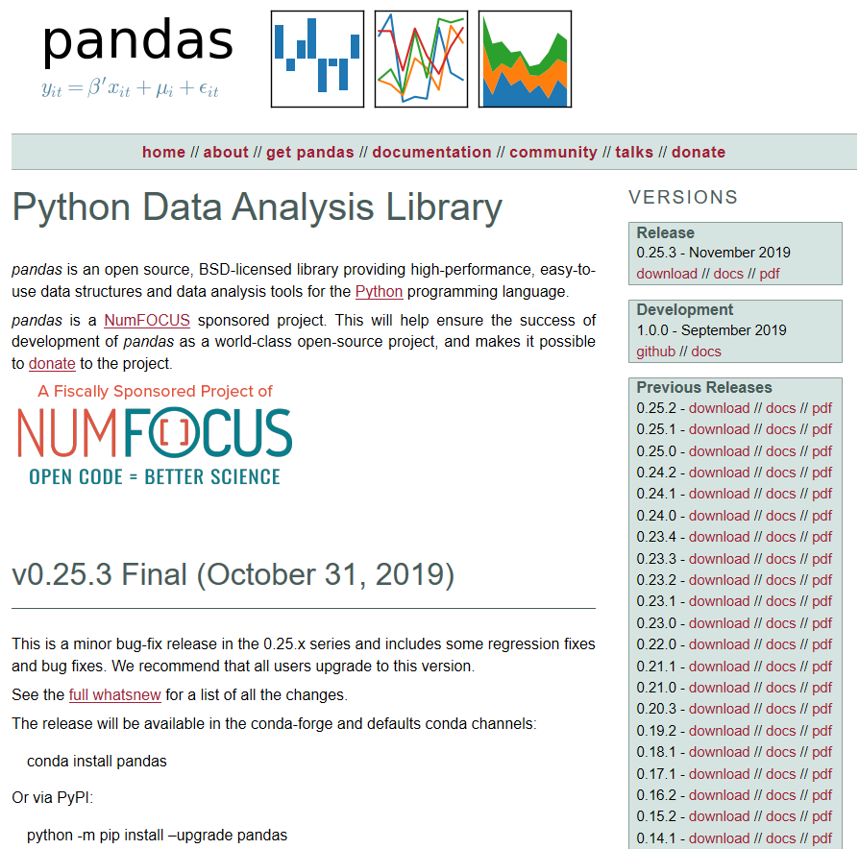
Panel Data

Slide 70
Pandas
Pandas takes data (like a CSV file, or a SQL database) and creates a Python object with rows and columns called a data frame that looks very similar to a table in Microsoft Excel.
People who are familiar with R would see similarities to R too.
This is so much easier to work with in comparison to working with lists and for loops
For example, a Data Frame could be defined to handle all summary crime data for 36 months.
Explore!

Slide 71
Summary
Take heart – it is impossible to learn everything there is to know about Python.
However, our simple snippets of code can easily turn our raw (crime) data into information.
Explore the Python modules and libraries to see what is available (and see what is possible).
Feel free to re-use existing code.
Have Fun!

