Slide 1

IS3S661 Strategic IS Management
Strategy Initiation:
Capability Analysis
David Kidner (J302) david.kidner@southwales.ac.uk

Slide 2
Strategy Initiation: Capability Analysis
So far, the Environmental Analysis looks outwards from the business or e-Commerce organisation to industry and society, both locally and globally.
Capability Analysis is inward-looking:
what are we good at?
Identifies our Strengths (and Weaknesses) cf. SWOT
A Capability is the Ability and Capacity that enable an organisation to achieve a business goal in a certain context
A Business Capability defines “WHAT” a business does at its core
Rather than How things are done or Where they are done.

Slide 3
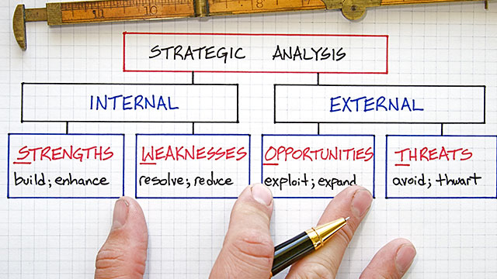
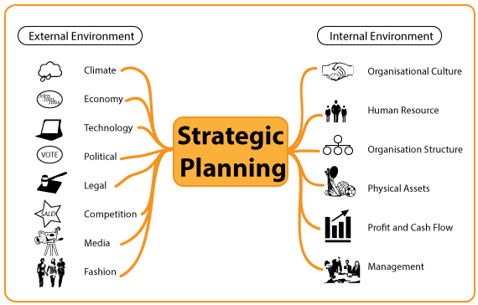
Last Week: SWOT
Strengths and weaknesses are internal to the company and can be directly managed by it, while the opportunities and threats are external and the company can only anticipate and react to them.

Slide 4
Capability Analysis
Learning Outcomes
We’ll be taking a look at …
(1) Unique Selling Proposition
(2) Value – What is it?
(3) Digital Value Chain
(4) Resource Analysis
(5) Core Competences

Slide 5
Unique Selling Proposition Product View
“Why should a customer buy our product / service?”
A unique selling proposition (USP) is a description of the qualities that are unique to a particular product or service and that differentiate it in a way which will make customers purchase it rather than its rivals.

Slide 6
Unique Selling Proposition Business View
“Why should a customer buy from us?”
A unique selling proposition (USP) defines your competitive advantage. You must identify what makes you different from your competitors and emphasise these advantages in your marketing.

Slide 7
USP
Marketing must make a proposition to the consumer. Not just words, not just show-window advertising. Each advertisement must say to each reader: "Buy this product, and you will get this specific benefit."
The proposition must be one that the competition either cannot, or does not, offer. It must be unique—either a uniqueness of the brand or a claim not otherwise made in that particular field of advertising.
The proposition must be so strong that it can move the mass millions, i.e., pull over new customers to your product.

Slide 8
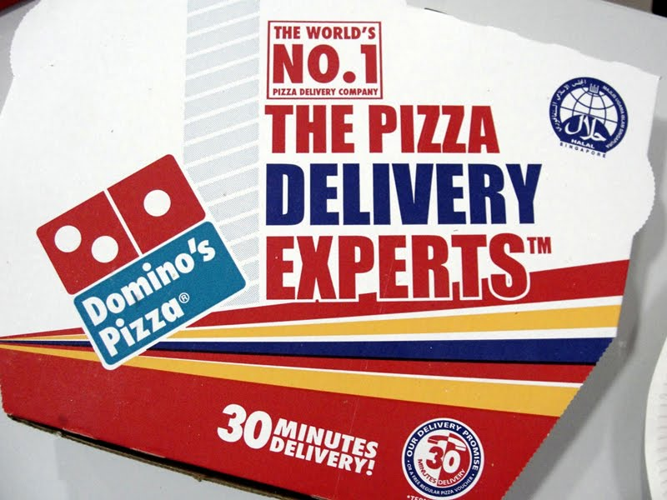
USP (Best Practice #1)
Domino’s Pizzas
Since 1973, “You get fresh, hot pizza delivered to your door in 30 minutes or less—or it's free.”
Online GPS Tracking to track your delivery.
Are they the cheapest?
Are they the best quality?
Are they value for money?

Slide 9

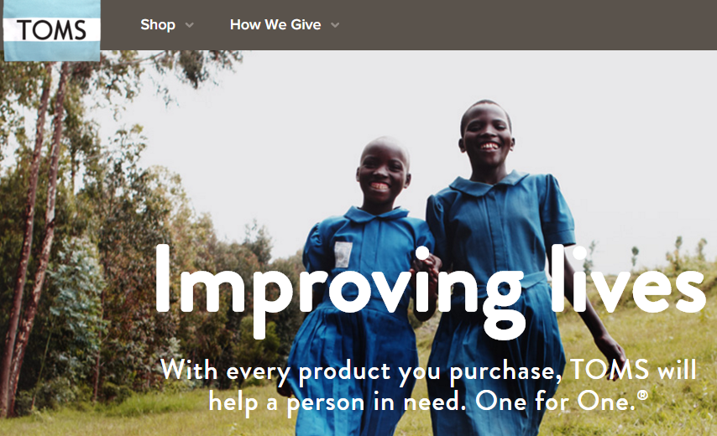
USP (Best Practice #2)
TOMS Shoes (www.toms.co.uk)

Slide 10
USP (Bad Practice #1)
Domino’s Pizzas
Since 2013 – No more free pizzas!
“Some people still see us as the guys who make pizza really fast. … What we recognize is that no matter how much we talk about quality, [some consumers] feel like speed of making pizza does not equal quality,” – Chief Marketing Officer Russell Weiner.
Focus is now on Quality rather than speed.

Slide 11
USP
Uniqueness can be sought in a number of ways:
By offering the lowest price.
By offering the highest quality.
By being exclusive.
(e.g. unique information, packaging, style)
By offering the best customer service.
By offering the widest choice.
By giving the best guarantee.

Slide 12
USP
1. Will customers see this as an advantage?
2. Is it significantly different from what competitors are doing?
3. Will customers believe in this USP?
4. Will they receive any benefits from using it?
5. Will it motivate them to make a purchase?

Slide 13
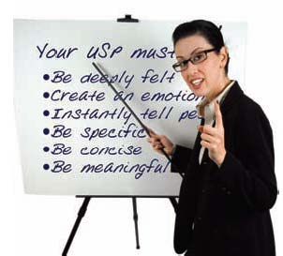
Creating a USP
People don’t buy things
They buy a result, solution or benefit
People don’t buy products or services
They buy beliefs and perceptions backed up by evidence
… Most businesses don’t have a USP
Need to identify strengths and capabilities
Particularly for e-Commerce businesses

Slide 14
Strategy Formulation: Value Creation
Strategy formulation revolves around the concepts of Value Creation and Value Capturing.
The concept of Value Creation is the core of any business as it opens up the opportunity for superior profitability.
Value Created is the difference between the consumer’s perceived benefit from a given product and the firm’s cost for providing that product.

Slide 15
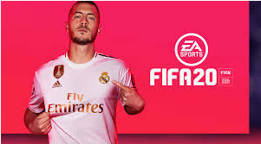
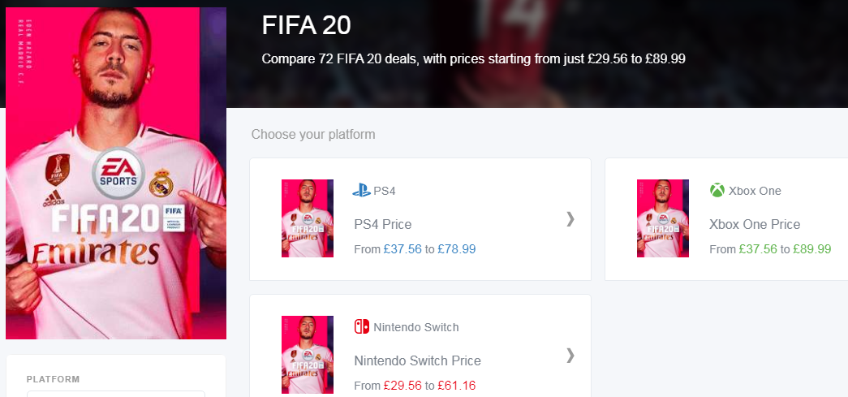
Consumer Benefit?
FIFA 20 was released 2 weeks ago.
How much would you be prepared to pay for it?
£80, £70, £60, £50, £40, £30, £20, £10, £5
… or like me, “Pay??”

Slide 16
Consumer Benefit?
Consumer Benefit consists of all the characteristics that an individual consumer values in a product or service.
When is the Buyer indifferent between buying and not buying?
Does the USP help to make it a necessary purchase?
E-Commerce has had a major impact
E.g. think about how eBay auctions work.

Slide 17
Value Creation
£50
Perceived
Consumer
Benefit
Consists of
Product & Service
Speed of Delivery
Brand
Reputation
… plus many other factors
… Must Have It This Week
etc.
Value Created
=
Consumer Benefit
Less
Total Costs
£40
Cost
£30
£20
Total Costs
Consists of
R&D
Raw Materials
Production
Marketing
Sales
etc.
£10

Slide 18






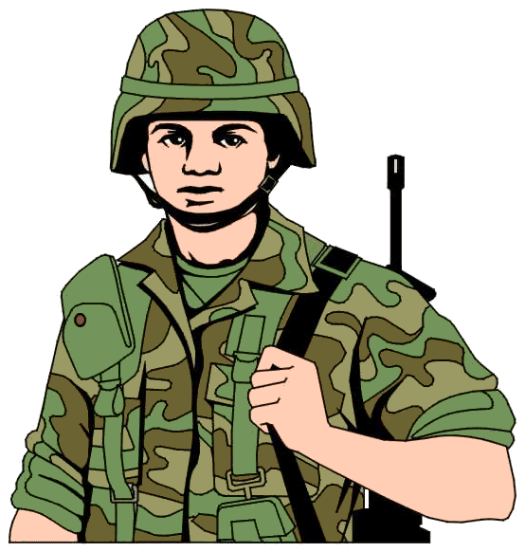







Perceived
Consumer
Benefits

Slide 19
Value Creation
Value Created is the difference between the benefit that consumers get from using a product and the costs that are incurred to produce the product.
Does not state anything about price or products
For a business to compete successfully, it:
Must be Positive
Costs must be lower than the benefit it provides to consumers! (Not always the case).
Must be Higher than the value created by competitors

Slide 20
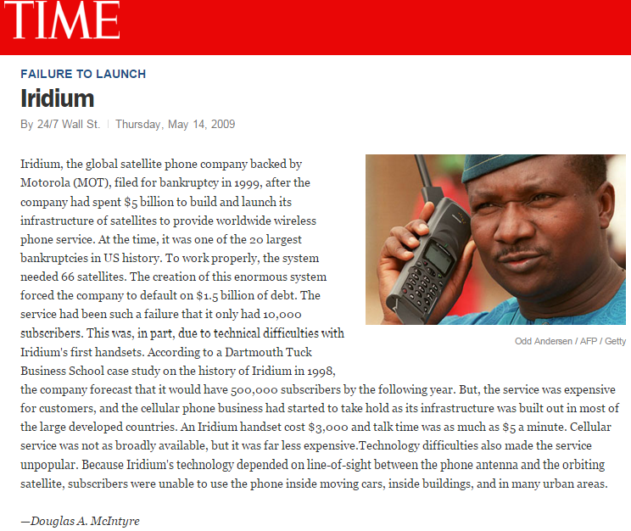
Value Creation Gone Wrong

Slide 21
Capturing Value
£50
Perceived
Consumer
Benefit
Value
Created
Consumer
Surplus
£40
Cost
£30
Retail Price £30
Producer
Surplus = Profit
£20
Total Costs
£10

Slide 22
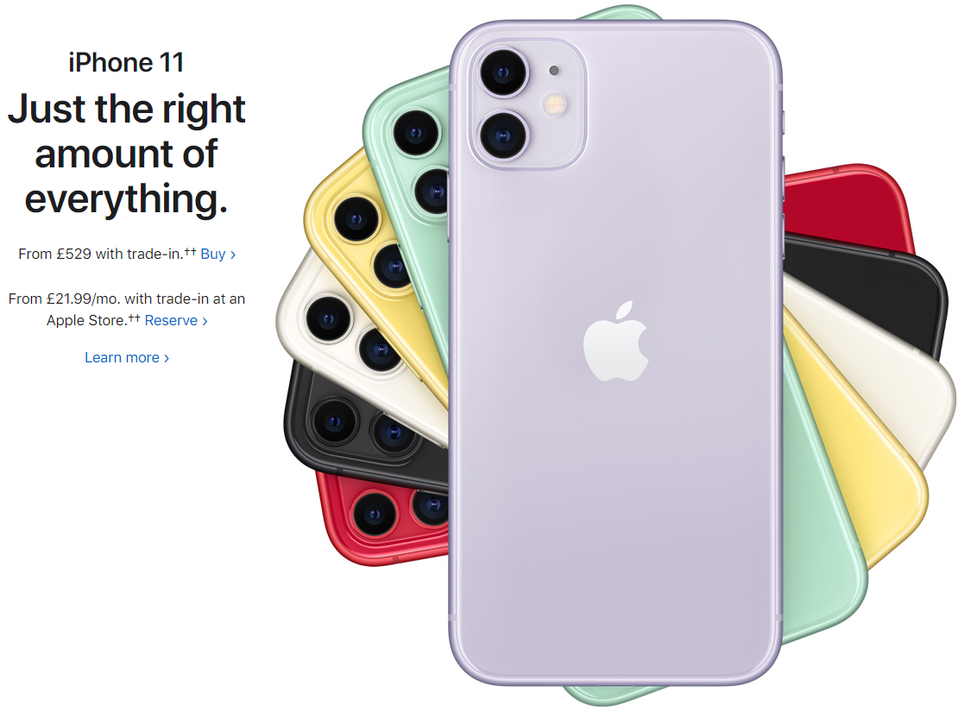
Stepping back a bit: For the Gamers out there ...
Does FIFA 20 have a USP?
If so, what is it ...?
What has it got that other games haven’t got?
For the Non-Gamers out there ...
Does Apple have a USP?
Does iPhone have a USP?
If so, what are they ...?
What has it got that other phones don’t?

Slide 23
Distributing Value
There are a number of factors which influence the distribution of value between buyers and sellers
Industry Structure: Industry in which a business competes
Porter’s 5 Forces helps to determine how value created is distributed: buyers or sellers.
Relative Level of a Business’s Value Creation
If a business can create higher value than its competitors then it has the potential to earn attractive profits, even in highly competitive industries
E.g. DELL has used a unique direct sales model eliminating expensive intermediaries in the distribution chain.

Slide 24
What is a Value Chain?
A Value Chain describes the categories of activities within and around an organisation, which together create a product or service.
Developed by Michael Porter, it is a well-established concept for considering key activities that an organisation can perform or manage with the intention of adding value for the customer as products and services move from conception to delivery to the customer.

Slide 25
Value Chain Model
An organisation’s activities can be divided into two parts:
Primary Activities (to produce goods & creating value):
(1) Inbound Logistics (incoming raw materials & inputs)
(2) Operations (Manufacturing and Testing)
(3) Outbound Logistics (Packaging, Storage, Distribution)
(4) Marketing and Sales (to buyers)
(5) Services
Support Activities
(1) Administrative Infrastructure (Accounting, Finance, etc)
(2) Human Resources Management
(3) Technology Development (R&D)
(4) Procurement (Purchasing)

Slide 26
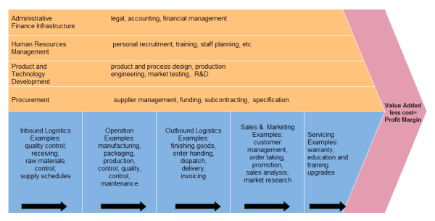
Value Chain Model

Slide 27
Michael Porter published the Value Chain Analysis in 1985 as a response to criticism that his Five Forces framework lacked an implementation methodology that bridged the gap between internal capabilities and opportunities in the competitive landscape. This framework focused on industry attractiveness as a determinant of the profit potential of all companies within that particular industry. However, significant differences in performance exist between companies operating within the same industry that can be explained either by the company's participation in a successful strategic group or by a firm's specific competitive advantages.
Value Chain Analysis helped identify a firm's core competencies and distinguish those activities that drive competitive advantage. The cost structure of an organisation can be subdivided into separate processes or functions assuming that the cost drivers for each of these activities behave differently. Porter's strength was to condense this activity based cost analysis into a generic template consisting of five primary activities and four support activities. The nine activity groups are:
Primary activities:
1. inbound logistics: materials handling, warehousing, inventory control, transportation;
2. operations: machine operating, assembly, packaging, testing and maintenance;
3. outbound logistics: order processing, warehousing, transportation and distribution;
4. marketing and sales: advertising, promotion, selling, pricing, channel management;
5. service: installation, servicing, spare part management;
Support activities:
6. firm infrastructure: general management, planning, finance, legal, investor relations;
7. human resource management: recruitment, education, promotion, reward systems;
8. technology development: research & development, IT, product and
process development;
9. procurement: purchasing raw materials, lease properties, supplier contract negotiations.
By subdividing an organisation into its key processes or functions, Porter was able to link classical accounting to strategic capabilities by using value as a core concept, i.e. the ways a firm can best position itself against its competitors given its relative cost structure, how the composition of the value chain allows the firm to compete on price, or how this composition allows the firm to differentiate its products to specific customer segments.

Slide 28
Value Chain Model & e-Commerce
The Value Chain Model has been re-evaluated in the context of global e-Commerce.
Some weaknesses:
Most applicable to manufacturing of physical products as opposed to providing services;
One-way chain involved with pushing products to the customer; does not understand customer needs;
Does not emphasise the importance of value networks such as social media.

Slide 29

Revised Value Chain Model (Deise et al. 2000)
Market Research
Real-time environmental / analytical scanning
Monitoring promotions; reviewing competitors offers & revise
Product Development
Online collection of customer information
Market Products
Procurement
Manage Selling & Fulfilment

Slide 30
Resource Analysis
The four key criteria by which capabilities can be assessed in terms of providing a basis for achieving sustainable competitive advantage are:
Value
Rarity
Inimitability
Non-Substitutability
Aka VRIN
Source: Jay Barney: ‘Firm resources and sustained competitive advantage’, Journal of Management, vol. 17 (1991), no. 1, pp. 99–120

Slide 31
VRIN Value of Strategic Capabilities
Strategic capabilities are of Value when they:
take advantage of opportunities and neutralise threats;
provide value to customers;
provide potential competitive advantage;
at a cost that allows an organisation to realise acceptable levels of return.

Slide 32
VRIN Rarity
Rare capabilities are those possessed uniquely by one organisation or by a few others only.
(e.g. a company may have patented products, have supremely talented people or a powerful brand.)
Rarity could be temporary.
(e.g. Patents expire, key individuals can leave or brands can be de-valued by adverse publicity.)

Slide 33
VRIN Inimitability
Inimitable capabilities are those that competitors find difficult to imitate or obtain.
Competitive advantage can be built on unique resources (a key individual or IT system) but these may not be sustainable (key people leave or others acquire the same systems).
Sustainable advantage is more often found in competences (the way resources are managed, developed and deployed) and the way competences are linked together and integrated.

Slide 34
VRIN Non-Substitutability
Competitive advantage may not be sustainable if there is a threat of substitution.
Product or service substitution from a different industry/market.
For example, postal services partly substituted by e-mail.
Competence substitution. For example, a skill substituted by expert systems or IT solutions

Slide 35
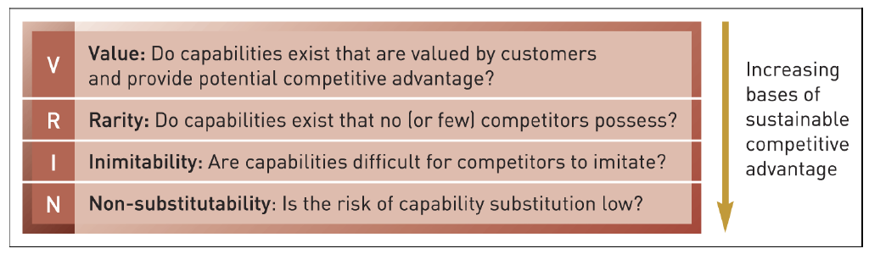
VRIN Summary

Slide 36
VRIN Framework
Resource | Valuable | Rare | Inimitable | Non-substitutable
Various resources | Yes | Yes | No | No
Listed down the left | Yes | No | No | No
You have to identify what resources are key | Yes | No | Yes | No
And identify the organisation’s strengths | Yes | Yes | In practice, yes | In practice, yes
We’re looking for a row of 4 x Yes’s

Slide 37
Resources
Inputs into a firm’s production process, e.g.
Capital equipment
Skills of individual employees
Patents
Finances
Talented managers
Capabilities
Capacity of a set of resources to perform in an integrative manner
A capability should not be
So simple that it is highly imitable
So complex that it defies internal steering and control
When the four key criteria of resources and capabilities (VRIN) are met, they become core competencies
Core competencies serve as a source of competitive advantage

Slide 38
Core Competence
The main strengths or strategic advantages of a business.
What is our organisation particularly good at?
A regional leader? National? Global?
Resources are marshalled and managed to maximise our core competences
Some organisations believe that any part of their operation that isn’t a national leader should be outsourced
Theoretically, a core competency should allow a company to expand into new end markets as well as provide a significant benefit to customers.
It should also be hard for competitors to replicate.

Slide 39
Resources & Capabilities …
Valuable
Core Competencies
Rare
Competitive Advantage
Inimitability
Costly to Imitate
Value Creation
Non-Substitutable
Above Average Returns

Slide 40
Summary
A Capability is the Ability and Capacity that enable an organisation to achieve a business goal in a certain context
Need to identify and capitalise on these:
Unique Selling Proposition
Identifying & Creating Value
Understanding the Value Chain
Assessing Capabilities - VRIN

