Slide 1
Data Science and data Mining

Slide 2
What is Data Science
What is data science?
Data science is the process of discovering patterns and trends in data
The answer to one question typically leads to new questions
Where is the science in data science?
Focuses on a real-world problem and aims to explain it
Uses testable ideas an evidence
How can data scientists find new questions to examine?
Questions often start with an observation
Data scientist may make a hypothesis about an observed phenomena
It is essential that the hypothesis is testable and is based on reason and prior information

Slide 3
What Are Data Analytic Techniques?
What types of questions require analytic techniques?
“What page will a visitor next view, given the visitor’s…..”
Browsing history
Demographics
“Should a credit card company approve a transaction that's waiting, given the…”
User's usage history
Item being purchased
Location of the merchant
What types of questions do not require analytic techniques?
“What pages did visitors view most often?”
“What are our sales figures, by city?”
“What products are most popular?”
Data mining tells us something that isn’t a simple summary of the data

Slide 4
Approaches for Data Mining Large Data
Historically, where the data set to be analyzed is too large for memory, the approach has been to data-mine a sample
Take a manageable subset
Fits in memory, runs in reasonable time
Develop a model
Limitations of this method?
Does not support finer-grained approaches
For example, making specific purchase recommendations such as: “Customers who bought product X, also bought ...”
Such techniques require much more data than broader approaches such as: “Our top 10 most popular products are ...”

Slide 5
Finding Business Questions: Where to Begin?
There are plenty of questions you could ask about your organization
Start by thinking broadly about the organization’s strategy
Most organizations will operate under a strategy map
The more familiar you are with the goals of the organization, the more focused your data science projects will be
Don’t worry initially about what data is available
Write down anything interesting you noticed in or around the organization
An observation can turn into a data science question
Talk about it with your colleagues!

Slide 6
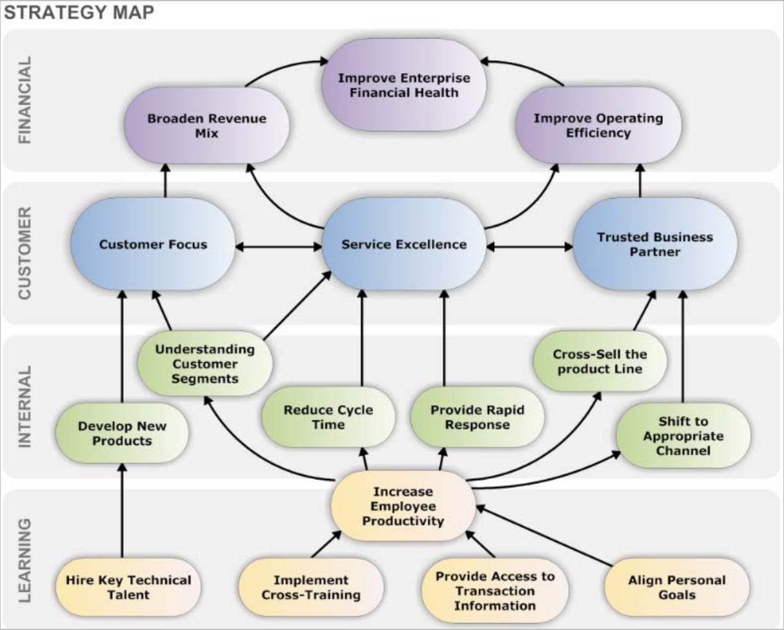
Align Data Science Questions to Organizational Strategy

Slide 7
Concept Maps
Write all topics down
Think in terms of differences and relationships among parameters
Draw connections to show which entities might be related
Brainstorm your map of ideas with colleagues
Customers
+ +
Products / Services
+
+
+
Sales
Draw lines between entities you think might have interesting relationships that might be worth investigating
+
+
Resources
+
Capabilities
+
+
Revenue
Cash
+

Slide 8
Examples of Business Questions
Hypothesis testing
Decreasing the number of required steps on the website will increase the number of conversions
Segmentation/classification
“What are the common characteristics of different groups of customers?”
Prediction
“Will this new customer become a profitable customer? If so, how profitable?”
Many business questions are causal questions: “What would happen if…
…I showed this ad?”
It’s easier to ask correlation questions: “What happened in the past when I showed this ad?”

Slide 9
Translating Business Questions Into Data Mining Problems
Hone each question until they
Have as narrow a scope as possible
Contain explicitly quantitative clauses
Are ranked by relative value
Are potentially answerable given the available data
For example
“Can we extract additional revenue from the logs of user activity on our website?”
may be honed to…
“Can we increase our online conversion rates from 1 percent to at least 2 percent by providing targeted recommendations?”
This might be translated to a final audience as:
“An item-based recommendation engine offers no additional conversion beyond what we’re already achieving.”

Slide 10
Data-Driven Decision Making
In the statistical world, a question is referred to as a “hypothesis”
A hypothesis is actually composed of two hypotheses:
A null hypothesis (H₀)
An alternative hypothesis (H_{a})
A business question such as:
“Do flexible work hours improve employee productivity?”
Would then be phrased as:
H₀ (null hypothesis): “There is no difference or real relationship between flexible work hours and employee productivity”
H_{a} (alternative hypothesis): “There is a negative relationship between the availability of flexible work hours and employee productivity”
Formulating a business question into a hypothesis
Focuses the data-mining effort by defining the variables of interest
Helps determine what data will and will not be needed in the study
Clarifies what statistical tests are required to answer the question

Slide 11
Data mining techniques
Clustering
Process of partitioning a set of data (or objects) into a set of meaningful sub-classes, called clusters.
Help users understand the natural grouping or structure in a data set.
Used either as a stand-alone tool to get insight into data distribution or as a preprocessing step for other algorithms.
Referred to as unsupervised learning because there is no set target

Slide 12
Classification
Predicts an outcome based on input data
Separates data into various categories
Comprises assigning a class label to a set of unclassified data sets
Thus, classification is categorized as supervised learning
Classification uses two data sets
The training set (seen data) to build the model
The observations have already been classified
The test set (unseen data) to measure its performance in terms of its error rate
Percentage of incorrectly classified instances in the data set

Slide 13
Association rules
discovers the probability of the co-occurrence of items in a collection.
The relationships between co-occurring items are expressed as association rules
often used to analyze sales transactions.

Slide 14
Type I and Type II Errors
A Type I Error (a false positive) occurs if the null hypothesis is rejected when it is actually true
For example, in a drug trial, if we reject the null hypothesis, we are claiming that a particular drug is beneficial in treating a disease
However, if the null hypothesis is true, then the drug does not treat the disease; we have made a false claim
A Type II Error (a false negative) occurs when the null hypothesis is false and we do not reject it
For example, concluding that a drug has no benefit in treating a disease when it actually does
Type I and Type II errors cannot be completely eliminated
The likelihood of either can be minimized, but typically the probability of the other will be increased
The particular use case will often determine which error you are more accepting of

Slide 15




Null Hypothesis vs. Alternate Hypothesis
The owner of a retail store assumes his employees are honest. However, the data from the daily takings is showing a number of discrepancies. The owner has the choice of a) assuming it is due to human error, and ignoring the situation or b) making an allegation of theft.
 Which is the null hypothesis and which is the alternate hypothesis?
Explain your answer.
 What would amount to a Type I error in this problem?
 What would amount to a Type II error in this problem?
 Which is more serious? Explain your answer.

Slide 16
Data Collection
A data scientist needs to look for data to disprove the null hypotheses
For example
Data needs to show that a recommender engine achieves a conversion rate of 3 percent or more, and is statistically inconsistent with the organization’s current conversion rate of 1.5 percent
These quantitative requirements impose constraints on the quality and quantity of the data needed to achieve the goal
Thus, our initial focus will be to identify appropriate data sets by asking:
Is the data we already have sufficient to answer the question asked?
If not, where and how can we get the data we really need? (this may entail proactive data collection)
Are there variances and biases within the data?
What is a reasonable and realistic baseline against which to test our hypothesis?
How much data do we need to reject our hypothesis?

Slide 17
Overview of the Data-Mining Process
A large number of visualizations and statistical tests are typically generated
To understand the nature and quality of the data sets
Insights derived from the data should be communicated back to stakeholders in a rapid cycle
Typically every few days to every week
Questions/hypotheses are further honed and typically new data sources are examined with each cycle
Through this iterative process, the data scientist reaches deeper insight into how exactly to answer valuable business questions with real data
The data scientist also reaches conclusions about viable tools that can be used to answer those questions with the data

Slide 18
Where Does Data Come From?
Data can come from both internal and external sources
Wireless sensor networks
NoSQL data stores
The Internet
Spatial data
Data warehouse
Transactional systems
NoSQL = not only structured query language

Slide 19
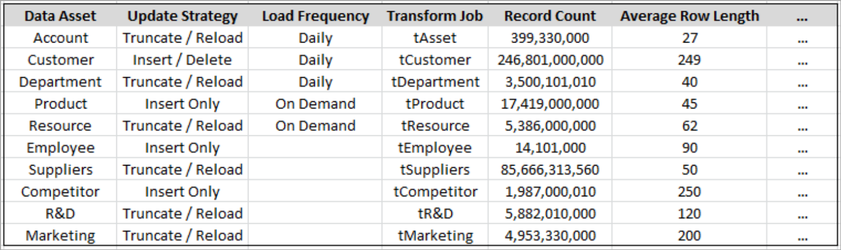
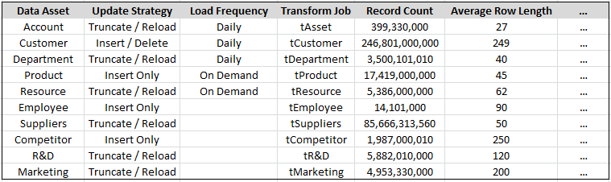
Data Sourcing
 Document each data source you intend using for size, frequency, and quality, etc.

Slide 20
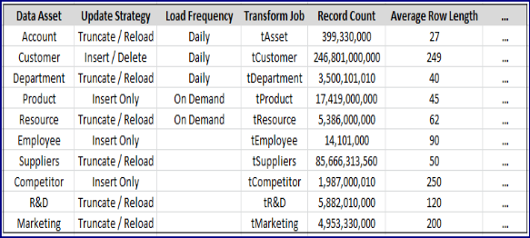
Evaluate What Data Is Available for Your Specific Question
How will you use the available data to answer your question
Customers
+ +
+
+
Sales
Products / Services
+
+
+
Resources
+
Capabilities
+
+
Revenue
Cash
+
Look at each of the related ideas on your concept map and evaluate which you have data available for

Slide 21
Combining Data Sources
 When combining separate data sources to answer your question, ensure you investigate availability of data across your time range of interest
Are you investigating across:
Multiple years?
The same month in different years?
 Equally, spatial data ranges should match when combining data sources
Local
International

