Slide 1
Data Science and data Mining

Slide 2
What is Data Science
What is data science?
Data science is the process of discovering patterns and trends in data
The answer to one question typically leads to new questions
Where is the science in data science?
Focuses on a real-world problem and aims to explain it
Uses testable ideas an evidence
How can data scientists find new questions to examine?
Questions often start with an observation
ata scientist may make a hypothesis about an observed phenomena
It is essential that the hypothesis is testable and is based on reason and prior information

Slide 3
What Are Data Analytic Techniques?
What types of questions require analytic techniques?
“What page will a visitor next view, given the visitor’s…..”
Browsing history
Demographics
“Should a credit card company approve a transaction that's waiting, given the…”
User's usage history
Item being purchased
Location of the merchant
What types of questions do not require analytic techniques?
“What pages did visitors view most often?”
“What are our sales figures, by city?”
“What products are most popular?”
Data mining tells us something that isn’t a simple summary of the data

Slide 4
Approaches for Data Mining Large Data
Historically, where the data set to be analyzed is too large for memory, the approach has been to data-mine a sample
Take a manageable subset
Fits in memory, runs in reasonable time
Develop a model
Limitations of this method?
Does not support finer-grained approaches
For example, making specific purchase recommendations such as: “Customers who bought product X, also bought ...”
Such techniques require much more data than broader approaches such as: “Our top 10 most popular products are ...”

Slide 5
Finding Business Questions: Where to Begin?
There are plenty of questions you could ask about your organization
Start by thinking broadly about the organization’s strategy
Most organizations will operate under a strategy map
The more familiar you are with the goals of the organization, the more focused your data science projects will be
Don’t worry initially about what data is available
Write down anything interesting you noticed in or around the organization
An observation can turn into a data science question
Talk about it with your colleagues!

Slide 6
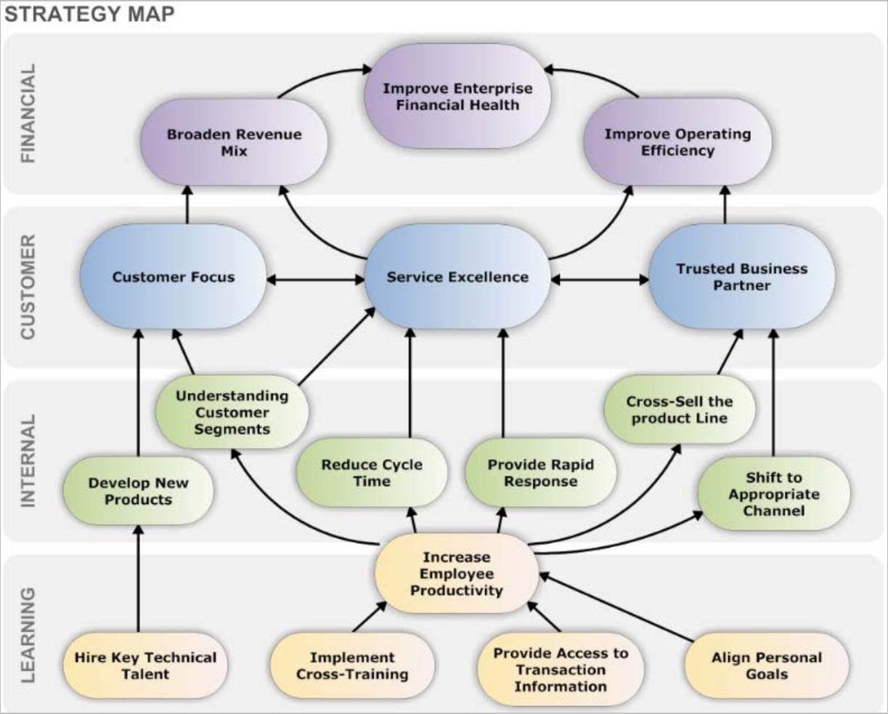
Align Data Science Questions to Organizational Strategy

Slide 7
Concept Maps
Write all topics down
Think in terms of differences and relationships among parameters
Draw connections to show which entities might be related
Brainstorm your map of ideas with colleagues
Customers
+ +
Products / Services
+
+
+
Sales
Draw lines between entities you think might have interesting relationships that might be worth investigating
+
+
Resources
+
Capabilities
+
+
Revenue
Cash
+

Slide 8
Examples of Business Questions
Hypothesis testing
Decreasing the number of required steps on the website will increase the number of conversions
Segmentation/classification
“What are the common characteristics of different groups of customers?”
Prediction
“Will this new customer become a profitable customer? If so, how profitable?”
Many business questions are causal questions: “What would happen if…
…I showed this ad?”
It’s easier to ask correlation questions: “What happened in the past when I showed this ad?”

Slide 9
Translating Business Questions Into Data Mining Problems
Hone each question until they
Have as narrow a scope as possible
Contain explicitly quantitative clauses
Are ranked by relative value
Are potentially answerable given the available data
For example
“Can we extract additional revenue from the logs of user activity on our website?”
may be honed to…
“Can we increase our online conversion rates from 1 percent to at least 2 percent by providing targeted recommendations?”
This might be translated to a final audience as:
“An item-based recommendation engine offers no additional conversion beyond what we’re already achieving.”

Slide 10
Data-Driven Decision Making
In the statistical world, a question is referred to as a “hypothesis”
A hypothesis is actually composed of two hypotheses:
A null hypothesis (H₀)
An alternative hypothesis (H_{a})
A business question such as:
“Do flexible work hours improve employee productivity?”
Would then be phrased as:
H₀ (null hypothesis): “There is no difference or real relationship between flexible work hours and employee productivity”
H_{a} (alternative hypothesis): “There is a negative relationship between the availability of flexible work hours and employee productivity”
Formulating a business question into a hypothesis
Focuses the data-mining effort by defining the variables of interest
Helps determine what data will and will not be needed in the study
Clarifies what statistical tests are required to answer the question

Slide 11
Type I and Type II Errors
A Type I Error (a false positive) occurs if the null hypothesis is rejected when it is actually true
For example, in a drug trial, if we reject the null hypothesis, we are claiming that a particular drug is beneficial in treating a disease
However, if the null hypothesis is true, then the drug does not treat the disease; we have made a false claim
A Type II Error (a false negative) occurs when the null hypothesis is false and we do not reject it
For example, concluding that a drug has no benefit in treating a disease when it actually does
Type I and Type II errors cannot be completely eliminated
The likelihood of either can be minimized, but typically the probability of the other will be increased
The particular use case will often determine which error you are more accepting of

Slide 12
Null Hypothesis vs. Alternate Hypothesis
The owner of a retail store assumes his employees are honest. However, the data from the daily takings is showing a number of discrepancies. The owner has the choice of a) assuming it is due to human error, and ignoring the situation or b) making an allegation of theft.
 Which is the null hypothesis and which is the alternate hypothesis?
Explain your answer.
 What would amount to a Type I error in this problem?
 What would amount to a Type II error in this problem?
 Which is more serious? Explain your answer.

Slide 13
Data Collection
A data scientist needs to look for data to disprove the null hypotheses
For example
Data needs to show that a recommender engine achieves a conversion rate of 3 percent or more, and is statistically inconsistent with the organization’s current conversion rate of 1.5 percent
These quantitative requirements impose constraints on the quality and quantity of the data needed to achieve the goal
Thus, our initial focus will be to identify appropriate data sets by asking:
Is the data we already have sufficient to answer the question asked?
If not, where and how can we get the data we really need? (this may entail proactive data collection)
Are there variances and biases within the data?
What is a reasonable and realistic baseline against which to test our hypothesis?
How much data do we need to reject our hypothesis?

Slide 14
Overview of the Data-Mining Process
A large number of visualizations and statistical tests are typically generated
To understand the nature and quality of the data sets
Insights derived from the data should be communicated back to stakeholders in a rapid cycle
Typically every few days to every week
Questions/hypotheses are further honed and typically new data sources are examined with each cycle
Through this iterative process, the data scientist reaches deeper insight into how exactly to answer valuable business questions with real data
The data scientist also reaches conclusions about viable tools that can be used to answer those questions with the data

Slide 15
Where Does Data Come From?
Data can come from both internal and external sources
Wireless sensor networks
NoSQL data stores
The Internet
Spatial data
Data warehouse
Transactional systems
NoSQL = not only structured query language

Slide 16
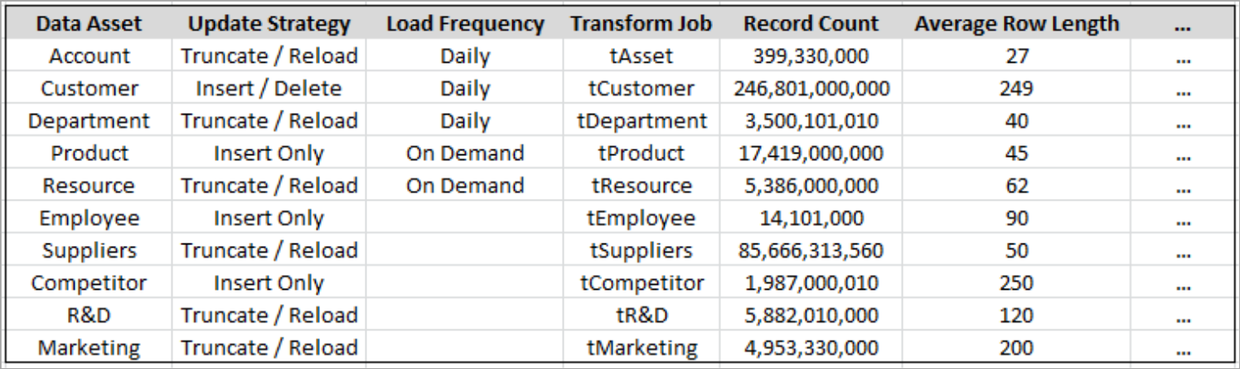
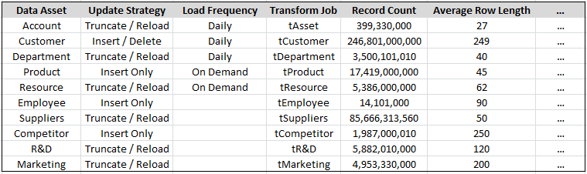
Data Sourcing
 Document each data source you intend using for size, frequency, and quality, etc.

Slide 17
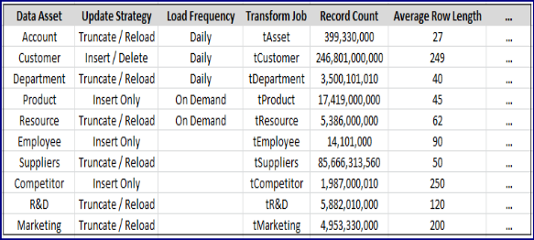
Evaluate What Data Is Available for Your Specific Question
How will you use the available data to answer your question
Customers
+ +
+
+
Sales
Products / Services
+
+
+
Resources
+
Capabilities
+
+
Revenue
Cash
+
Look at each of the related ideas on your concept map and evaluate which you have data available for

Slide 18
Combining Data Sources
 When combining separate data sources to answer your question, ensure you investigate availability of data across your time range of interest
Are you investigating across:
Multiple years?
The same month in different years?
 Equally, spatial data ranges should match when combining data sources
Local
International

Slide 19
Managing Unstructured Data

Slide 20
Contents
 Preprocess unstructured data in preparation for text mining
 Explore the concept of stemming
 Investigate the meaning of “stop” words
 Prepare a Term Document Matrix (TDM) of unstructured documents in preparation for analysis

Slide 21
What Is Unstructured Data?
 Types of unstructured data
Text documents
E-mails
Tweets and blogs
Video
Audio
 Objectives of unstructured data mining (text mining)
Discover patterns
Identify trends
Find associations among entities
Uncover predictive rules
Discover previously unknown knowledge

Slide 22

Benefits of Mining Unstructured Data
 Spam/phishing detection
 Sentiment analysis
 Plagiarism detection
 Organizing web search results
 Academic research
Can you give examples of potentially valuable unstructured data from your workplace?

Slide 23
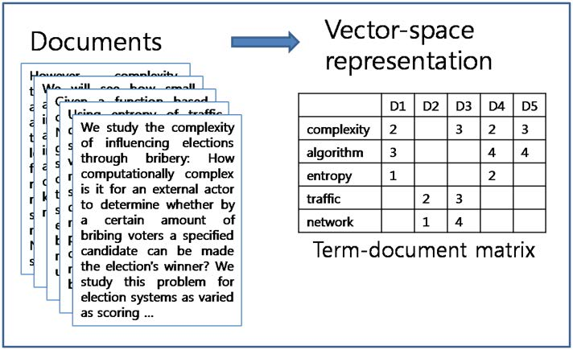
Challenges in Mining Unstructured Data
 A challenge of text-mining is converting unstructured and semistructured text into a vectorized structure
A simplified representation of the unstructured data
Object is represented in terms of its measurable features
The word algorithm appears four times in Document 4
D1-5

Slide 24
What Is a Document?
 For many text-mining tasks, the “document” will be obvious
 For example, e-mails, tweets, or call log records easily translate into a single vector for each message
 In longer documents, the entire document may be used, or it may be broken up into sections, paragraphs, or sentences
In clustering and classification, it will typically be the entire document
In document summarization, breaking up the document may be more appropriate

Slide 25
Text Splitting
 The first step is normally to vectorize the document through a process called tokenization
Text is split into a “bag of words”
A single word is referred to as a “gram”
An nGram is a contiguous sequence of n words from a given text
 Tokenization may result in loss of meaning
Whitespace or punctuation marks are often used to tokenize
This can result in loss of meaning in acronyms
For example, U.S.A. will be separated into different tokens (“U” “S” and “A” losing the meaning of the acronym
– Methods of acronym detection (e.g., custom dictionaries) are available to deal with situations such as these
 Dimensionality of the data
Each text word represents a dimension
Some words are more important than others in determining meaning

Slide 26
Text Preprocessing
 Typically documents are grouped together (into a corpus) for preprocessing and analysis
 Preprocessing usually involves
Number removal
Punctuation mark removal
Text case conversion
Stemming
Stop word removal

Slide 27
Stop Word Removal
 Text documents contain a large number of dimensions (words)
Removal of stop words acts as a technique for reducing the dimensionality
 Stop words refers to the common words that do not contribute as highly to meaning; they are
Articles—a, an, the
Conjunctions—and, or…
Prepositions—as, by, of …
Pronouns—you, she, he, it …
 Other non–context-related words can also be removed

Slide 28
Stemming
 The process for reducing derived words to their stem or root form
Typically achieved by removing -ing, -s, -er, -ed, etc.
For example: “mining,” “miner,” “mines,” “ mined”
Stemmed word “mine”

Slide 29
Term Frequency―Inverse Document Frequency
 To make the text suitable for data-mining algorithms, text will be treated as weighted vectors
 The most common approach used to weight text tokens is called Term Frequency–Inverse Document Frequency (TF-IDF)
Term Frequency (TF)
Number of times a term occurs in a document
Document Frequency (DF)
Number of documents that contain each word
Inverse Document Frequency (IDF) = 1/DF
TF-IDF = TF * IDF

Slide 30
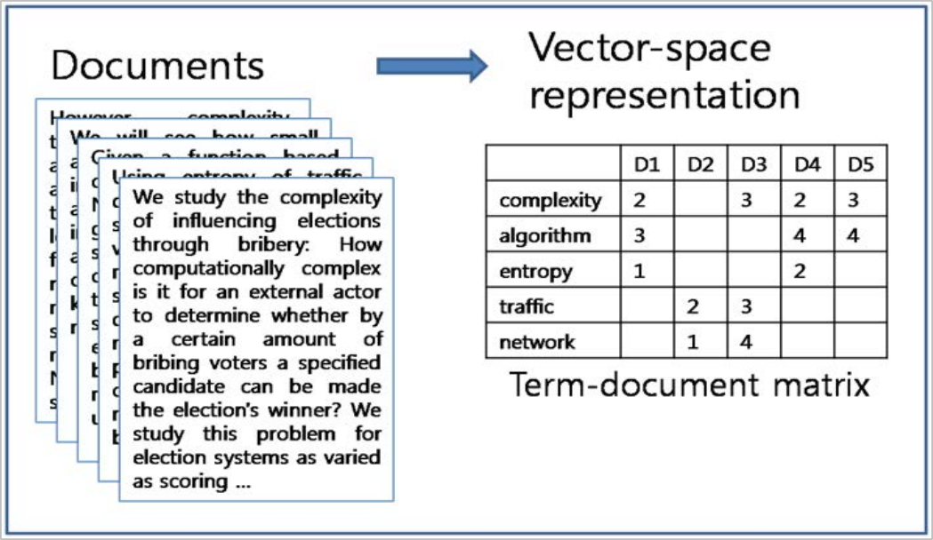
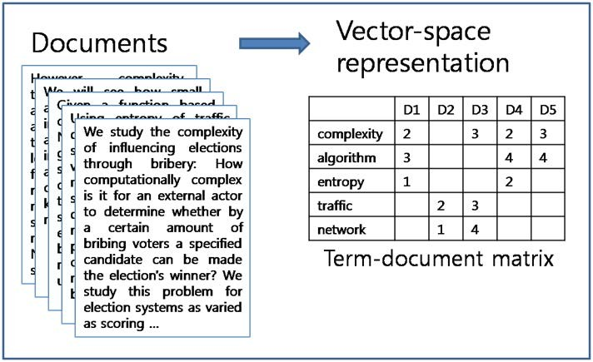
Term Frequency–Inverse Document Frequency
 The assumption behind TF-IDF is that terms that appear more frequently in a document should be given a
higher weight, unless they also appear in a lot of documents
 To prepare the corpus for analysis, a term document matrix (TDM) is created
Shows the terms and frequency of each word in the corpus

Slide 31
Retrieving Tweets From Twitter
 The twitteR package needs to be loaded into the session
>library(twitteR)
 Retrieve the tweets from the user timeline (after authentication)
>myTweets <- userTimeline("USW", n=150)
 To inspect the loaded tweets:
myTweets[1:5]
 To wrap tweet text on the screen use the following code:
>for (i in 1:5) { cat(paste("[[", i, "]] ", sep="")) writeLines(strwrap(myTweets[[i]]$getText(), width=75)) }

Slide 32
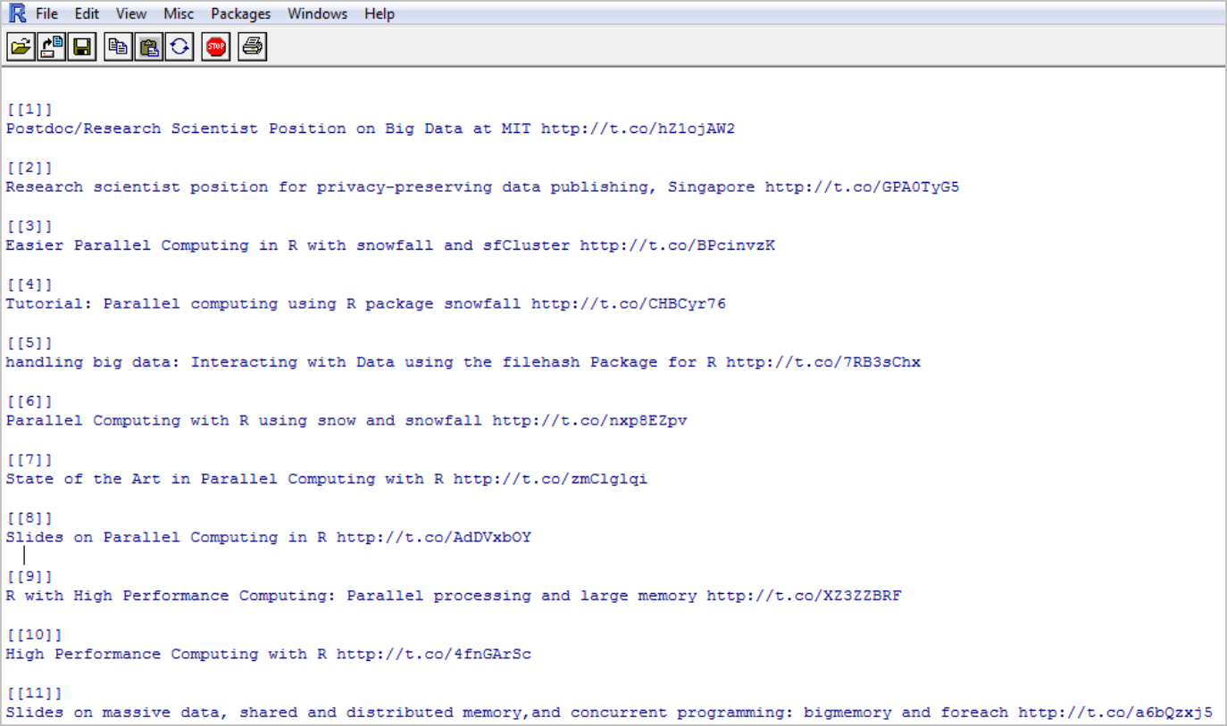
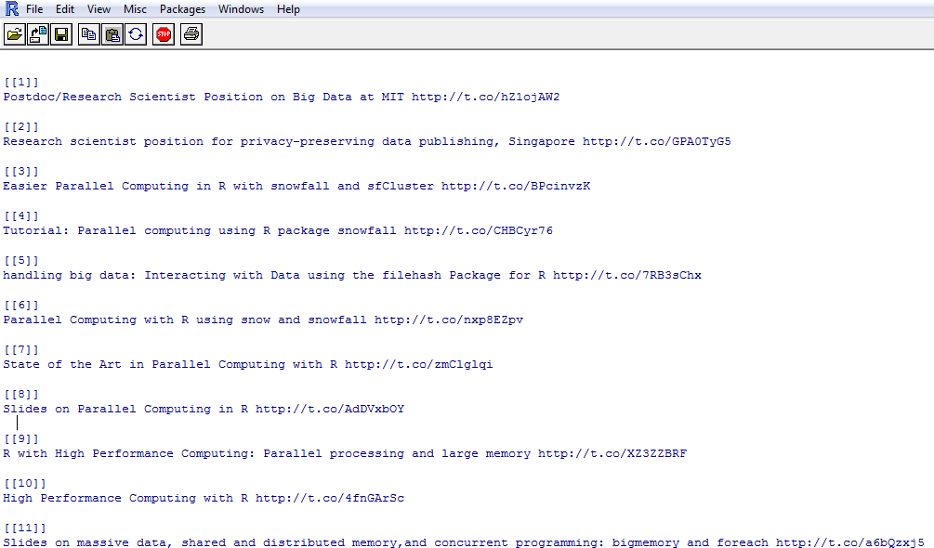
Sample Twitter Data Set
Source: www.rdatamining.com/data

Slide 33
Loading the Data
 Load the tm library for text processing, and the wordcloud
library for display
library(tm); library(wordcloud);
 Convert the tweets to a data frame
dataFrame <- do.call("rbind", lapply(myTweets, as.data.frame));
 Convert the data frame to a corpus, which is a collection of text documents
myDocuments <- Corpus(VectorSource(dataFrame$text))
 The inspect() function from the tm library may be used to view tweets
inspect(myDocuments[1:5])

Slide 34
Text Preprocessing
 Once the tweets are in a corpus, a number of transformations are required
Remove numbers
Remove punctuation
Strip out white space
Stemming
 tm_map is used to transform the corpus documents

Slide 35
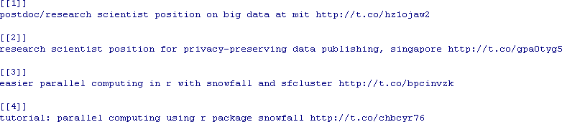
Converting Text to Lower Case
 Convert the tweet text to lowercase
myDocuments <- tm_map(myDocuments, content_transformer(tolower))
inspect(myDocuments[1:4])

Slide 36
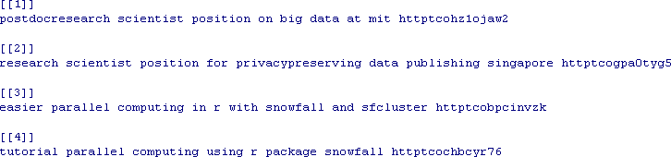
Removing Punctuation Marks
 Take a backup of the original tweets to support the (later) stem-completion process: originalBackup <- myDocuments
 To remove punctuation marks from the corpus:
myDocuments <- tm_map(myDocuments,removePunctuation)
inspect(myDocuments[1:4])

Slide 37
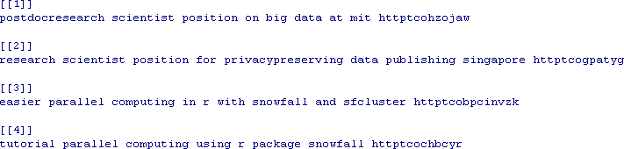
Removing Numbers
 To remove numbers from the corpus:
myDocuments <- tm_map(myDocuments,removeNumbers)
inspect(myDocuments[1:4])

Slide 38
Using User-Defined Functions for Text Preprocessing
 User-defined functions will often be employed to preprocess the text
 For example: URLs can be removed with a regular expression in a user-defined function
http[[:alnum:]]* matches strings that begin with http and are followed
by any number of alphanumeric characters
Text matching the pattern is then replaced with an empty sting using gsub()
removeURL<- function(x) gsub("http[[:alnum:]]*", "", x) myDocuments<-tm_map(myDocuments,
content_transformer(removeURL))

Slide 39
Removing Stop Words
 To remove the standard stop words from the corpus:
myDocuments <- tm_map(myDocuments, removeWords,
stopwords("english"))
 Before removing standard stop words from a corpus, extra stop words may be added to the list
myStopwords<- c(stopwords("english"), "other", "words")
 Words may be removed
Exclu<-which(myStopwords %in% c("across", "some"))
myStopwords <- myStopwords[-Exclu]
 To remove the modified stop word list:
myDocuments <- tm_map(myDocuments, removeWords, myStopwords)

Slide 40
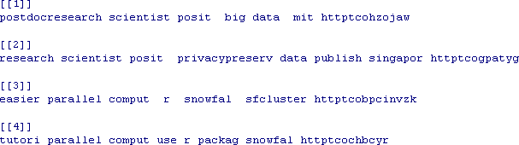
Text Stemming
 To stem words within the corpus:
myDocuments <- tm_map(myDocuments, stemDocument)
inspect(myDocuments[1:4])

Slide 41
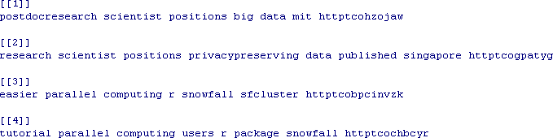
Text Stemming
 Completing the stemming process (optional)
myDocuments <- tm_map(myDocuments, stemCompletion, dictionary= originalBackup)
inspect(myDocuments[1:4])

Slide 42
Building a Term Document Matrix
 To create the TDM:
DTM <- TermDocumentMatrix(myDocuments, control=list(minWordLength=1))
inspect(DTM[90:105, 1:20]) # view a section of the TDM
OUTPUT:
A term-document matrix (16 terms, 20 documents) Non-/sparse entries: 11/309
Sparsity : 97% Maximal term length: 21
Weighting
: term frequency (tf) Docs
Terms | 1 | 2 | 3 | 4 | 5 | 6 | 7 | 8 | 9 | 10 | 11 | 12 | 13 | 14 | 15 | 16 | 17 | 18 | 19 | 20
data | 1 | 1 | 0 | 0 | 2 | 0 | 0 | 0 | 0 | 0 | 1 | 2 | 1 | 1 | 1 | 0 | 1 | 0 | 0 | 0
databases | 0 | 0 | 0 | 0 | 0 | 0 | 0 | 0 | 0 | 0 | 0 | 0 | 0 | 0 | 0 | 0 | 0 | 0 | 0 | 0
dataframe | 0 | 0 | 0 | 0 | 0 | 0 | 0 | 0 | 0 | 0 | 0 | 0 | 0 | 0 | 0 | 0 | 0 | 0 | 0 | 0
datasets | 0 | 0 | 0 | 0 | 0 | 0 | 0 | 0 | 0 | 0 | 0 | 0 | 0 | 0 | 0 | 0 | 0 | 0 | 0 | 0
datasetshttptconxrbuh | 0 | 0 | 0 | 0 | 0 | 0 | 0 | 0 | 0 | 0 | 0 | 0 | 0 | 0 | 0 | 0 | 0 | 0 | 0 | 0
datastream | 0 | 0 | 0 | 0 | 0 | 0 | 0 | 0 | 0 | 0 | 0 | 0 | 0 | 0 | 0 | 0 | 0 | 0 | 0 | 0
datatable | 0 | 0 | 0 | 0 | 0 | 0 | 0 | 0 | 0 | 0 | 0 | 0 | 0 | 0 | 0 | 0 | 0 | 0 | 0 | 0
details | 0 | 0 | 0 | 0 | 0 | 0 | 0 | 0 | 0 | 0 | 0 | 0 | 0 | 0 | 0 | 0 | 0 | 0 | 0 | 1
detection | 0 | 0 | 0 | 0 | 0 | 0 | 0 | 0 | 0 | 0 | 0 | 0 | 0 | 0 | 0 | 0 | 0 | 0 | 0 | 0
development | 0 | 0 | 0 | 0 | 0 | 0 | 0 | 0 | 0 | 0 | 0 | 0 | 0 | 0 | 0 | 0 | 1 | 0 | 0 | 0

Slide 43
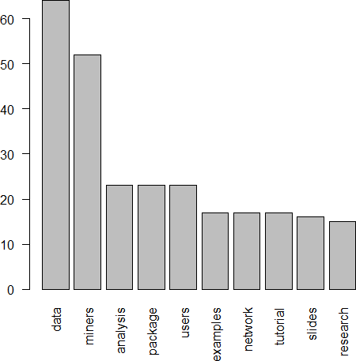
Word Frequency in Corpus
 To display frequency of words in corpus
matrix <- as.matrix(DTM)
wordFrequency <- rowSums(matrix)
sortedValues <- sort(wordFrequency ,decreasing=TRUE) topSortedWords <- subset(sortedValues, sortedValues >=15) barplot(topSortedWords , las=2)
Word appears 15 or more times in corpus

Slide 44
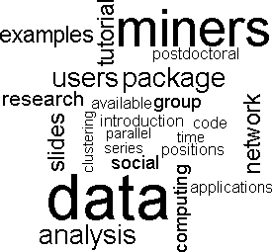
Displaying the Aggregate Output
 A word cloud can be used to display important words in the document
identifiers <- names(sortedValues) wordcloud(words=identifiers, freq=sortedValues, min.freq=8)

