Slide 1

IS3S661 Strategic IS Management
Strategy Initiation:
Vision and Environmental Analysis
David Kidner (J302) david.kidner@southwales.ac.uk

Slide 2

Last Week …A Strategy Life-Cycle
Strategy Assessment
Strategy Initiation
Strategy Implementation
Strategy Formulation
This Week …A Vision for Successful e-Business

Slide 3
Strategy Initiation
The initial phase of strategic planning in which the business examines itself and its environment.
Vision, Environmental and Capability Analyses.
Outcomes include:
Value Proposition
The benefit that a company’s products or services provide to customers; the consumer need that is being fulfilled
Core competencies
Forecasts
Competitor (industry) analysis
Business Environment Pressures

Slide 4
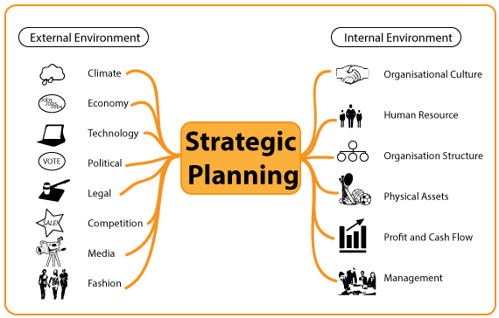

Understanding the Environmental Factors in Strategic Planning

Slide 5
Internal & External Environment
All businesses have an internal and external environment. The internal environment is very much associated with the human resource of the business or organisation, and the manner in which people undertake work in accordance with the mission of the organisation. To some extent, the internal environment is controllable and changeable through planning and management processes.
The external environment, on the other hand is not controllable. The managers of a business have no control over business competitors, or changes to law, or general economic conditions. However the managers of a business or organisation do have some measure of control as to how the business reacts to changes in its external environment.

Slide 6
Strategy Initiation
The initiation stage of our Strategic Planning Model has three parts:
Defining the Vision.
Environmental Analysis
Porter’s Five Forces;
PEST Analysis;
Other Approaches, e.g. SWOT, etc.
Capability Analysis.
This Week
Next Week

Slide 7
Vision and Environmental Analysis
Strategy Initiation
The start of a strategic plan is to decide what you want to do, and what people/situations around you require.
In this lecture we shall
consider the importance of defining the vision;
examine some environmental analysis techniques;
critically appraise the value of e-Commerce to buyers. (… finishing next week).

Slide 8
VISION
Strategy Initiation
The Vision of a company is the way that it views its products, its markets, its customers and itself.
The Vision defines what it wants to achieve and accomplish.
The Vision describes and communicates the future of the organisation:
profit;
market dominance;
“breaking the mould”.
Why is it important to define the Vision?

Slide 9
Importance of VISION?
The Vision answers the simple question
"Why are we here? (as a business)".
The Vision is the Goal.
It is not the same as a strategy;
Business strategy tells you how a company is going to achieve (or maintain) its Vision.
The strategy is a plan,
The tactics are how the plan will be executed, and
The Vision is the end-result.

Slide 10
Importance of VISION?
An e-Commerce organisation must develop a competitive advantage to survive. If you can’t answer this, you’re sure to fail:
“Why should a customer buy from us?”

Slide 11
Importance of VISION?
The MISSION STATEMENT provides a mechanism for achieving the Vision. It identifies
Organisation’s Core Purpose
Core Values
Beliefs
Culture
Primary Business
Primary Customers

Slide 12
Mission Statement Considerations
Purpose – communicates why an organisation exists
Beliefs – what the leaders of an organisation stand for
Core values – how decisions will be made and how people will be treated
Culture – how members should act
Primary business areas – what business the organisation engages in
Primary customers – which groups of people need to be satisfied

Slide 13
Vision / Mission Statement
A carefully crafted vision statement can help you communicate your company's goals to employees and management in a single sentence or a few concise paragraphs.
While a well-thought-out statement may take a few days or weeks to craft, the result will be a tool that helps inspire strategic decision making and product development for your business for years to come.

Slide 14
Vision and Strategy
Another way to think about strategy is to look at the Vision (Mission) Statement and where you are now.
If you haven't achieved your vision, your strategy is what you need to do.
If you have achieved your vision (pretty rare in the business world), your strategy is how you will maintain that vision against the inevitable competition.

Slide 15


MISSION & VISION
MISSION – Exceptional Service from Exceptional People
VISION – Taking Personal Responsibility for Achieving the Mission; Pursuing Excellence in Everything We Do; Displaying Honesty and Trust in all our Relations with Customers to Deliver Outstanding Service to them At All Times; Recognising and Respecting the Needs of Individuals.

Slide 16

Google’s Vision
"Google's vision is to organize the world's information and make it universally accessible and useful."
Their then-CEO Eric Schmidt put it a little differently:
"We want to have a little bit of Google in every transaction on the Internet."
How are they going to achieve this?
"Google's strategy is to combine the near-unlimited power of server-side computing with its database of human behaviour to create technological devices that are 'like magic'. All of a sudden there are things you can do that were not previously possible.” (Schmidt, 2010 Twitter).
So it should be clear that Google's goal is to take a piece of every buy and sell transaction on the internet by providing the best available information and by understanding what people want and how they act.
Visions should be simple statements understandable by everyone, inside or outside the company.

Slide 17
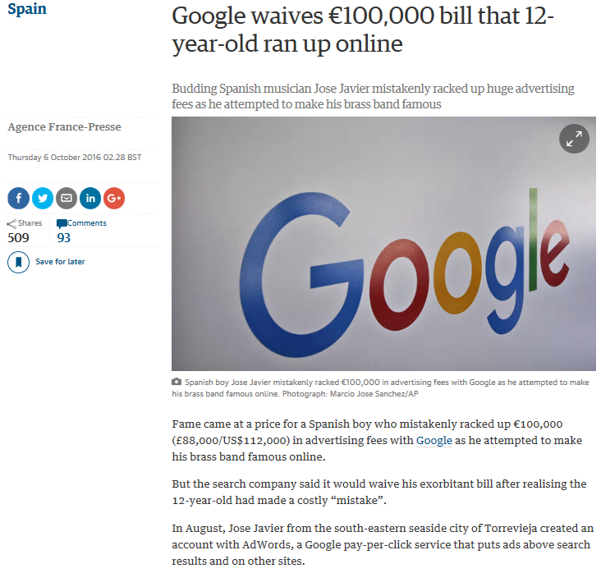

"We want to have a little bit of Google in every transaction on the Internet."

Slide 18

General Motors’ Vision
"We have a vision to design, build and sell the world's best vehicles. Our executive leaderships and our employees are committed to:
Building our market share, revenue, earnings and cash flow;
Improving the quality of our cars and trucks, while increasing customer satisfaction and overall perception of our products, and
Continuing to take a leadership role in the development of advanced energy saving technologies..."
The Vision is to design, build and sell the world's best cars.
How are they going to do that?
The strategy is to improve quality (which should increase customer satisfaction) and develop energy saving technologies.

Slide 19


Volkswagen Vision
In 2013, it stated …
“The Group’s goal is to offer attractive, safe and environmentally sound vehicles which can compete in an increasingly tough market and set world standards in their respective class.”

Slide 20
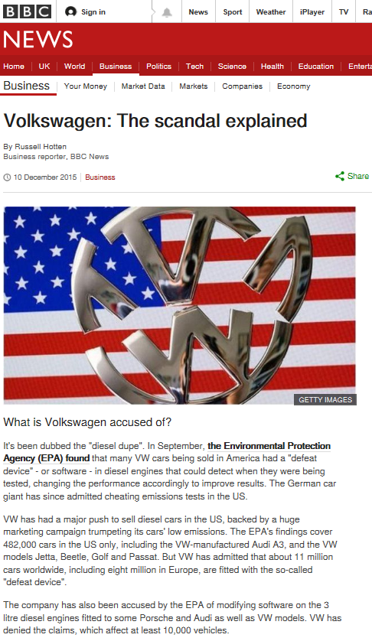
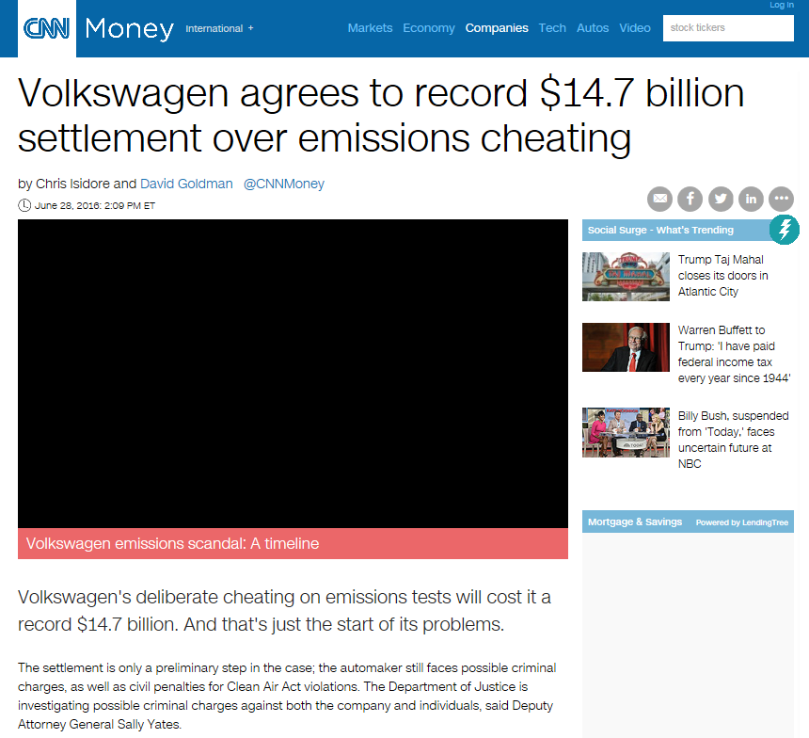
http://www.bbc.co.uk/news/business-34324772
http://money.cnn.com/2016/06/27/news/companies/
volkswagen-fine-emissions-cheating/index.html

Slide 21
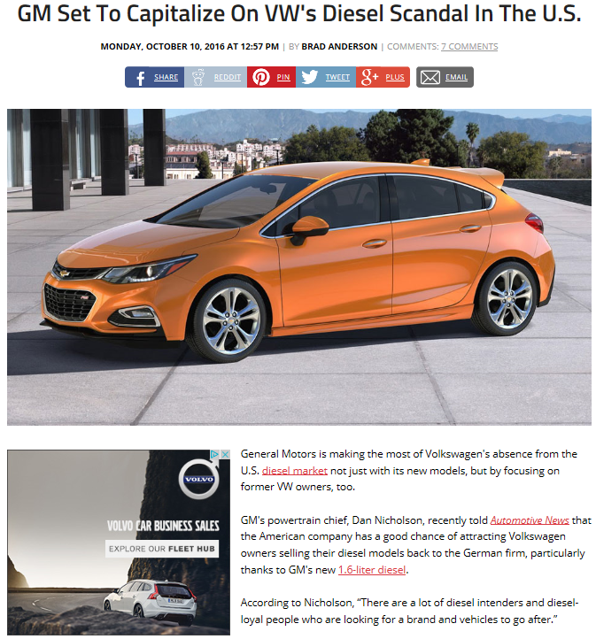
http://www.carscoops.com/2016/10/gm-set-to-capitalize-on-vws-diesel.html

Slide 22
Vision & Strategy
So the vision is the goal and the strategy is the plan to get there.
Everything about the company depends on the vision and strategy.
If the company's vision is to be “the world's lowest cost provider of Widget X”, then strategies have to be put in place to single-mindedly cut costs from the development, production, and delivery of Widget X. That doesn't mean that the company itself can't spend a lot of money achieving its vision. Maybe they have a huge R&D department dedicated to finding ways to make cheaper Widgets. But it does mean that if you, as an employee, come up with a way to make an improved Widget X with more features, it will be considered 'off-strategy'. The vision isn't to make better Widgets, and it isn't to make them higher quality, or last longer. Build a cheaper Widget X and you'll be a hero. That's what matters.
Doug Kalish, 2015, http://www.dougsguides.com

Slide 23
Do Strategies Change?
Of course, sometimes companies adopt the wrong strategy.
Before the days of iTunes, record companies resisted every attempt to distribute digital music, even going so far as to sue consumers of their products. They were trying to protect the highly lucrative and profitable CD business. Unfortunately, it was so easy to rip and distribute music that none of the protections they put in place worked.
Enter Steve Jobs and Apple who created a marketplace for digital music. The record producers had to join in, CD sales went off a cliff, and now Apple gets a huge cut of every song sold through iTunes.
Could the record companies have developed their own marketplace so that they wouldn't have to share the revenue with Apple?
Maybe, but their strategy was to protect what was in essence an un-protectable business.

Slide 24
Evolving Visions & Strategies
The business world is littered with failed strategies.
Technology changes, customers demand something different, cheaper and better competitors show up - lots of internal and external events can challenge the business strategy. The best companies review the strategy early and often.
How do you know if you have the right strategy?
Go back to the vision and figure out what has to happen to make the vision come true. Some of it is guesswork and optimism. But no business ever succeeded without a strategy.

Slide 25
Ever Changing Strategies …
A company starts out wanting to be the high quality, low volume, high price producer of widgets. But nobody is buying. So they try to become the 'celebrity widget' and pay a lot of bucks to some aging movie star to endorse their widgets in an expensive ad campaign. That makes the movie star rich but doesn't move widgets. So they decide to sell mass-market widgets at a mid-level price, but there is already a lot of competition and they can't differentiate their widgets from anyone else's. Then they find that nobody needs high quality widgets, the cheap ones are just as good. So the company changes strategy to produce low cost widgets, but they find the market is full of cheap Chinese widgets. Lastly, they try to license their 'superior' widget-making technology to the other manufacturers. Doom.
Companies that change strategies over and over don't understand their markets, or can't explain the value of their products, or what problem their products solve for the customer. And changing strategy is expensive. (Doug Kalish, 2015, http://www.dougsguides.com)

Slide 26
Environmental Analysis
How can an organisation respond to the Environmental Pressures it faces?
Firstly, it needs to identify the pressures and understand the competitive market powers.
Porter’s Five Forces model shows who has the power in a market.
Created by Michael Porter (Harvard Business School)
The model helps business managers to analyse the attractiveness and potential profitability of an industry sector.

Slide 27
Porter’s Five Forces
The Porter’s Five Forces tool can be very powerful.
It is a simple technique for judging exactly where power lies. As it helps to understand not only the strength of current competitive position but also the strength of an expected position.
It is a critical part of your planning process. If you gain a proper understanding of where the power lies, you can take advantage of the company’s strengths. You can also improve your firm’s weaknesses.
Overall, you will not take any wrong steps.
…provided you do your Research!

Slide 28
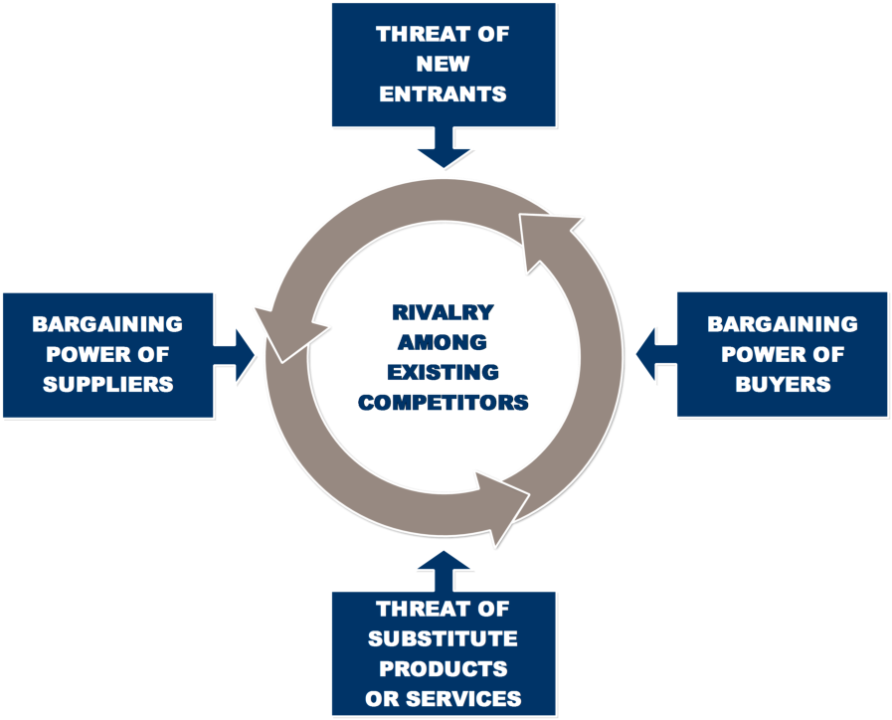
Porter’s
Five
Forces
The strength of the Five Forces will determine the level of Profit within an Industry that a Competitor can expect to make.

Slide 29
1. Industry Rivalry
The critical thing to consider here is the number and capability of your business competitors. If there are many competitors and if they offer equally appealing products and services, you will perhaps have very little power. This is because suppliers and buyers will choose the competing companies if they do not like the deal you are offering.
You will be very powerful if your product or service is unique. If competitors cannot offer what you provide, you will have immense strength. In short, the factors to be considered in this step are:
The number of competitors;
The quality difference between your product and competitor’s product;
High Fixed Costs (e.g. bricks and mortar facilities);
Switching costs involved for suppliers and buyers;
Customer loyalty;
Growth Rate of the Industry.

Slide 30
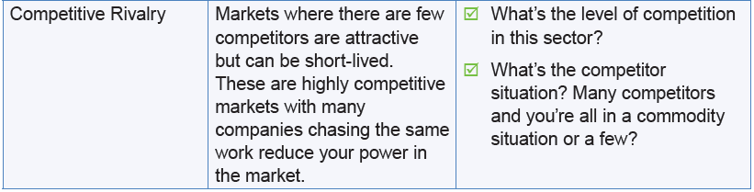
1. Industry Rivalry

Slide 31
2. Threat of New Entrants
Others ability to enter the market can affect power.
New businesses can swiftly enter the market and weaken your position (especially e-Commerce services).
Depends if the market has strong and durable barriers to entry – may help you maintain a favourable position.
Issues include:
Time and cost of entering the market and competing;
Trust and Brand Loyalty;
Economies of scale (Costs with respect to scale of output);
The amount of protection for the key technologies (e.g. IPR).
Deterrents – High Switching Costs; Stickiness of a Web Site; etc.

Slide 32
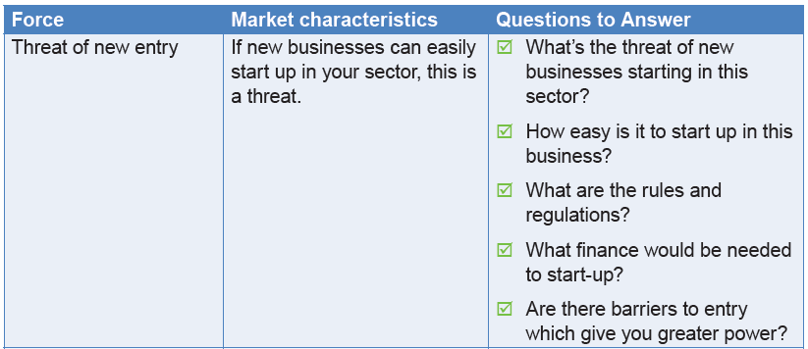
2. Threat of New Entrants

Slide 33
3. Threat of Substitute Products & Services
The ability of consumers to find an alternative product that serve essentially the same or similar purpose.
Issues include:
Price Comparison Websites (in your market place? Yet?);
Performance of the substitute product / service;
Cost of change;
Consider Microsoft – dominant player in S/W for PCs and Laptops
Facing big competition from tablets, mobile devices and smartphones that now provide many of the same functionalities as traditional PCs
… the software for which is not primarily Microsoft-based.
Microsoft Tablets, e.g. Surface Pro
Microsoft Smartphones and Phablets, e.g. Lumia
Microsoft Band (watch, health & fitness monitor, etc.).

Slide 34
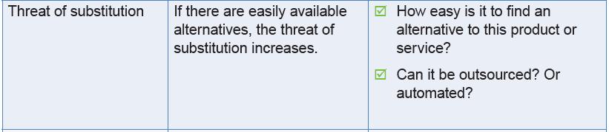
3. Threat of Substitute Products & Services

Slide 35
4. Bargaining Power of Suppliers
Often, the first step is to assess how easy it is for the suppliers to increase prices of inputs.
This depends on the following factors:
The number of suppliers of the key input
How unique their product or service is
Their strengths and how much control they have over you
The cost of switching from one to another
Fewer number of supplier choices means you need suppliers’ help more. This also means that fewer suppliers make them more powerful.

Slide 36
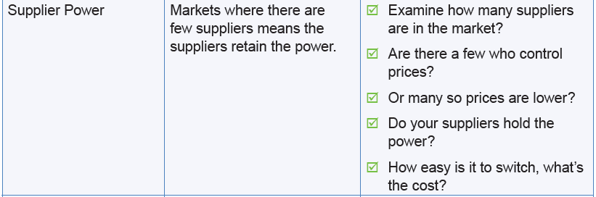
4. Bargaining Power of Suppliers

Slide 37
5. Bargaining Power of Buyers
When assessing buyer power, you have to ask yourself how easy it is for the customers to bring prices down. This depends on the following factors:
The number of buyers
The importance of each customer to a business
The cost to consumers switching from your offering to products and services by another company.
If you handle only some powerful purchasers, they often dictate the terms to you.

Slide 38
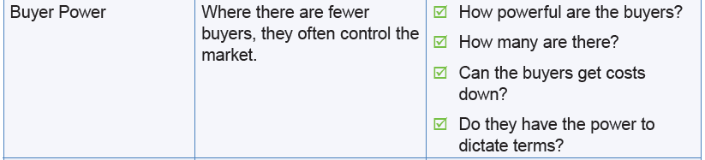
5. Bargaining Power of Buyers

Slide 39
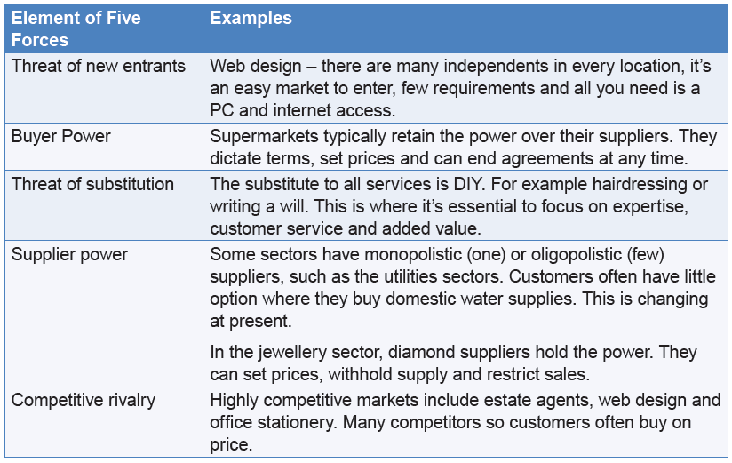
Examples of Where the Power Lies in Different Markets

Slide 40
Porter’s 5 Forces …
As rivalry among competing firms intensifies, industry profits decline, in some cases to the point where an industry becomes inherently unattractive.

Slide 41
Using Porter’s 5F
An e-Commerce organisation can use the model to assess:
the current situation;
the opportunities;
the threats.

Slide 42
Using Porter’s 5F
Fighting off the threats:
beat existing competitors, make them less viable;
build barriers against new entrants;
build barriers against substitute products or services;
reduce suppliers’ bargaining powers;
reduce customers’ bargaining powers.
(This is a rather negative outlook.)

Slide 43
Using Porter’s 5F
Taking advantage of opportunities:
out-perform existing competitors on cost and quality;
excel at what you do so customers don’t seek new entrants;
produce new and better products or services;
improve relationships with suppliers;
improve relationships and standards of service with customers.

Slide 44
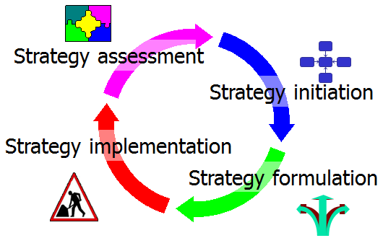
Summary
Defining the VISION & Mission Statement is essential.
We’ll take a look at some of these in tutorials & Coursework
Vision is the goal and the Strategy is the plan to get there.
Understanding the Environmental Issues allows us to analyse the attractiveness and potential profitability of an industry.
Porter’s Five Forces.
We’ll apply this in tutorials & Coursework 1.

Slide 45
