Slide 1
REVISION LECTURE
DR ALEX LOHFINK

Slide 2
TOPICS
DATA WAREHOUSE
Purpose
MOLAP/ROLAP
STAR SCHEMA
DATA MINING
DDBMS
Definition
Components
FRAGMENTATION
BIG DATA
Definition
Examples
NOSQL storage
MapReduce

Slide 3
Data Warehouse
DR ALEX LOHFINK

Slide 4
Business Intelligence Benefits
Main goal: improved decision making
Other benefits
Integrating architecture
Common user interface for data reporting and analysis
Common data repository fosters single version of company data
Improved organizational performance

Slide 5
Decision Support Database Requirements (cont’d.)
Database size
In 2008 – Wal-Mart had 2.5 petabytes of data its data warehouses
2013 - eBay has two systems in place.
Its primary data warehouse is 9.2 petabyes;
its “singularity system” that stores web clicks and other “big” data is more than 40 petabytes. It has a single table that’s 1 trillion rows.
DBMS must support very large databases (VLDBs)

Slide 6
Decision Support Database Requirements (cont’d.)
Database schema
Complex data representations
Aggregated and summarized data
Queries extract multidimensional time slices
Data extraction and filtering
Supports different data sources
Flat files
Hierarchical, network, and relational databases
Multiple vendors
Checking for inconsistent data

Slide 7
Star Schemas
Data-modeling technique
Maps multidimensional decision support data into relational database
Creates near equivalent of multidimensional database schema from relational data
Easily implemented model for multidimensional data analysis while preserving relational structures
Four components: facts, dimensions, attributes, and attribute hierarchies

Slide 8
Facts
Numeric measurements that represent specific business aspect or activity
Normally stored in fact table that is center of star schema
Fact table contains facts linked through their dimensions
Metrics are facts computed at run time

Slide 9
Dimensions
Qualifying characteristics provide additional perspectives to a given fact
Decision support data almost always viewed in relation to other data
Study facts via dimensions
Dimensions stored in dimension tables

Slide 10
Attributes
Use to search, filter, and classify facts
Dimensions provide descriptions of facts through their attributes
No mathematical limit to the number of dimensions
Slice and dice: focus on slices of the data cube for more detailed analysis

Slide 11
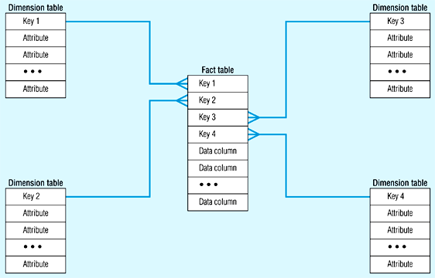
Star Schema (in RDBMS)
Notes:
11

Slide 12
Online Analytical Processing
Three main characteristics:
Multidimensional data analysis techniques
Advanced database support
Easy-to-use end-user interfaces

Slide 13
OLAP Architecture
Three main architectural components:
Graphical user interface (GUI)
Analytical processing logic
Data-processing logic
Designed to use both operational and data warehouse data
In most implementations, data warehouse and OLAP are interrelated and complementary
OLAP systems merge data warehouse and data mart approaches

Slide 14
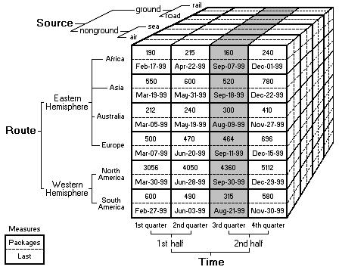

Slide 15
Multidimensional OLAP
Multidimensional online analytical processing (MOLAP) extends OLAP functionality to multidimensional database management systems (MDBMSs)
MDBMS end users visualize stored data as a 3D data cube
Data cubes can grow to n dimensions, becoming hypercubes
To speed access, data cubes are held in memory in a cube cache
An OLAP cube - method of storing data in a multidimensional form, generally for reporting purposes.
data (measures) categorized by dimensions
often pre-summarized across dimensions to improve query time over relational databases.
The query language used to interact and perform tasks with OLAP cubes is multidimensional expressions (MDX).

Slide 16
Multidimensional OLAP
Although it stores data like a traditional database does, an OLAP cube is structured very differently.
OLAP cubes, however, are used by business users for advanced analytics
Designed using business logic and understanding.
Can report on millions of records at a time
Business users can query OLAP cubes using plain English.

Slide 17
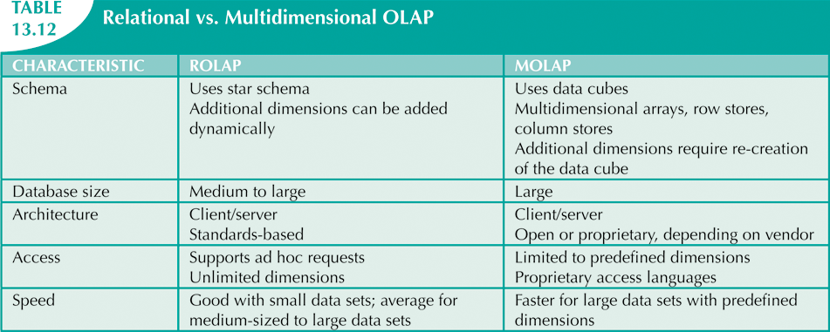

Slide 18
Data Mining
Data-mining tools do the following:
Analyze data
Uncover problems or opportunities hidden in data relationships
Form computer models based on their findings
Use models to predict business behavior
Runs in two modes
Guided
Automated

Slide 19
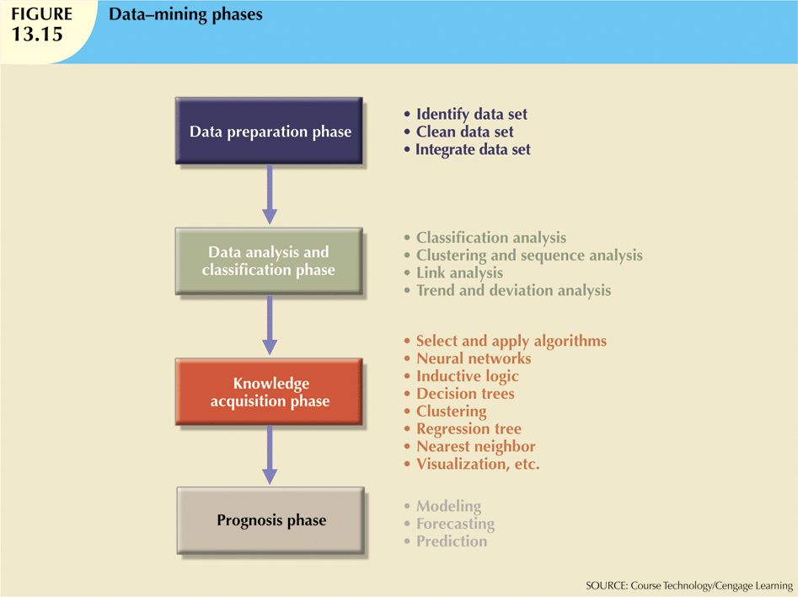

Slide 20
Data mining techniques
CLUSTERING
CLASSIFICATION
ASSOCIALTION RULES

Slide 21
Clustering:
 Clustering involves looking for natural groupings in data items that are
not driven by prespecified criteria
For example, do our customers naturally fall into different behavioral groups?
 Referred to as unsupervised learning because there is no set target
 Often used to aid in understanding of an aspect of the business in order to provide better products/services, marketing campaigns
For example, a better understanding of mobile phone customers may lead to different network packages being offered

Slide 22
Classification:
 The purpose of classification is to predict an outcome based on input data
 A number of predictor variables are combined to best decide the output for a target variable
Known as a classification model (a set of predictor rules)
 Classification separates data into various categories
Comprises assigning a class label to a set of unclassified data sets
Thus, classification is categorized as supervised learning
 Classification uses two data sets
The training set (seen data) to build the model
The observations have already been classified
The test set (unseen data) to measure its performance in terms of its error rate
Percentage of incorrectly classified instances in the data set
 Sometimes, a validation set is also used to tune the model
 The data sets need to be representative samples of the data that the model will be applied to

Slide 23
Association Rules
 Method of discovering relationships between seemingly unrelated items within a transactional data set
 Often used for market basket analysis
Proven useful for mass-market retail, such as supermarkets, convenience stores, drug stores, and fast-food chains
 Estimates how items are related to each other
How they group together
 An unsupervised data-mining technique
There is no specific target specified
 Easily understood by business users

Slide 24
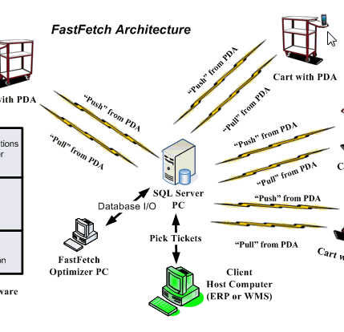
DISTRIBUTEd DATABASE SYSTEMS

Slide 25
What do we mean by distributed?
Full support for distributed databases implies a single application should be able to operate transparently on data:
that is spread across a variety of different databases,
managed by a variety of different DBMSs,
running on a variety of different machines,
supported by a variety of different operating systems
and connected together by a variety of different communications networks
Notes:
The term transparently means that the application operates from a logical point of view as if the data were all managed by a single DBMS running on a single machine

Slide 26
Distributed Database
Data is partitioned into ‘fragments’ – these may be replicated
Fragments are allocated to different sites
Each site is managed by a DBMS
Each DBMS may handle ‘Local applications’ but must handle at least one ‘Global application’
There may be a variety of different DBMSs (heterogeneous)
running on a variety of different machines,
supported by a variety of different operating systems
and connected together by a variety of different communications networks
Notes:
The term transparently means that the application operates from a logical point of view as if the data were all managed by a single DBMS running on a single machine

Slide 27
Components of a dds
The User Interface Handler
interprets user commands (typically in SQL) and formats results.
The Semantic Data Controller
performs authorisation checks to identify if the query can be processed.
The Global Query Optimiser
identifies and evaluates alternative ways of executing the query
The Global Execution Monitor
coordinates the execution of the query/request, and is responsible for global transaction management.
The Local DBMS
provides standard DBMS features, and cooperates, for example, in global transaction management.

Slide 28
Data Fragmentation
Fragment
Can be defined by an expression in a relational language which takes global relation as operands and produces the fragment as result
Types of fragmentation
Horizontal fragmentation
Derived horizontal fragmentation
Vertical fragmentation
Mixed fragmentation

Slide 29
Horizontal Fragmentation
Partitioning tuples of a global relation into subsets
Example:
Supplier(SNum, Name, City)
SNum is a supplier number
Horizontal fragmentation can be: Supplier₁ = σ _{City = “London”} Supplier
Supplier₂ = σ _{City = “Cardiff”} Supplier
Reconstruction is possible: Supplier = Supplier₁ ∪ Supplier₂
The set of predicates defining all the fragments must be complete, and mutually exclusive

Slide 30
Derived Horizontal Fragmentation
The horizontal fragmentation is derived from the horizontal fragmentation of another relation
Example:
Supply(SNum, Pnum, DeptNum, Qty)
Supply₁ = Supply ⋉_{SNum=SNum} Supplier₁
Supply₂ = Supply ⋉_{SNum=SNum} Supplier₂
⋉ is the semi-join operation
The predicates defining derived horizontal fragments are: Supply.SNum=Supplier.SNum and Supplier. City = “London“ Supply.SNum = Supplier.SNum and Supplier. City = “Cardiff"

Slide 31
Vertical Fragmentation
The vertical fragmentation of a global relation is the subdivision of its attributes into groups
Fragments are obtained by projecting the global relation over each group
Example: Employee(ENum, Name, Sal, Tax, Mnum, DNum)
The vertical fragmentation can be:
Employee₁ = Π_{Enum,Name,Mnum,DNum} Employee
Employee₂ = Π_{Enum,Sal,Tax} Employee
Reconstruction:
Employee = Employee₁ ⋈ Employee₂

Slide 32
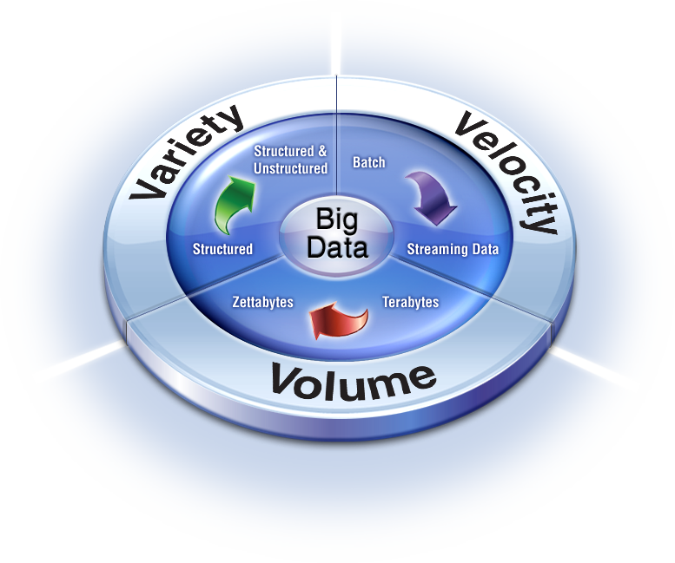
Big Data

Slide 33



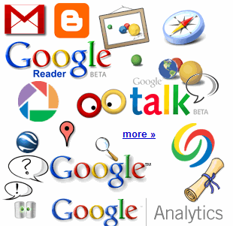

The Social Layer in an Instrumented Interconnected World
4.6 billion camera phones world wide
30 billion RFID tags today (1.3B in 2005)
12+ TBs of tweet data every day
100s of millions of GPS enabled devices sold annually
? TBs of data every day
2+ billion people on the Web by end 2011
25+ TBs of log data every day
76 million smart meters in 2009… 200M by 2014
Notes:
Obviously, there are many other forms of data. Let’s start with the hottest topic associated with Big Data today: social networks. Twitter generates about 12 terabytes a day of tweet data – which is every single day. Now, keep in mind, these numbers are hard to keep accurate, so the point is that they’re big, right? So don’t fixate on the actual number because they change all the time and realize that even if these numbers are out of date by 2 years, it’s at a point where it’s too staggering to handle exclusively using traditional approaches.
+CLICK+
Facebook over a year ago was generating 25 terabytes of log data every day (Facebook log data reference: http://www.datacenterknowledge.com/archives/2009/04/17/a-look-inside-facebooks-data-center/
) and probably about 7 to 8 terabytes of data that goes up on the Internet.
+CLICK+
Google, who knows? Look at Google Plus, YouTube, Google Maps, and all that kind of stuff. So that’s the left hand of this chart – the social network layer.
+CLICK+
Now let’s get back to instrumentation: there are massive amounts of proliferated technologies that allow us to be more interconnected than in the history of the world – and it just isn’t P2P (people to people) interconnections, it’s M2M (machine to machine) as well. Again, with these numbers, who cares what the current number is, I try to keep them updated, but it’s the point that even if they are out of date, it’s almost unimaginable how large these numbers are. Over 4.6 billion camera phones that leverage built-in GPD to tag your location or your photos, purpose built GPS devices, smart metres. If you recall the bridge that collapsed in Minneapolis a number of years ago in the USA, it was rebuilt with smart sensors inside it that measure the contraction of the concrete based on weather conditions, ice build up, and so much more.
So I didn’t realise how true it was when Sam P launched Smart Planet: I thought it was a marketing play. But truly the world is more instrumented, interconnected, and intelligent than it’s ever been before and this capability allows us to address new problems and gain new insight never before thought possible and that’s what the Big Data opportunity is going to be all about!
33

Slide 34
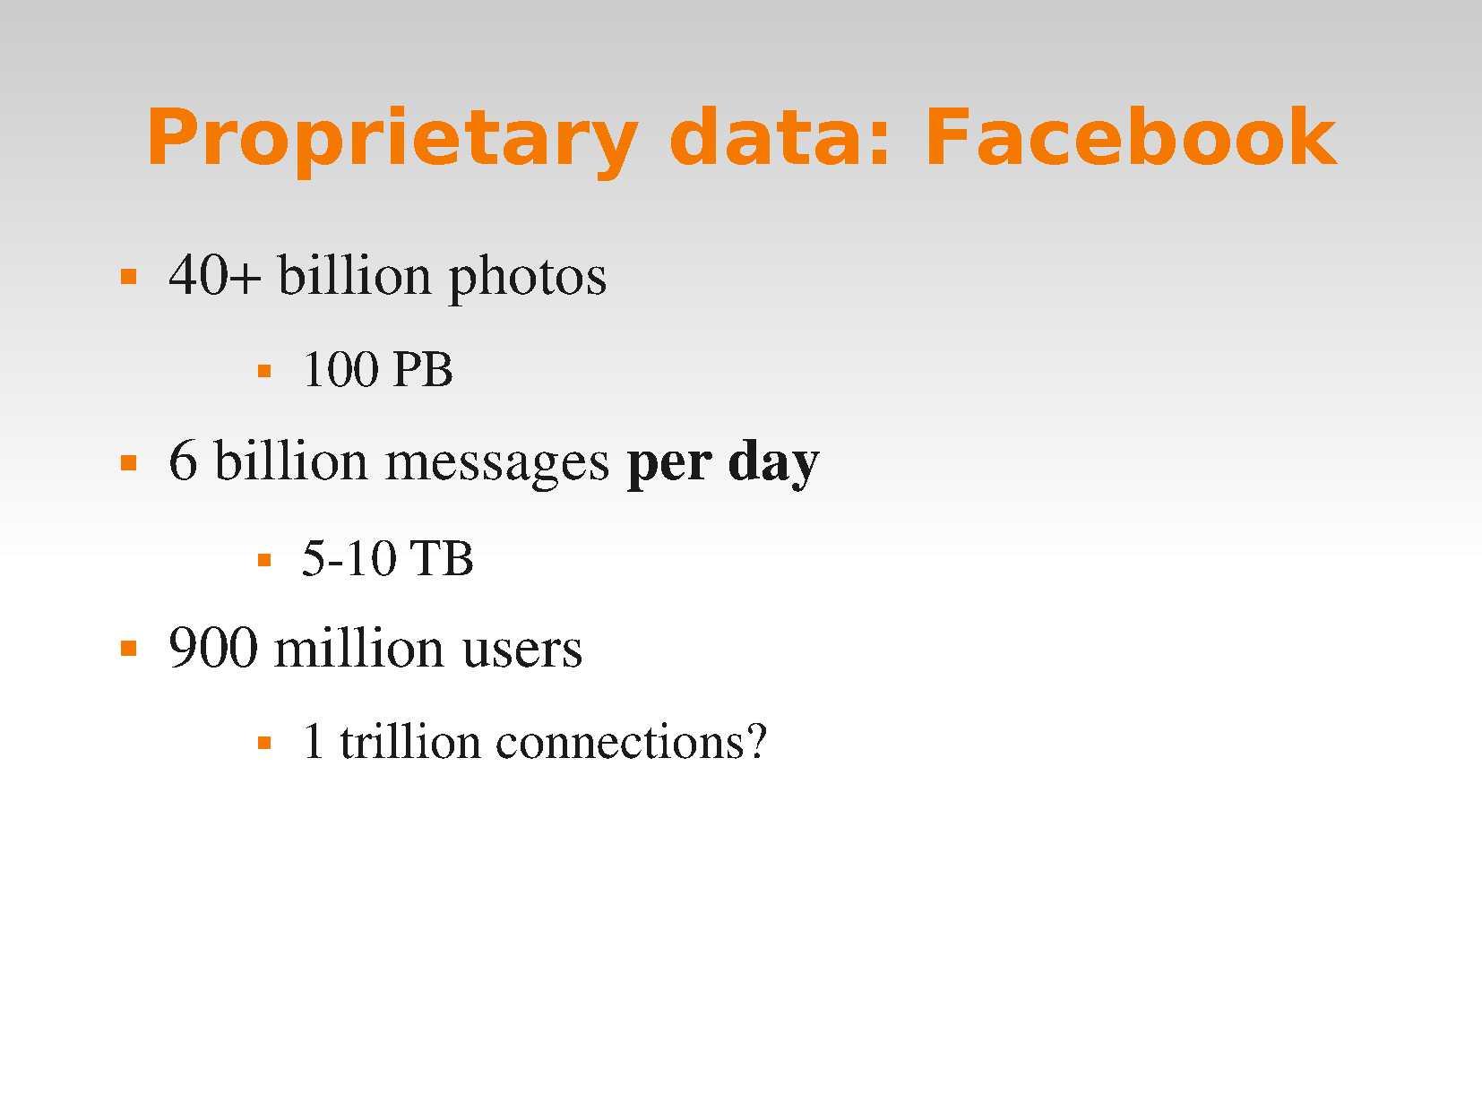

Slide 35
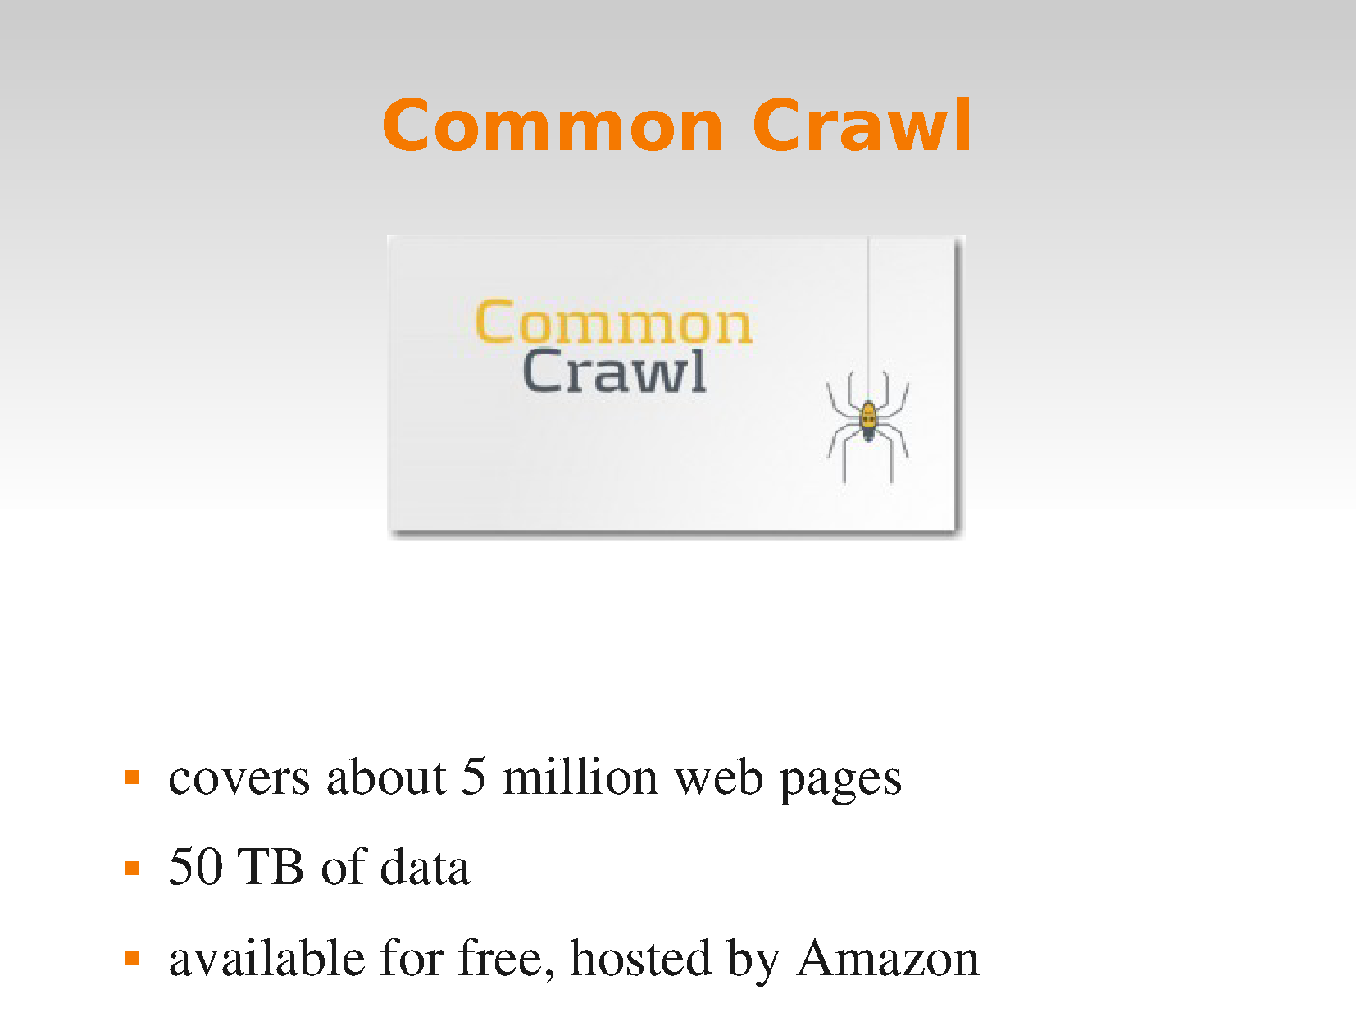

Slide 36
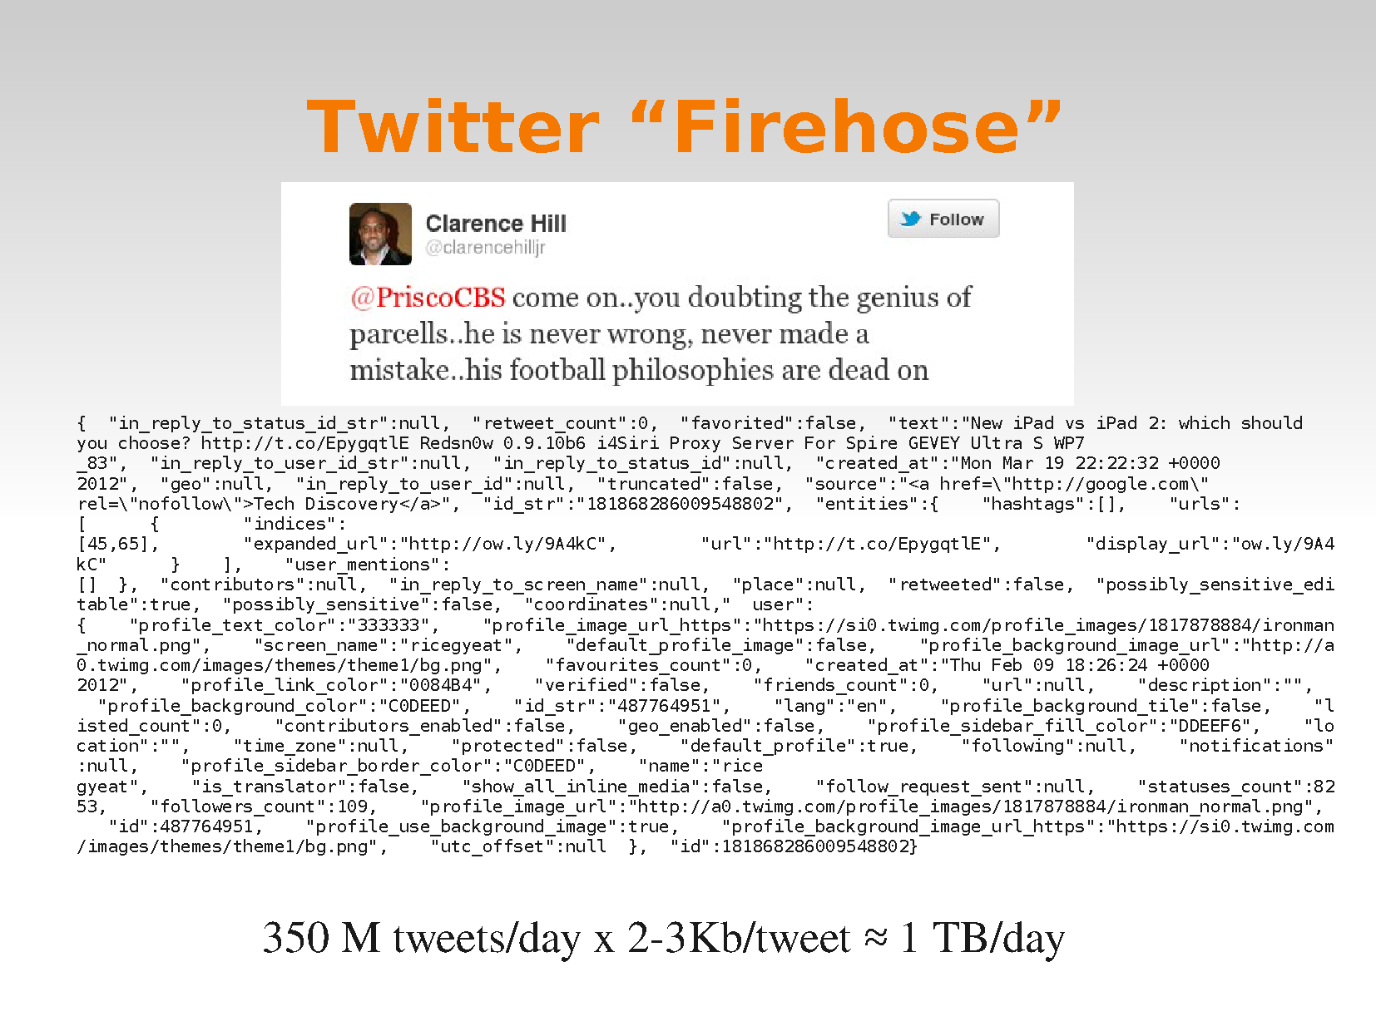

Slide 37
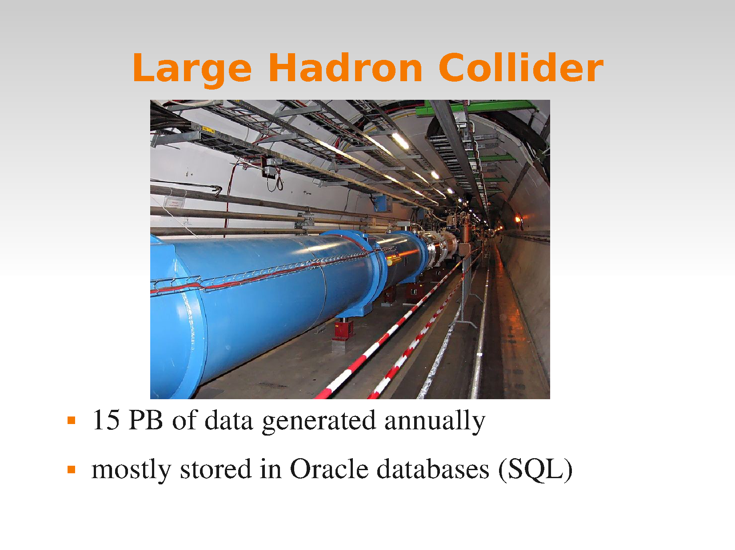

Slide 38
Storing BIG DATA

Slide 39

Core Components of Big Data Architecture
 Recall the core components of Big Data architecture below
HDFS provides the data storage
MapReduce provides Batch processing
Integration
Data Processing (MapReduce)
Security
Operations
Data Storage
(HDFS)

Slide 40
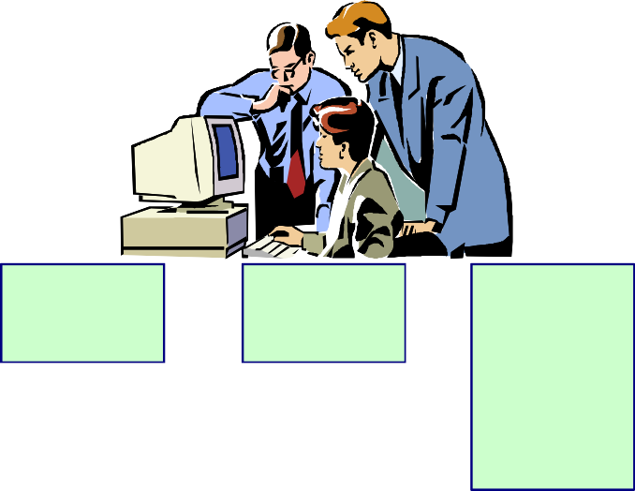
Pig, Hive, and Impala in Big Data Architecture
 Position of Pig, Hive, and Impala in architecture are shown below
Integration
Security
Operations
Pig
Hive
Impala
Map Reduce
Data Storage

Slide 41
The Storage Dilemma
 Cheap storage means organizations have the ability to store more data than ever before
 They also have access to more types of data
Structured
Unstructured
 Meeting the challenges of Big Data is a complex technical challenge
Volume
Variety
Velocity
Veracity
 The storage solution must satisfy a number of demands
4-2

Slide 42
Hadoop Distributed File System (HDFS)
 Designed for large-scale data processing
Allows storage of large data files > 100TB in one file
 Runs on top of native file system on each node
 Data is stored in units known as blocks
64MB (default) although normally larger
Each block is actually stored as a file
 Large files are stored in many blocks over many nodes
Enables file to be bigger than individual disks in Hadoop cluster
 Blocks are replicated to multiple nodes
Allows for node failure without loss of data
TB = terabyte

Slide 43
HDFS Blocks and Replication
 Consider a file loaded into HDFS
Blocks are distributed across nodes
Replicated by a configurable amount (known as the replication factor)
File
Block 1
Block 2
Block 3
Node 1
Node 2
Node 3
Block 1
Block 1
Block 3
Block 2
Block 3
Block 2

Slide 44
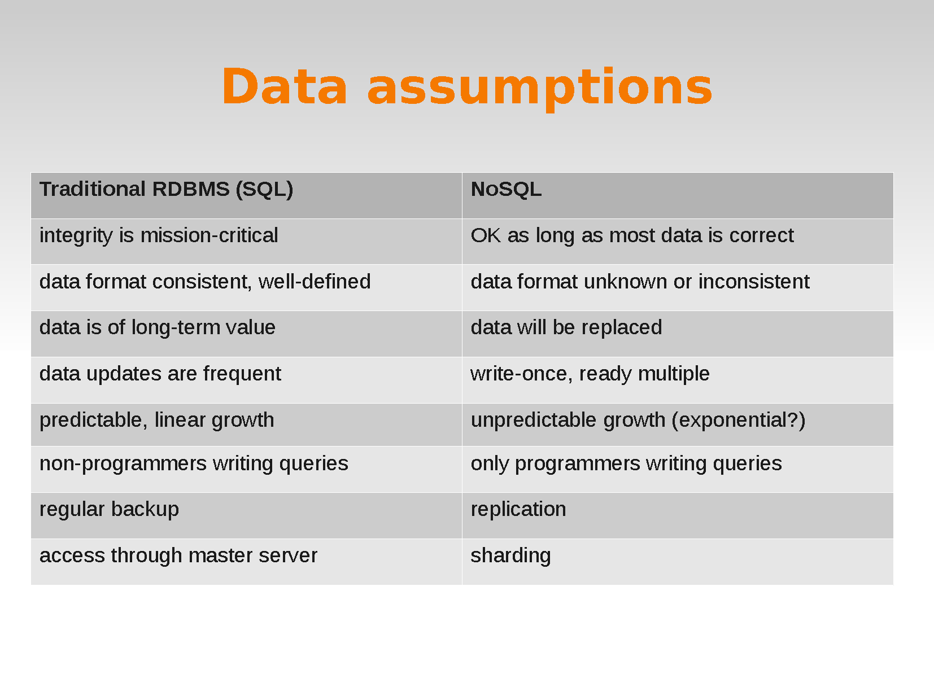

Slide 45
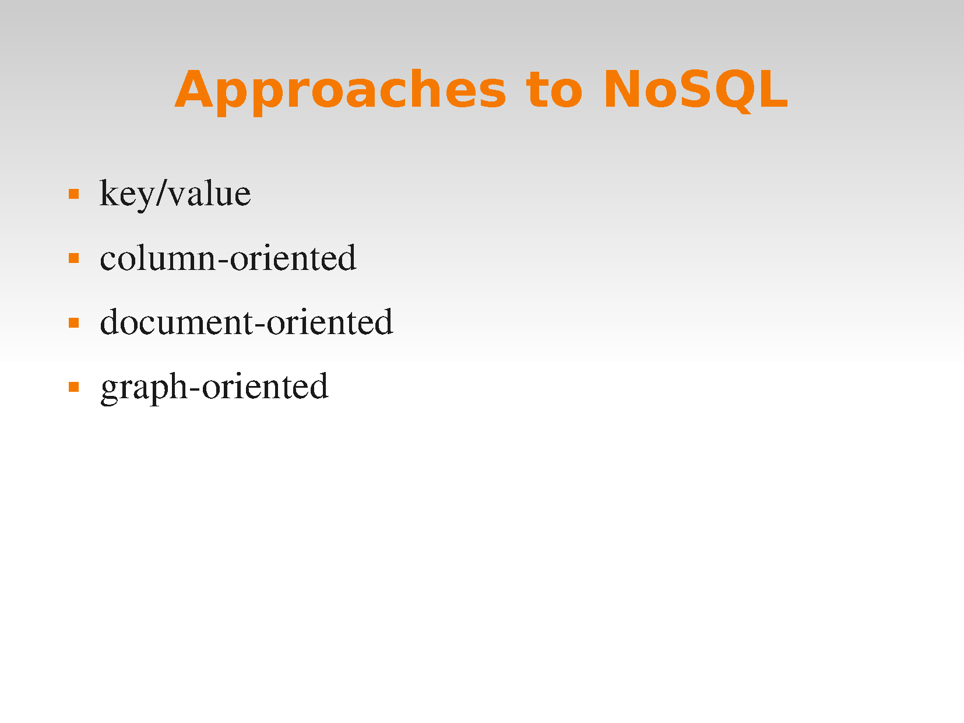

Slide 46
MapReduce
MapReduce is a programming model and an associated implementation for processing and generating large data sets with a parallel, distributed algorithm on a cluster.
A MapReduce program is composed of a Map() procedure that performs filtering and sorting (such as sorting students by first name into queues, one queue for each name) and a Reduce() procedure that performs a summary operation (such as counting the number of students in each queue, yielding name frequencies).

Slide 47
