Slide 1
IS3S662 Data Warehouse and Data Mining
DR ALEX LOHFINK

Slide 2
objectives
Know about:
DATA WAREHOUSE ARCHITECTURE
OLAP MOLAP AND ROLAP
STAR, SNOWFLAKE, STAR CONSTELLATION SCHEMAS
DATA MINING
Clustering
Classification
Association rule mining

Slide 3
Business Intelligence Benefits
Main goal: improved decision making
Other benefits
Integrating architecture
Common user interface for data reporting and analysis
Common data repository fosters single version of company data
Improved organizational performance

Slide 4
Decision Support Data
BI effectiveness depends on quality of data gathered at operational level
Operational data seldom well-suited for decision support tasks
Need reformat data in order to be useful for business intelligence

Slide 5
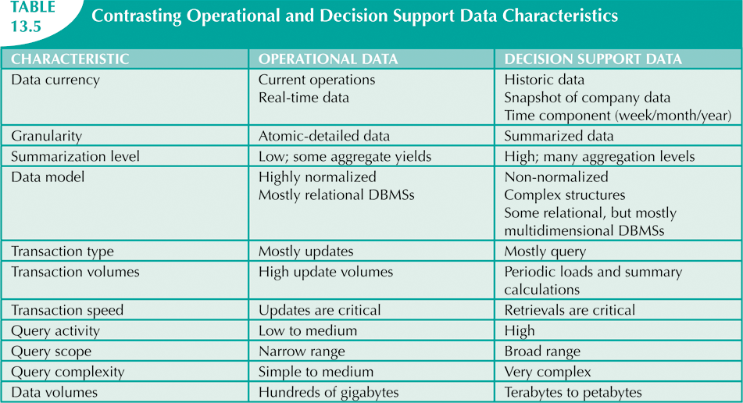

Slide 6
Decision Support Database Requirements (cont’d.)
Database schema
Complex data representations
Aggregated and summarized data
Queries extract multidimensional time slices
Data extraction and filtering
Supports different data sources
Flat files
Hierarchical, network, and relational databases
Multiple vendors
Checking for inconsistent data

Slide 7
Decision Support Database Requirements (cont’d.)
Database size
In 2008 – Wal-Mart had 2.5 petabytes of data its data warehouses
2013 - eBay has two systems in place.
Its primary data warehouse is 9.2 petabyes;
its “singularity system” that stores web clicks and other “big” data is more than 40 petabytes. It has a single table that’s 1 trillion rows.
DBMS must support very large databases (VLDBs)

Slide 8
The Data Warehouse
Integrated, subject-oriented, time-variant, and nonvolatile collection of data
Provides support for decision making
Usually a read-only database optimised for data analysis and query processing
Requires time, money, and considerable managerial effort to create

Slide 9
Data Warehouse DBMS Requirements
Load performance
Load processing
Data quality management
Query performance
Terabyte scalability
Mass user scalability
Networked data warehouse
Warehouse administration
Integrated dimensional analysis
Advanced query functionality

Slide 10
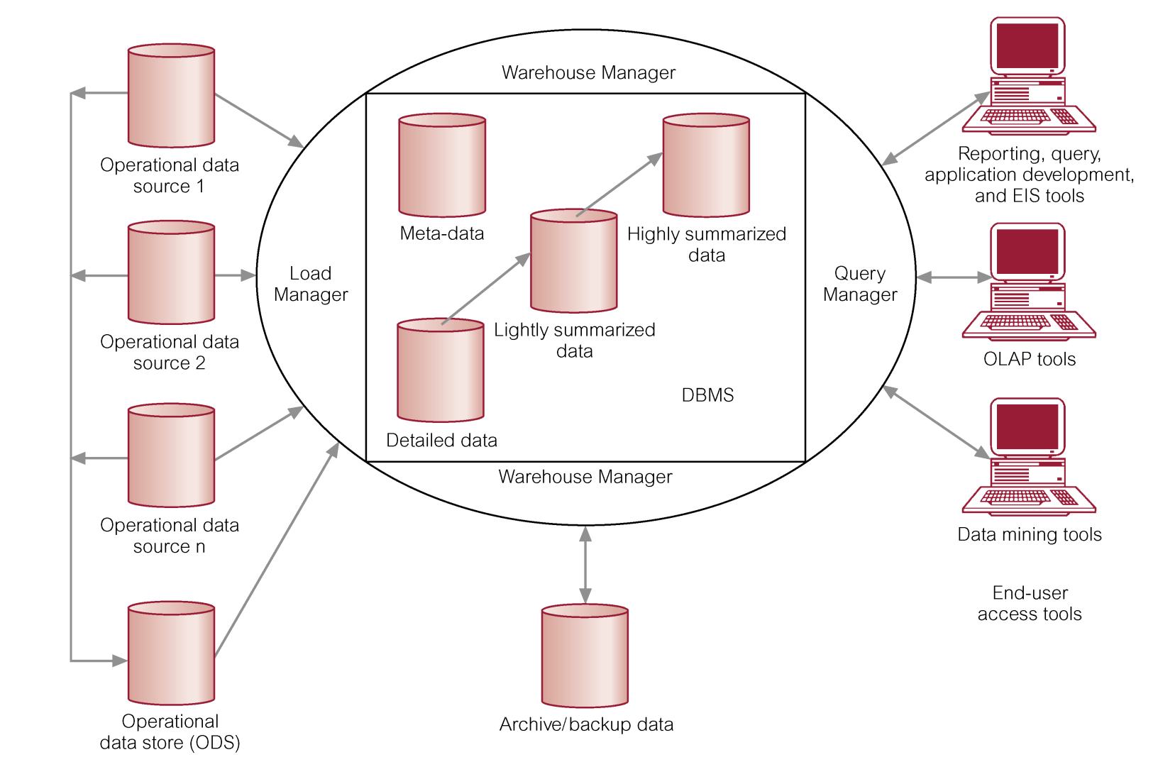
Architecture of a Data Warehouse and its Data Flows

Slide 11
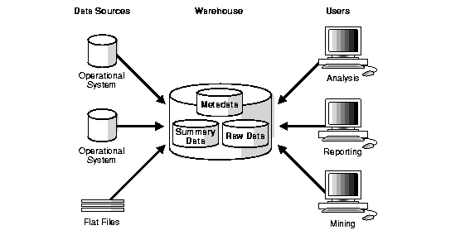

Slide 12
Data Warehouse Information Flows
Inflow - Processes associated with the extraction, cleansing, and loading of the data from the source systems into the data warehouse.
Upflow - Processes associated with adding value to the data in the warehouse through summarizing, packaging, and distribution of the data.

Slide 13
Data Warehouse Information Flows
Downflow - Processes associated with archiving and backing-up/recovery of data in the warehouse.
Outflow - Processes associated with making the data available to the end-users.
Metaflow - Processes associated with the management of the metadata.

Slide 14
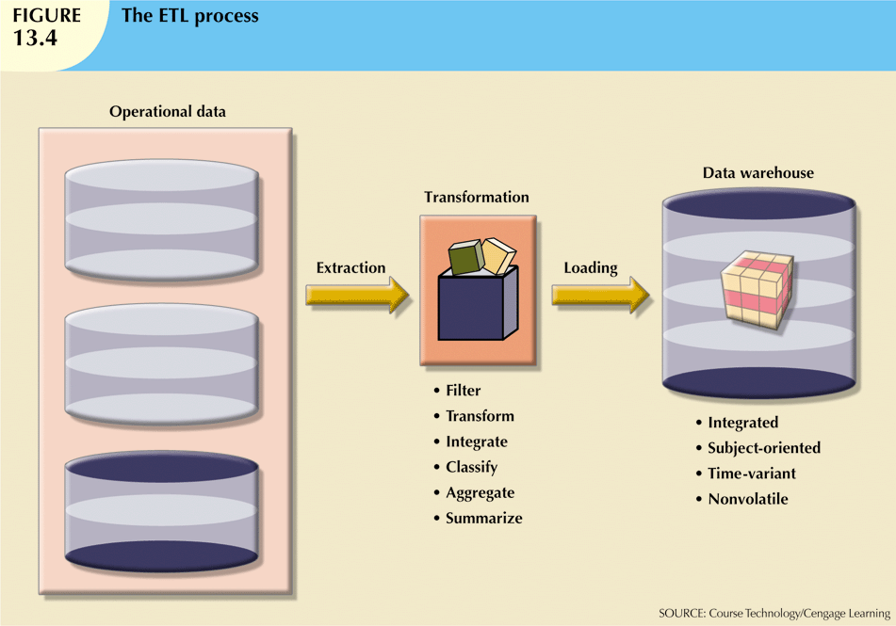

Slide 15
Online Analytical Processing
Three main characteristics:
Multidimensional data analysis techniques
Advanced database support
Easy-to-use end-user interfaces

Slide 16
Multidimensional Data Analysis Techniques
Data is processed and viewed as part of a multidimensional structure
Augmented by the following functions:
Advanced data presentation functions
Advanced data aggregation, consolidation, and classification functions
Advanced computational functions
Advanced data modeling functions

Slide 17
OLAP Architecture
Three main architectural components:
Graphical user interface (GUI)
Analytical processing logic
Data-processing logic

Slide 18
OLAP Architecture (cont’d.)
Designed to use both operational and data warehouse data
In most implementations, data warehouse and OLAP are interrelated and complementary
OLAP systems merge data warehouse and data mart approaches

Slide 19
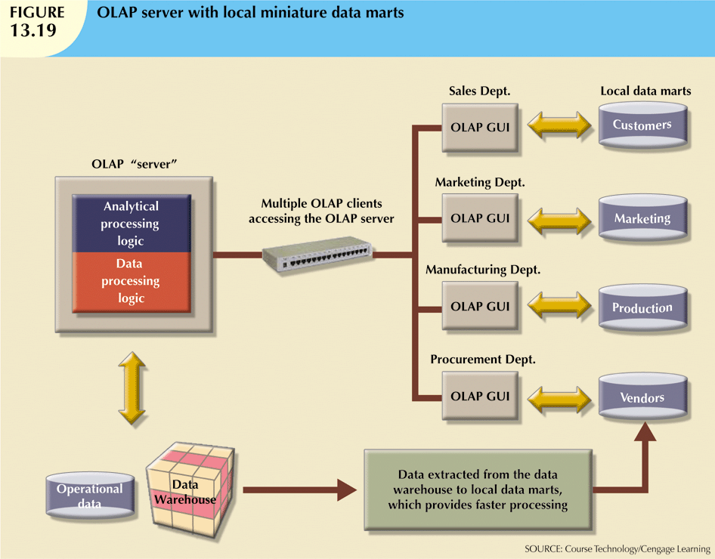

Slide 20
Relational OLAP
Relational online analytical processing (ROLAP) provides the following extensions:
Multidimensional data schema support within the RDBMS
Data access language and query performance optimized for multidimensional data
Support for very large databases (VLDBs)

Slide 21
Multidimensional OLAP
Multidimensional online analytical processing (MOLAP) extends OLAP functionality to multidimensional database management systems (MDBMSs)
MDBMS end users visualize stored data as a 3D data cube
Data cubes can grow to n dimensions, becoming hypercubes
To speed access, data cubes are held in memory in a cube cache

Slide 22
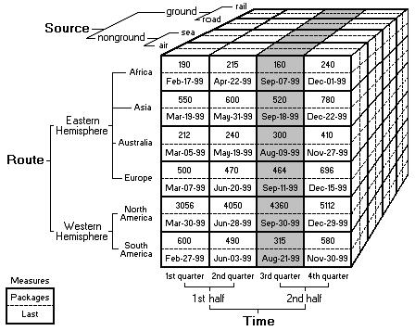

Slide 23
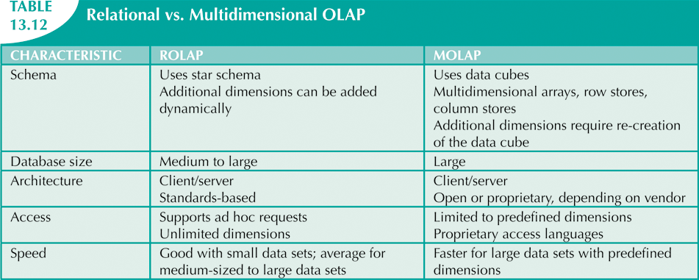

Slide 24
Star Schemas
Data-modeling technique
Maps multidimensional decision support data into relational database
Creates near equivalent of multidimensional database schema from relational data
Easily implemented model for multidimensional data analysis while preserving relational structures
Four components: facts, dimensions, attributes, and attribute hierarchies

Slide 25
Facts
Numeric measurements that represent specific business aspect or activity
Normally stored in fact table that is center of star schema
Fact table contains facts linked through their dimensions
Metrics are facts computed at run time

Slide 26
Dimensions
Qualifying characteristics provide additional perspectives to a given fact
Decision support data almost always viewed in relation to other data
Study facts via dimensions
Dimensions stored in dimension tables

Slide 27
Attributes
Use to search, filter, and classify facts
Dimensions provide descriptions of facts through their attributes
No mathematical limit to the number of dimensions
Slice and dice: focus on slices of the data cube for more detailed analysis

Slide 28
Star Schema Representation
Facts and dimensions represented in physical tables in data warehouse database
Many fact rows related to each dimension row
Primary key of fact table is a composite primary key
Fact table primary key formed by combining foreign keys pointing to dimension tables
Dimension tables are smaller than fact tables
Each dimension record is related to thousands of fact records

Slide 29
ROLAP: Dimensional Modeling Using Relational DBMS
Special schema design (dimensions): star, snowflake
Special indexes: bitmap, multi-table join
Proven technology (relational model, DBMS), tend to outperform specialized MDDB especially on large data sets
Products
IBM DB2, Oracle, Sybase IQ, Informix
Notes:
29

Slide 30
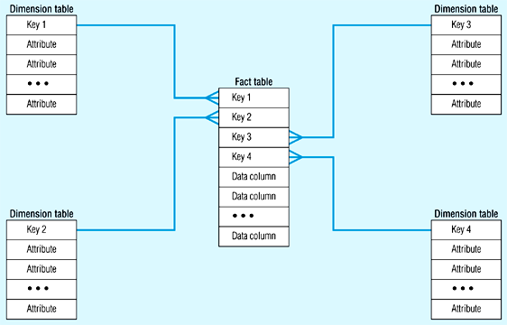
Star Schema (in RDBMS)
Notes:
30

Slide 31
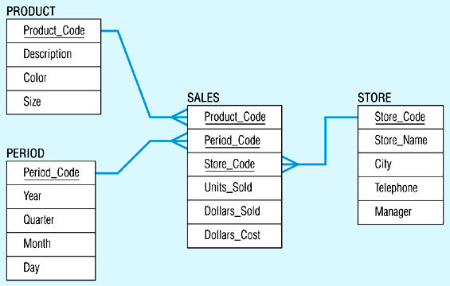
Star Schema Example
A single fact table, with detail and summary data
Fact table primary key has only one key column per dimension
Each key is generated
Each dimension is a single table, highly de-normalised
Notes:
31

Slide 32
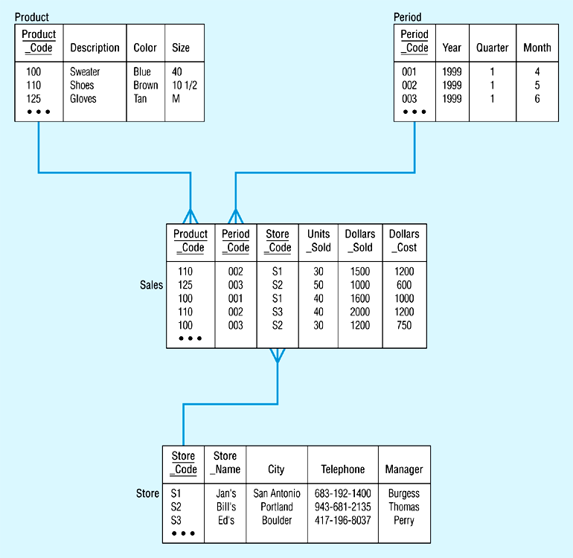
Star Schema with Sample Data
Notes:
32

Slide 33
Data Mart
A subset of a data warehouse that supports the requirements of a particular department or business function.
Characteristics include
Focuses on only the requirements of one department or business function.
Do not normally contain detailed operational data unlike data warehouses.
More easily understood and navigated.

Slide 34
Reasons for Creating a Data Mart
To give users access to the data they need to analyze most often.
To provide data in a form that matches the collective view of the data by a group of users in a department or business function area.
To improve end-user response time due to the reduction in the volume of data to be accessed.

Slide 35
Data Mining

Slide 36
Data Mining
Data-mining tools do the following:
Analyze data
Uncover problems or opportunities hidden in data relationships
Form computer models based on their findings
Use models to predict business behavior
Runs in two modes
Guided
Automated

Slide 37
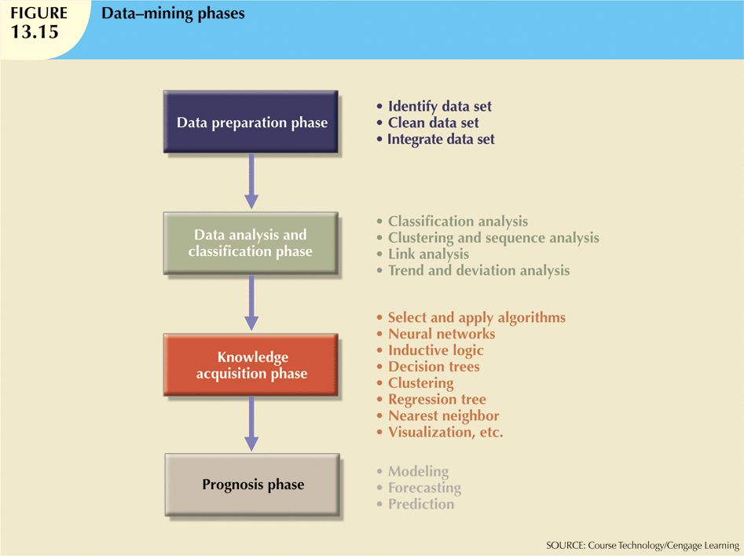

Slide 38
Clustering
Process of partitioning a set of data (or objects) into a set of meaningful sub-classes, called clusters.
Help users understand the natural grouping or structure in a data set.
Used either as a stand-alone tool to get insight into data distribution or as a preprocessing step for other algorithms.
Referred to as unsupervised learning because there is no set target

Slide 39
Classification
Predicts an outcome based on input data
Separates data into various categories
Comprises assigning a class label to a set of unclassified data sets
Thus, classification is categorized as supervised learning
Classification uses two data sets
The training set (seen data) to build the model
The observations have already been classified
The test set (unseen data) to measure its performance in terms of its error rate
Percentage of incorrectly classified instances in the data set

Slide 40
Association rules
discovers the probability of the co-occurrence of items in a collection.
The relationships between co-occurring items are expressed as association rules
often used to analyze sales transactions.

Slide 41
OLAP V DATA MINING
Data mining is the field of computer science which, deals with extracting interesting patterns from large sets of data. It combines many methods from artificial intelligence, statistics and database management.
OLAP (online analytical processing) as the name suggest is a compilation of ways to query multi-dimensional databases.

Slide 42
The end…

