Slide 1
Distributed databases 1
Dr alex lohfink

Slide 2
Distributed DBMSs
Learning objectives:
Architectures for DBMSs
Describe the essential characteristics of Distributed database systems
Understand the main design issues concerned with distributed DBMS
Horizontal and vertical fragmentation
Replication

Slide 3
Architectures for DBMSs
Compare:
Centralized database
Client-server databases
Distributed

Slide 4
Centralized Database
Mainframe
DB

Slide 5
Centralised Database
Central node holds the database
All processing is done centrally
All system components are accessed remotely via terminals
Local nodes sent copies of the relevant data for local use

Slide 6
Centralised Database
Advantages
Cost - economies of scale (hardware, software and operations)
Easier overall control over database (backup & recovery, security)
Disadvantages
Data are not readily accessible to users at remote site
data communication costs may be high
the database system fails totally when the central system fails

Slide 7
Advent of Client Server Processing
Cost of hardware fell
Mainframes replaced by PC’s and workstations
More processing moved to user side

Slide 8
Client-server Databases
Application processing is divided between client and server
Loosely coupled system
The client functions
user interface
local processing
server functions
Database functions
Additional functionality

Slide 9
Client-server Architecture
Client
Database
Server
User Interface
Application Logic
Application Logic
DBMS Functions

Slide 10
Servers
Responsible for:
Database storage/access
Integrity checking
Security
Data dictionary maintenance
Concurrent access management (locking etc)
Query optimisation
Recovery

Slide 11
Client
Responsible for:
User interface
Presenting data
Handling local devices (e.g. Printers)
Application Logic
Written in Excel, Report writer, 3GL, 4GL etc
Includes processing of forms, reports , menus

Slide 12
Client/server Benefits
Costs low
Delivers impressive computing power at a fraction of the costs of mainframe
Server working with current data
Data in one place so there is improved control of backup, recovery and security

Slide 13
Client/Server Benefits cont’d
Processing can be carried out on the appropriate machine reduces network traffic
Increased scalability.

Slide 14
Disadvantages of Client Server Architecture
Increased complexity
Network
Programming interfaces
Increased security

Slide 15
Terminology
Distributed Database: a logically interrelated collection of shared data physically distributed over a network
Distributed DBMS: software to manage a distributed db and make the distribution transparent to users
Distributed Processing – this is NOT necessarily a DDB since data may be centralised
Parallel DBMS – data and/or processing is distributed and run in parallel only for performance improvement
Notes:
Parallel DBMS – “only for perf improvement” – not because data is physically split whilst belonging logically together! These may be Shared Memory (but have many processors and many disks), Shared Disk (many processors, many memories and many shared disks), Shared Nothing (Memory, Processor and Disk at every location). Such version available from all major DBMS vendors for Data warehousing.

Slide 16
What do we mean by distributed?
Full support for distributed databases implies a single application should be able to operate transparently on data:
that is spread across a variety of different databases,
managed by a variety of different DBMSs,
running on a variety of different machines,
supported by a variety of different operating systems
and connected together by a variety of different communications networks
Notes:
The term transparently means that the application operates from a logical point of view as if the data were all managed by a single DBMS running on a single machine

Slide 17
Distributed Database
Data is partitioned into ‘fragments’ – these may be replicated
Fragments are allocated to different sites
Each site is managed by a DBMS
Each DBMS may handle ‘Local applications’ but must handle at least one ‘Global application’
There may be a variety of different DBMSs (heterogeneous)
running on a variety of different machines,
supported by a variety of different operating systems
and connected together by a variety of different communications networks
Notes:
The term transparently means that the application operates from a logical point of view as if the data were all managed by a single DBMS running on a single machine

Slide 18
A typical distributed DB system
Communication
Network
New York
London
Singapore

Slide 19
Components of a dds
The User Interface Handler
interprets user commands (typically in SQL) and formats results.
The Semantic Data Controller
performs authorisation checks to identify if the query can be processed.
The Global Query Optimiser
identifies and evaluates alternative ways of executing the query
The Global Execution Monitor
coordinates the execution of the query/request, and is responsible for global transaction management.
The Local DBMS
provides standard DBMS features, and cooperates, for example, in global transaction management.

Slide 20
Advantages
local control of data
improved performance
improved reliability and availability
cost effectiveness
scalability
shareability
Notes:
Local control of data - on-the-spot changes and local knowledge available
Improved performance – a) data placed nearest site of greatest demand
b) splitting up reduces size and complexity of local use
Improved reliability and availability - if 1 site goes down a) others not affected
b) data may be available elsewhere
Lower costs a) many smaller hardware units cheaper – and scalable
b) use of distant data can be aided by having local copies – reduce network costs
Scalability = Expandability
Sharability – removes islands of info

Slide 21
Disadvantages
lack of experience
complexity
cost
distribution of control
security
difficulty of managing change
duplication of data (essential for backup purposes)
Notes:
Lack of experience – of technology, of the politics concerning data ownership and rights,
Complexity – of setup, of control, of processing (queries), of recovery, of security.
Cost – procurement and maint, new HW if none already there, new/improved network if necessary.

Slide 22
Factors to complicate matters
replication of data
DDB design
partitioning
distributed query processing
distributed directory management
concurrency
deadlock management
reliability
OS support
heterogeneous databases
All factors are interrelated
Notes:
Heterogeneous – mapping data structures, translating the query language. May need a ‘getway’ to handle xlation. Issues from this – e.g. does the gateway handle concurrency control?
Semantic heterogeneity: e.g. attributes with same name are different things, e.g. attributes with different names mean the same thing.

Slide 23
DDB-Specific Design
Techniques
Fragmentation of tables– horizontal and vertical
Allocation of fragments – where stored
Replication of fragments – optional
Considerations
Each transaction’s frequency, performance required, site from which run, data accessed

Slide 24
Considerations (Fragmentation, Allocation, Replication)
For the data used by the most active 20% of queries consider:
Locality of Reference
Reliability and Availability
Acceptable performance
Storage capacities and costs
Communication costs
Notes:
Locality of reference: put close to where most needed. If needed at many sites the Replicate
Reliability and Availability: improved by Replication
Performance: avoid bottlenecks whilst balancing use of resources
Storage: consider what’s available at each site. Consider cheap mass storage (clusters). Balance against Locality of Reference above.
Comms costs: reduced if increase Locality of Reference. Increased Replication reduces read traffic but is increases by Update/Write traffic.

Slide 25
Fragmentation (Partitioning)
The database is divided into disjoint (non-overlapping) fragments
Each fragment is assigned to a particular site
Each fragment may be a single relation or set of relations
Each fragment is held at the node with the highest activity with regard to that fragment

Slide 26
Types of Fragmentation
Horizontal Fragmentation
the rows of a relation are distributed to many sites
Vertical Fragmentation
columns of a relation are projected to several sites sites
Combination of both

Slide 27
Fragmentation Advantages/Disadvantages
Advantages as before
Disadvantages (additional)
Inconsistent access speed
Backup vulnerability
usage cannot switch to another site where a copy exists
data may be lost if proper backup is not performed at each site

Slide 28
Horizontal or Vertical Fragmentation?
Horizontal fragmentation
used when organisational functions are replicated
but each is only concerned with a subset of the entity instance.
often based on geography.
Vertical fragmentation
typically applied across organisational functions with reasonably separate data requirements

Slide 29
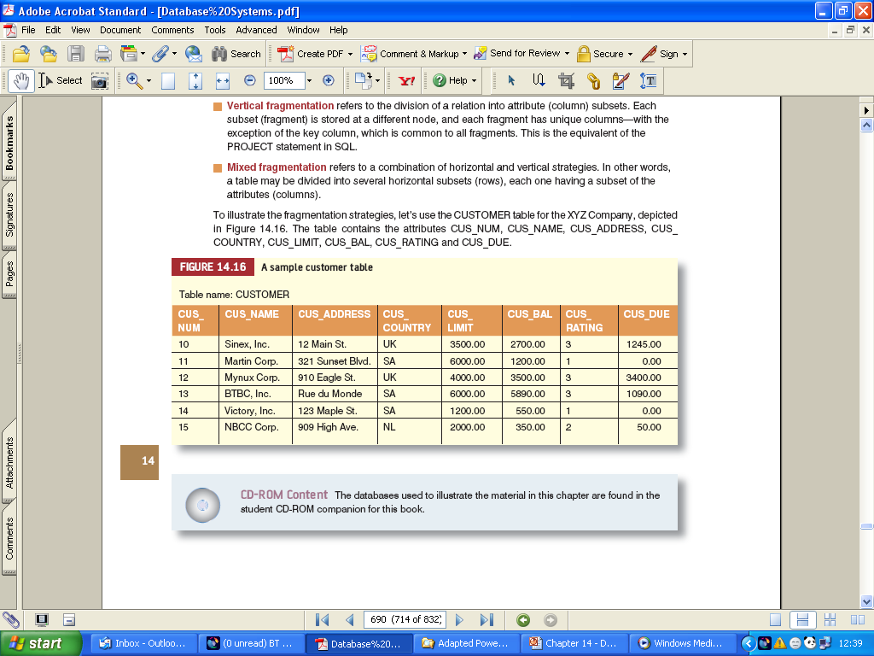
Data Fragmentation (continued)
Sample Customer File

Slide 30
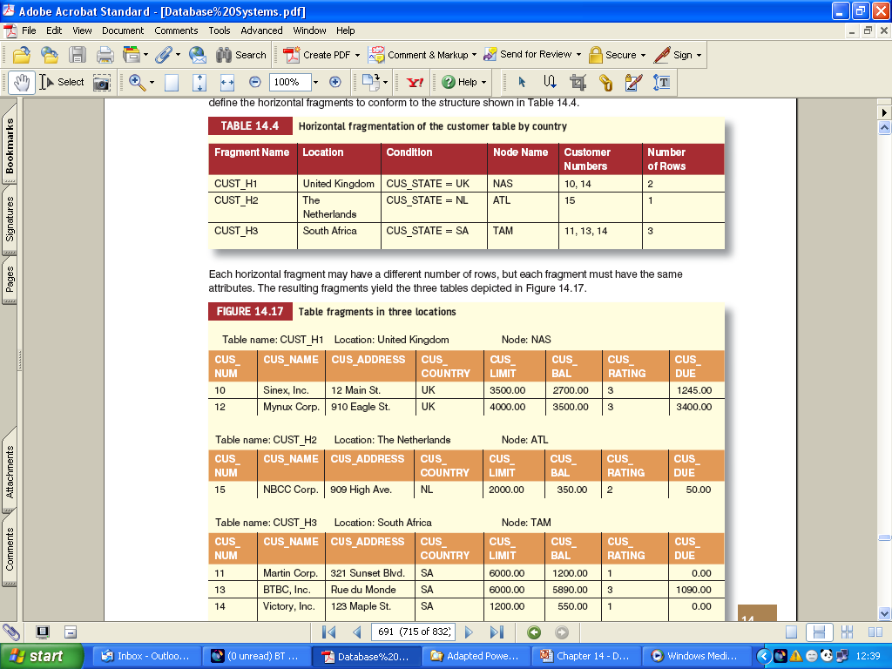
Data Fragmentation (continued)
Horizontal Fragmentation Based on the Country Column

Slide 31
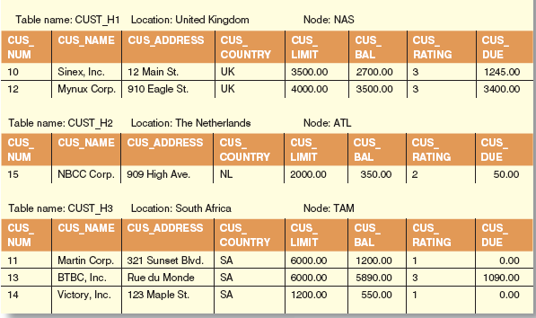
Data Fragmentation (continued)
Fragments at 3 Locations

Slide 32
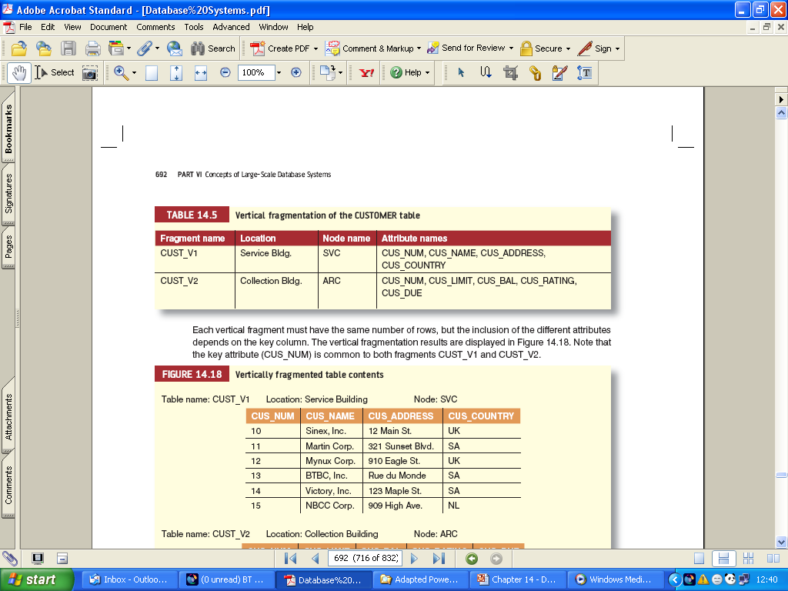
Data Fragmentation (continued)
Vertical Fragmentation of Customer File

Slide 33
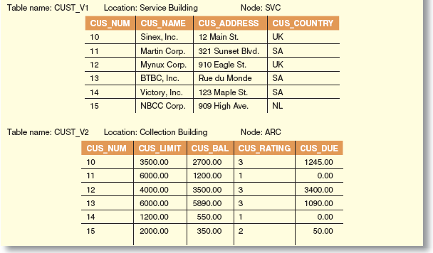
Data Fragmentation (continued)
Vertically Fragmented Tables Contents

Slide 34
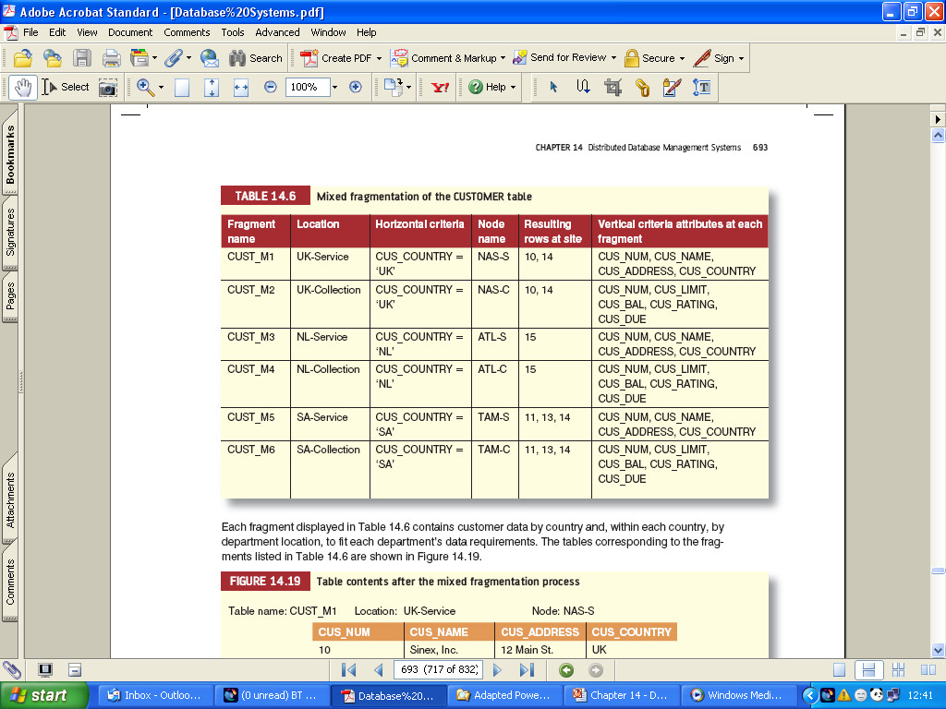
Data Fragmentation (continued)
Mixws Fragmentation of Customer Table

Slide 35
Replication
A full copy of the database is assigned to more than one site in the network
Complete and selective replication
Maximises local access to data
Disadvantage
creates update problems since each database change must be reliably processed and synchronised at all of the sites.

Slide 36
Synchronous vs. Asynchronous Replication
Synchronous
Before an update transaction commits, it synchronizes all copies of modified data
Asynchronous
Copies of an updated transaction are updated only periodically
Transaction that reads different copies of the same relation may see different values for short periods of time
Method is acceptable in many situations

Slide 37
Hybrid
The database is partitioned into critical and non-critical fragments
Non-critical fragments are stored at only one site
Critical fragments are stored at multiple sites

Slide 38
DDBMS – overriding principle
Almost unlimited combinations of the preceding strategies
Some data may be stored centrally
other data are replicated at sites
Also both horizontal and vertical partitions may be desirable
But
data should be stored at the sites where they will be accessed most frequently

