Slide 1
Data fragmentation
Dr alex lohfink

Slide 2
SYMBOLS:
σ - selection
∪ - union
⋈ - Natural join
⋉ - semijoin
Π - projection

Slide 3
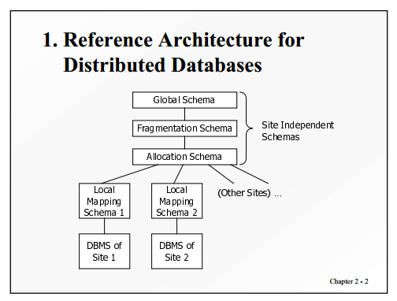

Slide 4
Data Fragmentation
Fragment
Can be defined by an expression in a relational language which takes global relation as operands and produces the fragment as result
Types of fragmentation
Horizontal fragmentation
Derived horizontal fragmentation
Vertical fragmentation
Mixed fragmentation

Slide 5
Rules of fragmentation
Completeness condition
All data of global relation must be mapped into fragments
Reconstruction condition
Always possible to reconstruct the global relation from the fragments
Disjointness condition
Useful mainly for horizontal fragmentation
Relaxed for vertical fragmentation

Slide 6
Completeness
– Decomposition of relation R into fragments R1,R2, . . . ,Rn is complete iff each data item in R can also be found in some Ri.
• Reconstruction
– If relation R is decomposed into fragments R1,R2, . . . ,Rn, then there should exist some relational operator ∇ that reconstructs R from its fragments, i.e., R = R1∇. . .∇Rn
∗ Union to combine horizontal fragments
∗ Join to combine vertical fragments
• Disjointness
– If relation R is decomposed into fragments R1,R2, . . . ,Rn and data item di
appears in fragment Rj , then di should not appear in any other fragment Rk, k 6= j
(exception: primary key attribute for vertical fragmentation)
∗ For horizontal fragmentation, data item is a tuple
∗ For vertical fragmentation, data item is an attribute

Slide 7
Horizontal Fragmentation
Partitioning tuples of a global relation into subsets
Example:
Supplier(SNum, Name, City)
SNum is a supplier number
Horizontal fragmentation can be: Supplier₁ = σ _{City = “London”} Supplier
Supplier₂ = σ _{City = “Cardiff”} Supplier
Reconstruction is possible: Supplier = Supplier₁ ∪ Supplier₂
The set of predicates defining all the fragments must be complete, and mutually exclusive

Slide 8
Derived Horizontal Fragmentation
The horizontal fragmentation is derived from the horizontal fragmentation of another relation
Example:
Supply(SNum, Pnum, DeptNum, Qty)
Supply₁ = Supply ⋉_{SNum=SNum} Supplier₁
Supply₂ = Supply ⋉_{SNum=SNum} Supplier₂
⋉ is the semi-join operation
The predicates defining derived horizontal fragments are: Supply.SNum=Supplier.SNum and Supplier. City = “London“ Supply.SNum = Supplier.SNum and Supplier. City = “Cardiff"

Slide 9
Vertical Fragmentation
The vertical fragmentation of a global relation is the subdivision of its attributes into groups
Fragments are obtained by projecting the global relation over each group
Example: Employee(ENum, Name, Sal, Tax, Mnum, DNum)
The vertical fragmentation can be:
Employee₁ = Π_{Enum,Name,Mnum,DNum} Employee
Employee₂ = Π_{Enum,Sal,Tax} Employee
Reconstruction:
Employee = Employee₁ ⋈ Employee₂

Slide 10
Mixed Fragmentation
More complex fragments can be defined using mixed fragmentation.
Mixed fragments are represented by fragmentation tree, with root as global relation, the leaves as fragments, and intermediate nodes correspond to intermediate results of the fragment defining expressions.
The set of nodes which are children of a given node represent the decomposition of this node by a fragmentation operation (vertical or horizontal)

Slide 11
Mixed Fragmentation
EMP1 =Π ENum,Name, Sal, Tax σDNum≤10 (EMP)
EMP2 =Π ENum,MNum, DNum σDNum≤10 (EMP)
EMP3 =Π ENum,Name, DNum σDNum>10 (EMP)
EMP4 =Π ENum,MNum, Sal, Tax σDNum>10 (EMP)
EMP
H
EMP1
V
EMP2
EMP3
V
EMP4

Slide 12
transparency
Transparency hides some aspect of the distribution from the user; an illusion may be provided that the data is not distributed”
Network transparency: there should be no difference in the way that local and remote data is addressed:
Location transparency: commands are independent of the location of the data.
Naming transparency: each schema object has a unique name.
Replication transparency: programs should be unchanged in the presence or absence of replicated data. Data may be replicated for reasons of performance or reliability.
Fragmentation transparency: programs should be able to operate in the same way over a database using different fragmentation schemes (e.g. vertical or horizontal fragmentation).
Language transparency: programs should be able to operate in the same way over databases that use different languages (e.g. SQL or OQL).

Slide 13
Distribution Transparency: Example
A Simple Application:
Supplier(SNUM, Name, City) Dom(City) = {“London”, “Cardiff”}
Horizontally fragmented into: Supplier₁ = σ _{City = “London”} Supplier Supplier₂ = σ _{City = “Cardiff”} Supplier
Application:
Read the supplier number from the terminal and return the name of the supplier with that number
Parameters to SQL queries are prefixed with “$”
Control variables from DDBMS are prefixed with “#”

Slide 14
Level 1: Fragmentation Transparency
DDBMS
Supplier₁
Site₁
Database
Operation
Supplier₂
Site₂
Supplier₂
Site₃
Read(terminal, $Snum);
Select Name into $Name
From Supplier
Where Snum = $Snum;
Write(terminal, $Name);
The DDBMS interprets the
database operation by
accessing the databases at
different sites in a way which
is completely determined by
the system.

Slide 15
Level 2: Location Transparency
DDBMS
Site₁
Supplier₁
Database
Operations
either
Supplier₂
Site₂
or
Supplier₂
Site₃
Read(terminal, $Snum);
Select Name into $Name
From Supplier₁
Where Snum = $Snum;
If not #FOUND then
Select Name into $Name
From Supplier₂
Where Snum = $Snum;
Write(terminal, $Name);
The application is independent from changes in allocation schema, but not from changes to fragmentation schema.

Slide 16
Level 3: Local Mapping Transparency
DDBMS
Site₁
Database
Operations
Supplier₁
Supplier₂
Site₃
Read(terminal, $Snum);
Select Name into $Name
From Supplier₁ at Site₁
Where Snum = $Snum;
If not #FOUND then
Select Name into $Name
From Supplier₂ at Site₃
Where Snum = $Snum;
Write(terminal, $Name);
The applications have to specify both the fragment names and the sites where they are located. The mapping of database operations specified in applications to those in DBMSs at sites is transparent.

Slide 17
Level 4: No Transparency
SUPINQUIRY;
Read(terminal,$Snum);
$SupIMS($SNum,$Found,$Name) at Site1;
If not #Found
$SupCODASYL(#SNum, $Found, $Name) at Site3;
Write(terminal,$Name);
DDBMS
SupCODASYL(…);
Find Sup_Record;
-
SupIMS(…);
Get unique Sup_Segment;
-
Local DBMS
(CODASYL)
Local DBMS
(IMS)
CODASYL Database
IMS Database
Site3
Site1

Slide 18
Distribution Transparency for Updates
Difficult Problems:
Broadcasting updates to all copies
Migration of tuples because of update of fragment defining attributes (fragmentation attributes)

Slide 19
An Update Application
EMP1 =Π _{ENum,Name, Sal, Tax} σ_{DNum≤10} (EMP)
EMP2 =Π _{ENum,MNum, DNum} σ_{DNum≤10} (EMP)
EMP3 =Π _{ENum,Name, DNum} σ_{DNum>10} (EMP)
EMP4 =Π _{ENum,MNum, Sal, Tax} σ_{DNum>10} (EMP)
EMP
H
EMP1
V
EMP2
EMP3
V
EMP4
Update DNum as 15 for Employee number 100
EMP1
ENum | Name | Sal | Tax
100 | Ann | 100 | 10
EMP2
ENum | MNum | DNum
100 | 20 | 10
Before Update
After Update
EMP3
ENum | Name | DNum
100 | Ann | 15
EMP4
ENum | MNum | Sal | Tax
100 | 20 | 100 | 10

Slide 20
Update – Level 1: Fragmentation Transparency
UPDATE Emp
SET DNum = 15
WHERE ENum = 100;

Slide 21
Update – Level 2: Location Transparency
Select Name, Tax, Sal into $Name, $Sal, $Tax
From EMP1
Where ENum = 100;
Select MNum into $MNum
From EMP2
Where ENum = 100;
Insert into EMP3(ENum, Name, DNum) (100,$Name, 15);
Insert into EMP4(ENum,Sal, Tax, MNum) (100,$Sal,$Tax, $MNum);
Delete EMP1 Where ENum = 100;
Delete EMP2 Where Euum = 100;

Slide 22
Update – Level 3: Local Mapping Transparency
Select Name, Tax, Sal into $Name, $Sal, $Tax
From EMP1 at site 1
Where ENum = 100;
Select MNum into $MNum
From EMP2 at site 2
Where ENum = 100;
Insert into EMP3(ENum, Name, DNum) at site 3: (100,$Name, 15);
Insert into EMP3(ENum, Name, DNum) at site 7: (100,$Name, 15);
Insert into EMP4(ENum,Sal, Tax, MNum) at site 4: (100,$Sal,$Tax, $MNum);
Insert into EMP4(ENum,Sal, Tax, MNum) at site 8: (100,$Sal,$Tax, $MNum);
Delete EMP1 at site 1 Where ENum = 100;
Delete EMP1 at site 5 Where ENum = 100;
Delete EMP2 at site 2 Where Euum = 100;
Delete EMP2 at site 6 Where Euum = 100;

Slide 23
Layers of transparency
There are tough problems in query optimization and transaction management that need to be tackled (in terms of system support and implementation) before fragmentation transparency can be supported.
Less distribution transparency the more the end-application developer needs to know about fragmentation and allocation schemes, and how to maintain database consistency.
Higher levels of distribution transparency require appropriate DDBMS support, but makes end-application developers work easy.

Slide 24
Some Aspects of top-down architecture
Distributed database technology is an “add-on” technology, most users already have populated centralized DBMSs. Whereas top down design assumes implementation of new DDBMS from scratch.
In case of OODBMs, top-down architecture makes sense because most OODBMs are going to be built from scratch.
In many application environments, such as semi-structured databases, continuous multimedia data, the notion of fragment is difficult to define.
Current relational DBMS products provide for some form of location transparency (such as, by using nicknames).

Slide 25
Architectural Models for DDBMS

Slide 26
Architectural Models for DDBMS
Multiple databases put together for sharing multiple DBMS
Classification based on
Autonomy of local systems
Distribution of local systems
Heterogeneity of local systems

Slide 27
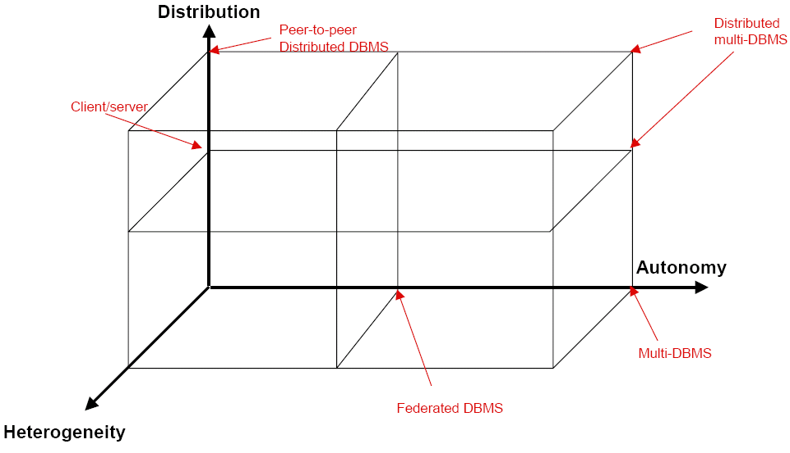
DBMS Implementation Alternatives

Slide 28
Dimensions: Autonomy
Distribution of control, not of data
Degree to which individual DBMSs can operate independently
Function of a number of factors: whether
component systems exchange information?
they can independently execute transactions?
one is allowed to modify them?
Not well understood and most troublesome!

Slide 29
Dimensions: Autonomy (contd.)
Dimension of autonomy:
Design autonomy
Communication autonomy
Execution autonomy
Classification of autonomy
Tight integration
Semiautonomous
Federated
Total isolation
Multi-database

Slide 30
Dimensions: Distribution
Distribution of data
Alternatives
No distribution
Client/server distribution
Peer-to-peer/Full distribution
No distinction of client vs. server

Slide 31
Dimensions: Heterogeneity
Various forms
Data managers
Data models
Expressive powers and limitations
Query languages
Different data access paradigms
Transaction management protocols
Networking protocols
Hardware

