Slide 1

NATIONAL INSTITUTE OF TECHNOLOGY KARNATAKA, SURATHKAL
Reduced-Parameter Water Quality Index Prediction for Data-Scarce River Systems
Evidence from 32,968 CPCB river monitoring visits, 2018–2021
Course: CV301 Environmental Engineering
Faculty: Saranya P
Team
Mayank Tiwari 241CV235
Sreenidhi Golamaru 241CV247
Krupa Marol 241CV231
Bharath Chowdary 241CV213
Srushti Dongre 241CV248
Notes:
Introduce the team and the question: can a few cheap, routinely measured parameters stand in for the full eight-parameter panel that a Water Quality Index needs? Everything shown uses real CPCB data from the National Water Data Portal.

Slide 2
Only 15% of river visits can compute a full WQI
14.7%
of 32,968 river visits report all 8 WQI parameters
75.8%
report pH, DO and BOD, the three best-covered parameters
Research question
Can reduced-parameter monitoring provide reliable WQI prediction for data-scarce river systems?
Notes:
CPCB visits rarely report the full panel. Three quarters report pH, DO and BOD, but only 14.7 percent report all eight parameters, so most visits never get a WQI. If a model can recover the full-panel index from the reduced panel, the index becomes available for about five times as many visits.

Slide 3
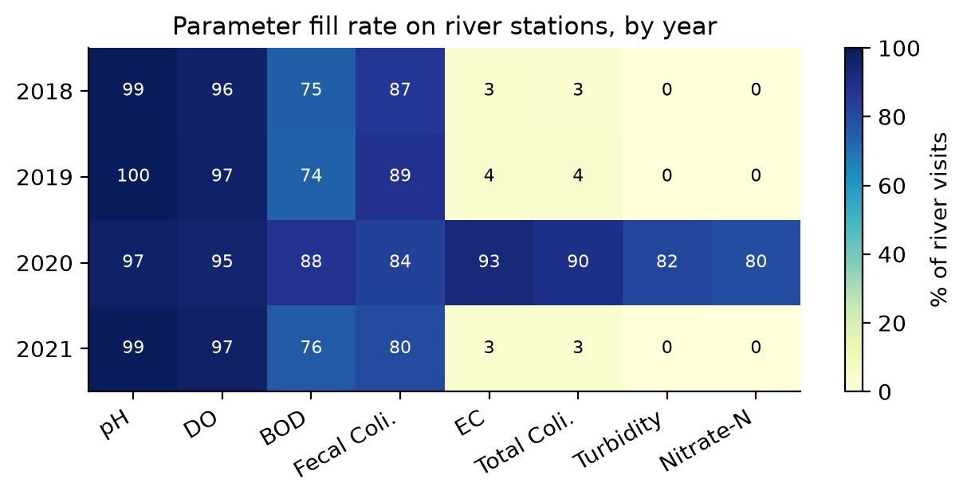
The full panel was recorded in one year only
211 raw CSVs
physical, chemical and biological tables (57 MB)
1
32,968 river visits
888 stations, 87 rivers, joined and audited
2
4,861 labelled visits
593 stations with all 8 parameters, all in 2020
3
Fill rate (% of river visits) by parameter and year
EC, coliforms, turbidity and nitrate were logged almost only in 2020. Other years carry a routine pH–DO–BOD–coliform panel: a real, not simulated, data-scarce setting.
Notes:
We downloaded 211 CSV files, joined physical, chemical and biological tables on station and date, filtered to rivers, and audited the pipeline. The most important finding: four of the eight parameters were recorded almost exclusively in 2020, so the ground truth exists for one year only, while 2018, 2019 and 2021 are naturally data-scarce.

Slide 4
pH and BOD drive 87.5% of the CPCB index
CPCB weighted-arithmetic WQI
WQI = Σ Wᵢ·qᵢ / Σ Wᵢ, with qᵢ capped at 100
Unit weight Wᵢ ∝ 1 / Sᵢ (Sᵢ = standard)
Fecal coliform exceeds its bathing standard on 34% of visits, yet explains 0.2% of the index.
Weights ∝ 1/Sᵢ reward parameters whose standard is a small number: 2 pH units or 3 mg/L, versus 500 MPN/100 mL.
Notes:
Because the index is linear in the capped sub-indices, its variance decomposes exactly. pH and BOD explain 87.5 percent; the coliforms and EC together explain under 0.3 percent. This is arithmetic, not hydrology: the weights are inversely proportional to the numeric value of each standard.

Slide 5
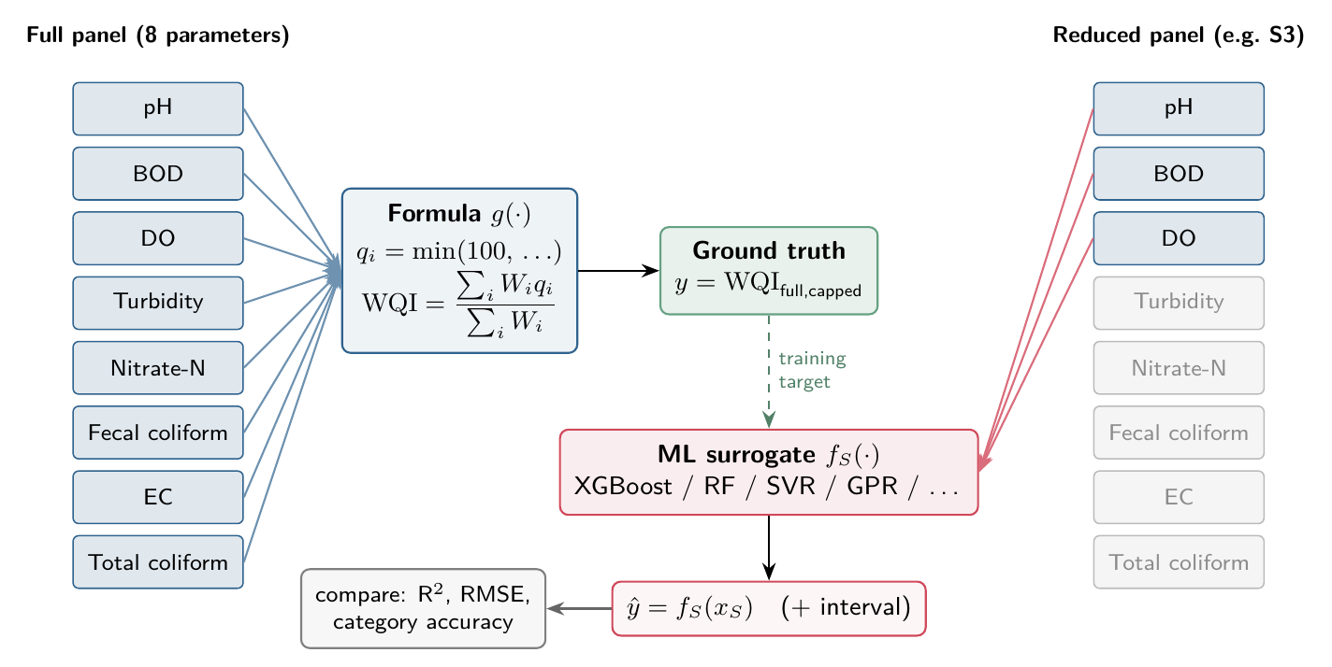
Approach: learn the full-panel WQI from a few inputs
The target never changes: every model predicts the same full-panel WQI, so subset sizes are compared fairly.
8 model families
Formula (no ML), Linear, kNN, SVR, MLP, Random Forest, XGBoost, Gaussian process
12 named + all 255 subsets
3, 4, 5, 7 and 8 parameters; availability-, importance- and sensor-based
5 validation schemes
random rows, unseen stations (primary), unseen rivers, states, season
Notes:
Surrogate modelling: the ground truth is computed once from all eight parameters. Each model sees only a subset and is trained to reproduce that same target. Headline numbers use unseen stations, which mimics deploying at a new site.

Slide 6
Importance: pH › BOD › turbidity › DO › nitrate
0.94
R² from pH and BOD alone
0
R² lost when coliforms or EC are removed from the full model
Correlation ≠ importance: the coliforms correlate with WQI (ρ ≈ 0.38) only because sewage raises BOD too. Seven methods agree on the order.
Notes:
Eight importance methods (correlation, mutual information, RF, XGBoost gain, permutation, SHAP, drop-column, analytic variance share) agree on the order. Forward selection reaches the ceiling at five parameters; the last three add nothing. Picking by correlation alone would have chosen the coliforms.

Slide 7
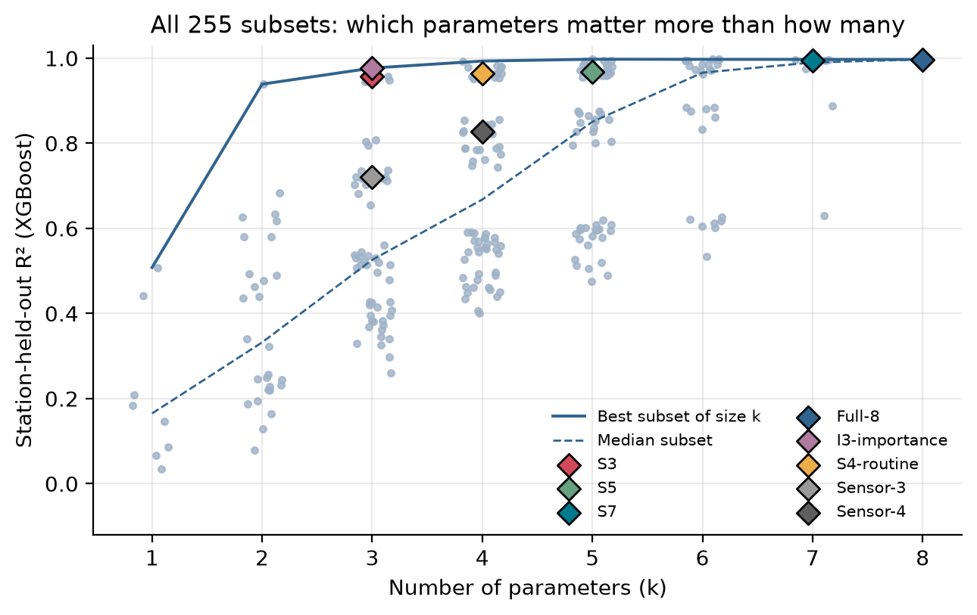
Choosing the right parameters beats adding more
0.977
best 3-parameter set: pH, BOD, turbidity
0.53
median 3-parameter set
2nd / 56
rank of the planned S3 (pH, DO, BOD): R² 0.957
Notes:
All 255 subsets were scored on unseen stations. At three parameters, R-squared ranges from 0.26 to 0.98 depending on which three. The best three beat the median six. The planned S3 is second of 56; the planned S5 only 13th of 56 because it adds the near-weightless coliform and EC.

Slide 8
Machine learning clearly beats re-weighting the formula
XGBoost is best for every subset; RF, MLP and GPR are close behind
The subset matters far more than the model: for S3, flexible models span R² 0.934–0.957
Linear regression fails (R² ≈ 0.74): the capped sub-indices are piecewise-linear
The model learns the expected contribution of the missing parameters; the formula cannot
Notes:
The natural no-ML alternative is to evaluate the formula over the parameters you have, with renormalised weights. The model beats it everywhere, most dramatically for probe-only panels. The model estimates the missing turbidity and nitrate contribution from correlations, season and region.

Slide 9
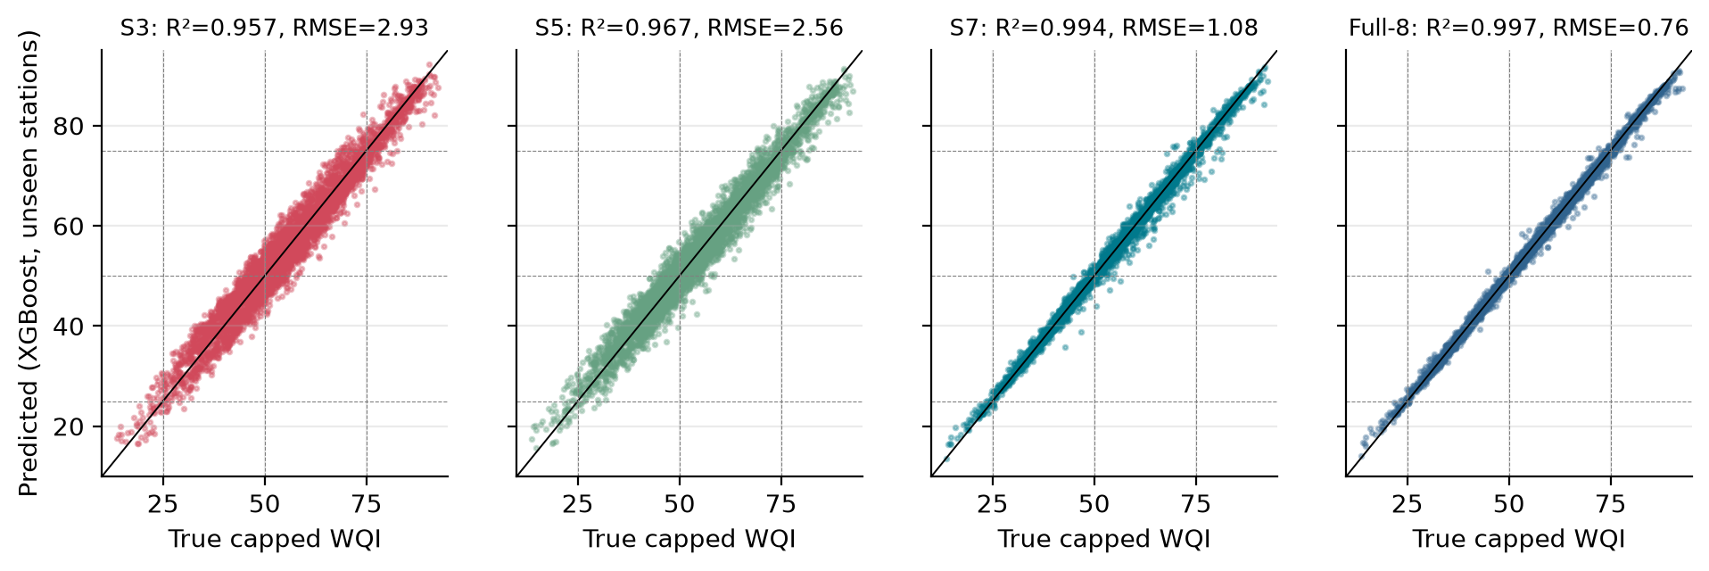
Three parameters predict the WQI at unseen stations
0.957
2.9
90.6%
0
R² (NSE) for pH, DO, BOD
RMSE in WQI points (target s.d. 14.1)
category accuracy (baseline 58%)
visits off by two or more categories
Notes:
With only pH, DO and BOD, the model reaches R-squared 0.957 at stations it has never seen, and every category error is to an adjacent class. Holding out whole rivers gives 0.942, whole states 0.943 and a whole season 0.949. Adding turbidity (S7 or I4) brings it to about 0.994.

Slide 10
Models need ~25 training stations to beat the formula
1
< 25 stations
use the formula
2
25–100 stations
Gaussian process
3
> 100 stations
XGBoost
Neural networks fail when data are scarce (R² < 0 with 9 stations). Extra parameters only pay off beyond about 50 stations.
Notes:
We kept 2 to 100 percent of the training stations while testing on the same unseen stations. Below about 25 stations no learned model beats the renormalised formula; GPR degrades most gracefully; XGBoost wins with more data. A sparsely monitored region gains more from more stations than from more parameters.

Slide 11
Calibrated intervals; pH precision matters most
Split-conformal 90% intervals
90.3%
empirical coverage on unseen stations (S3)
± 4.7
WQI points for S3; ± 1.6 for S7
62% of visits get an interval inside a single category; the rest are flagged “category uncertain”.
Notes:
Conformal intervals hold their nominal coverage at every level from 50 to 95 percent; raw quantile regression under-covers and GPR is miscalibrated away from 90 percent. Measurement noise matters more than parameter count: a pH error of only 0.1 units raises the full model's error from 0.76 to 3.13, worse than dropping five parameters.

Slide 12
Which panel works depends on the index definition
Equal weights shift importance to the coliforms (52%) and turbidity (18%)
Uncapped index: S3 R² 0.37, but pH + BOD + turbidity reaches 0.98
EC standard 250–4,000 µS/cm changes ≤ 0.35% of categories
S7 is the only panel robust to every definition
Notes:
A reduced panel inherits the priorities of the index it imitates. Under equal weights S3 explains only 62 percent of the variance; for the uncapped index, which tracks extreme silt and sewage events, turbidity is essential. The EC standard, our least well-sourced value, turns out not to matter.

Slide 13
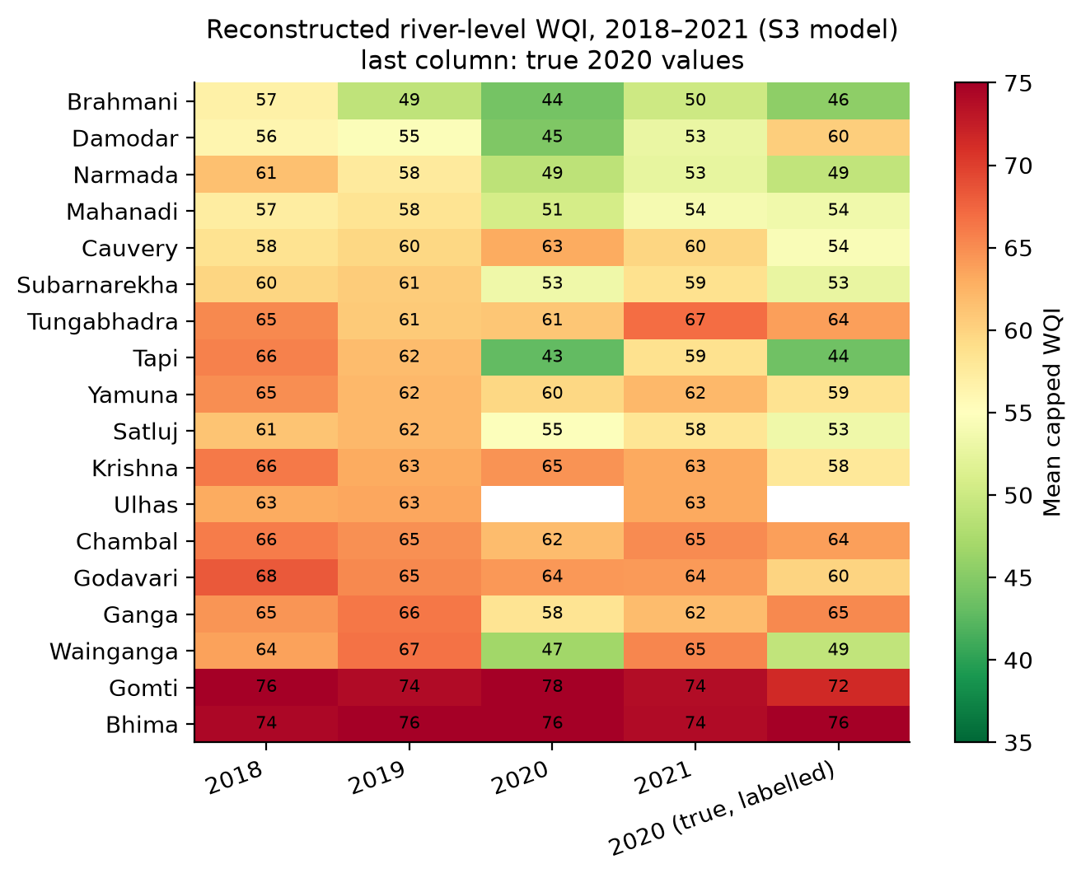
Deployment: first full-panel WQI for 255 stations
20,132
visits reconstructed (2018–2021)
255
stations that never had a WQI
3.0
shift-corrected RMSE (vs 2.9 in CV)
Caveat: outside 2020, BOD ≤ 1 mg/L is never reported (left blank). Year-to-year trends must account for this reporting floor.
Notes:
We applied the pH-DO-BOD model to every visit lacking a full panel. An adversarial check shows the inputs differ mainly in BOD; reweighting the CV errors for that shift gives RMSE 3.0, so accuracy barely changes. The data also revealed that low BOD values are left blank outside 2020, which would otherwise look like a trend.

Slide 14
Recommended monitoring kit
Tier | Parameters | R² | Category acc. | 90% interval
0 Routine (no new cost) | pH, DO, BOD, fecal coliform + location, month | 0.977 | 93.9% | ± 3.6
1 + turbidity probe | pH, DO, BOD, turbidity | 0.994 | 96.8% | ± 1.6
2 + nitrate field kit | pH, DO, BOD, turbidity, nitrate-N | 0.998 | 97.7% | ± 1.1
Public-health robust | S7: + both coliforms, EC | 0.994 | 97.0% | ± 1.5
Screening only | pH, DO, EC, turbidity (all probes) | 0.828 | 82.4% | ± 9.8
1
Calibrate pH to ±0.05 and quality-control BOD
2
Route to a dedicated model for whatever was measured
3
Publish the conformal interval with every estimate
4
Report fecal coliform exceedance alongside the WQI
Notes:
Tier 0 needs nothing new: the routine panel plus location and month already gives R-squared 0.977. A single turbidity probe brings it to 0.994. The operating rules matter as much as the parameters: pH calibration, routing to the right model instead of imputing, publishing intervals, and reporting coliforms separately because the CPCB weighting ignores them.

Slide 15
Answer: yes, with the right three parameters
1
pH, DO and BOD reproduce the CPCB WQI
R² 0.957 and 91% category accuracy at unseen stations; 0.994 with a turbidity probe
2
Learning beats re-weighting
once data from about 25 stations are available, with calibrated ±4.7-point intervals
3
Mind the index and the instruments
the CPCB weights ignore coliforms, and pH precision matters more than parameter count
Next: more full-panel years, censored-BOD handling, NSF/CCME indices, satellite turbidity, a field tool.
Thank you. Questions?
Notes:
Summarise: reduced-parameter monitoring works for the CPCB index if the right parameters are measured precisely and the model has enough stations to learn from. Close with the caveats and next steps, then take questions.

