Slide 1




PROJECT PRESENTATION
KING COUNTY
REAL ESTATE EVALUATION
01
From housing records to a live valuation dashboard
KING COUNTY REAL ESTATE EVALUATION / DEPI
Notes:
Introduce the team and the project: use historical house sales to estimate value, understand price patterns and make the analysis accessible through a dashboard. Template: https://www.canva.com/templates/EAGpduGnIqo/
Evidence: original project notebooks Cleaning.ipynb, Visualization.ipynb, MachineLearning.ipynb and Dash source; project directory E:/codex_output/King-County-Real-Estate-Evaluation-DEPI-/.
Photo: George Freeney-Jones, Seattle skyline from Kerry Park (2016), cropped. CC BY-SA 4.0. https://commons.wikimedia.org/wiki/File:20160124_GFJ2757-kerry-park-skyline_seattle-wa-panoramic.jpg ; https://creativecommons.org/licenses/by-sa/4.0/
ROW REVEAL VERSION: Table headers stay visible. Reveal each row with a click. Before/after examples reveal raw value, calculation, then result. Use Slide Show mode. Click / Right Arrow reveals the next group (2 groups on this slide). Click the footer to return to contents. Agenda section names link directly to each presenter section.

Slide 2
TEAM / EDITABLE NAMES
SIX SECTIONS. ONE COMPLETE STORY.
02
Section | Presenter
01 Introduction | mahmoud samir
02 Data cleaning | menna sokker
03 Data visualization | mohnad hamed
04 Feature engineering & correlations | omar marzouk
05 Machine learning & XGBoost | zeyad ahmed
06 Live dashboard | mohamed elmhlawy
KING COUNTY REAL ESTATE EVALUATION / DEPI
Notes:
Evidence: original project notebooks Cleaning.ipynb, Visualization.ipynb, MachineLearning.ipynb and Dash source; project directory E:/codex_output/King-County-Real-Estate-Evaluation-DEPI-/.
ROW REVEAL VERSION: Table headers stay visible. Reveal each row with a click. Before/after examples reveal raw value, calculation, then result. Use Slide Show mode. Click / Right Arrow reveals the next group (6 groups on this slide). Click the footer to return to contents. Agenda section names link directly to each presenter section.

Slide 3
01 / INTRODUCTION
INTRODUCTION
03
mahmoud samir
How can housing data support a better price discussion?
KING COUNTY REAL ESTATE EVALUATION / DEPI
Notes:
Presenter handoff. Add the team member name to the editable placeholder. How can housing data support a better price discussion?
Evidence: original project notebooks Cleaning.ipynb, Visualization.ipynb, MachineLearning.ipynb and Dash source; project directory E:/codex_output/King-County-Real-Estate-Evaluation-DEPI-/.
ROW REVEAL VERSION: Table headers stay visible. Reveal each row with a click. Before/after examples reveal raw value, calculation, then result. Use Slide Show mode. Click / Right Arrow reveals the next group (2 groups on this slide). Click the footer to return to contents. Agenda section names link directly to each presenter section.

Slide 4
01 / INTRODUCTION
A PRACTICAL QUESTION: WHAT IS THIS HOME WORTH?
04
01
Estimate a sale price from property size, quality, location and age.
02
Help clients compare options and question unusually high or low asking prices.
03
Help a real estate team screen listings and explain which attributes matter.
04
Use the dashboard to explore scenarios and the evidence behind them.
Historical evidence: 2014–2015 sales. Estimates support a discussion; they are not current appraisals.
KING COUNTY REAL ESTATE EVALUATION / DEPI
Notes:
Evidence: original project notebooks Cleaning.ipynb, Visualization.ipynb, MachineLearning.ipynb and Dash source; project directory E:/codex_output/King-County-Real-Estate-Evaluation-DEPI-/.
ROW REVEAL VERSION: Table headers stay visible. Reveal each row with a click. Before/after examples reveal raw value, calculation, then result. Use Slide Show mode. Click / Right Arrow reveals the next group (5 groups on this slide). Click the footer to return to contents. Agenda section names link directly to each presenter section.

Slide 5
01 / INTRODUCTION
THE DATA AT A GLANCE
05
Scope | What it contains
21,613 raw transactions | King County, Washington — including Seattle area
Sale dates | 2 May 2014 → 27 May 2015
Target | Sale price in US dollars
Physical attributes | Bedrooms, bathrooms, living area, lot area, floors
Quality & surroundings | Grade, condition, view, waterfront, neighboring areas
Place & time | Zipcode, latitude, longitude, build / renovation year
KING COUNTY REAL ESTATE EVALUATION / DEPI
Notes:
Evidence: original project notebooks Cleaning.ipynb, Visualization.ipynb, MachineLearning.ipynb and Dash source; project directory E:/codex_output/King-County-Real-Estate-Evaluation-DEPI-/.
ROW REVEAL VERSION: Table headers stay visible. Reveal each row with a click. Before/after examples reveal raw value, calculation, then result. Use Slide Show mode. Click / Right Arrow reveals the next group (6 groups on this slide). Click the footer to return to contents. Agenda section names link directly to each presenter section.

Slide 6
02 / DATA CLEANING
DATA CLEANING
06
menna sokker
From 21,613 raw rows to 21,612 usable sales.
KING COUNTY REAL ESTATE EVALUATION / DEPI
Notes:
Presenter handoff. Add the team member name to the editable placeholder. From 21,613 raw rows to 21,612 usable sales.
Evidence: original project notebooks Cleaning.ipynb, Visualization.ipynb, MachineLearning.ipynb and Dash source; project directory E:/codex_output/King-County-Real-Estate-Evaluation-DEPI-/.
ROW REVEAL VERSION: Table headers stay visible. Reveal each row with a click. Before/after examples reveal raw value, calculation, then result. Use Slide Show mode. Click / Right Arrow reveals the next group (2 groups on this slide). Click the footer to return to contents. Agenda section names link directly to each presenter section.

Slide 7
02 / DATA CLEANING
WHAT CHANGED — AND WHAT DID NOT
07
Before | Action | After
13 missing bedroom values
Fill with median
3 bedrooms
10 missing bathroom values
Fill with median
2.25 bathrooms
Date stored as text
Parse as datetime
Usable sale year / month
One 33-bedroom record
Keep 0 < bedrooms ≤ 15
One row removed
CSV index + property ID
Drop non-predictive identifiers
Neither enters the model
21,613 rows
Retain valid sales
21,612 rows; zero missing cells
KING COUNTY REAL ESTATE EVALUATION / DEPI
Notes:
Cleaning.ipynb cells 1–9. Exact duplicate rows excluding the CSV index: zero. Repeated IDs can be repeat transactions; no duplicate-removal step was performed.
Evidence: original project notebooks Cleaning.ipynb, Visualization.ipynb, MachineLearning.ipynb and Dash source; project directory E:/codex_output/King-County-Real-Estate-Evaluation-DEPI-/.
ROW REVEAL VERSION: Table headers stay visible. Reveal each row with a click. Before/after examples reveal raw value, calculation, then result. Use Slide Show mode. Click / Right Arrow reveals the next group (18 groups on this slide). Click the footer to return to contents. Agenda section names link directly to each presenter section.

Slide 8
02 / DATA CLEANING
MISSING VALUES: BEFORE → AFTER
08
Field | Before | Rule | After
bedrooms | NaN (13 cells)
Median of column
3.0
bathrooms | NaN (10 cells)
Median of column
2.25
date | 20141209T000000
Convert to datetime
2014-12-09
Why median? It is less affected by extreme values than the mean.
The notebook filled these values before the train/test split. A future pipeline should fit imputation on training data only.
KING COUNTY REAL ESTATE EVALUATION / DEPI
Notes:
Evidence: original project notebooks Cleaning.ipynb, Visualization.ipynb, MachineLearning.ipynb and Dash source; project directory E:/codex_output/King-County-Real-Estate-Evaluation-DEPI-/.
ROW REVEAL VERSION: Table headers stay visible. Reveal each row with a click. Before/after examples reveal raw value, calculation, then result. Use Slide Show mode. Click / Right Arrow reveals the next group (11 groups on this slide). Click the footer to return to contents. Agenda section names link directly to each presenter section.

Slide 9
02 / DATA CLEANING
ONE IMPLAUSIBLE RECORD WAS FILTERED
09
Observed record | Value
21,613
Bedrooms | 33
raw rows
Interior living area | 1,620 sq ft
Sale price | $640,000
21,612
Sale date | 25 June 2014
Applied rule | 0 < bedrooms ≤ 15
rows retained
Luxury prices were retained. This was a bedroom plausibility filter.
KING COUNTY REAL ESTATE EVALUATION / DEPI
Notes:
Cleaning.ipynb: rule (bedrooms > 0) & (bedrooms <= 15). Actual removed row ID 2402100895, raw index 15870. Do not say all luxury outliers were removed.
Evidence: original project notebooks Cleaning.ipynb, Visualization.ipynb, MachineLearning.ipynb and Dash source; project directory E:/codex_output/King-County-Real-Estate-Evaluation-DEPI-/.
ROW REVEAL VERSION: Table headers stay visible. Reveal each row with a click. Before/after examples reveal raw value, calculation, then result. Use Slide Show mode. Click / Right Arrow reveals the next group (10 groups on this slide). Click the footer to return to contents. Agenda section names link directly to each presenter section.

Slide 10
02 / DATA CLEANING
A CLEAN TABLE, READY FOR EXPLORATION
10
01
21,612 rows, with no missing values remaining.
02
27 analytical columns after engineering and dropping redundant originals.
03
Saved CSV also contains an export index; the model excludes it.
04
Median sale price: $450,000. Prices span $75,000 to $7.7 million.
KING COUNTY REAL ESTATE EVALUATION / DEPI
Notes:
Evidence: original project notebooks Cleaning.ipynb, Visualization.ipynb, MachineLearning.ipynb and Dash source; project directory E:/codex_output/King-County-Real-Estate-Evaluation-DEPI-/.
ROW REVEAL VERSION: Table headers stay visible. Reveal each row with a click. Before/after examples reveal raw value, calculation, then result. Use Slide Show mode. Click / Right Arrow reveals the next group (4 groups on this slide). Click the footer to return to contents. Agenda section names link directly to each presenter section.

Slide 11
03 / DATA VISUALIZATION
DATA VISUALIZATION
11
mohnad hamed
Read the patterns before choosing the model.
KING COUNTY REAL ESTATE EVALUATION / DEPI
Notes:
Presenter handoff. Add the team member name to the editable placeholder. Read the patterns before choosing the model.
Evidence: original project notebooks Cleaning.ipynb, Visualization.ipynb, MachineLearning.ipynb and Dash source; project directory E:/codex_output/King-County-Real-Estate-Evaluation-DEPI-/.
ROW REVEAL VERSION: Table headers stay visible. Reveal each row with a click. Before/after examples reveal raw value, calculation, then result. Use Slide Show mode. Click / Right Arrow reveals the next group (2 groups on this slide). Click the footer to return to contents. Agenda section names link directly to each presenter section.

Slide 12
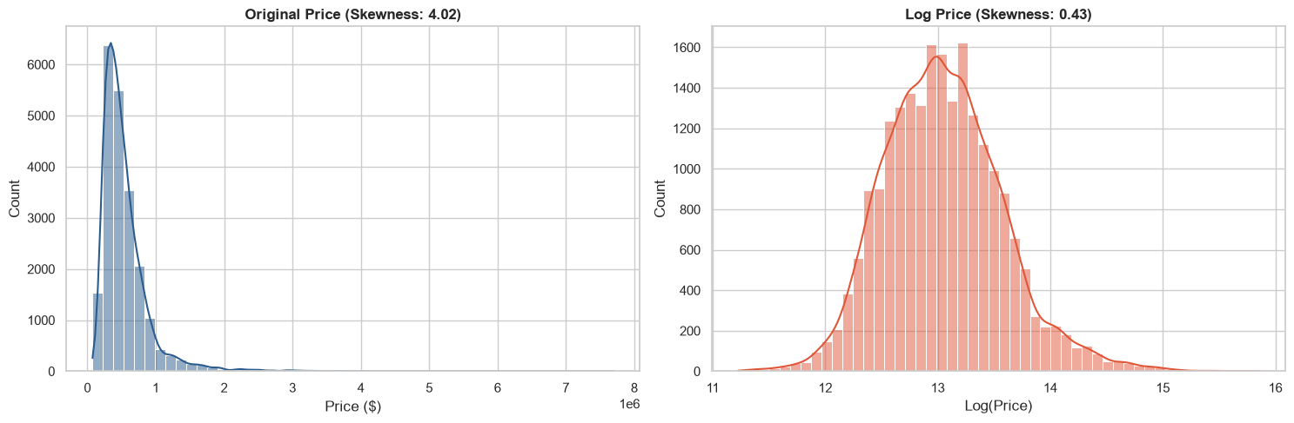
03 / DATA VISUALIZATION
PRICE SKEWNESS: WHY TRANSFORM THE TARGET?
12
Raw-price skewness: 4.02. • log1p(price) skewness: 0.43. • The log target reduces the influence of the long luxury tail.
KING COUNTY REAL ESTATE EVALUATION / DEPI
Notes:
Explain the visible pattern before its implication. Raw-price skewness: 4.02. log1p(price) skewness: 0.43. The log target reduces the influence of the long luxury tail.
Source: Visualization.ipynb, cell 2. Figure preserved from notebook output.
Evidence: original project notebooks Cleaning.ipynb, Visualization.ipynb, MachineLearning.ipynb and Dash source; project directory E:/codex_output/King-County-Real-Estate-Evaluation-DEPI-/.
ROW REVEAL VERSION: Table headers stay visible. Reveal each row with a click. Before/after examples reveal raw value, calculation, then result. Use Slide Show mode. Click / Right Arrow reveals the next group (2 groups on this slide). Click the footer to return to contents. Agenda section names link directly to each presenter section.

Slide 13
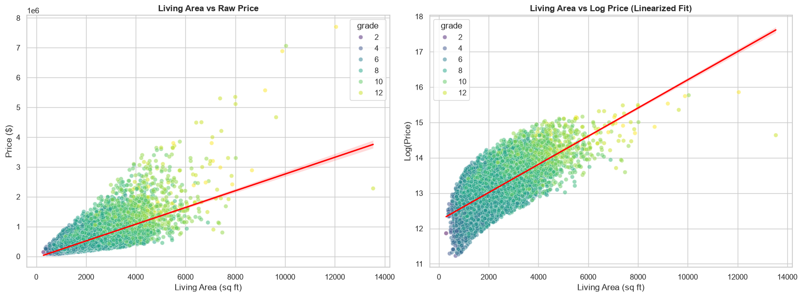
03 / DATA VISUALIZATION
LIVING AREA AND PRICE MOVE TOGETHER
13
Larger interiors generally sell for more. • Grade separates homes with similar area. • Log price makes the trend easier to inspect.
KING COUNTY REAL ESTATE EVALUATION / DEPI
Notes:
Explain the visible pattern before its implication. Larger interiors generally sell for more. Grade separates homes with similar area. Log price makes the trend easier to inspect.
Source: Visualization.ipynb, cell 3. Figure preserved from notebook output.
Evidence: original project notebooks Cleaning.ipynb, Visualization.ipynb, MachineLearning.ipynb and Dash source; project directory E:/codex_output/King-County-Real-Estate-Evaluation-DEPI-/.
ROW REVEAL VERSION: Table headers stay visible. Reveal each row with a click. Before/after examples reveal raw value, calculation, then result. Use Slide Show mode. Click / Right Arrow reveals the next group (2 groups on this slide). Click the footer to return to contents. Agenda section names link directly to each presenter section.

Slide 14
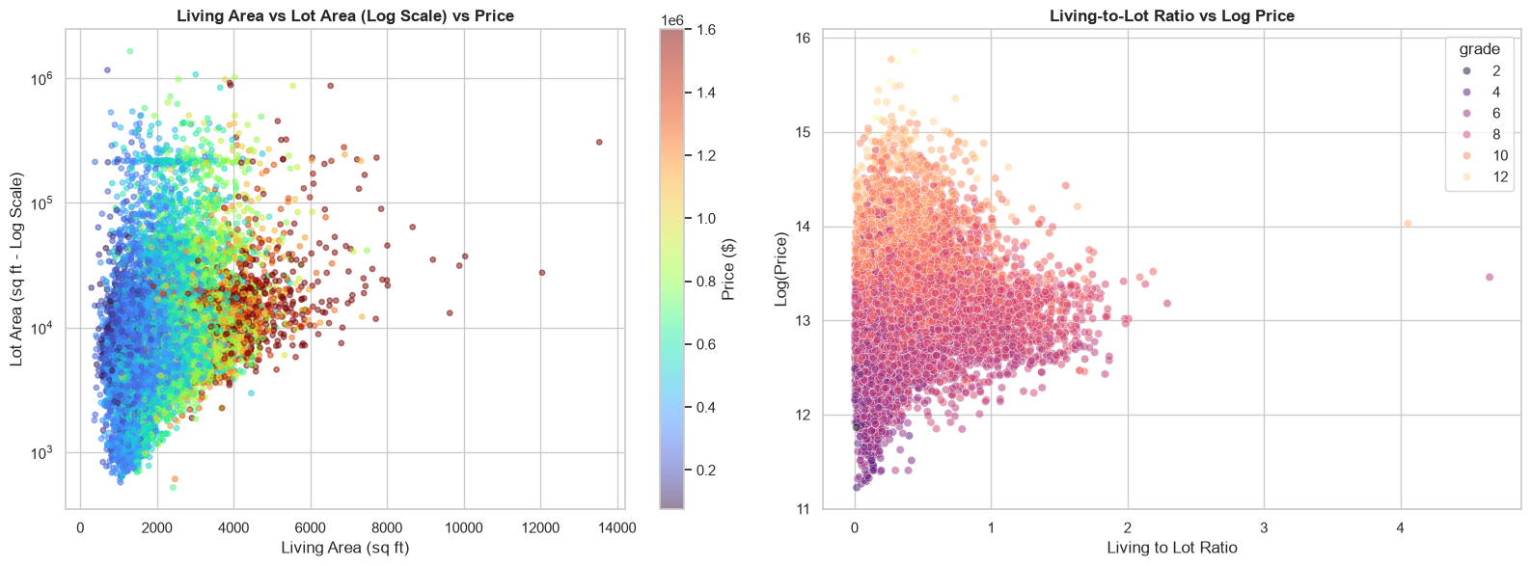
03 / DATA VISUALIZATION
LOT SIZE IS NOT THE SAME AS LIVING SPACE
14
Lot sizes span several orders of magnitude. • Living-to-lot ratio summarizes built-space intensity. • A large lot alone does not determine price.
KING COUNTY REAL ESTATE EVALUATION / DEPI
Notes:
Explain the visible pattern before its implication. Lot sizes span several orders of magnitude. Living-to-lot ratio summarizes built-space intensity. A large lot alone does not determine price.
Source: Visualization.ipynb, cell 4. Figure preserved from notebook output.
Evidence: original project notebooks Cleaning.ipynb, Visualization.ipynb, MachineLearning.ipynb and Dash source; project directory E:/codex_output/King-County-Real-Estate-Evaluation-DEPI-/.
ROW REVEAL VERSION: Table headers stay visible. Reveal each row with a click. Before/after examples reveal raw value, calculation, then result. Use Slide Show mode. Click / Right Arrow reveals the next group (2 groups on this slide). Click the footer to return to contents. Agenda section names link directly to each presenter section.

Slide 15
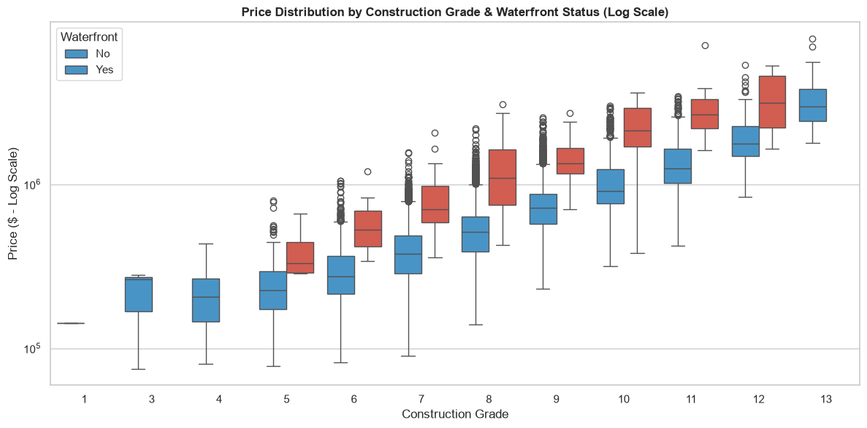
03 / DATA VISUALIZATION
QUALITY AND WATERFRONT STATUS MATTER
15
Median prices rise with construction grade. • Waterfront homes show a substantial unadjusted premium. • These comparisons describe associations, not causal effects.
KING COUNTY REAL ESTATE EVALUATION / DEPI
Notes:
Explain the visible pattern before its implication. Median prices rise with construction grade. Waterfront homes show a substantial unadjusted premium. These comparisons describe associations, not causal effects.
Source: Visualization.ipynb, cell 6. Figure preserved from notebook output.
Evidence: original project notebooks Cleaning.ipynb, Visualization.ipynb, MachineLearning.ipynb and Dash source; project directory E:/codex_output/King-County-Real-Estate-Evaluation-DEPI-/.
ROW REVEAL VERSION: Table headers stay visible. Reveal each row with a click. Before/after examples reveal raw value, calculation, then result. Use Slide Show mode. Click / Right Arrow reveals the next group (2 groups on this slide). Click the footer to return to contents. Agenda section names link directly to each presenter section.

Slide 16
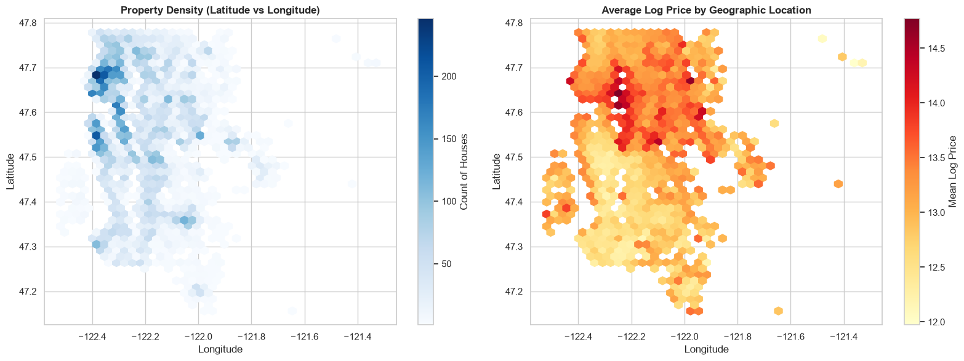
03 / DATA VISUALIZATION
GEOGRAPHY REVEALS DIFFERENT MICRO-MARKETS
16
Sales density and price hotspots are different questions. • Mean log price varies across coordinates. • Location belongs in the predictive feature set.
KING COUNTY REAL ESTATE EVALUATION / DEPI
Notes:
Explain the visible pattern before its implication. Sales density and price hotspots are different questions. Mean log price varies across coordinates. Location belongs in the predictive feature set.
Source: Visualization.ipynb, cell 7. Figure preserved from notebook output.
Evidence: original project notebooks Cleaning.ipynb, Visualization.ipynb, MachineLearning.ipynb and Dash source; project directory E:/codex_output/King-County-Real-Estate-Evaluation-DEPI-/.
ROW REVEAL VERSION: Table headers stay visible. Reveal each row with a click. Before/after examples reveal raw value, calculation, then result. Use Slide Show mode. Click / Right Arrow reveals the next group (2 groups on this slide). Click the footer to return to contents. Agenda section names link directly to each presenter section.

Slide 17
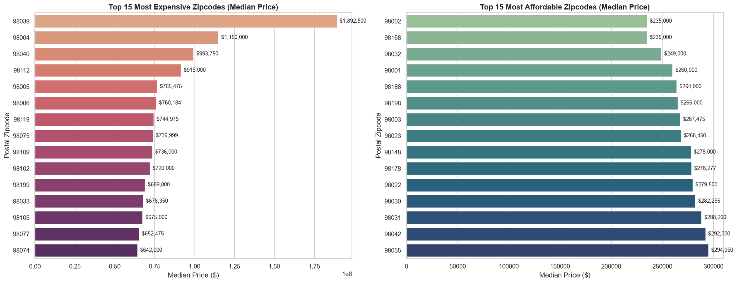
03 / DATA VISUALIZATION
ZIPCODES SHOW LARGE PRICE DIFFERENCES
17
98039 median: $1,892,500. • 98004 median: $1,150,000. • 98002 and 98168 medians: $235,000.
KING COUNTY REAL ESTATE EVALUATION / DEPI
Notes:
Explain the visible pattern before its implication. 98039 median: $1,892,500. 98004 median: $1,150,000. 98002 and 98168 medians: $235,000.
Source: Visualization.ipynb, cell 9. Figure preserved from notebook output.
Evidence: original project notebooks Cleaning.ipynb, Visualization.ipynb, MachineLearning.ipynb and Dash source; project directory E:/codex_output/King-County-Real-Estate-Evaluation-DEPI-/.
ROW REVEAL VERSION: Table headers stay visible. Reveal each row with a click. Before/after examples reveal raw value, calculation, then result. Use Slide Show mode. Click / Right Arrow reveals the next group (2 groups on this slide). Click the footer to return to contents. Agenda section names link directly to each presenter section.

Slide 18
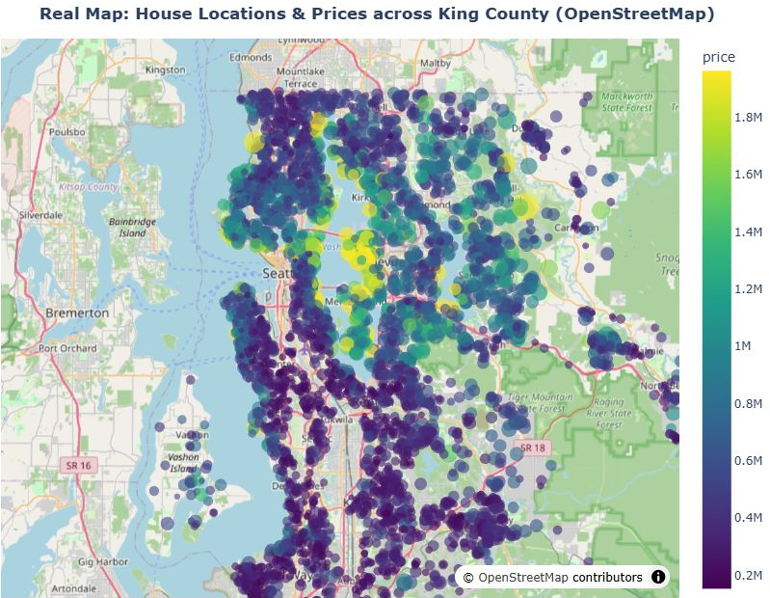
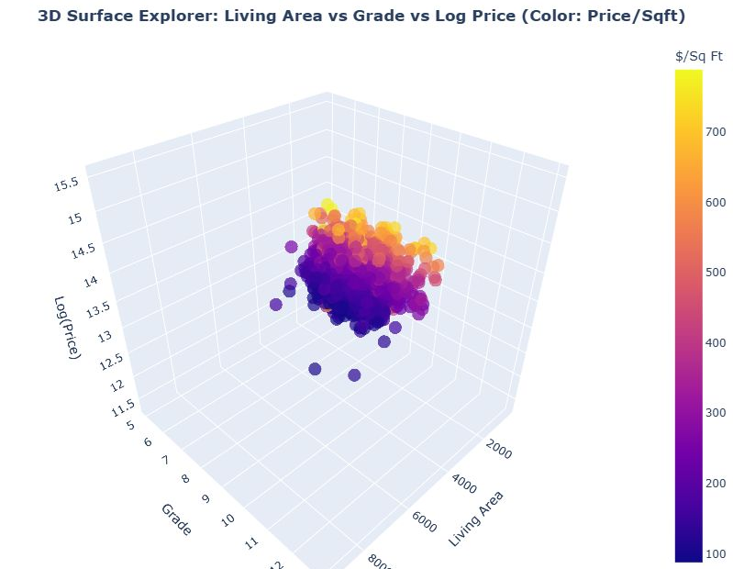
03 / DATA VISUALIZATION
INTERACTIVE MAP AND 3D EXPLORER
18
MAP / Price, size and location
3D / Living area × grade × log price
KING COUNTY REAL ESTATE EVALUATION / DEPI
Notes:
Notebook Visualization.ipynb cell 1 maps the full 21,612 cleaned records; cell 8 uses a fixed 5,000-record sample for 3D. These screenshots show the corresponding live dashboard views; the dashboard map uses a 5,000-record sample. https://omarwolf28.github.io/king-county-dash/
Evidence: original project notebooks Cleaning.ipynb, Visualization.ipynb, MachineLearning.ipynb and Dash source; project directory E:/codex_output/King-County-Real-Estate-Evaluation-DEPI-/.
ROW REVEAL VERSION: Table headers stay visible. Reveal each row with a click. Before/after examples reveal raw value, calculation, then result. Use Slide Show mode. Click / Right Arrow reveals the next group (2 groups on this slide). Click the footer to return to contents. Agenda section names link directly to each presenter section.

Slide 19
04 / FEATURE ENGINEERING
FEATURE ENGINEERING
19
omar marzouk
Turn raw property facts into useful model signals.
KING COUNTY REAL ESTATE EVALUATION / DEPI
Notes:
Presenter handoff. Add the team member name to the editable placeholder. Turn raw property facts into useful model signals.
Evidence: original project notebooks Cleaning.ipynb, Visualization.ipynb, MachineLearning.ipynb and Dash source; project directory E:/codex_output/King-County-Real-Estate-Evaluation-DEPI-/.
ROW REVEAL VERSION: Table headers stay visible. Reveal each row with a click. Before/after examples reveal raw value, calculation, then result. Use Slide Show mode. Click / Right Arrow reveals the next group (2 groups on this slide). Click the footer to return to contents. Agenda section names link directly to each presenter section.

Slide 20
04 / FEATURE ENGINEERING
TIME FEATURES: A REAL BEFORE → AFTER
20
Raw value | Calculation | Engineered value
date = 2014-12-09
Extract year / month
sale_year = 2014; sale_month = 12
yr_built = 1951
max(2014 − 1951, 0)
house_age = 63
yr_renovated = 1991
1 if renovation year > 0
is_renovated = 1
yr_renovated = 1991
max(2014 − 1991, 0)
years_since_renovation = 23
If not renovated: years_since_renovation = house_age.
KING COUNTY REAL ESTATE EVALUATION / DEPI
Notes:
Cleaning.ipynb cell 9. Actual second source record: price538000, built1951, renovated1991, sold2014-12-09. Age differences clipped at zero. Unrenovated years_since_renovation defaults to house_age.
Evidence: original project notebooks Cleaning.ipynb, Visualization.ipynb, MachineLearning.ipynb and Dash source; project directory E:/codex_output/King-County-Real-Estate-Evaluation-DEPI-/.
ROW REVEAL VERSION: Table headers stay visible. Reveal each row with a click. Before/after examples reveal raw value, calculation, then result. Use Slide Show mode. Click / Right Arrow reveals the next group (13 groups on this slide). Click the footer to return to contents. Agenda section names link directly to each presenter section.

Slide 21
04 / FEATURE ENGINEERING
SPACE FEATURES: A REAL BEFORE → AFTER
21
Raw value(s) | Calculation | New value
Basement = 400 sq ft
1 if area > 0
has_basement = 1
Living 2,570; lot 7,242
2570 / max(7242, 1)
living_to_lot_ratio = 0.3549
3 bedrooms; 2.25 bathrooms
3 + 2.25
total_rooms = 5.25
Price $538,000; living 2,570
538000 / max(2570, 1)
price_per_sqft = $209.34
Basement 400; lot 7,242
400 / max(7242, 1)
basement_to_lot_ration = 0.0552
Only the first two enter the final model. The original basement-ratio column name contains “ration”.
KING COUNTY REAL ESTATE EVALUATION / DEPI
Notes:
Evidence: original project notebooks Cleaning.ipynb, Visualization.ipynb, MachineLearning.ipynb and Dash source; project directory E:/codex_output/King-County-Real-Estate-Evaluation-DEPI-/.
ROW REVEAL VERSION: Table headers stay visible. Reveal each row with a click. Before/after examples reveal raw value, calculation, then result. Use Slide Show mode. Click / Right Arrow reveals the next group (16 groups on this slide). Click the footer to return to contents. Agenda section names link directly to each presenter section.

Slide 22
04 / FEATURE ENGINEERING
SEPARATE PREDICTORS FROM THE ANSWER
22
Role | Fields / transformation
Target | log_price = ln(1 + price)
Prediction in dollars | price_prediction = exp(log_prediction) − 1
Final inputs | 14 retained original fields + 7 engineered fields
EDA only; excluded from X | total_rooms, price_per_sqft, basement_to_lot_ration
Dropped original columns | sqft_above, sqft_basement, yr_built, yr_renovated
Identifiers excluded | id, date, export index
KING COUNTY REAL ESTATE EVALUATION / DEPI
Notes:
Cleaning.ipynb cell 9; MachineLearning.ipynb selected features. log_price is the target. price_per_sqft contains the sale price and would leak the answer if used to predict that same price.
Evidence: original project notebooks Cleaning.ipynb, Visualization.ipynb, MachineLearning.ipynb and Dash source; project directory E:/codex_output/King-County-Real-Estate-Evaluation-DEPI-/.
ROW REVEAL VERSION: Table headers stay visible. Reveal each row with a click. Before/after examples reveal raw value, calculation, then result. Use Slide Show mode. Click / Right Arrow reveals the next group (6 groups on this slide). Click the footer to return to contents. Agenda section names link directly to each presenter section.

Slide 23
04 / CORRELATIONS
WHICH FEATURES CORRELATE WITH RAW PRICE?
23
High linear association supports inspection; low correlation does not rule out a nonlinear effect.
KING COUNTY REAL ESTATE EVALUATION / DEPI
Notes:
Cleaning.ipynb cell 10. Pearson correlations are associations and are not XGBoost feature importance.
Evidence: original project notebooks Cleaning.ipynb, Visualization.ipynb, MachineLearning.ipynb and Dash source; project directory E:/codex_output/King-County-Real-Estate-Evaluation-DEPI-/.
ROW REVEAL VERSION: Table headers stay visible. Reveal each row with a click. Before/after examples reveal raw value, calculation, then result. Use Slide Show mode. Click / Right Arrow reveals the next group (2 groups on this slide). Click the footer to return to contents. Agenda section names link directly to each presenter section.

Slide 24
04 / CORRELATIONS
HIGH CORRELATION: WHAT DID WE DO?
25
Feature pair | Pearson r | How to interpret / handle
sqft_living ↔ sqft_above | 0.877 | Dropped sqft_above; retained total living area
house_age ↔ years_since_renovation | 0.910 | Both retained; renovation still distinguishes homes
bedrooms ↔ total_rooms | 0.895 | total_rooms excluded from final model
sqft_living ↔ grade | 0.763 | Both retained: size and construction quality differ
sale_year ↔ sale_month | −0.782 | Both retained; this is a short historical sample
The notebook did not remove every correlated pair. Correlation review and final input selection are distinct steps.
KING COUNTY REAL ESTATE EVALUATION / DEPI
Notes:
Evidence: original project notebooks Cleaning.ipynb, Visualization.ipynb, MachineLearning.ipynb and Dash source; project directory E:/codex_output/King-County-Real-Estate-Evaluation-DEPI-/.
ROW REVEAL VERSION: Table headers stay visible. Reveal each row with a click. Before/after examples reveal raw value, calculation, then result. Use Slide Show mode. Click / Right Arrow reveals the next group (6 groups on this slide). Click the footer to return to contents. Agenda section names link directly to each presenter section.

Slide 25
04 / MODEL-READY DATA
THE EXACT 21 INPUTS — ONE REAL RECORD
26
Feature | Value | Feature | Value | Feature | Value
bedrooms | 3 | condition | 3 | has_basement | 1
bathrooms | 2.25 | grade | 7 | sale_year | 2014
sqft_living | 2570 | zipcode | 98125 | sale_month | 12
sqft_lot | 7242 | lat | 47.721 | house_age | 63
floors | 2 | long | −122.319 | is_renovated | 1
waterfront | 0 | sqft_living15 | 1690 | years_since_renovation | 23
view | 0 | sqft_lot15 | 7639 | living_to_lot_ratio | 0.3548743
X: 21 predictors | y: log_price | price and target-derived EDA fields stay outside X.
KING COUNTY REAL ESTATE EVALUATION / DEPI
Notes:
Feature order comes from model_features.pkl / MachineLearning.ipynb. Actual second cleaned row; all 21 fields shown. Target log_price =13.1956156979 (price538000).
Evidence: original project notebooks Cleaning.ipynb, Visualization.ipynb, MachineLearning.ipynb and Dash source; project directory E:/codex_output/King-County-Real-Estate-Evaluation-DEPI-/.
ROW REVEAL VERSION: Table headers stay visible. Reveal each row with a click. Before/after examples reveal raw value, calculation, then result. Use Slide Show mode. Click / Right Arrow reveals the next group (8 groups on this slide). Click the footer to return to contents. Agenda section names link directly to each presenter section.

Slide 26
05 / MACHINE LEARNING
MACHINE LEARNING
27
zeyad ahmed
Compare four models on the same held-out homes.
KING COUNTY REAL ESTATE EVALUATION / DEPI
Notes:
Presenter handoff. Add the team member name to the editable placeholder. Compare four models on the same held-out homes.
Evidence: original project notebooks Cleaning.ipynb, Visualization.ipynb, MachineLearning.ipynb and Dash source; project directory E:/codex_output/King-County-Real-Estate-Evaluation-DEPI-/.
ROW REVEAL VERSION: Table headers stay visible. Reveal each row with a click. Before/after examples reveal raw value, calculation, then result. Use Slide Show mode. Click / Right Arrow reveals the next group (2 groups on this slide). Click the footer to return to contents. Agenda section names link directly to each presenter section.

Slide 27
05 / MACHINE LEARNING
THE EXPERIMENT SETUP
28
Decision | What the notebook actually did
Inputs / target | 21 selected inputs → log_price
Split | 80% train / 20% test; random_state = 42
Training rows | 17,289
Test rows | 4,323
R² | Calculated on the log-price target
Dollar errors | Inverse transform with expm1, then MAE and RMSE
Same split for all four candidates. No cross-validation or parameter search is shown in the notebook.
KING COUNTY REAL ESTATE EVALUATION / DEPI
Notes:
Evidence: original project notebooks Cleaning.ipynb, Visualization.ipynb, MachineLearning.ipynb and Dash source; project directory E:/codex_output/King-County-Real-Estate-Evaluation-DEPI-/.
ROW REVEAL VERSION: Table headers stay visible. Reveal each row with a click. Before/after examples reveal raw value, calculation, then result. Use Slide Show mode. Click / Right Arrow reveals the next group (7 groups on this slide). Click the footer to return to contents. Agenda section names link directly to each presenter section.

Slide 28
05 / MACHINE LEARNING
THE COMPARISON — REAL NOTEBOOK RESULTS
29
Model | R² on log price ↑ | RMSE ($) ↓ | MAE ($) ↓
XGBoost | 0.909803 | 119,932.59 | 64,599.45
Random Forest | 0.889783 | 139,933.32 | 72,425.40
Polynomial Ridge | 0.832066 | 164,024.75 | 92,827.07
Linear Regression | 0.778078 | 255,705.38 | 113,986.74
XGBoost wins all three metrics on this split.
KING COUNTY REAL ESTATE EVALUATION / DEPI
Notes:
MachineLearning.ipynb cell 3 output. Highest R² selected; exact R² to6decimals, dollar errors to2decimals.
Evidence: original project notebooks Cleaning.ipynb, Visualization.ipynb, MachineLearning.ipynb and Dash source; project directory E:/codex_output/King-County-Real-Estate-Evaluation-DEPI-/.
ROW REVEAL VERSION: Table headers stay visible. Reveal each row with a click. Before/after examples reveal raw value, calculation, then result. Use Slide Show mode. Click / Right Arrow reveals the next group (5 groups on this slide). Click the footer to return to contents. Agenda section names link directly to each presenter section.

Slide 29
05 / MACHINE LEARNING
XGBOOST REDUCES THE DOLLAR ERROR
30
10.8% lower MAE than Random Forest • 43.3% lower MAE than Linear Regression
KING COUNTY REAL ESTATE EVALUATION / DEPI
Notes:
Evidence: original project notebooks Cleaning.ipynb, Visualization.ipynb, MachineLearning.ipynb and Dash source; project directory E:/codex_output/King-County-Real-Estate-Evaluation-DEPI-/.
ROW REVEAL VERSION: Table headers stay visible. Reveal each row with a click. Before/after examples reveal raw value, calculation, then result. Use Slide Show mode. Click / Right Arrow reveals the next group (2 groups on this slide). Click the footer to return to contents. Agenda section names link directly to each presenter section.

Slide 30
05 / MACHINE LEARNING
WHY XGBOOST FITS THIS PROBLEM
31
01
It achieved the best held-out results among the four candidates.
02
Tree splits capture nonlinear relationships and interactions between size, grade and place.
03
Boosting adds trees sequentially to improve the current prediction.
04
Depth and row/column sampling control complexity; they do not guarantee freedom from overfitting.
KING COUNTY REAL ESTATE EVALUATION / DEPI
Notes:
Evidence: original project notebooks Cleaning.ipynb, Visualization.ipynb, MachineLearning.ipynb and Dash source; project directory E:/codex_output/King-County-Real-Estate-Evaluation-DEPI-/.
ROW REVEAL VERSION: Table headers stay visible. Reveal each row with a click. Before/after examples reveal raw value, calculation, then result. Use Slide Show mode. Click / Right Arrow reveals the next group (4 groups on this slide). Click the footer to return to contents. Agenda section names link directly to each presenter section.

Slide 31
05 / MACHINE LEARNING
THE ACTUAL MODEL CONFIGURATIONS
32
Model | Configuration used
Linear Regression | Default sklearn LinearRegression
Polynomial Ridge | StandardScaler → degree-2 PolynomialFeatures → Ridge(alpha=100)
Random Forest | 100 trees; random_state=42; n_jobs=−1
XGBoost | 200 trees; learning_rate=0.08; max_depth=6
XGBoost sampling | subsample=0.8; colsample_bytree=0.8; random_state=42
These are the settings in the code, not the result of an undocumented tuning search.
KING COUNTY REAL ESTATE EVALUATION / DEPI
Notes:
Evidence: original project notebooks Cleaning.ipynb, Visualization.ipynb, MachineLearning.ipynb and Dash source; project directory E:/codex_output/King-County-Real-Estate-Evaluation-DEPI-/.
ROW REVEAL VERSION: Table headers stay visible. Reveal each row with a click. Before/after examples reveal raw value, calculation, then result. Use Slide Show mode. Click / Right Arrow reveals the next group (6 groups on this slide). Click the footer to return to contents. Agenda section names link directly to each presenter section.

Slide 32
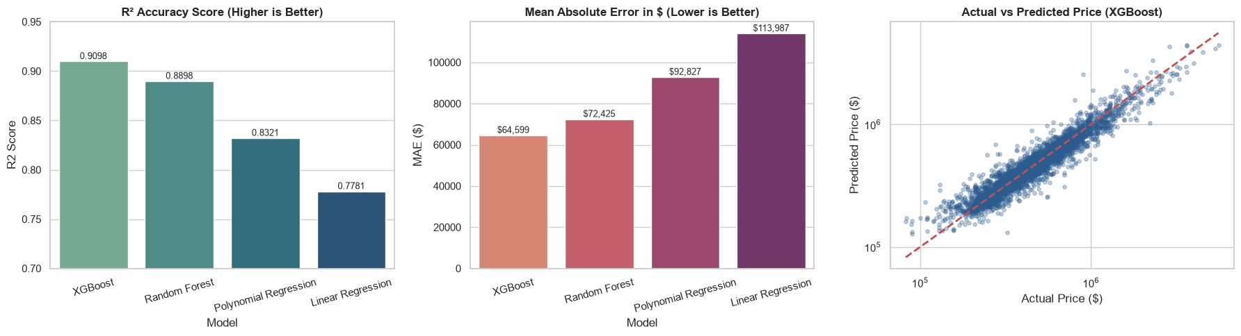
05 / MACHINE LEARNING
THE ORIGINAL NOTEBOOK BENCHMARK FIGURE
33
Different metrics answer different questions: explained log variance, large-error sensitivity, typical absolute dollar error.
KING COUNTY REAL ESTATE EVALUATION / DEPI
Notes:
MachineLearning.ipynb cell 4. Original notebook three-panel benchmark. R² is on log prices; RMSE/MAE are on inverse-transformed dollar prices.
Evidence: original project notebooks Cleaning.ipynb, Visualization.ipynb, MachineLearning.ipynb and Dash source; project directory E:/codex_output/King-County-Real-Estate-Evaluation-DEPI-/.
ROW REVEAL VERSION: Table headers stay visible. Reveal each row with a click. Before/after examples reveal raw value, calculation, then result. Use Slide Show mode. Click / Right Arrow reveals the next group (2 groups on this slide). Click the footer to return to contents. Agenda section names link directly to each presenter section.

Slide 33
05 / MACHINE LEARNING
WHAT THE FITTED MODEL RELIED ON
34
Grade ≈ 48.1%, latitude ≈ 14.2%, living area ≈ 11.9%. Importance depends on this model and data.
KING COUNTY REAL ESTATE EVALUATION / DEPI
Notes:
Saved XGBoost feature_importances_ values. Relative built-in importance; not causal effects and not raw-price correlations.
Evidence: original project notebooks Cleaning.ipynb, Visualization.ipynb, MachineLearning.ipynb and Dash source; project directory E:/codex_output/King-County-Real-Estate-Evaluation-DEPI-/.
ROW REVEAL VERSION: Table headers stay visible. Reveal each row with a click. Before/after examples reveal raw value, calculation, then result. Use Slide Show mode. Click / Right Arrow reveals the next group (2 groups on this slide). Click the footer to return to contents. Agenda section names link directly to each presenter section.

Slide 34
05 / MACHINE LEARNING
WHAT THE RESULTS DO — AND DO NOT — PROVE
35
01
The winner is supported by one random held-out split of historical data.
02
R² = 0.909803 describes log-price variation; it is not “91% price accuracy”.
03
MAE ≈ $64,599 is an average error, not a guarantee for an individual home.
04
Next: train-only imputation, temporal validation, newer sales and calibrated prediction intervals.
KING COUNTY REAL ESTATE EVALUATION / DEPI
Notes:
Evidence: original project notebooks Cleaning.ipynb, Visualization.ipynb, MachineLearning.ipynb and Dash source; project directory E:/codex_output/King-County-Real-Estate-Evaluation-DEPI-/.
ROW REVEAL VERSION: Table headers stay visible. Reveal each row with a click. Before/after examples reveal raw value, calculation, then result. Use Slide Show mode. Click / Right Arrow reveals the next group (4 groups on this slide). Click the footer to return to contents. Agenda section names link directly to each presenter section.

Slide 35
06 / DASHBOARD
DASHBOARD
36
mohamed elmhlawy
Turn the analysis into a link anyone can open.
KING COUNTY REAL ESTATE EVALUATION / DEPI
Notes:
Presenter handoff. Add the team member name to the editable placeholder. Turn the analysis into a link anyone can open.
Evidence: original project notebooks Cleaning.ipynb, Visualization.ipynb, MachineLearning.ipynb and Dash source; project directory E:/codex_output/King-County-Real-Estate-Evaluation-DEPI-/.
ROW REVEAL VERSION: Table headers stay visible. Reveal each row with a click. Before/after examples reveal raw value, calculation, then result. Use Slide Show mode. Click / Right Arrow reveals the next group (2 groups on this slide). Click the footer to return to contents. Agenda section names link directly to each presenter section.

Slide 36
06 / DASHBOARD
THE LIVE PROJECT
37
OPEN THE LIVE DASHBOARD
omarwolf28.github.io/king-county-dash/
01
Price Prediction & Location Map
02
Exploratory Visualizations
03
Machine Learning & Why XGBoost
04
Dataset Explorer & Dictionary
KING COUNTY REAL ESTATE EVALUATION / DEPI
Notes:
Live deployment: https://omarwolf28.github.io/king-county-dash/ ; repository: https://github.com/omarwolf28/king-county-dash . Original Dash appearance retained in the static browser deployment; saved XGBoost trees evaluated in browser.
Evidence: original project notebooks Cleaning.ipynb, Visualization.ipynb, MachineLearning.ipynb and Dash source; project directory E:/codex_output/King-County-Real-Estate-Evaluation-DEPI-/.
ROW REVEAL VERSION: Table headers stay visible. Reveal each row with a click. Before/after examples reveal raw value, calculation, then result. Use Slide Show mode. Click / Right Arrow reveals the next group (6 groups on this slide). Click the footer to return to contents. Agenda section names link directly to each presenter section.

Slide 37
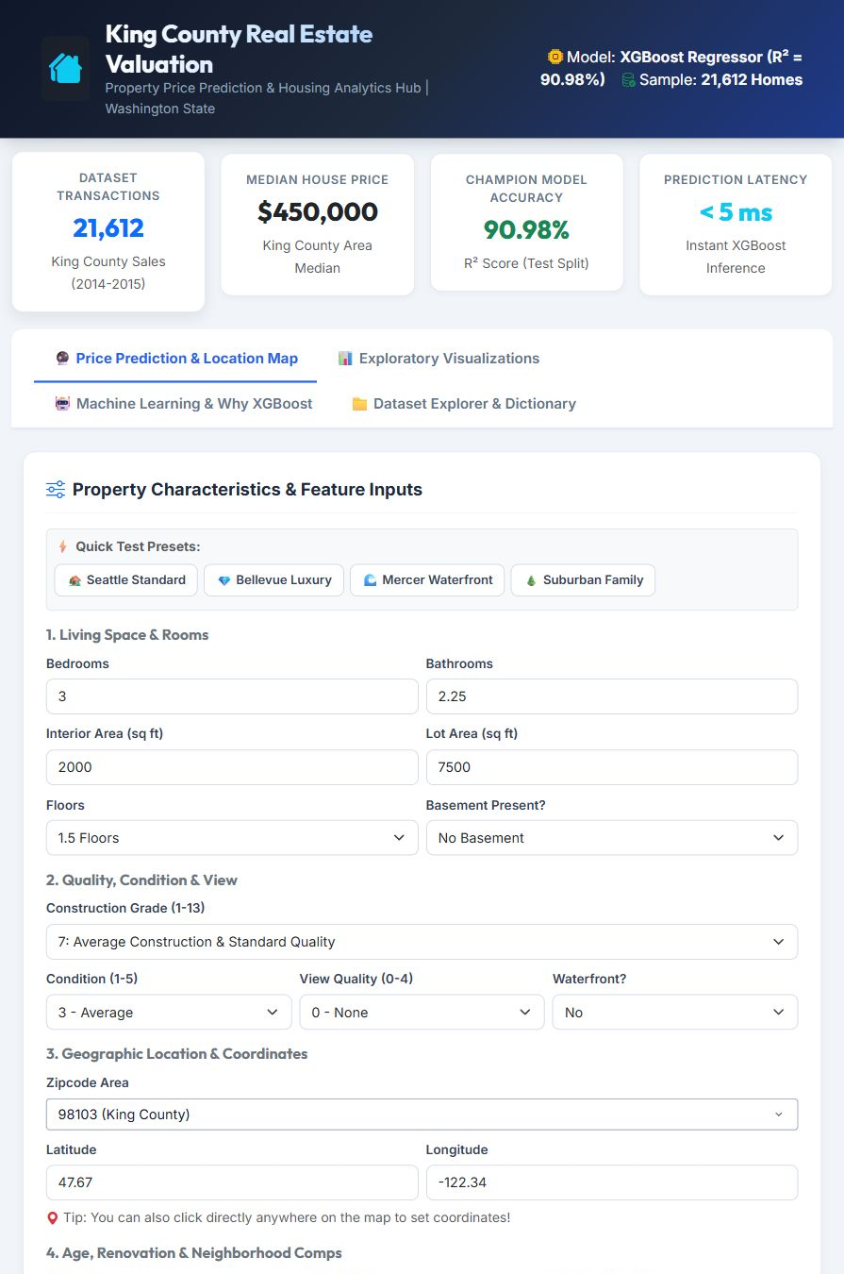
06 / DASHBOARD
PREDICTION: FROM INPUTS TO AN ESTIMATE
38
01
Four groups: space, quality, location, age / neighborhood.
02
Four presets: Seattle, Bellevue, Mercer waterfront, suburban family.
03
Estimate, price tier, $/sq ft, density, age and renovation status.
04
The displayed ±MAE band is an error guide, not a calibrated confidence interval.
KING COUNTY REAL ESTATE EVALUATION / DEPI
Notes:
Demo: open Seattle Standard; show the four input groups; change living area or grade and recalculate. The browser builds21model inputs. Sale year/month are fixed at2015/6, so describe it as a historical model.
Evidence: original project notebooks Cleaning.ipynb, Visualization.ipynb, MachineLearning.ipynb and Dash source; project directory E:/codex_output/King-County-Real-Estate-Evaluation-DEPI-/.
ROW REVEAL VERSION: Table headers stay visible. Reveal each row with a click. Before/after examples reveal raw value, calculation, then result. Use Slide Show mode. Click / Right Arrow reveals the next group (5 groups on this slide). Click the footer to return to contents. Agenda section names link directly to each presenter section.

Slide 38
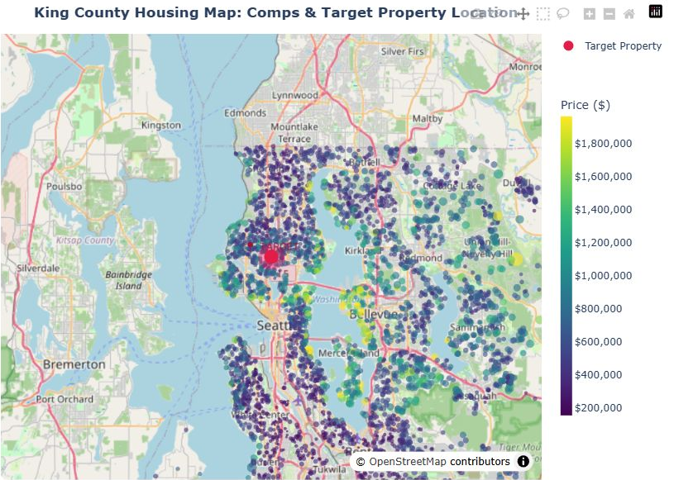
06 / DASHBOARD
MAP: EXPLORE COMPARABLE HOMES
39
01
Target home highlighted in crimson.
02
Filter comps by maximum price and waterfront status.
03
Click a comparable to relocate the target.
04
Zipcode selection updates location coordinates.
KING COUNTY REAL ESTATE EVALUATION / DEPI
Notes:
Demo: switch to Bellevue or Mercer preset. Point out the crimson target, adjust maximum comp price and enable waterfront only. Click a comparable point to relocate the target coordinates and nearest zipcode. Dashboard map uses5000sampled transactions.
Evidence: original project notebooks Cleaning.ipynb, Visualization.ipynb, MachineLearning.ipynb and Dash source; project directory E:/codex_output/King-County-Real-Estate-Evaluation-DEPI-/.
ROW REVEAL VERSION: Table headers stay visible. Reveal each row with a click. Before/after examples reveal raw value, calculation, then result. Use Slide Show mode. Click / Right Arrow reveals the next group (5 groups on this slide). Click the footer to return to contents. Agenda section names link directly to each presenter section.

Slide 39
06 / DASHBOARD
EXPLORE THE EVIDENCE BEHIND THE ESTIMATE
40
Dashboard tab | Features to demonstrate
Exploratory Visualizations | Nine views; map, distributions, correlations, spatial patterns, zipcodes and rotatable 3D
Machine Learning | Model scores, comparison charts, actual vs predicted, residuals and feature importance
Dataset Explorer | First 15 records, paginated preview and a feature dictionary
Chart controls | Hover details, zoom / pan, reset axes and download a chart
Explain chart findings using the notebook evidence in Sections 03–05.
KING COUNTY REAL ESTATE EVALUATION / DEPI
Notes:
Evidence: original project notebooks Cleaning.ipynb, Visualization.ipynb, MachineLearning.ipynb and Dash source; project directory E:/codex_output/King-County-Real-Estate-Evaluation-DEPI-/.
ROW REVEAL VERSION: Table headers stay visible. Reveal each row with a click. Before/after examples reveal raw value, calculation, then result. Use Slide Show mode. Click / Right Arrow reveals the next group (5 groups on this slide). Click the footer to return to contents. Agenda section names link directly to each presenter section.

Slide 40
06 / DASHBOARD
A SIMPLE LIVE DEMO ROUTE
41
01
Start with Seattle Standard; explain one estimate and its MAE guide.
02
Change living area or grade, then try Mercer Waterfront.
03
Filter the map and click a comparable property.
04
Show a visualization, the model comparison and the dataset dictionary.
KING COUNTY REAL ESTATE EVALUATION / DEPI
Notes:
Evidence: original project notebooks Cleaning.ipynb, Visualization.ipynb, MachineLearning.ipynb and Dash source; project directory E:/codex_output/King-County-Real-Estate-Evaluation-DEPI-/.
ROW REVEAL VERSION: Table headers stay visible. Reveal each row with a click. Before/after examples reveal raw value, calculation, then result. Use Slide Show mode. Click / Right Arrow reveals the next group (4 groups on this slide). Click the footer to return to contents. Agenda section names link directly to each presenter section.

Slide 41
CLOSING
FROM RAW SALES TO AN ACCESSIBLE TOOL
42
01
Cleaned 21,612 sales and documented the transformations.
02
Explored size, quality, geography and the price distribution.
03
Built 21 model inputs and compared four regressors.
04
Selected XGBoost and delivered a public interactive dashboard.
THANK YOU / QUESTIONS
KING COUNTY REAL ESTATE EVALUATION / DEPI
Notes:
Evidence: original project notebooks Cleaning.ipynb, Visualization.ipynb, MachineLearning.ipynb and Dash source; project directory E:/codex_output/King-County-Real-Estate-Evaluation-DEPI-/.
ROW REVEAL VERSION: Table headers stay visible. Reveal each row with a click. Before/after examples reveal raw value, calculation, then result. Use Slide Show mode. Click / Right Arrow reveals the next group (5 groups on this slide). Click the footer to return to contents. Agenda section names link directly to each presenter section.

Slide 42
APPENDIX / SOURCE TRAIL
WHERE THE PRESENTATION FACTS COME FROM
43
Source | Evidence used
Cleaning.ipynb | Missing values, bedroom rule, feature formulas and correlations
Visualization.ipynb | Seven original PNG figures; map and 3D exploration
MachineLearning.ipynb | Split, configurations, metric table and original benchmark figure
Saved model + feature list | 21-column feature order and fitted model importances
Dash source + live dashboard | Input groups, presets, filters, four tabs and demo steps
Canva template EAGpduGnIqo | Blue / black / white design, embedded fonts and original frame
KING COUNTY REAL ESTATE EVALUATION / DEPI
Notes:
All project file paths refer to the original supplied project. Notebook cell numbering here follows extraction indexes starting at0. Source plots are images intentionally retained from notebooks; text, tables and new comparison charts are editable.
Evidence: original project notebooks Cleaning.ipynb, Visualization.ipynb, MachineLearning.ipynb and Dash source; project directory E:/codex_output/King-County-Real-Estate-Evaluation-DEPI-/.
ROW REVEAL VERSION: Table headers stay visible. Reveal each row with a click. Before/after examples reveal raw value, calculation, then result. Use Slide Show mode. Click / Right Arrow reveals the next group (6 groups on this slide). Click the footer to return to contents. Agenda section names link directly to each presenter section.

Slide 43
APPENDIX / VISUAL CREDITS
VISUAL SOURCES AND PRESENTATION NOTES
44
TEMPLATE
Blue and Black Simple Business Proposal Presentation
https://www.canva.com/templates/EAGpduGnIqo/
SEATTLE PHOTO
George Freeney-Jones — Kerry Park skyline, 2016 (cropped)
Wikimedia Commons; CC BY-SA 4.0
PROJECT VISUALS
Original notebook outputs and captures of the live dashboard.
KING COUNTY REAL ESTATE EVALUATION / DEPI
Notes:
Evidence: original project notebooks Cleaning.ipynb, Visualization.ipynb, MachineLearning.ipynb and Dash source; project directory E:/codex_output/King-County-Real-Estate-Evaluation-DEPI-/.
Photo source: https://commons.wikimedia.org/wiki/File:20160124_GFJ2757-kerry-park-skyline_seattle-wa-panoramic.jpg
License: https://creativecommons.org/licenses/by-sa/4.0/
Live app: https://omarwolf28.github.io/king-county-dash/
ROW REVEAL VERSION: Table headers stay visible. Reveal each row with a click. Before/after examples reveal raw value, calculation, then result. Use Slide Show mode. Click / Right Arrow reveals the next group (1 groups on this slide). Click the footer to return to contents. Agenda section names link directly to each presenter section.

