Slide 1

Housing :Price Prediction
Submitted by: Mohamed Adel Hafez

Slide 2
ACKNOWLEDGMENT
References:
https://www.towardsdatascience.com
www.analyticsvidhya.com
www.kaggle.com

Slide 3
INTRODUCTION
Business Problem Framing
You are required to model the price of houses with the available independent variables. This model will then be used by the management to understand how exactly the prices vary with the variables. They can accordingly manipulate the strategy of the firm and concentrate on areas that will yield high returns. Further, the model will be a good way for the management to understand the pricing dynamics of a new market.
Conceptual Background of the Domain Problem
This project is all about predicting the house Price.
Domain Knowledge: https://www.surpriseaz.gov/448/Housing- Programs
Review of Literature Information for train dataset
Range Index: 1168 entries, 0 to 1167
Data columns (total 81 columns)
Dtypes: float64(3), int64(35), object(43)
memory usage: 739.2+ KB
Information for test dataset
Range Index: 292 entries, 0 to 291
Data columns (total 80 columns)
Dtypes: float64(4), int64(34), object(42)
memory usage: 182.64+ KB
Motivation for the Problem Undertaken
The project is provided to me by Flip Robo Technologies as apart of the internship programme. The exposure to real world data and the

Slide 4
opportunity to deploy my skills in solving a real time problem has been my primary motivation.
Analytical Problem Framing
Mathematical/ Analytical Modeling of the Problem

Slide 5
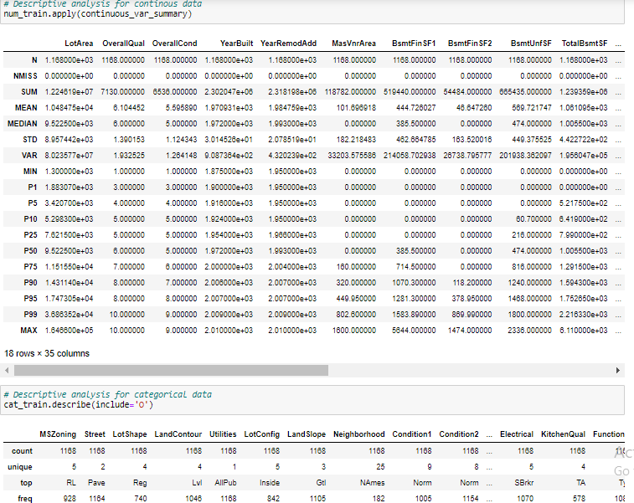
Our objective is to predict house price which can be resolve by use of regression-based algorithm. Final model is select based on evaluation benchmark among different models with different algorithms, Further Hyperparameter tuning performed to build more accurate model out of best model.
Data Sources and their formats
There are 2 data sets that are given in CSV format.one is training and one is testing.
Train file: It contains all the independent variables and the target variable. The dimension of data is 1168 rows and 81 columns.
Test file: It contains all the independent variables only without the target variable. The dimension of data is 292 rows and 80 columns.
Data Pre-processing Done

Slide 6
Removing all the null values and dropping the column with 45% of the null values- filled it with the central tendency .
Encode the object columns- LabelEncoder()
Both Feature extraction & selection.
Multicollinearity- VIF technique
Correlation
Visualization
Data Inputs- Logic- Output Relationships
Selected top 39 Features for modelling.
Correlation
Removed outliers
Hardware and Software Requirements and Tools Used
Hardware used: Inteli7 with 2.4GHZ
RAM- 4GB
Software used: -
Anaconda-navigator
Jupyter notebook
Matplotlib.pyplot / Seaborn
Numpy / pandas
Scikit-learn / sklearn
Model/s Development and Evaluation
Identification of possible problem-solving approaches (methods)

Slide 7
Null Values
EDA
Feature extraction & selection -RFE/Fregression
VIF
Correlation
Visualization
Model Building
Hyperparameter Tuning
Testing dataset
Testing of Identified Approaches (Algorithms)
Linear Regression
KNN
SVM (Regressor)
Decision Tree Regressor
RandomForest Regressor
ADABoost Regressor
Gradient Boost Regressor
XGBoost Regressor
Run and Evaluate selected models

Slide 8
Line,ar1Regress1ion
lr=LinearRegressicn()
lr .,ht (x_train_sc,y_train) pred_train=lr,predi.ct(x_train_sc) pred_test=lr. predict (x_test_sc) score_train=r2_sccre(y_train, pred_ r·afo) score_test=r·2_score(y_te st,.pred_test)
inse = inean_squared_error(y_test, pred_test) print(' R2_Score_train: ', score_train) print(' R2_Score_test: ', score_test)
print('i1ean alisolute error : ',mean_at>solute_errcr(y_test,pred_test)) print(1' SE = ', n . sqrt (mse). round(4))
R2 _score_t rain: e. 8845627870917223 R2_Score_test: 0. 8744175,291604862
iiean a,bsoltJJte ern,r : 0.097579•36996349996
RMSE = 0.1369
Cross validation oftlie Model
for i in(2, 10):
cv_score=cross_val_sc re( Ir, x,y, cv=i)
cv_mean= cv_score .,meall()
cv_std= cv_sccre,std()
print(f'At Cross fold {i} ttie c scoremean is {cv_ ean} and the cv score std is {cv_std}, testing accuracy score= {score_te, print(' \n')
At cross fold 2 the cv score mean is 0,,85217204<1&&1S334 and ttie cv score std is 0.011142%425'0533533, testing accuracy score=
0 .,,8744775291604,86,2
At cross fold 10 the cv scoremean is 0.,857'11368J8,62S n and the cv score std is 0,07597908%9170%3, testing accuracy score=
0 .,8744775291604,86,2
Activ,
{' leaming rate': 0.e09,. 'max_depth': 4,
'min_samples_leaf': 25,. 'min_samples_9p it': 2s,
1
n_c:s.timators : 12.rt)2..11
1
'randoo_state' : 58,
'subsa le': 0.4}
gtw_mooel=gbr _mcdel. liest_est icator_
train_p ed=gbr _ del .predict (x_train_sc) te·st_pred=gb _mcdel. p edict(x_ est_sc)
r_squared = r2_score(y_train, train_pred)
print['The t ain R-squar-.e va:ue is: ', r_squared.rnund("))
The tra.in R-square value i.s: 0,, 9241
r_squared = r2_score(y_test, test.J)resd)
print['The train R-squar-.e value is: ', r_squared.rnund(4))
The train R-sq are value i.s: 0,, 89QS
mse =mean_squared_error(y_tc-st,. test_pred)
print['i-iean absolute error : ', mean_ab,solute_error(y_test.,test_ red)) print[' RMSE = ', np. sqrt(m,se) .round('!))
Mean atlsolute enror : 0,,08485,719037181733 MS.E = 0.1267
# cross_val_score
score = crnss_val_,cc e(gbr_mcdel,x scale, y, cv=10) print['\0J3[1m'+'cross validation score : ',gbr_model,":"+'\033[€i:l\n') print("l'.,.an OJ score : ", scar,; .mean())
print( 'Difference in R2 & OJ score: ', (r2_score(y_test, te.st_pred)•100)-(,rnre. ean()*100))
cross V,alidation score :: 6radiientl!oost:ingReijressor{learning rate=0,,,00'l•, ax_depth=4,mi.n_sa ples_leaf=25, miin,_samples_split=25, n_estimator-;=1200,
random_s.tate=58, subs,ample=0.4)
Act
Got
Mean OJ Seo roe e,88€6497688116034
Differe,nce irn R2 &. CV score : 1 ,,2033211219!053612

Slide 9
Polynominal
poly=P lync ial1Features( egree=3) xtrain_poly=poly.,fit_transforo,(,::_trai _sc) xtest_Jpoly=poly.,tras for<>(x_te st_sc)
lr2=LinearRegressio ()
lr2. fit (xtr·ain_poly, y_train)
j :
i ..- LinearRegression i
I LinearRegressicn() i
pred_train=lr2.pre ict(xtrain_poly) pred_test=lr2. predict(xtest_p y)
r2_train = r2_score(y_train, pred_trai.n)
print("The train R-square value is: 'J r2_train.round(4))
The train R-square va ue i:s: ll.. 0
r2_test = r·2_score (y _test, pred_test)
print('The test R-square value is: r2_test,.round(4))
Th·• test R-square value is: e.7937
mse = rnean_squared_error (y_test, pred_test)
print('i1ean absolute error : ', rnean_at>solute_errcr(y_test,pred_test)) print('Rl-1SE = ', np.sqrt(mse) .rournd(4))
Mean absolurl:e error 0.1214\%764 3530225 RIISE 0 .1754
# using lasso regularization
tuned_parameters = [{'alpha': [0.001,e.01,0.1,0.,003], 'random_state': [58H]
Lassccv = Gridsearc (\/(Lasso(),
tuned_parametersJ
CV=10J
n_job-s=-lJ scoring='rieg_meari_s(luared_error • ,, verbose=2)
Lassccv,.fit(xtrain_poly, y_train)
print(' Best combi11ation:'J LassoC\f, best_par·a:m:s._);
Htti1ng 10 folds for each of 4 candidates, totalling 46 fits Best combination: { 'alp a': 0.,01, 'r·arndo _state': 58}
ft. Lasso model
LaSSO=Lasso( alpha=0. 01)
lass _rnodel=Lasso. fi t(xtrain_poly,,y_train}
train_pred= asso_raodel. predict(xtrain_poly) test_pred=lasso_mcdel.pre<Jict(xtest_poly)
r_squared = r2_s,core(y_trainJ train_pred)
print('The train R-square value is: ', r_squared.round(4))
The train R-square value is: e.9462
r_squared = r2_sccre(y_test, test_pre<l)
print('The test R-s uare value is: ', r_squared.rcund(4})
The tes R-squar,e value is: 0.85'53
mse =mean_squared_error(y_test, test_pred)
print(' 1e.a11 alJsoltJte error : ', rnean_a!Jsolute_errcr(y_test_.test_pred))
print('RJ,ISE = ', np.sqrt(mse).round(4))
nean a solurl:e error : 0.0%611520'55263018
f\SE 0.1459
Act 'fa
G"o to Se

Slide 10
knn:t<;tleighocrsRegressor ()
knn_par-ams={' n_neighbors':[5, 7, 9, 11], •,eights': ['distance',,'uniform' I,m' etric':[' anhatten', 'eucliMan' I}
knn_model= GridSearchCV(knn, k:nn_params,n,=10, n_jotas=-1, vertaose=True). fit(x_train_sc, y_train)
fittir11g10 folds for- each of 16 candidates, totalli.ng LOO fits
knn_mooeL t>est_params_
{ 'metri,c': 'euclidean', 'n_rneightior:s': 9,, ',.eights': 'distance'}
knn_mooel = Ktleighb r:sReg,esscr( n_neigtibors=9, ,,reights='distance',met r,ic='euclidean' ). f.it (x_tra in_sc, y_train) train_pred=knn_ del.predict (x_train_sc)
te-st_pred=k:nn_model. predict(x_test_sc)
r_squared = r2_scor (y_train, trainyr,ed)
print('The train R-square value is: •, r_squared.round(4))
The train R-square value is : L 0
r_squared = r2_score(y_test, test_pred)
print('The test R-square value is: ', r_squared.rou.nd(4))
The test R-square value is: 0. 7877
mse =mearn_squared_error(y_test, test_pred)
print(' .ean absolute error : ', mean_at>soluJ1:e_eTror(y_te,st,,testyred)) print(' RMSE = ', np. sqrt(mse) .round(4))
Mean absolute error : 0,.12249' 27602769'145
MSE 0,.171!
It cross_va[_swre
s,ccre = cross_val_s,ccre(knn,X_scale,, yJ CV=10)
print('\033 lm'+'cross validation srnre :',knn,":"+'\033[0m\n') print(" .ean CV Score :",score.mean())
print('Difference in R2 & cv score:' ,(r2_sco e(y_te·st,,test_pred)•100)-(sccre. ean()•100))
cross vaHd:at:ilon, score :: KNeighborsRegressor() Mean 0/ Score : 0.7&76301462591948
Differe:nce irn R2 &, OJ sc re: 0. 0103291.6048518473
Act
Go+
SVM
svr=SVR(kernel='linear') svr.fit(x_t:rain_sc,,y_train)
SVR
ISVR(kemel=' inear') i
......................,,,,,,,,,,,,,,,,,,,,,,...............!
r_squared = r2_score{y_train, rain_pr,ed)
print('The train R-squa,re value is: ', r_squared.rou d("))
The train R-square value is: 1,.0
r_squared = r2_score{y_t-est, test_pred)
print('The train R-square value is: ', r_squared.round("))
The train R-sq are value is: 0,. 7&77
ms,e = mean_squared_error(y_test, test_pred)
print(·r,.ean absolute error : ', mean_absolLrte_error(y_test, test_pred)) print(' RMSE = ', np. sqrt(mse) .round(4))
Mean absolut,e error : 0.12249'9'.27602769145
115,E 0 .178
It cross_val_swre
score = cross_val_scc e(svr,x_scale,, y, cv:10)
?rint ( '\033[lm' +' cross Validatior1score : ' , svr,":"+' \033[0m\n' ) print ("r-i.e,m CV Score :", score m. ean())
print( 'Difference in R2 & 0/ score: ', (r2_score(y_test,,te:st_prect)•100)-(sccre. ean()*lOO))
cross valid:at:ilon, score : SVR,(kernel:' Hnear')
/Jlean OJ score : 0.,!!6296164901.97367
Differe.nce i.n R2 &, CV score: -7,.52282iH5569002
Ar

Slide 11
IDecis!ion Tree Regr,es.sor
dt:r=DecisionTreeRegressor() dtr .. "it(x_train sc,y_train)
i Y' Decision reeRegressor i
1. cisi n·.. eRegr ().1
trairn_pred=dtr. predi.ct (x_tra in._sc) tes _pred=dtr .. predict(x_test_sc)
r_squared = r2_score(y_train, rain_pred)
prillt("The train R-sq are value is: ·, r_squared.. round(4))
The rain R- sq are value is: 1.. 0
r _squared = r2_score(y_test, test_pred)
prillt("The train R-sq are value is: ·, r_squared.. round(4))
The tra.in R-square value is: 0.. 643
mse = ean_squared_error(y_te·s ,. test_pred)
prillt('r,.,.an absolute err-a- : ',mean_absolute_error(y_te·s ,.test_pred)) prillt(" RMSE = ·, np. sqrt(mse) .rmrnd(4))
Mean aa,solute error : 0..1648860499.6456133
MS£ = 0.23W
;, cross_voL_score
score = cross_val_sccre(dtr,x_scale, y, cv=10) print('\0J3[1m'+'cross validation score : ',dtr,":"+'\033[0m\n') print("r,.ean Cl/ score : ", scorem. eanO)
print('Di Lference in R2 & cv score: ', (r2_score(y_test, test_pred)•100)-(scc e. ean()•100))
cross V,alid!ation score :: DecisionrreeRegr,essorO Mean cv score : e,71.300457281.5519
Differe,nce i.n a2 & CV score: -7.. 001500158314312
Ac
rfr=RandomFcres egressorO
rfr,fit(x_train_sc, y_train)
! • RaMomForestRegressor !
Go
i aMomForestRegressor() !
l...................................................................!
train_pred=rfr. predict (x_train_sc) te,st pred=rfr,predict(x_test_sc)
r_squared = r2_score(y_train, train_pred)
print("The train R-square value is: ·, r_squared.round(4))
The tra.in R-square value is: 0.9803
r_squared = r2_score(y_test, test_pred)
print('The train R-square value is: ', r_squared.round(4))
The train R-square value is: 0,8500.
mse = rnean_squared_error(_v_test, test_pred)
print(•r,.,.,.n absolute err-or : •,mean_absolute_error(y_test, test_pred))
print ( • RMSE = ·, np. sqrt.(mse).round(4))
flean absolute enror : 0,100.00868567191776
MSE = 0,14%
# cro,s_val_score
score = cross_val_sccre(rfr,X sc.a e, y, CV=10)
print ( '\0J3[1m' +' cross validation score : ' , rfr, " :"+' \033[ em\n' ) print(""l'iear1Cl/ score :"',score.mean())
print("Difference in R2 & CV score: ',(r2_score(y_test,test_pred)'100)-(sccre. earn()*100))
cross Valid!ation score : Rand.omForest!Regressor() ftean OJ Sc.ore : e,861379710570"2938
Difference in R2 & cv score: -1. 125548671744582

Slide 12
Ar:iaBoostRegressor
ada =AdaBo stRegressc ()
ada ,.fit(x_ ai.n_sc,y_train)
!^{i} .. AdaBoostR.egriess r I:
l. - -8. - - -r.:".5.: !.J..1
train_pred= adar .,pre-dict(x_train_sc) test_pred= adar.predict (x_test_sc)
r_squared = r2_score{y_trair1, train_pred)
print['Tlie train R-sq are value is: ·, r_squared,.round(4))
The train R-square value is: 0,.8681
r_squared = r2_score(y_te;t, test_pred)
print['Tl1e train R-sq are value is: ·, r_squared,.round(4))
The train R-square value is: 0,.8005
mse =mean_squared_error(y_test, test_pred)
print(' .cari absolute error : ', mean_ab-solute_error[y_tes ,te:st_pred)) print[' RMSE = ', np. sqrt(mse·) .ro1md(4))
Mean a sollJlte enro : 0 .12155701278070667
RMSE = 0 •1.725
II cross_va[_score
:s.ccre = cross_ya.l,_sccre(adar.,X_s.cale_. yJl cv=10) print['\033[1m'+'Cross validation sc re :',adar,":"+'\e33[€Cl\n') print("r-:.eari QJ score :",score.mean())
print['Difference in 2 & CV Scone: ', (r2_score(_v_test,,test_pred)'l!l0)-(srnre.
cross vabd:ation score : MaBoostRegr,essor()
an()*lOO))
Mean CV SCONe : 0. 7954522662398535,
Difference in R2 & cv score: 0.50524250590,.647
Act v
GradientfJoost
gtl'r=Gradientsoostin11Regr,essor() gtl'r .,fit {x_trairi_sc, y_train)
j • Gradient8oostingR.egressor i
!Granierit.BoostingR.egre·ssor{)!
L. :
train_pred= gbr. predict (x_train_sc) test_P'red= gbr. predict(x_test sc)
r_squared = r2_score(y_trai , train_pred)
?rint['The trai11R-squar-e value is: ', r_squar,ed_round(4))
Tr,e tra.in R-square val e i.s: 0.9635
r_squared = r2_score{y_test, test_pre-d)
?rint( 'The traill R-squar,e value is: ', r_squared- round[4))
The train R-square val e is: 0.8843
mse = 111ean_squared_error(y_te·st, test_pred)
print[ 'l'.ean absolute error : ', mean_ab-sollJlte_e,rror(y_test, test_P'red)) print[' RMSE = ', np. sqrt(m,se) .round(4))
I-lean al>solute error : 0,.0893941447@38882
f15,E = 0,.1314
tt Cross_val._score
srnre = cross_val_srnre[gbr,X_scale,, y, CV=10)
?rint['\033[1m'+'cross vali ation score : ',gbr,":"+'\033[0m\n')
?rint(" .can QJ score :",score.mean())
?rint( 'Difference in R2 & cv scone: ', (r2_score{y_te·s , test_pred)•1ee)-(sccre.
Cross V,ali,td:iion, Score :: GradlienlJEloost:illgRegiressor ()
an()*100))
Act
Got
Mean OI score : 0.8811804593722684
Differe,nce ill R2 & CV Sc re: 0.3162646156351059

Slide 13
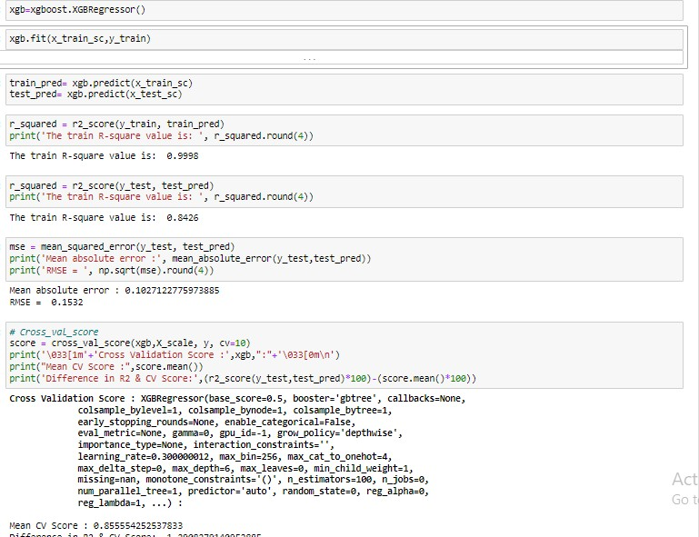
Key Metrics for success in solving problem under consideration
Using R2score for accuracy as it is a regression problem with cost function loss metrics as RMSE,MAE
Visualizations

Slide 14
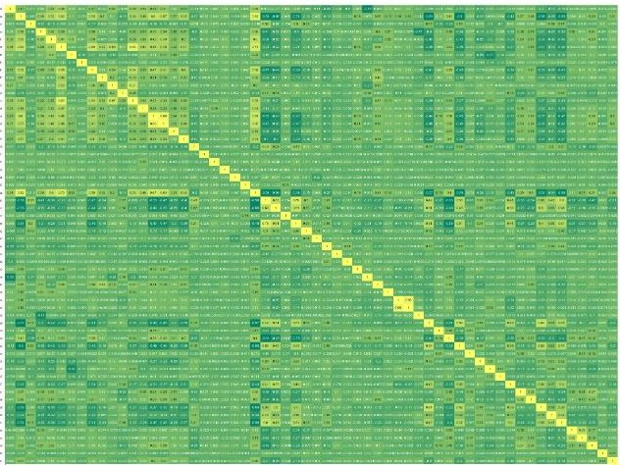

# heotmoo correlation
plt.figure(figsize = (40,25))
sns,heatmap(train_final.corr(), annot=True, cmap-='surrmer•)
plt.shew()
ll 111! i P 1 ! 11111 I Ii l l ! ¹i ¹! p l I ¹ !I q 1 I t l i l I d i lJ l p ! !I II i I i11
I
Go

Slide 15
..
Combine effect of RoofStyle & Total Floor Space on Sale Price
• • •
RoofS<)tc
Gable
."."..'
700000
. """""..
SheO
600000
M:msord
Q)
500000
•
u
400000
Q)
iv
ti)
300000
200000
-
·-
. ,!M
•.•,,.j;.JS
100000
'i
• .• # • • •
-2
0
-4
0
GrlivArea
2
4
Observation :-
For Hig.hfloor areaconstruction mainly Hip style Roof isused andinvariably high cost properties mostly comes upwith Hip StyleRoot.-

Slide 16



plt,rcParams['figure.autolayout'] = True plt,figure(figsize = (10,6))
sns,barplot{y = num_train_eda[· salePrice·], X= cat_train[· ,-1szoni.ng·]) plt.title('Avg.sale Price as Per zone', fcntsize=22, fcntweight='bold') plt.xlabel('House Property zcne', fontsize= 18, fontNeight='bold') plt,ylabel('Avg.Sale Price of HOuse', fontsize-=18, fontNeight='bold') plt.xticks(fontsize=16,fcntweight ='bold') plt,yticks(fontsize=16,fcntweight ='bold')
plt.tight_layout()
plt.shcw()
Avg. Sale Price as Per Zone
I
.",'
200000
I
:,
-
0
^{:i::} 150000
0
I
"u'
I
·;:
^{a.} 100000
."; '
"'
"'
50000
0
RL
RM
FV
House Property Zone
RH
C (all)

Slide 17


hi pr
fOr <OJ la ,.,, l•'ilu\_oNil.(01,_.,,,
!)ll.H€<1.-..( ns,h ... { 4, l) .d!)1•1M)
1.11,.dh tplot{,.,,.._11"/1111_oNilj col j)
plt.t.h<M()
0.000125
0.000100
0.000075
0.000050
0.000025
0.000000
0
5QJCO 100000 150000
lotAliQ
l
Ill {lit". fOr col 1ac.:it_L,•.:iin.colu-.
!)ll.Ht11""( ns,h ... { 1$, l) .d!)1•1M)
1.11,.COUllt,ll<M{Ut_t,•.:it.{cot J)
plt.t.h!M()
..
..
0
..
••
";1w,, corld\'11 1.<. ur-1>""'1 JOOS. /11
",,.,..._. uro? Old,.,., .,..., lh,tlr tn Jillk <lll/J"" ..,.,,.,..,,.,, b.<HI th 1116')
"l'\lH of 111.-. """'"-' ..,-,., iw-,id •r4H tc.,d.!nt.trr a A,,.,;r,wr.
It tll1\ck"(Jotfl)II"'• U ft4t, tllUl>ilp<' tli .- 1....-.
"torl'.<N'>{111 - tnt.<dP, l4i>d ,;t0p,t""" w,.a.-., -r ,..,.ii,f\l>ON>Wd u ,.,,.r,, .-..-.,.
"M>•·•H t, ti># ontr d<.LOW:•f to fl¥ rc:wd(1to,, J'.
"l'\lH of 111.-. dwUWI? 11,,,. SU\ot.-.-f.-ttr Oo?1<lrl»tl.
"l'\lH of 111.-. ...,.... .._.,, U<"I? J..HVy{ ) o.-J,;10.-y (Jff').
"AU ,-,.,,ONSr (Co.p0,a.,.> s.,, t.-.,-, .or<l't"t<>t.
"AU ,,,,,,.Ur ur<Hr...,..., 11,,,. o,,,ilWN.
"uU ,,..,. "'•r""iot.- of 111.-. hA.,.-., ..,-,., V-.,:,yt St.d(/111.
" Jt,,;,()f Hyt.-. ON o?tr.....,. G lor o.- H(,t.
" l'\lH iOlto? r,;ot,t(ftclt>J; 11,,... ..-t.
"l'\lH hA.,.-., ,..,,,., S1""'111.-.1 Ct.-u,ir e,- ,"'-"• aMJ ot.- c(o!Jtrt4M
"l'\lH of 111.-. Jut .. ry;,,r <l,. ur"<l!•fr O.• Co,,...,.rt_l {Bs.tJ.
"uU -.,.,,.,, h..N Gt,.<, AHr<tlq.
" of f"'" 1'tr...-tor flt•Uh of tl>or !Joi tt.,;,flnU/lld.
"l'\lH of 111.-. ljl,rll lof.,.,f,....... ""' th 111>•-..0l o,,,Hr<on.
"""''" rhlln M of ,,..,. 911.....,..,, <l,. &1"°9"" tuorfr.,,,.

Slide 18
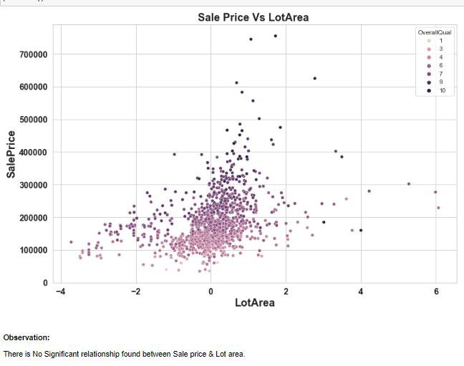
CONCLUSION
From our most important features
understand how exactly the prices vary with the variables. They can
accordingly manipulate the strategy of the firm and concentrate on areas that will yield high returns. Further, the model will be a good way for the management to understand the pricing dynamics of a new market.

