Slide 1
Software Engineering Chapter -1: Introduction
Lecturer: Dr.Tasnim Zayet
E-mail: tzayet@birzeit.edu
Office: Masri320
Materials by: Dr. Tasnim Zayet, Dr. Adel Taweel, Dr. Samer Zein

Slide 2
Objectives
Understand what software engineering is and why it is important.
What is meant by software development process and why it is important?
Understand that the development of different types of software systems may require different software engineering techniques.

Slide 3

Software Everywhere
Government
Education
Industry
Science
Banks
Entertainment

Slide 4
However, building and maintaining software is hard and is getting harder
Software Development is complex!

Slide 5
Software Complexity
Important to distinguish “small” systems (one developer, one user, experimental use only) from “Complex” systems (multiple developers, multiple users, products)
Experience with “small” systems is misleading
One person techniques do not scale up

Slide 6

Why Software Engineering?
Analogy with bridge building:
Building a bridge over a stream is an easy and one person job.
Building a bridge over a river? (the one-person job techniques do not scale)

Slide 7
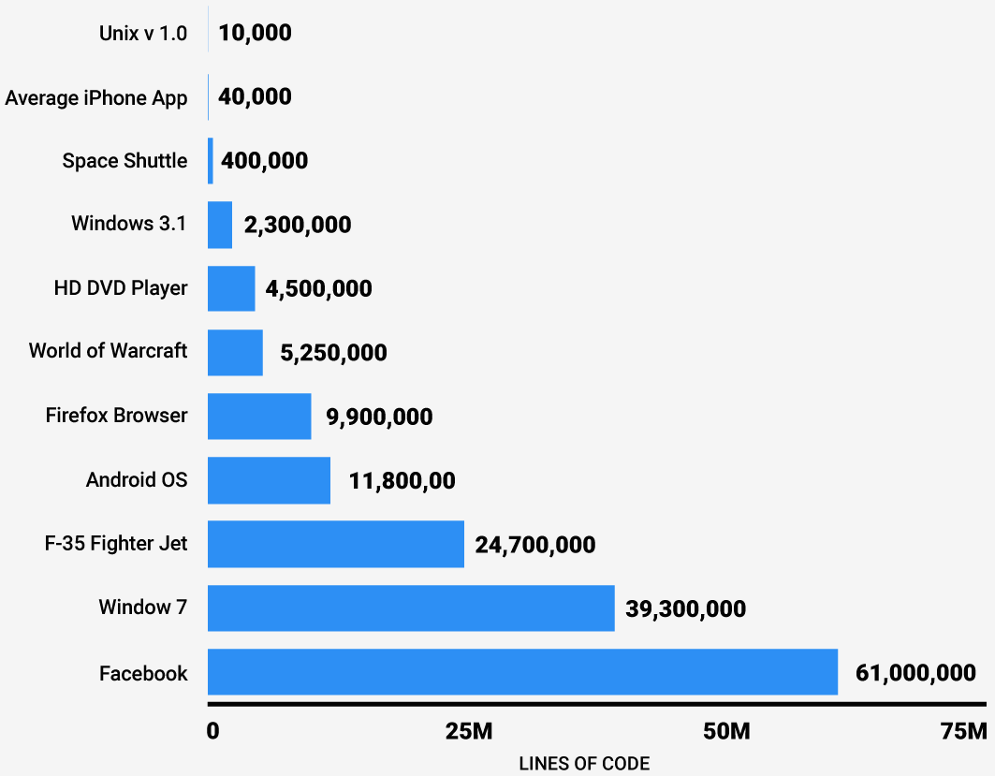
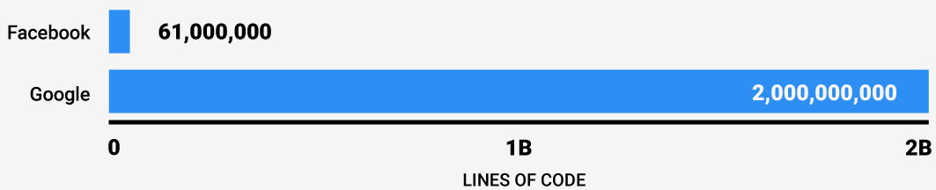
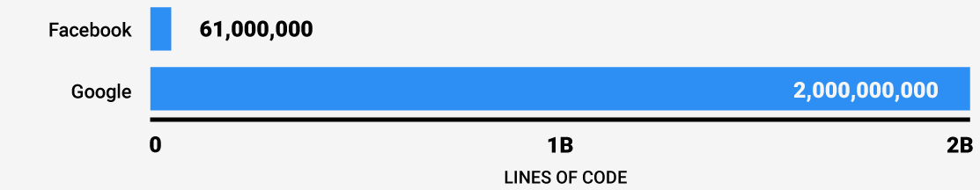
Why Software Engineering ?
Size is a key factor
Size
is a key factor
Complexity
increases as
Size
increases!

Slide 8
Software engineering is thus using engineering methods to manage
this complexity efficiently

Slide 9
Professional Software Development
The vast majority of software development is a professional activity:
Special team of developers.
For specific business purpose.
Formal and systematic (Process).
Software will be maintained and changed throughout its life
Software Engineering supports professional SW development, not amateur development.

Slide 10
Software Products
Generic Products
Marketed
Sold to anyone
The specification owned by the software developer
Customized Products
For specific customers to meet their own needs.
The specification is owned by the customer.

Slide 11
Industry and Software Engineering
Increasing demands: Systems have to be built and delivered more quickly; larger, even more complex systems are required
Low expectations: It is relatively easy to write computer programs without using software engineering methods and techniques.
Many companies have drifted into software development as their products and services have evolved.
They do not use software engineering methods in their everyday work.
Consequently, their software is often more expensive and less reliable than it should be.

Slide 12
Different Approaches!
It is pointless to look for universal notations, methods, or techniques for software engineering because different types of software require different approaches.
All of these applications need software engineering; they do not all need the same software engineering techniques.
Very
Different
MIS
Controller for scientific Instrument
Gaming

Slide 13
What is the difference between software engineering and computer science?
Computer Science
Software Engineering
is concerned with
theory
fundamentals
Algorithms, date structures, complexity theory, numerical methods
the practicalities of developing and
delivering useful software
SE deals with practical problems in
complex software products
Computer science theories are currently insufficient to act as a complete underpinning for software engineering, BUT it is a foundation for practical aspects of software engineering

Slide 14
SE history
SE introduced first in 1968 – conference about “software crisis” when the introduction of third generation computer hardware led to more complex software systems than before
Early approaches based on informal methodologies led to
Delays in software delivery
Higher costs than initially estimated
Unreliable, difficult to maintain software
Thus, there is a need for new methods and techniques to manage the production of complex software, ones that consider the intangible nature of software as a product.

Slide 15
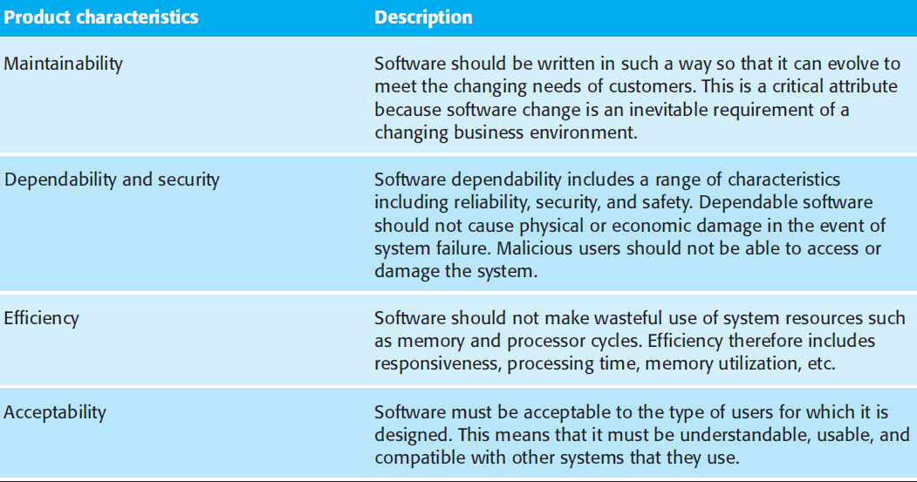
Attributes of Good Software

Slide 16
Software myths
Management myths
Standards and procedures for building software exist
Add more programmers if behind schedule
Customer myths
A general description of objectives enough to start coding
Requirements may change as software is flexible
Practitioner myths
Task accomplished when the program works
“Working program” the only project deliverable

Slide 17
Software failures
Therac-25 (1985-1987): six people overexposed during treatments for cancer
Taurus (1993): the planned automatic transaction settlement system for London Stock Exchange cancelled after five years of development
Ariane 5 (1996): rocket exploded soon after its launch due error conversion (16 floating point into 16-bit integer)
The Mars Climate Orbiter assumed to be lost by NASA officials (1999): different measurement systems (Imperial and metric)

Slide 18
More Software failures
Passport System delays cause backlog (1999, UK)
Ferry Company left thousands of lorries stranded for 12 hours (back up also failed, 1999, UK)
Inland Revenue (IR) ‘losing tax records’ (2000, UK)
=> IR spokesman said ‘All major IT initiatives have some kind of teething problems ....’
=> Guardian (20 July 2000) ‘At the centre of the crisis are two computer systems .... Files appear to have gone missing somewhere between the two’
General Motors Ford Cars (2016, USA + Worldwide): A “software bug” that may cause human safety, 4.5M cars recalled.

Slide 19
Even More Software failures
In 1995 annual US spending on software projects reached 250 billion dollars
This involved some 175,000 projects
Of this spend:
Overspend cost 59 billion dollars
Cancelled projects cost 81 billion dollars
Causes of Software Failures?

Slide 20
Why software projects fail?
Inaccurate understanding of customer needs
Inability to deal with changing requirements
Modules that do not fit together
Software that are hard to maintain/extend
Poor Quality
Testing….normally should cost 40%
Unacceptable performance
Technology change and team-member change over time in long period projects
Greater complexity= greater changes = potential errors!

Slide 21
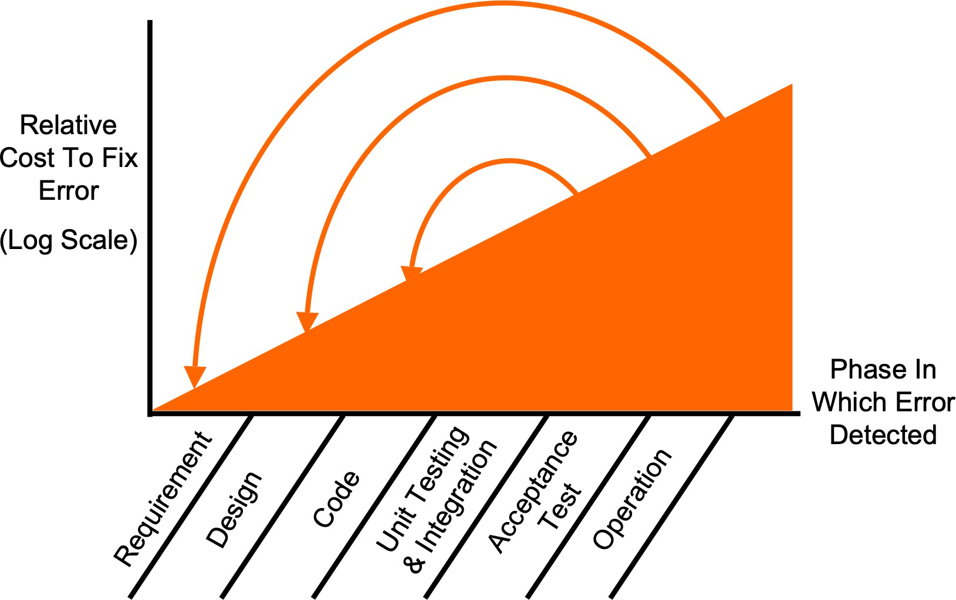
Cost of delayed error detection
Bugs: the later detected, the
higher cost
to fix

Slide 22
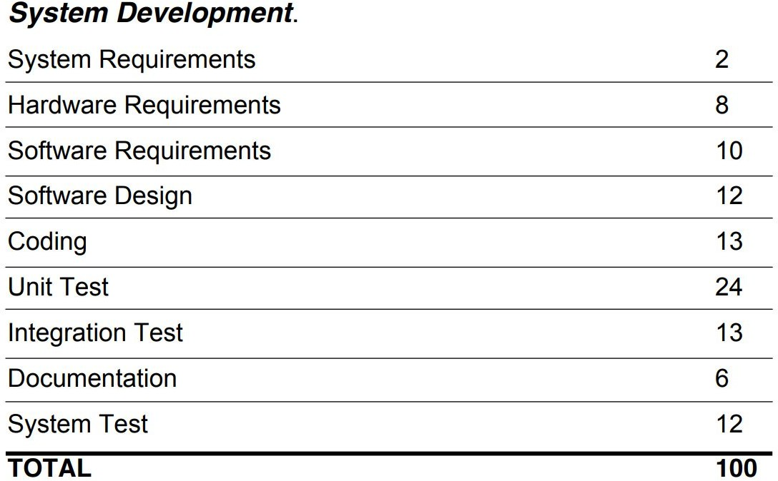
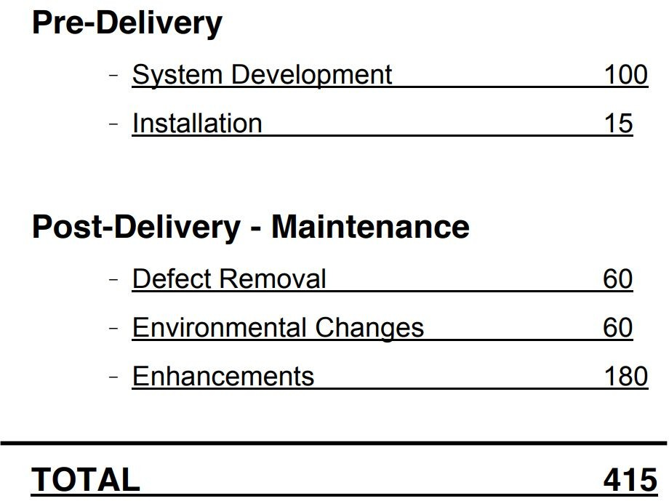
Software Costs

Slide 23
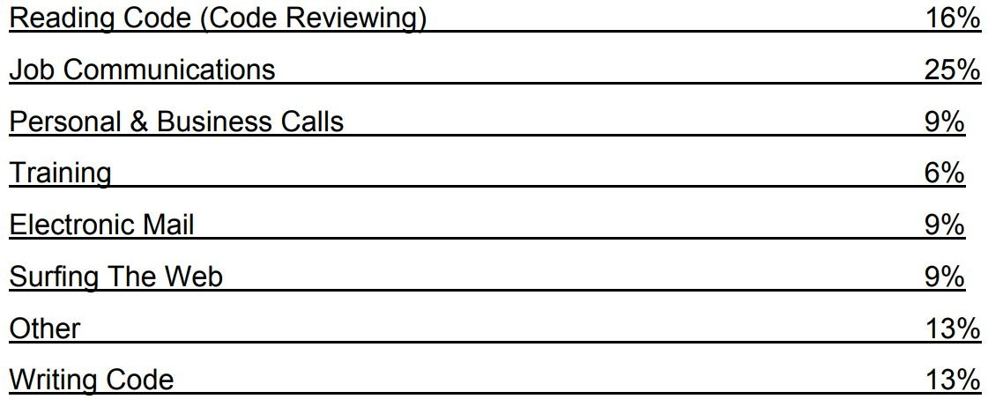
What Do Coders Actually Do?
Initial writing code is 13% of 100/415 of 13% of development.
=>THUS CODING IS ONLY 0.004 of TOTAL DEVELOPMENT COST

Slide 24
Software Engineering…
Did software engineering overcome these
issues?

Slide 25
Software Engineering: Progress
Important progress in Software Engineering:
Ability to produce more complex software has increased
New technologies have led to new SE approaches
A better understanding of the activities involved in software development
Effective methods to specify, design and implement software have been developed
New notations and tools have been produced

Slide 26
So what is a successful software project?
Good software should:
Deliver the required functionality
Efficient: does not waste voluble resources, response time
Usable
Dependable: reliable, secure, and safe.
Maintainable
Within budget and time

Slide 27
Software Development Process
A systematic approach for software development.
It is a sequence of activities that leads to the production of software.
Fundamental activities in all software processes are:
Specification - what the system should do and its development constraints
Development - production of the software system (design and implementation)
Validation - checking that the software is what the customer wants
Evolution - changing the software in response to changing demands

Slide 28
What are the costs of software engineering?
Roughly 60% of costs are development costs, 40% are testing costs. For custom software, evolution costs often exceed development costs
Costs vary depending on the type of system being developed and the requirements of system attributes, for example for high system performance and reliability costs can be high.
Distribution of costs depends on the development model that is used

Slide 29
What is CASE ? (Computer-Aided Software Engineering)
Software systems which are intended to provide automated support for software process activities, such as requirements analysis, system modelling, debugging and testing
Upper-CASE
Tools to support the early process of requirements and design
Lower-CASE
Tools to support later activities such as programming, debugging and testing

Slide 30
Software Engineering fundamentals that Apply to all Types of Software
Clear Development Process
Performance
Clear Requirements
Dependability
Reusability

Slide 31
What are the key challenges facing software engineering?
Software engineering in the 22st century faces three key challenges:
Legacy systems
Old, valuable systems must be maintained and updated
Increasing Diversity and Heterogeneity
Systems are distributed and include
a mix of different hardware and software
Dependability and Delivery
Having trustworthy software with faster
delivery of software (time-to-market)

