Slide 1
Video Scenes Classification
Prepared by:
Mohamad Kassem - Mohamad Jaffal - Mohamad Bazzal
Under the supervision of Dr. Siba Haidar
Jury Members: Dr. Bassem Haidar - Dr. Ihab Sbiety - Dr. Antoun Yaacoub
Senior Project i3308 Academic Year 2019/2020

Slide 2
Project Description:
Video scenes classification into:
Violent Scenes.
Non-Violent Scenes.

Slide 3
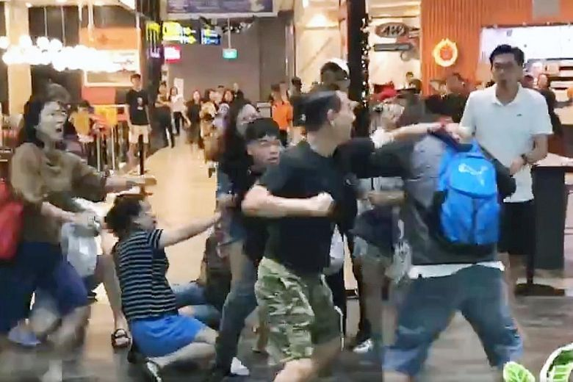
Project Importance
Detection of unusual behaviors
Useful for general security

Slide 4

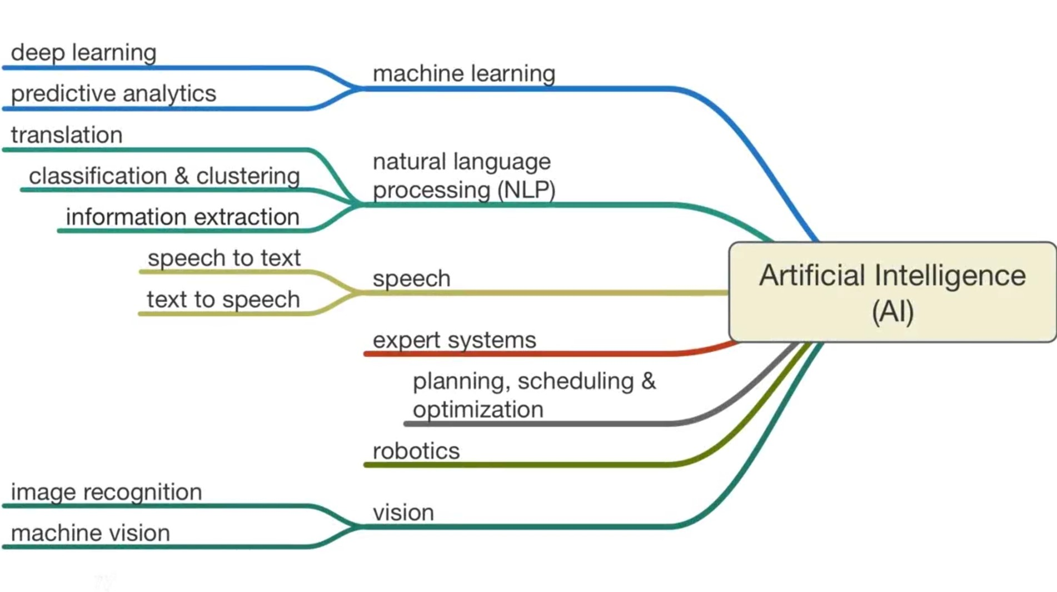
AI

Slide 5
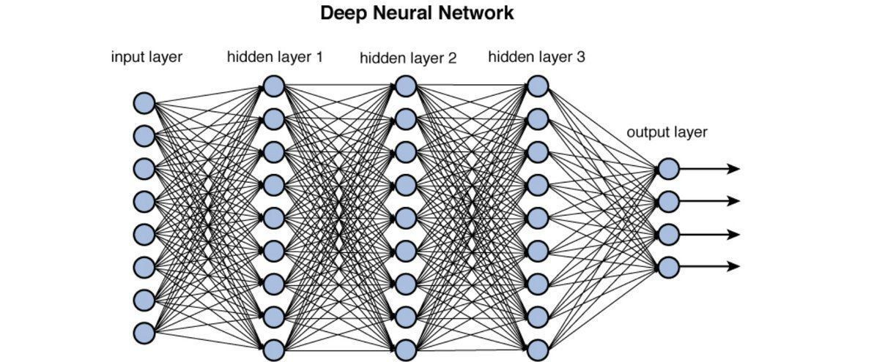
Convolutional Neural Network (CNN)
What is CNN?
What is a Neuron?
What about Neuron Weights?
Types of Layers

Slide 6
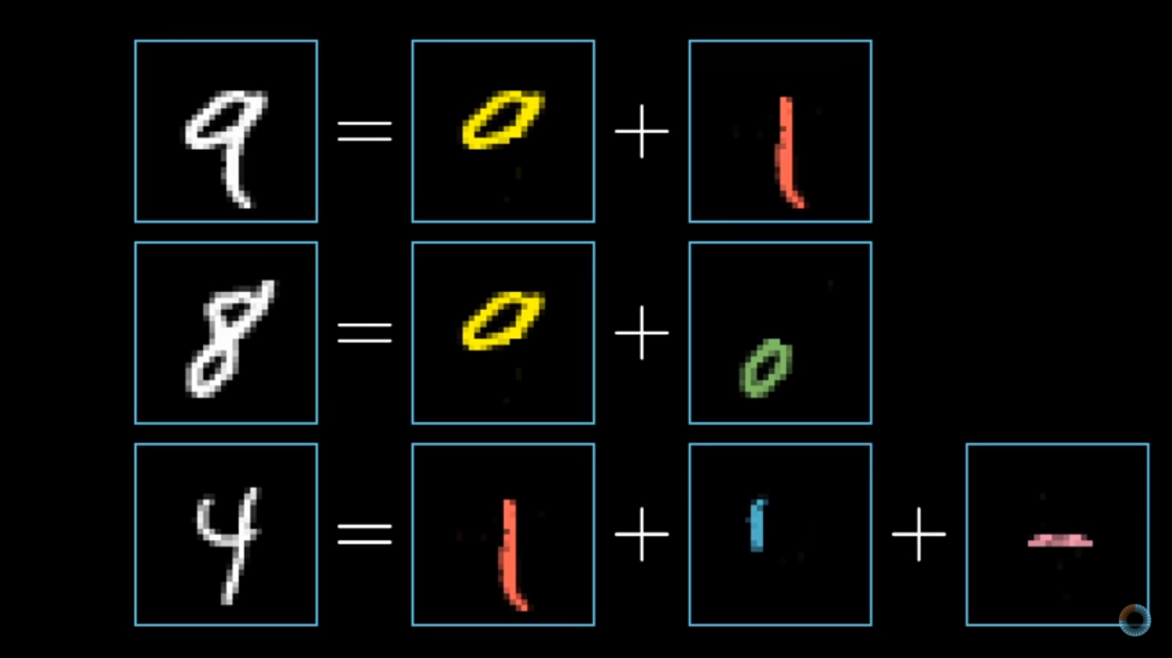
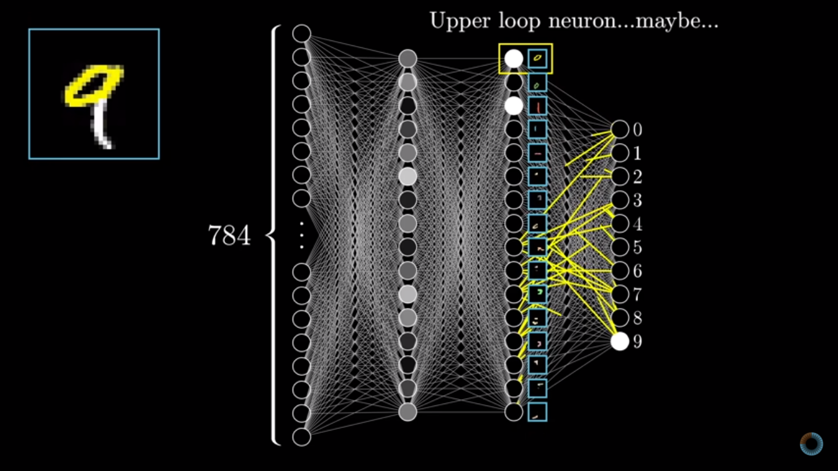
Convolutional Neural Network (CNN)

Slide 7
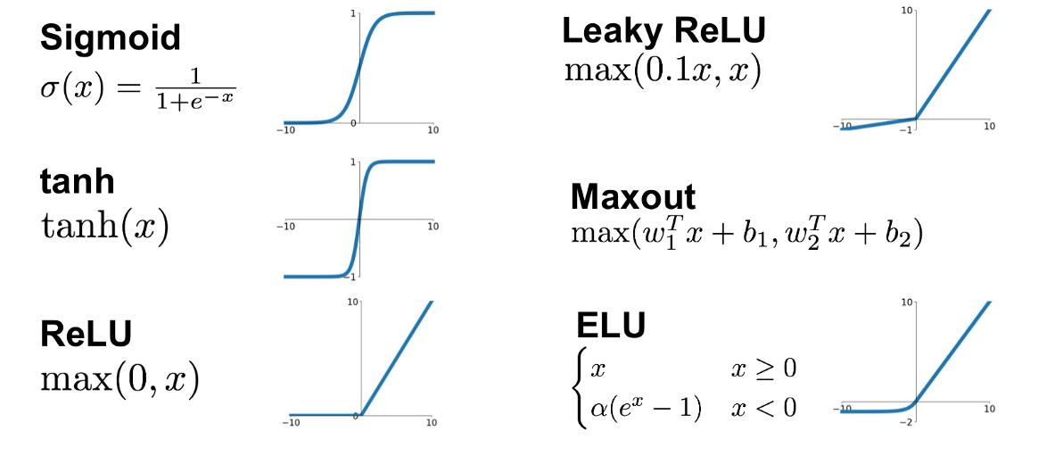
Activation functions
What is an Activation Function?
Types of Activation Functions

Slide 8
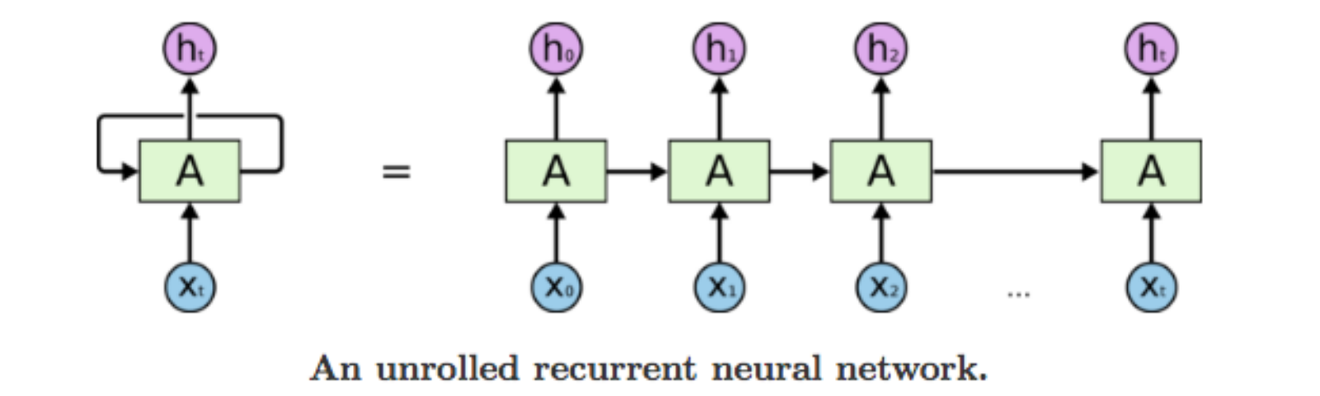
Recurrent Neural Network (RNN)
What is RNN?
What is it used for?
How does RNN works?

Slide 9
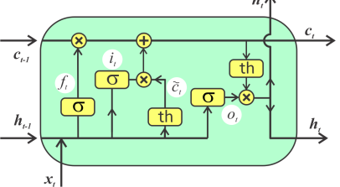
Long-Short Term Memory (LSTM)
What is LSTM?
What is it capable of doing?
Gates:
Forget Gate
Input Gate
Cell Update
Output Gate

Slide 10
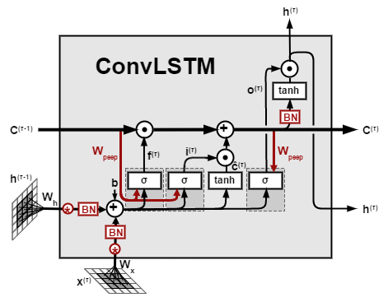
Convolutional LSTM (ConvLSTM)
What is ConvLSTM?
ConvLSTM vs LSTM:

Slide 11
Dataset
SDHA Dataset:
120 Videos (60 + 60)
Length: 2-4 sec
Resolution: 720*480
Frame Rate: 30fps
https://cvrc.ece.utexas.edu/SDHA2010/Human_Interaction.html#Data
Real-Life-Violence Dataset:
2000 Videos (1000 + 1000)
Length: 2-7 seconds
Resolution: 1920*1080
Frame Rate: 25 fps
https://www.kaggle.com/mohamedmustafa/real-life-violence-situations-dataset

Slide 12

Tensorflow
What is Tensorflow?
Low&High-level APIs.

Slide 13

Keras
What is Keras?
High-Level API.
Tensorflow vs Keras

Slide 14
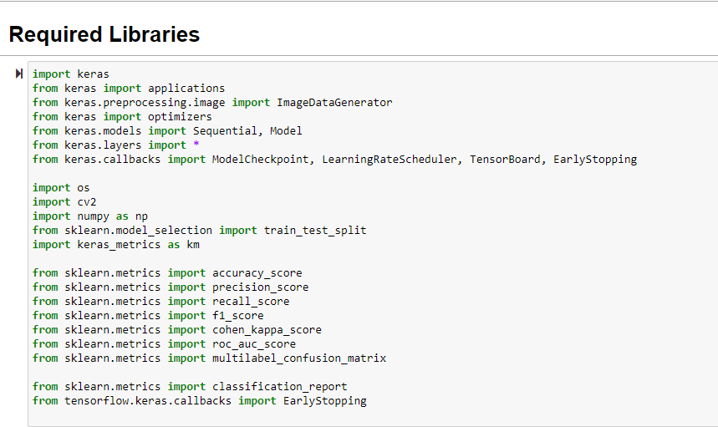
Libraries:

Slide 15
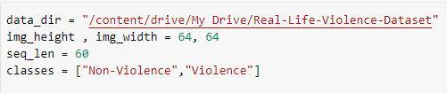
1. Data preparation:
Constants declaration:
img_height & img_weight
seq_len
classes

Slide 16
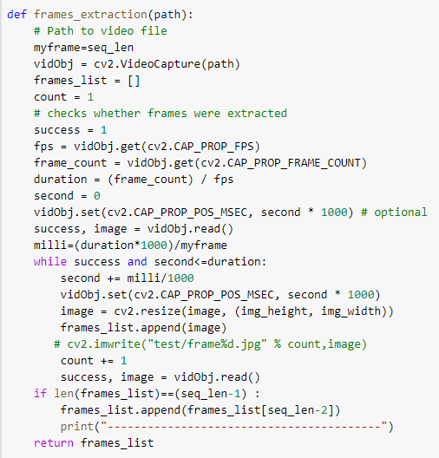
Frames Extraction:
Input: video path
Output: list of frames
Uniform Time variation

Slide 17
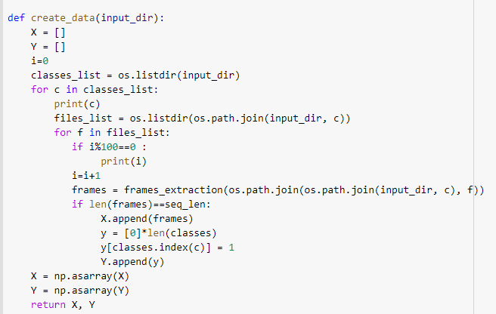
Data Creation:
Input: dataset path
Output: Pair (X,Y)

Slide 18
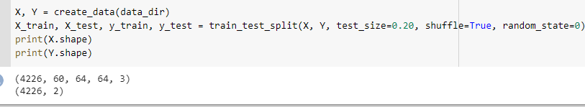
Train-Test Split:
Training dataset
Testing dataset

Slide 19
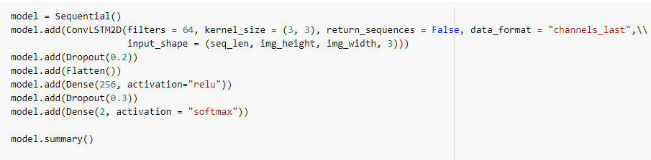
2. ConvLSTM-Based Model Design:
Input Shape: (60, 64, 64, 3).

Slide 20
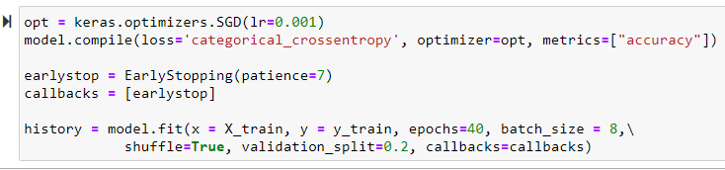
3. Model Training:
What is an Optimizer/Lr ?
What is epoch/batch_size?
What is Early Stopping used for?

Slide 21

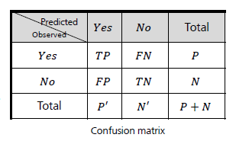
4. Model Evaluation:
accuracy = (TP + TN) / (P + N)
recall = TP/P
precision = TP / (TP + FP)
f-score = (2 * precision * recall) / (precision + recall)

Slide 22
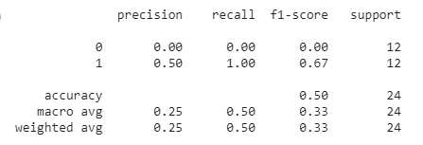
1st Run:
• Dataset: SDHA (120 videos).
• seq_len: 50
• Optimizer: SGD & Learning Rate: 0.001
• Batch Size: 8
• Number of Epochs: 15
Accuracy: 50%

Slide 23
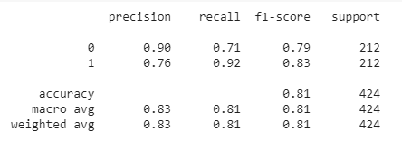
2nd Run:
• “Real-Life-Violence-Dataset + SDHA” (2120 videos).
• seq_len: 30
• Optimizer: SGD & Learning Rate: 0.001
• Batch Size: 8
• Number of Epochs: 40
Accuracy: 81%

Slide 24
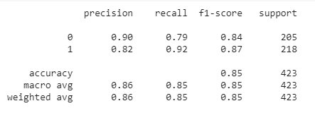
3rd Run:
•“Real-Life-Violence-Dataset + SDHA” (2120 videos).
• seq_len: 60
• Optimizer: SGD & Learning Rate: 0.0001
• Batch Size: 8
• Number of Epochs: 40
Accuracy: 85%

Slide 25
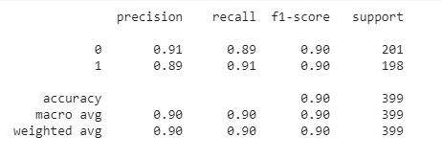
4th Run:
• Real-Life-Violence-Dataset (2000 videos).
• seq_len: 60
• Optimizer: SGD & Learning Rate: 0.001
• Batch Size: 8
• Number of Epochs: 40
Accuracy: 90%

Slide 26
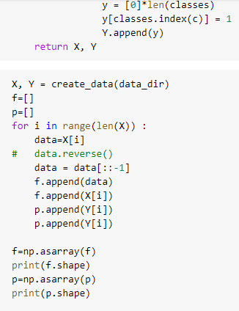
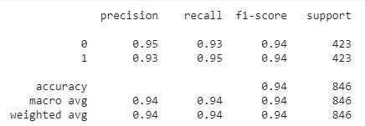

Final Run:
•“Real-Life-Violence-Dataset + SDHA” (4240 videos)
• seq_len: 60
• Optimizer: SGD & Learning Rate: 0.001
• Batch Size: 16
• Number of Epochs: 40
Accuracy: 94%
Doubled dataset in reverse order

Slide 27
Conclusion
Classification into Violence & Non-Violence is important.
High accuracy -> Reliability
Future Considerations:
GUI.
Image Processing.
New Horizon for us.

Slide 28

Thank You!

