Slide 1
Google Colab

Slide 2
About Me:
Mohamad Kassem.
Graduated From Lebanese University Faculty of Science (2020) in the major of Computer Science.
Senior Project: “Video Scenes Classification using Keras” ,under the supervision of Dr. Siba Haidar.
Doing Masters in CPS2 at “Université de Lyon” at Saint-Étienne (France).
CPS2 (Cyber Physical Social Systems): It involves many topics and technologies, and focuses mainly on the domains of Artificial Intelligence & Internet of things.
Contact me:
Email: m7md.kassem.1999@gmail.com
LinkedIn: linkedin.com/in/mohamad-kassem-6950231b1

Slide 3
Why Google Colab?
Colab or Colaboratory is a free laboratory from Google Research.
It is a Web IDE used to execute python code through your browser in a predefined environment (Zero configuration required). Which saves you lots of time and work that it could take if you for instance decide to use Jupyter Notebook.
Colab is easy to use and makes it easy to share files because it stores your files in the cloud (on Google Drive).
Colab is mainly used to train machine learning and deep learning models. Because beside all what we have already mentioned, Colab also allows us to train our models using GPU or TPU (Beside CPU).
And this is a very important opportunity if you don't have GPU in your compute. Because training big deep learning models with huge datasets using CPU is
not recommended.

Slide 4
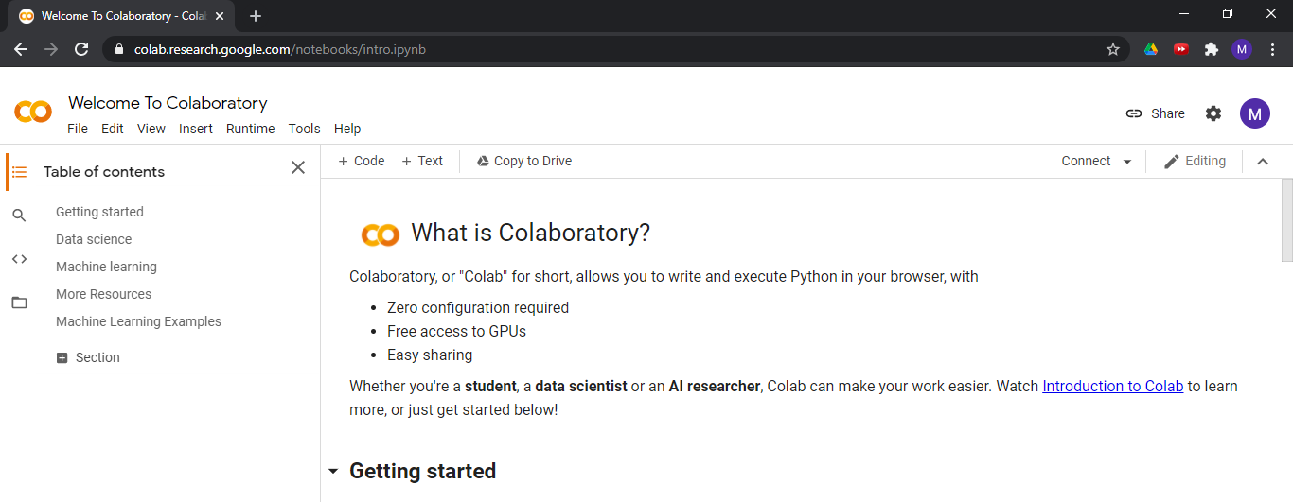
Colab getting Started:
Go to your browser type “Google Colab” or via this link: https://colab.research.google.com/
After Signing in you should reach this welcome page which contains several information and tutorials for you in order to get started with Colab:

Slide 5

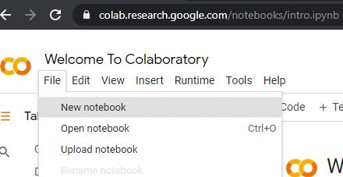
Creating your first notebook:
Now you can work with Colab notebooks through 3 different ways:
Uploading an existing notebook from your computer.
Opening an existing notebook from your Google Drive.
Creating a new notebook which will be saved to your
Google Drive in a Folder called “Colab Notebooks”
that should be automatically created.
If it is your first time to use Colab then you will need to create a new notebook at File>New notebook:

Slide 6
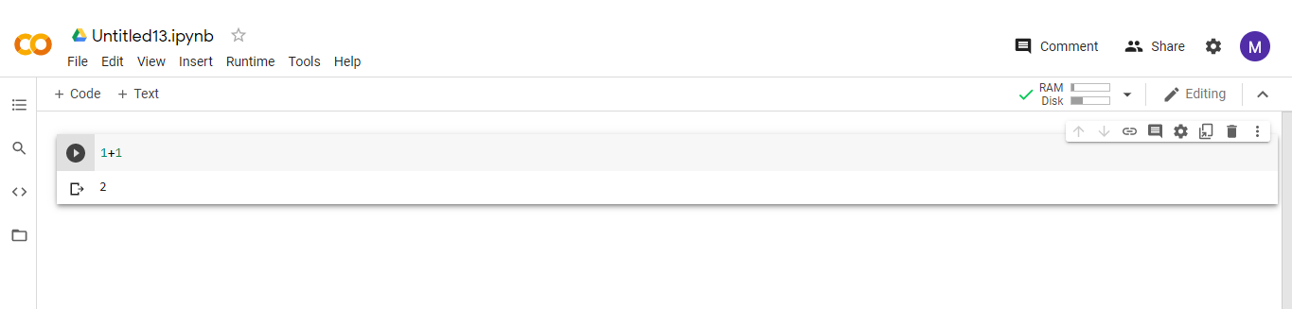
Now an Untitled notebook with .ipynb should be created for you and it will automatically be saved to the drive. You can rename it by clicking on “Untitled.ipynb”.
You can run your cell of code by clicking on the black arrow on the left or “Ctrl+Enter”
And you will see the result directly below the executed cell.
The is also several nice functionalities that you can easily discover in the toolbar.
One of these is changing the Runtime to GPU (Runtime is set to CPU by default).

Slide 7
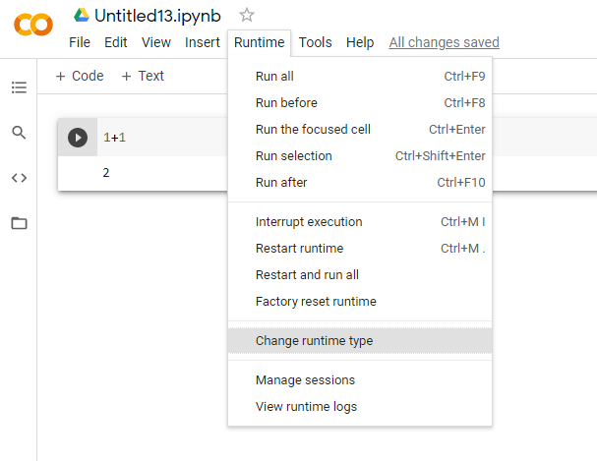
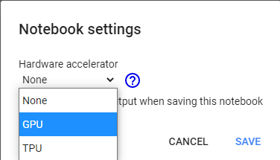
In order to change Runtime to GPU in your current notebook in the toolbar go to Runtime>Change runtime type. As
you see in the figure on the left:
In the dialog box the pops up Select GPU and save:

Slide 8
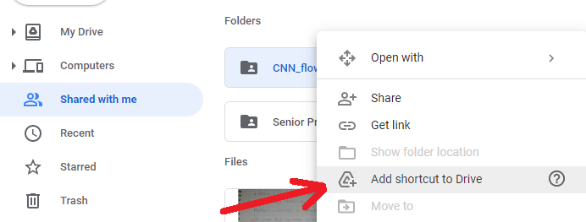

How to use your dataset in Colab?
In order to use your dataset for the training of your model, you will need to do the following steps:
1. Sign in to your google drive and access this Sharing link: https://drive.google.com/drive/folders/13mcdbcYDZTMEViO8WH9usuqyg6Neuo2U?usp=sharing
Now you should be able to see the dataset folder in your Drive in the “Shared with me” section.
Add the dataset Folder to your “My Drive” directory as a shortcut, through the “Add shortcut to Drive” button.
Now you should be able to see the shortcut of the dataset folder in your “My Drive” Directory.

Slide 9
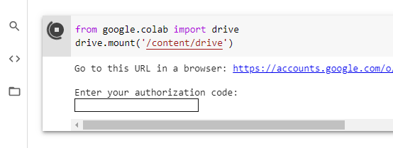
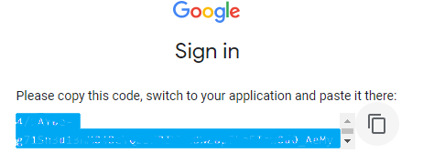
3. Mount (Connect) Colab to the Drive:
Execute the 2 lines of code below:
from google.colab import drive
drive.mount('/content/drive’)
Upon the execution you should see
a URL and Textbox. Click on the URL
and follow the simple steps:
Choose your google account.
Allow access to your google drive.
Finally you should see a code like the figure on the left. Copy this code and go back to the notebook.

Slide 10
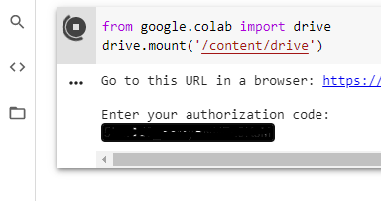
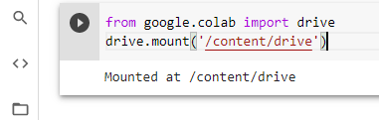
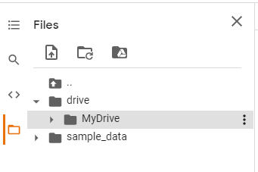

Now paste the copied authorization code in the textbox and press Enter:
The execution of the cell of code now should finish and you should see the result: “Mounted at /content/drive”
Now browse the files on the left and go to drive/MyDrive/… to reach your targeted dataset directory in the drive.
Copy the path of the directory
And now you can store it in a python string and use it to train your dataset!

