Slide 1
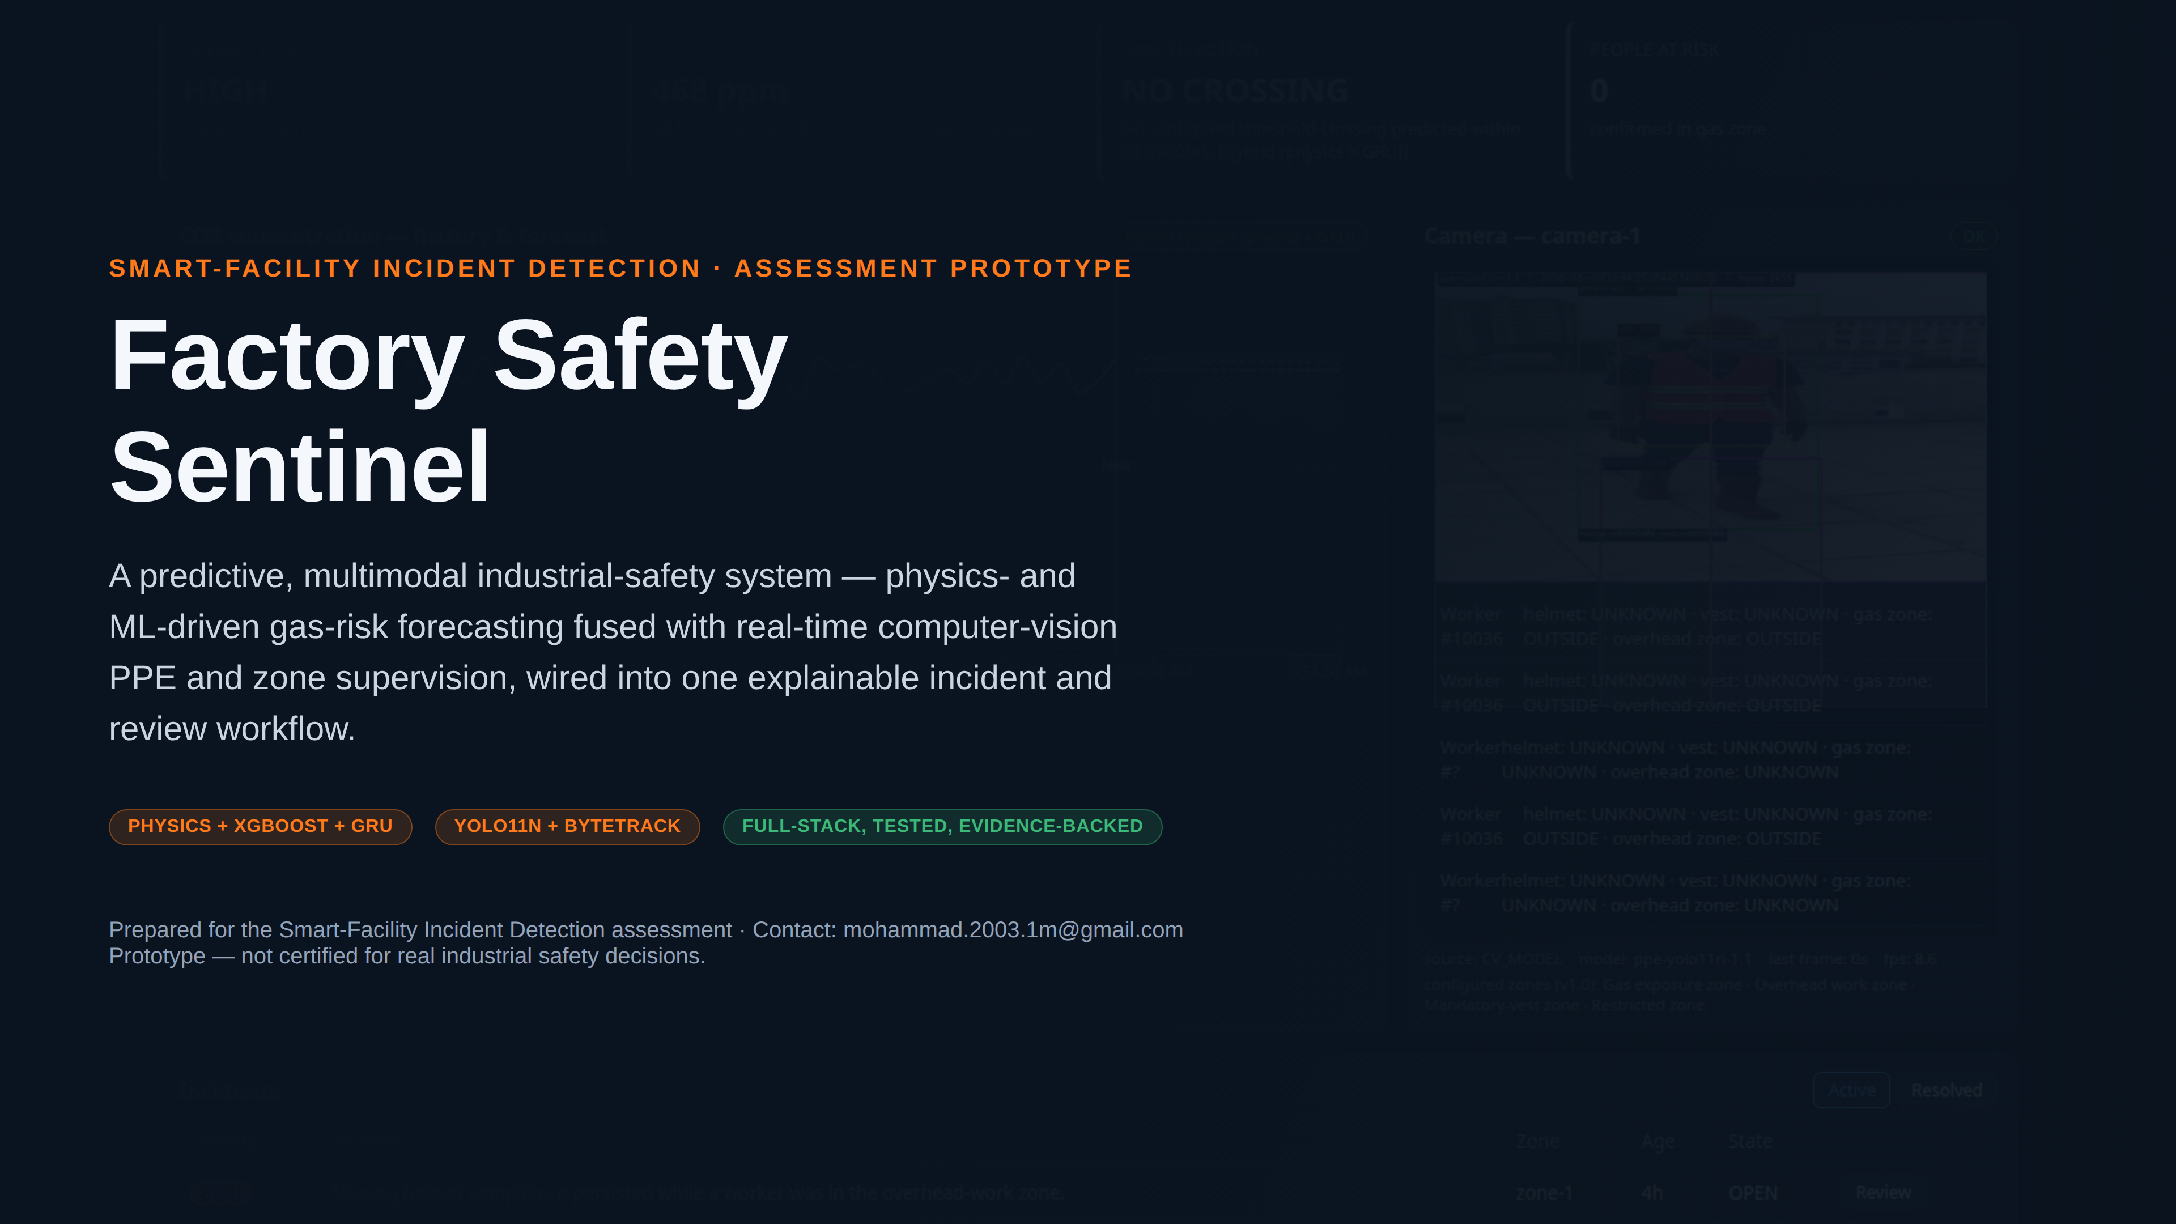
Notes:
SAY: This is Factory Safety Sentinel — a prototype that predicts gas risk before it becomes dangerous and watches worker PPE/zone compliance in real time, both feeding one incident and review workflow a manager actually uses.
EVIDENCE: Hero image is the real, live dashboard captured this session (docs/screenshots/final/01_dashboard_normal_state.png).
TRANSITION: Let's start with the problem this solves.
LIKELY QUESTION: Is this a finished commercial product?
ANSWER: No — it's an assessment prototype with a fully working backend/frontend/tests, explicitly not certified for real safety decisions (stated on this slide and throughout).

Slide 2
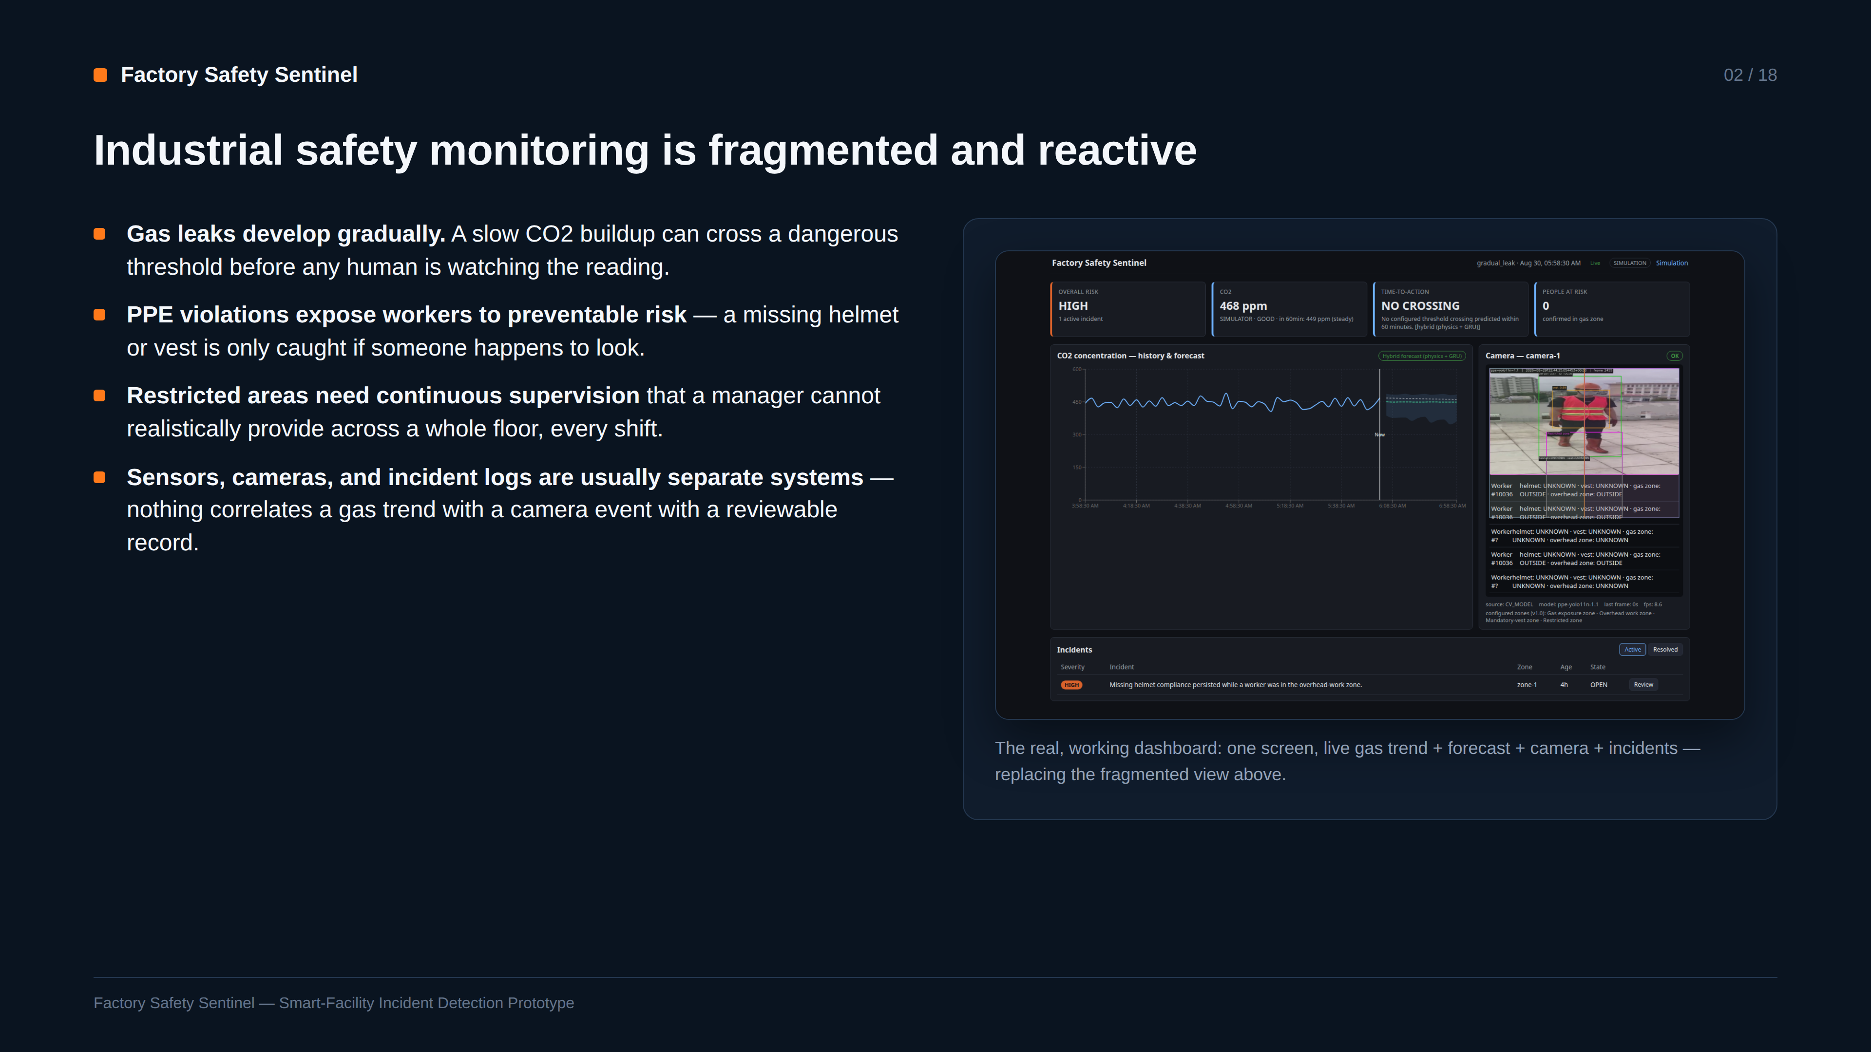
Notes:
SAY: Four real gaps: gradual leaks outrun human attention, PPE violations go unnoticed, restricted zones can't be watched continuously, and today's tools don't unify sensor, camera, and incident data into one place.
EVIDENCE: Framed against the actual dashboard screenshot, not a stock photo — this is what the unified view looks like.
TRANSITION: Here's how the assessment brief maps onto what was actually built.
LIKELY QUESTION: Isn't this solved already by existing SCADA/BMS systems?
ANSWER: Those systems are usually threshold-only and reactive; this prototype adds predictive forecasting (physics+ML) and vision-based PPE/zone supervision on top, unified in one incident workflow — the gap being addressed, not a claim no monitoring exists at all.

Slide 3
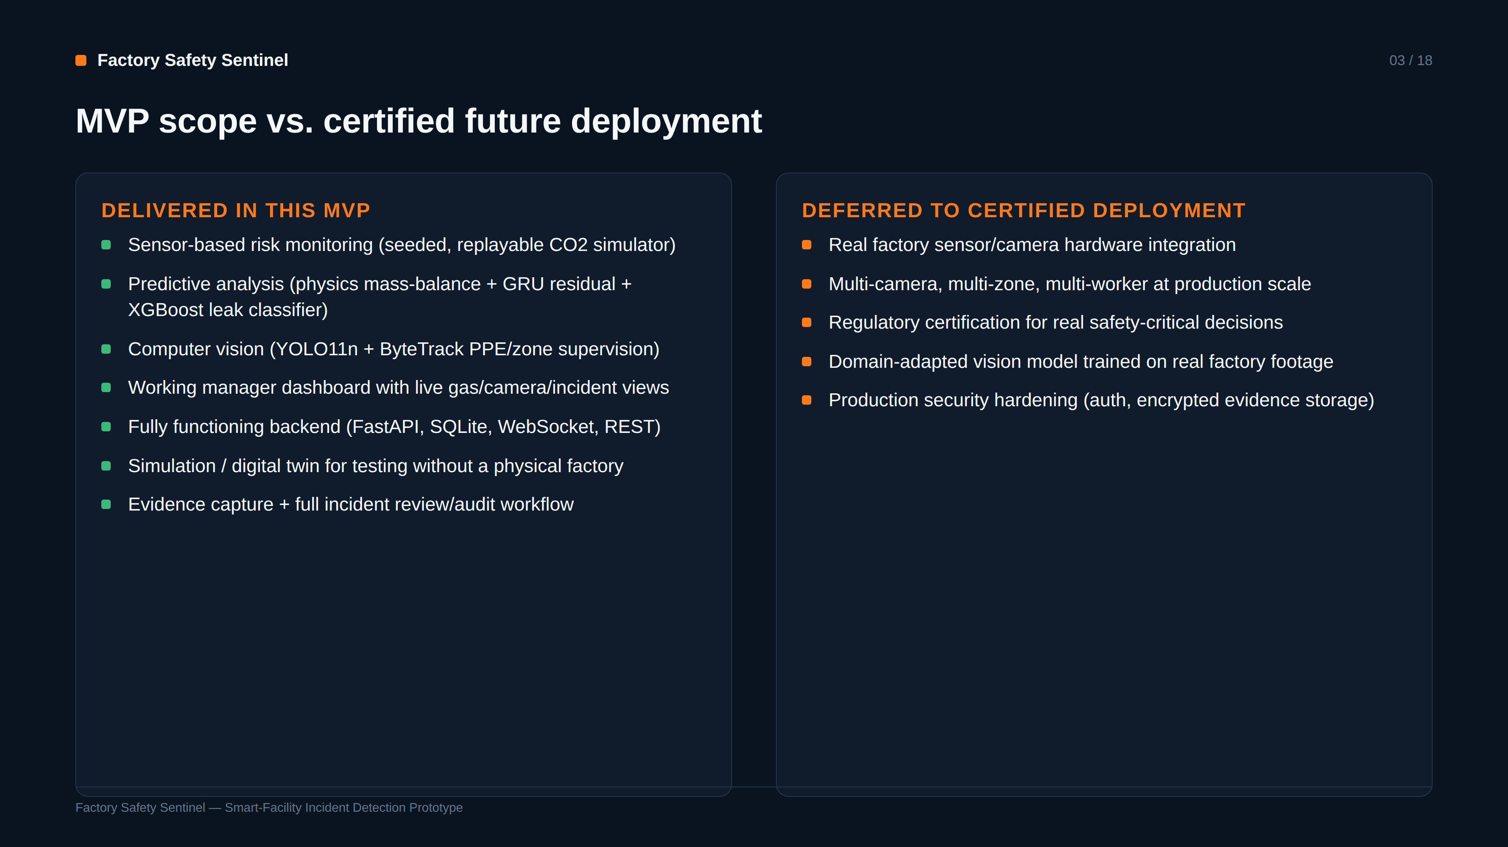
Notes:
SAY: Everything in the left column is real and working today; the right column is explicitly out of scope for an assessment prototype and reserved for a certified deployment.
EVIDENCE: This split is stated directly in the project's own CLAUDE.md scope document, not asserted only in this deck.
TRANSITION: Now the architecture that delivers the left column.
LIKELY QUESTION: Why defer multi-camera/multi-worker instead of building it?
ANSWER: The assessment's P0 scope is one workcell/camera/gas-zone end-to-end and fully tested, rather than partial multi-entity support — CLAUDE.md's own frozen-scope decision, to keep the vertical slice complete and defensible.

Slide 4
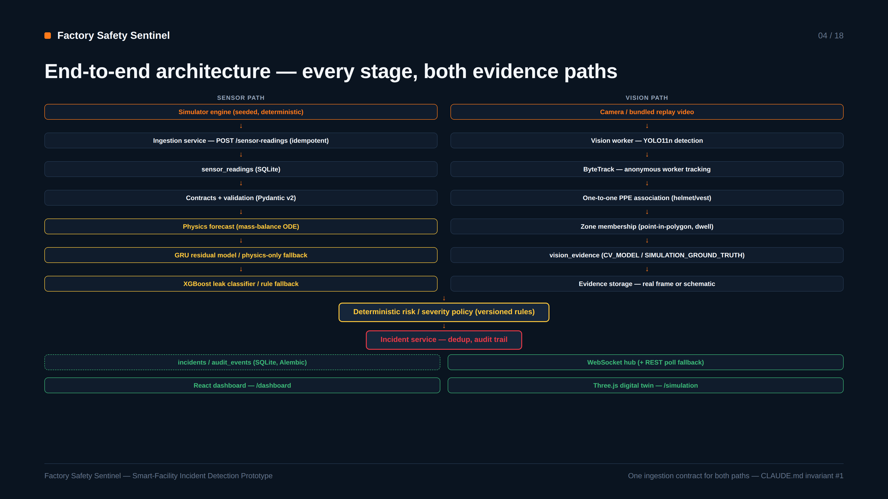
Notes:
SAY: Two parallel evidence streams — gas sensors and camera — both terminate in one deterministic risk/incident policy, which writes to the database and pushes live WebSocket updates to the dashboard and simulation UI.
EVIDENCE: Matches the actual module layout (backend/app/services/pipeline.py, backend/app/inference/, backend/app/domain/risk/policy.py) — not a conceptual sketch.
TRANSITION: Let's look at exactly which of these boxes are trained models versus deterministic logic.
LIKELY QUESTION: Is this a microservices architecture?
ANSWER: No — deliberately a modular monolith (one FastAPI process) with replaceable Python adapters, per CLAUDE.md; simpler to run, test, and reason about for this scope.

Slide 5
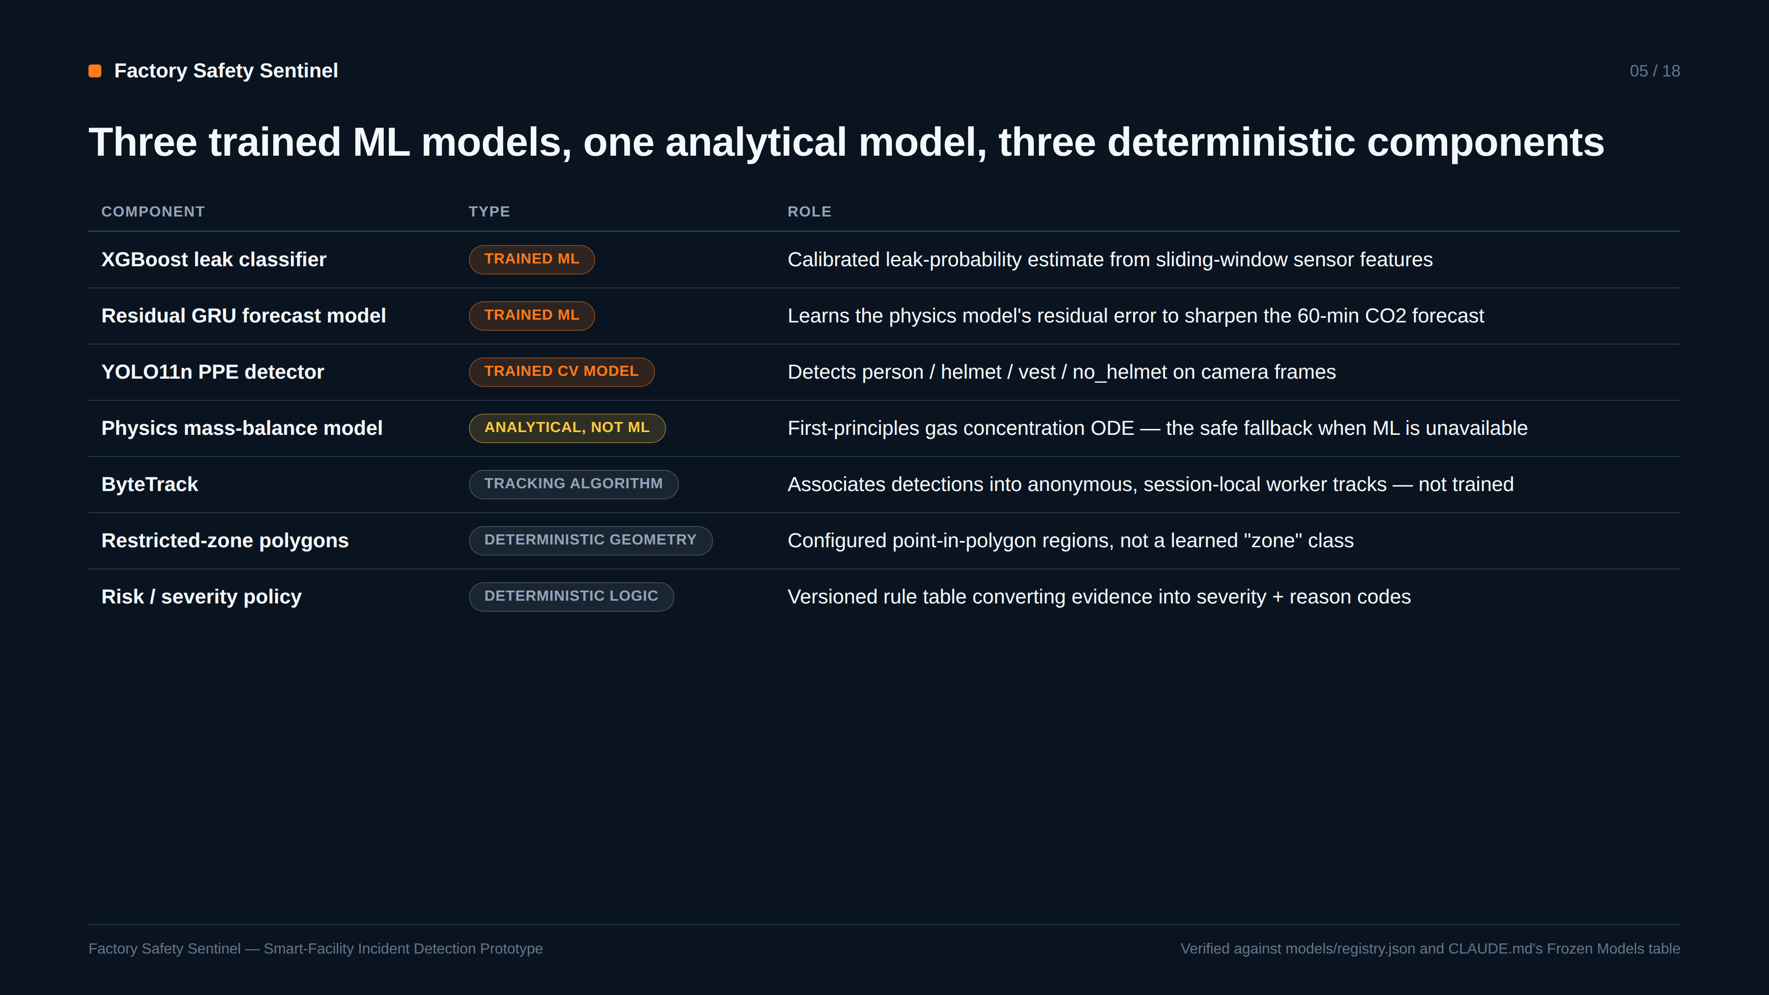
Notes:
SAY: Exactly three trained ML models plus one analytical physics model, confirmed against the model registry — everything else, including ByteTrack and the zone/severity logic, is deterministic by design so the system stays explainable and auditable.
EVIDENCE: models/registry.json lists exactly three trained artifacts (leak_classifier, ppe_detector, forecast_gru); CLAUDE.md's Frozen Models table independently confirms the same breakdown.
TRANSITION: Here's why each of the three trained models was chosen specifically.
LIKELY QUESTION: Why not make the risk policy itself a learned model?
ANSWER: Explainability and auditability — CLAUDE.md invariant #6 requires severity to be deterministic and separate from raw model confidence, so every incident's reason codes are traceable to a versioned rule, not an opaque score.

Slide 6
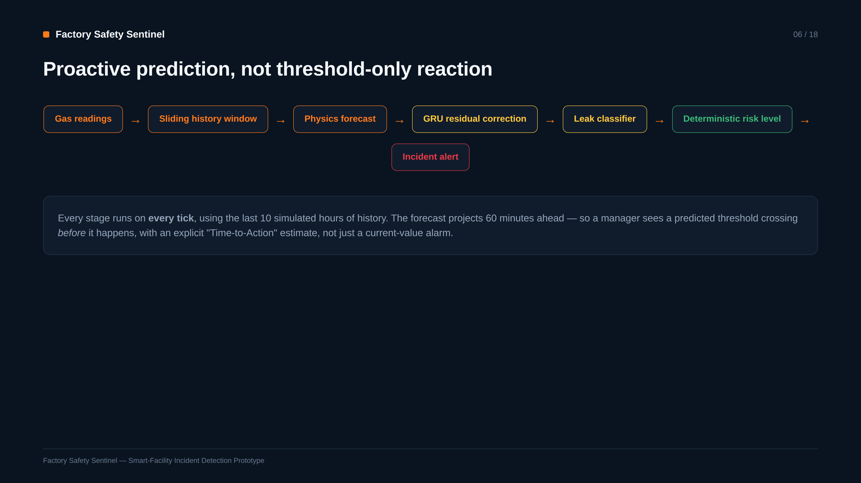
Notes:
SAY: This is the full sensor path: real readings feed a 10-hour sliding window, the physics model projects forward, the GRU corrects its residual error, the classifier estimates leak probability, and a deterministic policy turns that into a severity with a Time-to-Action estimate.
EVIDENCE: Runs every tick against real ingested readings, not a one-shot batch job — backend/app/services/pipeline.py::run_risk_pipeline.
TRANSITION: The physics behind that forecast is worth showing explicitly.
LIKELY QUESTION: What happens if the GRU model artifact is missing?
ANSWER: It falls back to physics-only forecasting automatically (CLAUDE.md's safe-fallback invariant) — never crashes, never fabricates a number; shown live in the gru_benchmark_report.json fallback behavior.

Slide 7
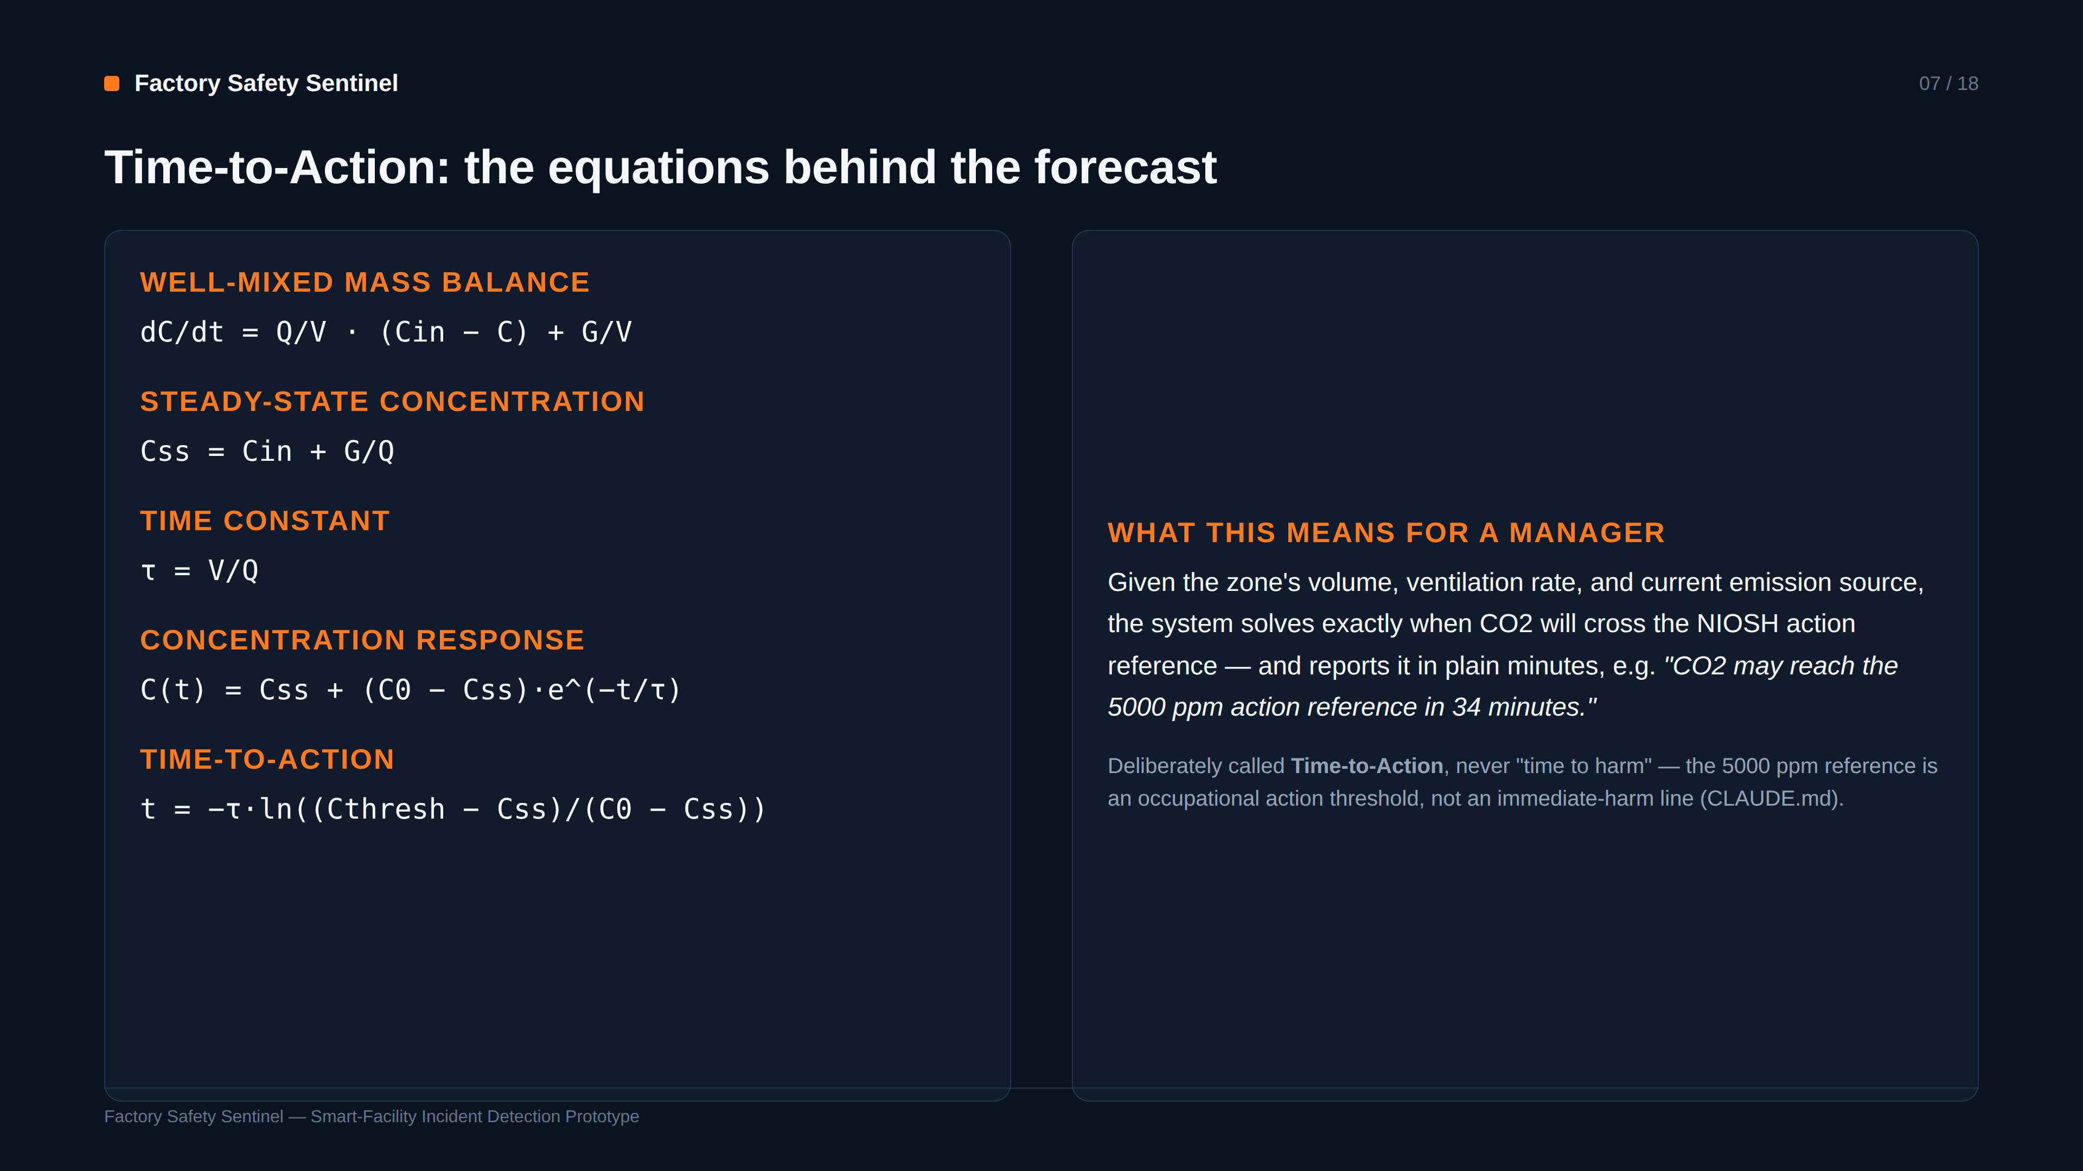
Notes:
SAY: This is genuine analytical physics, not a black box: a well-mixed mass-balance ODE, solved in closed form for the time a threshold will be crossed given the zone's current ventilation and source rate.
EVIDENCE: backend/app/domain/forecast physics module implements exactly these closed-form equations; unit-tested against analytical and numerical cases.
TRANSITION: How well does the ML layer improve on physics alone?
LIKELY QUESTION: Why is it called Time-to-Action and not time-to-harm?
ANSWER: The 5000ppm NIOSH reference is an 8-hour occupational action level, not an acute-harm threshold — CLAUDE.md is explicit that conflating the two would be misleading, so the system's own language avoids it.

Slide 8
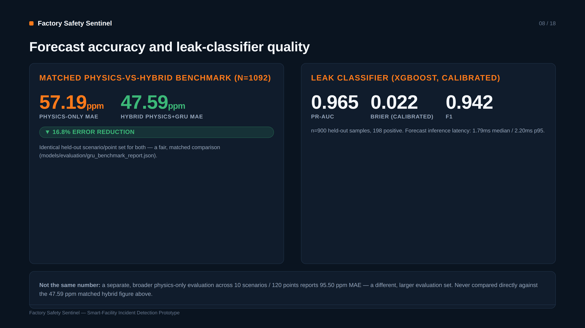
Notes:
SAY: On the exact same held-out points, the GRU residual correction cuts physics-only error by 16.8 percent, from 57.19 to 47.59 ppm MAE. The leak classifier separately reaches 0.965 PR-AUC, well-calibrated after Platt scaling.
EVIDENCE: Both numbers pulled and asserted programmatically from gru_benchmark_report.json and leak_model_metrics.json — printed and verified at slide-build time.
TRANSITION: Now the vision side: how the system watches PPE and zones.
LIKELY QUESTION: Why do you separate the two physics MAE numbers so carefully?
ANSWER: They're evaluated on different held-out sets (1092 matched points vs. 120 points across 10 scenarios) — comparing them directly would overstate or understate the GRU's real contribution, so the deck keeps them explicitly separate.

Slide 9
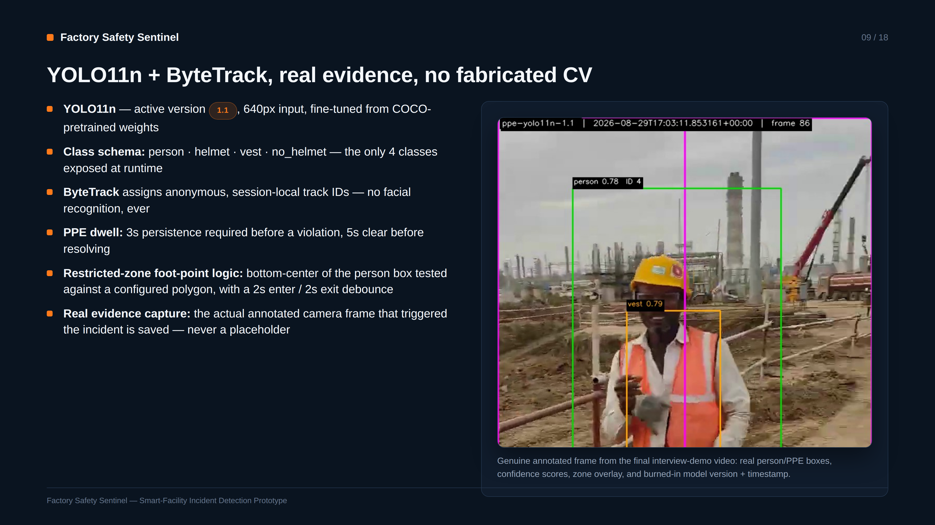
Notes:
SAY: Detection, tracking, PPE dwell, and zone dwell are all real, timestamp-based state machines, not single-frame heuristics — and every burned-in field on this evidence frame, boxes, confidence, model version, is genuinely produced by the pipeline, not composited afterward.
EVIDENCE: This exact frame is a real captured evidence image from this session's interview-demo run, is_real_camera_frame=true in the database.
TRANSITION: How the detector itself was trained and evaluated comes next.
LIKELY QUESTION: Why person-box bottom-center for zone membership instead of the whole box?
ANSWER: It approximates where the worker is actually standing on the floor plane — using the full bounding box would falsely flag a zone entry as soon as any part of a tall person's box overlapped it.

Slide 10
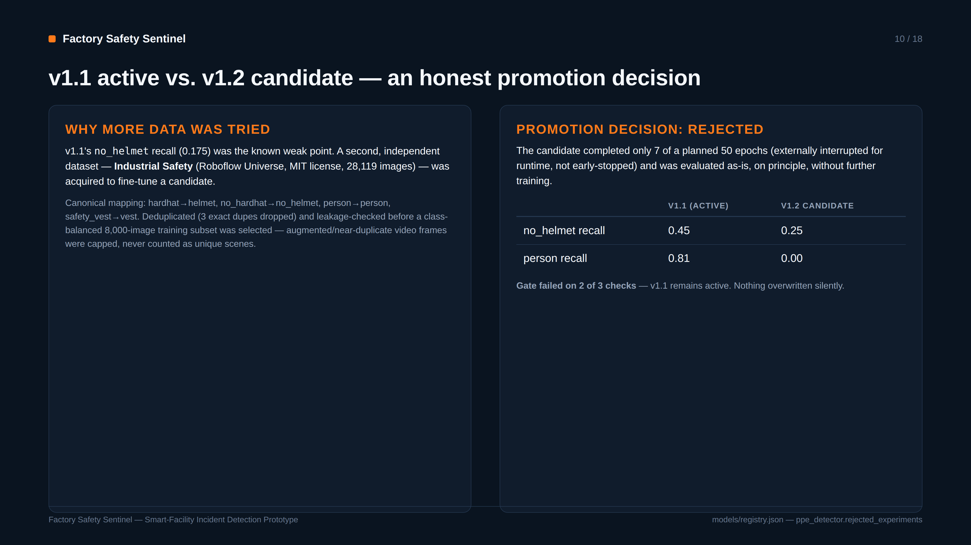
Notes:
SAY: A genuine second attempt was made to fix the known no_helmet weakness with more data — but the resulting candidate, evaluated honestly against a mechanical promotion gate, failed and was rejected. v1.1 stayed active. That negative result is fully recorded, not hidden.
EVIDENCE: models/registry.json's ppe_detector.rejected_experiments entry and models/evaluation/vision_v1.2_comparative_evaluation.json are the source of the table on this slide.
TRANSITION: Here's what the currently active model actually achieves.
LIKELY QUESTION: If it failed, why show it in the presentation?
ANSWER: It demonstrates the promotion-gate discipline working as designed — a real engineering process that can say no, which is more credible than only showing successes.

Slide 11
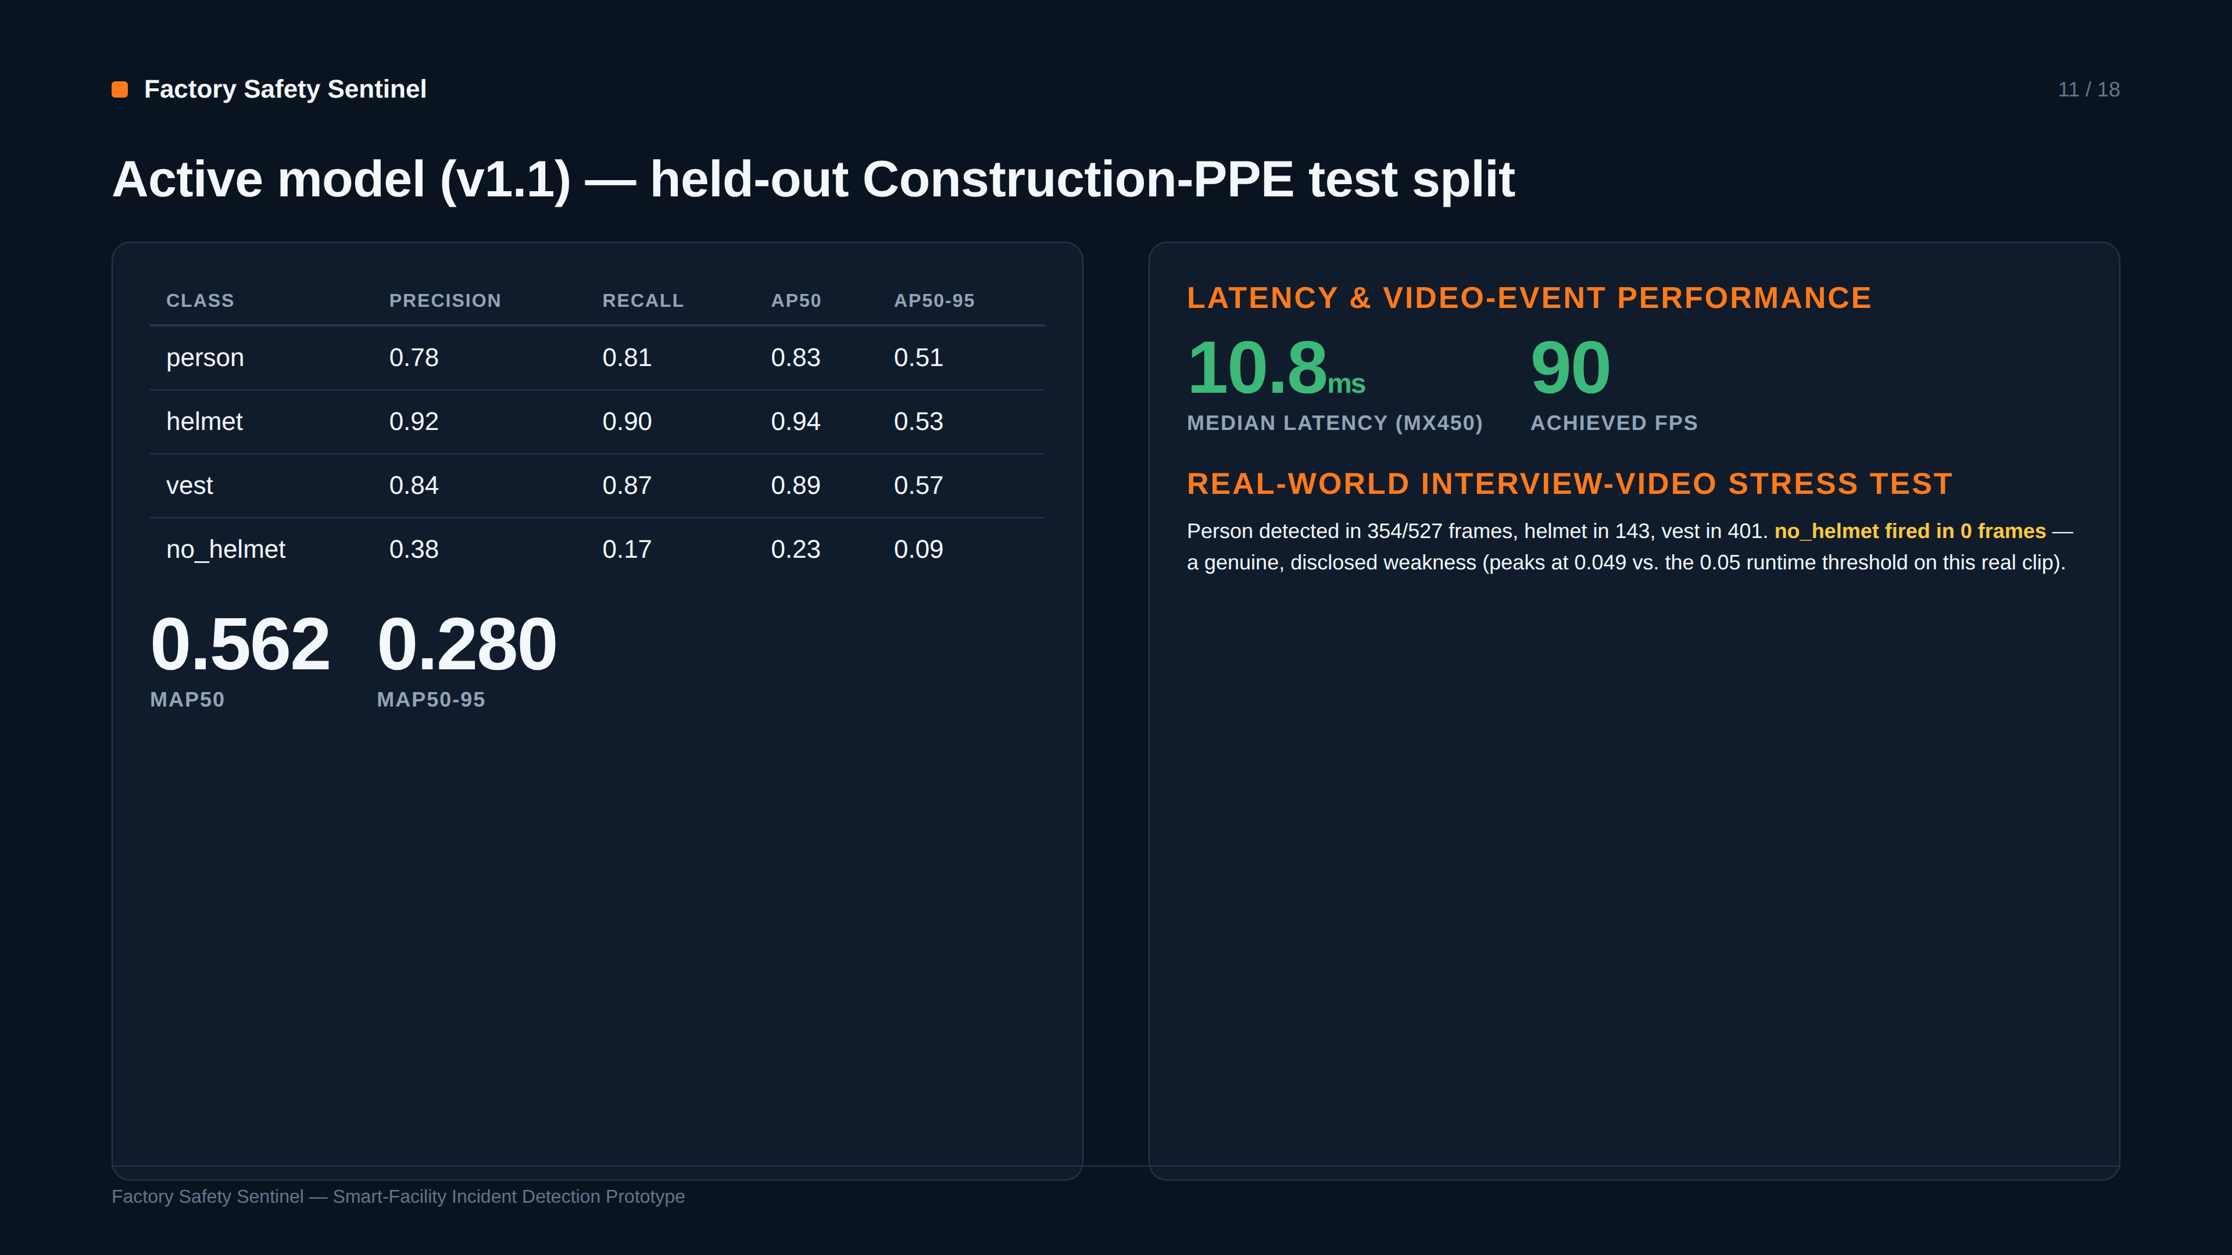
Notes:
SAY: Helmet and vest detection are strong — over 0.90 and 0.87 AP50. no_helmet remains the honest weak point, both on the held-out benchmark and, more strikingly, on real interview footage where it never fires at the registered threshold — a real domain-gap finding, not swept under the rug.
EVIDENCE: Per-class table and mAP figures are read directly from vision_model_metrics.json; the real-clip numbers from this session's interview_video_detection_summary.json.
TRANSITION: Here is what all of this looks like assembled into the manager's dashboard.
LIKELY QUESTION: Given no_helmet's weakness, does the system ever catch missing helmets at all?
ANSWER: Yes — via a second, independent policy path: 'no positive helmet evidence while a worker is in the overhead-work zone' still triggers a violation, demonstrated live in this session's interview-demo incidents, even when the no_helmet class itself stays silent.

Slide 12
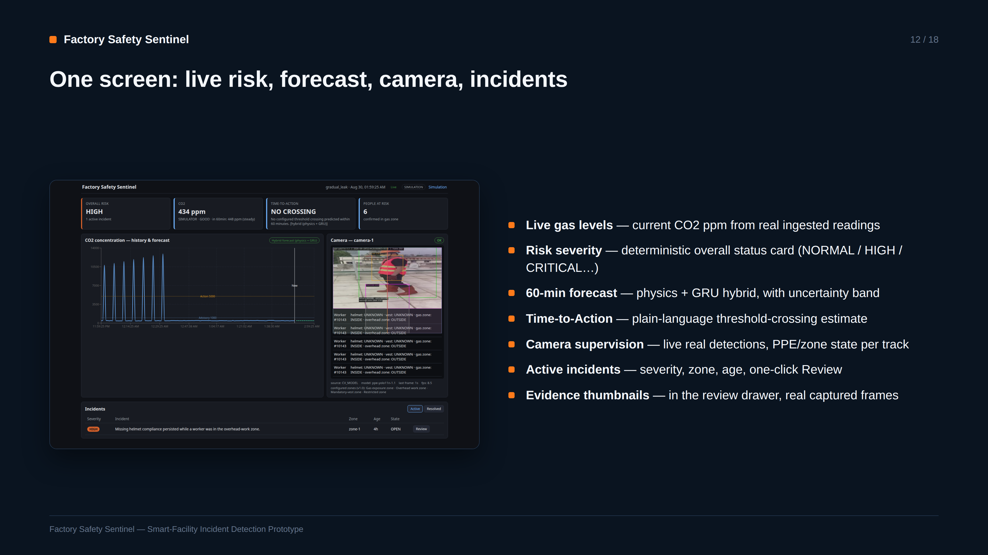
Notes:
SAY: This is the real running dashboard mid-incident: three active alerts, a rising forecast band, and live camera detections all on one screen — every value here comes from the backend, never invented client-side.
EVIDENCE: Real screenshot captured this session while a gradual_leak scenario and the interview-demo video were both actually running.
TRANSITION: Let's look at three real safety events this system actually caught.
LIKELY QUESTION: Does the dashboard poll or use live push updates?
ANSWER: Both — WebSocket events push live changes, with REST polling (5s) and a fresh REST snapshot on reconnect as the fallback/resync path, so state never silently goes stale.

Slide 13
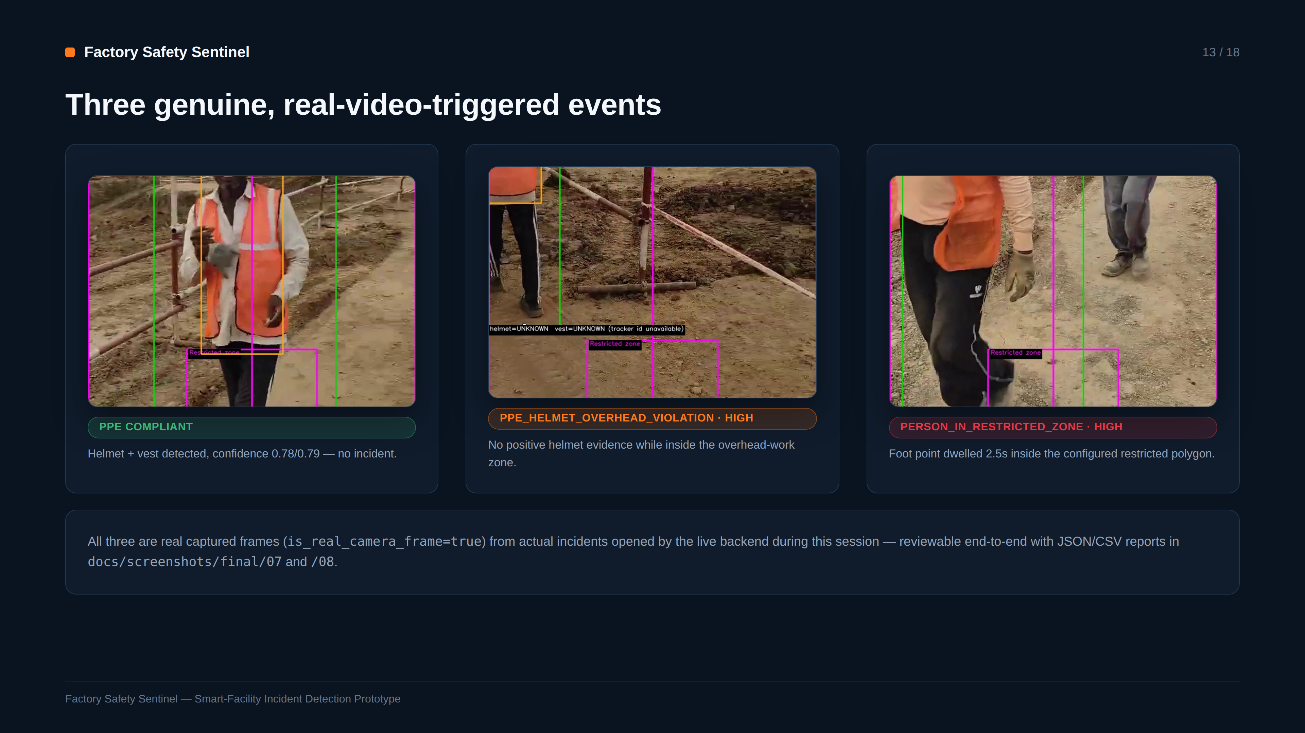
Notes:
SAY: Three real, distinct incident types fired from the same interview video during live testing: compliant PPE producing no alert, a helmet violation, and a restricted-zone intrusion — each with its own genuine captured frame.
EVIDENCE: All three evidence JPEGs are committed under docs/screenshots/final/evidence_*.jpg, copied from backend/data/incident-evidence/ with is_real_camera_frame=true confirmed in the JSON report.
TRANSITION: These all ran without a physical factory — here's the digital twin that makes that possible.
LIKELY QUESTION: Could these three incidents have been staged/cherry-picked?
ANSWER: They were the incidents that genuinely fired during make interview-demo runs this session, verified via the real API before any screenshot was taken — not hand-selected from a larger pool of attempts.

Slide 14
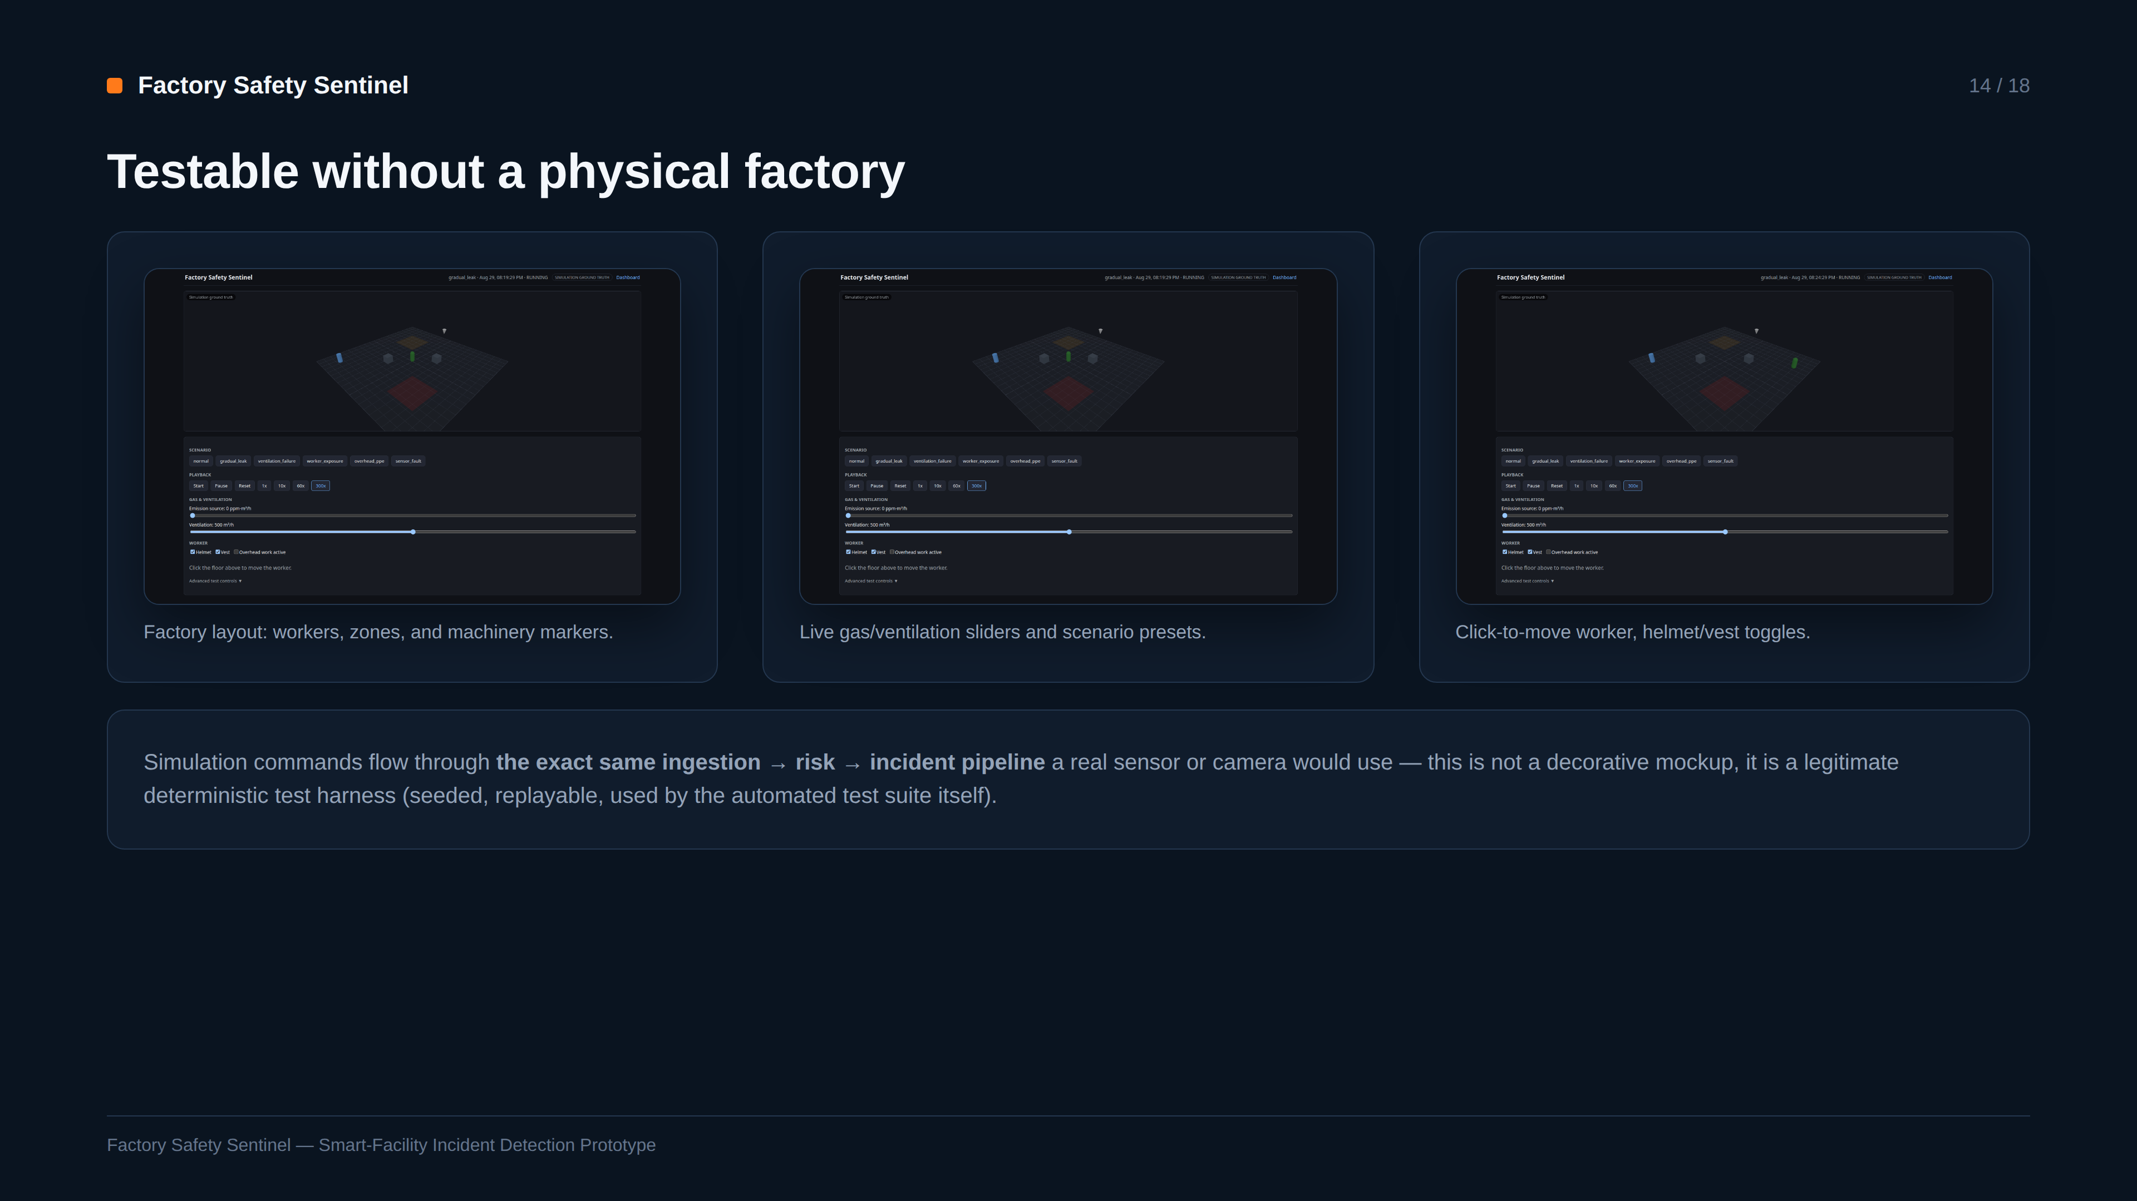
Notes:
SAY: The simulation isn't a toy — it's the same ingestion contract and risk pipeline a real device would use, which is exactly why it's valid engineering testing: every scenario is seeded and reproducible, and the automated tests run against it directly.
EVIDENCE: Three real screenshots of the actual Three.js simulation page, captured live this session.
TRANSITION: Let's walk the full real sequence end-to-end.
LIKELY QUESTION: Isn't a simulator just avoiding the hard problem of real hardware?
ANSWER: It's the standard approach for testing safety-critical logic before hardware exists — CLAUDE.md invariant #1 (one ingestion path) means swapping in a real device later requires zero backend changes, only a new adapter.

Slide 15
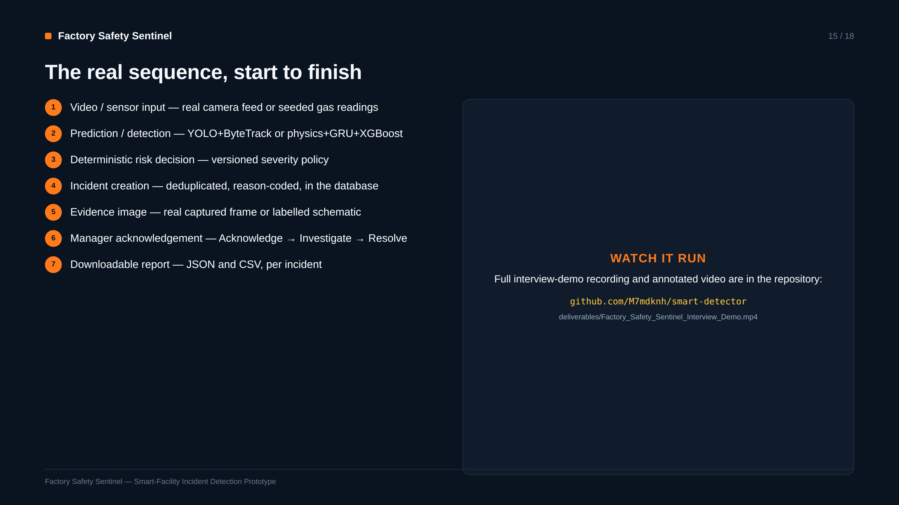
Notes:
SAY: This exact seven-step sequence is what ran live this session — real video in, real detection, a real deterministic decision, a real database row, a real evidence frame, a real human review action, and a real downloadable report.
EVIDENCE: Every step corresponds 1:1 to a verified API call or database write from this session's interview-demo runs, not a conceptual sequence diagram.
TRANSITION: Here's how that's proven by the test suite, not just a demo.
LIKELY QUESTION: Is the GitHub link live right now?
ANSWER: It's the planned repository URL for this submission; Prompt 3 in this workflow verifies and updates the final link before publication.

Slide 16
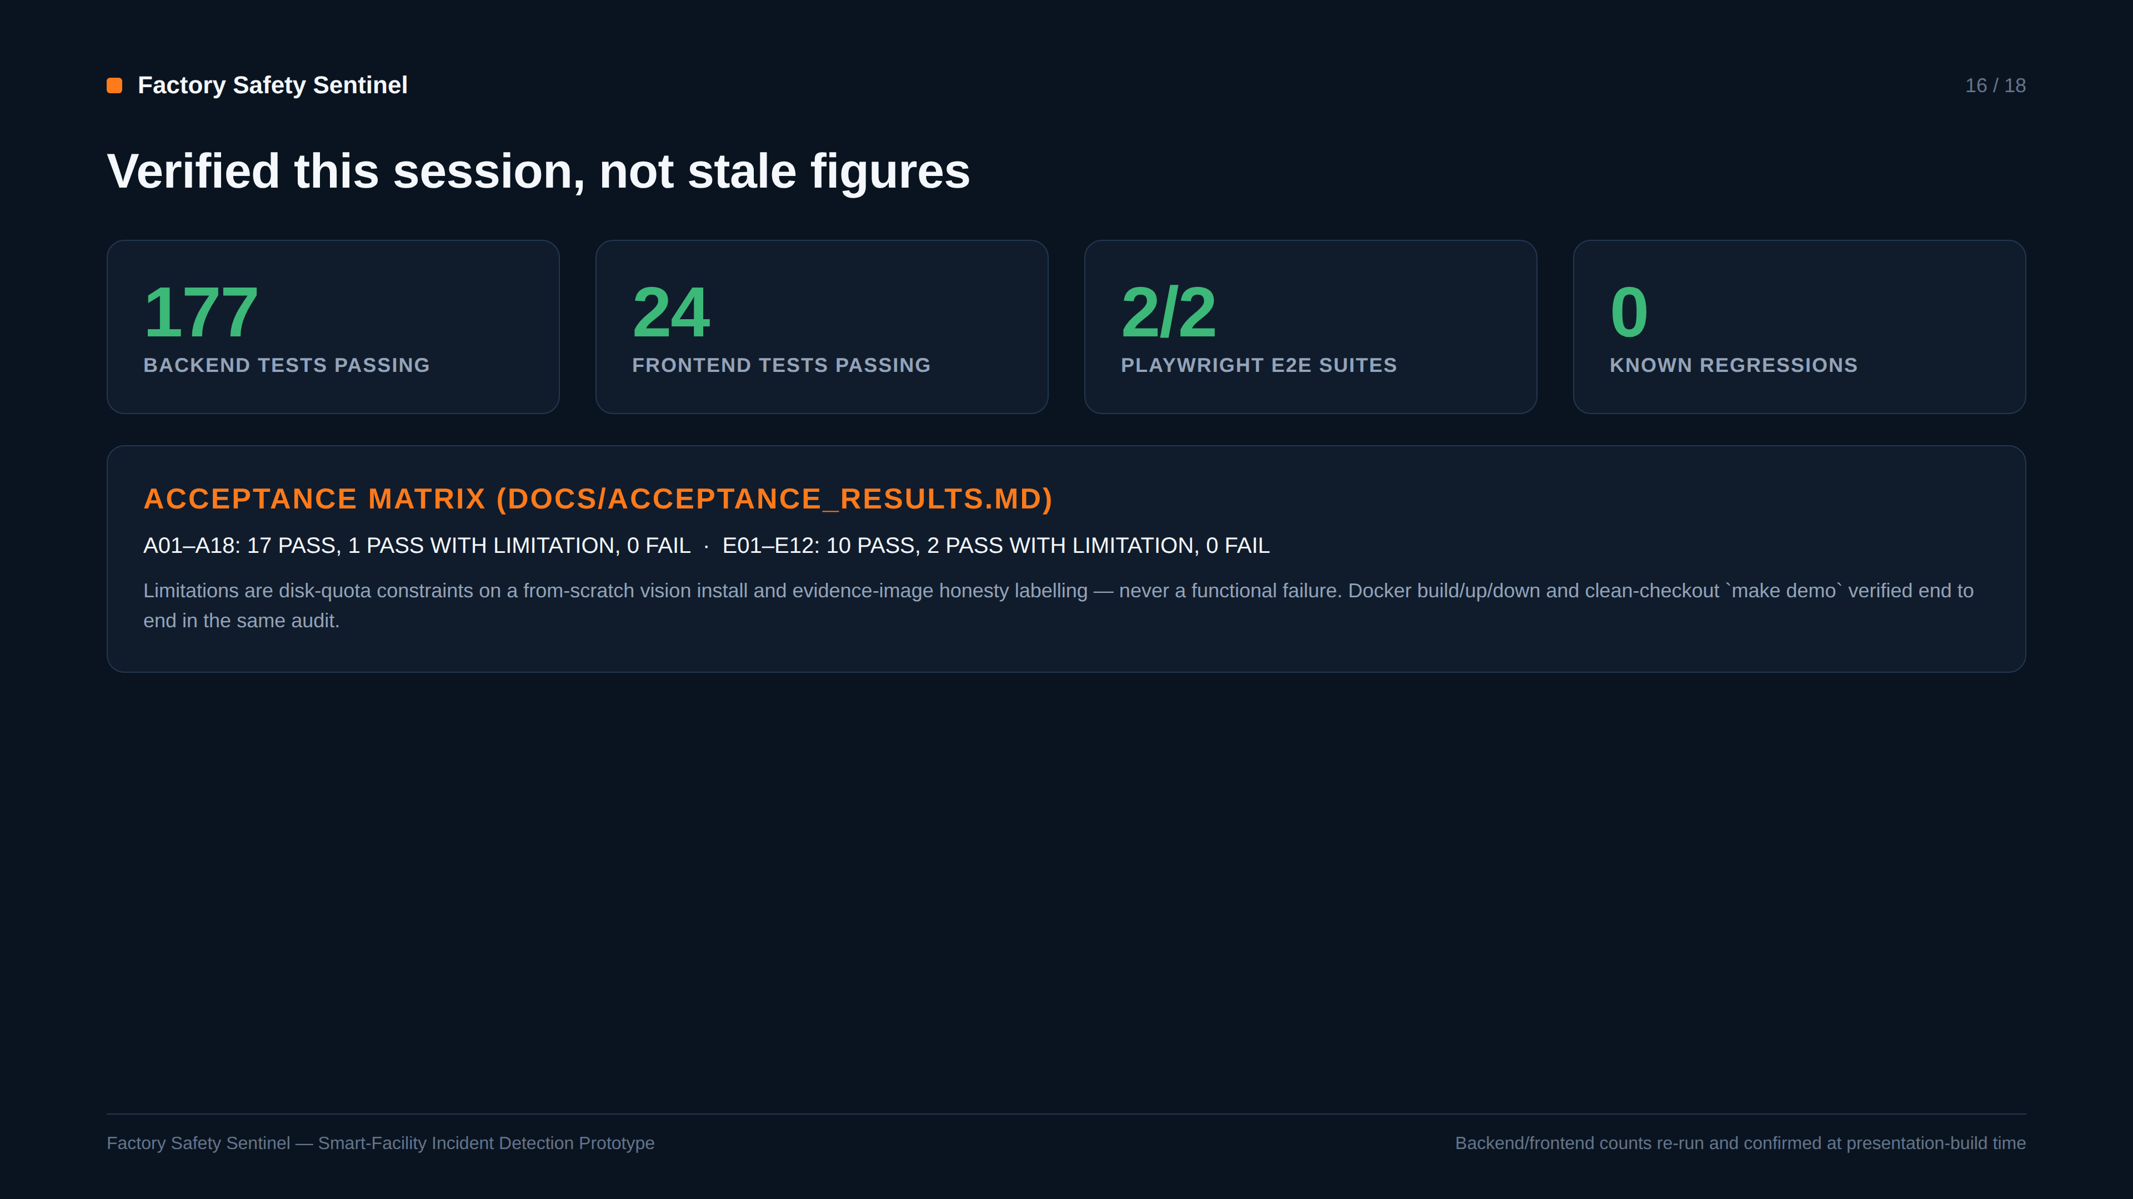
Notes:
SAY: 177 backend tests and 24 frontend tests pass right now — re-run at the time this deck was built, not copied from an old report — plus both Playwright e2e suites and a documented acceptance matrix with zero failures.
EVIDENCE: Test counts were re-executed via pytest and vitest immediately before building this slide; the acceptance matrix is docs/ACCEPTANCE_RESULTS.md, dated and cross-referenced.
TRANSITION: No system is without limitations — here they are, stated directly.
LIKELY QUESTION: What exactly are the 'PASS WITH LIMITATION' items?
ANSWER: Mainly a sandbox disk-quota constraint that prevented a second from-scratch vision-dependency install in one audit pass, and the intentional schematic-vs-real evidence-image distinction — both disclosed, neither a functional defect.

Slide 17
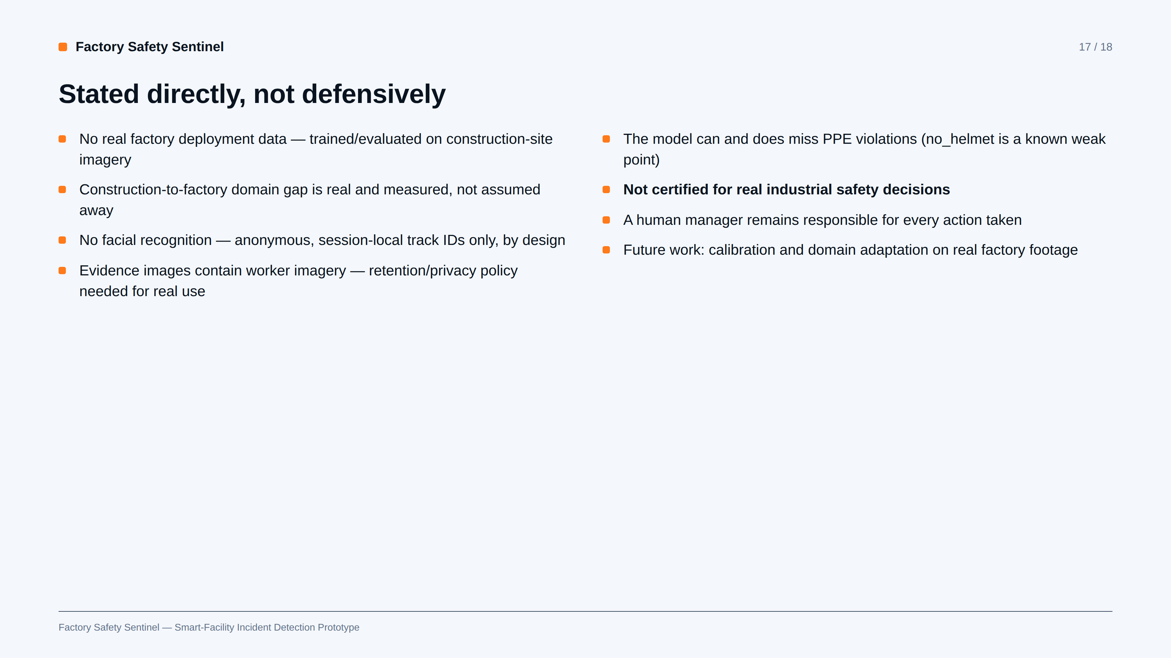
Notes:
SAY: These are stated plainly because they are true, not because the system failed — a prototype that hides its limitations is less trustworthy than one that measures and discloses them.
EVIDENCE: Every point here traces to a specific evaluation finding or an explicit CLAUDE.md invariant, not a generic disclaimer list.
TRANSITION: Bringing it together: what this system is actually worth.
LIKELY QUESTION: What's the single biggest limitation for real deployment?
ANSWER: The domain gap — a construction-site-trained detector applied to a real factory floor needs re-evaluation and likely fine-tuning on real factory footage before any safety-relevant claim would be trustworthy.

Slide 18
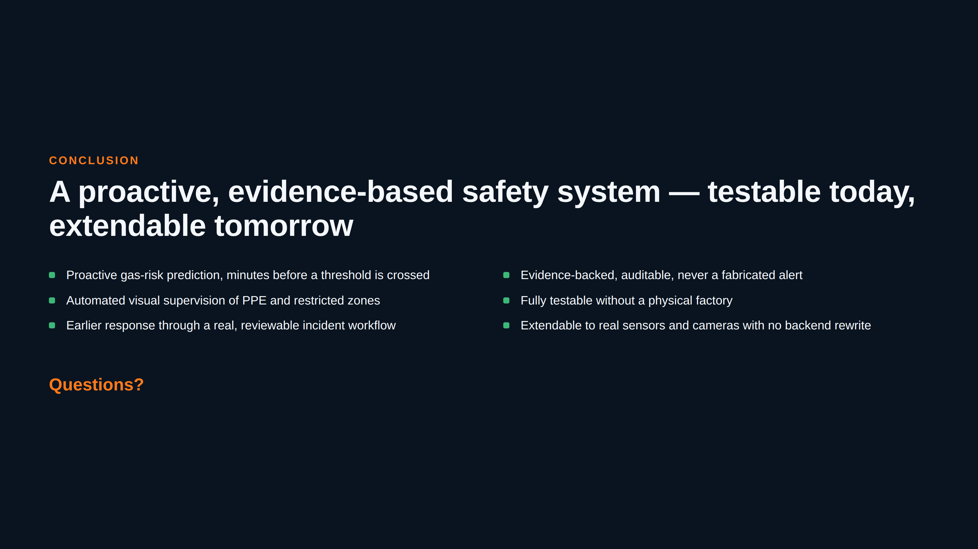
Notes:
SAY: Factory Safety Sentinel proves the full loop — predict, detect, decide, evidence, review — works end to end, is genuinely tested, and is built so the next step to real hardware is an adapter, not a rewrite. Thank you — happy to take questions.
EVIDENCE: Every claim on this slide has been shown with a real screenshot, metric, or test result earlier in the deck.
TRANSITION: (End of presentation — open floor for questions.)
LIKELY QUESTION: What would you build next with more time?
ANSWER: Domain-adapted vision fine-tuning on real factory footage and a second gas profile (CO), per the project's own documented P1 roadmap.

