Slide 1
Hotel Management System
Dr\Ibrahim El-Semman

Slide 2
Team Members
Mahmoud Hamdy Morsy محمود حمدى مرسى احمد
Information System (Section 3)
Mahmoud Abdel Karim Mohamedمحمود عبد الكريم محمد خلف
Computer Science (Section 2)
Mohamed Sayed Mahmoud Youssefمحمد سيد محمود يوسف
Computer Science (Section 2)
Mohamed Rady Abdelkader محمد راضي عبدالقادر
Information System (Section 6)
Mohamed Mahmoud Abdel-Tawab محمد محمود عبدالتواب
Computer Science (Section 2)
Abdulazez Nasser Fathy عبد العزيز ناصر فتحي
Computer Science (Section 1)

Slide 3
Links
Presentation
https://aunedu-my.sharepoint.com/:p:/g/personal/mahmoudhamdy_compit_aun_edu_eg/EWViSeeDTudFkU9EFUfT2fMBsi7ZjhD8deXmKhytB9WvIg?e=SvHIQI
Database Schema
https://lucid.app/lucidchart/26e5b745-620e-4e93-b92b-a80f12672188/edit?invitationId=inv_45fa42ea-34a5-4221-9777-341db3f7a534
SQL Code
https://ideone.com/LJ6ffe (view only)
https://codeshare.io/eVmyE9
Source Code(GitHub)
https://github.com/MahmoudHamdy00/HotelManagementSystem

Slide 4
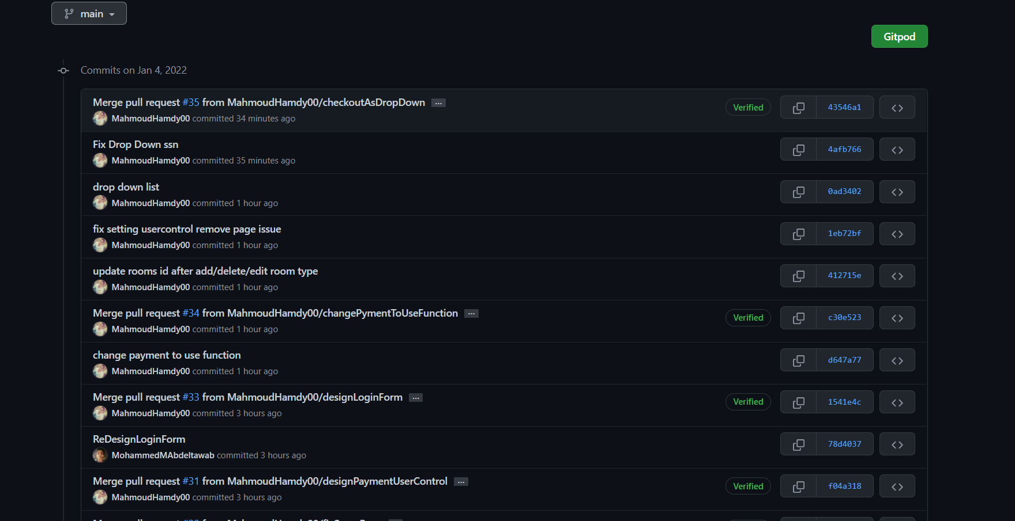
GitHub Commits

Slide 5
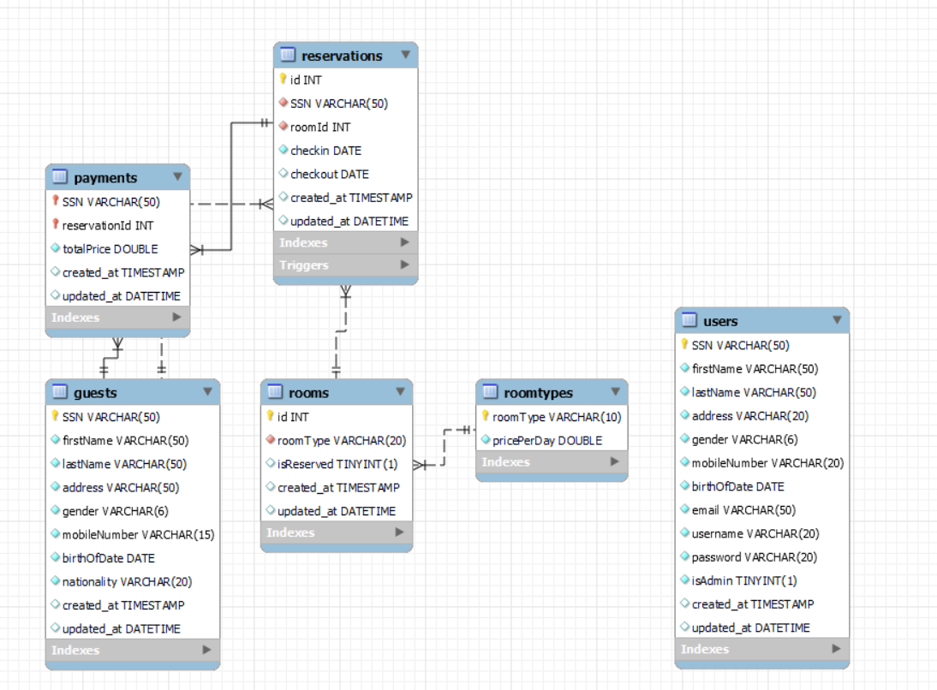
ER-Diagram

Slide 6
PROCEDURE To get the total Price
DELIMITER //
CREATE PROCEDURE GetTotalPrice(in reservationId int,out totalPrice double)
BEGIN
select @checkInDate := Reservations.checkin ,@checkOutDate := Reservations.checkout ,@roomId := Reservations.roomId
from Reservations where Reservations.id=reservationId ;
select @roomType:=rooms.roomType from rooms where rooms.id=@roomId; select @roomPrice:=RoomTypes.pricePerDay
from RoomTypes where @roomType=RoomTypes.roomType; SET totalPrice=(DATEDIFF(@checkOutDate,@checkInDate)+1)*@roomPrice;
select totalPrice;
END //
DELIMITER ;

Slide 7
Trigger to reserve(set as busy) room after create a reservatin
DELIMITER // CREATE TRIGGER `reserveRoom` AFTER INSERT ON `reservations` FOR EACH ROW begin update rooms set rooms.isReserved=true where rooms.id=new.roomId; end// DELIMITER ;

Slide 8
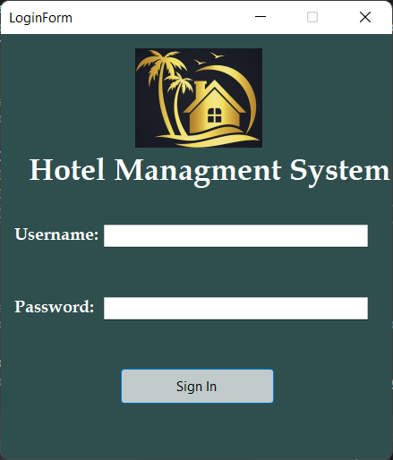
Login Form

Slide 9
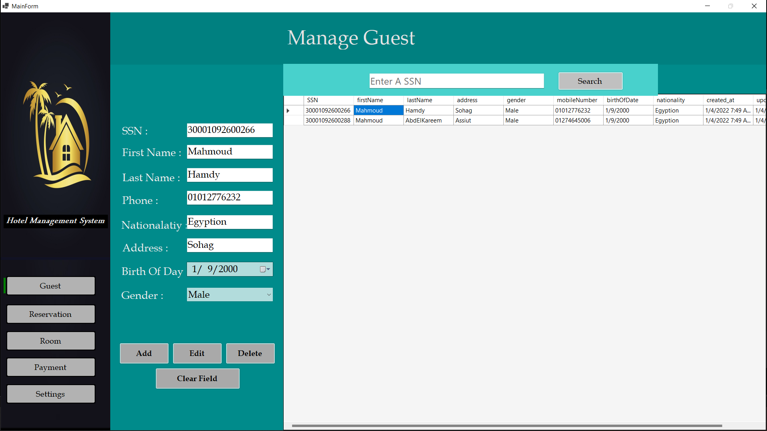
Guest Form (Add/Update/Delete)

Slide 10
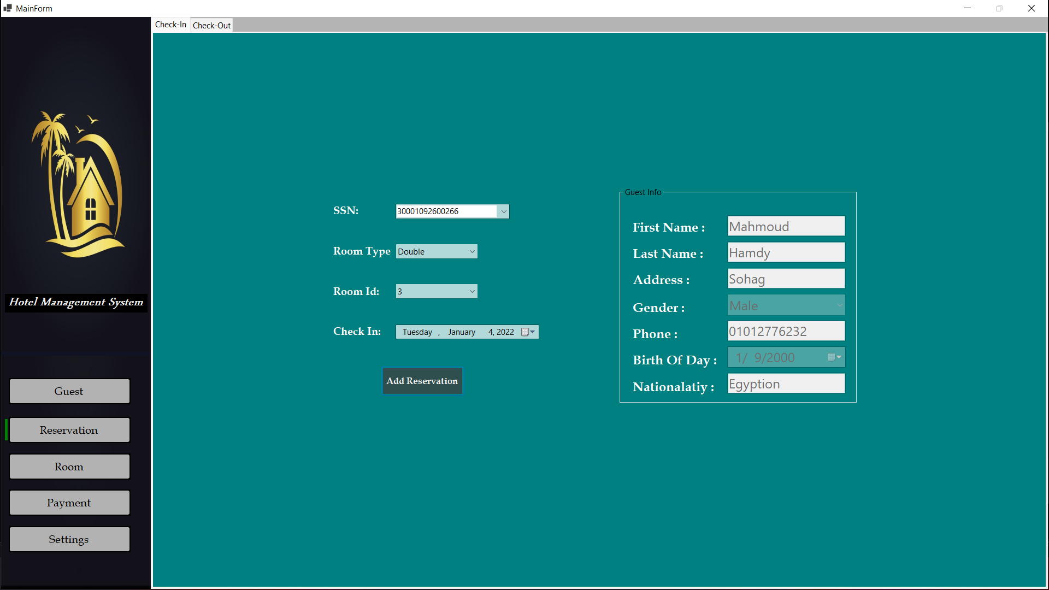
Check-In

Slide 11
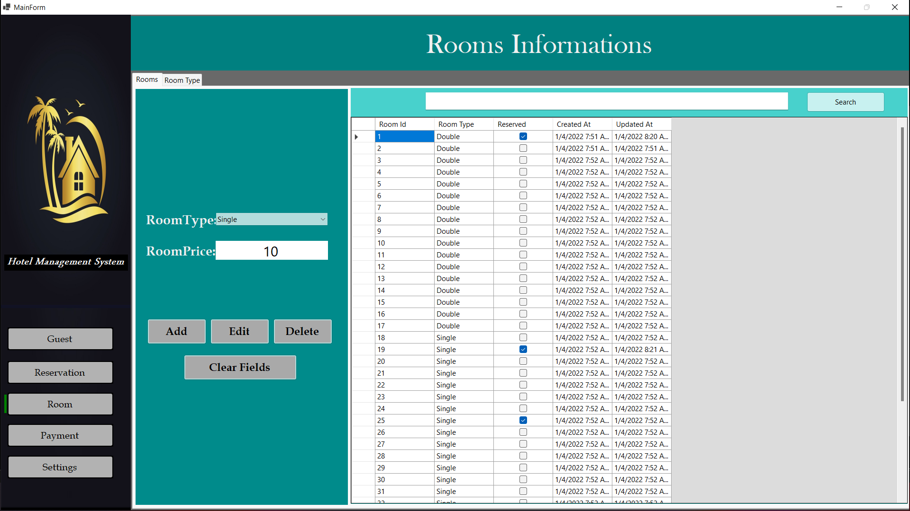
Rooms(Add/Update/Delete)

Slide 12
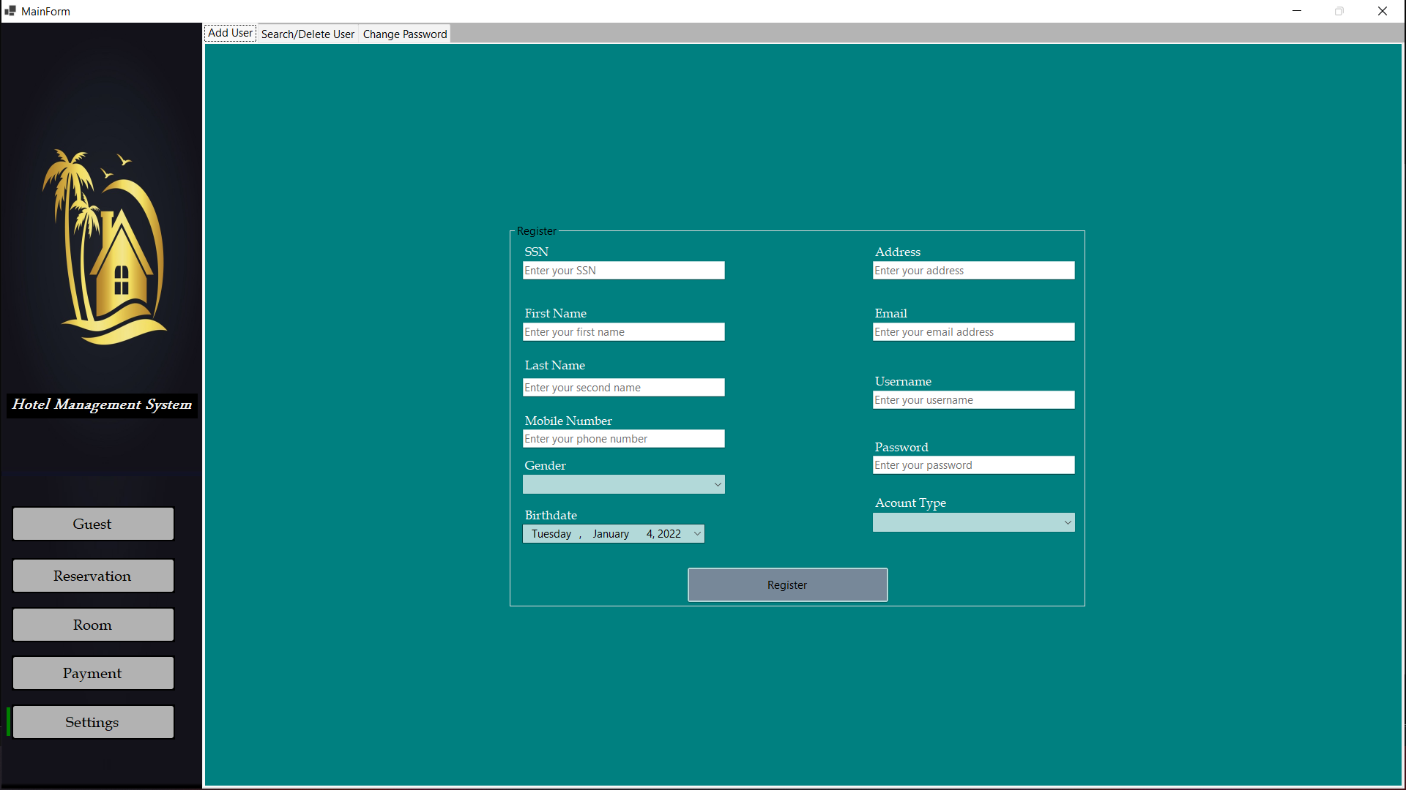
Add User

Slide 13
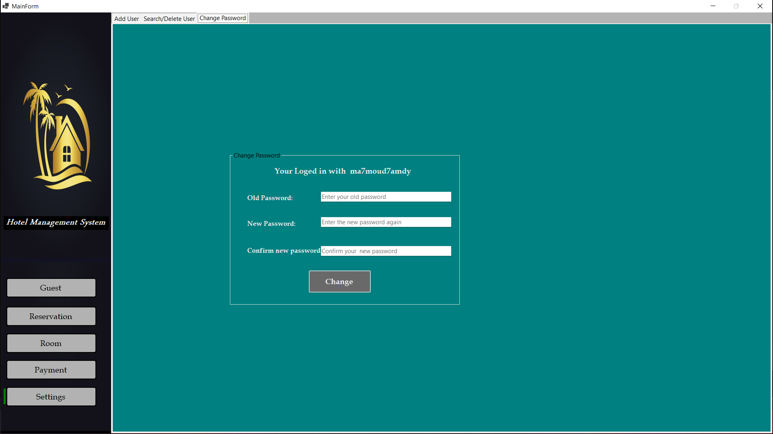
Change (Add/Update/Delete)

Slide 14
Thanks

