Slide 1
Discussion deck
Stress–Repair Proteomic Imbalance and SIS Emotion After Stroke
Preliminary cross-sectional StrokeCog analysis
for scientific feedback and longitudinal-project discussion
Core idea
A derived stress–repair imbalance feature may summarize emotional vulnerability better than isolated pathway changes.
Longitudinal question
Does this proteomic imbalance appear before later SIS emotion decline?
Meeting purpose
Get your judgment on framing, validation strategy, and feasible next steps.
use the preliminary signal as a concrete starting point for expert feedback
Li Gong · PhD candidate, University of Toronto / Sunnybrook Research Institute
Discussion with Dr. Lansberg
Li Gong
Notes:
Opening script: Thank Dr. Lansberg for meeting. Emphasize that this is a preliminary, hypothesis-generating analysis using cross-sectional StrokeCog clinical and plasma proteomic data. The goal is not to claim prediction yet, but to ask whether the stress–repair imbalance feature is biologically reasonable and worth testing longitudinally.

Slide 2
MEETING PURPOSE
Specific questions for discussion
1
Refine the biological framing
2
Decide the strongest next analysis
3
Explore whether this could grow into a fellowship-style project
Is “stress–repair imbalance” the right biological summary feature?
Would longitudinal SIS3 trajectory be the right outcome?
What would make the hypothesis most convincing: repeated proteomics, imaging integration, or external validation?
Preliminary, hypothesis-generating analysis for discussion
Li Gong
Notes:
Use this slide only briefly. You want the meeting to feel like a scientific discussion. Say that the purpose is to learn how he would shape the direction and what next analysis would be most credible.

Slide 3
SIGNIFICANCE
Clinical motivation and knowledge gap
The unmet need is not just identifying current mood status, but recognizing who may need closer long-term monitoring.
Clinical problem
Some stroke survivors experience persistent or delayed mood/emotional vulnerability that affects quality of life and long-term recovery.
Current gap
It remains unclear which patients need closer monitoring, when biological vulnerability emerges, and what mechanisms should guide intervention strategies.
Opportunity
Plasma proteomic profiles may provide an interpretable window into biological states not fully captured by clinical scores alone.
Current SIS3 status
Biological vulnerability
Future SIS3 decline?
First step in this proposal
Define a biologically interpretable stress–repair proteomic imbalance profile associated with SIS emotion status, then test longitudinally whether it precedes later SIS emotion decline.
Preliminary, hypothesis-generating analysis for discussion
Li Gong
Notes:
Emphasize that the outcome is SIS3, the Stroke Impact Scale emotion domain. This is not a depression diagnosis and not a broad cognition endpoint. The gap is the timing and biological interpretation of delayed emotional vulnerability.

Slide 4
OBSERVATION 1
Preliminary observation: imbalance is more informative
The key signal is the mismatch: relatively greater stress-response activation with weaker repair/neurovascular remodeling.
Stress-response activation
monoamine/kynurenine · vesicle trafficking · cellular stress/proteostasis · growth-survival signaling
Repair / neurovascular remodeling
complement/coagulation · endothelial/BBB · synaptic plasticity · integrin/ECM remodeling
Derived imbalance feature
Stress − Repair
positive values suggest stress predominance over repair/remodeling
−
=
Interpretation
Cautious wording for meeting
In the cross-sectional data, lower-SIS3 patients appeared to show a broader stress–repair imbalance. This feature may provide a more interpretable biological readout than discussing many individual modules separately.
“This does not prove prediction. It identifies a candidate feature and time window to test in longitudinal data.”
Preliminary, hypothesis-generating analysis for discussion
Li Gong
Notes:
Say: The value is not a single pathway. The value is a derived feature that summarizes a biologically meaningful mismatch. Lower SIS3 appeared to be associated with stress predominance and weaker repair/remodeling signals. This is why the imbalance feature may be more useful than isolated pathway interpretation.

Slide 5
OBSERVATION 2
Preliminary observation: profiles are time-structured
The biological meaning of lower SIS3 may differ by post-stroke stage, which makes longitudinal validation essential.
0–1 year
early post-stroke
clinical status + baseline biology
1–3 years
possible transition window
stress-related activity may become more prominent
>3 years
late stage
more heterogeneous lower-SIS3 phenotype
What the cross-sectional result suggests
What it cannot show yet
Lower-SIS3 patients did not appear to show one fixed proteomic signature across all time windows. Instead, the imbalance profile showed time-since-stroke dependence, particularly among lower-SIS3 patients.
Cross-sectional timing cannot prove within-patient biological progression. The key next test is whether early imbalance precedes later SIS emotion decline within the same patients.
Preliminary, hypothesis-generating analysis for discussion
Li Gong
Notes:
Avoid saying time-dependent biology is novel. Say: time-dependent biology is expected. The interesting question is whether the biology linked to lower SIS3 is stable or stage-dependent. The cross-sectional result raises that longitudinal hypothesis.

Slide 6
PROJECT FRAME
Central hypothesis and specific aims
The longitudinal version tests whether stress–repair imbalance is an early candidate indicator of emotional vulnerability.
Central hypothesis
Post-stroke SIS emotion status and trajectory are associated with a time-dependent stress–repair imbalance, characterized by relatively greater stress-response activation and weaker repair/neurovascular remodeling signals.
Aim 1
Define stress–repair plasma proteomic imbalance associated with SIS emotion status after stroke.
Aim 2
Test whether cross-sectional time-structured patterns reflect within-patient SIS emotion trajectories.
Future extension
Integrate imaging markers to define the sequence among protein changes, brain changes, and later SIS emotion outcomes.
Expected output
A biologically interpretable framework, not a final predictive biomarker claim from cross-sectional data.
Decision needed
Should the first project focus on SIS3 trajectory, imaging integration, or validation in another cohort?
Preliminary, hypothesis-generating analysis for discussion
Li Gong
Notes:
This is the most important proposal slide. Emphasize status and trajectory. The key phrase: candidate indicator of future emotional vulnerability, if longitudinally validated.

Slide 7
NEXT ANALYSIS
Longitudinal validation: test temporal ordering
The decisive test is temporal ordering: proteomic imbalance first, SIS emotion decline later.
Patient initially emotionally preserved
Time 1
SIS3 > 63
Proteomic imbalance measured
Lag window
protein trajectory
± imaging change
Time 2
SIS3 stable vs decline
trajectory outcome
Analysis questions
• Does baseline imbalance predict later SIS3 decline among patients initially above threshold?
• Does change in imbalance track or precede SIS3 trajectory?
• Do imaging markers help place protein signals in a protein → brain → clinical sequence?
Translational value if supported
A candidate early indicator for closer monitoring and future risk-informed intervention design.
Preliminary, hypothesis-generating analysis for discussion
Li Gong
Notes:
This is where the meeting can become exciting. Explain that if the imbalance is present before decline, then it is not only a correlate of current emotional state, but a candidate indicator of future vulnerability.

Slide 8
PROPOSAL VALUE
Innovation and expected impact
The innovation is the derived imbalance feature: a simpler, biologically interpretable summary of coordinated stress and repair biology.
Innovation
Shifts from isolated proteins or individual modules to a derived stress–repair imbalance profile that captures the relative predominance of stress activation over repair/neurovascular remodeling.
Expected impact
If validated longitudinally, this framework could help identify patients who appear emotionally preserved early after stroke but may later experience SIS emotion decline.
How I would phrase the value
“The preliminary signal suggests that a stress–repair imbalance may be more informative than individual pathway changes alone. If this imbalance is also observed longitudinally and precedes later SIS3 decline, it could provide a candidate early indicator of post-stroke emotional vulnerability.”
Preliminary, hypothesis-generating analysis for discussion
Li Gong
Notes:
Use this slide if he asks what is new. Say directly: time-dependent biology after stroke is common sense; the value here is deriving an imbalance feature and testing whether it precedes emotional decline.

Slide 9
BACKUP
Analysis workflow and guardrails
The workflow keeps the analysis biologically interpretable while avoiding overclaiming from cross-sectional data.
Data
85 patients with SIS3 and plasma proteomic data
Lower SIS3 ≤63; Higher SIS3 >63
Time bins: 0–1 y, 1–3 y, >3 y
Proteomic processing
Remove low-detection proteins
Z-standardize NPX across patients
Map proteins to literature-aligned modules
Profiles
Stress-response activation
Repair/neurovascular remodeling
Stress–repair imbalance = stress − repair
Outputs
Lower vs higher SIS3 comparisons
Time-stratified patterns
Longitudinal hypotheses
Guardrails in interpretation
• Cross-sectional data cannot establish within-patient progression.
• Subgroup size is limited and imbalanced across SIS3/time bins.
• Current results are hypothesis-generating and need longitudinal validation.
• The purpose is to define a candidate biological feature, not a clinical biomarker claim yet.
Preliminary, hypothesis-generating analysis for discussion
Li Gong
Notes:
This backup slide helps if he asks about methods or limitations. Keep the tone careful: exploratory, biologically organized, ready for longitudinal testing.

Slide 10
QUESTIONS FOR DR. LANSBERG
Discussion close
The best outcome is clear advice on whether this is the right framing and what dataset/analysis would make it credible.
Biological framing
Is stress–repair imbalance a reasonable way to summarize the signal, or would you frame it differently?
Outcome and timing
Would SIS3 trajectory be the right longitudinal endpoint, or should this be broadened to mood/cognition/recovery?
Most convincing next step
Repeated proteomics? Imaging integration? External validation? A specific cohort or trial dataset?
Potential fit
Could this be shaped into a focused fellowship/postdoctoral project or related collaborative contribution?
Closing sentence
“I would be very grateful for your advice on whether this is a biologically reasonable and feasible first step, and what analysis would make the longitudinal hypothesis stronger.”
Preliminary, hypothesis-generating analysis for discussion
Li Gong
Notes:
Use this to end the meeting. Do not ask directly for a job at the beginning. Let the scientific discussion lead into fit and opportunity.

Slide 11
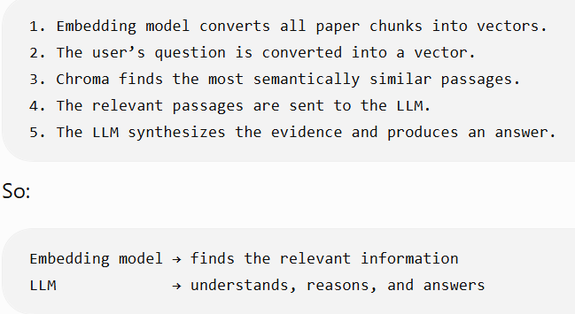
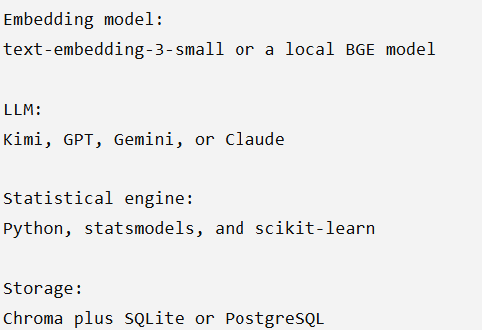
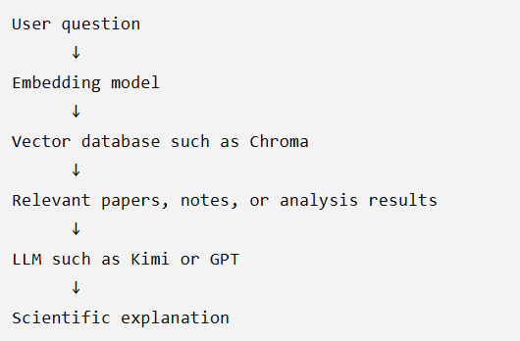
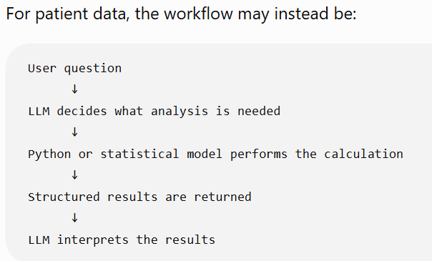
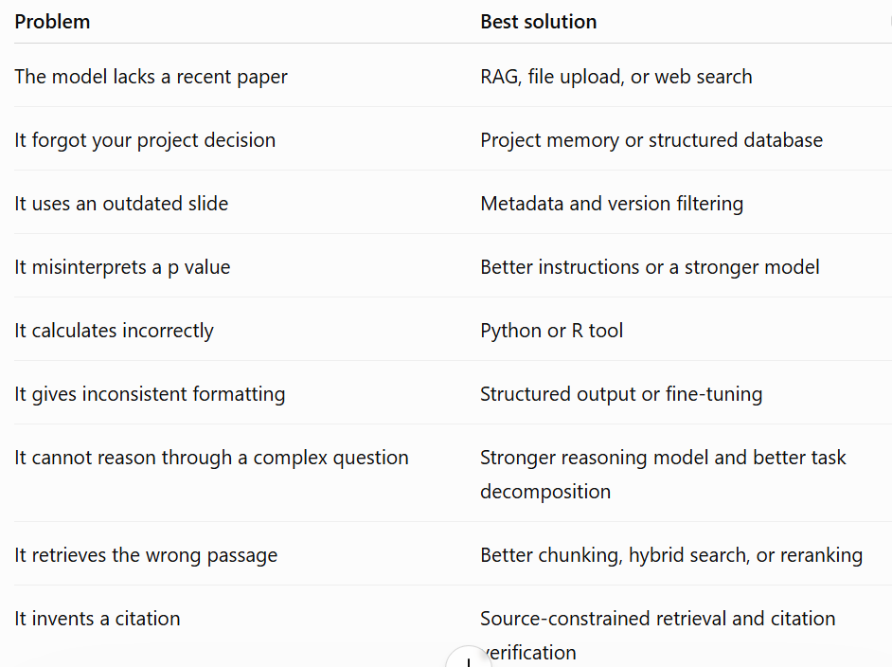
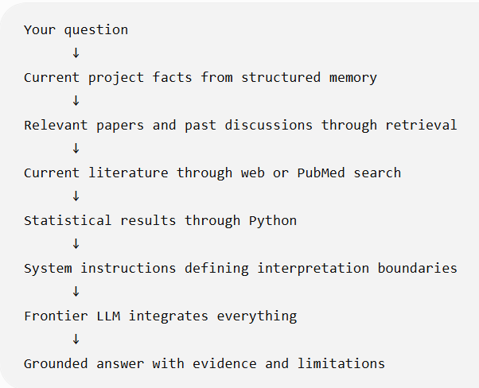
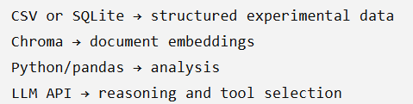
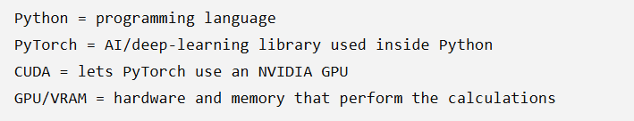
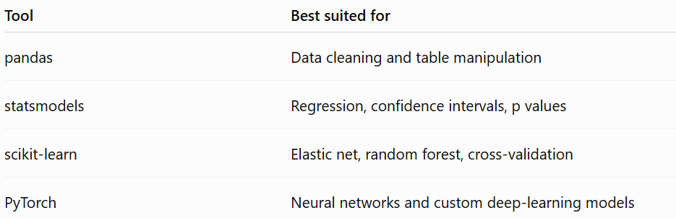
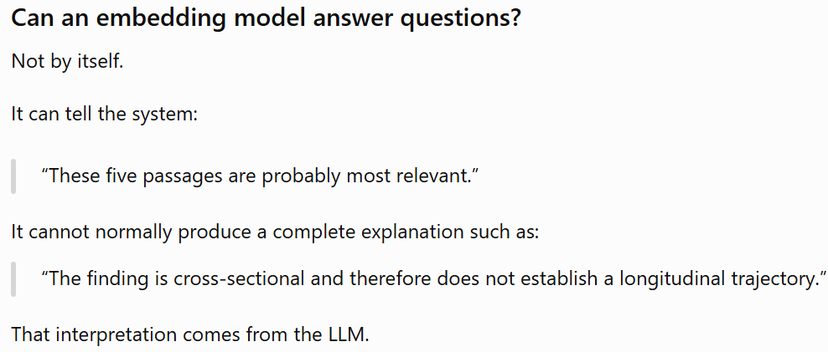

Slide 12
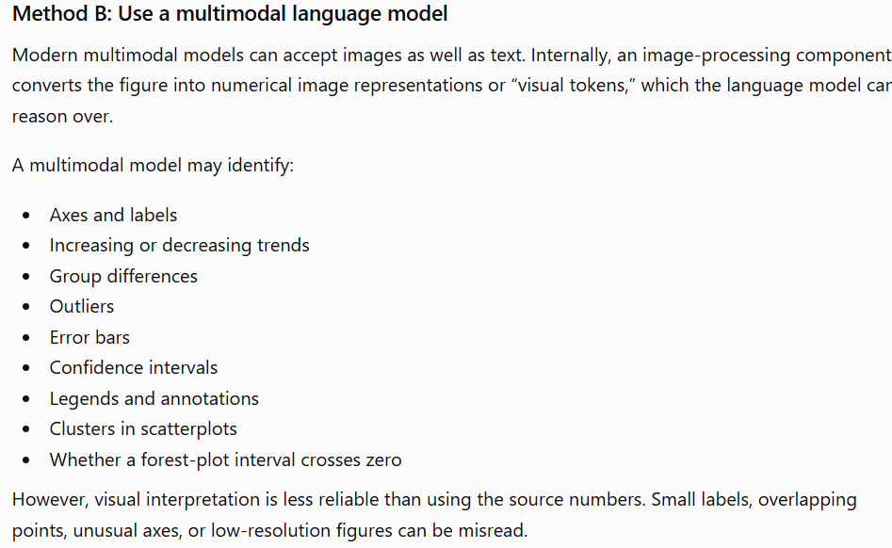
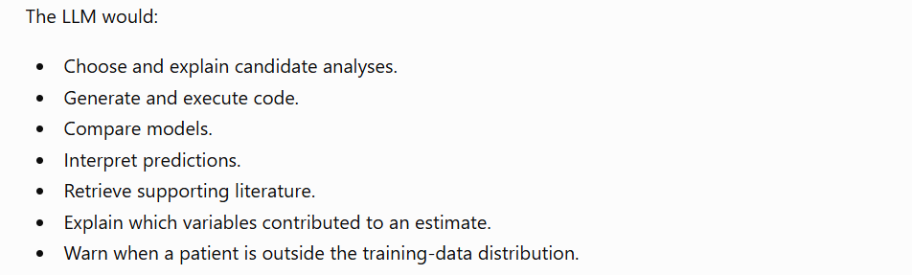
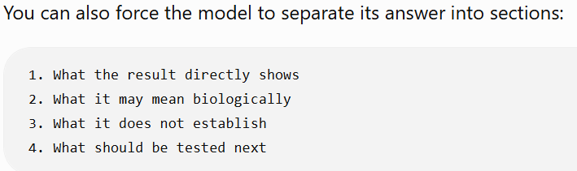
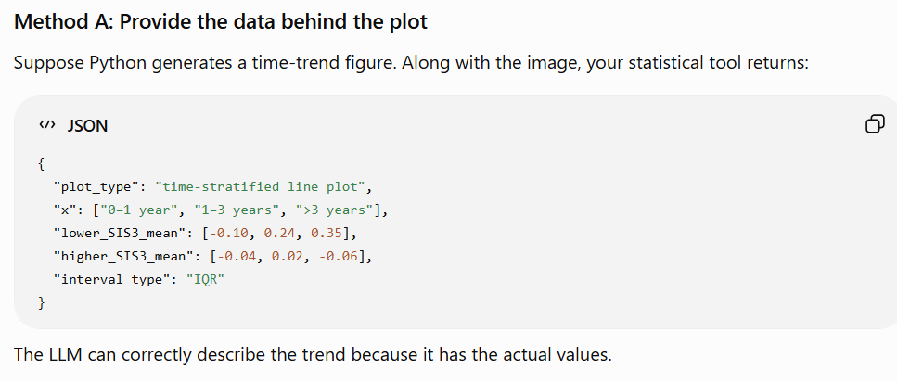
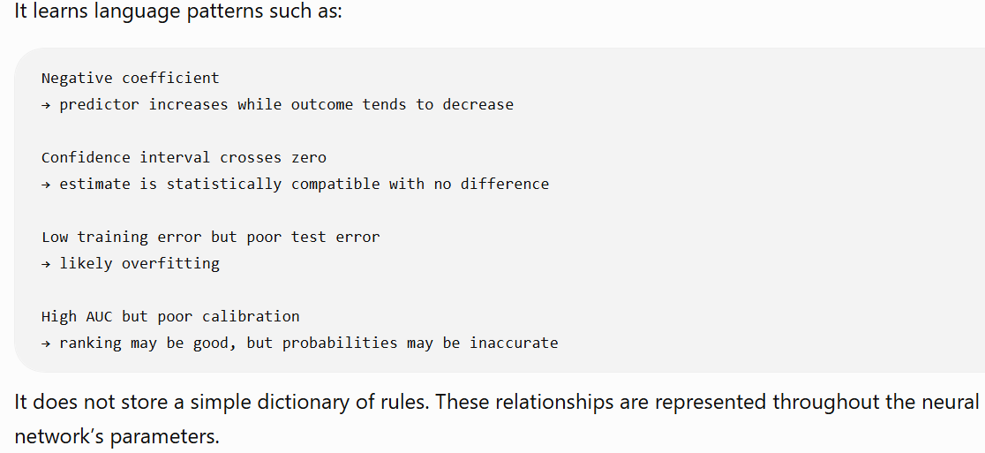


Slide 13
