Slide 1
CSE- 4th Semester
COMPUTER ARCHITECTURE & ORGANIZATION
Notes:
Manav Rachna College of Engineering

Slide 2
Classification of computer study in 3 categories:
Computer design: This is concerned with the hardware design of the computer. In this designer decides on the specifications of the computer system.
Computer Organization: This is concerned with the way the hardware components operate and the way they are connected to form the computer system.
Computer Architecture: This is concerned with the structure and behavior of the computer as seen by the user. It includes the information formats, the instruction set and addressing modes for accessing memory.

Slide 3
DIGITAL COMPUTERS
Imply that the computer deals with digital information
Digital information: is represented by binary digits (0 and 1)
Gate
Binary digital input signal
GATE
Binary digital output signal
Gates – blocks of Hardware that produce 1 or 0 when input logic requirements are satisfied.
Functions of gates can be described by:
Truth Table
Boolean Function

Slide 4
Truth Table: All the possible output for all the possible combinations of input in tabular form creates a truth table.
Boolean Function: The Function that describes the working of gate in terms of either products or sum of its input or combination of both is called Boolean function.
There are three basic gates: AND, OR and NOT
There are two universal gates: NAND and NOR

Slide 5
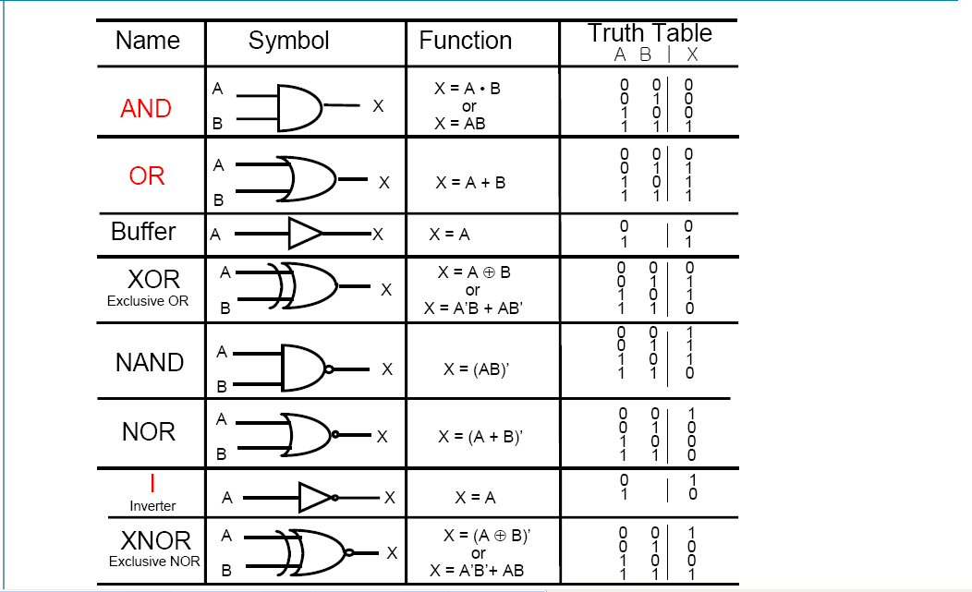

Slide 6


BOOLEAN ALGEBRA
Commutative Law
x + y = y + x [3+4 = 4+3]
x·y = y·x [8x9 = 9x8]
In Boolean algebra:
A+B = B+A
A.B=B.A

Slide 7


Associative Law
(x+y) + z = x+(y+z) [(3 + 4) + 5 = 3 + (4 + 5)]
(x·y) ·z = x·(y·z) [(8 x 9) x 6 = 8 x (9 x 6)]
In Boolean Algebra:
(A+B) + C= A+(B+C)
(A·B) ·C = A·(B·C)

Slide 8
Distributive Law
x(y+z) = xy + xz (multiplication can be distributed over addition)
x+(y•z) ≠ (x+y)• (x+z) (addition cannot be distributed over multiplication)
In Boolean algebra
A•(B+C) = (A•B) + (A•C) (AND can be distributed over OR)
A
B
C
B
A
C

Slide 9
A+(B•C) = (A+B) • (A+C) (OR can be distributed over AND)
C
A
C
B
B
A

Slide 10
DEMORGAN'S LAWS
AND and OR logic are related by DeMorgan's Laws
A•B = A+B (The complement of the product equals the sum of the complements)
A+B = A•B (The complement of the sum equals the product of the complements)
Rules of AND Rules of NAND
A•0 = 0 A NAND 0 = 1
A•1 = A A NAND 1 = A
A•A = A A NAND A = A
A•A = 0 A NAND A = 1
Rules of OR Rules of NOR
A+0 = A A NOR 0 = A
A+1 = 1 A NOR 1 = 0
A+A = A A NOR A = A
A+A = 1 A NOR A = 0

Slide 11
Rules of XOR Rules of XNOR
A⊕ 0 = A A XNOR 0 = A
A⊕1 = A A XNOR 1 = A
A⊕A = 0 A XNOR A = 1
A⊕A = 1 A XNOR A = 0

