Slide 1
CSE – 4th Semester
COMPUTER ARCHITECTURE & ORGANIZATION
Notes:
Manav Rachna College of Engineering

Slide 2
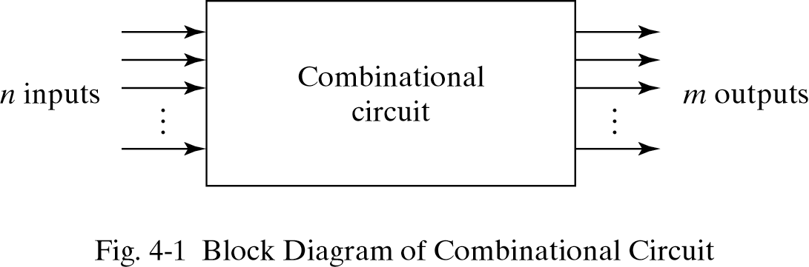
Combinational Circuits
Combinational circuits are circuits without memory where the outputs are obtained from the inputs only. An n-input m-output combinational circuit is of the form.

Slide 3
Designing Combinational Circuits
In general we have to do following steps:
Problem description
Input/output of the circuit
Define truth table
Simplification for each output
Draw the circuit

Slide 4
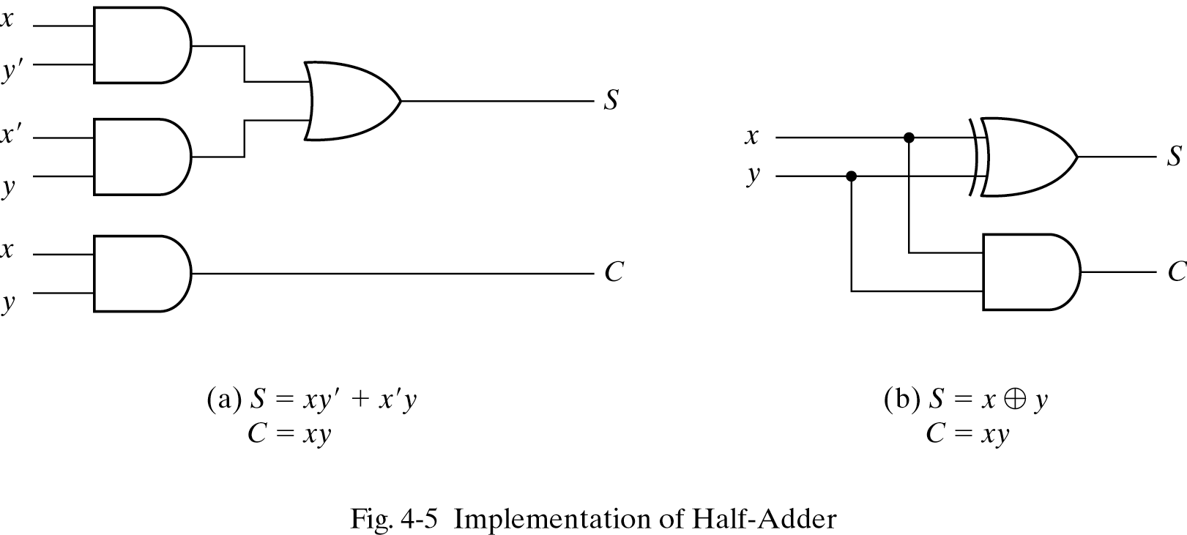
Half-Adder

Slide 5
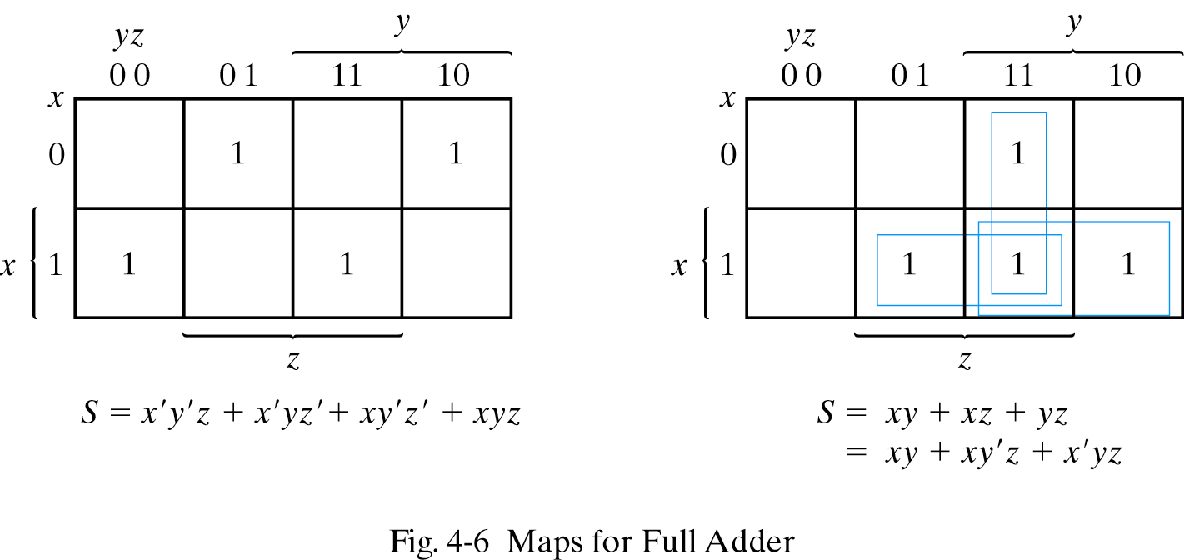
Full-Adders

Slide 6
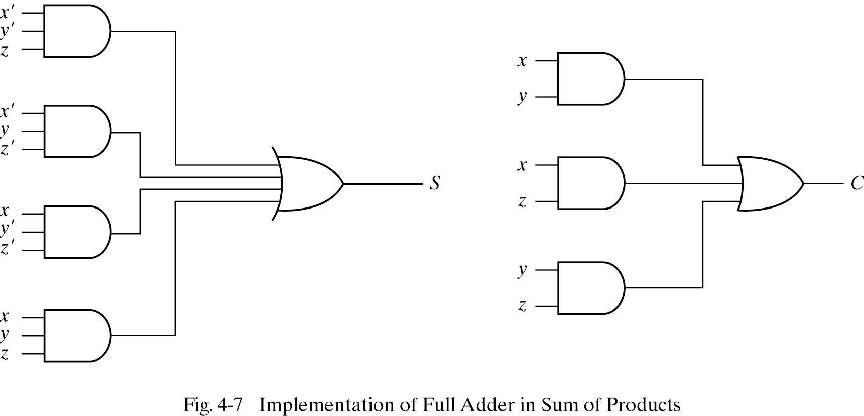

Slide 7
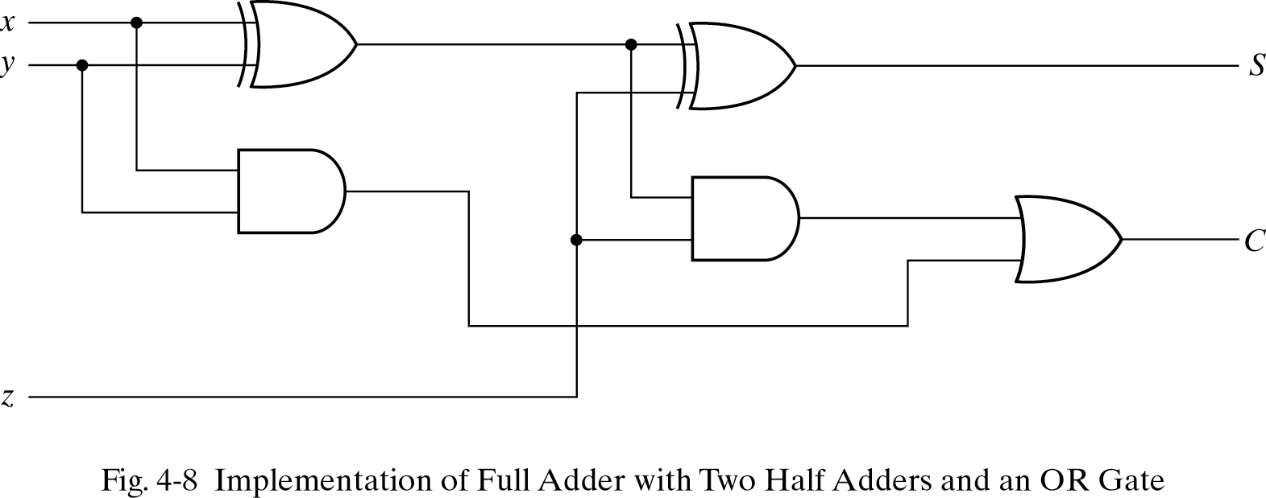

Slide 8
Binary adder
Binary adder that produces the arithmetic sum of binary numbers can be constructed with full adders connected in cascade, with the output carry from each full adder connected to the input carry of the next full adder in the chain
Note that the input carry C0 in the least significant position must be 0.

Slide 9
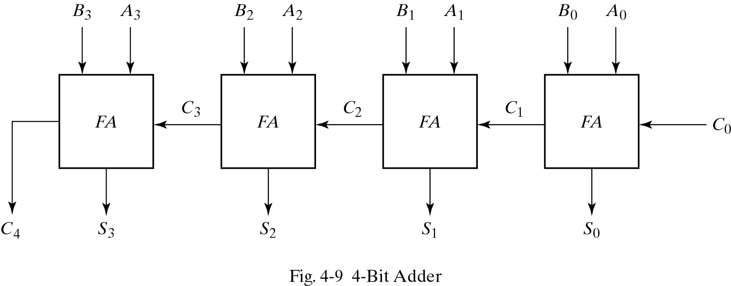
Binary Adder

Slide 10
Binary Adder
For example to add A= 1011 and B= 0011
subscript i: 3 2 1 0
Input carry: 0 1 1 0 C_{i}
Augend: 1 0 1 1 A_{i}
Addend: 0 0 1 1 B_{i}
-------------------------------
Sum: 1 1 1 0 S_{i}
Output carry: 0 0 1 1 C_{i+1}

Slide 11
Multiplexer
It is a combinational circuit that selects binary information from one of the input lines and directs it to a single output line
Usually there are 2^{n} input lines and n selection lines whose bit combinations determine which input line is selected
For example for 2-to-1 multiplexer if selection S is zero then I₀ has the path to output and if S is one I₁ has the path to output (see the next slide)

Slide 12
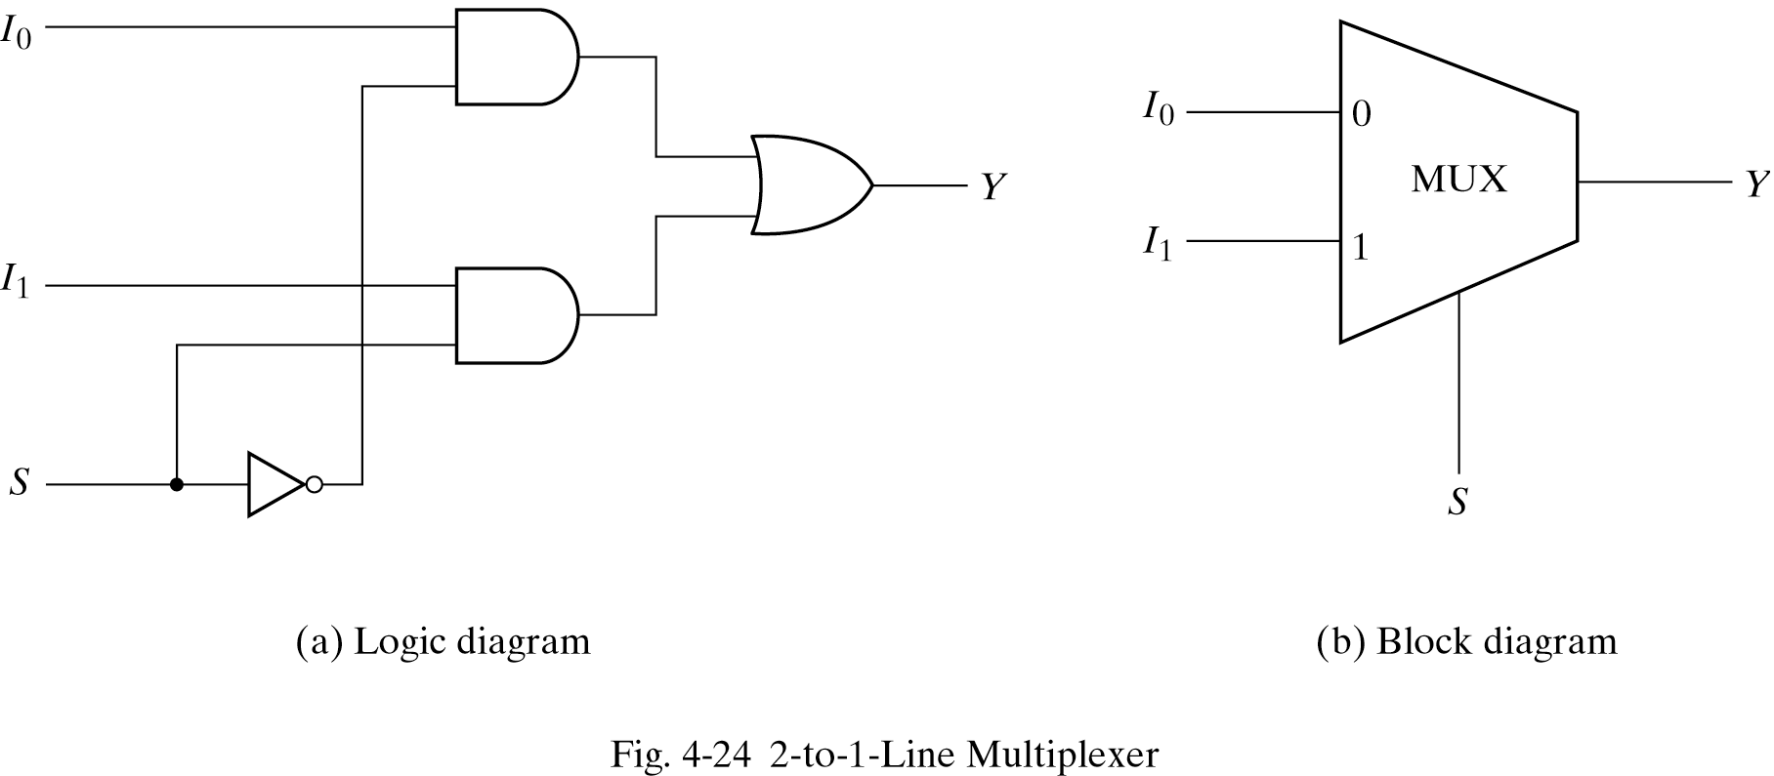
2-to-1 multiplexer

Slide 13
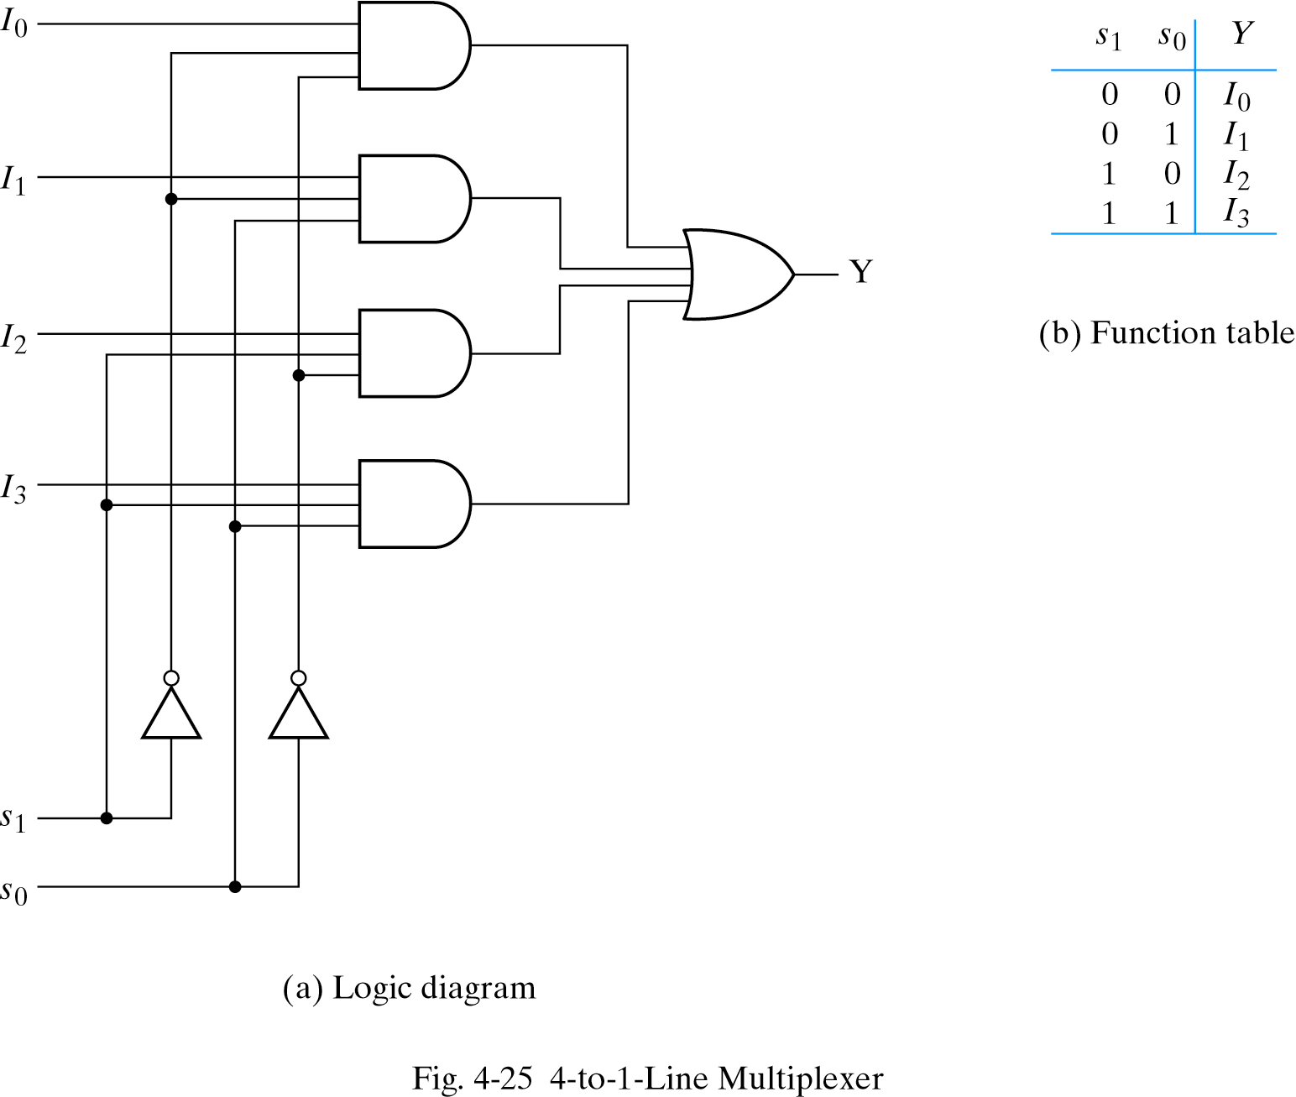

Slide 14
Decoder
Is a combinational circuit that converts binary information from n input lines to a maximum of 2^{n} unique output lines For example if the number of input is n=3 the number of output lines can be m=2³ . It is also known as 1 of 8 because one output line is selected out of 8 available lines:
3 to 8
decoder
enable

Slide 15
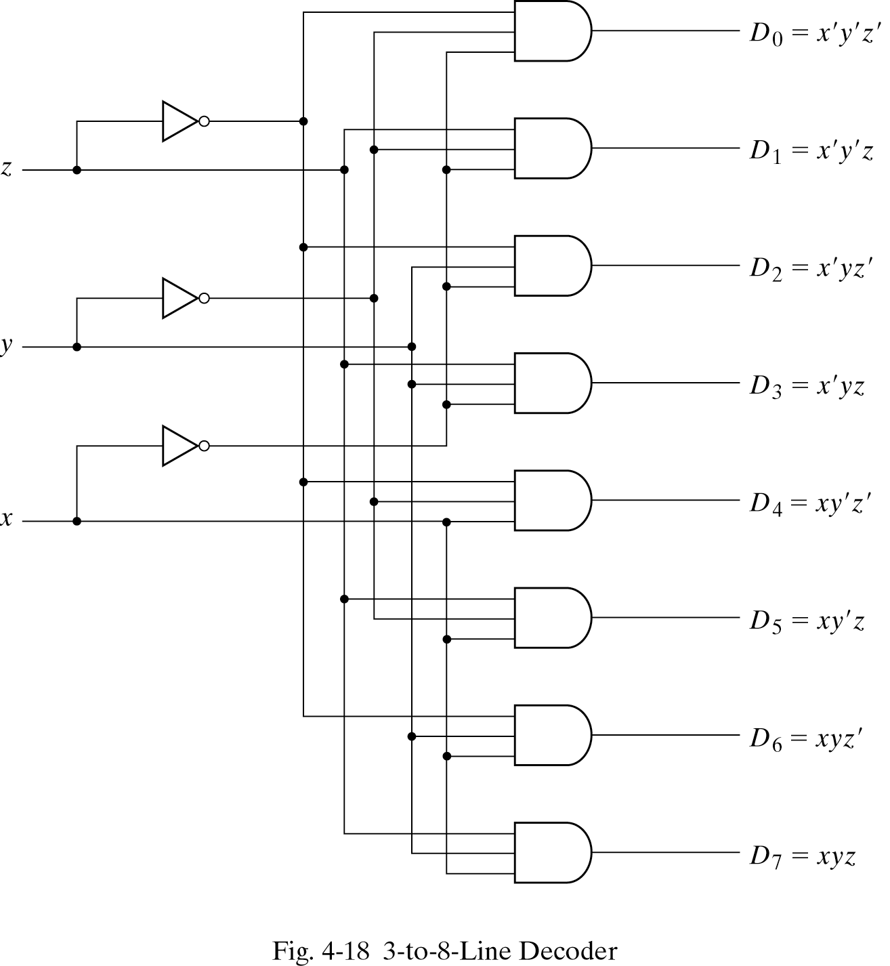

Slide 16
Decoder with Enable Line
Decoders usually have an enable line,
If enable=0 , decoder is off. It means all output lines are zero
If enable=1, decoder is on and depending on input, the corresponding output line is 1, all other lines are 0
See the truth table in next slide

Slide 17
Truth table for decoder
E a2 a1 a0 D7 D6 D5 D4 D3 D2 D1 D0
-----------------------------------------------------------
0 x x x 0 0 0 0 0 0 0 0
1 0 0 0 0 0 0 0 0 0 0 1
1 0 0 1 0 0 0 0 0 0 1 0
1
1 ……………………………………….
1 ……………………………………..
1
1
1 1 1 1 1 0 0 0 0 0 0 0

Slide 18
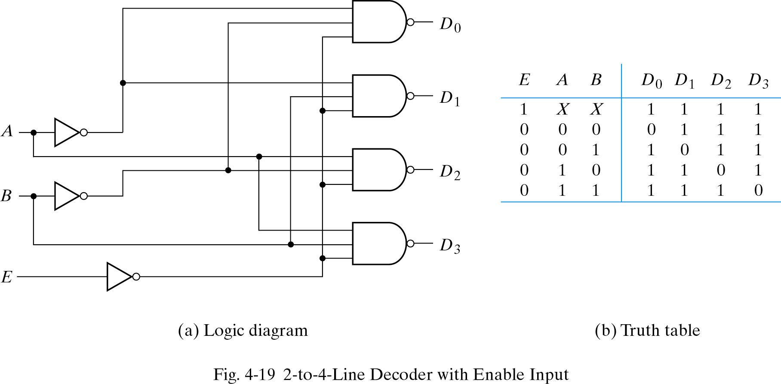

Slide 19
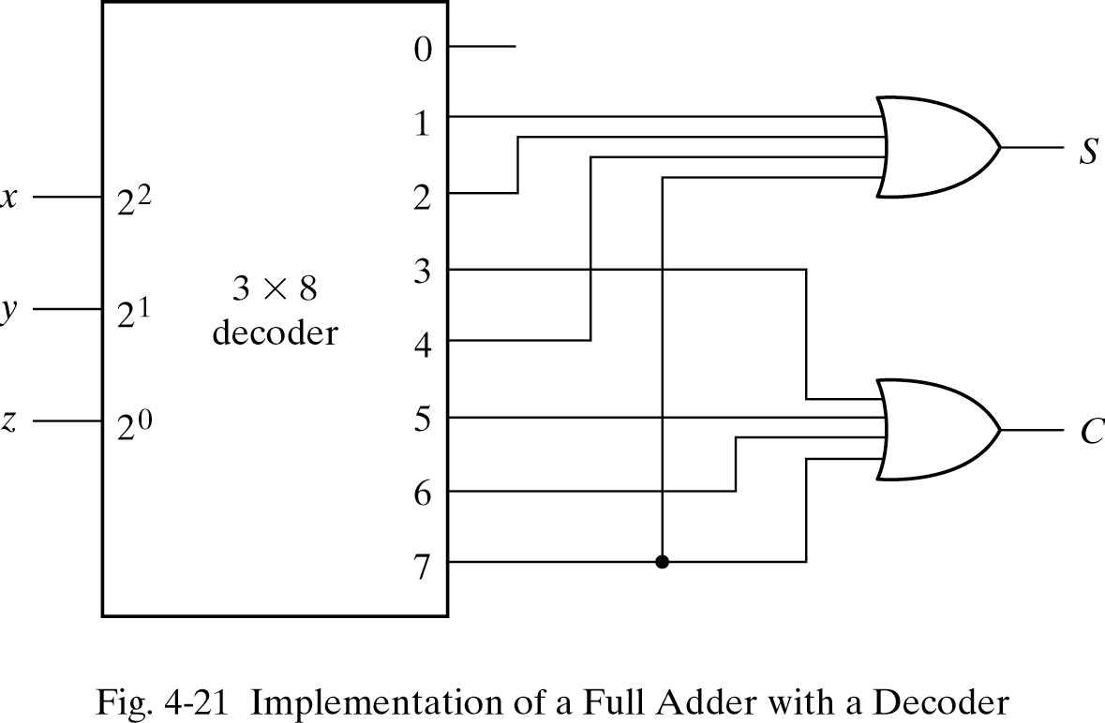
Major application of Decoder
Decoder is use to implement any combinational cicuits ( f^{n} ). For example the truth table for full adder is s (x,y,z) = ∑ ( 1,2,4,7) and C(x,y,z)= ∑ (3,5,6,7). The implementation with decoder is:

Slide 20
Encoder
The process of assigning a code to every possible object is called Encoding. Encoder is a digital circuit that performs the inverse operation of a decoder
Generates a unique binary code from several input lines.
Generally encoders produce2-bit, 3-bit or 4-bit code. n bit encoder has 2^{n} input lines
2 bit encoder

