Slide 1
CSE – 4th Semester
COMPUTER ARCHITECTURE & ORGANIZATION
Notes:
Manav Rachna College of Engineering

Slide 2
Von Neumann Concept

Slide 3
Von Neumann Architecture
The von Neumann architecture is a design model for a stored-program digital computer that uses a processing unit and a single separate storage structure to hold both instructions and data.
It is named after the mathematician and early computer scientist John von Neumann.

Slide 4
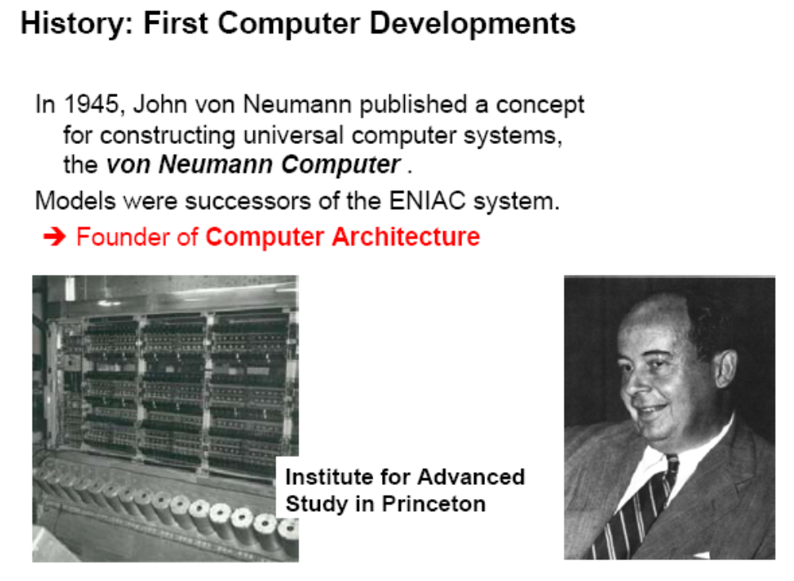

Slide 5
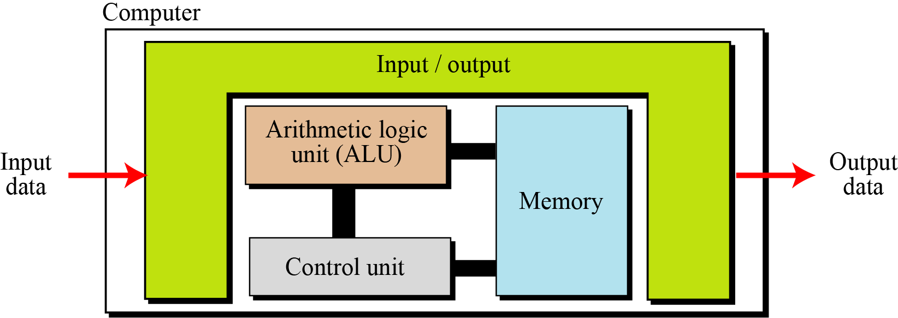
Four Subsystems
Computers built on the von Neumann model divide the computer hardware into four subsystems: memory, arithmetic logic unit, control unit, and input/output
The von Neumann model

Slide 6
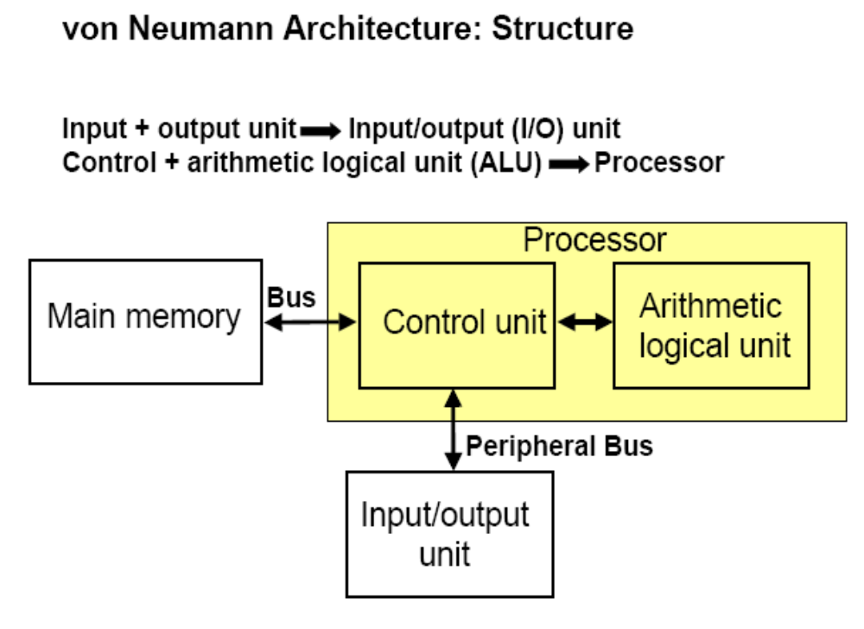

Slide 7
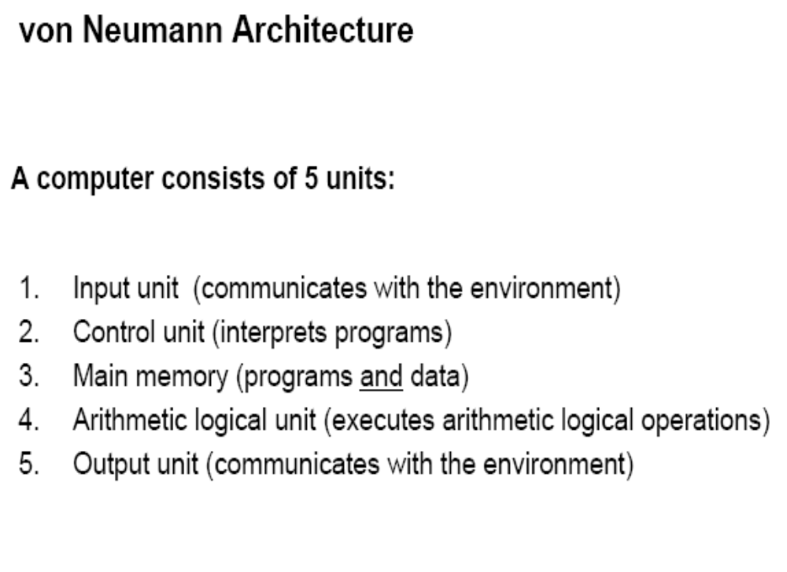

Slide 8
A stored-program digital computer is one that keeps its programmed instructions, as well as its data, in read-write, random-access memory (RAM).
The mechanisms for transferring the data and instructions between the CPU and memory are, however, considerably more complex than the original von Neumann architecture.
The terms "von Neumann architecture" and "stored-program computer" are generally used interchangeably.

Slide 9
The Stored program concept
The von Neumann model states that the program must be stored in memory. This is totally different from the architecture of early computers in which only the data was stored in memory: the programs for their task was implemented by manipulating a set of switches or by changing the wiring system.
The memory of modern computers hosts both a program and its corresponding data. This implies that both the data and programs should have the same format, because they are stored in memory. In fact, they are stored as binary patterns in memory—a sequence of 0s and 1s.

Slide 10
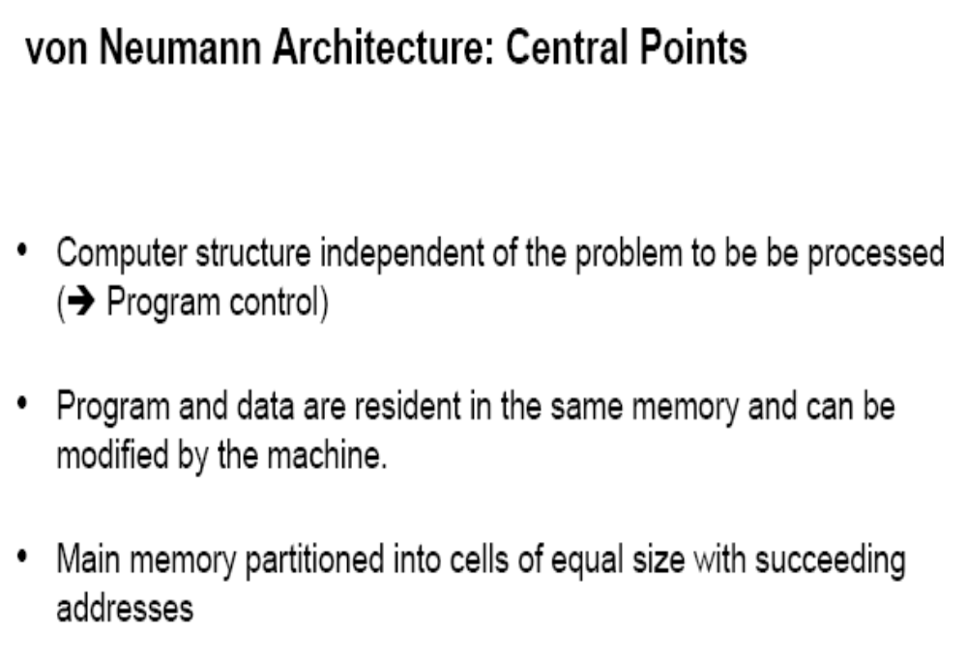

Slide 11
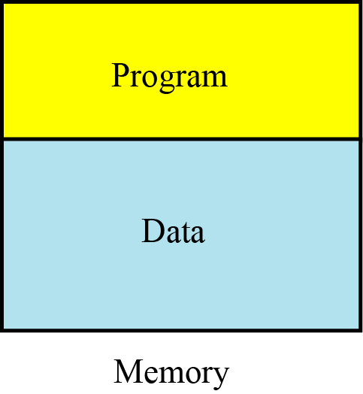
Program and data in memory

Slide 12
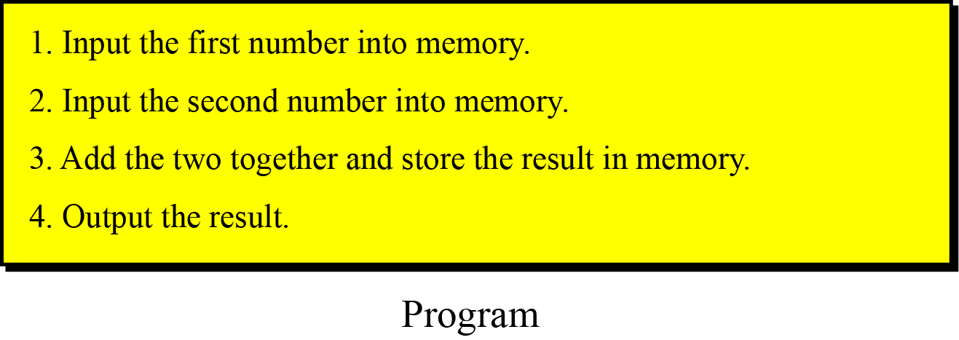
A program made of instructions

Slide 13
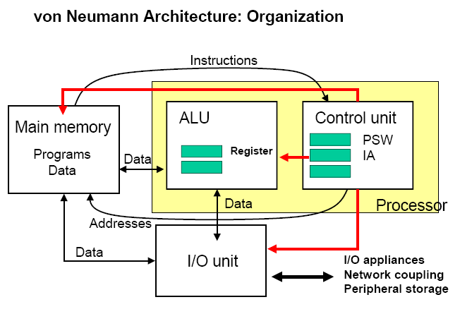
PSW-Processor Status Word (Status Register)
IA- instruction Address

Slide 14
Sequential execution of instructions
A program in the von Neumann model is made of a finite number of instructions. In this model, the control unit fetches one instruction from memory, decodes it, then executes it. In other words, the instructions are executed one after another. Of course, one instruction may request the control unit to jump to some previous or following instruction, but this does not mean that the instructions are not executed sequentially. Sequential execution of a program was the initial requirement of a computer based on the von Neumann model. Today’s computers execute programs in the order that is the most efficient.
→The process that moves information through the sub-components is called the “fetch execute” cycle.

Slide 15
Fetch, Decode, Execute
Imagine that you have written a computer program that has been translated into a set of machine language instructions and placed into memory
Each instruction will pass through three phases: fetch, decode and execute
These 3 steps will be repeated, over and over for every instruction until a HALT instruction is reached (or a fatal error occurs)
Let’s step through the cycle

Slide 16
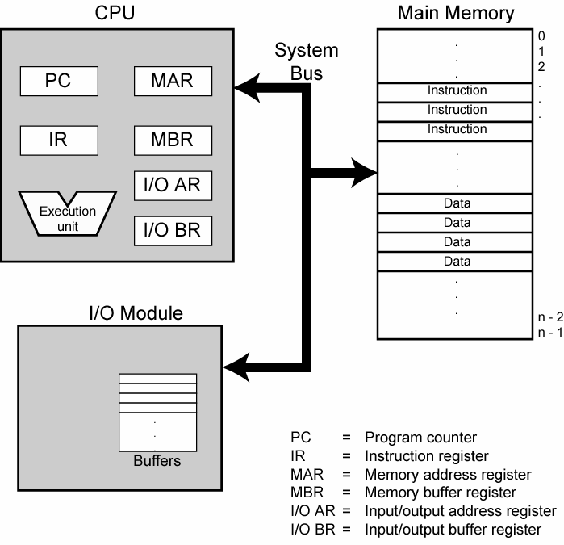

Slide 17
The CPU exchanges data with memory. For this purpose, it typically makes use of two internal (to the CPU) registers:
1.) A memory address register (MAR), which specifies the address in memory for the next read or write.
2.) A memory buffer register (MBR)/(MDR), which contains the data to be written into memory or receives the data read from memory.

Slide 18
Phase One: Fetch
The Control Unit gets the next instruction from memory and moves it into the Instruction Register (IR)
This is accomplished by the following steps:
  The address in the Program Counter (PC) is moved to the MAR (machine address register).
  A fetch is initiated, which brings the contents of the cell referenced by the PC to the MDR (Machine Data Register ).
  Move the instruction from the MDR to the Instruction Register (IR) for decoding
  Increment the PC to point to the next instruction

Slide 19
Phase Two: Decode
The operation code portion of the contents of the instruction register is read from the IR.
The binary number is fed to a decoder circuit, which activates the appropriate circuitry for the operation.

Slide 20
Phase Three: Execution Phase
Once the decoder identifies what operational circuitry should be activated, the particular instruction set member is executed.
Here is a typical series of steps carried out to perform a LOAD operation (which moves contents from main memory to a register)
  Send the address held in the IR to the MAR
  Fetch the contents of the cell whose address is now in the MAR and place the contents into the MDR
  Copy the contents of the MDR into some designated register
Obviously, each instruction set member will require a unique series of steps to be carried out

Slide 21
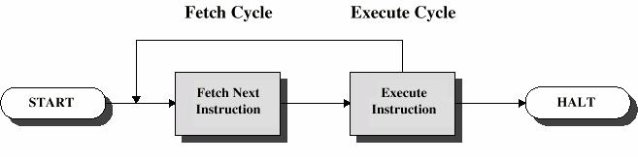

Slide 22
Completing a Program
When one instruction has been executed, the fetch execute cycle moves to the next address.
It can do this because the PC was incremented to reflect the address location of the next executable address
In this way, a series of machine level instructions can be executed, one at a time.

