Slide 1

TOPICS COVERED
Data Communication
  Data Communication Model
  Components of Data Communication Model
  Mode of Transmission
What is Computer Network?
  Network
  Internet
  Network Structure
  Networking Equipments
Types Of Communication Networks
  Classification Based on Coverage
  Classification Based on Topology
  Classification Based on Connection Method
MANAV RACHNA UNIVERSITY.

Slide 2
DATA COMMUNICATION:
Transfer of data from one device to another via transmission medium.
Data can be in any form for e.g. (Text, image, audio, video, numbers etc)
  Transmission Media
      Twisted pairs
      Coaxial cables
      Fiber optics
      Line-of-sight transmission: lasers, infra-red, microwave,
      radio wave etc
      Satellite links
MANAV RACHNA UNIVERSITY.

Slide 3
DATA COMMUNICATION MODEL
Network
MANAV RACHNA UNIVERSITY.
Source
Destination
Basic Communication Model

Slide 4
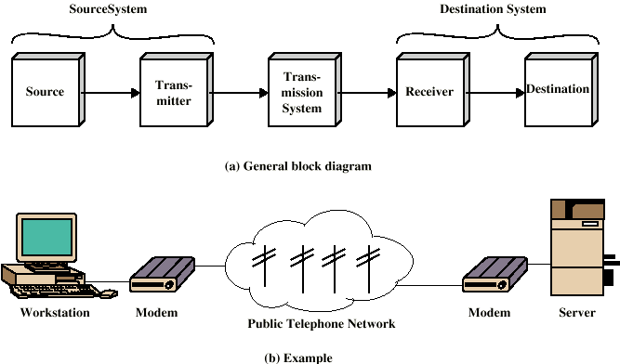
SIMPLIFIED DATA COMMUNICATIONS MODEL
MANAV RACHNA UNIVERSITY.
Contd…

Slide 5
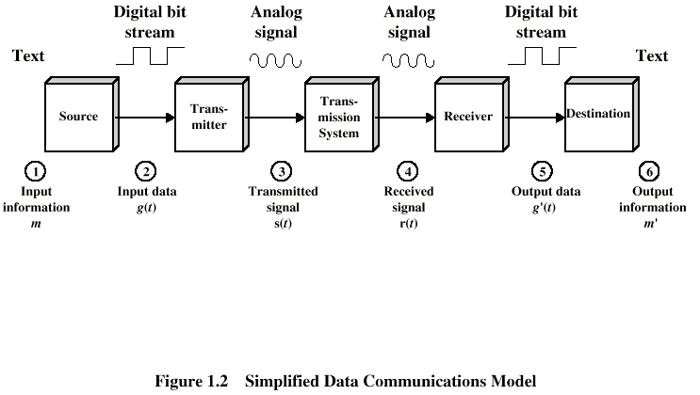
SIMPLIFIED DATA COMMUNICATIONS MODEL
MANAV RACHNA UNIVERSITY.

Slide 6
  Components Of Data Communication:
    Sender
    Receiver
    Message
    Medium
    Protocol
Communication System = Hardware + Software
Efficiency of data communication system depends on four components:
    Delivery
    Accuracy
    Timeliness
    Jitter
Rule 1:
Rule 2:
:
:
Rule n:
Rule 1:
Rule 2:
:
:
Rule n:
Protocol
Protocol
Message
Sender
Receiver
Medium
MANAV RACHNA UNIVERSITY.

Slide 7
COMPONENTS
Source : Generates data to be transmitted
Transmitter : Converts data into transmittable signals
Transmission System : Carries data
Receiver : Converts received signal into data
Destination : Takes incoming data
MANAV RACHNA UNIVERSITY.

Slide 8

Mode of Data Transmission:
Simplex
Half duplex
Full duplex
Direction of Data
Mainframe
Monitor
Station
Direction of data at time 1
Station
MANAV RACHNA UNIVERSITY.
Direction of data at time 2
Station
Direction of data all the time
Station

Slide 9
Synchronous & Asynchronous Transmission
MANAV RACHNA UNIVERSITY.

Slide 10
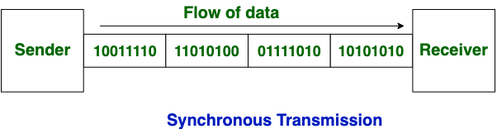
SYNCHRONOUS TRANSMISSION
In Synchronous Transmission, data is sent in form of blocks or frames.
This transmission is the full duplex type. Between sender and receiver the synchronization is compulsory.
In Synchronous transmission, There is no gap present between data. It is more efficient and more reliable than asynchronous transmission to transfer the large amount of data.
MANAV RACHNA UNIVERSITY.

Slide 11
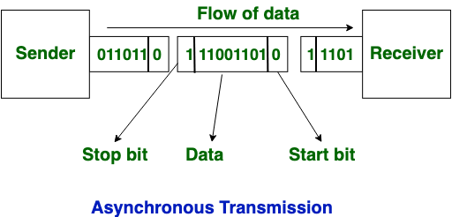
ASYNCHRONOUS TRANSMISSION
In Asynchronous Transmission, data is sent in form of byte or character.
This transmission is the half duplex type transmission. In this transmission start bits and stop bits are added with data. It does not require synchronization.
MANAV RACHNA UNIVERSITY.

Slide 12
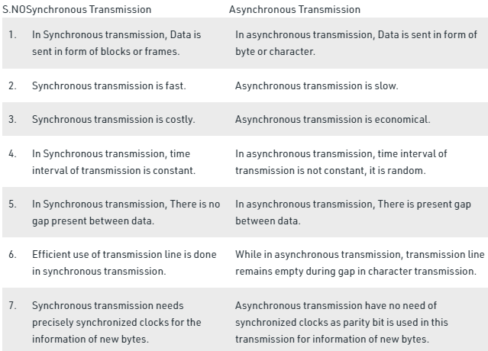
MANAV RACHNA UNIVERSITY.

Slide 13
NETWORK:
A network is a set of communication devices (often referred to as nodes) connected by media links.
  Communicating devices or nodes:
    Computer
    Printer
  Example devices are:
    Mainframes, Minicomputers, Supercomputers
    Workstations, Personal Computers
    Printers, Disk Servers, Robots
    Gateways, Switches, Routers, Bridges
    Cellular phone, Pager etc
MANAV RACHNA UNIVERSITY.

Slide 14
INTERNET: INTERCONNECTION OF NETWORKS
Internet: When two or more networks are connected ,they become an internetwork or internet.
History of the Internet
1969 - Researchers at four US campuses create the first hosts of the ARPANET.
1971 - The ARPANET grows to 23 hosts connecting universities and research centers.
1973 - The ARPANET goes international with connections to England and Norway.
1982 - The term "Internet" was used for the first time and TCP/IP was created.
1992 - Internet Society is chartered. World-Wide Web released by CERN.
MANAV RACHNA UNIVERSITY.

Slide 15
INTERNET TODAY:
Today internet is made up of many WAN and LAN joined by connecting devices and switching stations.
Today most of the end users uses the services of Internet service providers (ISP).
Different ISPs:
  International Service Provider (ISP): Connects nations together.
  National Service Provider (NSP): These are backbone networks created and maintained by specialized companies. Backbone networks are connected by complex switching networks called NAP (network access points).
  Regional Internet Service Provider: These are smaller ISP that are connected to one or more national ISP .
  Local Internet Service Provider: The local ISPs can be connected to regional ISP or directly to national ISP. They provides direct service to end users.
MANAV RACHNA UNIVERSITY.

Slide 16

NETWORK STRUCTURE
Point-to-Point Networks
  Each communication line connects a pair of nodes.
  A packet (or message) is transmitted from one node to another.
  Intermediate nodes receive and store entire packet and then forward to the next node.
  Also called “Store-and-Forward” or “Packet-Switching”.
  Some topologies : Star, Ring, Tree.
Dedicated link
MANAV RACHNA UNIVERSITY.

Slide 17

Broadcast / Multi-Point Networks
  Have a single communication line shared by all computers on the network.
  Packets sent by a host are received by all computers.
  Some Topologies: Bus, Satellite, Radio.
Multiple Access / Shared Medium
MANAV RACHNA UNIVERSITY.

Slide 18
NETWORKING EQUIPMENT
HUB
A hub is the device at which data converges from one or more directions and is forwarded out in one or more directions.
Seen in local area networks
BRIDGE
A bridge is a product that connects a local area network (LAN) to another local area network that uses the same protocol (for example, Ethernet or token ring).
A bridge examines each message on a LAN, "passing" those known to be within the same LAN, and forwarding those known to be on the other interconnected LAN (or LANs).
SWITCHES
Allow different nodes of a network to communicate directly with each other.
Allow several users to send information over a network at the same time without slowing each other down.
MANAV RACHNA UNIVERSITY.

Slide 19
ROUTER
A router is a device or a software in a computer that determines the next network point to which a packet should be forwarded toward its destination.
Allow different networks to communicate with each other.
A router creates and maintain a table of the available routes and their conditions and uses this information along with distance and cost algorithms to determine the best route for a given packet.
A packet will travel through a number of network points with routers before arriving at its destination.
GATEWAY
A gateway is a network point that acts as an entrance to another network.
Gateway nodes are computers that control traffic within the company’s network or at the local Internet Service Provider (ISP).
MANAV RACHNA UNIVERSITY.

Slide 20
WHAT IS THE DIFFERENCE BETWEEN?
BRIDGE : Device to interconnect two LANs that use the SAME logical link control protocol but may use different medium access control protocols.
ROUTER : Device to interconnect SIMILAR networks, e.g. similar protocols and workstations and servers.
GATEWAY : Device to interconnect DISSIMILAR protocols and servers, e.g. Macintosh and IBM LANs and equipment.
MANAV RACHNA UNIVERSITY.

Slide 21
TYPES OF COMMUNICATION NETWORKS
Communication Networks can be categories into different types based on the following factors:
  Coverage
      (LAN,WAN,MAN)
  Topology
      (Bus, Ring, Star, Tree, Hybrid, Mesh, Irregular)
  Connection method
        (Wireless and Wired Technologies)
MANAV RACHNA UNIVERSITY.

Slide 22
CLASSIFICATION ACCORDING COVERAGE
Local Area Networks (LANs)
Small interconnected of personal computers or workstations and printers within a building or small area up to 10 Kms.
Ownership usually by a single organization.
Very high transmission rates (100s Mb/s to G bytes/s).
LAN equipment usually owned by organization. Medium may be owned or leased from telephone company provider or common carrier.
Twisted pair, fiber optics etc are used in LAN to servers.
Examples: Ethernet, IBM Token Ring, Token Bus, FDDI, Fast Ethernet, ATM, Gigabit Ethernet.
MANAV RACHNA UNIVERSITY.

Slide 23
  Metropolitan Area Networks (MANs)
    up to 50 km
    fiber optics is a popular technology for MANs
    may be private or public
    may involve a number of organizations
    Examples: cable TV networks , ATM networks
  Wide Area Networks (WANs)
    a few km to thousands of km
    point-to-point networks (also called long-haul networks)
    lower data transmission rate than LANs
    fiber optics is a popular technology for MANs ownership usually by more than a single organization
    Examples: ARPANET, MILNET (US military), Internet
MANAV RACHNA UNIVERSITY.

Slide 24
NETWORK TOPOLOGIES
NODE : anything connected to the network, usually a computer, but it could be a printer or a scanner
SEGMENT : any portion of a network that is separated by a switch,
bridge or a router from another part of a network.
BACKBONE : the main cabling of a network that all of the segment
connect to. Usually, the backbone is capable of carrying
more information than the individual segments.
TOPOLOGY : The way each node is physically connected to the
network.
MANAV RACHNA UNIVERSITY.

Slide 25
Network Topologies Classification
MANAV RACHNA UNIVERSITY.

Slide 26
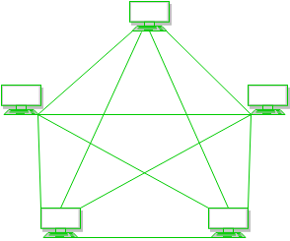
MESH TOPOLOGY
In a mesh topology, every device is connected to another device via the particular channel.
Every device is connected with another via dedicated channels. These channels are known as links.
MANAV RACHNA UNIVERSITY.

Slide 27
If suppose, N number of devices are connected the total number of ports that are required by each device is N-1.
If suppose, N number of devices are connected with each other in a mesh topology, then a total number of dedicated links required to connect them is ^{N}C₂ i.e. N(N-1)/2.
Advantages:
  It is robust.
  Data is reliable because data is transferred among the devices through dedicated channels or links.
  Provides security and privacy.
Problems :
  Installation and configuration are difficult.
  The cost of cables is high as bulk wiring is required, hence suitable for less number of devices.
  The cost of maintenance is high.
MANAV RACHNA UNIVERSITY.

Slide 28
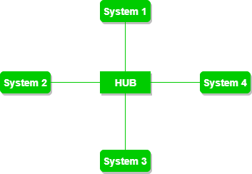
STAR TOPOLOGY
In star topology, all the devices are connected to a single hub through a cable.
This hub is the central node and all other nodes are connected to the central node.
The hub can be passive or active in nature
MANAV RACHNA UNIVERSITY.

Slide 29
Advantages of this topology :
  If N devices are connected to each other in a star topology, then the number of cables required to connect them is N. So, it is easy to set up.
  Each device requires only 1 port i.e. to connect to the hub, therefore total number of ports required is N.
Problems with this topology :
  If the concentrator (hub) on which the whole topology relies fails, the whole system will crash down.
  The cost of installation is high.
  Performance is based on the single concentrator i.e. hub.
MANAV RACHNA UNIVERSITY.

Slide 30
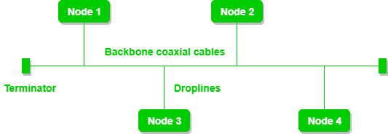
BUS TOPOLOGY
Bus topology is a network type in which every computer and network device is connected to a single cable.
It transmits the data from one end to another in a single direction.
No bi-directional feature is in bus topology. It is a multi-point connection and a non-robust topology because if the backbone fails the topology crashes.
MANAV RACHNA UNIVERSITY.

Slide 31
Advantages of this topology :
  If N devices are connected to each other in a bus topology, then the number of cables required to connect them is 1, which is known as backbone cable, and N drop lines are required.
  The cost of the cable is less as compared to other topologies, but it is used to build small networks.
Problems with this topology :
  If the common cable fails, then the whole system will crash down.
  If the network traffic is heavy, it increases collisions in the network. To avoid this, various protocols are used in the MAC layer known as Pure Aloha, Slotted Aloha, CSMA/CD, etc.
  Security is very low.
MANAV RACHNA UNIVERSITY.

Slide 32
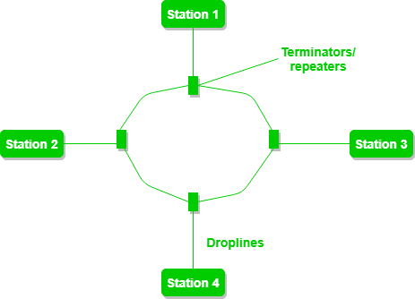
RING TOPOLOGY
In this topology, it forms a ring connecting devices with its exactly two neighboring devices.
A number of repeaters are used for Ring topology with a large number of nodes,
The transmission is unidirectional, but it can be made bidirectional by having 2 connections between each Network Node, it is called Dual Ring Topology.
MANAV RACHNA UNIVERSITY.

Slide 33
One station is known as monitor station which takes all the responsibility to perform the operations.
To transmit the data, the station has to hold the token. After the transmission is done, the token is to be released for other stations to use.
When no station is transmitting the data, then the token will circulate in the ring.
Advantages of this topology :
  The possibility of collision is minimum in this type of topology.
Problems with this topology :
  Troubleshooting is difficult in this topology.
  The addition of stations in between or removal of stations can disturb the whole topology.
  Less secure.
MANAV RACHNA UNIVERSITY.

Slide 34
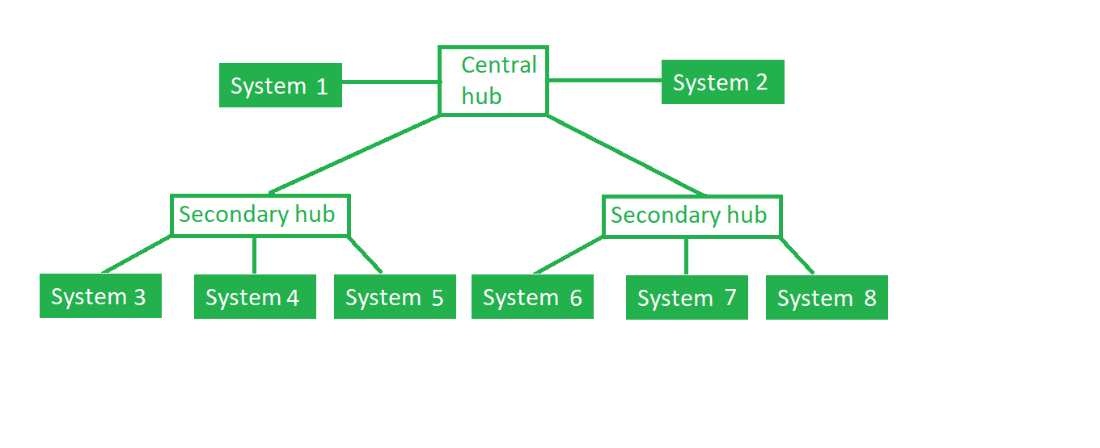
TREE TOPOLOGY
This topology is the variation of Star topology. This topology has a hierarchical flow of data.
In this, the various secondary hubs are connected to the central hub which contains the repeater. In this data flow from top to bottom i.e. from the central hub to secondary and then to the devices or from bottom to top i.e. devices to the secondary hub and then to the central hub. It is a multi-point
MANAV RACHNA UNIVERSITY.

Slide 35
Advantages of this topology :
  It allows more devices to be attached to a single central hub thus it increases the distance that is travel by the signal to come to the devices.
  It allows the network to get isolate and also prioritize from different computers.
Problems with this topology :
  If the central hub gets fails the entire system fails.
  The cost is high because of cabling.
MANAV RACHNA UNIVERSITY.

Slide 36
CLASSIFICATION ACCORDING TYPES OF CONNECTION
WIRED TECHNOLOGIES:
Twisted-Pair Wire - This is the most widely used medium for telecommunication. Twisted-pair wires are ordinary telephone wires which consist of two insulated copper wires twisted into pairs and are used for both voice and data transmission. The use of two wires twisted together helps to reduce crosstalk and electromagnetic induction. The transmission speed ranges from 2 million bits per second to 100 million bits per second.
Coaxial Cable – These cables are widely used for cable television systems, office buildings, and other worksites for local area networks. The cables consist of copper or aluminum wire wrapped with insulating layer typically of a flexible material with a high dielectric constant, all of which are surrounded by a conductive layer. The layers of insulation help minimize interference and distortion. Transmission speed range from 200 million to more than 500 million bits per second.
MANAV RACHNA UNIVERSITY.

Slide 37
Fiber Optics – These cables consist of one or more thin filaments of glass fiber wrapped in a protective layer. It transmits light which can travel over long distance and higher bandwidths. Fiber-optic cables are not affected by electromagnetic radiation. Transmission speed could go up to as high as trillions of bits per second. The speed of fiber optics is hundreds of times faster than coaxial cables and thousands of times faster than twisted-pair wire.
WIRELESS TECHNOLOGIES:
Terrestrial Microwave – Terrestrial microwaves use Earth-based transmitter and receiver. The equipment look similar to satellite dishes. Terrestrial microwaves use low-gigahertz range, which limits all communications to line-of-sight. Path between relay stations spaced approx. 30 miles apart. Microwave antennas are usually placed on top of buildings, towers, hills, and mountain peaks.
Communications Satellites – The satellites use microwave radio as their telecommunications medium which are not deflected by the Earth's atmosphere. The satellites are stationed in space, typically 22,000 miles above the equator. These Earth-orbiting systems are capable of receiving and relaying voice, data, and TV signals.
MANAV RACHNA UNIVERSITY.

Slide 38
WIRELESS TECHNOLOGIES(contd…)
Cellular Systems – Use several radio communications technologies. The systems are divided to different geographic area. Each area has low-power transmitter or radio relay antenna device to relay calls from one area to the next area.
Wireless LANs – Wireless local area network use a high-frequency radio technology similar to digital cellular and a low-frequency radio technology. Wireless LANs use spread spectrum technology to enable communication between multiple devices in a limited area. Example of open-standard wireless radio-wave protocol is IEEE 802.11b (Wi-Fi).
MANAV RACHNA UNIVERSITY.

