Slide 1
Computer Networks
OSI Model & Introduction to TCP/IP
MANAV RACHNA UNIVERSITY.
Notes:
Manav Rachna College of Engineering

Slide 2
CONTENTS
THE OSI MODEL
LAYERS IN THE OSI MODEL
TCP/IP PROTOCOL SUITE
ADDRESSING
TCP/IP VERSIONS
MANAV RACHNA UNIVERSITY.

Slide 3
2.1
THE
OSI
MODEL
MANAV RACHNA UNIVERSITY.

Slide 4

ISO is the organization.
OSI is the model.
MANAV RACHNA UNIVERSITY.

Slide 5
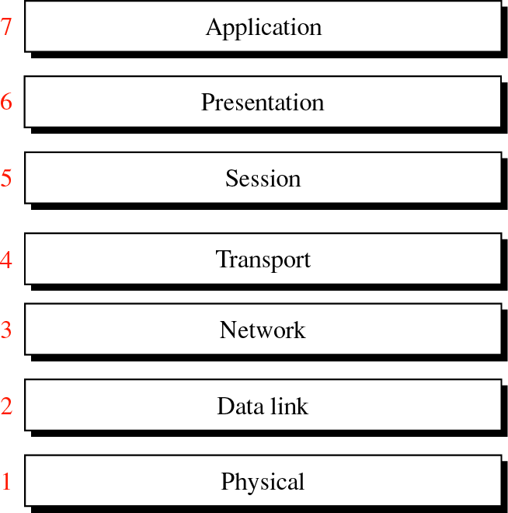
Figure 2-1
OSI
Model
MANAV RACHNA UNIVERSITY.

Slide 6
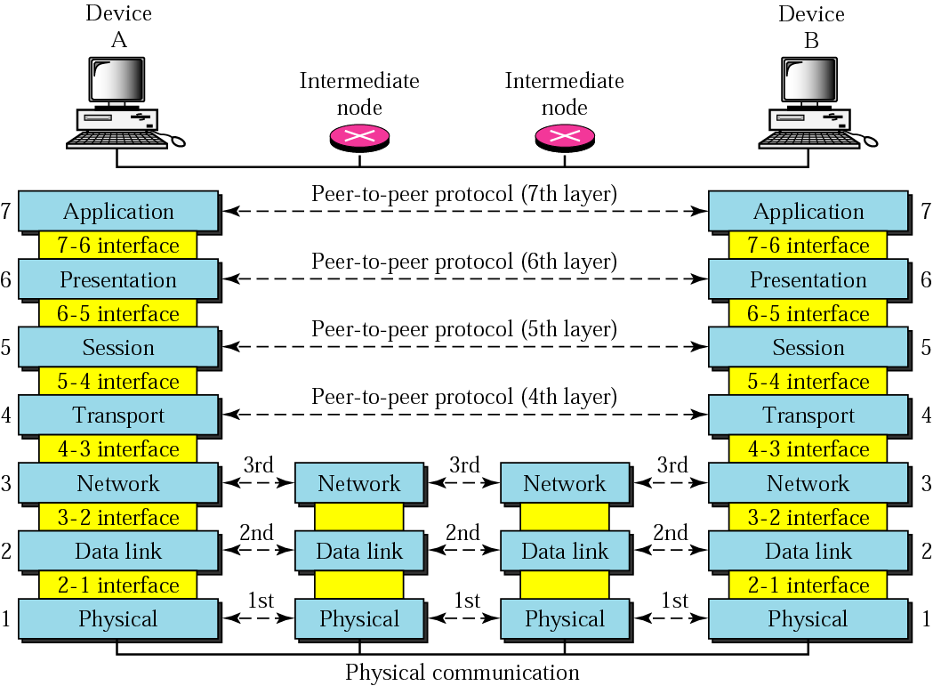
Figure 2-2
OSI layers
MANAV RACHNA UNIVERSITY.

Slide 7
Headers are added
to the data at layers
6, 5, 4, 3, and 2.
Trailers are usually
added only at layer 2.
MANAV RACHNA UNIVERSITY.

Slide 8
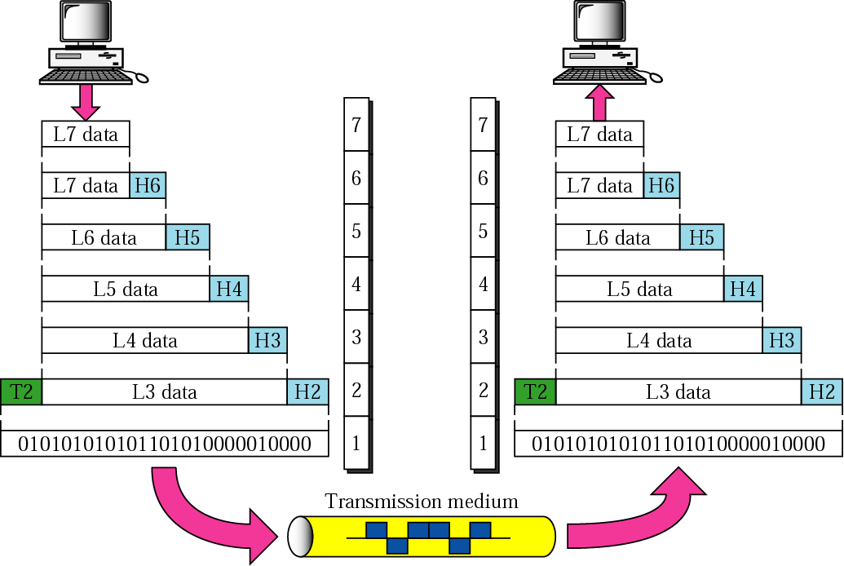
Figure 2-3
An exchange using the OSI model
MANAV RACHNA UNIVERSITY.

Slide 9
2.2
LAYERS
IN
THE
OSI
MODEL
MANAV RACHNA UNIVERSITY.

Slide 10
LAYER 1 – THE PHYSICAL LAYER
Converts bits into electronic signals for outgoing messages
Converts electronic signals into bits for incoming messages
This layer manages the interface between the computer and the network medium (coaxial, twisted pair, etc.)
This layer tells the driver software for the MAU (media attachment unit( ex. network interface cards like modems)) what needs to be sent across the medium
The bottom layer of the OSI model
SUMMARY: The physical layer is responsible for movements of individual bits from one hop (node) to the next.
MANAV RACHNA UNIVERSITY.

Slide 11
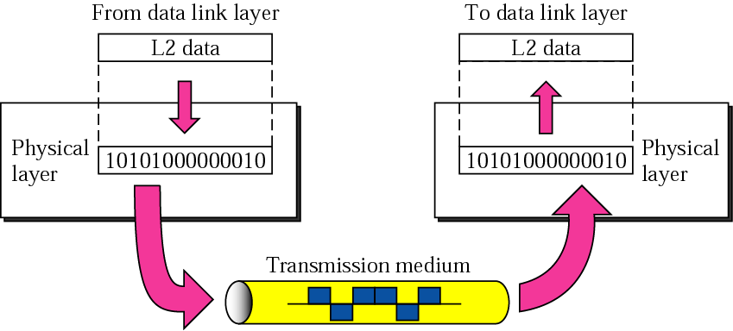
Figure 2-4
Physical Layer
MANAV RACHNA UNIVERSITY.

Slide 12
LAYER 2 – THE DATA LINK LAYER
Handles special data frames (packets) between the Network layer and the Physical layer.
At the receiving end, this layer packages raw data from the physical layer into data frames for delivery to the Network layer.
At the sending end this layer handles conversion of data into raw formats that can be handled by the Physical Layer.
SUMMARY: The data link layer is responsible for moving frames from one hop (node) to the next.
MANAV RACHNA UNIVERSITY.

Slide 13
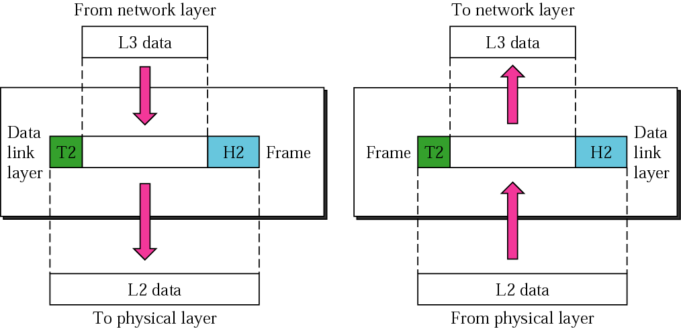
Figure 2-5
Data Link Layer
MANAV RACHNA UNIVERSITY.

Slide 14

HOP-TO-HOP DELIVERY
MANAV RACHNA UNIVERSITY.

Slide 15
LAYER 3 – THE NETWORK LAYER
Handles addressing messages for delivery, as well as translating logical network addresses and names into their physical counterparts
Responsible for deciding how to route transmissions between computers
This layer also handles the decisions needed to get data from one point to the next point along a network path
This layer also handles packet switching and network congestion control
SUMMARY: The network layer is responsible for the delivery of individual packets from the source host to the destination host.
MANAV RACHNA UNIVERSITY.

Slide 16
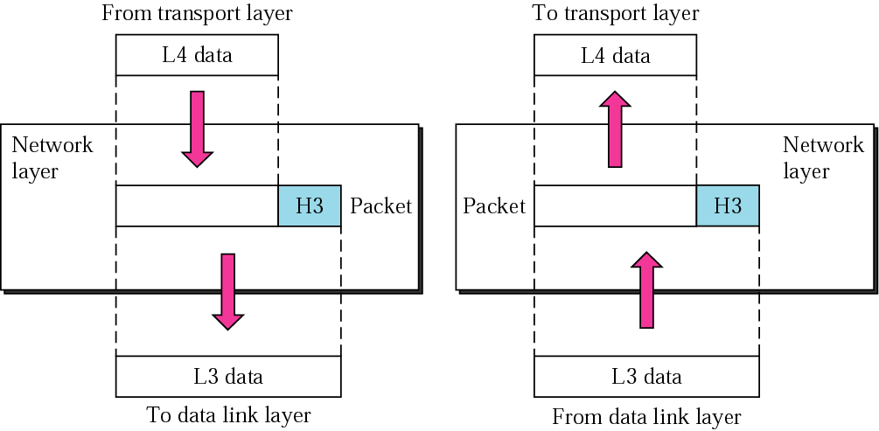
Figure 2-7
Network Layer
MANAV RACHNA UNIVERSITY.

Slide 17

SOURCE TO DESTINATION DELIVERY
MANAV RACHNA UNIVERSITY.

Slide 18
LAYER 4 – THE TRANSPORT LAYER
Manages the transmission of data across a network
Manages the flow of data between parties by segmenting long data streams into smaller data chunks (based on allowed “packet” size for a given transmission medium)
Reassembles chunks into their original sequence at the receiving end
Provides acknowledgements of successful transmissions and requests resends for packets which arrive with errors
SUMMARY: The transport layer is responsible for the delivery of a message from one process to another.
MANAV RACHNA UNIVERSITY.

Slide 19
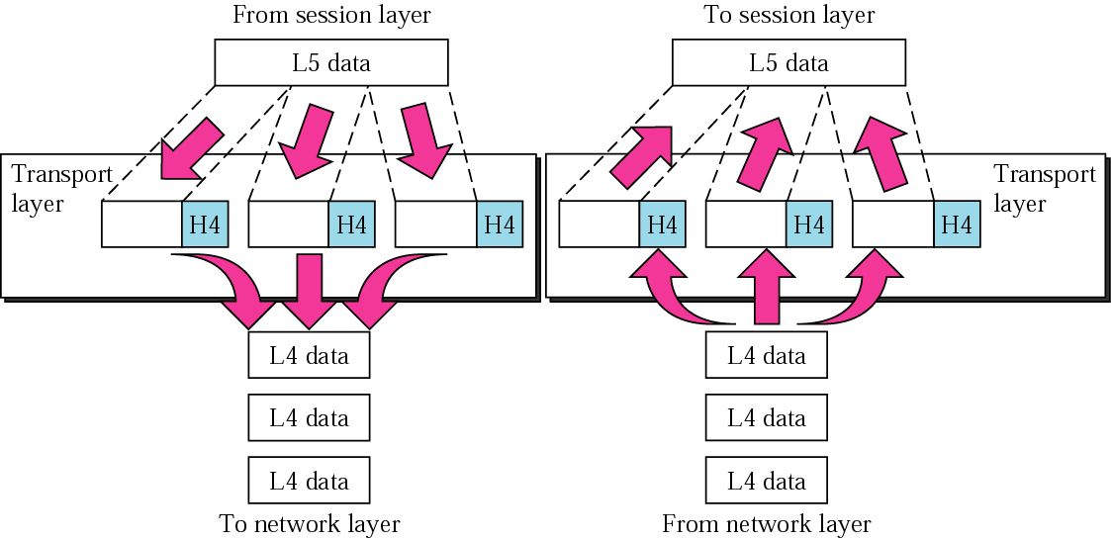
Figure 2-9
Transport Layer
MANAV RACHNA UNIVERSITY.

Slide 20
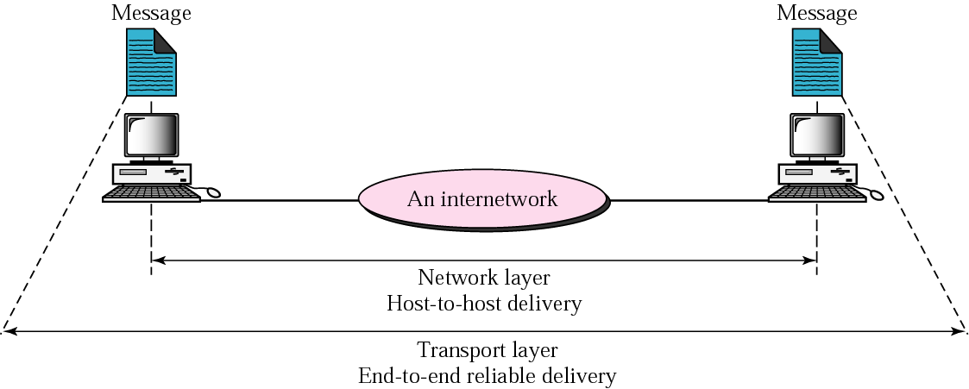
Figure 2-10
Reliable Process To Process Delivery of a message
MANAV RACHNA UNIVERSITY.

Slide 21
LAYER 5 – THE SESSION LAYER
Enables two networked resources to hold ongoing communications (called a session) across a network
Applications on either end of the session are able to exchange data for the duration of the session
Responsible for initiating, maintaining and terminating sessions
Responsible for security and access control to session information (via session participant identification)
Responsible for synchronization services, and for checkpoint services
SUMMARY: The session layer is responsible for dialog control and synchronization.
MANAV RACHNA UNIVERSITY.

Slide 22
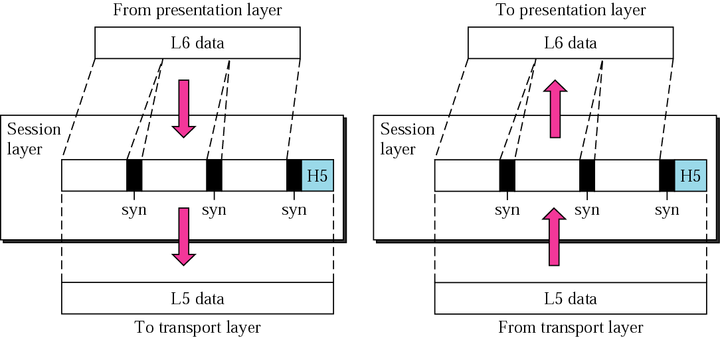
Figure 2-11
Session Layer
MANAV RACHNA UNIVERSITY.

Slide 23
LAYER 6 – THE PRESENTATION LAYER
Manages data-format information for networked communications (the network’s translator).
Responsible for Conversion of data.
This layer is also responsible for certain protocol conversions, data encryption/decryption, or data compression/decompression.
A special software facility called a “redirector” operates at this layer to determine if a request is network related on not and forward network-related requests to an appropriate network resource .
SUMMARY: Responsible for data security.
MANAV RACHNA UNIVERSITY.

Slide 24
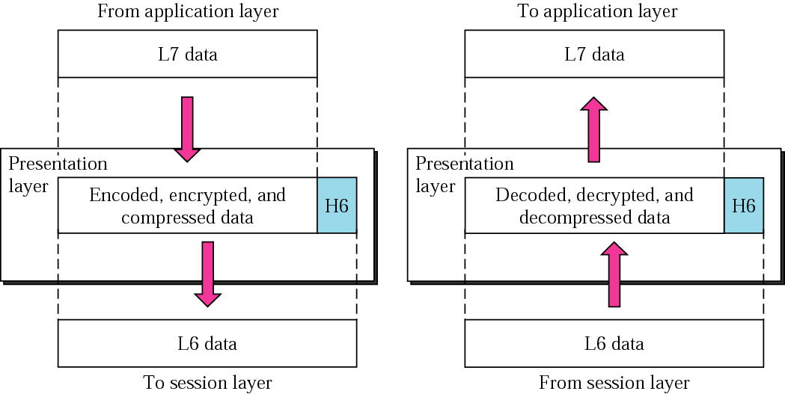
Figure 2-12
Presentation Layer
MANAV RACHNA UNIVERSITY.

Slide 25
LAYER 7 – THE APPLICATION LAYER
The top layer of the OSI model .
Provides a set of interfaces for sending and receiving applications to gain access to and use network services, such as: networked file transfer, message handling and database query processing.
SUMMARY: The application layer is responsible for providing services to the user.
MANAV RACHNA UNIVERSITY.

Slide 26
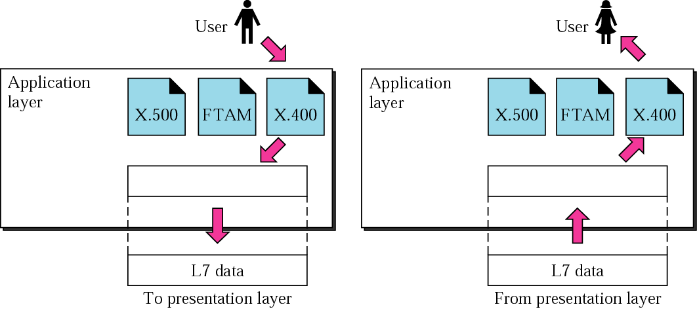
Figure 2-13
Application Layer
MANAV RACHNA UNIVERSITY.

Slide 27
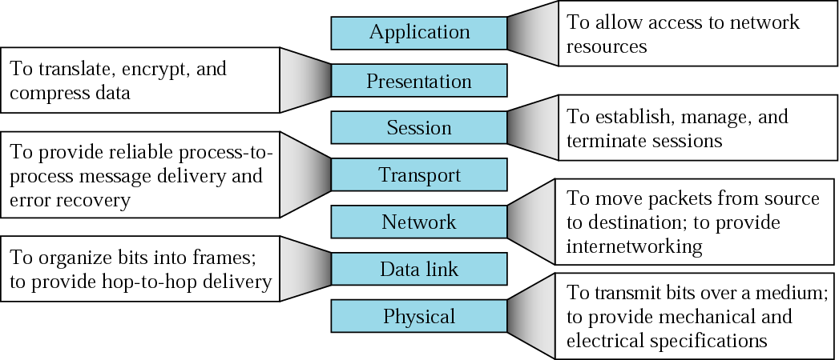
Figure 2-14
Summary of layers
MANAV RACHNA UNIVERSITY.

Slide 28
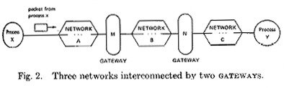
TCP/IP MOTIVATION
ARPA wanted to connect several separate, dissimilar networks to create an internetwork.
MANAV RACHNA UNIVERSITY.
Above is a figure from the paper proposing TCP, an internetworking protocol …
Notes:
Figure from the paper referenced in the following slide.

Slide 29
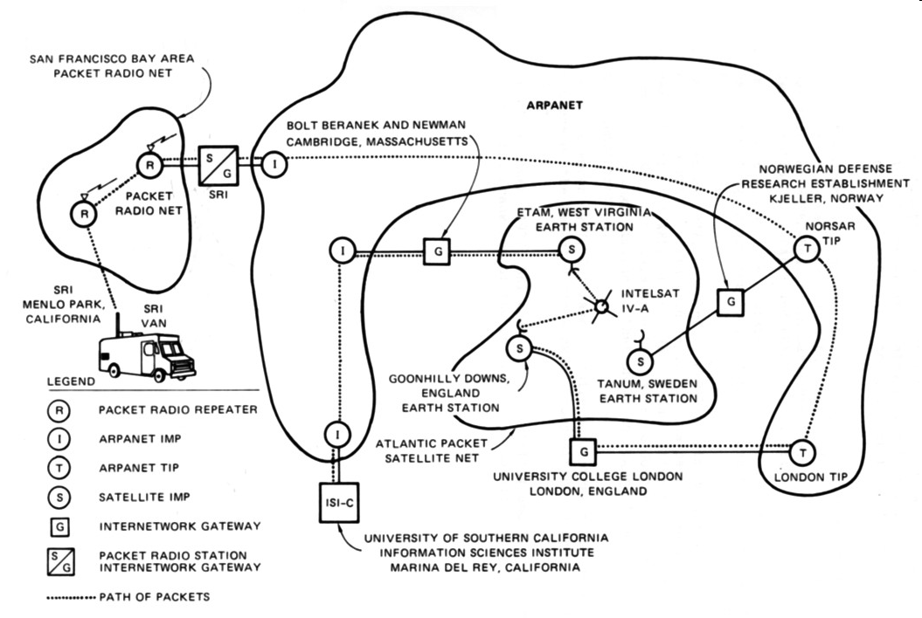
TCP DEMONSTRATION, OCTOBER 1977
MANAV RACHNA UNIVERSITY.
Interconnected three networks: ARPANet, SATNet, and the San Francisco Bay area packet radio network
Notes:
http://www.sri.com/about/timeline/images/1977map_000.jpg

Slide 30
TCP/IP MILESTONES
March 1978, TCP split into TCP and IP because packet voice applications required fast transport without error checking (UDP)
January 1 1983, ARPAnet converts to TCP/IP, and splits into Milnet for operational applications and ARPANet for research
1985, The U.S. National Science Foundation initiates the NSFNET program with the goal of connecting all US and many foreign universities
1986, NSF deploys a six node network with 56 Kbps links using TCP/IP
MANAV RACHNA UNIVERSITY.
Which day was the “birth of the Internet?”

Slide 31
2.3
TCP/IP
PROTOCOL
SUITE
MANAV RACHNA UNIVERSITY.

Slide 32
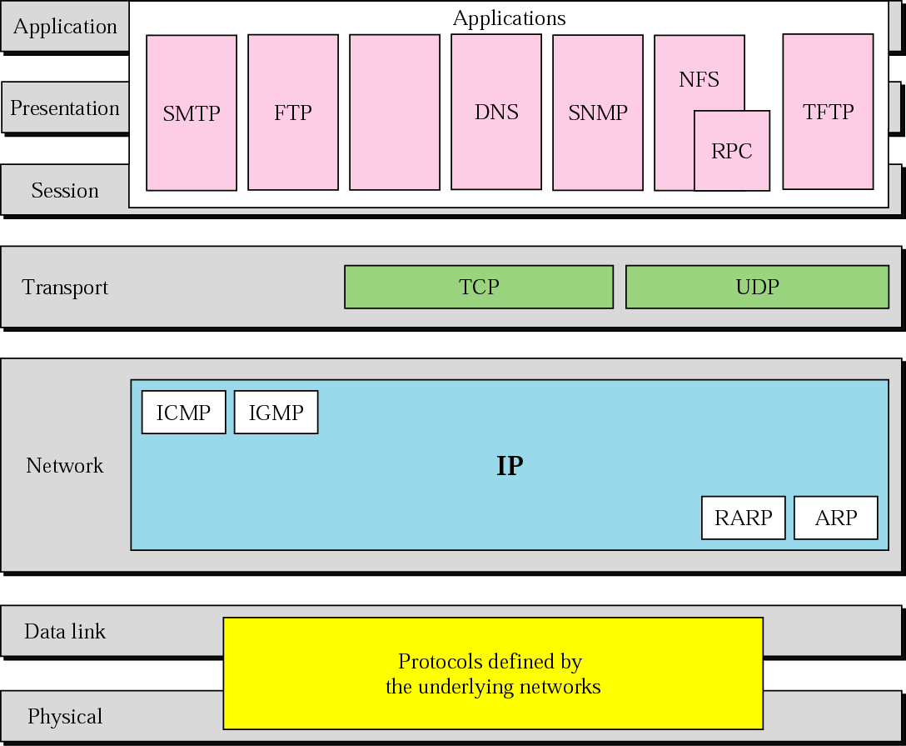
Figure 2-15
TCP/IP and OSI model
MANAV RACHNA UNIVERSITY.

Slide 33
2.4
ADDRESSING
MANAV RACHNA UNIVERSITY.

Slide 34
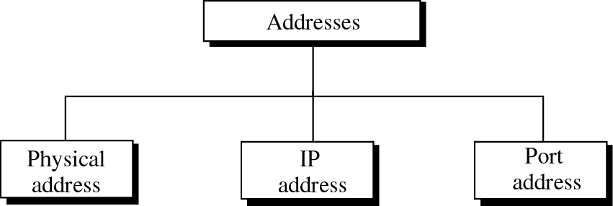
Figure 2-16
Addresses in TCP/IP
MANAV RACHNA UNIVERSITY.

Slide 35
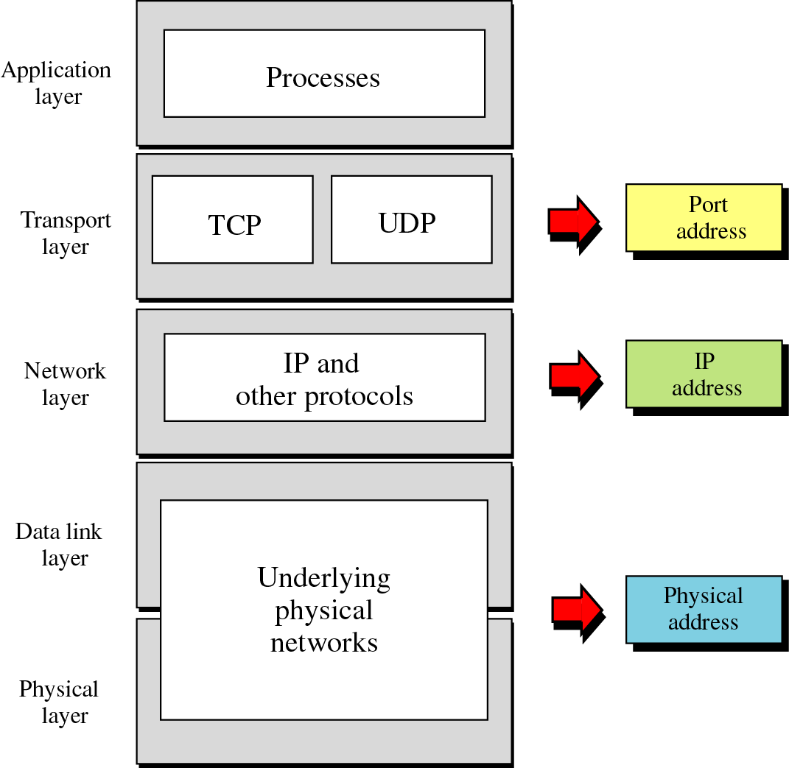
Figure 2-17
Relation-
ship
of
layers
and
addresses
in TCP/IP
MANAV RACHNA UNIVERSITY.

Slide 36
Example 1
Figure 2.18 shows an example of physical addresses.
MANAV RACHNA UNIVERSITY.

Slide 37
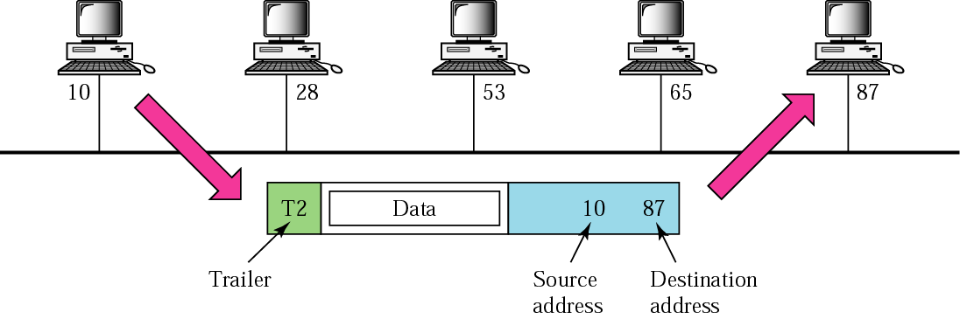
Figure 2-18
Physical addresses
MANAV RACHNA UNIVERSITY.

Slide 38
Example 2
Most local area networks use a 48-bit (6 bytes) physical address written as 12 hexadecimal digits, with every 2 bytes separated by a hyphen as shown below:
MANAV RACHNA UNIVERSITY.
07-01-02-01-2C-4B
A 6-byte (12 hexadecimal digits) physical address

Slide 39
Example 3
Figure 2.19 shows an example of Internet addresses.
MANAV RACHNA UNIVERSITY.

Slide 40
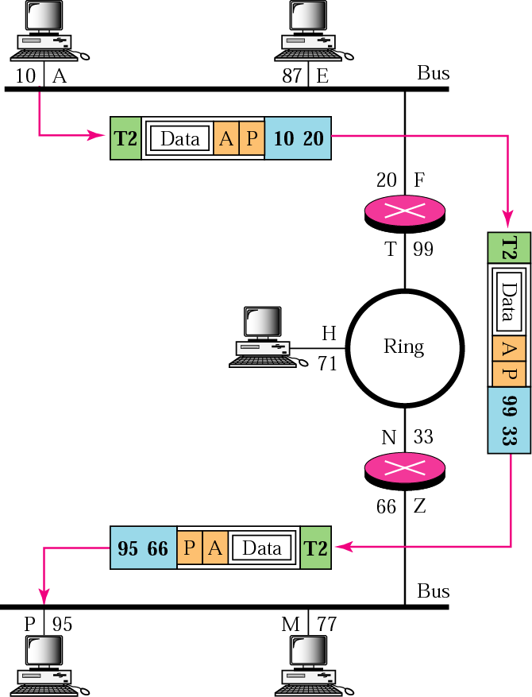
Figure 2-19
IP addresses
MANAV RACHNA UNIVERSITY.

Slide 41
Example 4
As we will see in Chapter 4, an Internet address (in IPv4) is 32 bits in length, normally written as four decimal numbers, with each number representing 1 byte. The numbers are separated by a dot. Below is an example of such an address.
MANAV RACHNA UNIVERSITY.
132.24.75.9

Slide 42
Example 5
Figure 2.20 shows an example of transport layer communication.
MANAV RACHNA UNIVERSITY.

Slide 43
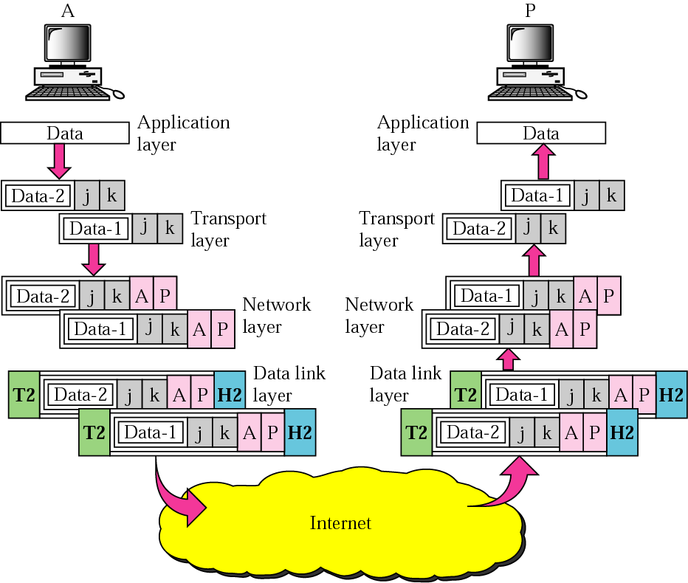
Figure 2-20
Port addresses
MANAV RACHNA UNIVERSITY.

Slide 44
Example 6
As we will see in Chapters 11 and 12, a port address is a 16-bit address represented by one decimal number as shown below.
MANAV RACHNA UNIVERSITY.
753 A 16-bit port address

Slide 45
TCP/IP MODEL
The TCP/IP model was developed prior to the OSI model.
The TCP/IP model is not exactly similar to the OSI model.
The TCP/IP model consists of five layers: the application layer, transport layer, network layer, data link layer and physical layer.
TCP/IP is a hierarchical protocol made up of interactive modules, and each of them provides specific functionality.
Here, hierarchical means that each upper-layer protocol is supported by two or more lower-level protocols.
MANAV RACHNA UNIVERSITY.

Slide 46
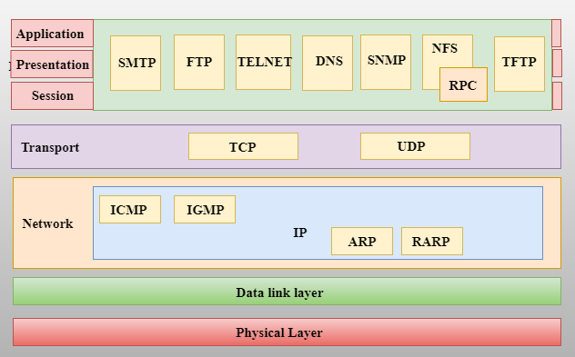
Functions of TCP/IP layers
MANAV RACHNA UNIVERSITY.

Slide 47
NETWORK ACCESS LAYER
A network layer is the lowest layer of the TCP/IP model.
A network layer is the combination of the Physical layer and Data Link layer defined in the OSI reference model.
It defines how the data should be sent physically through the network.
This layer is mainly responsible for the transmission of the data between two devices on the same network.
The functions carried out by this layer are encapsulating the IP datagram into frames transmitted by the network and mapping of IP addresses into physical addresses.
The protocols used by this layer are ethernet, token ring, FDDI, X.25, frame relay.
MANAV RACHNA UNIVERSITY.

Slide 48
INTERNET LAYER
An internet layer is the second layer of the TCP/IP model.
An internet layer is also known as the network layer.
The main responsibility of the internet layer is to send the packets from any network, and they arrive at the destination irrespective of the route they take.
Following are the protocols used in this layer are:
IP Protocol: IP protocol is used in this layer, and it is the most significant part of the entire TCP/IP suite.
Following are the responsibilities of this protocol:
  IP Addressing:
  Host-to-host communication:
  Data Encapsulation and Formatting:
  Fragmentation and Reassembly:
  Routing
MANAV RACHNA UNIVERSITY.

Slide 49
ARP PROTOCOL
ARP stands for Address Resolution Protocol.
ARP is a network layer protocol which is used to find the physical address from the IP address.
The two terms are mainly associated with the ARP Protocol:
  ARP request: When a sender wants to know the physical address of the device, it broadcasts the ARP request to the network.
  ARP reply: Every device attached to the network will accept the ARP request and process the request, but only recipient recognize the IP address and sends back its physical address in the form of ARP reply. The recipient adds the physical address both to its cache memory and to the datagram header
MANAV RACHNA UNIVERSITY.

Slide 50
ICMP PROTOCOL
ICMP stands for Internet Control Message Protocol.
It is a mechanism used by the hosts or routers to send notifications regarding datagram problems back to the sender.
A datagram travels from router-to-router until it reaches its destination. If a router is unable to route the data because of some unusual conditions such as disabled links, a device is on fire or network congestion, then the ICMP protocol is used to inform the sender that the datagram is undeliverable.
MANAV RACHNA UNIVERSITY.

Slide 51
ICMP PROTOCOL
An ICMP protocol mainly uses two terms:
  ICMP Test: ICMP Test is used to test whether the destination is reachable or not.
  ICMP Reply: ICMP Reply is used to check whether the destination device is responding or not.
The core responsibility of the ICMP protocol is to report the problems, not correct them. The responsibility of the correction lies with the sender.
ICMP can send the messages only to the source, but not to the intermediate routers because the IP datagram carries the addresses of the source and destination but not of the router that it is passed to.
MANAV RACHNA UNIVERSITY.

Slide 52
TRANSPORT LAYER
The transport layer is responsible for the reliability, flow control, and correction of data which is being sent over the network.
The two protocols used in the transport layer are User Datagram protocol and Transmission control protocol.
User Datagram Protocol (UDP)
  It provides connectionless service and end-to-end delivery of transmission.
  It is an unreliable protocol as it discovers the errors but not specify the error.
  User Datagram Protocol discovers the error, and ICMP protocol reports the error to the sender that user datagram has been damaged.
  UDP consists of the following fields:
  Source port address
  Destination port address
  Total length
  Checksum
MANAV RACHNA UNIVERSITY.

Slide 53
TRANSMISSION CONTROL PROTOCOL (TCP)
It provides a full transport layer services to applications.
It creates a virtual circuit between the sender and receiver, and it is active for the duration of the transmission.
TCP is a reliable protocol as it detects the error and retransmits the damaged frames. Therefore, it ensures all the segments must be received and acknowledged before the transmission is considered to be completed and a virtual circuit is discarded.
At the sending end, TCP divides the whole message into smaller units known as segment, and each segment contains a sequence number which is required for reordering the frames to form an original message.
At the receiving end, TCP collects all the segments and reorders them based on sequence numbers.
MANAV RACHNA UNIVERSITY.

Slide 54
APPLICATION LAYER
An application layer is the topmost layer in the TCP/IP model.
It is responsible for handling high-level protocols, issues of representation.
This layer allows the user to interact with the application.
When one application layer protocol wants to communicate with another application layer, it forwards its data to the transport layer.
There is an ambiguity occurs in the application layer. Every application cannot be placed inside the application layer except those who interact with the communication system. For example: text editor cannot be considered in application layer while web browser using HTTP protocol to interact with the network where HTTP protocol is an application layer protocol.
MANAV RACHNA UNIVERSITY.

Slide 55
PROTOCOLS USED AT APPLICATION LAYER
HTTP: HTTP stands for Hypertext transfer protocol. This protocol allows us to access the data over the world wide web. It transfers the data in the form of plain text, audio, video. It is known as a Hypertext transfer protocol as it has the efficiency to use in a hypertext environment where there are rapid jumps from one document to another.
SNMP: SNMP stands for Simple Network Management Protocol. It is a framework used for managing the devices on the internet by using the TCP/IP protocol suite.
SMTP: SMTP stands for Simple mail transfer protocol. The TCP/IP protocol that supports the e-mail is known as a Simple mail transfer protocol. This protocol is used to send the data to another e-mail address.
MANAV RACHNA UNIVERSITY.

Slide 56
DNS: DNS stands for Domain Name System. An IP address is used to identify the connection of a host to the internet uniquely. But, people prefer to use the names instead of addresses. Therefore, the system that maps the name to the address is known as Domain Name System.
TELNET: It is an abbreviation for Terminal Network. It establishes the connection between the local computer and remote computer in such a way that the local terminal appears to be a terminal at the remote system.
FTP: FTP stands for File Transfer Protocol. FTP is a standard internet protocol used for transmitting the files from one computer to another computer
MANAV RACHNA UNIVERSITY.

Slide 57
OSI Model | TCP/IP Model
It stands for Open System Interconnection. | It stands for Transmission Control Protocol.
In the OSI model, the transport layer provides a guarantee for the delivery of the packets. | The transport layer does not provide the surety for the delivery of packets. But still, we can say that it is a reliable model.
In this model, the session and presentation layers are separated, i.e., both the layers are different. | In this model, the session and presentation layer are not different layers. Both layers are included in the application layer.
In this model, the network layer provides both connection-oriented and connectionless service. | The network layer provides only connectionless service.
Protocols in the OSI model are hidden and can be easily replaced when the technology changes. | In this model, the protocol cannot be easily replaced.
It consists of 7 layers. | It consists of 4 layers.
It provides standardization to the devices like router, motherboard, switches, and other hardware devices. | It does not provide the standardization to the devices. It provides a connection between various computers.
MANAV RACHNA UNIVERSITY.

