Slide 1

Chapter 7
Transmission Media
7.<number>
Copyright © The McGraw-Hill Companies, Inc. Permission required for reproduction or display.

Slide 2

Figure 7.1 Transmission medium and physical layer
7.<number>

Slide 3

Figure 7.2 Classes of transmission media
7.<number>

Slide 4
7-1 GUIDED MEDIA
Guided media, which are those that provide a conduit from one device to another, include twisted-pair cable, coaxial cable, and fiber-optic cable.
Topics discussed in this section:
Twisted-Pair Cable
Coaxial Cable
Fiber-Optic Cable
7.<number>

Slide 5
Twisted Pair
- This is the most widely used medium for telecommunication.
Twisted-pair wires are ordinary telephone wires which consist of two insulated copper wires twisted into pairs and are used for both voice and data transmission.
The use of two wires twisted together helps to reduce crosstalk and electromagnetic induction. The transmission speed ranges from 2 million bits per second to 100 million bits per second.
7.<number>

Slide 6
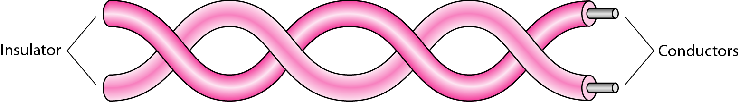
Figure 7.3 Twisted-pair cable
7.<number>

Slide 7

Figure 7.4 UTP and STP cables
7.<number>

Slide 8

Table 7.1 Categories of unshielded twisted-pair cables
7.<number>

Slide 9

Figure 7.5 UTP connector
7.<number>

Slide 10

Figure 7.6 UTP performance
7.<number>

Slide 11
Coaxial Cable
These cables are widely used for cable television systems, office buildings, and other worksites for local area networks.
The cables consist of copper or aluminum wire wrapped with insulating layer typically of a flexible material with a high dielectric constant, all of which are surrounded by a conductive layer.
The layers of insulation help minimize interference and distortion. Transmission speed range from 200 million to more than 500 million bits per second.
7.<number>

Slide 12

Figure 7.7 Coaxial cable
7.<number>

Slide 13

Table 7.2 Categories of coaxial cables
7.<number>

Slide 14

Figure 7.8 BNC connectors
7.<number>

Slide 15

Figure 7.9 Coaxial cable performance
7.<number>

Slide 16
Fiber Optic Cable
These cables consist of one or more thin filaments of glass fiber wrapped in a protective layer.
It transmits light which can travel over long distance and higher bandwidths. Fiber-optic cables are not affected by electromagnetic radiation.
Transmission speed could go up to as high as trillions of bits per second.
The speed of fiber optics is hundreds of times faster than coaxial cables and thousands of times faster than twisted-pair wire.
7.<number>

Slide 17

Figure 7.10 Bending of light ray
7.<number>

Slide 18

Figure 7.11 Optical fiber
7.<number>

Slide 19

Figure 7.12 Propagation modes
7.<number>

Slide 20

Figure 7.13 Modes
7.<number>

Slide 21

Table 7.3 Fiber types
7.<number>

Slide 22

Figure 7.14 Fiber construction
7.<number>

Slide 23

Figure 7.15 Fiber-optic cable connectors
7.<number>

Slide 24

Figure 7.16 Optical fiber performance
7.<number>

Slide 25
7-2 UNGUIDED MEDIA: WIRELESS
Unguided media transport electromagnetic waves without using a physical conductor. This type of communication is often referred to as wireless communication.
Topics discussed in this section:
Radio Waves
Microwaves
Infrared
7.<number>

Slide 26

Figure 7.17 Electromagnetic spectrum for wireless communication
7.<number>

Slide 27

Figure 7.18 Propagation methods
7.<number>

Slide 28

Table 7.4 Bands
7.<number>

Slide 29

Figure 7.19 Wireless transmission waves
7.<number>

Slide 30

Figure 7.20 Omnidirectional antenna
7.<number>

Slide 31

Note
Radio waves are used for multicast communications, such as radio and television, and paging systems.
7.<number>

Slide 32

Figure 7.21 Unidirectional antennas
7.<number>

Slide 33
Note
Microwaves are used for unicast communication such as cellular telephones, satellite networks,
and wireless LANs.
7.<number>

Slide 34
Note
Infrared signals can be used for short-range communication in a closed area using line-of-sight propagation.
7.<number>

Slide 35
Line Configuration
Line configuration refers to the way two or more communication devices attached to a link.
Line configuration is also referred to as connection.
A Link is the physical communication pathway that transfers data from one device to another.
For communication to occur, two devices must be connected in same way to the same link at the same time.
There are two possible line configurations.
1. Point-to-Point.
2. Multipoint.
7.<number>

Slide 36
Point-to-Point
A Point to Point Line Configuration Provide dedicated link between two devices use actual length of wire or cable to connect the two end including microwave & satellite link. E.g. Infrared remote control & tv’s remote control.
The entire capacity of the channel is reserved for transmission between those two devices.
Most point-to-point line configurations use an actual length of wire or cable to connect the two ends, but other options, such as microwave or satellite links, are also possible.
7.<number>

Slide 37
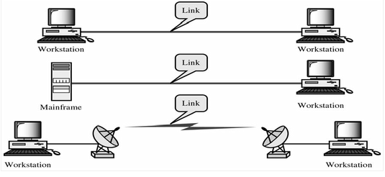
Point to point network topology is considered to be one of the easiest and most conventional network topologies. It is also the simplest to establish and understand. To visualize, one can consider point to point network topology as two phones connected end to end for a two way communication
7.<number>

Slide 38
Multipoint Configuration
Multipoint Configuration also known as Multidrop line configuration one or more than two specific devices share a single link capacity of the channel is shared.
More than two devices share the Link that is the capacity of the channel is shared now.
With shared capacity, there can be two possibilities in a Multipoint Line Config:
  Spatial Sharing
  Temporal (Time) Sharing
7.<number>

Slide 39
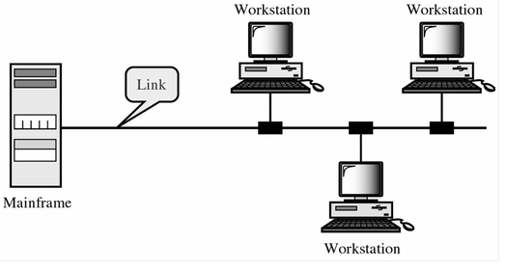
Spatial Sharing: If several devices can share the link simultaneously, its called Spatially shared line configuration
Temporal (Time) Sharing: If users must take turns using the link , then its called Temporally shared or Time Shared Line Configuration
7.<number>

Slide 40
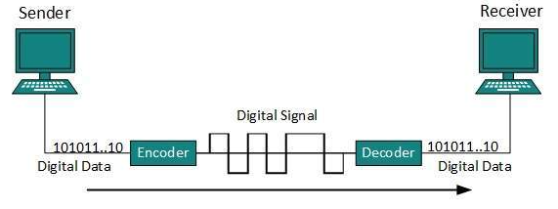
Line Coding
The process for converting digital data into digital signal is said to be Line Coding. Digital data is found in binary format.It is represented (stored) internally as series of 1s and 0s.
7.<number>

Slide 41
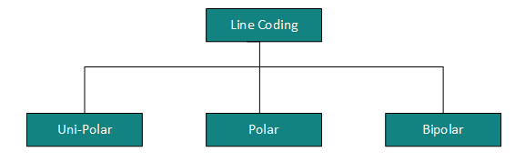
Line Coding contd.
Digital signal is denoted by discreet signal, which represents digital data.There are three types of line coding schemes available
7.<number>

Slide 42
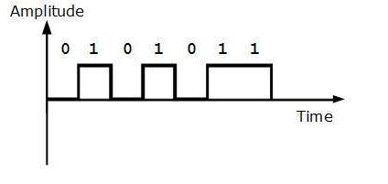
Unipolar Coding
Unipolar encoding schemes use single voltage level to represent data. In this case, to represent binary 1, high voltage is transmitted and to represent 0, no voltage is transmitted. It is also called Unipolar-Non-return-to-zero, because there is no rest condition i.e. it either represents 1 or 0.
7.<number>

Slide 43
Polar Encoding
Polar encoding scheme uses multiple voltage levels to represent binary values. Polar encodings is available in four types:
Polar Non-Return to Zero (Polar NRZ)
It uses two different voltage levels to represent binary values. Generally, positive voltage represents 1 and negative value represents 0. It is also NRZ because there is no rest condition.
7.<number>

Slide 44
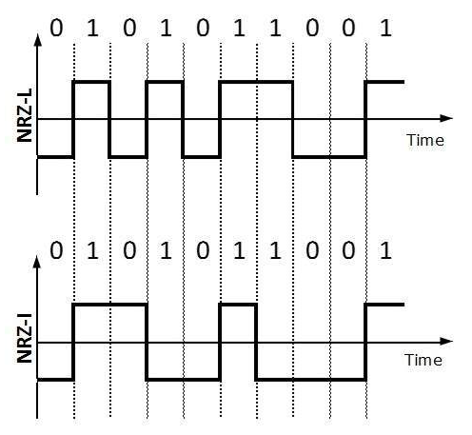
NRZ scheme has two variants: NRZ-L and NRZ-I.
NRZ-L changes voltage level at when a different bit is encountered whereas NRZ-I changes voltage when a 1 is encountered.
7.<number>

Slide 45
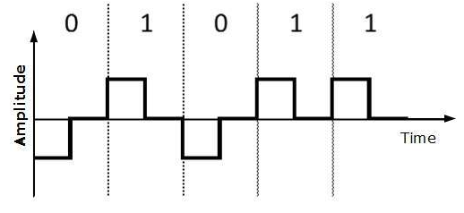
Return to Zero (RZ)
Problem with NRZ is that the receiver cannot conclude when a bit ended and when the next bit is started, in case when sender and receiver’s clock are not synchronized.
RZ uses three voltage levels, positive voltage to represent 1, negative voltage to represent 0 and zero voltage for none. Signals change during bits not between bits.
7.<number>

Slide 46
Polar Encoding contd.
Manchester: This encoding scheme is a combination of RZ and NRZ-L. Bit time is divided into two halves. It transits in the middle of the bit and changes phase when a different bit is encountered.
Differential Manchester: This encoding scheme is a combination of RZ and NRZ-I. It also transit at the middle of the bit but changes phase only when 1 is encountered.
7.<number>

Slide 47
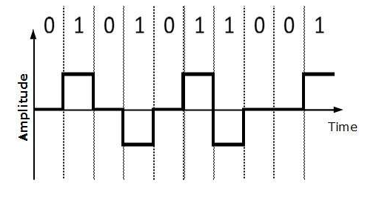
Bipolar Encoding
Bipolar encoding uses three voltage levels, positive, negative and zero. Zero voltage represents binary 0 and bit 1 is represented by altering positive and negative voltages
7.<number>

