Slide 1

WATCH • LISTEN • TESTIFY
Endless Revival Through Prayer
Main Text: James 5:17

Slide 2
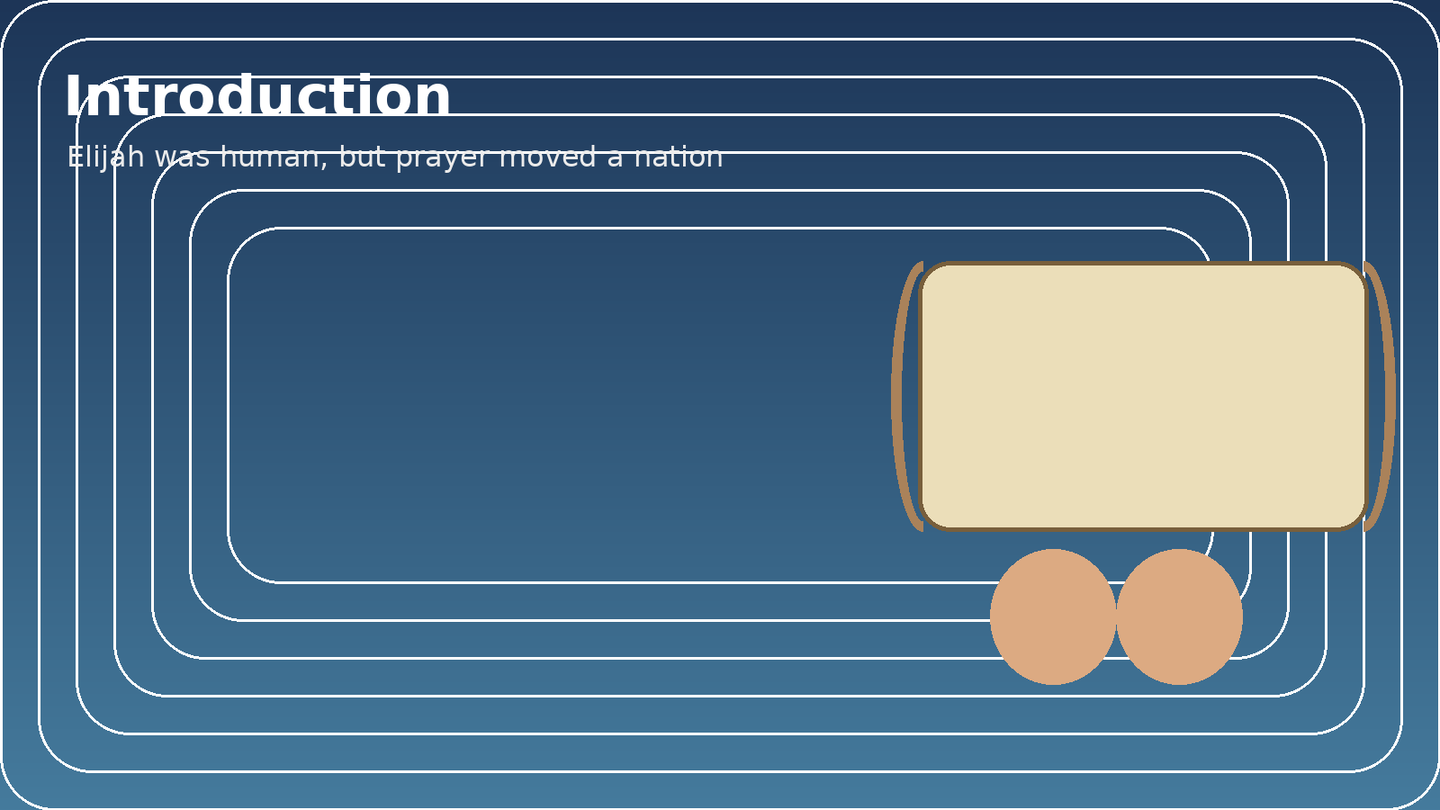
Introduction
Tonight we talk about Endless Revival
Not emotional moments
Not temporary excitement
But sustained oil
James 5:17
"Elijah was a man with a nature like ours, and he prayed earnestly that it would not rain..."
Elijah was human:
Had fears, weakness, pressure
But prayer changed a nation
Revival is sustained by:
1) Watchfulness
2) Obedience
3) Testimony
Through prayer

Slide 3

1) WATCH
Before physical drought, there was spiritual drought
Israel had turned to idols
God warned: Deuteronomy 11:16-17
Elijah knew the covenant
He confronted Ahab - He was a watchman
Watching means:
Guard your heart
Guard your home
Guard your church
Jesus said: "Watch!"
Revival dies when the church sleeps

Slide 4

2) LISTEN
Pattern in 1 Kings 17-18:
"The word of the LORD came..."
Go to Cherith -> Zarephath -> Return to Ahab -> Pray for rain
Obedience produces miracles
Jesus said: John 5:19
"The Son can do nothing by Himself..."
Listening produces authority
Oil is built in hidden seasons:
At the brook
In the widow's house
In private prayer

Slide 5
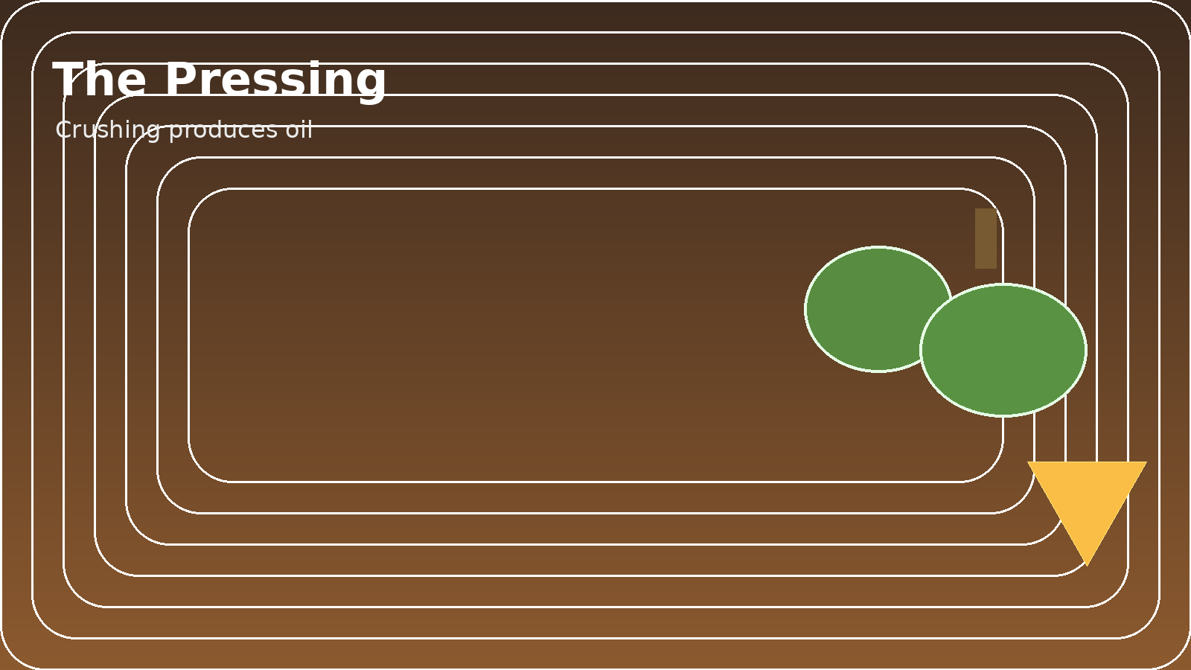
3) THE PRESSING (THE OIL)
Olives must be crushed to release oil
Elijah pressed for 3.5 years:
Brook dried
Widow had one meal
Child died
Stood alone on Mount Carmel
Crushing produces oil
Jesus said: Luke 16:16
"The Kingdom is pressed into..."
Pressing = pursuit, hunger, surrender
Prayer is the pressing

Slide 6
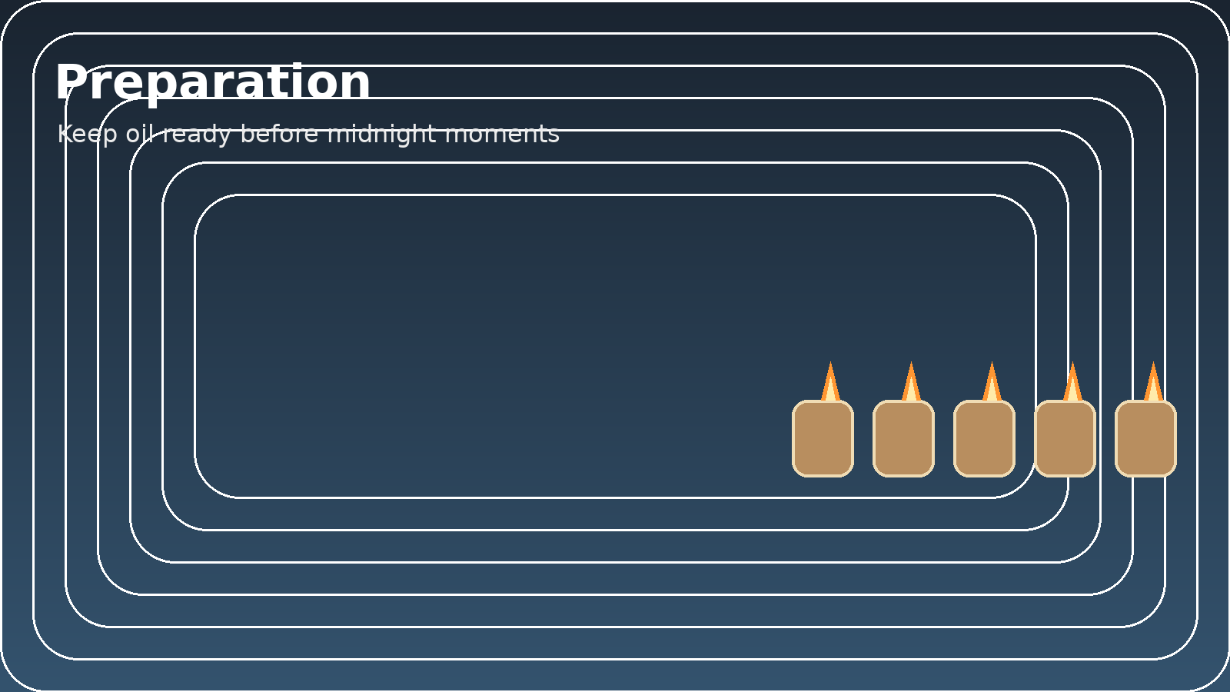
4) TEN VIRGINS - PREPARATION
Matthew 25: Ten virgins
All waiting, all sleeping, midnight cry
Only five had oil
Preparation happens before sudden moments
Elijah appeared suddenly - but he was prepared
Question: If midnight came tonight, would we be ready?

Slide 7
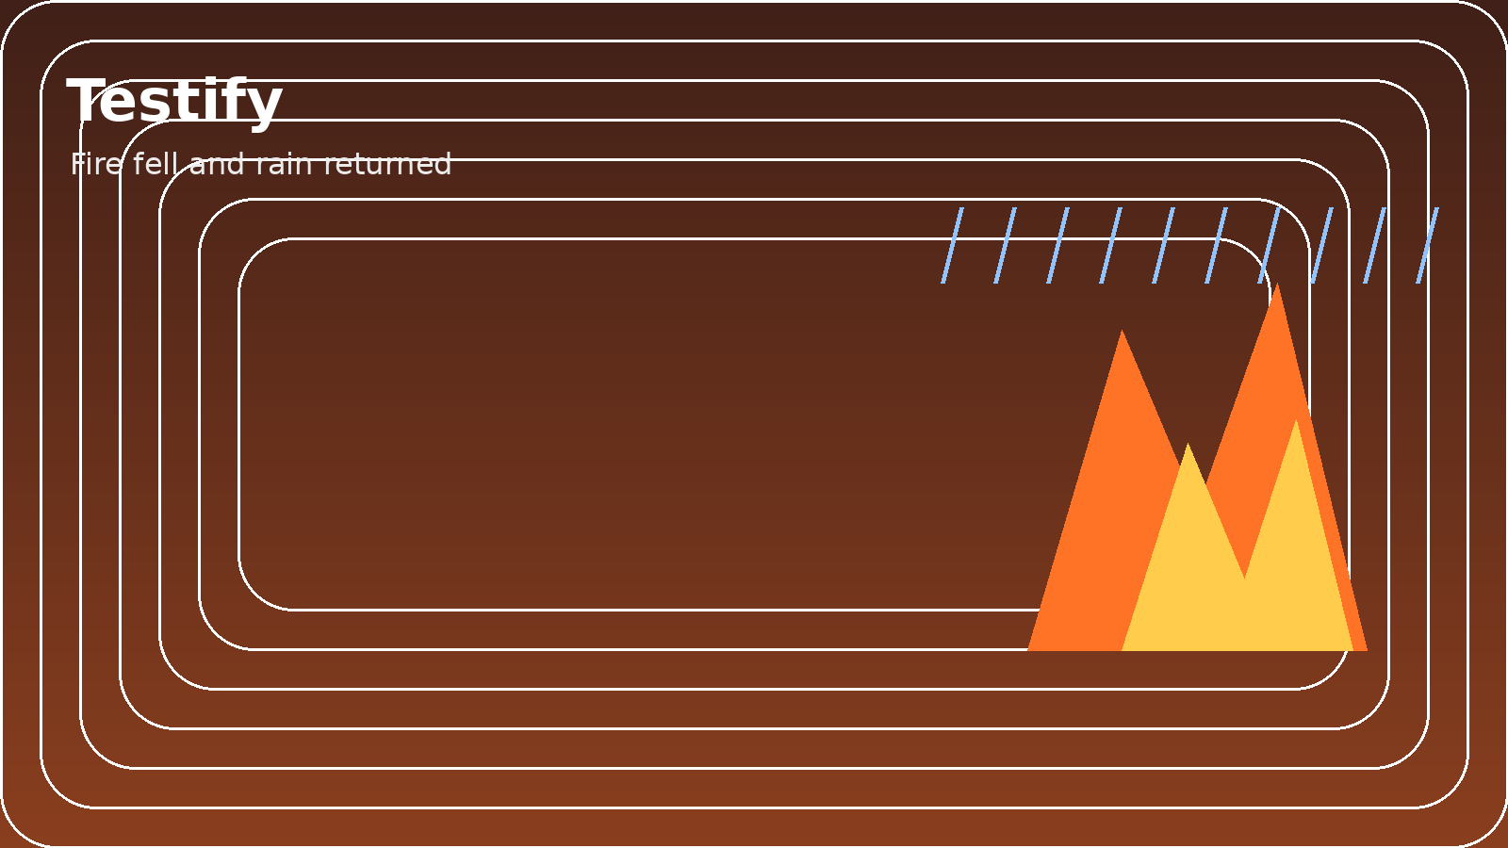
5) TESTIFY
During the drought:
Widow's flour and oil did not run out
Widow's son was raised
Fire fell from heaven
Rain returned
People recognized God:
Yahweh = "I AM"
Revival happens when people recognize who God is
We testify Jesus - John 14:6
Way -> Watch and follow Him
Truth -> Testify boldly
Life -> Listen and abide

Slide 8
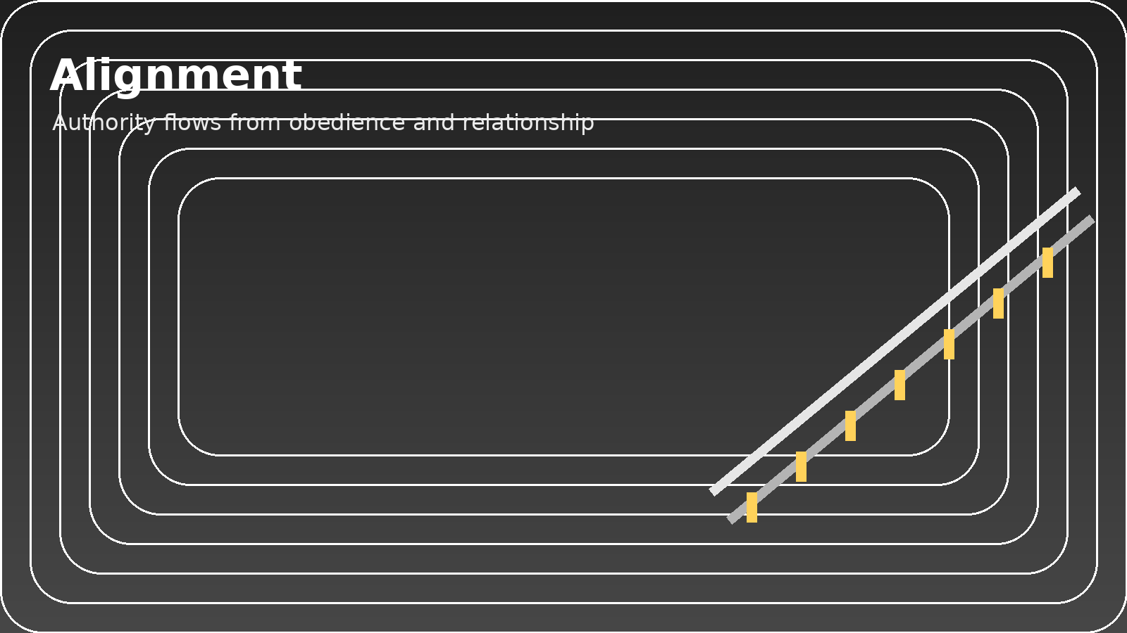
6) ALIGNMENT - THE GUARDRAIL
Warning: We do not release power at will
Jesus: "I do nothing on My own"
Kingdom authority flows from alignment
Oil = relationship maintained, not power controlled

Slide 9
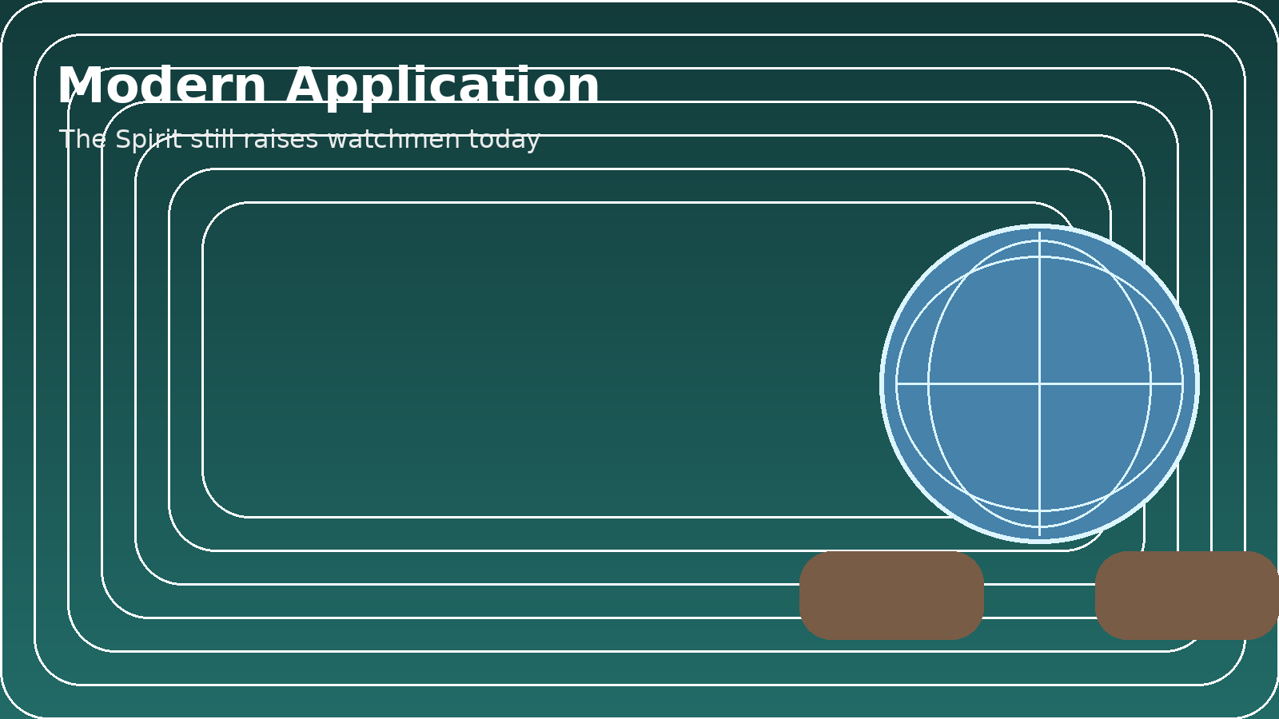
MODERN APPLICATION
Spirit dwells in us today
Kingdom flows through surrender
For Deaf believers:
You may not hear sound, but you discern spiritually
God is raising:
Watchmen
Prayer warriors
Faithful witnesses
James 5:16 - The prayer of the righteous is powerful and effective

Slide 10
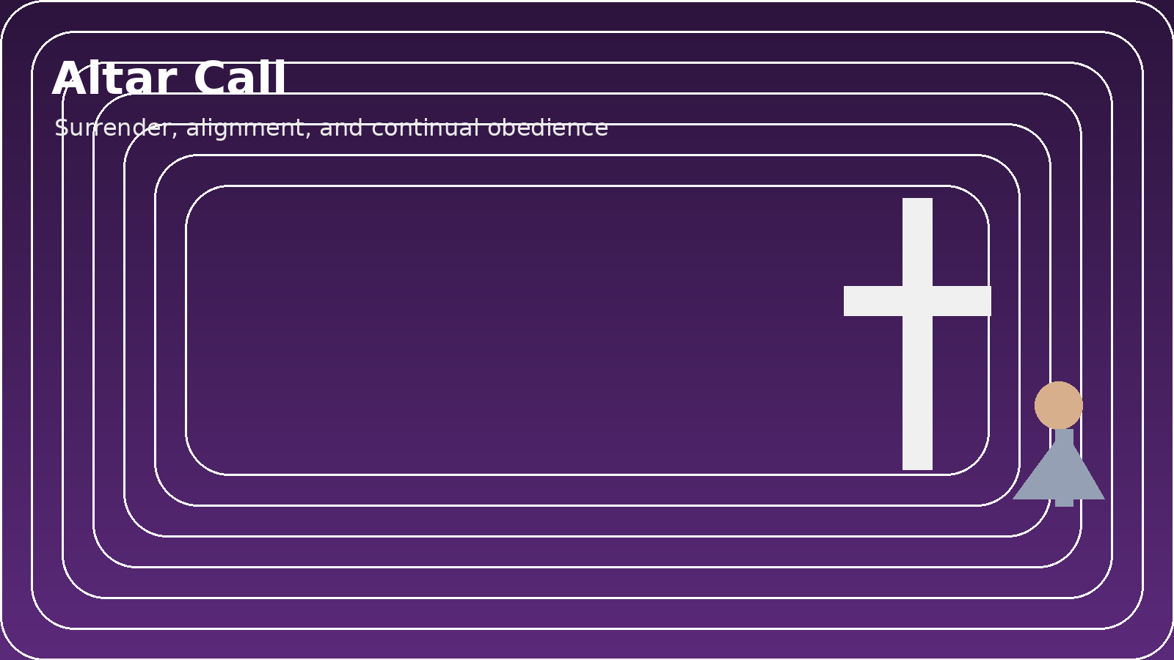
ALTAR CALL
Stand, not for hype, but for surrender
Pray:
"Father,
Press us if You must.
Crush pride. Remove distraction. Align our hearts with Yours.
Make us watchers. Make us listeners. Make us faithful witnesses.
Let our prayers be powerful and effective,
Not because we control heaven,
But because we walk with You.
Let revival be endless,
Because obedience is continual.
In Jesus' name, Amen."

