Slide 1
DT Slide Worksheets
Fall 2025 / Winter 2026
technically functional
SE 4G06

Slide 2
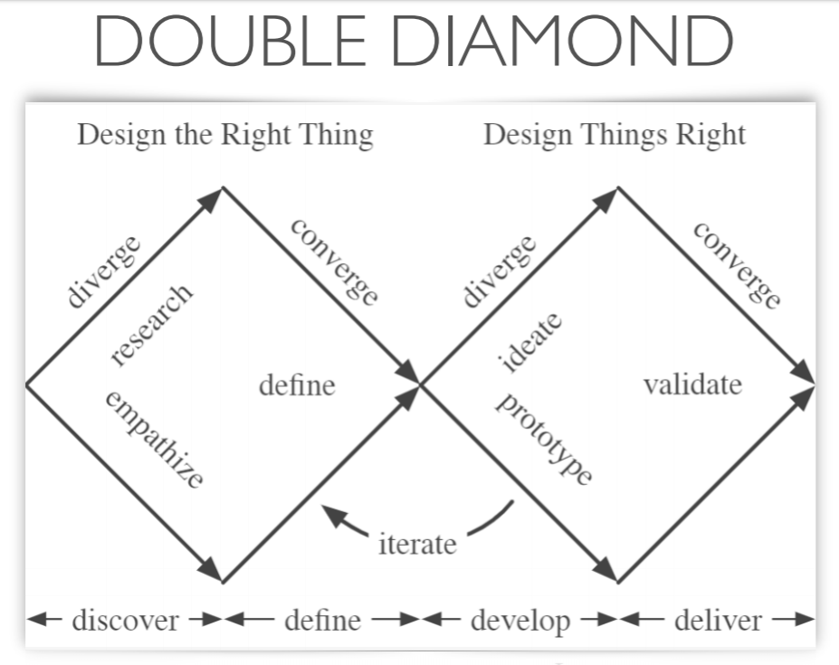
Notes:
https://macoutreach.rocks/DT.html

Slide 3
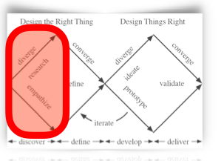
Prepare for Interview
Find two to three potential users for your app. These can be your peers if applicable, or your supervisor(s).
Goals:
Understand the problem: what is the current day-to-day solution used by the user? What problems do they have?
Currently users perform their exercises unmonitored with limited guidance since their previous physiotherapist appointment. Alternative solutions exist such as exercise libraries which show exercise demonstrations as well as text instructions on how to perform these exercises. There are exercise platforms that allows users to track exercises they enter manually, some even allow for custom exercise entry. Problems exist with feedback, or lack thereof, and interconnection with a patient’s physiotherapist which mainly occurs through email, text, or some other generally informal route.
Determine what value you can add to their current processes, without interfering with them (this will probably not be perfect in the first prototype!)
Working on those problem points, a system that can both monitor and provide feedback on patient exercises as well as facilitate communication about prescribed exercises could fix both problems while providing the conveniences of other solutions. A system that held the information for exercises, like an exercise library, provided instructions on exercises/workouts, recorded and recognized exercise progress, and allowed for communication between patients and physiotherapists could increase convenience and maintainability of exercise routines at home.
Notes:
Estimated Time:
Details: This is the stage where you are tackling the first diamond: figuring out

Slide 4
Understand Our User
Before the interview, research the problem domain. E.g. you wouldn’t want to go into an interview about accounting software if you know nothing about accounting. Come up with some answers to questions like:
What are the usual practices in this area of domain expertise?
Physiotherapy patients are given exercises to perform after injury or surgery to help recovery. Recovery focuses on regaining strength in affected muscles and movement/freedom in affected joints. The usual practice follows a flow like this; patient undergoes surgery or receives injury and has a short term of rest. Physiotherapist meets with patient to assess capability for movement and recovery, prescribes exercises/stretches to be done (most commonly daily or several times a day), patient performs these exercises for about a week before returning to the physiotherapist for reassessment. This cycle repeats, extending the time between visits, until the physiotherapist or the patient is happy with the level of recovery.
What are some common problems people face in this domain?
Patients feel uncertain, get increased pain, or stop doing their exercises altogether between appointments with their physiotherapist. Some patients do exercises with incorrect technique, don’t push themselves far enough, or don’t do them enough. These cases heavily impact recovery speed, increasing the number of visits and duration of healing, or limiting the recoverable strength and mobility recoverable through physiotherapy. Physiotherapists also can’t monitor their patients progress and rely on patients telling the truth which can create discrepancies between actual and perceived effort.
What are some existing solutions?
Patients can check exercise instructions through existing exercise libraries such as SimpleSet or PhysiApp. Physiotherapists can contact their patients through existing digital infrastructure such as email, text, or social media. Most patients are put in contact with physiotherapists by family doctors prior to surgery or after receiving an injury which would require physiotherapy.
Which problems provide the biggest pain points?
Patients limiting their own recovery through lack of exercising, lack of effort, or lack of understanding of prescribed exercises likely create the largest pain points. Patient communication with physiotherapists would likely be a close second, and patient to physiotherapist connection is likely the least painful of the three to overcome.
Notes:
Estimated Time:
Details: This is the stage where you are tackling the first diamond: figuring out

Slide 5
Intro Script
What would you say to a potential interviewee to explain why you're excited to work in this problem area and why you need their help?
(For Physiotherapists)
From the moment we formed our group, we set out with the goal of creating something to help people. Most of us have gone through physiotherapy for varying injuries and surgeries, and with this experience wanted to help people in that situation to recover better, faster, and stronger than before. With your help, we want to identify the areas of the physiotherapy process that we can better support and improve upon with a digital solution. We want to make at home exercises easier to perform, create more consistent habits in physiotherapy patients with assigned exercises, and facilitate effective communication between you and your patients.
Notes:
Estimated Time:
Details: This is the stage where you are tackling the first diamond: figuring out

Slide 6
Respect Privacy
The best approach to keeping people’s information private is not to collect data which could identify it when you don’t need to.
In this exercise, do be careful not to include too much identifying information, especially if you are interviewing random users (for a supervisor interview this is less of a problem because it’s “obvious” who they are, but still try to be sensitive and don’t ask any questions that are too personal or aren’t related to the problem at hand).
Likely don’t need name or email with so few participants. Don’t need company and occupation, both together could identify a participant. Company is likely more identifiable than occupation, and occupation should have enough information to be relevant to general user testing. Participant communication (email, phone number, etc.) shouldn’t be recorded within the project.
Notes:
Estimated Time:
Details: This is the stage where you are tackling the first diamond: figuring out

Slide 7
Interview Questions
Put questions here to guide your interview. It’s okay (and encouraged!) to think of follow-up questions as you go, just be sure to write them down during the interview.
What types of exercises would you recommend we start with for our proof of concept — should we focus on one simple movement or aim for multiple (2–3 exercises)?
Are there specific lower-body or posture exercises you would recommend us focusing on?
In what ways would you be comfortable being involved: helping us define exercises, reviewing our approach, or other ways?
Should we focus on a specific limitation (to narrow our scope some more)? For example, spasticity? hyper-mobility?
What deviations from 'proper' form should we look for?
What are some key indicators that you look for in proper exercises overall?
What are some key indicators that you look for in proper exercises specifically in regards to form?
How do you properly gauge time under tension for assigned exercises?
Notes:
Estimated Time:
Details: This is the stage where you are tackling the first diamond: figuring out

Slide 8
Interview Transcript
In this slide, practice your interview with your peers (preferably, someone outside of your group). This will allow you to “debug” your interview questions. Have at least two of your group members take notes (you may have to have different slides to avoid conflicts in collaboration) while the other one or two does the interview.
This is really open-ended. Maybe have a better/more narrow concept of what you want to work on?
This is focussed on the narrow concept, make the previous question reflect this!
This seems good, definitely should turn into a conversation about responsibilities and expectations for both the group and the advisor.
Limitation is confusing wording, consider changing to something more understandable; facet, quality, attribute, etc.
Seems good, very domain knowledge based so hard to know. At least a good start for conversation!
Indicators is okay wording, but again kind of confusing. Seems this is talking about the same thing as question 4, make the wording match!
Same as above.

Slide 9
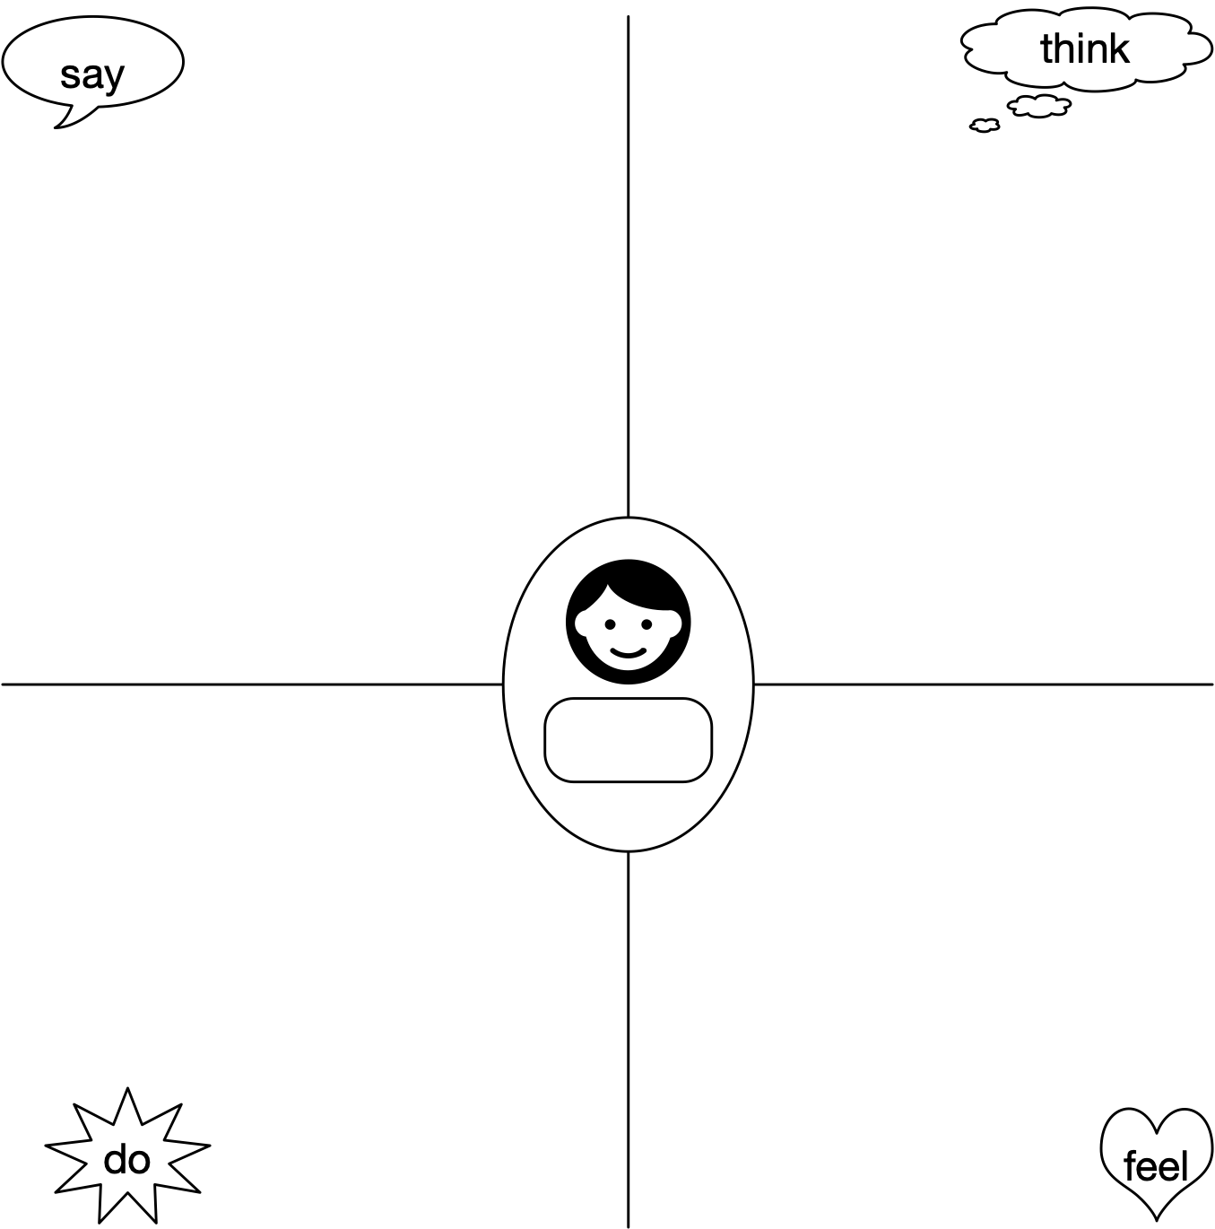
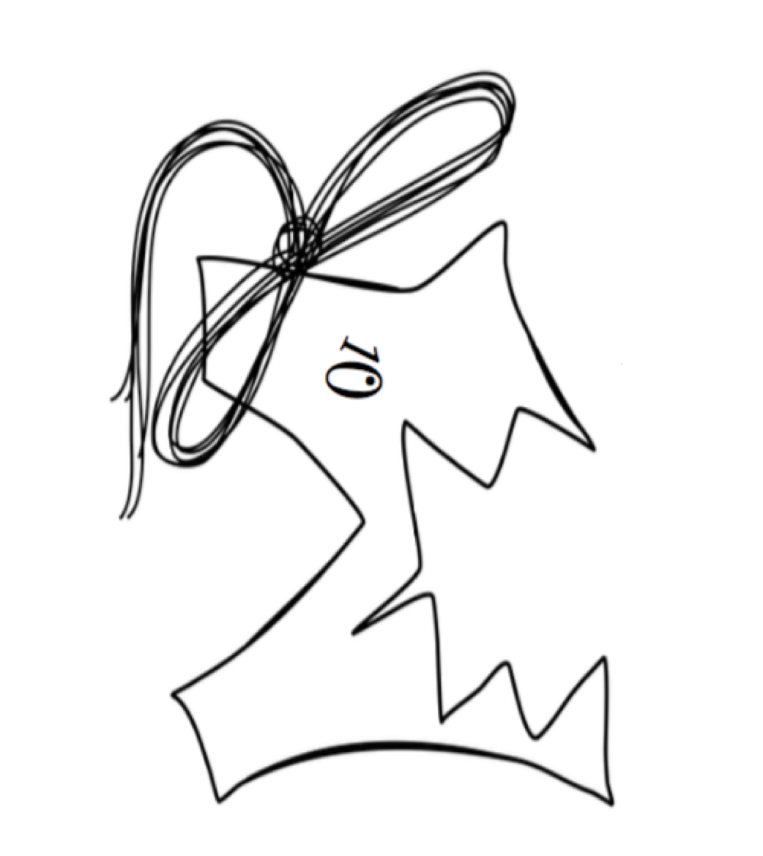
Interview 1
There are a lot of options for exercises.
Exercises or stretches?
How often would they be involved?
Limitation? What do you mean?
Indicators? Again, could you explain?
Time-under tension?
Too many to choose from; provide limited scope.
Again, extended scope; provide limits.
Busy scheduling most likely, provide estimate.
Unclear wording.
Unclear wording
Limited domain knowledge? (Not for PT)
Empathy Map:
Use to take notes when interviewing/shadowing individual users, and again when creating a fictional target user. Have one person do the talking, and a second take notes, but steer the conversation to cover all 4 areas.
say: What they say in response to questions or volunteer.
think: Things you infer about their knowledge or opinions, because they avoid a topic or direct answers, are surprised by or do not understand some questions.
do: Steps they take in doing a task, either observed from shadowing, or noted when they describe how they do their work.
feel: Things you infer about their feelings, such as whether they would enjoy using a proposed solution, or would prefer the way things work now.
Assess patient status/progress
Assign patients exercises/stretches
Demonstrate/assist in initial exercises/stretches
Set check-in for patient
Repeat
Team
Care for patient recovery
Assistance in check-ins or continued comms
Would likely be greatly appreciated
Central place for exercises, rather than just a written prescription may be highly valuable in assisting patients.
1

Slide 10
Interview Skills: Fill this out after empathy map interview for your group. Highlight your choices.
Did you… | circle one
set up interview, giving context? | Somewhat | Yes | Definitely!
make them comfortable? | Somewhat | Yes | Definitely!
ask open-ended questions? | Never | Sometimes | Whenever appropriate
Ask follow-ups? | Never | Sometimes | Whenever appropriate
Ask how they felt about things? | Never | Sometimes | Whenever appropriate
Ask for stories, or to describe the steps of a job? | Never | Sometimes | Whenever appropriate
React to non-verbal clues they were uncomfortable, wanted to say more, etc.? | Never | Sometimes | Always

Slide 11
Revised Questions
Revise your questions based on what you found out in your practice interview.
We’re thinking of focusing on lower-body, single joint exercises. What would you recommend we start with for our proof of concept?
Are there specific lower-body or posture exercises, not stretches, you would recommend us focusing on?
In what ways would you be comfortable being involved: helping us define exercises, reviewing our approach, or other ways? This would likely entail a weekly meeting and possible daily messages through Microsoft Teams.
What specific details of an exercise should we focus on? For example, spasticity or hyper-mobility.
What deviations from 'proper' form should we look for? What are the issues you look for in meetings with patients?
What are some key details that you look for in proper exercises overall? What are good signs that correlate with patient recovery performance?
What are some key indicators that you look for in proper exercises specifically in regards to form? How do these correlate with patient recovery performance?
How do you properly gauge time under tension for assigned exercises?
Notes:
Estimated Time:
Details: This is the stage where you are tackling the first diamond: figuring out

Slide 12
Interview Transcript
- Recommend focusing scope to something like knee, where there's 1 plane of movement or your elbow (straight or bent) - We chose to focus on a single leg specifically at the knee with one range of motion. -Really depends on the population -would recommend post-operative as its most standardized, with any other rehab everyone does something different, but for post-op, you most likely do the same types of exercise -exercises to recommend include: straight leg raise, knee slide. -Kevin is pretty flexible, available to meet once a week or bi-weekly, just let him know! -narrow scope down even more by just focusing on just stretching the knee and that range of motion. -people usually don't push enough, if post surgery they might be scared to push -measure their knee, knee replacements if they're not bending enough tell them to push a little harder -everything is standardized in the first few weeks, but from there it is for a free for all, it is dependent with physio and patient -it would be very complicated, better to just track it and give feedback -Kevin would recommend using range of motion instead of strength as strength would be too hard to measure. range of motion could be measured by having the first bit of range and then seeing their next range of motion to see if they pushed more. -patients don't know how much they should be stretching, so focusing on this would actually be very relevant -TUT would be easier to measure than muscle activation, it would still be more complicated, there is no set TUT it varies, but you could have it as a set TUT -for knee: measured by range of motion and how hard they are pushing
Notes:
Estimated Time:
Details: This is the stage where you are tackling the first diamond: figuring out

Slide 13
Interview 1
One plane of movement recommended.
Exercises depend on population.
Recommend post-operative patients as the focus for any digital product.
Narrow scope to just the knee
Standardized effort for the first couple of weeks on post-operative patients, but then it all becomes dependent on the patients progress and physio’s recommended route.
People usually don’t push enough post surgery.
Limitations of technology and at-home video taking. Tried something like this before?
Easy to trivialize patients with similar exercises; many different movements and options.
Too many fields and too much information to possibly capture within a small solution.
So many options and differences between exercises, limit scope as much as possible.
Standardized exercises to be supported, then modifiable exercise plan/support should be produceable.
Need a way to track effort!
Empathy Map:
Use to take notes when interviewing/shadowing individual users, and again when creating a fictional target user. Have one or two people do the talking, and at least two others take notes, but steer the conversation to cover all 4 areas.
Say: What they say in response to questions or volunteer.
think: Things you infer about their knowledge or opinions, because they avoid a topic or direct answers, are surprised by or do not understand some questions.
do: Steps they take in doing a task, either observed from shadowing, or noted when they describe how they do their work.
feel: Things you infer about their feelings, such as whether they would enjoy using a proposed solution, or would prefer the way things work now.
Meet with patients and assess their readiness and capability for physiotherapy exercises.
Assign the standardized exercises with modifiable sets and reps if still within the first couple weeks of physio.
Otherwise, assess required movement/strength requirements and assign possible sets/reps.
Ensure patients know what to do and how to do it.
Set check-in, dependent on patient status and capability!
Kevin (PT)
Showed a deep interest in their patients recovery.
Displayed regret about busy schedule and inability to repeatedly work with the same patients.
Clearly wants the best recovery for patients in both strength and mobility.

Slide 14
Interview Skills: Fill this out after empathy map interview for your group. Highlight your choices.
Did you… | circle one
set up interview, giving context? | Somewhat | Yes | Definitely!
make them comfortable? | Somewhat | Yes | Definitely!
ask open-ended questions? | Never | Sometimes | Whenever appropriate
Ask follow-ups? | Never | Sometimes | Whenever appropriate
Ask how they felt about things? | Never | Sometimes | Whenever appropriate
Ask for stories, or to describe the steps of a job? | Never | Sometimes | Whenever appropriate
React to non-verbal clues they were uncomfortable, wanted to say more, etc.? | Never | Sometimes | Always

Slide 15
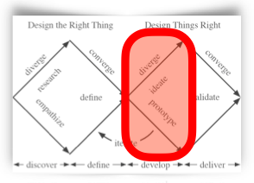
Idea Generator (Fill This In)
Problems/Pain Points Approaches | A. Consistency | B. Performance (Actually do it) | C. Communication | D. Linking PTs to Patients
1. Increased Responsibility | Exercise tracker with consistency/streak rewards. | Exercise recorder; ensure exercise is performed. | Short digital meeting facilitator. | Platform for physiotherapy selection; tinder for physios!
2. Increased Knowledge | Knowledge base for habit forming and exercise linkage to healing. | Exercise library. | Physiotherapist and patient dedicated communication platform. | Physiotherapy forum, centralized knowledge base.
3. Time-Saving | Daily exercise timer. | Super-set creator/workout optimizer. | Daily check-in message, like a sticky note for physiotherapy. | Physiotherapist matching based on default entries (survey).
4. Habit Building | Checklists, trackers, timers, rewards. | Checklists for good form, good repetition growth. | Physiotherapist based daily checklist form. | Non-singular PT check-in platform. Match with an available PT that can see your chart when you need assistance.
Notes:
Game Examples: Puzzle game, Cooking game, Card game

Slide 16
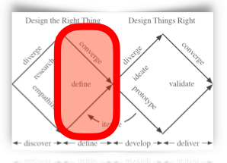
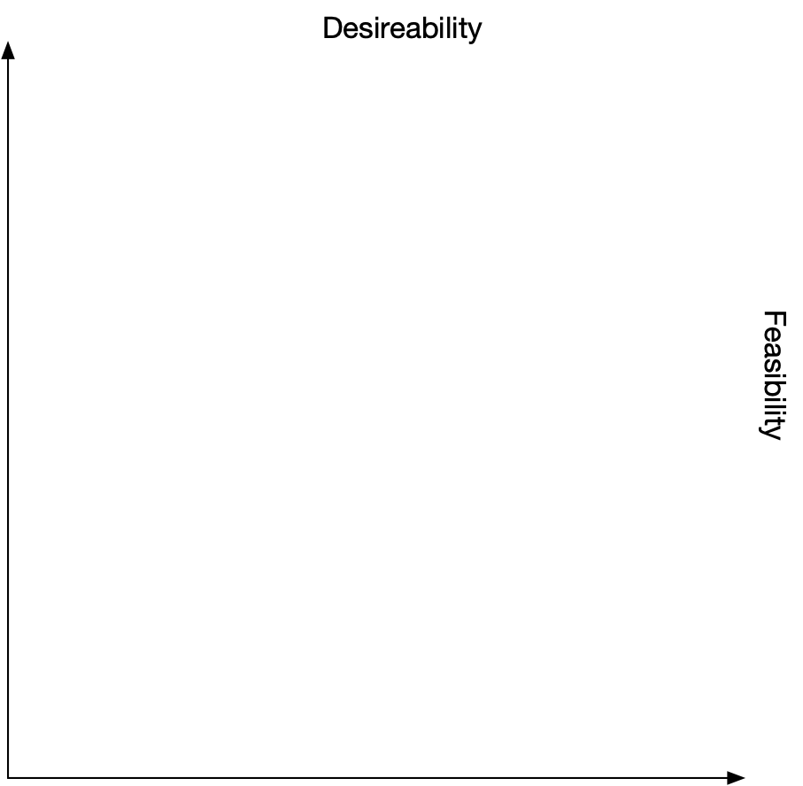
Desirability vs. Feasibility Plot
C2
1. As a group, discuss the ideas in reverse order, and assign then Desirability and Feasibility scores by plotting the number on the scatter plot.
2. Pick the best two overall ideas write it in the boxes below.
B1
Feasibility
C1
A3
D1
B3
D4
C3
B2
Desirability
D4
A1
D2
D3
Define two games you will design and what data you hope to collect from them.
A4
A2
B4
(Prototype 1)
B1: Exercise Recorder
(Prototype 2)
C2: Dedicated PT and Patient Comms
C4

Slide 17
Discussion Points
Write down questions raised by this process which you should not think about now, but may be useful later. For example, are there parts of what you learned in your interview that you do not know how to implement yet?
Linking patients and physiotherapists together, such that physios can see patients progress is going to become very important. Synchronous modification/feedback might be required. Need to learn this.
Health concerns; our system might not be able to modify plans or suggest edits/gamify based on health regulations.
Health data; what kind of privacy is required for patients? For physios? Can we ensure this?
Video storage; do we keep patient exercise recordings (if we take them)? Can we store all that data?
Notes:
Estimated Time:
Details: This is the stage where you are tackling the first diamond: figuring out

Slide 18
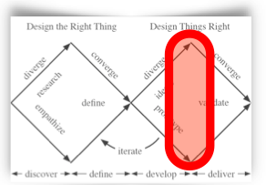
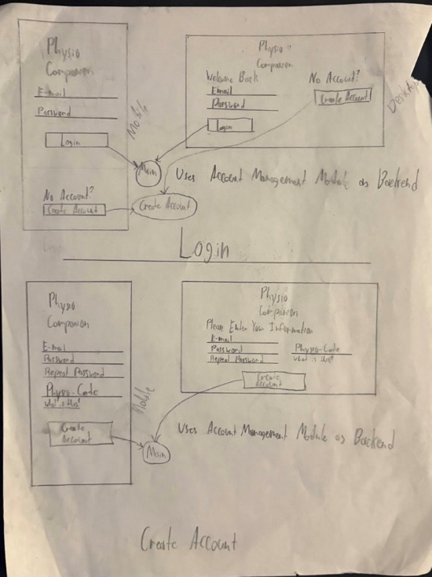
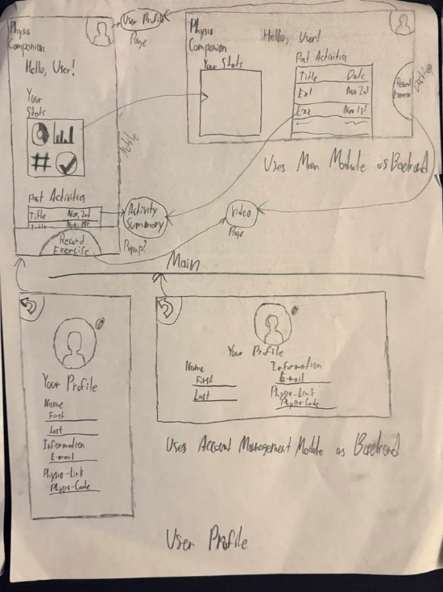
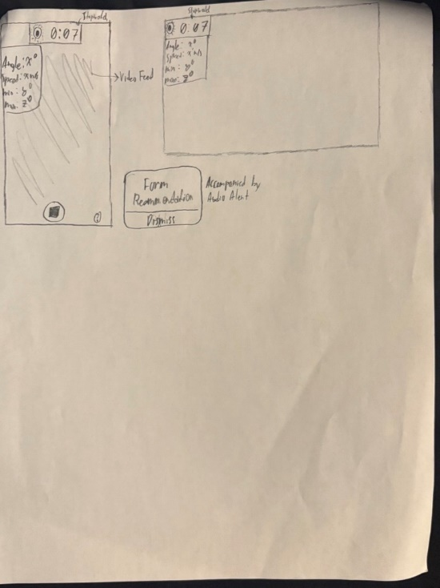
Prototype
1
Exercise Recorder
Use any drawing tool you want (including actual paper or a tablet!) to create a paper prototype. You will need to duplicate this slide for different pages/actions in your app.
Do not worry about making your prototype look good; for now focus on functionality. You want to give your user/supervisor enough information to get good feedback.

Slide 19
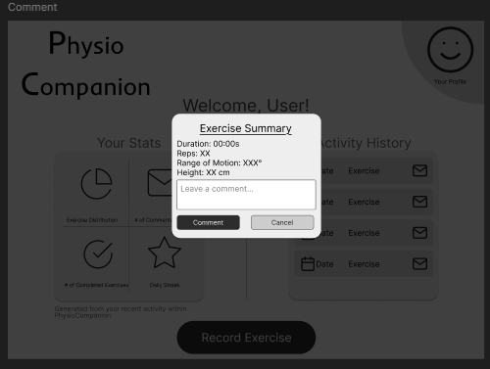
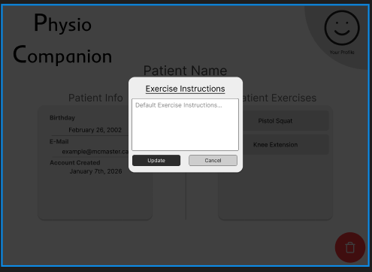
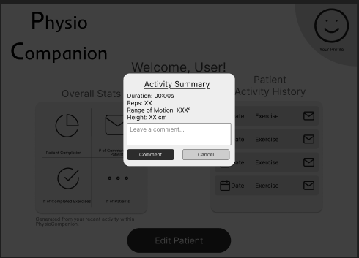
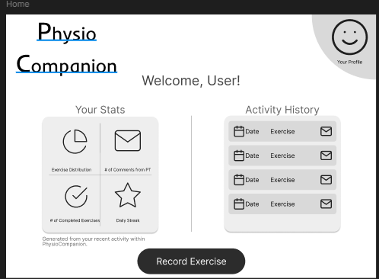
Prototype
2
Patient & Physio Dedicated Communication
Use any drawing tool you want (including actual paper or a tablet!) to create a paper prototype. You will need to duplicate this slide for different pages/actions in your app.
Do not worry about making your prototype look good; for now focus on functionality. You want to give your user/supervisor enough information to get good feedback.

Slide 20
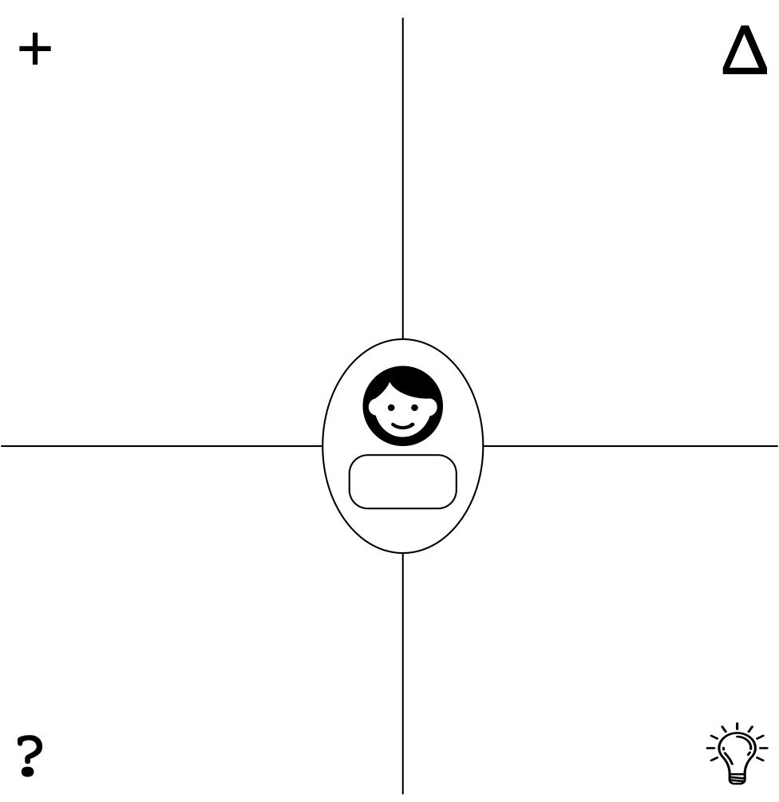
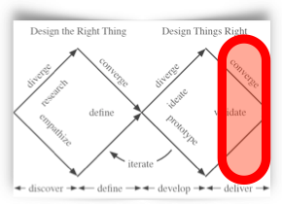

Prototype
1
Information is presented clearly in dedicated areas
Functionality seems clearly understandable
Looks good with example data, wondering what a new patient looks like with no data
Clean display doesn’t crowd the eye
There could be even more information presented at once; possibly going to end up with too many menus to maneuver
Color theme is professional but not ‘fun’.
Perhaps a bottom ribbon with possible pages to access, a lot of apps have this.
More general information/dialogue on the camera, these specific numbers might not mean a lot to some people.
Feedback Grid:
Use to take notes when getting feedback from individual users. Have one person do the talking, and a second take notes, but steer the conversation to cover all 4 areas.
+ | What did they like about it?
∆ | What would they like changed?
? | What questions did they ask?
 | What new ideas came out of the discussion?
How will this display show me how I am doing with my exercises?
Will my physiotherapist be able to see the video when I am done recording it?
What kinds of health data will this collect from me?
How will the numbers displayed on the screen actually assist my exercising?
Will I be able to see those small numbers while I’m recording an exercise?
Patient
Much more helper text, a lot of things need explaining!
With good position and understandable presentation of data we can put a lot more on the screen. Don’t overload, but don’t treat them like they can’t understand it all.
More general feedback on exercise screen such as ‘do this now’, or possibly include encouraging colors.
If users can’t see the screen, can they hear feedback through the speakers?
5
https://www.svgrepo.com/svg/120932/light-bulb

Slide 21
Prototype
1
Presentation of exercises and patients seems clear enough.
Menus are clear, data displayed makes logical sense.
Information captured by the video should help in assessing patient progress and current status.
Patient list seems efficient in allowing selection of individuals.
More information in each menu/display
Create a place for me to give the patient feedback, or even where I can reach out to them about their exercises
More information captured/capturable from the exercise videos by patients
More explanations of certain displays. Eg what goes in the pie chart on the home page?
Feedback Grid:
Use to take notes when getting feedback from individual users. Have one person do the talking, and a second take notes, but steer the conversation to cover all 4 areas.
+ | What did they like about it?
∆ | What would they like changed?
? | What questions did they ask?
 | What new ideas came out of the discussion?
How will the menus change based on different patients?
Can I view all patient data at once?
How will I provide patients with feedback based on their exercises?
Will I have to watch the videos of patients exercising to get the information?
Physio
Overall patient display when no user is selected?
Maintain constant user data of all exercises, or limited time range? (Week, month, last 3 days, etc.)
What extra data can we gather from the video apart from angles and time?
5
https://www.svgrepo.com/svg/120932/light-bulb

Slide 22
Prototype
2
Constant interaction with the physiotherapist would really help.
Being able to present questions or comments along with data would be great.
Modifiable instructions that can be personalized to me is a great idea.
Overall data display of my entered exercises and physio feedback is easy to access
Could the data be changed to something more general and easy to obtain? Sets, reps, time, etc. rather than angles and average rep time?
Can there be a notification feature for physiotherapist comments?
Feedback Grid:
Use to take notes when getting feedback from individual users. Have one person do the talking, and a second take notes, but steer the conversation to cover all 4 areas.
+ | What did they like about it?
∆ | What would they like changed?
? | What questions did they ask?
 | What new ideas came out of the discussion?
How accurately can I collect that data on my own?
Will the physiotherapist be able to provide relevant and effective feedback on my exercises based on this data?
Will this improve the efficacy of my exercises, or does it still rely on the physio?
How long will I expect this to take? How long do I expect for a response from my physio?
Patient
Notification system?
Should data be less specific for users, more information available to physios but less to patients? Does this create a lack of clarity between the two parties?
Similar pages between the two parties, varied information based on patient or physio?
Can we trust users for input data?
5
https://www.svgrepo.com/svg/120932/light-bulb

Slide 23
Prototype
2
Quick and constant connection with patients at home is great.
Full free-range of entry is great for comments.
Modification of exercise instructions is good to personalize exercises.
Simple data entry means quick use of system.
Can there be a sets and reps entry? Makes it easier for patient and physio to set expectations.
Can the coloring be made a little more contrasting? Hard to see difference between menus and background sometimes. Borders maybe.
Can there be even more data presented on the menus for forming of advice in comments and exercise instruction writing?
Feedback Grid:
Use to take notes when getting feedback from individual users. Have one person do the talking, and a second take notes, but steer the conversation to cover all 4 areas.
+ | What did they like about it?
∆ | What would they like changed?
? | What questions did they ask?
 | What new ideas came out of the discussion?
How often will I be expected to login and leave feedback?
Is there any way to view all of the feedback I have left at once?
How long will this data be stored for?
Physio
Overall feedback screen? Comment counter?
Feedback prompting? E.g. ‘It’s been 8 hours since this exercise was uploaded, please leave some feedback!’
Data storage and integrity; what are the norms and conventions?
5
https://www.svgrepo.com/svg/120932/light-bulb

Slide 24
Prototype 1
Prototype 2
Clear representation of data and linked patients
Video screen has clear functionality and effective data for physios
Home page effectively displays historical exercise data
Patients feel the usage of their data is clearly conveyed
UI seems easy on the eye and easy to navigate
Clear representation of data and linked patients
Comment usage on activities is clear and variable on entry
Ability to modify exercise instructions to personalize to patients is excellent
Clear visuals of all selected patient’s data for leaving feedback and reviewing previous feedback are helpful
Navigation of the menus is simple.
Pros
Perhaps not enough data shown to both sides; more information required from patients to present to physios.
Data screen is capturing feels arbitrary to patients but important to physios.
While data usage is clear, data collection is unclear from the prototype.
Feedback is uncertain, will there be feedback, how, etc.
Navigation is clear but perhaps not as easy as it could be. (Clear concept, roundabout process)
Relies on entered data from users rather than gathered data.
Physios missing a sets/reps field(s) for setting expectations for patients.
While navigation is simple, it isn’t presented clearly.
No notifications to alert when one party or the other has left feedback.
Data that is useful for physios is hard to gather without proper tools by the patient.
Cons
What did you learn about the prototypes? Do you refine any, synthesize them, or go in a new direction?
Notes:
New pros and cons slide

Slide 25
Action Plan
How do we develop a new prototype, based on the feedback from prototypes 1 and 2 and our own pro/con analysis?
What they/we said: | How we will improve:
Feedback is uncertain AND relies on entered data. | Combine the approaches; make the communication system and the recording system features of the same system.
Not enough data shown AND no gathered data. | Include more data derived from the recording as well as some user entered data on select fields.
Data feels arbitrary AND not enough data. | Increase data available on both screens to increase clarity between parties, increase visibility of general information for patients.
Navigation unclear. | Increased helper/guider text, possibly a tutorial to introduce navigation options. Banner along the bottom with options?

Slide 26
Reflection
Reflect on the following questions:
What parts of this process were difficult? How did you overcome these barriers?
User testing/participation as well as ideation was difficult when there was already an image of the system in our minds. To overcome this, we tried to write down our approach and throw it away, completely disregard it when talking to users or thinking of alternatives. Perhaps this way we could build on their criticism to not only fix the issues they pointed out but find issues of our own.
Additionally, the prototyping was difficult to make unique compared to each other with that image already made. We had an idea of what the advisors were interested in seeing and so had set on the path to making that already. It did bring out clarity that we weren’t all imagining the same system which made us communicate better as a team and even use those different mental images as alternatives and prototype differences.
How did this process help you understand your user and problem better?
There was a clear difference between average user knowledge, expert domain knowledge, and our implied knowledge from working on and researching the problem. Not to mention the implied knowledge of operating the prototypes because we made them; of course, we understand how the navigation is supposed to work when we had the intention first.
It was also interesting to see the care the physio held for improvement on the patient’s side; a real interest and care for someone’s recovery. During both prototype conversations we were able to find many different things that appealed to the pt that weren’t currently implemented in our prototypes (such as sets and reps) which they felt would increase the efficacy of their feedback and thus the rate of recovery.
How will you use what you’ve learned in your future career as a software engineer?
Clearly forming interpretations of a client (or advisor’s) ideas early is dangerous for limiting ideation and misdirecting prototyping and questioning. Trying to remain neutral about any direction until the stakeholders have identified clear needs and wants, and even then, until they have viewed prototypes and made additional requests. From this exercise, it really seems the better software engineer provides the widest possible range of solutions and allows the stakeholders to narrow in on the one that best solves their problem, rather than selecting one themselves.

