Slide 1
LAB WALKTHROUGH
What did the performance
claim survive?
AP
↓
claim
A pedagogical route from average precision to prevalence-robust,
replication-supported model replacement
survived
Stats_Paper_Extending_PRAUC_v12
Computational lab presentation
Notes:
Open with the paper’s governing question. The talk is not about proposing another context-free score; it is about making the conditions of a performance claim explicit.
[Sources]
- Stats_Paper_Extending_PRAUC_v12.tex, abstract and Section 1.

Slide 2
WHY AP?
AUROC describes separation—but our decisions
receive a selected set
SEPARATION
SELECTED SET
→
How often does a positive
outrank a negative?
Who actually enters the review,
assay, or intervention queue?
The composition of the selected set is itself a scientific outcome.
WHY AP?
02
Notes:
Contrast a ranking statistic with the object that downstream decisions actually consume: a selected set.
[Sources]
- Stats_Paper_Extending_PRAUC_v12.tex.

Slide 3
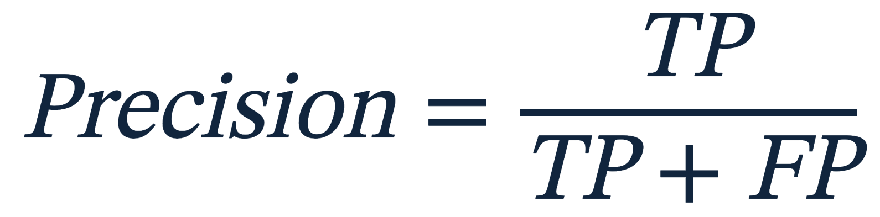
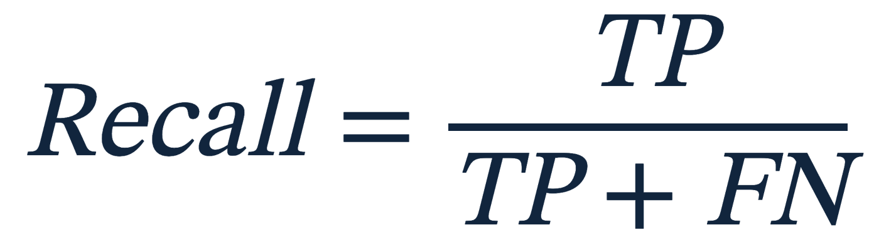
WHY AP?
Precision asks whom we selected;
recall asks whom we missed
PRECISION
RECALL
Of the cases we selected,
how many are positive?
Of all positive cases,
how many did we select?
Move the score threshold → both quantities change together.
WHY AP?
03
Notes:
Define the two axes before showing a PR curve. Emphasize that neither is a threshold-free property.
[Sources]
- Stats_Paper_Extending_PRAUC_v12.tex.

Slide 4
WHY AP?
A PR curve records what happens
as the selected set grows
ONE RANKED LIST
1
2
3
4
5
6
7
8
→
+
−
+
−
−
+
−
−
Every positive expands recall; every false positive can dilute precision.
recall →
WHY AP?
04
Notes:
Walk the threshold down the list. The curve is generated by a sequence of selected sets.
[Sources]
- Stats_Paper_Extending_PRAUC_v12.tex.

Slide 5
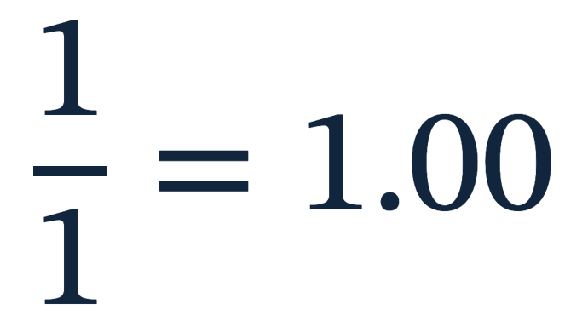
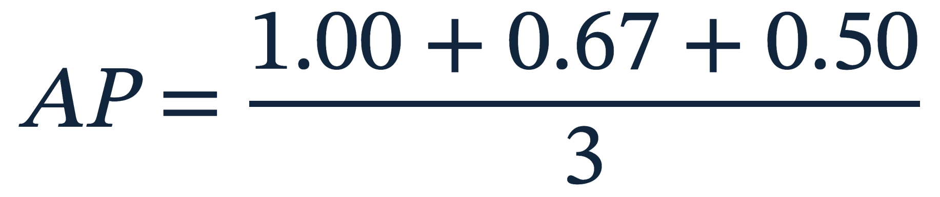
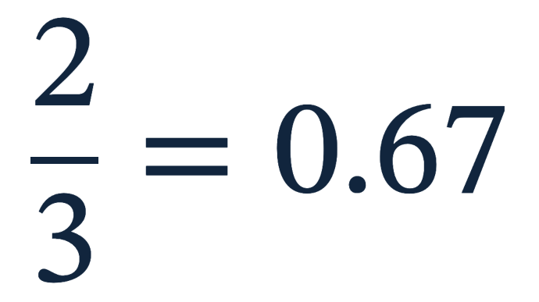
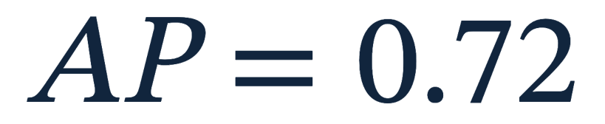
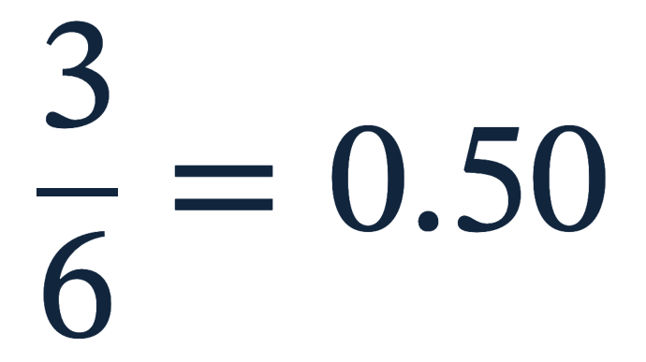
WHY AP?
AP rises when positives
appear early
POSITIVE RANKS
+
rank 1
+
rank 3
+
rank 6
AP is a weighted summary of precision over recall—not the area of a smooth geometric shape.
WHY AP?
05
Notes:
Calculate AP directly from the three positive ranks. This makes the later weighted formula less mysterious.
[Sources]
- Stats_Paper_Extending_PRAUC_v12.tex.

Slide 6

POPULATION
The ranking can stay unchanged
while precision collapses
SAME OPERATING BEHAVIOR
The classifier did not change.
50% prevalence
0.94
The supply of negatives did.
1% prevalence
Precision therefore describes
a ranking in a population.
0.14
POPULATION
06
Notes:
Use the numerical contrast to create the central population tension. TPR and FPR are unchanged.
[Sources]
- Stats_Paper_Extending_PRAUC_v12.tex.

Slide 7
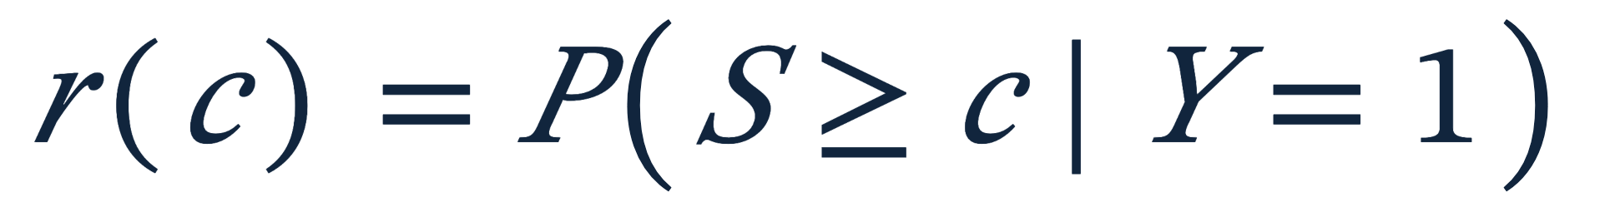
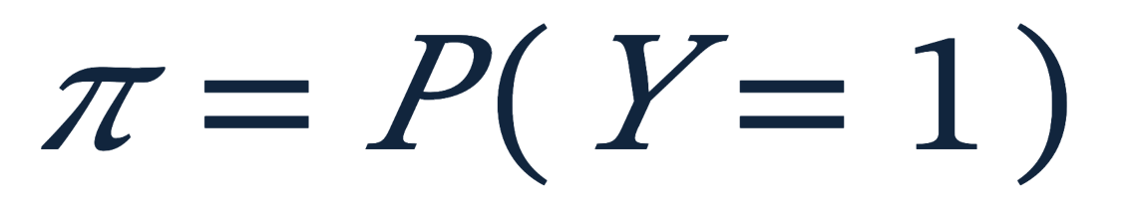
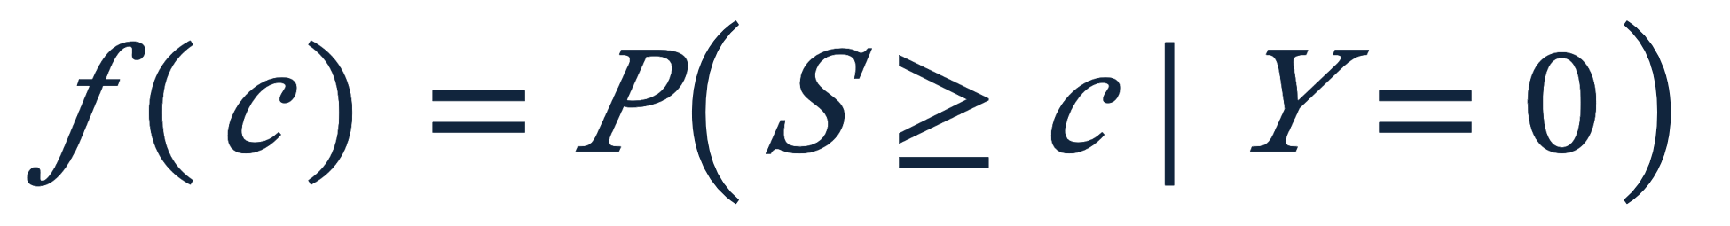
POPULATION
Change the class prior—but preserve
within-class ranking behavior
KEEP
CHANGE
→
The target population’s
class prior
Observed class-conditional
ranking behavior
POPULATION
07
Notes:
State the transformation criterion before presenting the formula: preserve class-conditional behavior; alter only the prior.
[Sources]
- Stats_Paper_Extending_PRAUC_v12.tex.

Slide 8
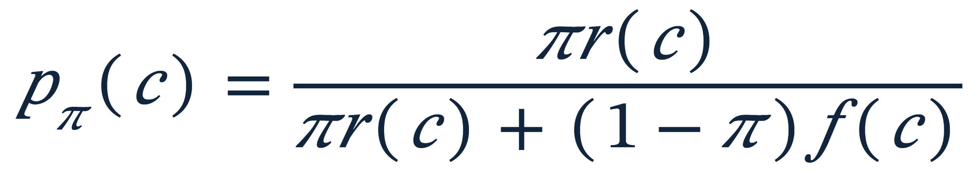
POPULATION
Prior-standardized precision makes
the target prevalence explicit
1% target
5% target
10% target
20% target
50% target
0.14
0.46
0.64
0.80
0.94
The example fixes recall at 0.80 and the false-positive rate at 0.05.
POPULATION
08
Notes:
Substitute r=.80 and f=.05. The values reproduce the slide 6 precision contrast and fill in intermediate populations.
[Sources]
- Stats_Paper_Extending_PRAUC_v12.tex.

Slide 9
POPULATION
Reweighting is licensed only when
class-conditional scores transport
LICENSED
NOT LICENSED
Severity shifts
Measurement shifts
Within-class scores shift
Only the class prior changes.
Those changes belong in the regime.
Invariance is a prespecified transport claim—not something the reweighted curve can prove.
POPULATION
09
Notes:
Draw a firm boundary around the reweighting claim. If score behavior within class changes, prevalence must be represented through environments in the regime.
[Sources]
- Stats_Paper_Extending_PRAUC_v12.tex.

Slide 10
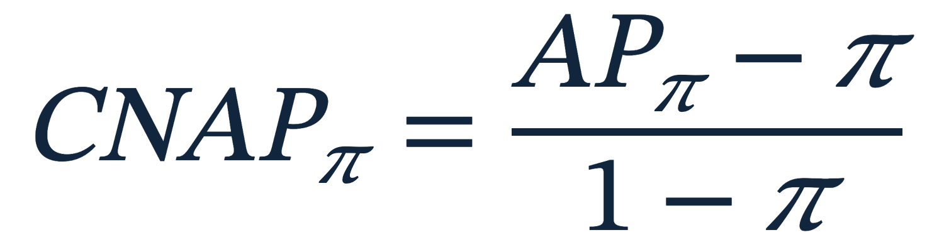

POPULATION
AP needs a common baseline
before prevalences can be compared
Random ranking has
→
So a raw AP of 0.30 means
something different at 1%
than at 20% prevalence.
0 marks population random ranking
1 marks perfect ranking
Normalize after evaluating the ranking in the target population.
POPULATION
10
Notes:
Explain why raw AP values at different prevalences do not share a random baseline.
[Sources]
- Stats_Paper_Extending_PRAUC_v12.tex.

Slide 11
POPULATION
Chance normalization aligns the endpoints—
not the whole prevalence profile
Same ranking
Same endpoints
Difficulty varies
by prevalence
target prevalence →
POPULATION
11
Notes:
Normalization makes zero and one common, but it does not erase how false positives matter differently as prevalence changes.
[Sources]
- Stats_Paper_Extending_PRAUC_v12.tex.

Slide 12
POPULATION
If the claim must hold everywhere,
an average answers the wrong question
.01 target
.05 target
.20 target
.40 target
minimum
0.55
0.48
0.31
0.52
→
0.31
Average: 0.47
but the claim failed at 0.31
Robust CNAP is the largest level attained at every declared prevalence.
POPULATION
12
Notes:
Ask whether the scientific claim is an expectation across populations or a level that must hold in all of them. The infimum answers only the latter.
[Sources]
- Stats_Paper_Extending_PRAUC_v12.tex.

Slide 13

ASSESSMENT
A performance claim needs three declarations:
populations, regime, and attempts
Π
ℛ
K
Where must the
claim hold?
What may vary in a
complete replication?
How many attempts
must be survived?
ASSESSMENT
13
Notes:
Introduce the assessment only now that both population and repetition questions are visible.
[Sources]
- Stats_Paper_Extending_PRAUC_v12.tex.

Slide 14
ASSESSMENT
“Replication” is incomplete until we say
what is allowed to change
REGIME
EVALUATION
ENVIRONMENT
MODEL
Fixed model
new units
same environment
same fitted model
New environment
new units
new environment
same fitted model
Repeated development
new units
new environment
refit + reselect
A unit bootstrap identifies only the first target.
ASSESSMENT
14
Notes:
A bootstrap is not a scientific target. The regime names the target; resampling must then represent it.
[Sources]
- Stats_Paper_Extending_PRAUC_v12.tex.

Slide 15
ASSESSMENT
Prevalence is computed within each draw;
other conditions are generated by the regime
COMPUTED CHALLENGE
GENERATED CHALLENGE
Evaluate every target prevalence
within the same replication
Draw environments, units,
or development runs from the regime
Licensed by score-level
prior-shift invariance
Cannot be recovered by
reweighting one evaluation
If invariance fails, prevalence becomes part of the environments generated by the regime.
ASSESSMENT
15
Notes:
Resolve the apparent asymmetry. Prevalence is part of the same assessment, but invariance lets it be computed within a realized replication.
[Sources]
- Stats_Paper_Extending_PRAUC_v12.tex.

Slide 16
CORROBORATION
Expected performance can conceal a replication
that defeated the claim
Replication 1
Replication 2
mean
0.70
+
0.05
→
0.375
A claim at 0.375 did not survive replication 2.
CORROBORATION
16
Notes:
Pause on the failed average. The number 0.375 summarizes compensation, not survival.
[Sources]
- Stats_Paper_Extending_PRAUC_v12.tex.

Slide 17
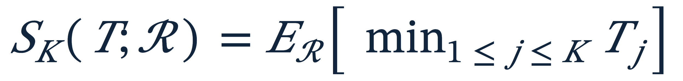
CORROBORATION
Support is the expected level retained
by every declared challenge
draw 1
draw 2
draw 3
draw 4
0.62
0.47
0.71
0.29
→
min
0.29
Expectation is over repeated executions of the declared regime.
CORROBORATION
17
Notes:
The realized minimum is the greatest level all K challenges retain. Expectation keeps the result on the performance scale.
[Sources]
- Stats_Paper_Extending_PRAUC_v12.tex.

Slide 18
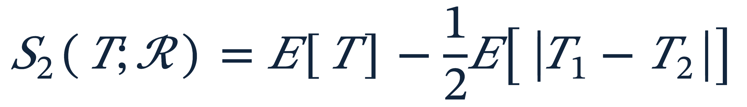
CORROBORATION
With two attempts, corroboration charges
half the replication disagreement
Expected performance
−
Half the expected disagreement
0.50
0.12
Supported level: 0.38
CORROBORATION
18
Notes:
At K=2 the operator has a transparent decomposition. This is not a standard-error penalty.
[Sources]
- Stats_Paper_Extending_PRAUC_v12.tex.

Slide 19
CORROBORATION
In Popper’s sense, survival is support—
not probability of truth
WHAT THE CLAIM EARNS
WHAT IT DOES NOT EARN
It survived specified
opportunities for defeat.
A probability that the
model or claim is true.
The assessment makes those
opportunities criticizable.
Nor a fixed confidence level.
Corroboration remains negative: the claim has not yet been defeated under 𝒜.
CORROBORATION
19
Notes:
Use Popper carefully: the language is negative and conditional. Support records survival under stated tests; it is not confirmation.
[Sources]
- Stats_Paper_Extending_PRAUC_v12.tex.

Slide 20
CORROBORATION
A bootstrap estimates projected support;
it does not manufacture replications
COMPUTATION
EVIDENCE
1 observed evaluation
New sites, measurements,
or development runs
↓
1,000 bootstrap draws
Can reveal failures the bootstrap
held fixed.
Less Monte Carlo error
More bootstrap draws improve computation; more attempts strengthen the claim; new environments change the evidence.
CORROBORATION
20
Notes:
Separate B, K, and genuinely new evidence. This prevents computational effort from being mistaken for severity.
[Sources]
- Stats_Paper_Extending_PRAUC_v12.tex.

Slide 21
CORROBORATION
Each replication must face
the full prevalence set
Replication 1 fails first
at low prevalence.
Replication 2 fails first
at high prevalence.
Each replication must reveal its own limiting population.
CORROBORATION
21
Notes:
The different profile shapes show why each replication must face the entire prevalence set before replications are combined.
[Sources]
- Stats_Paper_Extending_PRAUC_v12.tex.

Slide 22
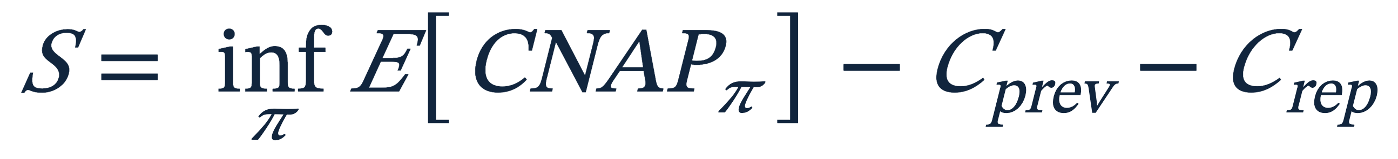
CORROBORATION
Support equals mean performance
minus two costs of challenge
0.54
−0.08
−0.06
0.40
→
→
→
Best fixed-prevalence
expected profile
Movement of limiting
prevalence
Replication
disagreement
Supported
performance
The costs diagnose why support is low; they are not new headline estimands.
CORROBORATION
22
Notes:
The numerical decomposition is illustrative. Its job is diagnostic: distinguish weak mean performance, moving limiting populations, and unstable retained levels.
[Sources]
- Stats_Paper_Extending_PRAUC_v12.tex.

Slide 23
ESTIMATION
A fixed-model bootstrap preserves
the order of the scientific claim
1
2
3
4
Resample units
→
Build profile
→
Retain worst target
→
Apply support
Stratify by observed
outcome class
Evaluate every target
on those same units
Keep the profile minimum
for each replication
Average minima over
groups of attempts
Resampling separately at each prevalence would destroy the joint profile.
ESTIMATION
23
Notes:
Walk left to right. The same sampled units must generate the complete prevalence profile.
[Sources]
- Stats_Paper_Extending_PRAUC_v12.tex.

Slide 24

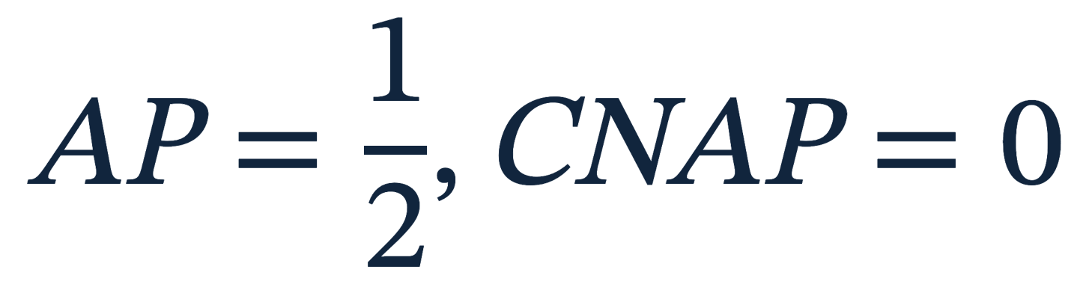
DESIGN ANCHOR
Finite-sample AP has a design anchor
that need not equal prevalence
ONE POSITIVE + ONE NEGATIVE; 50% PREVALENCE
ordering 1
ordering 2
support
+
−
−
+
→
0.25
Pure noise can return positive supported CNAP because stepwise AP rewards favorable finite orderings.
DESIGN ANCHOR
24
Notes:
This two-unit example proves that a population chance anchor does not automatically center a finite design.
[Sources]
- Stats_Paper_Extending_PRAUC_v12.tex.

Slide 25
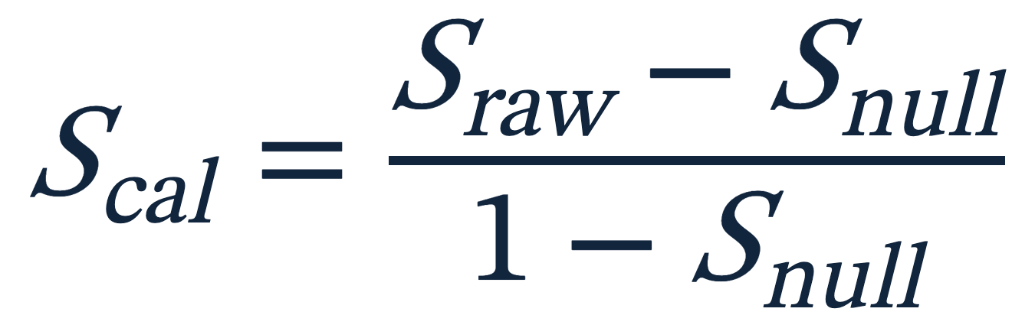
DESIGN ANCHOR
Conditional calibration makes one model
interpretable—but not comparable
FOR ONE FIXED SCORE VECTOR
Permute labels under the
design’s allowed symmetry
→
Raw value + anchor + ratio
must travel together.
→ estimate its conditional
null anchor
Different score vectors have different anchors → calibrated values cannot be subtracted.
DESIGN ANCHOR
25
Notes:
Calibration is useful for describing one fixed model. Stress the non-composability of different conditional anchors.
[Sources]
- Stats_Paper_Extending_PRAUC_v12.tex.

Slide 26

REPLACEMENT
Subtracting two marginal reports combines
adverse cases that never co-occurred
MODEL A’S MARGINAL WORST CASE
MODEL B’S MARGINAL WORST CASE
site 1
1% prevalence
CNAP 0.30
site 2
30% prevalence
CNAP 0.25
But no evaluation ever contained that comparison.
REPLACEMENT
26
Notes:
A replacement effect must be realized under the same conditions. Marginal worst cases do not supply it.
[Sources]
- Stats_Paper_Extending_PRAUC_v12.tex.

Slide 27
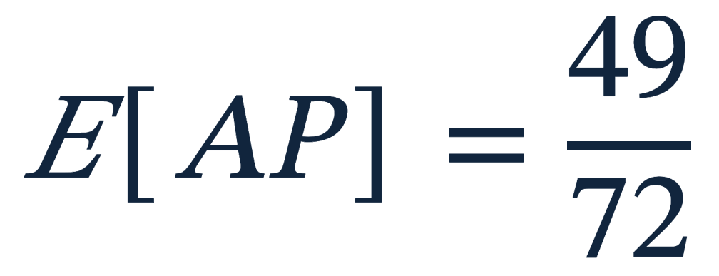
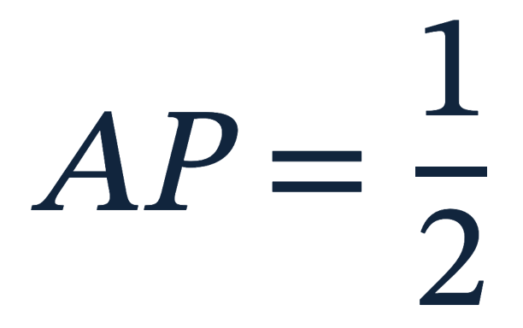

REPLACEMENT
Pairing can still reward
arbitrary tie-breaking
MODEL A: FOUR DISTINCT SCORES
MODEL B: ONE COMPLETE TIE
0.9
0.7
0.5
0.3
0.5 0.5 0.5 0.5
No association—yet the expected paired difference is positive:
REPLACEMENT
27
Notes:
Both models are uninformative. The finer score vector nevertheless receives positive expected advantage under ordinary AP.
[Sources]
- Stats_Paper_Extending_PRAUC_v12.tex.

Slide 28

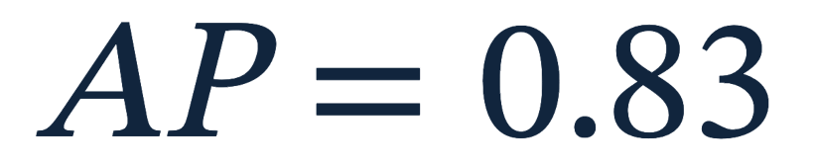

REPLACEMENT
Tie averaging removes expected credit
for distinctions the model did not make
ONE TIED BLOCK WITH TWO POSITIVES
average
+
+
−
+
−
+
−
+
+
→
0.81
Useful refinement still helps when it aligns with outcomes; arbitrary refinement earns zero expected advantage.
REPLACEMENT
28
Notes:
Tie averaging changes the convention rather than subtracting a null artifact. Arbitrary within-block order is averaged away.
[Sources]
- Stats_Paper_Extending_PRAUC_v12.tex.

Slide 29
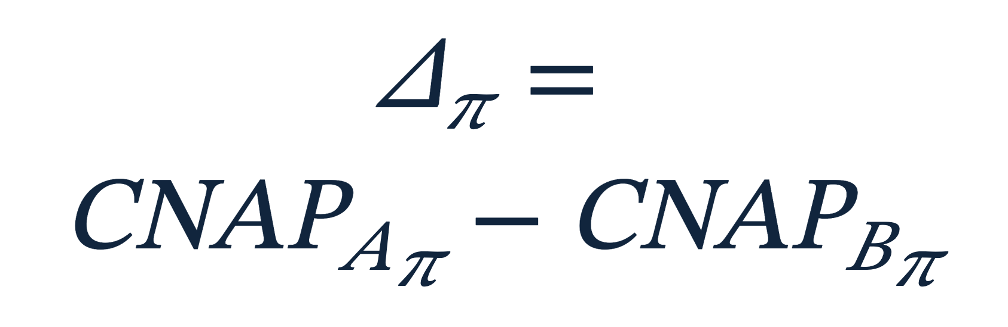
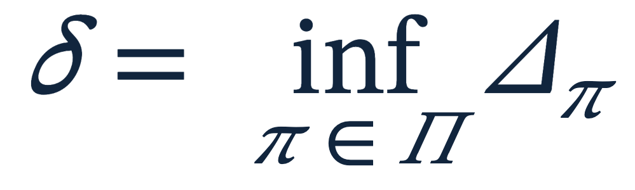
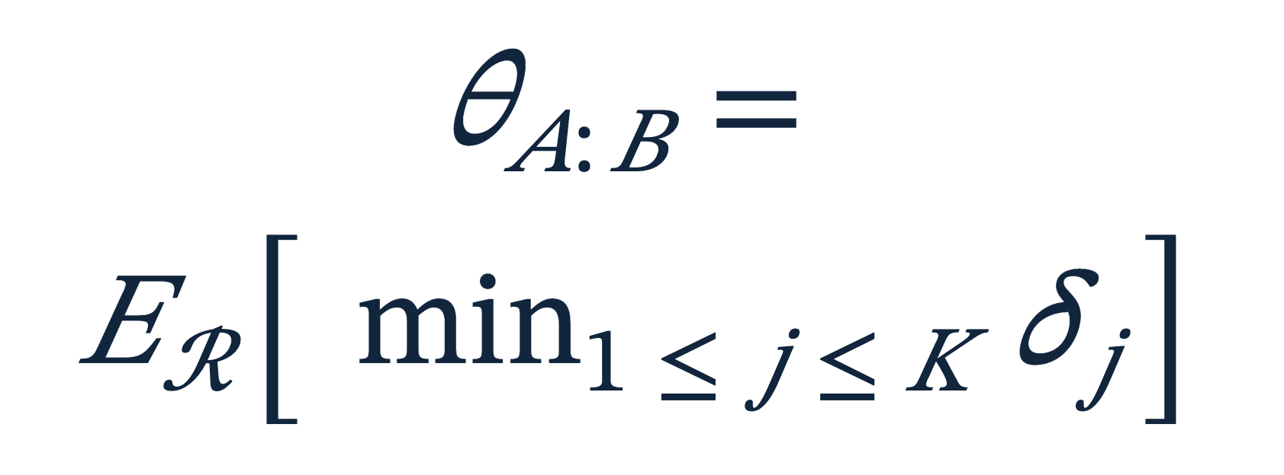

REPLACEMENT
Form the paired advantage before
applying either challenge
PAIR
POPULATION
REPLICATION
EXPECTATION
→
→
→
Same units → same prevalence → same replication
REPLACEMENT
29
Notes:
Build the estimand from left to right. Pair first; challenge second.
[Sources]
- Stats_Paper_Extending_PRAUC_v12.tex.

Slide 30
REPLACEMENT
Tie neutrality needs an
exchangeable-label reference law
Conditionally on both score vectors and the observed positive count,
every label vector with that many positives is equally likely.
DEFENSIBLE REFERENCE
NOT AUTOMATIC
i.i.d. held-out units
under a signal-free label law
matched, clustered, or
heterogeneous-risk designs
Without the law, the paired estimand remains descriptive—but the no-positive-anchor guarantee is lost.
REPLACEMENT
30
Notes:
The reference guarantee has a real design assumption. Pairing and tie averaging do not create exchangeability.
[Sources]
- Stats_Paper_Extending_PRAUC_v12.tex.

Slide 31


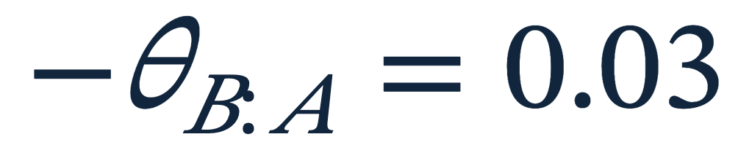
REPLACEMENT
Coherent replacement permits
a no-verdict region
Both orientations cannot be positive.
no verdict
0
The declared challenges may defeat superiority in both directions.
REPLACEMENT
31
Notes:
The operator is not odd, but the orientation inequality prevents contradictory positive recommendations. It still allows honest indecision.
[Sources]
- Stats_Paper_Extending_PRAUC_v12.tex.

Slide 32
REPLACEMENT
Replacement needs a lower bound
above the decision margin
ILLUSTRATIVE RESULT
Performance evidence is one decision input; costs, fairness, calibration, and intervention effects remain separate.
estimate .08
lower bound .03
decision margin .05
Do not replace: the outer lower bound does not exceed the decision margin.
REPLACEMENT
32
Notes:
A positive estimate is insufficient. The uncertainty-qualified effect must clear a prespecified practical margin.
[Sources]
- Stats_Paper_Extending_PRAUC_v12.tex.

Slide 33
INTERPRETATION
The number is meaningful only together
with the assessment it survived
Supported quantity: raw support or paired advantage
Π
Which populations had to be survived?
ℛ
What changed in a complete replication?
K
How many opportunities for defeat were joined?
?
Which invariance, symmetry, and uncertainty assumptions qualify the result?
INTERPRETATION
33
Notes:
Model performance is assessment-relative. Reporting only the scalar removes the conditions that gave it meaning.
[Sources]
- Stats_Paper_Extending_PRAUC_v12.tex.

Slide 34
SYNTHESIS
Performance becomes a scientific claim
only when its challenges are declared
Name populations
Expose failures
Demand survival
Make the claim
→
→
→
Standardize the prior
and normalize
Minimum over target
prevalence in each draw
Expected minimum
over attempts
Paired, tie-neutral,
margin-qualified
Support is not a new name for high performance.
It is the surviving magnitude after the challenges have been declared.
SYNTHESIS
34
Notes:
Return to the opening question. The framework’s contribution is a claim structure that can be criticized and improved.
[Sources]
- Stats_Paper_Extending_PRAUC_v12.tex.

Slide 35
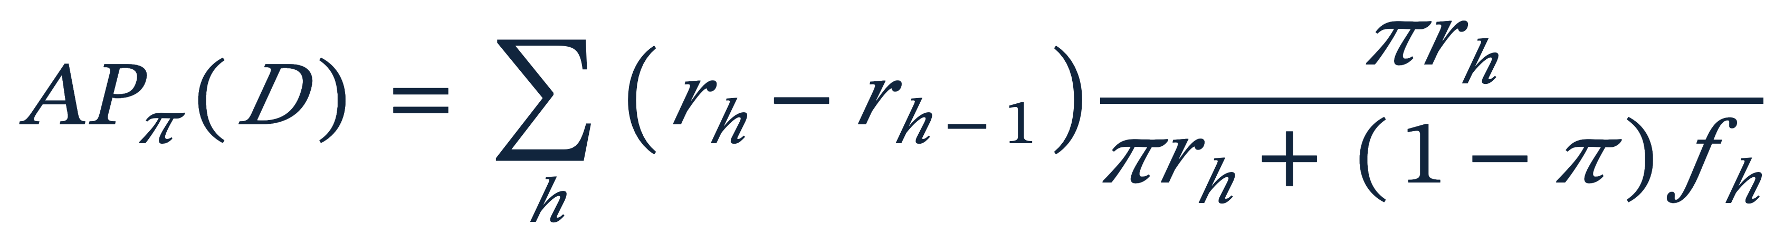
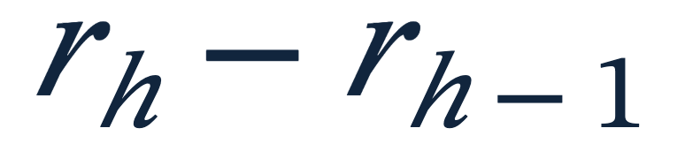

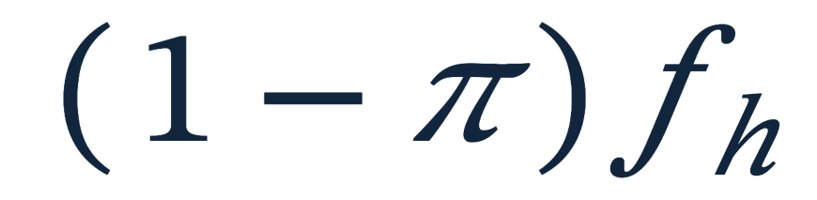
BACKUP
Empirical prior-standardized AP is
a weighted threshold sum
recall gained when a score block enters
target-population positive mass selected
target-population negative mass selected
BACKUP
35
Notes:
Use this only if the audience wants the exact empirical AP definition.
[Sources]
- Stats_Paper_Extending_PRAUC_v12.tex.

Slide 36
BACKUP
More attempts strengthen the challenge
but do not broaden the regime
The attempt count controls
how many draws
must survive jointly
It does not decide whether
sites or model fits vary.
attempts →
BACKUP
36
Notes:
K and the regime control different aspects of severity. The values in the chart are illustrative.
[Sources]
- Stats_Paper_Extending_PRAUC_v12.tex.

Slide 37
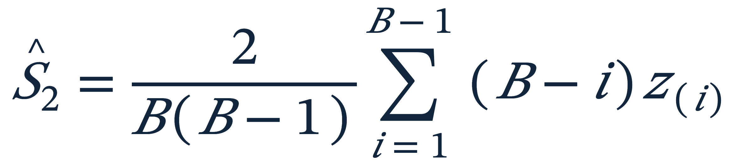
BACKUP
The two-attempt estimator avoids
enumerating replication pairs
Sort the retained bootstrap effects
ordered 1
ordered 2
ordered 3
ordered 4
ordered 5
.12
.20
.31
.44
.58
Small values receive larger weights because they are the minimum in more pairs.
BACKUP
37
Notes:
The sorted formula gives the complete order-two U-statistic efficiently.
[Sources]
- Stats_Paper_Extending_PRAUC_v12.tex.

Slide 38
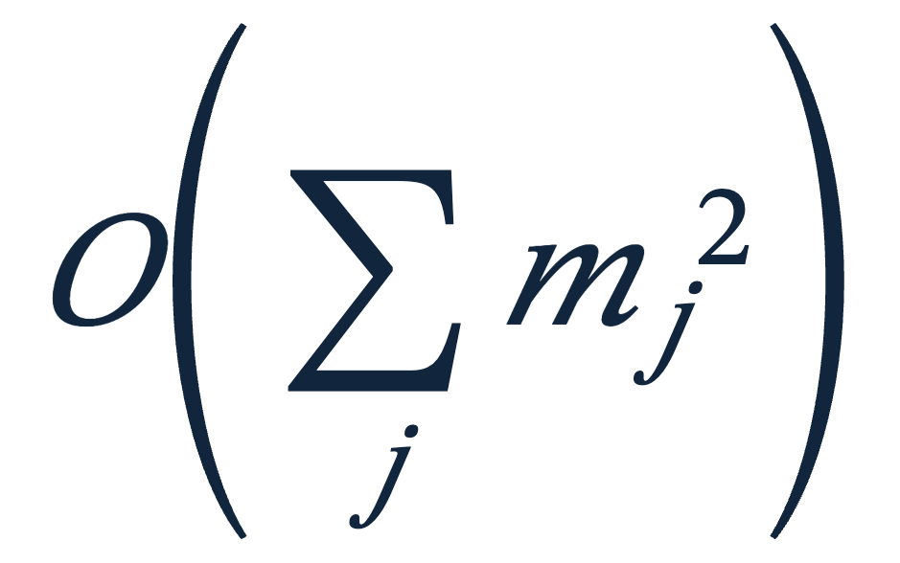
BACKUP
Tie averaging can be computed
without enumerating orderings
FOR EACH TIED BLOCK
Average its prior-standardized
precision over k and t
1. Choose the position k
of a focal positive
2. Count t preceding positives
with a hypergeometric law
→
Computational cost
No enumeration or random jitter is required.
The combinatorial weights do not depend on prevalence and can be reused during the search.
BACKUP
38
Notes:
The closed form integrates over positions and within-block label composition; the visible slide intentionally omits the full combinatorial expression.
[Sources]
- Stats_Paper_Extending_PRAUC_v12.tex.

Slide 39
BACKUP
Outer uncertainty asks how well
one evaluation identifies the target
Observed evaluation
Outer sample
Full inner procedure
lower
bound
→
→
→
one empirical score–label distribution
new empirical distribution of units
profile → infimum → support
Coverage is not automatic when the minimizing prevalence is flat or moves.
BACKUP
39
Notes:
Outer resampling targets inferential uncertainty about the supported functional, not replication variation itself.
[Sources]
- Stats_Paper_Extending_PRAUC_v12.tex.

Slide 40
BACKUP
Key references
POPULATION + CORROBORATION
DESIGN + COMPUTATION
Popper, K. (1959). The Logic of Scientific Discovery.
Bestgen, Y. (2015). Exact expected AP of the random baseline.
Popper, K. (1963). Conjectures and Refutations.
Ojala & Garriga (2010). Permutation tests for classifier performance.
Siblini et al. (2020). Master your metrics with calibration.
Bareinboim & Pearl (2013). Transportability of experimental results.
Elkan, C. (2001). Foundations of cost-sensitive learning.
Hoeffding, W. (1948). U-statistics.
Saerens et al. (2002). Adjusting outputs to new priors.
Perdomo et al. (2020). Performative prediction.
Complete references appear in Stats_Paper_Extending_PRAUC_v12.tex.
BACKUP
40
Notes:
Use this slide for questions about intellectual lineage and technical sources.
[Sources]
- Stats_Paper_Extending_PRAUC_v12.tex.

