Slide 1
LAB WALKTHROUGH
How do we judge model quality?
How to choose performance metric(s)
↓
How can we improve our metrics
How well do performance claims survive attempts to refute them?
↓

Slide 2

WHY AP?
AUROC vs Average Precision (AP/AUPRC)
AP: Vary classification threshold but only look at positives.
Model provides a score, s. (The darker the higher)
-
-
-
+
+
+
-
+
Eg, at a particular threshold
AUROC: vary classification threshold in order to compute area under Receiver Operating Curve. It also has a probability interpretation.
the probability that a randomly chosen positive example receives a higher score than a randomly chosen negative example.
-
-
+
+
$$AUROC= P( s\left(x_{pos}\right)>s\left(x_{neg}\right) )$$
AP has no probability interpretation. It asks:
On average, how pure are the model's predictions while progressively retrieving more of the true positives?
02

Slide 3
AUROC and AP answer different questions
Each has the property the other lacks.
AUROC
Average Precision
Does the model rank positives above negatives?
How good is the set of positives it retrieves?
✓
Precision-based — scores the retrieved set itself
✓
Prevalence-invariant — comparable across populations
✓
✗
Prevalence-dependent — good (reflects difficulty of task when there is class imbalance) and bad (not comparable across populations with different prevalence)
✗
Blind to the purity of what you actually retrieve. (Can look good just because there are many negatives)
What we want. AP’s question, with AUROC’s cross dataset comparability.
1 · Two metrics
2 · Comparability
3 · Supported claims
Notes:
AUROC is not inflated by class imbalance — it is prevalence-invariant by construction, being the probability that a random positive outranks a random negative. That invariance is a genuine strength: it is threshold-free and it is comparable across populations. Its limitation is different: it scores ranking, not the purity of the retrieved set. With 999,000 negatives, an FPR of 0.1% is 999 false positives against 900 true ones — precision 47%. AP fixes exactly that, because its baseline is the prevalence and it scores the retrieved set. But AP gives up the property AUROC had: comparability across populations. The rest of the talk is about recovering it.

Slide 4
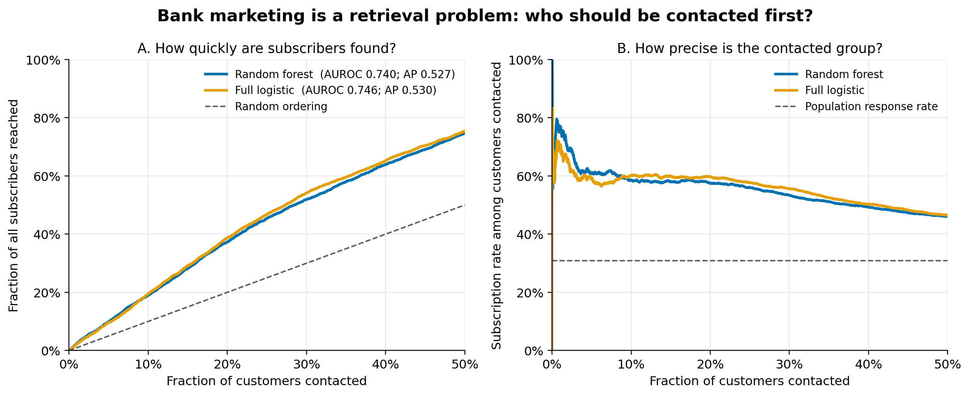
DOMAIN STUDY
Example: Banking dataset (banks must cla
A. How quickly are subscribers found?
B. How precise is the contacted group?
DOMAIN STUDY
18
Notes:
The bank must decide which customers to contact first in a direct-marketing campaign, given limited contact capacity. The positive outcome is that a contacted customer becomes a client.
This is a ranking task—similar to our neoantigen ranking task.
AP is relevant because it rewards rankings that place likely subscribers near the top, reach subscribers quickly, and maintain a high subscription rate among contacted customers.

Slide 5
DOMAIN STUDY
Two comparisons play different roles
DATA AND SPLIT
PRIMARY QUESTION
POSITIVE CONTROL
41,188 campaign records
Random forest
versus full logistic
Full versus
demographic logistic
First 32,950 rows train each model.
Final 8,238 rows form the source-ordered evaluation.
Call duration is excluded before fitting.
Candidate: random forest
Incumbent: full logistic
Can the candidate justify replacing the incumbent?
The reduced model omits non-demographic predictors.
This checks that the procedure can return a supported replacement.
Training prevalence 6.37% • Evaluation prevalence 30.83% • Deployment prevalence range: [0.01,0.5]
DOMAIN STUDY
19
Notes:
The dataset is the UCI Bank Marketing dataset: 41,188 observations from Portuguese bank telephone-marketing campaigns, ordered from May 2008 through November 2010. The outcome y records whether the customer subscribed to a term deposit.
For the primary comparison, the random forest and full logistic regression use exactly the same 19 predictors:
Customer characteristics: age, job, marital status, education, credit default, housing loan, and personal loan.
Current campaign information: contact method, month, day of week, and number of campaign contacts.
Prior campaign history: days since prior contact, number of earlier contacts, and prior campaign outcome.
Economic conditions: employment variation rate, consumer price index, consumer confidence index, three-month Euribor rate, and number employed.
Categorical variables are one-hot encoded and numeric variables standardized. The models differ in how they use this information: logistic regression fits an additive linear model on the log-odds scale, while the random forest can represent nonlinearities and interactions. See the [model construction (line 142)](/Users/thomm15/Documents/Stats_Paper_AUPRC_extension/supported_ap_code/domain_study/banking_story.py:142).
Importantly, call duration is excluded. Although highly predictive, it is only known after the call has occurred, so it cannot inform the bank’s pre-contact ranking decision.
The first 32,950 chronologically ordered observations train the models and the last 8,238 evaluate them. This produces a substantial temporal prevalence shift: 6.37% subscribers in training versus 30.83% in evaluation ([report (line 6)](/Users/thomm15/Documents/Stats_Paper_AUPRC_extension/supported_ap_code/domain_study/outputs/REPORT.md:6)).
There is also a third, demographic-only logistic classifier used as a positive control; it receives only age, job, marital status, and education.

Slide 6
ASSESSMENT
Declare what a replacement claim must survive
POPULATION SET Π
REGIME ℛ
SUPPORT ORDER K
DECISION MARGIN
1%–50%
Fixed model
K = 2
δ = 0
Every target prevalence in the declared deployment range.
New independent evaluation units; class-stratified resampling.
Two complete evaluations must retain the claimed advantage.
Any strictly positive lower bound clears the performance margin.
Transport assumption: class-conditional score distributions remain stable across target prevalences.
ASSESSMENT
20
Notes:
Prevalence is a computed challenge within each resampled evaluation, not a claim that the observed prevalence is uncertain.
The study does not represent refitting, reselection, or a new deployment environment.
[Sources]
- Stats_Paper_Extending_PRAUC_v12.tex, assessment and estimation sections.
- supported_ap_code/domain_study/outputs/REPORT.md.

Slide 7
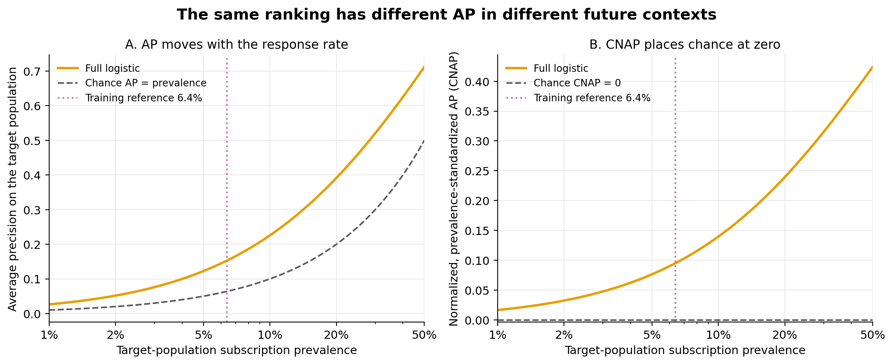
POPULATION
AP needs a target prevalence
POPULATION
21
Notes:
The full-logistic ranking is held fixed while target prevalence changes.
CNAP places population random ranking at zero, but it does not make the interior profile prevalence-invariant.
[Sources]
- Stats_Paper_Extending_PRAUC_v12.tex, prevalence standardization section.
- supported_ap_code/domain_study/outputs/tables/prevalence_standardization.csv.

Slide 8
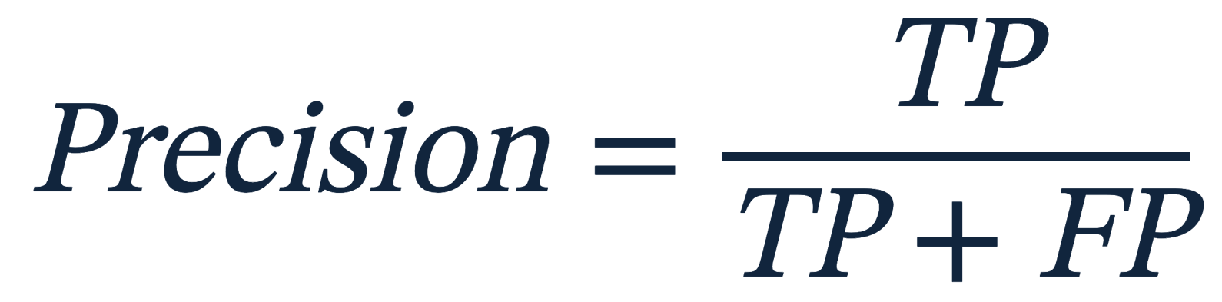
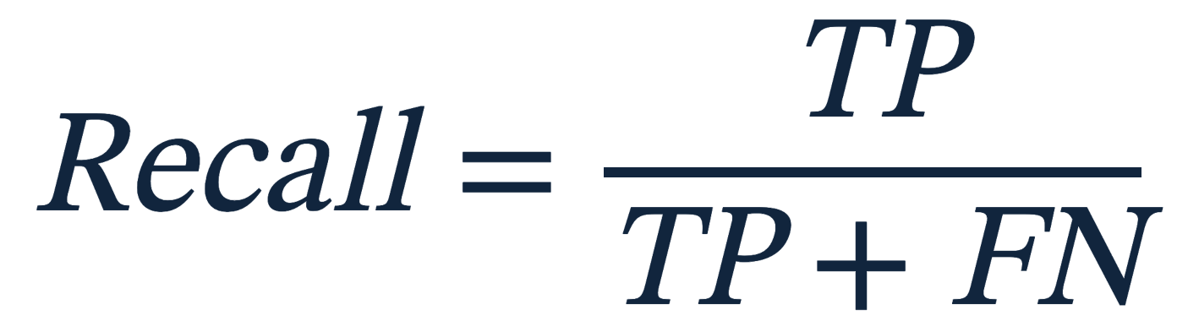

WHY AP?
AP combines precision with each gain in recall
PRECISION AT STEP n
RECALL AT STEP n
P_n: precision after
threshold step n
R_n: recall after
threshold step n
AP is computed by traversing the examples in descending score order and adding
each time a positive example is encountered.
$$\left(R_{n}−R_{\left\{n−1\right\}}\right)∗P_n$$
03
Notes:
Define the two axes, then connect them to the empirical sum: P_n is precision after step n and R_n − R_(n−1) is the recall gain. Each product is one contribution to AP.
[Sources]
- Stats_Paper_Extending_PRAUC_v12.tex.

Slide 9
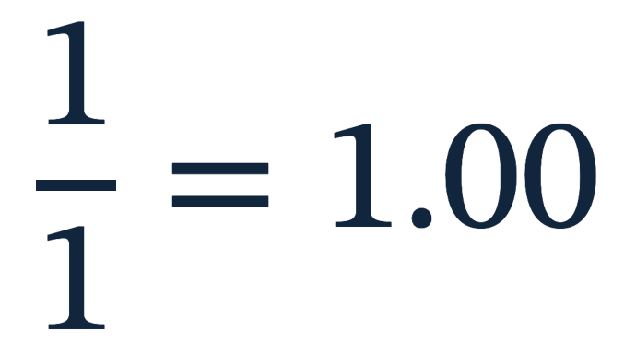
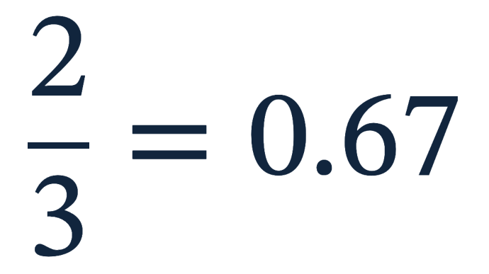
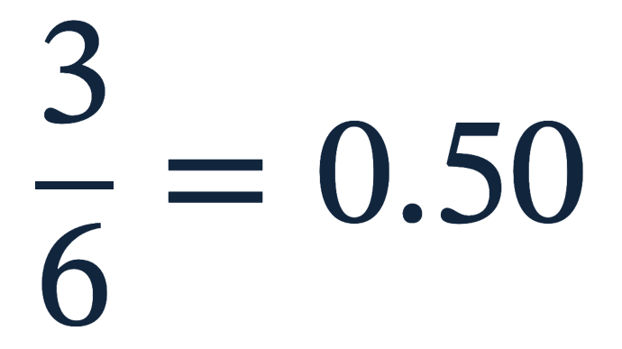
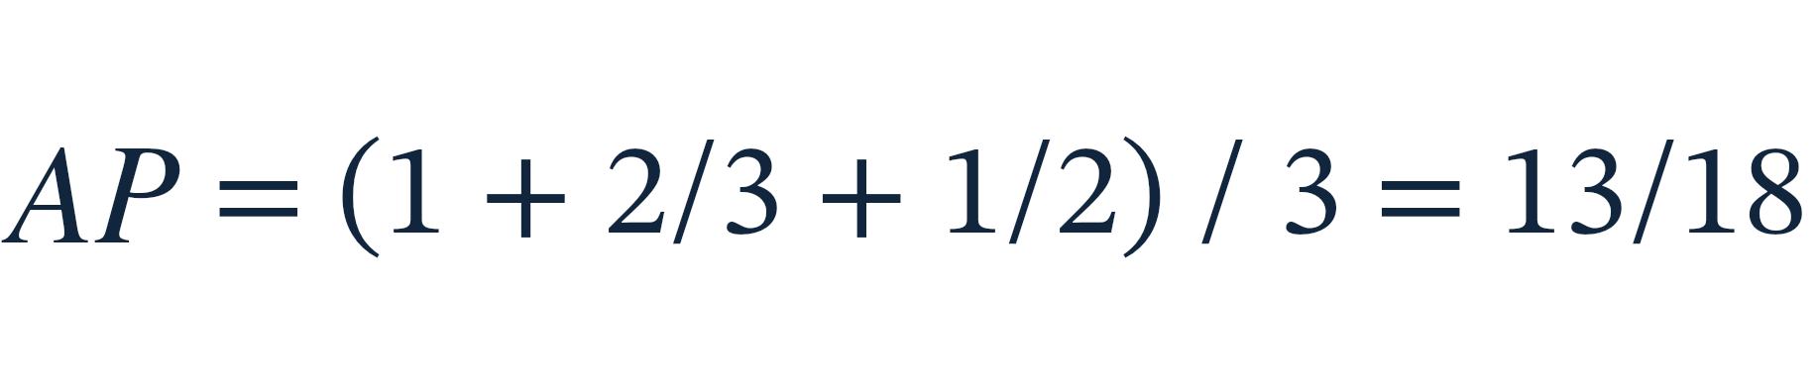
WHY AP?
How to compute AP
Ranked score list
1
2
3
4
5
6
7
8
+
rank 1
+
−
+
−
−
+
−
−
+
rank 3
Every positive expands recall; every false positive can dilute precision.
+
rank 6
= 0.72
05
Notes:
Walk the threshold down the list. The curve is generated by a sequence of selected sets.
[Sources]
- Stats_Paper_Extending_PRAUC_v12.tex.

Slide 10

WHY AP?
AP rises when positives
appear early
POSITIVE RANKS
+
rank 1
+
rank 3
+
rank 6
AP is a weighted summary of precision over recall—not the area of a smooth geometric shape.
WHY AP?
06
Notes:
Calculate AP directly from the three positive ranks. This makes the later weighted formula less mysterious.
[Sources]
- Stats_Paper_Extending_PRAUC_v12.tex.

Slide 11
PROBLEM I · THE TARGET POPULATION
AP is a recall-weighted sum of precisions
Each distinct score value defines a threshold, and the ranking is traversed from the top.
A block of negative cases alone gains no recall, although its false positives lower the precision of every block below it.
No prevalence appears anywhere in the expression.
05 / 56
Notes:
The recall increments are computed from the observed positives alone, which is what makes them free of the class prior. This is also why the weighted implementation works: weight each positive by pi/n+ and each negative by (1-pi)/n-, and weighted recall is unchanged.

Slide 12
PROBLEM I · THE TARGET POPULATION
Ordinary AP already carries a prevalence
Divide numerator and denominator by n. The share of positives in the evaluation sample enters as the observed prevalence, and the class-conditional rates enter as r and f.
An average precision value is therefore already indexed to a population: the one the evaluation sample happened to have. Nothing about it was declared, and nothing about it was chosen.
06 / 56
Notes:
TP/n = (n+/n)(TP/n+) = pi-hat times r, and FP/n = (n-/n)(FP/n-) = (1 - pi-hat) times f. The identity is exact; ordinary AP is the case where the target prevalence equals the sample's own.

Slide 13
PROBLEM I · THE TARGET POPULATION
Precision odds factor into prior and ranking
Written as odds, replacing the observed prevalence with a declared target π touches one factor.
Prior standardization replaces the first factor and retains the second. Applying it at every distinct threshold gives the prior-standardized value, $AP_{π}$.
07 / 56
Notes:
Equivalently: weight each positive unit by pi/n+ and each negative by (1-pi)/n-. Weighted stepwise AP returns the same quantity.

Slide 14
POPULATION
What problems do we need to solve to improve AP?
Prevalence Standardization –> AP should be standardized to explicitly declared target prevalence(s) relevant to where the model will be deployed.
Random ranking should produce AP=0
Perfect ranking should produce AP=1
08

Slide 15
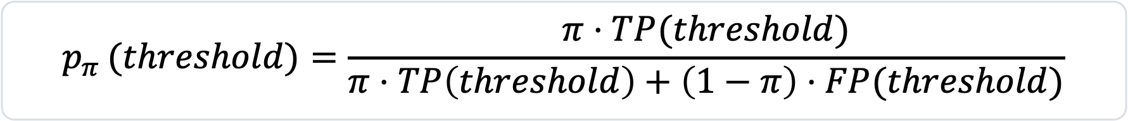
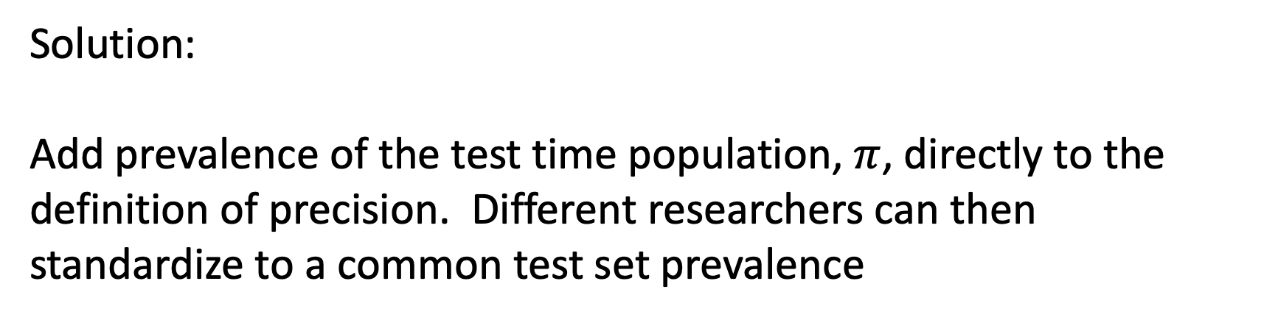
POPULATION
Problem 1 – How to prevalence standardize
Solution:
Add prevalence of the test time population, $π$, directly to the definition of precision. Different researchers can then standardize to a common test set prevalence
$$p_{π }(threshold)=\frac{π⋅TP(threshold)}{π⋅TP\left(threshold\right)+\left(1−π\right)⋅FP(threshold)}$$
09

Slide 16


POPULATION
Problems 2 and 3 - How to ensure random classifier produces AP=0 and perfect classifier produced AP=1?
Random ranking still has
→
So a raw AP of 0.30 means
something different at 1%
than at 20% prevalence.
0 marks population random ranking
1 marks perfect ranking
POPULATION
11
Notes:
In the literature, people have solved problem 1, and separately problems 2-3. I haven’t seen anyone combine them into my CNAP_pi

Slide 17
POPULATION
AP needs a target prevalence
POPULATION
21
Notes:
See part B

Slide 18






POPULATION
My idea: Evaluate $CNAP_{π}$ across a scientifically relevant prevalence set, $Π=\{\}$, and take the minimum.
.01 target $π$
.05 target $π$
.20 target $π$
.40 target $π$
minimum
0.55
0.48
0.31
0.52
→
0.31
$CNAP_{Π}=min_{\left\{π∈Π\right\}}CNAP_{π}$(the largest level attained at every declared prevalence.)
POPULATION
13
Notes:
The minimum is a severe test in the Popperian sense.
It asks what prediction claim survives all prevalence values we are likely to encounter when the model is deployed.

Slide 19

ASSESSMENT
There can be more ways to challenge a performance claim than prevalence.
Π
ℛ
K
Does the performance claim survive multiple prevalences?
Does the performance claim survive replication in the data-generating regime when other factors vary?
Does the performance claim survive more severe tests?
ASSESSMENT
14

Slide 20
PROBLEM II · REPEATING THE EVALUATION
The regime declares which mechanisms are redrawn
ℛ is a probability law for one complete replication of the claim under study.
Mechanism | Fixed model | New environment | Repeated development
Evaluation units | redrawn | redrawn | redrawn
Environment | held | redrawn | redrawn
Measurement process | held | declared | declared
Fitted model | held | held | redrawn
Training and selection | held | held | rerun
Independence is required between complete replications; dependence within one is permitted, so a clustered or multisite design resamples the coarsest unit its design treats as independent.
16 / 56
Notes:
Is the performance claim about a fixed model, is it about performance in a new environment? Is it about a training procedure?

Slide 21
CORROBORATION
How do replicated evaluations add support for a performance claim?
Suppose we have two replications (K=2) from our regime.
The claim that the model has
Support for CNAP > 0.05 is defeated. Both evaluations support a max CNAP of 0.05.
Evaluation 1
Evaluation 2
CNAP=0.70
CNAP=0.05
Claim retained
Claim retained
15
Notes:
A level claim survives a set of K evaluations only if every evaluation exceeds that level.
The realized minimum is the greatest level retained by one set of K challenges; the support operator averages that retained level over executions of the declared regime.
Support remains on the scale of T. It is neither a probability that the claim is true nor a confidence bound.
[Sources]
- Stats_Paper_Extending_PRAUC_v12.tex, replication-survival support section.

Slide 22
PROBLEM III · EXPECTED PERFORMANCE
The support (across regime replications) operator
Writing T for that effect, the realized minimum is the greatest level one set of K challenges retained; the expectation averages it over executions of the regime. At K = 2, support is expected performance less half the expected disagreement between two replications — a cost made visible rather than converted into a standard error.
22 / 56
Π★
ℛ
K
Notes:
K = 2 is the first value at which joint survival asks more than expected performance. Other values must be prespecified and examined for sensitivity. The quantity stays on the scale of the effect: not a probability, not a confidence bound.

Slide 23
PROBLEM IV · CHANCE IN A FINITE DESIGN
Anchor the support operator to [0,1]
Condition on the scores, their tie structure, the evaluation units and the class counts, then assign outcomes uniformly over the label vectors preserving those counts and rerun the entire robust procedure.
The regime is not replaced: every permutation is bootstrapped under the same declared ℛ, and only the label law changes.
Perfect separation is a fixed point at one under the stratified bootstrap, which makes the calibrated ratio interpretable. Raw value, anchor and calibrated ratio travel together.
37 / 56
Notes:
Even though we anchored CNAP to the 0,1 scale, applying the support operator takes it off the scale again.
We can renormalize by empirically estimating the chance level of the support operator, and then calibrating based on that.

Slide 24
PROBLEM IV · CHANCE IN A FINITE DESIGN
Calibrated values cannot be compared across models
Two models with different score vectors have different conditional anchors and therefore different affine scales, so their calibrated values can be neither subtracted nor ranked.
Within one model
Across two models
Raw value, anchor and ratio travel together, and the ratio is interpretable against the design that produced it.
Each ratio is affine on its own anchor, so a difference or a ranking of calibrated values rests on no common scale.
A further condition, and not a comparison problem: where the outcomes were used for selection, tuning or early stopping, permuting them around a supposedly fixed score vector reproduces nothing.
38 / 56
Notes:
Unfortunately, even after calibration to the model specific null, we technically still can’t directly compare this value with that same quantity evaluated on another model.
This led me to a very interesting idea. A way to actually compare supported, chance normalized AP across models.

Slide 25
PROBLEM V · MODEL REPLACEMENT
Forming the difference before both challenges
The tie-averaged value is chance-normalized exactly as before, and within each replication the same sampled units and outcomes serve both models, so the marginal score of either is never an intermediate input.
46 / 56
Π★
ℛ
K
Notes:
A positive value is an advantage for A that survives every declared prevalence and the replication criterion.

Slide 26
PROBLEM V · MODEL REPLACEMENT
The replacement margin
Let d be the smallest retained advantage that would justify replacing B by A. A positive point estimate does not establish the population inequality, so the rule requires an outer lower bound to exceed d, with pairing preserved through the outer and inner layers.
Coverage must be established for the intended design, especially where the minimizing prevalence is nonunique or moves under perturbation. Costs, feasibility, calibration, fairness and consequences at operating thresholds remain separate inputs.
A positive supported ranking advantage is not by itself a command to deploy.
52 / 56
Π★
ℛ
K
Notes:
The margin translates performance evidence into one component of a decision.

Slide 27
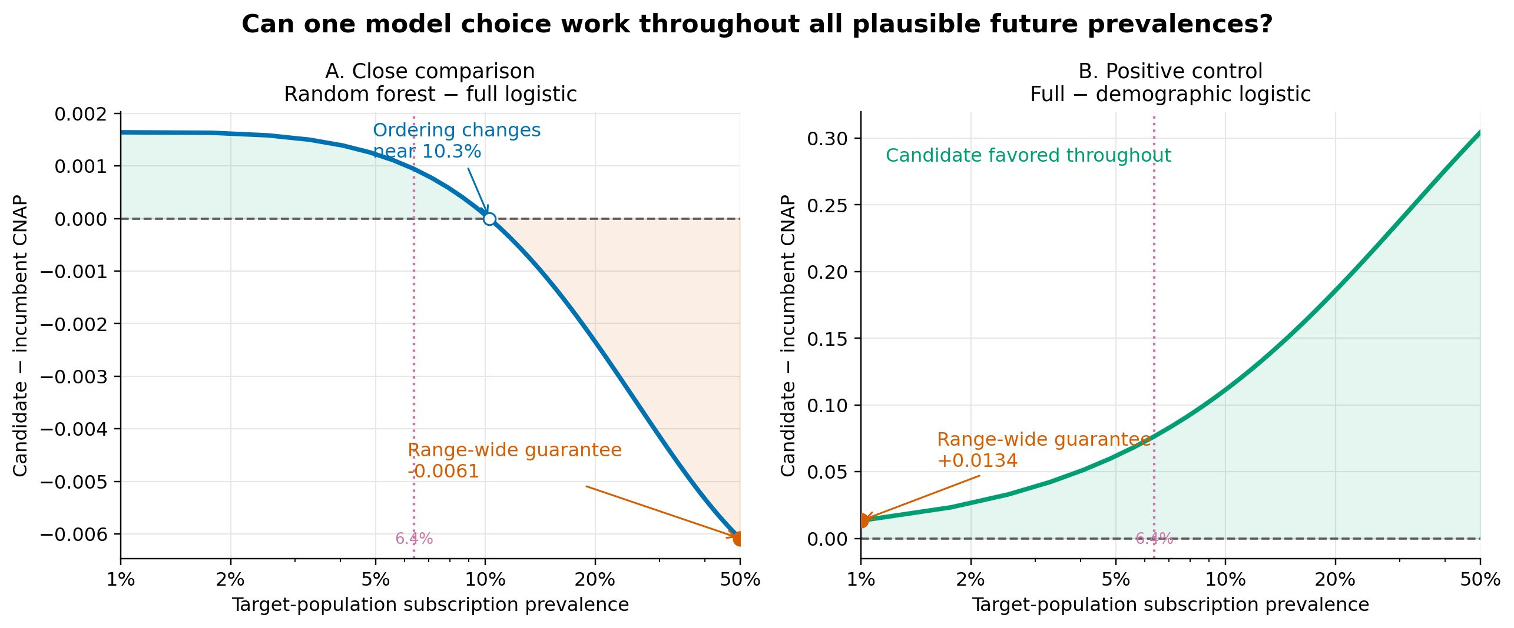

REPLACEMENT
$$θ_{\left\{A,B\right\}}$$
How does ( support for random forest over full logistic regression in the Banking example) change with prevalence?
24
Notes:
The primary comparison changes ordering near 10.3% prevalence, so neither model wins throughout the range.
The positive control remains favorable throughout and has a positive range-wide effect.
[Sources]
- supported_ap_code/domain_study/outputs/reports/random_forest_vs_full_logistic.json.
- supported_ap_code/domain_study/outputs/reports/full_vs_demographic_logistic.json.

Slide 28
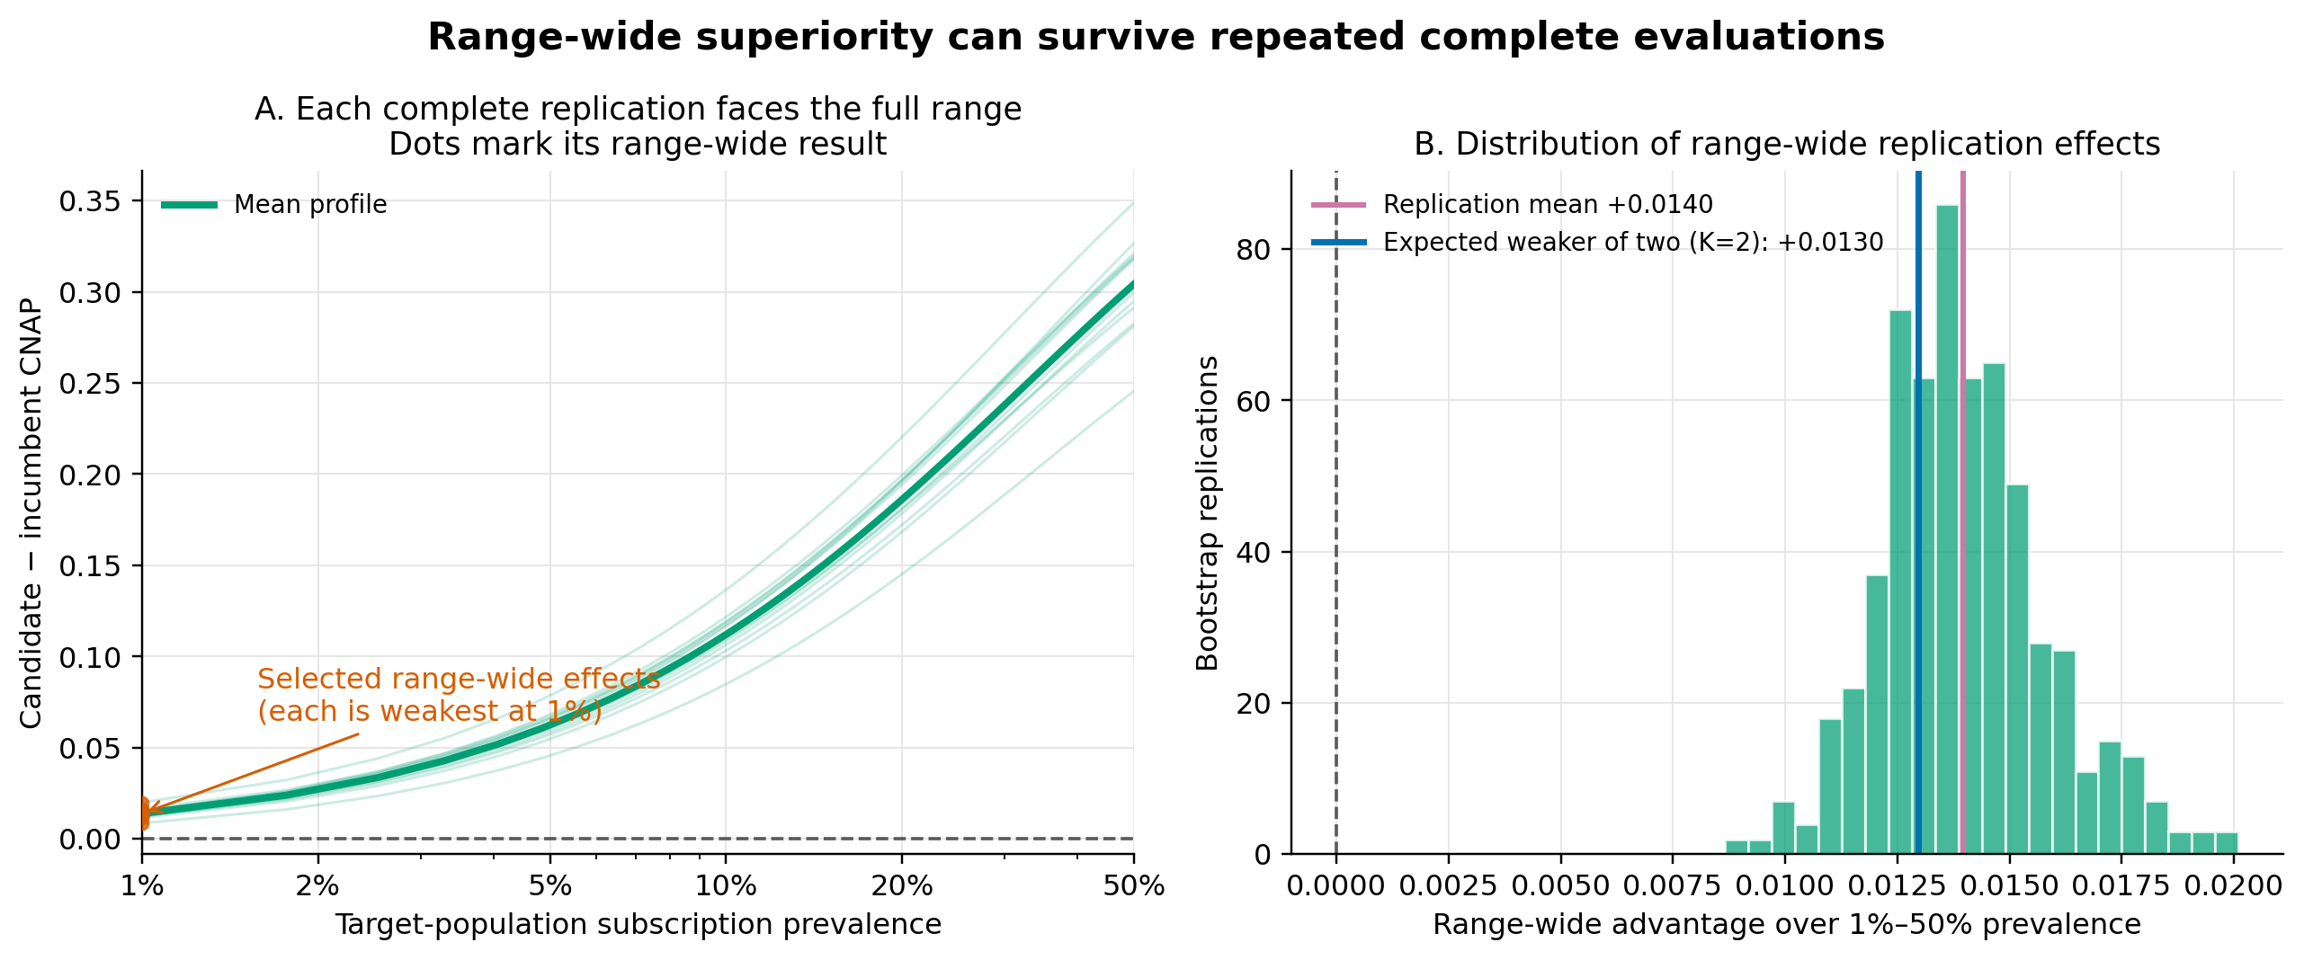
What survives two evaluations?
CORROBORATION
26
Notes:
Each thin profile is evaluated over the full prevalence range before its minimum is retained.
The K=2 supported value is the expected weaker of two range-wide replication effects.
[Sources]
- supported_ap_code/domain_study/outputs/reports/full_vs_demographic_logistic_inner_trace.json.
- Stats_Paper_Extending_PRAUC_v12.tex, support estimation section.

Slide 29
REPLACEMENT
Replacement needs a lower bound above δ
Replace B with A only if: outer 95% lower bound for support > δ
OUTER SAMPLE
FULL INNER PROCEDURE
LOWER BOUND
New empirical distribution
Rerun everything
Decision evidence
Resample evaluation units
Profile → infimum → K=2 support
Take the outer 5th percentile
The nominal 95% percentile bound still requires design-specific coverage validation.
REPLACEMENT
27
Notes:
The outer layer asks how well one observed evaluation identifies the supported target.
The nonsmooth prevalence minimum means ordinary bootstrap coverage is not automatic.
[Sources]
- Stats_Paper_Extending_PRAUC_v12.tex, outer uncertainty section.
- supported_ap_code/domain_study/outputs/REPORT.md.

Slide 30
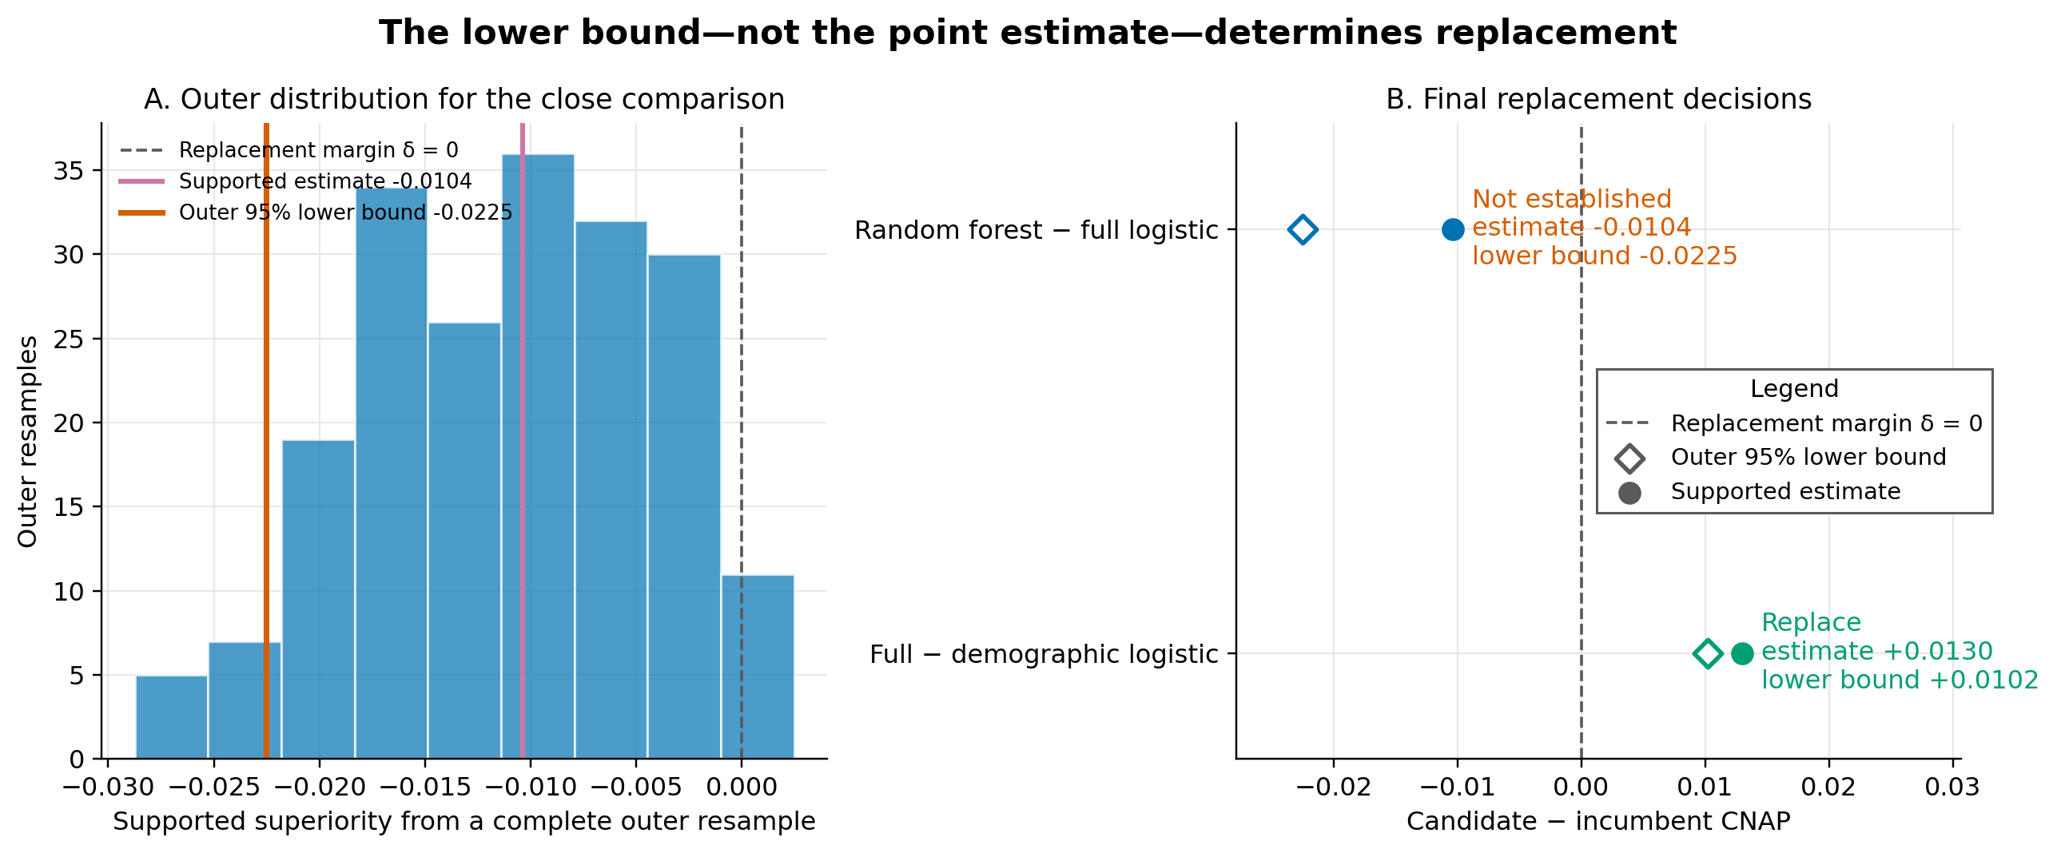
REPLACEMENT
Only the positive control clears the margin
REPLACEMENT
28
Notes:
The random-forest candidate does not clear the zero replacement margin.
The positive control has a positive supported estimate and a positive outer lower bound.
[Sources]
- supported_ap_code/domain_study/outputs/reports/random_forest_vs_full_logistic.json.
- supported_ap_code/domain_study/outputs/reports/full_vs_demographic_logistic.json.

Slide 31
ORIENTATION
“Do not replace” is not a reverse verdict
CANDIDATE ORIENTATION
REVERSE ORIENTATION
Random forest − logistic
Logistic − random forest
Observed range-wide effect −0.0061
Supported estimate −0.0104
Outer lower bound −0.0225
Decision: replacement not established
Observed range-wide effect −0.0016
Supported estimate −0.0037
Outer lower bound not computed
A formal reverse verdict needs its own outer run.
The profiles cross near 10.3% prevalence: over 1%–50%, neither model is uniformly better.
ORIENTATION
29
Notes:
Failure to establish A over B is not evidence that B is superior to A.
The prevalence infimum makes the reversed orientation a separate estimand rather than the negative of the forward supported value.
[Sources]
- Stats_Paper_Extending_PRAUC_v12.tex, orientation coherence section.
- supported_ap_code/domain_study/outputs/reports/random_forest_vs_full_logistic.json.

Slide 32
INTERPRETATION
Conclusions travel with the assessment design
Π
Population transport
ℛ
Fixed-model regime
Class-conditional score distributions are assumed stable as prevalence changes.
Evaluation units vary; fitting, selection, and new environments do not.
≈
Reference behavior
?
Outer uncertainty
The no-positive-anchor result uses an exchangeable-label reference law.
Nominal percentile coverage requires design-specific validation.
This is ranking evidence—not a complete deployment decision about cost, calibration, fairness, or intervention effects.
INTERPRETATION
30
Notes:
Assessment-relative reporting prevents the supported value from being detached from its population and replication challenges.
Operational deployment still requires inputs outside ranking performance.
[Sources]
- Stats_Paper_Extending_PRAUC_v12.tex, interpretation and reporting sections.
- supported_ap_code/domain_study/outputs/REPORT.md.

Slide 33
SYNTHESIS
From score comparison to criticizable claim
1
2
3
4
NAME CONTEXTS
PAIR FIRST
DEMAND SURVIVAL
QUALIFY DECISION
Target prevalence
1%–50%
Tie-neutral
CNAP advantage
Range minimum
and K = 2
Outer bound
above δ = 0
Primary comparison: no replacement. Positive control: replace. The difference is the claim each comparison survived.
SYNTHESIS
31
Notes:
Close by returning to the decision problem rather than to the mechanics.
The framework does not produce a universal model winner; it makes the replacement claim explicit and open to criticism.
[Sources]
- Stats_Paper_Extending_PRAUC_v12.tex, conclusion.
- supported_ap_code/domain_study/outputs/REPORT.md.

Slide 34
BACKUP
Key references
POPULATION + CORROBORATION
DESIGN + COMPUTATION
Popper, K. (1959). The Logic of Scientific Discovery.
Bestgen, Y. (2015). Exact expected AP of the random baseline.
Popper, K. (1963). Conjectures and Refutations.
Ojala & Garriga (2010). Permutation tests for classifier performance.
Siblini et al. (2020). Master your metrics with calibration.
Bareinboim & Pearl (2013). Transportability of experimental results.
Elkan, C. (2001). Foundations of cost-sensitive learning.
Hoeffding, W. (1948). U-statistics.
Saerens et al. (2002). Adjusting outputs to new priors.
Perdomo et al. (2020). Performative prediction.
Complete references appear in Stats_Paper_Extending_PRAUC_v12.tex.
BACKUP
37
Notes:
Use this slide for questions about intellectual lineage and technical sources.
[Sources]
- Stats_Paper_Extending_PRAUC_v12.tex.

