Slide 1
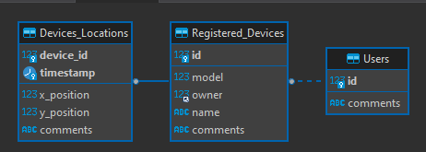
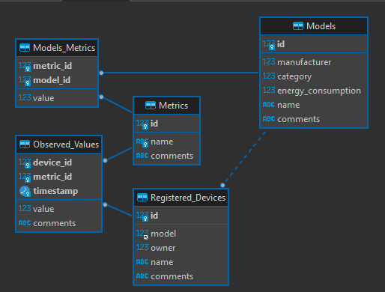
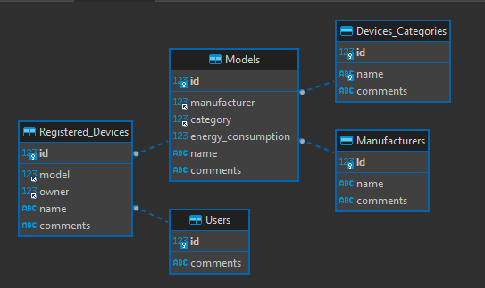
Database ERD

Slide 2
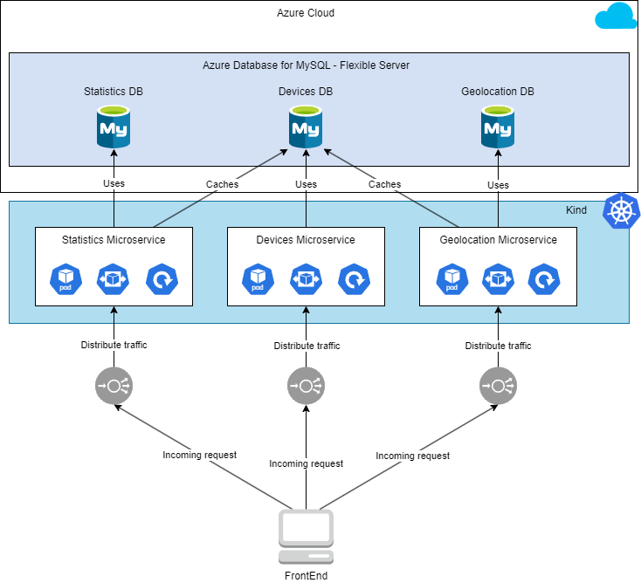
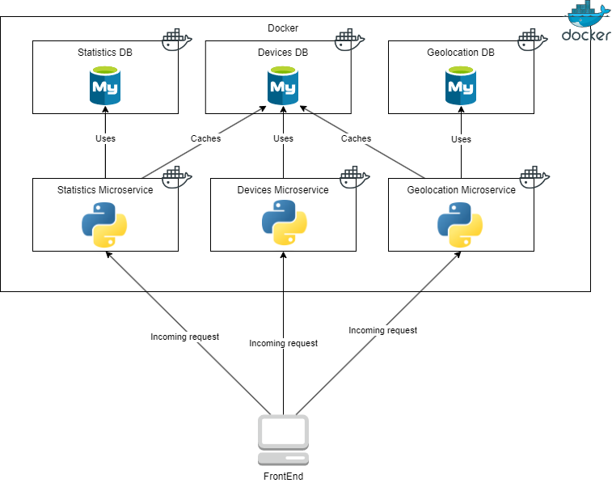

Slide 3
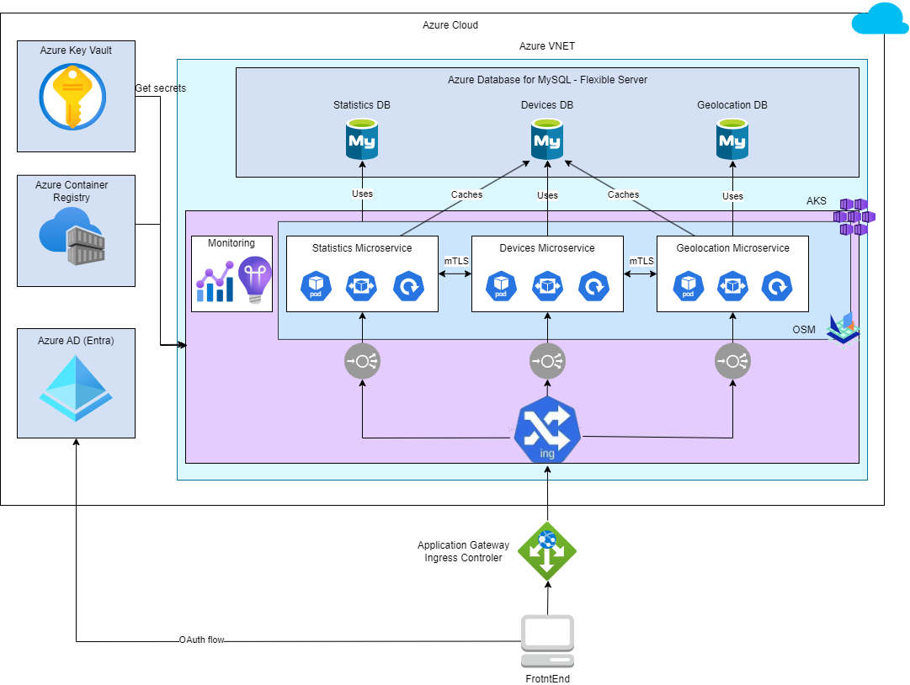

Slide 4
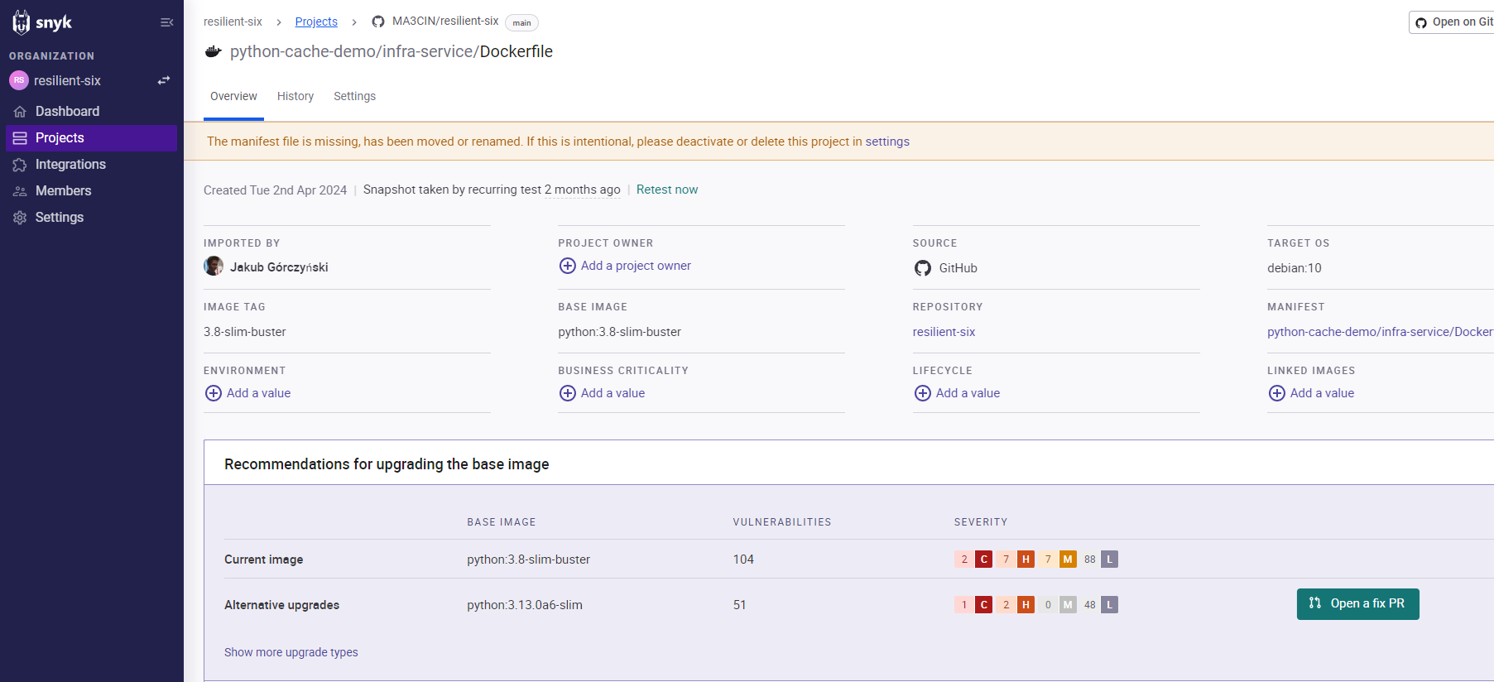
SNYK – container image scanning for vulnerabilities

Slide 5
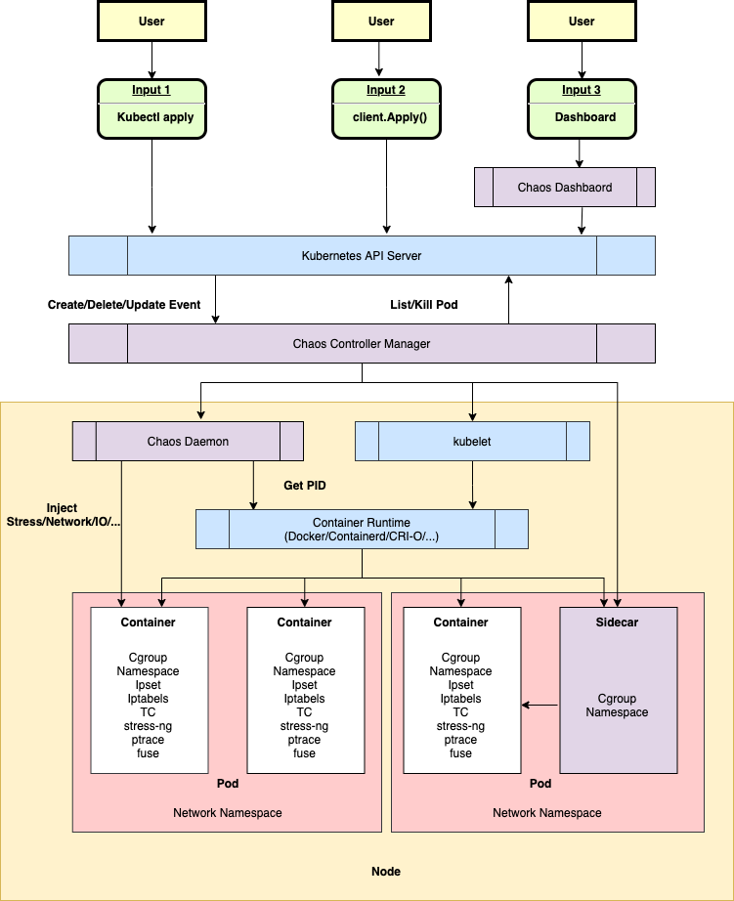
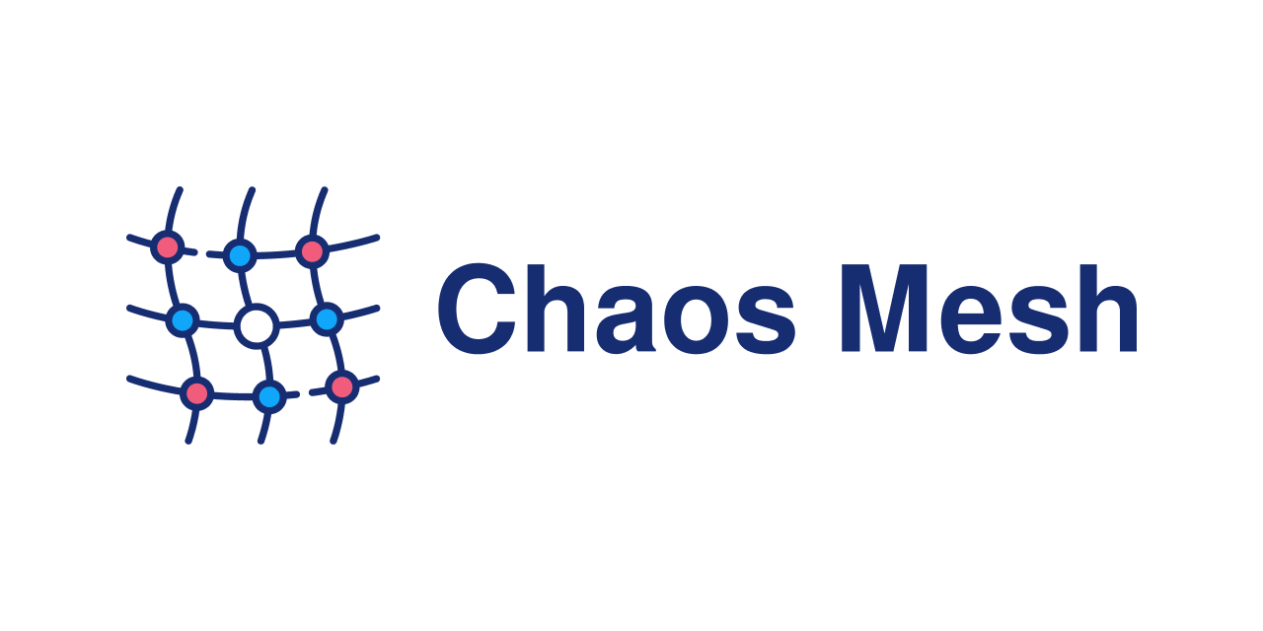
Chaos Mesh for Chaos Engineering

Slide 6
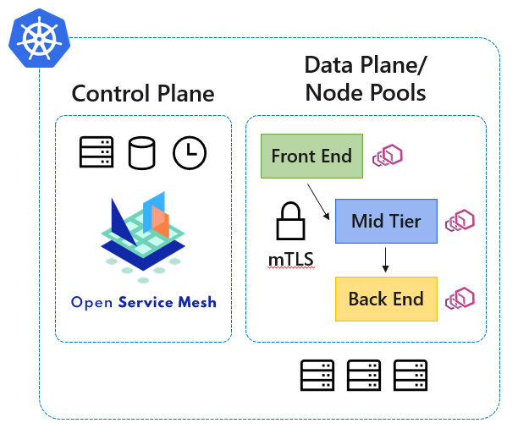
Open Service Mesh with mTLS
For East-West communication mTLS established with Tresor as a Certificate Issuance Facility and CA
https://github.com/openservicemesh/osm/tree/release-v0.11/pkg/certificate/providers/tresor

Slide 7
Azure free tier limitations – Self signed certs
Azure LoadBalancer is L4 and cant terminate TLS traffic. An App Gateway or an Nginx Ingress Controler is needed.

Slide 8
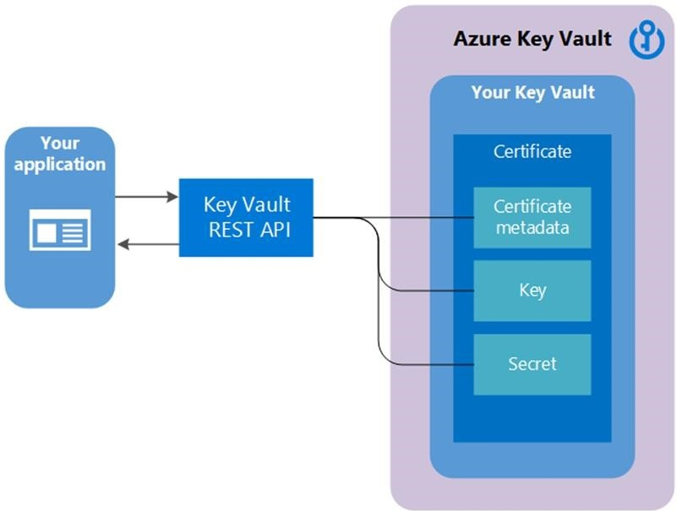
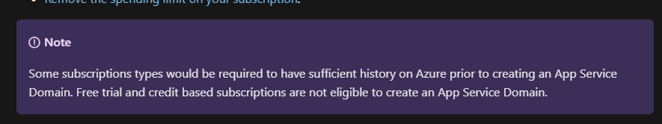
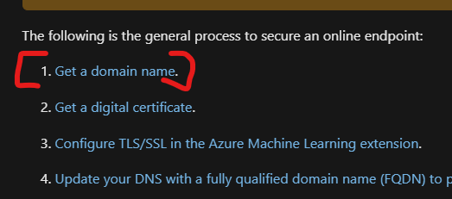

Azure free tier limitations - Domain
public IP limits (3), Kubernetes node resource limits
Privilege limits, AGIC limits, CA Certificate limits

