Slide 1
Bahrain Average Expenditure Per Visitor Per Trip
December 7th, 2024

Slide 2

Introduction of Bahrain
- Bahrain: an island nation in the Arabian Gulf.
- A unique hub for finance, trade, and culture in the Middle East.
- Rich history as a crossroads of ancient trade routes.
- Strategic location with modern infrastructure, vital for the region's economy.
- Progressive governance and diversifying economy.
- Key sectors: banking, tourism, and technology.
- Project focus: Bahrain's demographics, economy, and regional role.
- Highlights challenges and opportunities shaping its future.

Slide 3
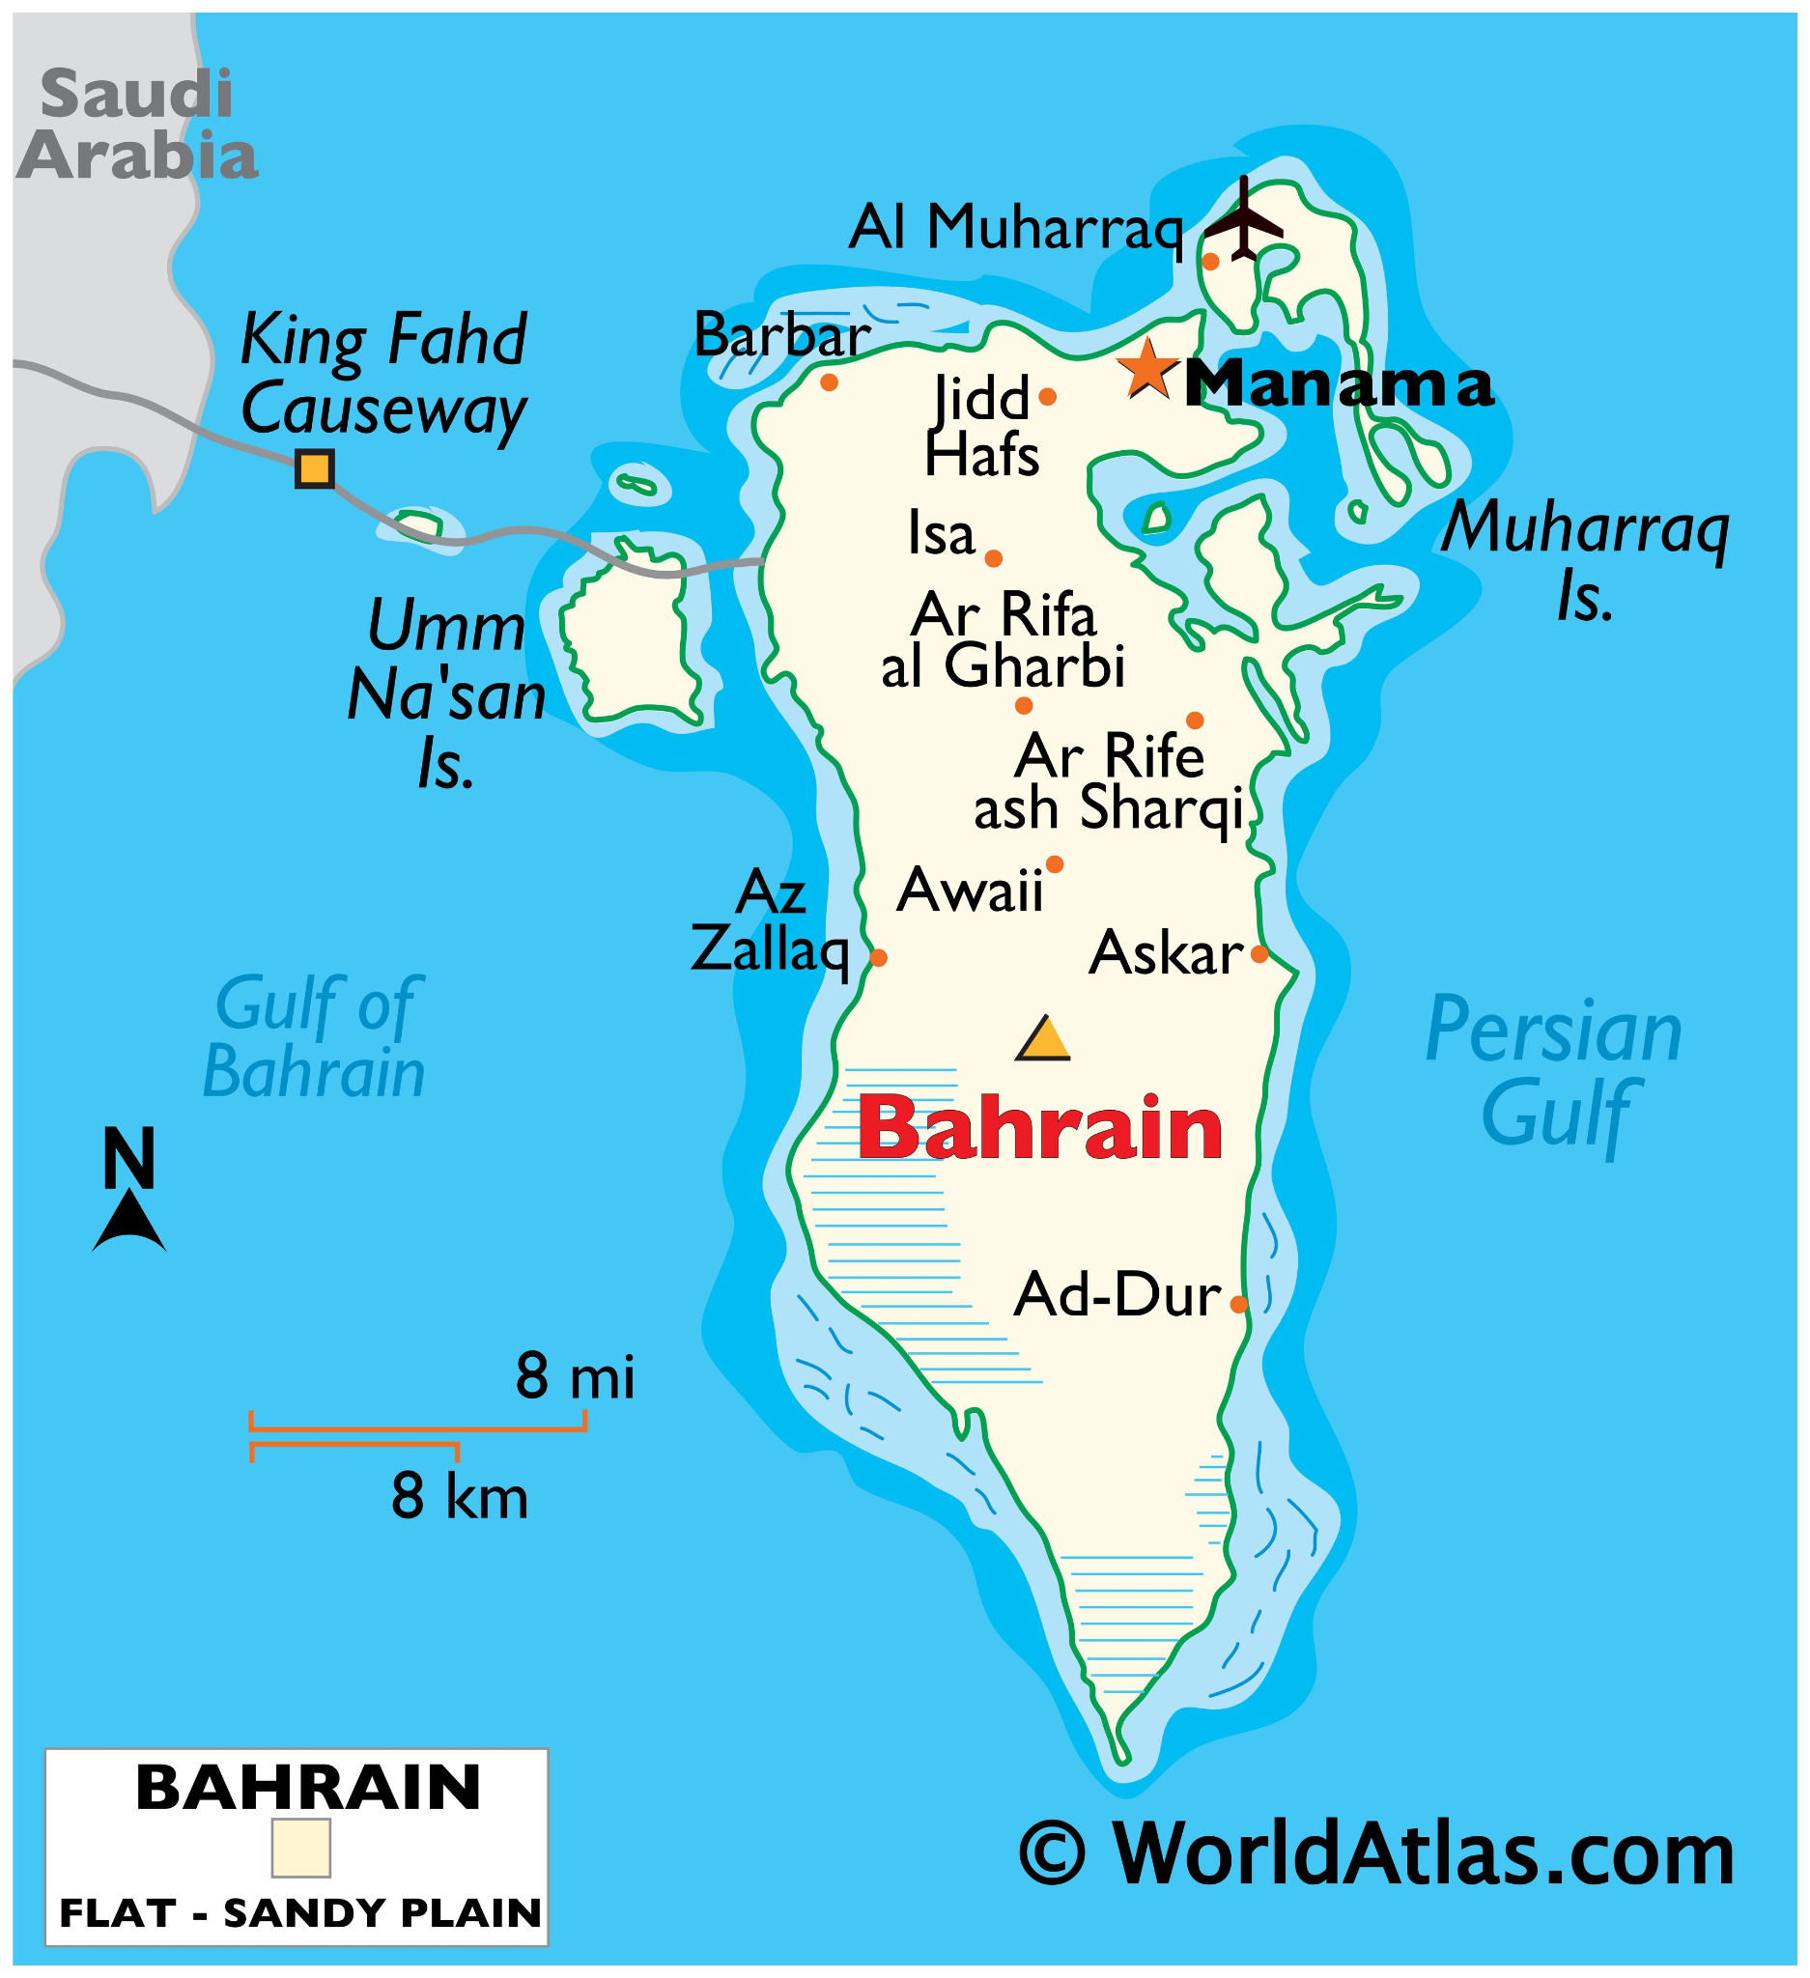
Map Of Bahrain

Slide 4
Government
- Constitutional monarchy led by King Hamad bin Isa Al Khalifa.
- Blend of traditional monarchy and modern governance.
- Bicameral legislature:
- **Council of Representatives**: elected by citizens.
- **Shura Council**: appointed by the King.
- Supports Bahrain’s progressive governance approach.
- Promotes political stability and regional engagement.
- Active member of the Gulf Cooperation Council (GCC).

Slide 5
Economy
- One of the most diverse economies in the Gulf region.
- Key sectors: finance, oil, and tourism.
- Historically reliant on oil production as an economic cornerstone.
- Proactive diversification:
- Regional financial hub with strong banking and insurance industries.
- Significant investment in tourism:
- Promotes rich cultural heritage and modern infrastructure.

Slide 6
Population
- Diverse population of over 1.7 million.
- Includes Bahraini nationals and a significant expatriate community.
- Multicultural society shaped by Bahrain’s historical role as a trade hub.
- High literacy rate and access to advanced healthcare and education.
- Culture deeply rooted in Arab traditions, enriched by expatriates.
- Expatriates contribute significantly to the workforce:
- Key sectors: construction, finance, and services.

Slide 7
Environment
- Arid climate with low-lying desert terrain.
- Comprises 33 islands; Bahrain Island is the largest.
- Diverse marine life and ecosystems:
- Includes mangroves and coral reefs.
- Vital for biodiversity and coastal protection.
Environmental challenges:
- Land reclamation and desertification.
- Impacts of climate change: rising sea levels and extreme heat.
- Efforts to address challenges:
- Environmental conservation initiatives.
- Sustainable urban planning strategies.

Slide 8
Analysis of Visitor Spending in Bahrain (2017-2023)
2017 stands out with the highest visitor spending, especially among overnight visitors.
2020 (pandemic year) caused significant declines, particularly in same-day visitor spending.
Post-2020: Spending stabilized but remains lower than pre-pandemic levels.
Seasonality plays a role in total spending, with months like March, June, and December showing spending peaks.
Visitor Type Impact: Overnight visitors contribute more to spending compared to same-day visitors.

Slide 9
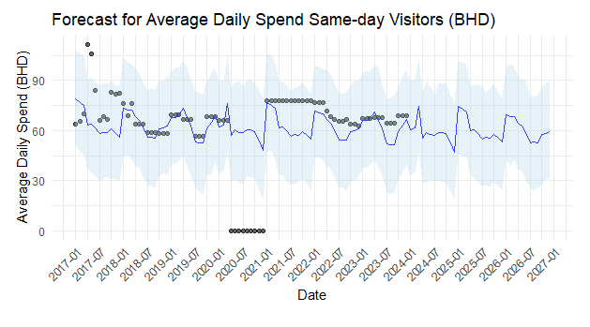
Three-Year Forecast

Slide 10
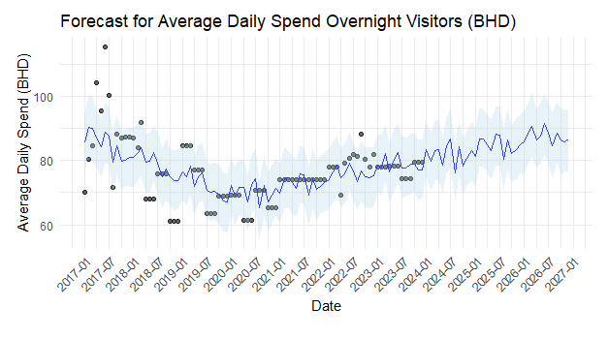
Three-Year Forecast

Slide 11
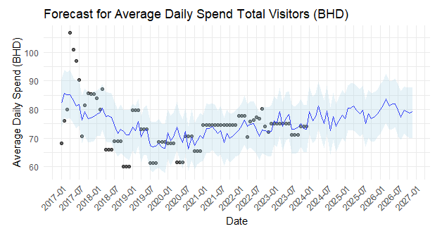
Three-Year Forecast

Slide 12
Three-Year Forecast
Overnight visitors play a key role in driving the recovery of average daily spend.
Same-day visitors’ spending remains low and stable, highlighting limited contribution to the overall recovery.
The forecast signals a gradual improvement in visitor spending, with strategic focus needed on overnight tourism to sustain growth.

Slide 13
Comparison To Qatar And Saudi
Bahrain, Qatar, and Saudi Arabia each have unique tourism strengths and development strategies. Bahrain focuses on cultural heritage, F1 racing, and weekend tourism with key attractions like the Bahrain International Circuit and UNESCO sites. Qatar emphasizes luxury tourism, sports events (e.g., World Cup facilities), and cultural landmarks like the National Museum and The Pearl-Qatar. Saudi Arabia leads in religious tourism (Hajj and Umrah) and ambitious projects like NEOM and the Red Sea Project. While Bahrain is compact with strong connectivity, Qatar and Saudi Arabia boast larger infrastructures, with Saudi Arabia driving extensive future developments. Together, they complement the Gulf region's diverse and growing tourism market.

Slide 14
SWOT Analysis
Bahrain's strengths include its strategic location, strong connectivity (King Fahd Causeway, expanded airport), cultural heritage (UNESCO sites), and hosting major events like Formula 1. Its weaknesses are limited land area, heavy reliance on weekend tourism, and smaller infrastructure compared to regional peers. Opportunities lie in expanding tourism projects (Bahrain Bay, Hawar Islands), diversifying attractions, and leveraging its position as a cultural and business hub. Threats include regional competition from Qatar and Saudi Arabia, economic reliance on oil, and vulnerability to global economic fluctuations and climate change.

