Slide 1
Overview for Aruba
Haochen Li

Slide 2
Introduction
Objectives
Economic Analysis: GDP trends for Aruba
Environmental Impact: CO2 emissions from the transportation sector
Mangrove Change Detection: Analysis using remote sensing TIF files

Slide 3
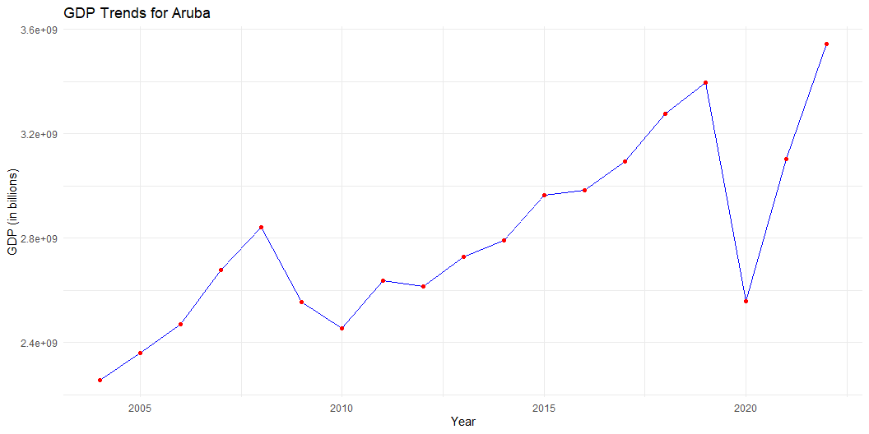
GDP for Aruba
Sharp decrease around 2008: Likely caused by the global financial crisis.
Significant drop around 2020: Strongly linked to the economic impacts of the COVID-19 pandemic.

Slide 4
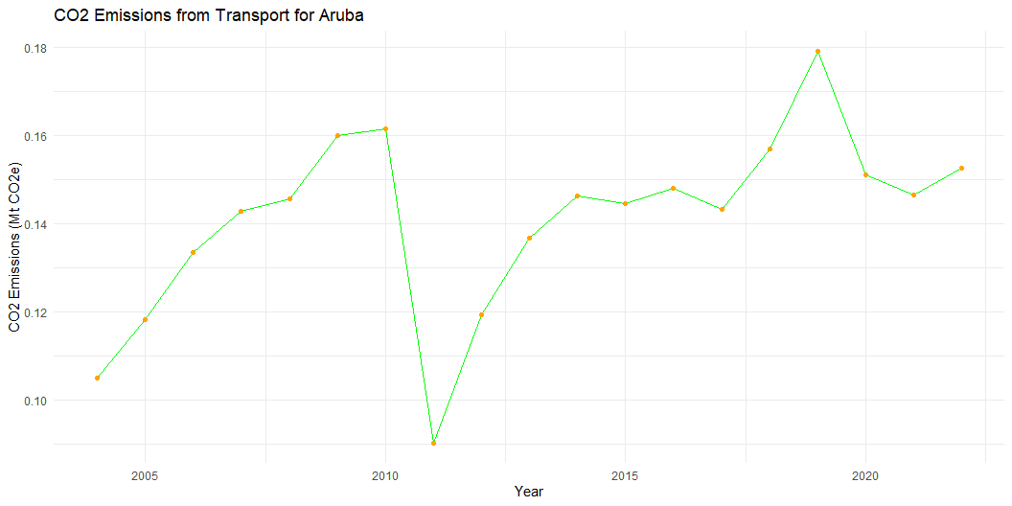
CO2 Emissions for Aruba
Sharp decrease around 2010: CO2 emissions from transport energy sources show a steep decline, possibly due to reduced activity or policies.
Fluctuations post-2010: CO2 emissions remained inconsistent, showing some recovery and stabilization over time.

Slide 5
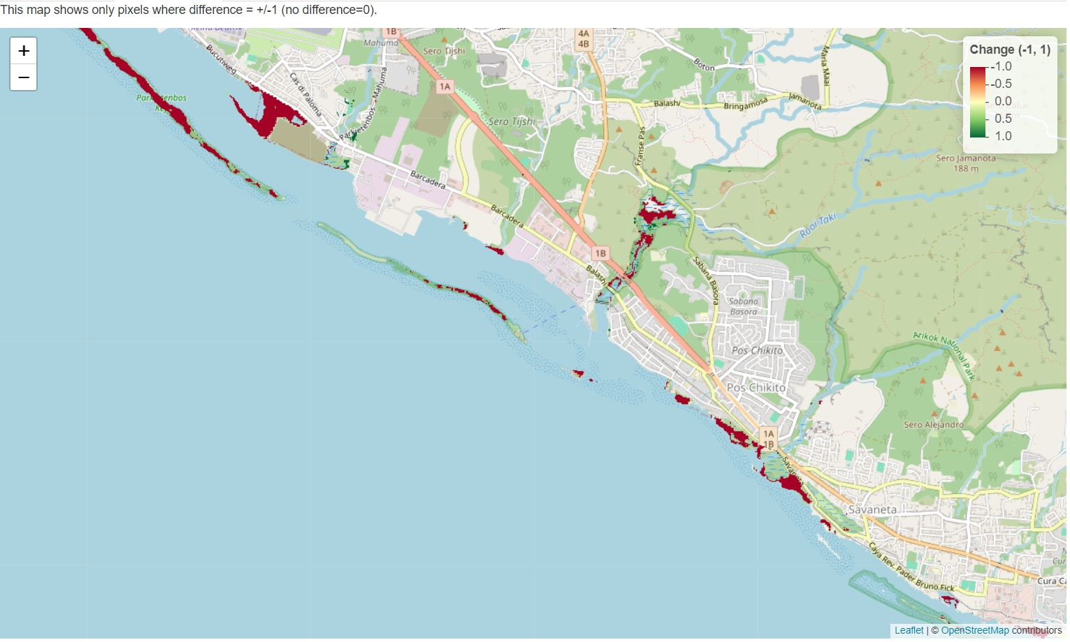
Mangrove Change Detection
Analyzed mangrove vegetation changes using remote sensing data.
Interactive Map
Significant decrease in mangrove vegetation observed. - Major decrease detected in May. - Red pixels indicate areas with vegetation loss. - Comparison analysis highlights critical regions for conservation efforts.

Slide 6
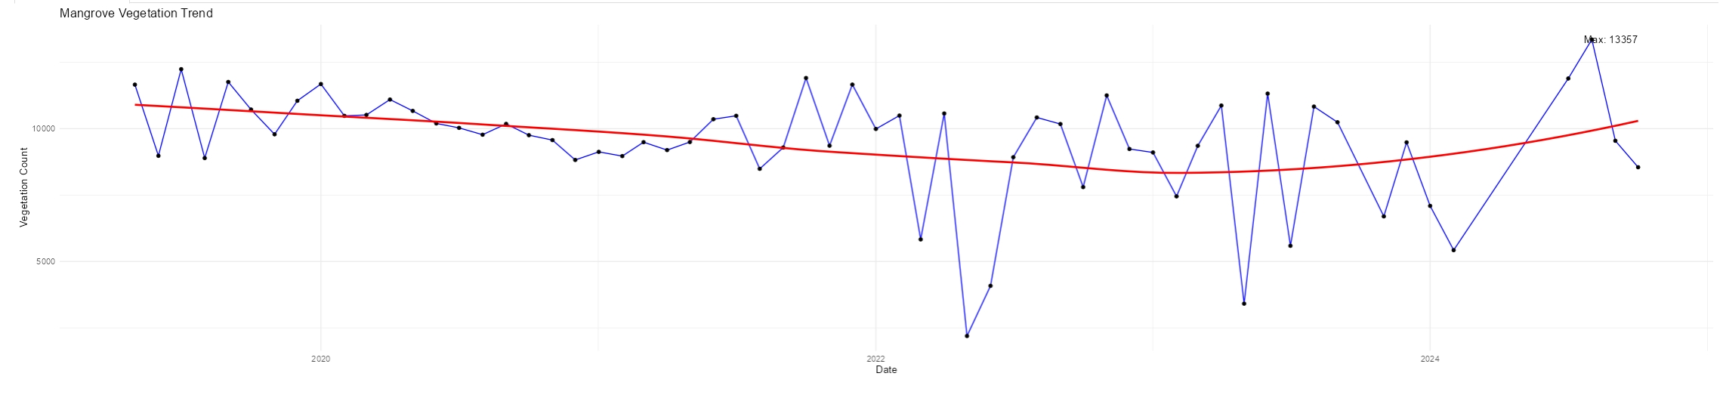
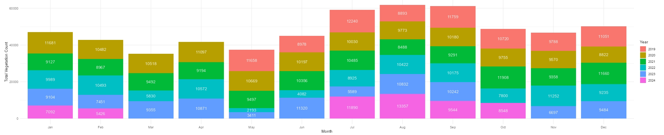
Mangrove Trend Analysis
Time Trend Comparison
Seasonal Comparison

Slide 7
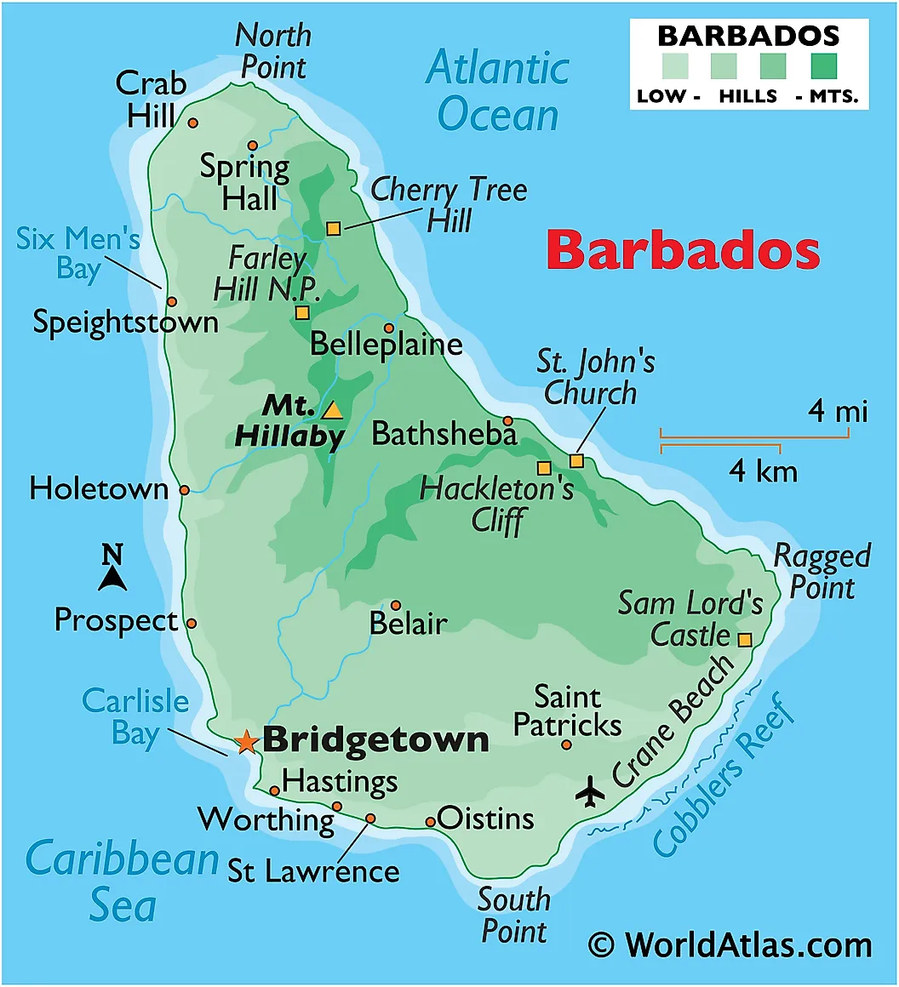
Comparison: Aruba vs Barbados
Overview
Table: Comparative Metrics
Metric | Aruba | Barbados
Population (2023) | 107,000 | 281,000
GDP (2023) | $3.5 Billion | $5.3 Billion
GDP per Capita | $32,710 | $18,860
CO2 Emissions | 0.3 Mt CO2e | 1.2 Mt CO2e
Tourism Contribution | 80% of GDP | 40% of GDP

Slide 8
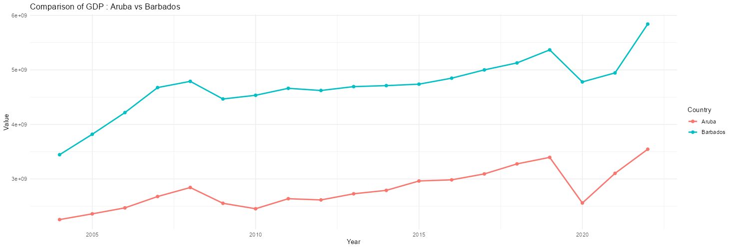
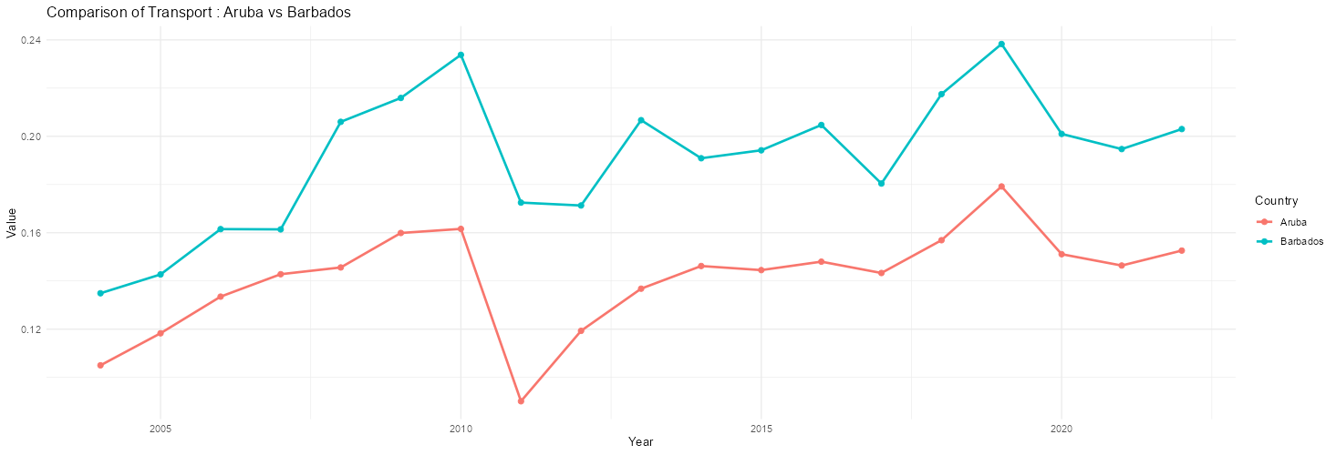
Comparison: Aruba vs Barbados
GDP Comparison
CO2 Emissions Comparison

Slide 9
SWOT Analysis
Strengths (S) - Tourism: A significant economic driver. - Pre-pandemic GDP growth showed strong reliance on tourism.
Weaknesses (W) - Over-reliance on tourism. - Sharp GDP decline during the COVID-19 pandemic.
Opportunities (O) - Biodiversity conservation initiatives. - Mangrove restoration programs to enhance ecological benefits.
Threats (T) - Mangrove forest degradation. - Climate change and rising sea levels pose risks to tourism and ecosystems.

Slide 10
Thank You!

