Slide 1
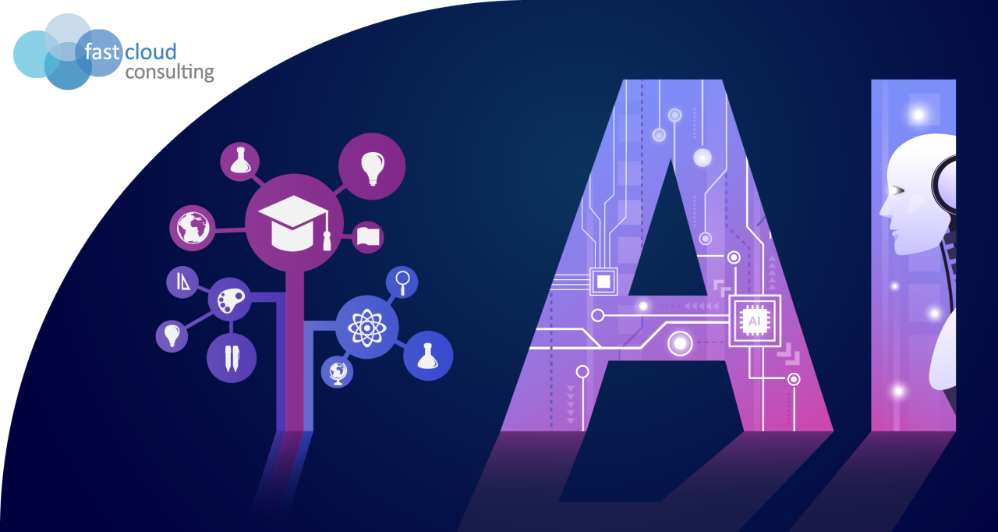
Electronic Engineering GPA Predictor System
Presented by:
Muhammad Sohail
Maaz Bin Fazal
Muhammad Sheraz
Abdul Wahid
Semester:
6th
Course name:
Artificial Intelligence
Course Instructor:
Dr. Abbas Abbasi

Slide 2
Contents of Presentation
Introduction
Objective
Importance of GPA Prediction
Methodology Overview
Model Development
Model Evaluation
Results
Conclusion
References

Slide 3
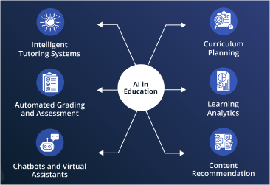
Introduction
Brief overview of GPA prediction using machine
learning.
Explanation of how machine learning can enhance
GPA prediction accuracy.
Mention common algorithms used in GPA
prediction(e.g., regression models, neural networks).
Figure 1:AI in Education

Slide 4
Objective
Develop an AI system to predict the GPA of Electronic Engineering students.
Achieve high accuracy and precision (target 80-95%).
Test and evaluate the model's effectiveness.
Deploy the model in a user-friendly application.

Slide 5
Importance of GPA Prediction
Benefits of Predicting GPA:
Helps students identify areas needing improvement.
Assists educators in providing targeted support.
Useful for academic planning and career guidance.
Cited Studies:
Reference studies on GPA importance in academic success.

Slide 6
Methodology Overview
Steps Involved:
Data Collection(from Student records, academic performance databases).
Exploratory Data Analysis (EDA)
Data Preprocessing
Model Development
Model Evaluation
Deployment

Slide 7
Exploratory Data Analysis (EDA)
Analyze Data:
Data distribution, patterns, and correlations.
Visualizations:
Histograms, scatter plots to understand the dataset.
Identify Key Predictors:
Key factors influencing GPA.

Slide 8
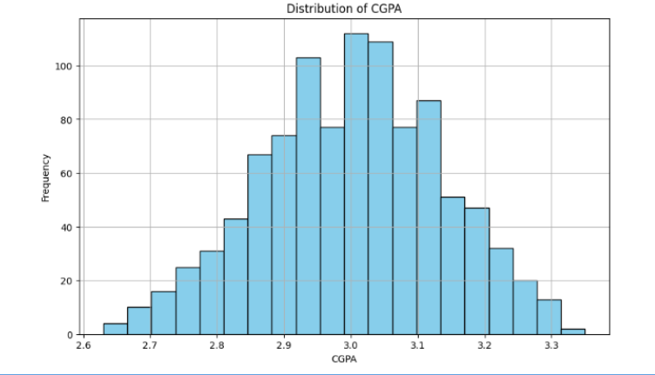
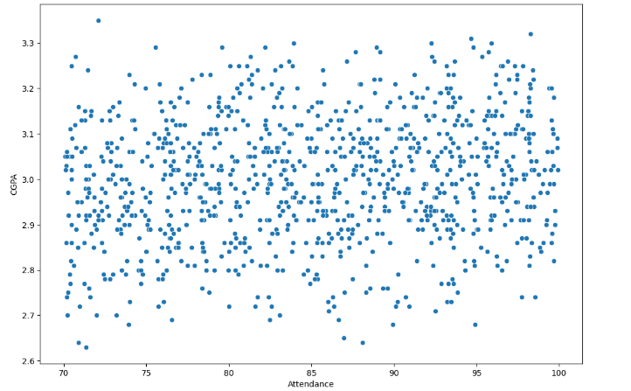
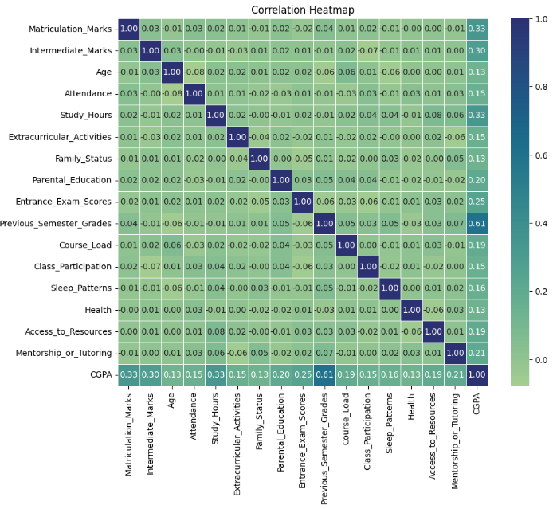
Exploratory Data Analysis (EDA)
Distribution Plot
Scatter Plot
Correlation Heatmap

Slide 9
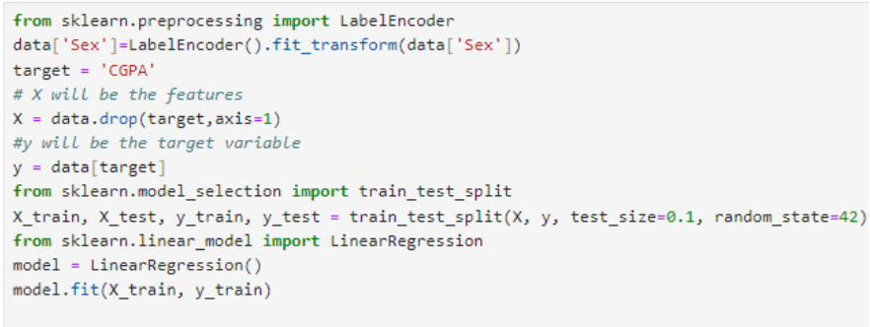
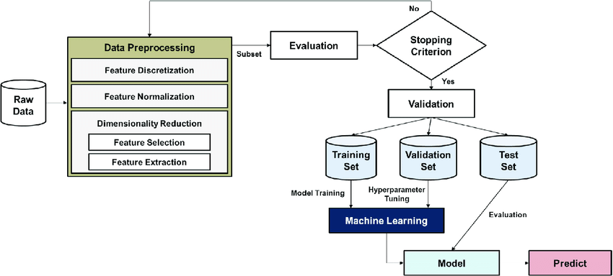
Data Preprocessing
Data Preprocessing
Flow Chart of Data Preprocessing

Slide 10
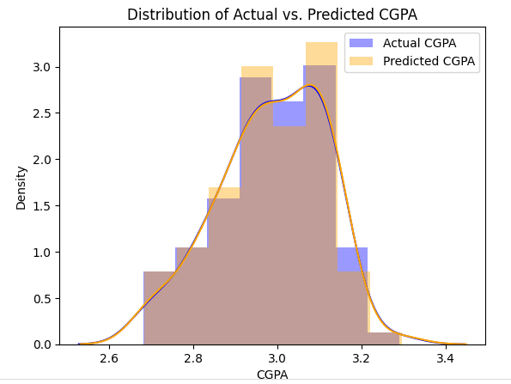
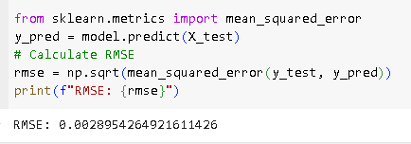
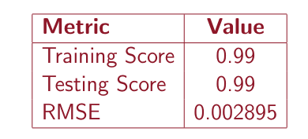
Model Evaluation
Metric Performance
Distribution of Actual vs Predict CGPA

Slide 11
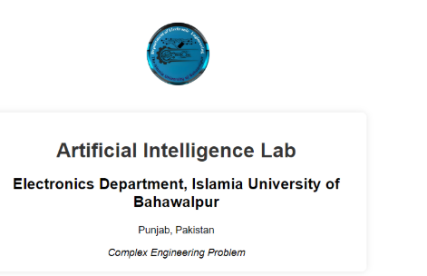
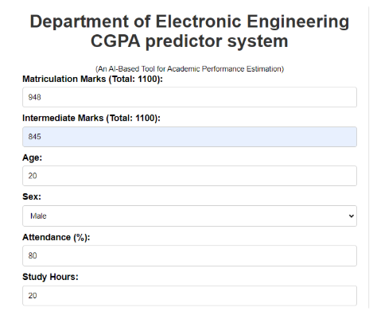
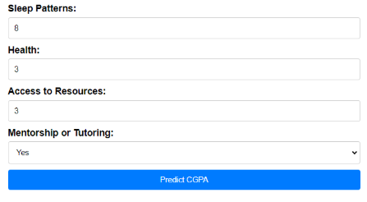
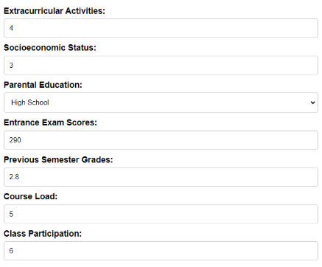

Model Deployment

Slide 12
Conclusion
The GPA Predictor System uses AI to predict student performance.
Provides valuable insights for educators and students.
Aims to improve academic experiences through accurate predictions.
This procedure can make it easier for the teacher to assess each student’s performance and plan a more effective study plan.
Ongoing research and teamwork in this area can create new ways to help students succeed and improve education.

Slide 13
References
[1] Md Zahidul Islam. “Application of artificial intelligence in educational assessment”. In: Journal of Advances in Mathematics and Computer Science 31.3 (2019), pp. 1–18.
[2] Zhi Li et al. “A survey on deep learning for big data”. In: Information Fusion 42 (2018), pp. 146–157.
[3] Alvin Rajkomar et al. “Scalable and accurate deep learning with electronic health records”. In: npj Digital Medicine 1.1 (2018), pp. 1–10.
[4] J¨urgen Schmidhuber. “Deep learning in neural networks: An overview”. In: Neural networks 61 (2015), pp. 85–117.

Slide 14
Thank you

