Slide 1
Restaurant Analysis of swigy
A.Rexton Machado MBE11

Slide 2
Objectives
1.Data cleaning and preprocessing
2.Data visualization with Power BI
3.Data analysis and interpretation
4.Creating interactive dashboards
5.Understanding key business metrics in the food delivery industry

Slide 3
Project Overview
The project Swiggy Food Delivery Analysis, which delves into food delivery and restaurant analysis with a focus on Swiggy, a prominent food delivery platform. Our project involved data extraction, comprehensive data analysis, and the creation of an interactive dashboard. Let's explore the project's process, analysis, key findings, and recommendations.

Slide 4
Data Cleaning 🧹
In the data cleaning phase, Power Query was utilized to refine the extracted dataset from Swiggy, ensuring its accuracy and consistency for further analysis. Several key cleaning processes were implemented:
Cleaning Duplicate Data: Duplicate records within the dataset were identified and eliminated using Power Query. Removing duplicates ensured that each entry was unique, preventing any distortions in the analysis due to redundant information.
2. Removing Null Values: Null or missing values in the dataset were identified and removed to enhance data completeness. Power Query allowed for the easy identification and filtering out of these null values, ensuring that the dataset was comprehensive and reliable for subsequent analysis.

Slide 5
💡Primary Insights
Our analysis yielded the following key insights:
🏷️Delivery Time and Customer Ratings
There is a limited correlation between delivery time and customer ratings. However, it's noteworthy that top-rated restaurants typically maintain an average delivery time of around 53 minutes.
🏷️Strategic Location:
The project's recommendation to establish a remote kitchen strategically located between Koramangala, Indiranagar, and Ashok Nagar capitalizes on high customer concentration in these areas. This central location reduces delivery times, enhances operational efficiency, and fosters customer loyalty.
🏷️Market Balance
Serving customers from all three areas ensures a balanced market presence, mitigating the risk of losing customers to competitors exclusively located in one area.
These insights are valuable for optimizing restaurant strategies and enhancing customer experiences in the food delivery market.

Slide 6
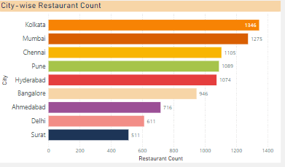
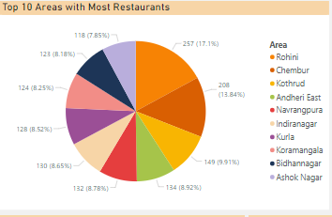

Slide 7
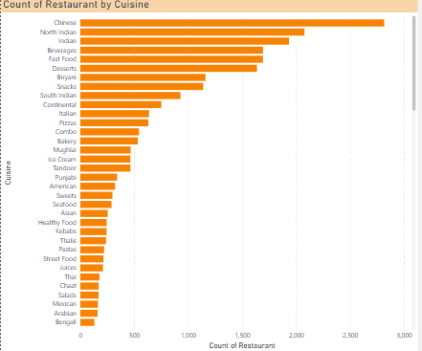
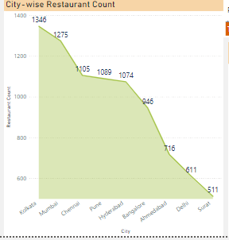

Slide 8
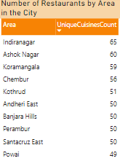
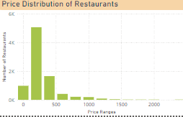


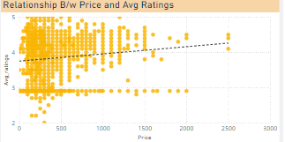
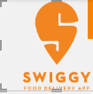

Slide 9
Insights and Recommendations
Restaurant Market Saturation and Expansion Opportunities
Insight: Areas with the highest concentration of restaurants show market saturation, while underserved regions present growth opportunities.
Recommendation: Focus on expanding into regions with fewer restaurants and optimize delivery zones for high-density areas.
Restaurant Performance and Customer Ratings
Insight: A correlation between high ratings and customer satisfaction factors such as price, delivery time, and total ratings.
Recommendation: Invest in improving delivery times and food quality, while adjusting prices based on customer feedback to enhance overall restaurant ratings.
Delivery Efficiency and Operational Improvements
Insight: Delivery time significantly impacts customer satisfaction and ratings.
Recommendation: Optimize delivery logistics by analyzing time patterns and improve operational efficiency through better route planning and partnerships.

Slide 10
Thank You

