Slide 1








Myntra
Analysis
A.Rexton Machado-MBE11

Slide 2

Key Aspects
Product Range: Wide selection of clothing, footwear, accessories, beauty products, and home decor from Indian and international brands.
Introduction to
Myntra.com
Myntra is one of India's leading e-commerce platforms, founded in 2007, is a leading Indian e-commerce platform focused on fashion and lifestyle products.
Initially starting with personalized gifts, it later shifted to apparel and accessories, becoming a key player in online fashion retail.
User Interface: Easy-to-use website and app with intuitive navigation and filters.
Personalization: Uses AI to recommend products based on user preferences.
Exclusive Brands: Offers designer collaborations and exclusive collections.
Myntra Insider: Loyalty program with perks like early sales access and special offers.
Customer Service: Provides smooth returns, exchanges, and fast deliveries.

Slide 3




Marketplace Model: Connects third-party sellers with customers, earning commissions on sales.
Private Labels: Sells its own in-house brands like Roadster and HRX for higher margins.
Exclusive Partnerships: Offers exclusive collections and brand launches.
Myntra Insider Program: Loyalty program that rewards frequent buyers and boosts retention.
Personalization: Uses AI and data analytics for personalized shopping experiences.
Logistics: Efficient supply chain via Flipkart’s network for fast deliveries.
Business
Model
Marketplace Model
Private Labels
Exclusive Partnerships
Myntra Insider Program
Personalization
Logistics

Slide 4





Market Position and Growth
Technology Integration (2018 - Present): Use of AI and data analytics for personalized shopping experiences and recommendations.
Loyalty Programs: Successful implementation of the Myntra Insider program, boosting customer retention and engagement.
Market Leader: One of India's top online fashion retailers, competing with Amazon Fashion and AJIO.
Strategic Partnerships: Collaborations with domestic and international brands for exclusive launches and collections.
Strong Product Portfolio: Well-positioned in apparel, footwear, accessories, and lifestyle products.
Ecosystem Support: Backing from Flipkart and Walmart, enhancing operational capabilities and market reach.
Product Expansion: Diversification into various categories, including apparel, footwear, and home decor.
Overall, Myntra's growth trajectory reflects its ability to adapt to market changes, leverage technology, and maintain a customer-centric approach, positioning itself as a leader in the Indian fashion e-commerce space.

Slide 5
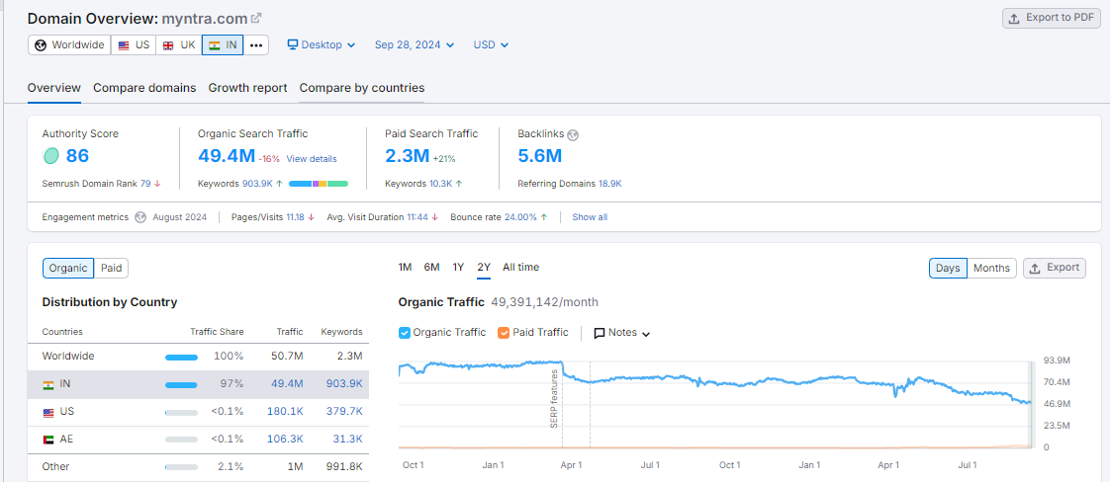
Overview

Slide 6
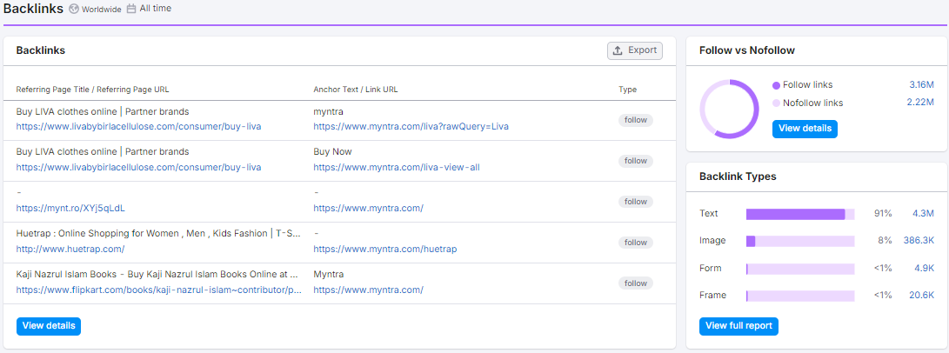
Backlinks Page

Slide 7
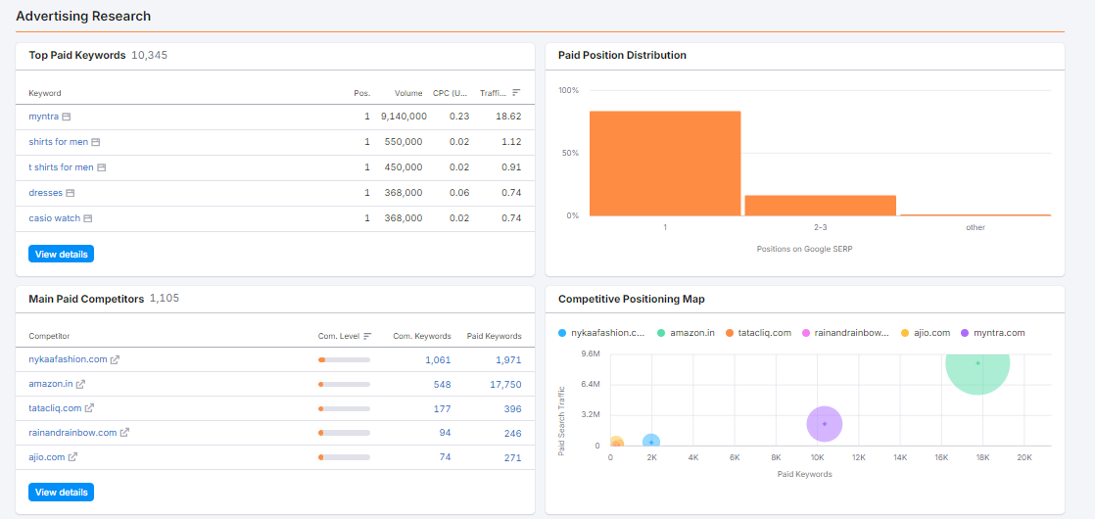
Ads & competitors

Slide 8




23
F I N A N C I A L Y E A R
Myntra’s
Revenue Breakdown
Operating Revenue: ₹4,375 crore, a 25% increase from the previous year (2022).
Total Expenses: ₹5,290 crore, up from ₹4,206 crore in FY22.
Advertising and Promotional Expenses: ₹1,758 crore, a 35% increase, making it the largest component of total expenses.
Employee Expenses: ₹631 crore for the financial year.
Losses: ₹782 crore, compared to ₹598 crore in the previous year.

Slide 9



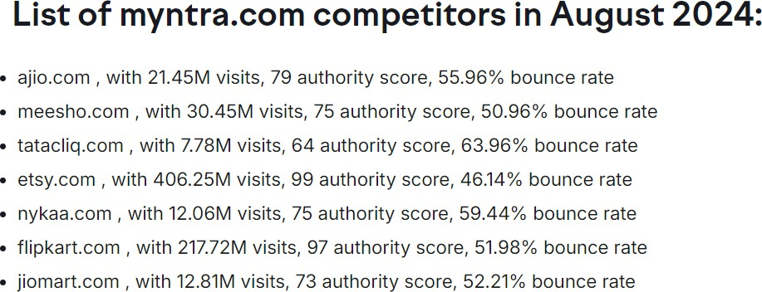

Understanding the competitive landscape is crucial for Myntra as it formulates its strategies to enhance customer engagement and market share. Each competitor brings different strengths to the table, from niche offerings to extensive logistics networks.

Slide 10



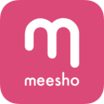


Competitive Analysis: Myntra vs. Key Competitors
Myntra vs. Ajio:
Market Share: Ajio leads with 55% market share; Myntra has 45%. Product Range: Ajio excels in unique ethnic wear collections Pricing: Both are aggressive, but Ajio often offers deeper discounts.
Myntra vs. Meesho:
Business Model: Meesho's social commerce model attracts a different demographic.
Target Market: Meesho appeals to price-sensitive shoppers, while Myntra emphasizes fashion trends.
Myntra vs. Tata CLiQ:
Brand Focus: Tata CLiQ targets premium products and curated experiences. Quality: Focuses on high-quality items over mass-market offerings.

Slide 11
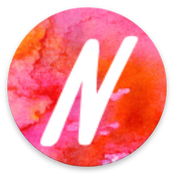


Myntra vs. Nykaa Fashion:
Target Audience: Nykaa appeals to younger consumers with a focus on beauty and wellness. Growth: Rapid customer base expansion through influencer marketing.
Unique Proposition: Nykaa focuses on personalized beauty experiences.
Myntra vs. Amazon Fashion:
Product Diversity: Amazon's vast range includes electronics, overshadowing Myntra's fashion focus. Customer Trust: Amazon's strong delivery and service reputation gives it an edge.
Logistics: Amazon’s logistics support faster delivery.
Myntra vs. Flipkart Fashion:
Market Position: Myntra benefits from Flipkart's resources but competes with its fashion offerings. Pricing: Both engage in competitive pricing; Flipkart often bundles offers.
Myntra operates in a competitive landscape dominated by players like Ajio, Flipkart and Amazon, each offering unique advantages. To stay relevant, Myntra must innovate and enhance customer experiences amid rising competition from emerging brands like Nykaa and Meesho.

Slide 12
Artificial Intelligence (AI):
MyStylist: An AI-powered personal style assistant that recommends complete outfits based on a user's preferences and browsing history.
Myntra’s Tech
Innovations
Machine Learning (ML):
Personalized Recommendations: ML algorithms analyze user data to suggest products that are likely to appeal to them.
Image and Visual Search: ML-powered image recognition allows users to search for similar products based on a visual reference.
Inventory Management: ML helps optimize inventory levels by predicting demand and preventing stockouts.
MyFashionGPT: A generative AI tool that allows users to describe their desired outfit or style, and Myntra's AI generates personalized recommendations.
Maya: A virtual stylist that helps users visualize how clothes will look on them through augmented reality (AR) technology.
Augmented Reality (AR):
Virtual Try-On: AR allows users to virtually try on clothes and see how they look on them before making a purchase.
Blockchain:
Supply Chain Transparency: Blockchain can be used to track the origin and authenticity of products, ensuring transparency and ethical sourcing.

Slide 13


Internet of Things (IoT):
Smart Fitting Rooms: IoT-enabled fitting rooms can provide personalized recommendations and enhance the shopping experience.
Myntra’s Tech
Innovations
Natural Language Processing (NLP):
Voice Search and Chatbots: NLP allows users to search for products using voice commands and interact with chatbots for customer support.
Cloud Computing:
Scalability and Flexibility: Myntra leverages cloud- based infrastructure to scale its platform to meet peak demand and adapt to changing business needs.
Other Technologies:
Mobile App Optimization: Myntra's app is designed to provide a seamless and engaging mobile shopping experience.
Data Analytics: Myntra uses data analytics to gain insights into customer behavior and optimize its marketing and operations.
Impact of Technology
Myntra has implemented to stay ahead of the curve and provide a superior shopping experience to its customers.

Slide 14





Myntra's Data-Driven Personalization
Benefits: Increases customer satisfaction, improves conversion rates, enhances engagement, and optimizes marketing efforts.
Collects data: Gathers information about customers' browsing, purchases, demographics, and AI interactions.
Analyzes data: Uses advanced techniques to understand customer preferences, trends, and behavior.
Real-time adjustments: Makes immediate changes to marketing and recommendations based on data insights.
Personalized recommendations: Suggests products tailored to individual customers' interests.
Targeted marketing: Sends relevant marketing messages to specific customer segments.
Personalized product pages: Displays content and recommendations unique to each customer.
AI stylists: Provides personalized outfit recommendations and styling advice.

Slide 15

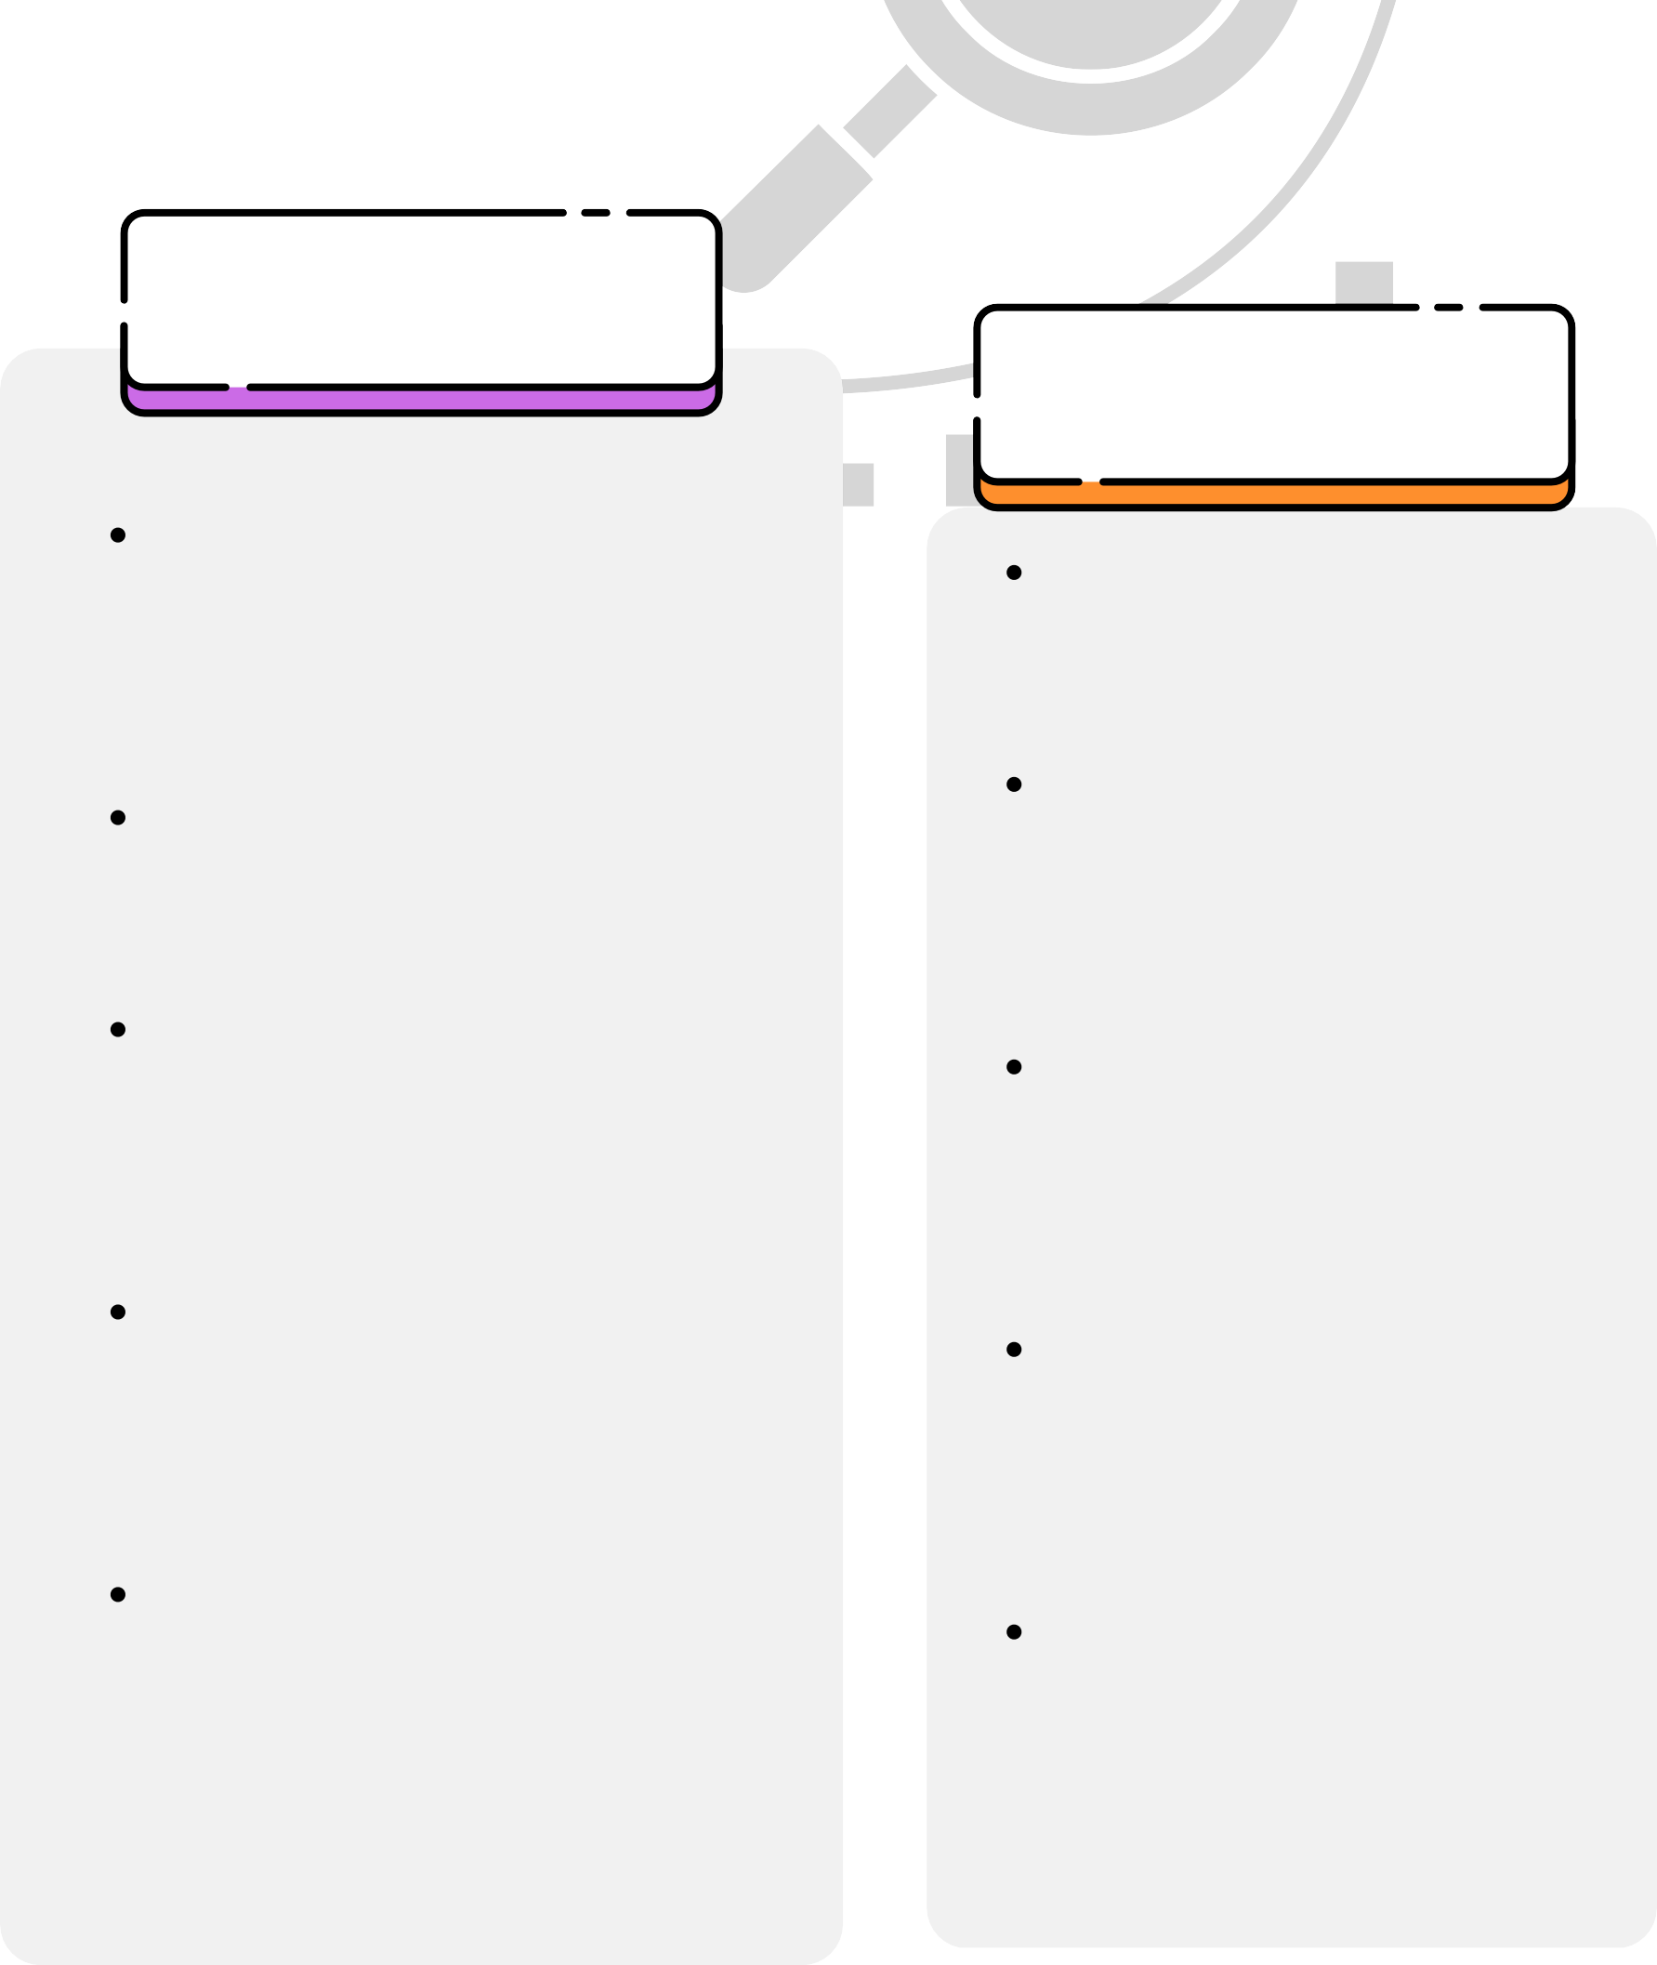

_{SWOT} Analysis
STRENGTH
OPPURTUNITY
THREAT
Data-driven personalization: Enhances user experience with targeted recommendations.
Strong brand recognition: A leading player in India's fashion e-commerce.
Wide product selection: Offers a diverse range of fashion apparel and accessories.
Mobile app optimization: Ensures smooth shopping on mobile devices.
Technological advancements: Utilizes AI and AR for an innovative platform.
WEAKNESS
Expanding into new categories: Exploring beauty, personal care, and homeware segments.
Leveraging technology: Enhancing AI for advanced personalization and logistics. Targeting new customer segments: Focusing on Tier 2 and Tier 3 cities with localized marketing.
Omnichannel approach: Blending online and offline experiences for seamless shopping.
Sustainability initiatives: Promoting eco-friendly products and ethical sourcing practices.
Economic slowdown: Reduced consumer spending may affect sales. Government regulations: Changes in e-commerce rules or taxation could create challenges.
Shifting consumer preferences: Rising demand for faster delivery and unique products.
Supply chain disruptions: Global supply issues may impact product availability and costs.
Data privacy concerns: Ensuring robust customer data security is crucial in the digital era.
High dependence on discounts: Attracts price-sensitive customers, but may not be sustainable long-term.
Limited control over inventory:
Relies heavily on third-party
sellers.
Delivery logistics challenges: Ensuring efficient and timely delivery across India can be complex.
Competition: Faces strong competition from established players and emerging startups. Counterfeit concerns: Maintaining product authenticity and quality control can be
difficult.

Slide 16

Low-Impact Customers:
Characteristics: Infrequent shoppers, mainly focused on discounts. Feedback: Limited, often related to price sensitivity or return issues. Engagement: Low impact on social media conversations, with
Myntra’s Customer
Review Analysis
Medium-Impact Consumers:
occasional feedback during sales.
High-Impact Customers:
Characteristics: Active on social media platforms like YouTube and Instagram. These users often post reviews, share unboxing videos, and engage in fashion-related content.
Feedback: They emphasize style, variety, and app experience. Positive mentions of exclusive collections, personalization, and seamless navigation are common.
Engagement: Their feedback can shape brand perception and influence peers, making them key brand advocates.
Characteristics: Casual shoppers who occasionally purchase during sales or special offers.
Feedback: Comments revolve around pricing, delivery, and product quality. They appreciate discounts but express concerns about delays or mismatches between product images and actual items.
Engagement: While not as vocal, their experiences impact review ratings and shopping decisions.

Slide 17
Enhance Engagement: Develop targeted loyalty programs to convert low-impact consumers into active shoppers.
Strategic
Recommendations
Omnichannel Integration: Create a seamless online-offline shopping experience to cater to diverse consumer preferences.
for Myntra
Utilize User-Generated Content: Encourage high-impact consumers to share their experiences on social media for authentic brand visibility.
Utilize User-Generated Content: Encourage high-impact consumers to share their experiences on social media for authentic brand visibility.
Optimize Inventory: Strengthen inventory management with third-party sellers to reduce return issues.
Expand Categories: Explore new segments like beauty and homeware to attract a broader audience.
Improve Customer Support: Enhance responsiveness to build trust and address return-related concerns.

Slide 18


As we conclude our analysis of Myntra, we’ve explored its strengths, weaknesses, market position, and competitive landscape. Key insights highlight the importance of enhancing customer engagement, optimizing inventory management, and leveraging technology for future growth.

